Slide 1
Conditional Updates of Operating Mode and Parameters
Date: 2025-07-09
Authors:

Slide 2
Abstract
Some operating modes may coexist with each other and may impact the enablement/disablement/parameters of other operating modes/parameters.
E.g., when the operating BW is changed, e.g., by DBE/AP PUO/DPS/OMN/OMI, certain operating modes, e.g., NPCA/DSO/DPS, should/shall be disabled, or may be enabled, or may update the parameters, e.g., NPCA primary channel/DSO subband/DPS HCM/LCM.
This submission presents conditional updates of operating mode and parameters
It allows to enable, disable, or update the parameters of a certain operating mode conditionally based on another operating mode.
E.g., DBE as the condition to enable, disable, or update NPCA/DSO/DPS operations outside of the BSS BW.
It helps to reduce overhead and complexity for both DBE STAs and non-DBE STAs.
It does not change the existing NPCA/DSO/DPS/OMP/critical update procedures.

Slide 3
Recap: UHR Critical Update and OMP Procedure [1]
AP follows the critical update procedure for advance notification of updates to operation modes/parameters
The AP indicates which operating modes are currently enabled in UHR Operation element.
AP indicates the parameters for enabled operating modes in UHR Operation element (not in Beacon).
AP shall include the UHR Parameters Update element to provide enhanced critical update.
Non-AP STA follows the OMP procedure to enable, disable or update the parameters of certain operating mode(s) for the non-AP MLD or its affiliated non-AP STA(s).
The non-AP STA sends an OMP request (UHR Mode Change element) to update certain mode(s).
The AP sends an OMP response (UHR Link Reconfiguration Notify frame) to accept the request.
The non-AP STA sends an ACK to the AP in response to the OMP response.
The AP and non-AP STA start to operate with the requested modes/parameters immediately after the ACK or at the expiration of the transition timeout.

Slide 4
Background
Some operating modes/parameters have impact on other operating modes/parameters
Some modes are mutually exclusive with each other and shall not be enabled at the same time/channel, e.g., NPCA and DSO [1].
Some operating modes may coexist and impact with each other [2, 3]
Some operating modes are in AP-/BSS-level and may impact other AP-/BSS-/STA-level operating modes/parameters.
Some operating modes are changed in a scheduled way in BI-/SP-level and may impact other dynamic/scheduled operating modes/parameters in SP-/TXOP-/PPDU-level.
There are proposals to indicate NPCA Enabled over DBE BW [3]
Extend existing NPCA Enabled field to also indicate NPCA enablement over DBE BW when DBE mode is enabled
If NPCA PCH is within BSS BW, then NPCA is enabled for both BSS BW and DBE BW (when DBE mode is enabled)
If NPCA PCH falls outside the BSS BW, then NPCA is only enabled for DBE BW. Non-DBE STAs shall not perform NPCA in this case.

Slide 5
Proposal: Conditional Updates of Operating Mode and Parameters (1/2)
To enable, disable, or update the parameters of a certain operating mode, e.g., NPCA/DSO/DPS, conditionally based on another operating mode, e.g., DBE.
DBE is the pre-condition for NPCA operations outside of BSS BW (similar for DSO/DPS).
If DBE is enabled and NPCA parameters are outside of BSS BW and within DBE BW:
A new “NPCA Enabled For DBE BW” field indicates whether NPCA is enabled outside of BSS BW and within DBE BW.
A new “Mode Specific Operation Parameters For NPCA For DBE BW” field is present to indicate the NPCA parameters outside of BSS BW and within DBE BW.
If DBE is not enabled or NPCA parameters are inside of BSS BW:
No changes. Follow the existing signaling and rules for NPCA/OMP/critical update.
No need to indicate “NPCA Enabled For DBE BW” in UHR Operation element.
Avoid ambiguity/complexity issues if the existing “NPCA Enabled” field is extended to indicate NPCA enablement over DBE BW or over BSS BW.

Slide 6
Proposal: Conditional Updates of Operating Mode and Parameters (2/2)
High flexibility, no extra overhead/complexity/ambiguity for non-DBE STAs and DBE STAs.
Within BSS BW: no changes to the existing NPCA/DSO/DPS/OMP/critical update rules.
Outside of BSS BW and within DBE BW:
Non-DBE STAs are not aware of the enablement/parameters outside of BSS BW.
The AP does not need to announce Operation Parameters to non-DBE STAs.
For DBE STAs:
Follow the existing UHR rules/signaling for NPCA/DSO/OMP/critical update and any future enhancements.
Certain operating modes, e.g., NPCA/DSO/DPS, can be automatically enabled/disabled/updated when DBE is activated/terminated. It reduces overhead and complexity, e.g., avoiding frequent OMP request for each STA.
Across BSS BW and DBE BW: if an operating mode is changed from BSS BW and DBE BW:
Follow the existing OMP/critical update procedure;
DBE STAs may have conditional updates automatically based on DBE activation/termination.

Slide 7
Signaling Options for Conditional Updates of Operating Mode and Parameters
Mode Enabled Indication for DBE BW
UHR Operation element
UHR Operation Parameters
DBE Operation Parameters
UHR Mode Change element
Mode Specific Parameters field for DBE/NPCA/DSO/DPS
Mode Specific Parameters for DBE BW
UHR Parameters Update element
Mode Specific Parameters field for DBE/NPCA/DSO/DPS

Slide 8
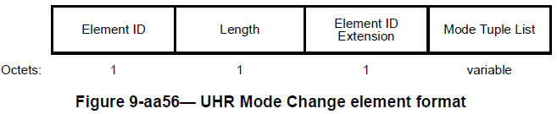
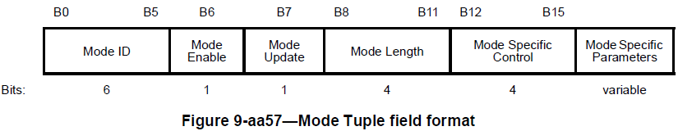
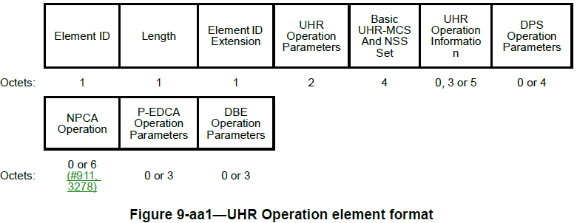
Options for Mode Enabled Indication for DBE BW (Outside of BSS BW)
For UHR Operation element:
Option 1: In UHR Operation Parameters field
E.g., if DBE Enabled (B2) is 1, then a bit from B4-B15 indicates NPCA Enabled for DBE BW
Option 2: In DBE Operation Parameters field
E.g., if DBE Enabled is 1, then a bit from B3-B7 indicates NPCA Enabled for DBE BW
Option 3: In a new field
E.g., Conditional Operation Parameters field, appended after existing frame/element/field if DBE is enabled
For UHR Mode Change element:
Option 1: Inside of DBE Mode Tuple filed
Option 2: Outside of DBE Mode Tuple field
Option 3: In a new field
E.g., Conditional Operation Parameters field, appended after existing frame/element/field if DBE is enabled
[more details in slide 20-22]
[more details in slide 23]
Option 3
New field
0 or TBD
Option 2
Option 1
Presence indication
Option 1
New field
Mode Specific Parameters for DBE is not present
Mode Specific Parameters for NPCA for DBE BW
0 or TBD
0 or TBD
Option 2
Option 3

Slide 9
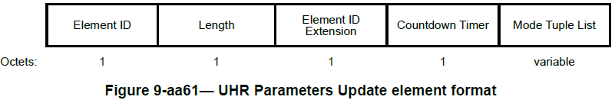
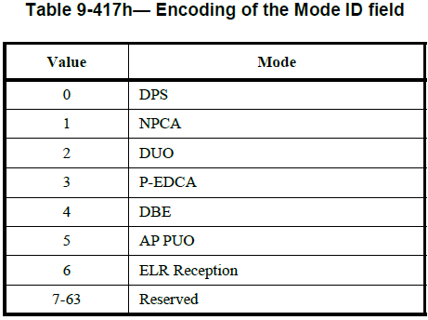
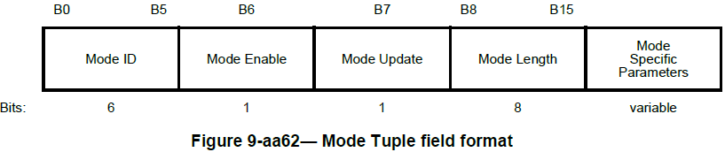
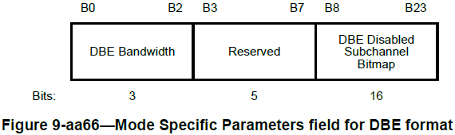
Options for Mode Specific Parameters for DBE BW (Outside of BSS BW)
Option 1: Inside of Mode Specific Parameters for DBE
Presence indication: implicit (by Length/Mode Length field) or explicit (in Mode Tuple field or Mode Specific Parameters field for DBE)
Option 2: Outside of Mode Specific Parameters for DBE
New Mode ID may be needed to not confuse non-DBE STAs, or revise NPCA/DSO Mode Tuple field for DBE
Option 3: In a new field
Option 3: in a new field
Mode Specific Parameters for NPCA for DBE BW
0 or TBD
Option 2: outside of DBE Mode Tuple filed
Mode Specific Parameters for NPCA for DBE BW
0 or TBD
Option 1: inside of DBE Mode Tuple filed
Mode Specific Parameters for NPCA for DBE BW
0 or TBD
Presence indication

Slide 10
Example 1: DBE + NPCA
BSS BW = 40 MHz, DBE BW = 80 MHz/160 MHz/320 MHz
NPCA is disabled for BSS BW, i.e., NPCA Enabled = 0, following the existing NPCA rules.
The DBE AP may enable NPCA outside of BSS BW and within DBE BW
DBE Enabled field is 1
NPCA Enabled for DBE BW is present and is set to 1
NPCA Parameters for DBE BW is present
DBE STAs that support NPCA may enable NPCA outside of BSS BW and within DBE BW
The OMP/critical update procedures can be extended to automatically enable/disable NPCA along with DBE activation/termination.
NPCA Parameters for DBE BW can be negotiated in advance and remain static/semi-static, following the OMP procedure.
DBE STAs does not need to send OMP request every time when DBE is activated/terminated.

Slide 11
Example 2: DBE + DSO
BSS BW = 80 MHz, DBE BW = 160 MHz/320 MHz
DSO may be enabled for 20 MHz-only non-AP STAs and is disabled for other non-AP STAs within BSS BW, following the existing DSO rules.
DBE STAs that support DSO (80 MHz operating STAs) may enable DSO outside of BSS BW and within DBE BW
DBE Enabled is 1
DSO Enabled for DBE BW is present and is set to 1
DSO Parameters for DBE BW is present
The OMP/critical update procedures can be extended to automatically enable/disable DSO when DBE is activated/terminated.
DSO Parameters for DBE BW can be negotiated in advance and remain static/semi-static, following the OMP procedure.
No need for each DSO STA to send OMP request when DBE is activated/terminated.

Slide 12
Example 3: DBE + DPS
Example 3.a DBE + DPS Mobile AP (similar as Example 1 DBE + NPCA)
The DPS Mobile AP may have disable/enable DPS inside/outside of BSS BW. The enablement/parameters outside of BSS BW can be automatically and conditionally based on DBE activation/termination.
In this case, the DBE execution (switching to the DBE BW) is based on DPS ICF/ICR and DPS parameters such as ICF Required field.
The DPS Mobile AP may also enable DPS for within BSS BW and DBE BW and change DPS parameters, such as LCM and ICF Required, based on DBE activation/termination.
Example 3.b DBE + DPS Assisting AP (similar as Example 2 DBE + DSO)
DBE STAs that support DPS may enable DPS and/or update DPS parameters outside of BSS BW. The enablement/parameters outside of BSS BW can be automatic, conditionally based on DBE activation/termination.
For Example 3.a and 3.b, need to identify the major use cases and potential benefits compared with following the existing DBE and DPS rules.

Slide 13
Conclusions
This contribution presents conditional updates of operating mode and parameters to enable, disable, or update the parameters of a certain operating mode conditionally based on another operating mode and parameters.
It allows to use DBE to update operating modes/parameters, e.g., NPCA/DSO/DPS, outside of BSS BW and within DBE BW, without introducing extra overhead or complexity.
Within BSS BW:
The AP, non-DBE STAs and DBE STAs follow the existing UHR rules, signaling and any future enhancements, e.g., NPCA, DSO, DPS, OMP, critical updates.
Outside of BSS BW and within DBE BW:
Non-DBE STAs are not aware of the enablement/parameters outside of BSS BW and follow existing rules -> no extra overhead/complexity, e.g., for OMP/Probe Request procedures.
DBE STAs may automatically update the enablement/parameters outside of BSS BW -> reduced overhead/complexity, e.g., avoiding frequent OMP request for each STA.

Slide 14
References
[1] IEEE P802.11bn D1.0, September 2025
[2] 25/0835, Coexistence of Features with Operating Mode Switching Operations, Yongsen Ma (Samsung)
[3] 25/1204, DBE Operation with NPCA, Binita Gupta (Cisco Systems)

Slide 15
Straw Polls – SP1
SP1: Do you support to define a Mode Enabled Indication for DBE BW field (or other TBD name) in the DBE Operation Parameters field of the UHR Operation element if DBE is enabled and the operating mode parameters are outside of BSS BW?
Reference:
(slide 8, left) Options for Mode Enabled Indication for DBE BW (Outside of BSS BW) for UHR Operation element: Option 2

Slide 16
Straw Polls – SP2
SP2: Do you support to define a Mode Enabled Indication for DBE BW field (or other TBD name) in the Mode Specific Parameters field for DBE of the UHR Mode Change element if DBE is enabled and the operating mode parameters are outside of BSS BW?
Reference:
(slide 8, right) Options for Mode Enabled Indication for DBE BW (Outside of BSS BW) for UHR Mode Change element: Option 1

Slide 17
Straw Polls – SP3
SP3: Do you support to define a Conditional Operation Parameters field (e.g., Mode Specific Parameters field for DBE BW or other TBD name) in the Mode Specific Parameters field for DBE of UHR Parameters Update element if DBE is enabled and the operating mode parameters are outside of BSS BW?
Reference:
(slide 9) Options for Mode Specific Parameters for DBE BW (Outside of BSS BW) for UHR Parameters Update element: Option 1

Slide 18
Backup: Background
NPCA and DSO are mutually exclusive that shall not be enabled at the same time, which is already specified in 11bn draft.
Co-TDMA is needed for Co-BF, e.g., to support sounding or in-BSS ICFs/ICRs of two Co-BF APs in the same TXOP.
Reduced performance and efficiency if Co-BF and DPS are enabled at the same time, with DPS ICF/ICR/IFCS/padding introducing extra overhead and complexity, and in the meantime Co-BF already has high overhead and complexity. So some APs/STAs may disable Co-BF when DPS (assisting) is enabled or disable DPS (assisting) when Co-BF is enabled.
If an AP has AP PUO/DPS (assisting) enabled, other APs may not want MAPC with this AP.
Some features are enabled/activated in scheduled manner in BI-/SP-level with expected start time, and some features are in dynamic manner in TXOP-/PPDU-level.
Some features are in AP-/BSS-level, and some features are in STA-level.

Slide 19
Backup: Conditional Updates of Operating Mode and Parameters
Options for NPCA parameters (similar for DSO/DPS):
Option 1: only allow one set of NPCA parameters
Option 1.a: allow to change NPCA parameters conditionally based on activation/termination of DBE, from BSS BW to DBE BW and vice versa
Option 1.b: allow to change NPCA parameters across BSS BW and DBE BW, with explicit/implicit indication. E.g., if NPCA primary is changed to outside of BSS BW, NPCA is considered as disabled for non-DBE STAs (implicit) or NPCA is disabled by following the OMP/critical update procedure (explicit).
Option 1.c: do not allow to change NPCA parameters across BSS BW and DBE BW
May still enable, disable, or update NPCA parameters within BSS BW following the OMP/critical update procedure
Option 2: allow multiple sets of NPCA parameters for BSS BW and DBE BW
Option 2.a: only allow one set of active NPCA parameters for DBE STAs
Either inside or outside of BSS BW. May have implicit or explicit indication of which set of NPCA parameters is active
Option 2.b: allow multiple sets of active NPCA parameters for DBE STAs
Both inside and outside of BSS BW. AP and non-AP STA need to select/confirm which set of NPCA parameters to use

Slide 20
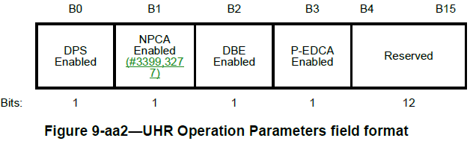
Mode Enabled Indication for DBE BW For UHR Operation element (1/3)
Option 1: In UHR Operation Parameters field, Reserved bits: B4-B15
E.g., if DBE Enabled (B2) is 1, then a bit from B4-B15 indicates NPCA Enabled for DBE BW
May have an explicit presence indication, e.g., Conditional Operation Parameters Present field
Option 1
If DBE Enabled is 1 (may also have explicit presence indication)
… | NPCA Enabled for DBE BW | …
back

Slide 21
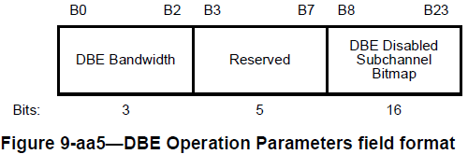
Mode Enabled Indication for DBE BW For UHR Operation element (2/3)
Option 2: In DBE Operation Parameters field
Reserved bits: B3-B7, e.g., if DBE Enabled is 1, then a bit from B3-B7 indicates NPCA Enabled for DBE BW
May have implicit/explicit presence indication
If DBE Enabled is 1
Option 2
… | NPCA Enabled for DBE BW | …
back

Slide 22
Mode Enabled Indication for DBE BW For UHR Operation element (3/3)
Option 3: In a new field
E.g., appended after existing frame/element/field for additional indication if DBE is enabled
use existing field, new presence field, or length to identify the presence of the indication for DBE BW
Option 3.b (implicit indication)
The presence of the New field, e.g., Conditional Operation Parameters field, can be indicated by
Option 3.a: if the DBE Enabled field is 1
Option 3.b: if the DBE Enabled field is 1 and the Length field is a certain value and/or depending on presence of NPCA/DSO Operation Parameters (implicit indication)
Option 3.c/3.d: if the DBE Enabled is 1 and a presence indication field is 1, e.g., Conditional Operation Parameters Present field, in the UHR/DBE Operation Parameters field (explicit indication)
New field
0 or TBD
Option 3
… | Conditional Operation Parameters Present | …
… | NPCA Enabled for DBE BW | …
Option 3.c/3.d (explicit indication):
in the UHR Operation Parameters field or in the DBE Operation Parameters field
Option 3.a/3.b/3.c/3.d:
If DBE Enabled is 1 and/or presence field is 1
back

Slide 23
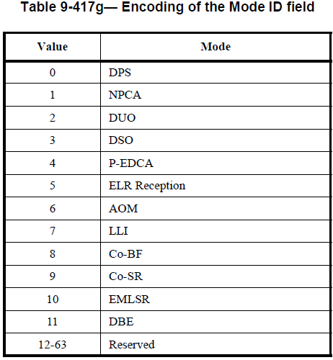
Mode Enabled Indication for DBE BW For UHR Mode Change element
In UHR Mode Change element – Mode Tuple List field – Mode Specific Parameters field
Reuse existing fields or define new fields; Reuse existing Mode IDs or define new Mode IDs
Carried inside or outside (may need new Mode ID) of Mode Specific Parameters for DBE
Presence indication: implicit (by Length/Mode Length) or explicit (in DBE Mode Specific Control)
Option 3: in a new field
Mode Specific Parameters for NPCA for DBE BW
0 or TBD
Option 2: outside of DBE Mode Tuple filed
Mode Specific Parameters for NPCA for DBE BW
0 or TBD
Presence indication
Note: for the Modes that appear in UHR Mode Change element or UHR Parameters Update element, define a unified Mode ID encoding table. So there is no need to maintain/process two Mode ID Encoding tables for AP/non-AP STA, which helps reduce complexity/ambiguity.
Option 1: inside of DBE Mode Tuple field
Mode Specific Parameters for DBE is not present
Mode Specific Parameters for NPCA for DBE BW
0 or TBD
back

