Slide 1
Optical Wireless Channel modelling and Measurements
Date: 2025-09-18
Authors:

Slide 2
Abstract
September 2025
This contribution presents channel modelling and measurement campaigns for enhanced light communications. A new channel modelling approach has been introduced which can operate in real environments using point cloud data captured by a LIDAR scanner. The accuracy of the channel models are validated using our optical channel sounder system. Finally, potential use case scenarios available for channel modelling and measurements are discussed in the context of UCM project.

Slide 3
Outline
Introduction
Motivation
ELC channel modelling method
3D environment modelling based on LIDAR data
Enhanced modelling methodology
ELC measurement campaigns
Use case scenarios for UCM
Conclusions

Slide 4
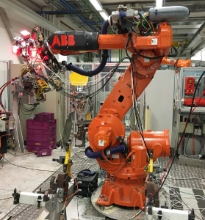
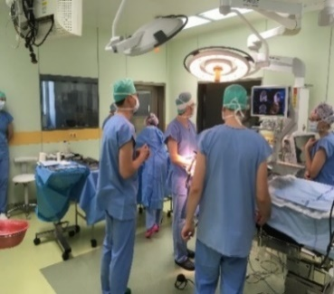
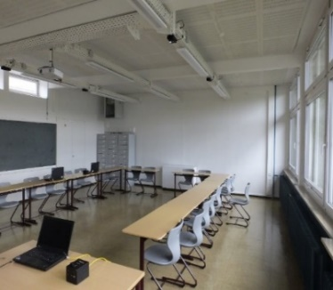
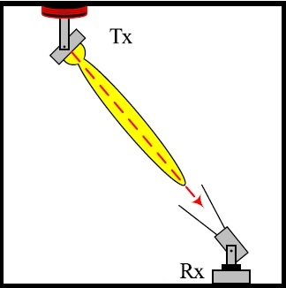
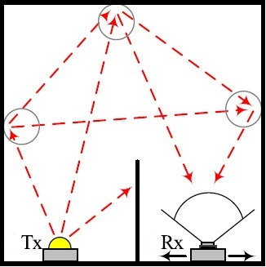
Introduction
Enhanced Light Communictaion (ELC)
Wireless communication using light
Mobile, bidirectional, high-speed data
Light remains in one room, No EMI
Applications
Leverage unique properties of light (competition with WiFi)
Industry, hospitals, offices, class- and conference rooms
Fundamental challenges for channel modelling
LOS vs. NLOS, Path loss, Link blockage
Weak multipath reflections, but measurable
Two main modeling approaches
Deterministic : Site-Specific, highly accurate models
Stochastic : Non-site specific, based on probability distributions
Industrial OWC
Medical OWC
Class rooms
LOS Propagation
NLOS Propagation

Slide 5
Motivation
SoA: Deterministic channel models
Manual entry of 3D environment
Tiles, Iterative, Modified Monte Carlo, Ray tracing
Limitations of present models
Approaches are very complex and time-consuming
Not suitable for distributed MIMO with multiple mobile users
Barely validated in realistic environments
New channel modelling
Complete 3D modeling using LIDAR point cloud data
Efficient modelling with significantly reduced complexity
more efficient generation of MU-MIMO CIRs and mobility
Experimental validation in various indoor environments
Input
Propagation Model
Output
3D model using LIDAR
New ELC channel modelling approach
Channel Response
Channel Parameters
Lightsource & detector specifications
Performance Parameters
Block Diagram

Slide 6
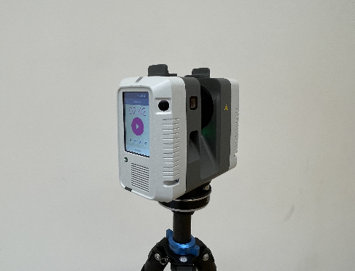
3D modelling using LIDAR
Motivation : Reduce complexity in 3D modelling
Leica RTC360 as LIDAR scanner (wavelength: 1550 nm)
Scanned at multiple positions in the room (to overcome occlusions / invisible regions)
Point cloud data from multiple scans are processed and optimized
LIDAR scanner is calibrated for reflectance estimation [1]
output data: (x,y,z) coordinates, surface normal, and reflectance of each detected point
Leica RTC360
Results in the room before and after intensity correction

Slide 7
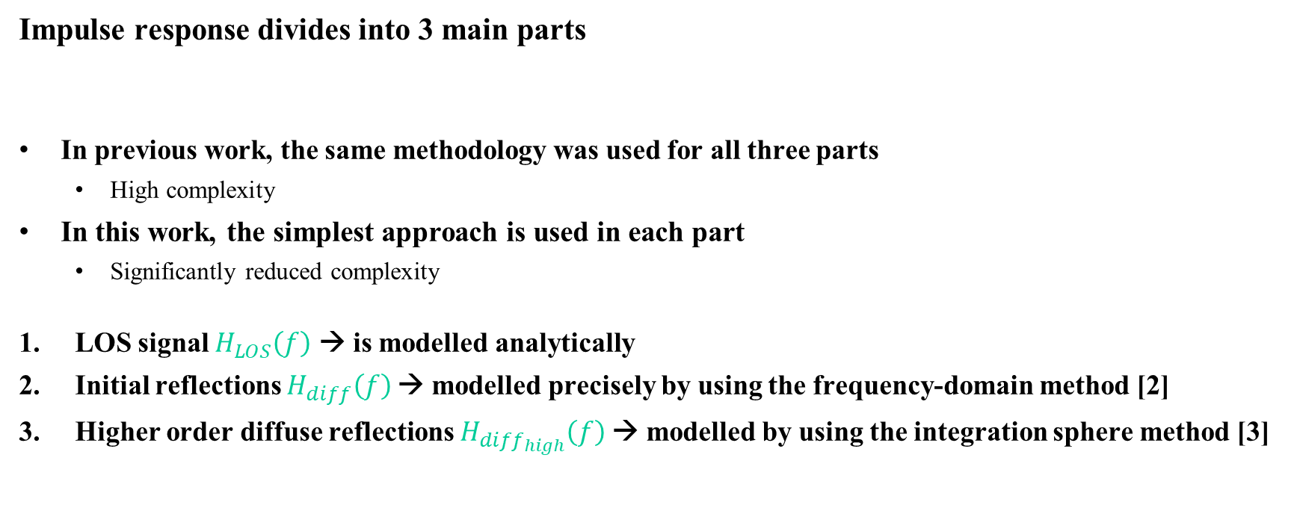
ELC channel modeling methodology
Impulse response divides into 3 main parts
In previous work, the same methodology was used for all three parts
High complexity
In this work, the simplest approach is used in each part
Significantly reduced complexity
LOS signal $H_{LOS}\left(f\right)$ → is modelled analytically
Initial reflections $H_{diff}\left(f\right)$→ modelled precisely by using the frequency-domain method [2]
Higher order diffuse reflections $H_{{diff}_{high}}\left(f\right)$→ modelled by using the integration sphere method [3]
Total channel model = ${H_{LOS}\left(f\right)+H}_{diff}\left(f\right)+H_{{diff}_{high}}\left(f\right)$
Typical impulse response for single link [3]

Slide 8
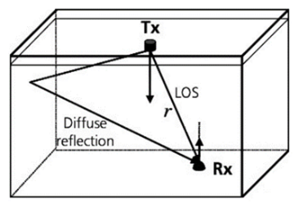
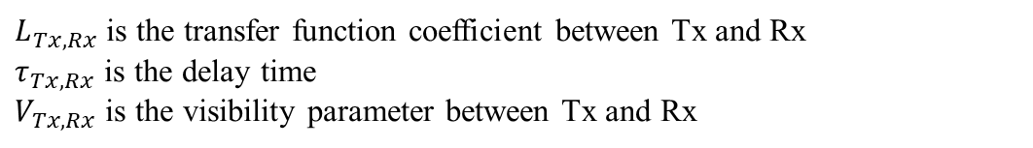
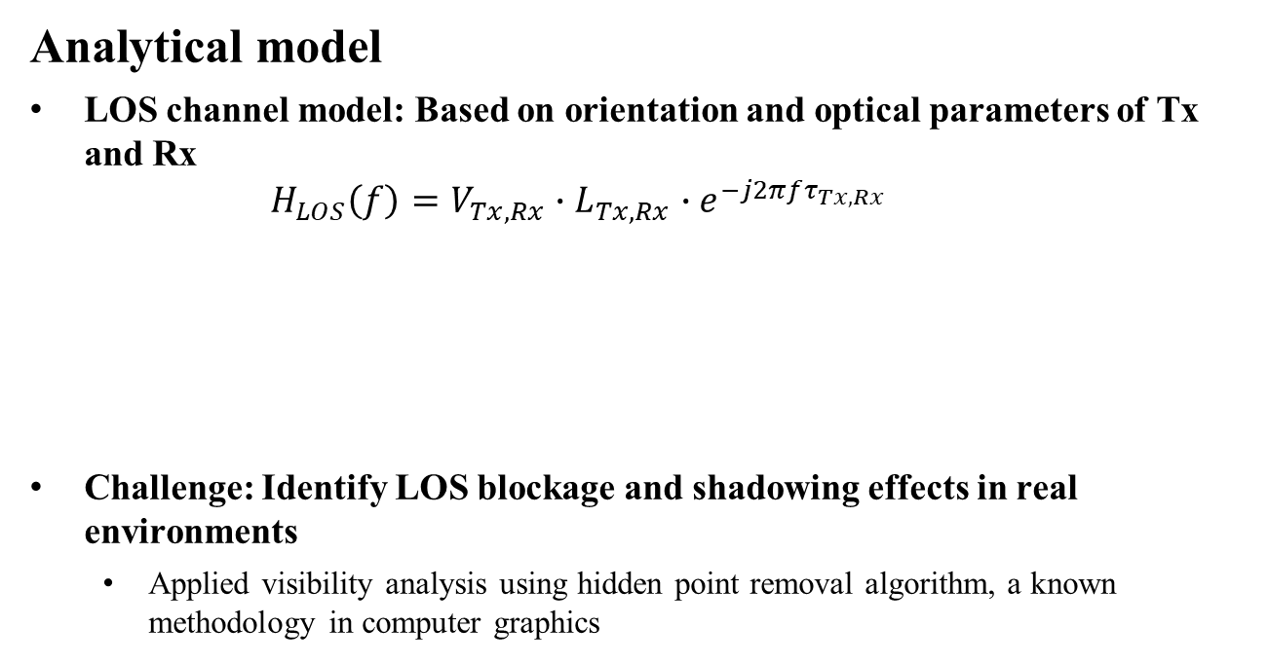
LOS channel
Analytical model
LOS channel model: Based on orientation and optical parameters of Tx and Rx
$$H_{LOS}\left(f\right)=V_{Tx, Rx}∙L_{Tx, Rx}∙e^{−j2πfτ_{Tx, Rx}}$$
Challenge: Identify LOS blockage and shadowing effects in real environments
Applied visibility analysis using hidden point removal algorithm, a known methodology in computer graphics
$L_{Tx,Rx}$ is the transfer function coefficient between Tx and Rx
$τ_{Tx, Rx}$ is the delay time
$V_{Tx,Rx}$ is the visibility parameter between Tx and Rx

Slide 9
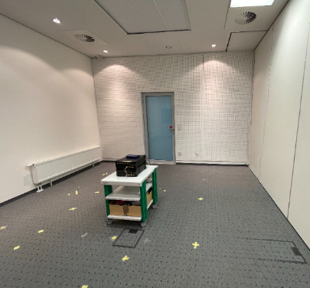

Visibility analysis
Motivation : Define link blocking and shadowing effects
Define all points in point cloud data that are visible from each Tx, Rx, and surface point position
Use hidden point removal algorithm: Visibility Radius = ${10}^{R}$, optimal value for $R=$ 1.5 [4]
Position of Tx1(looking towards the corner)
Variation of visible points for different R values
R = 1
R = 3
R = 4

Slide 10
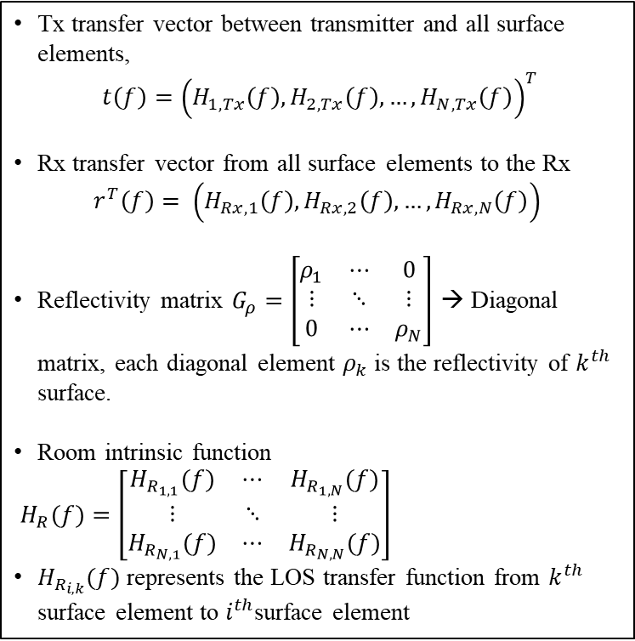
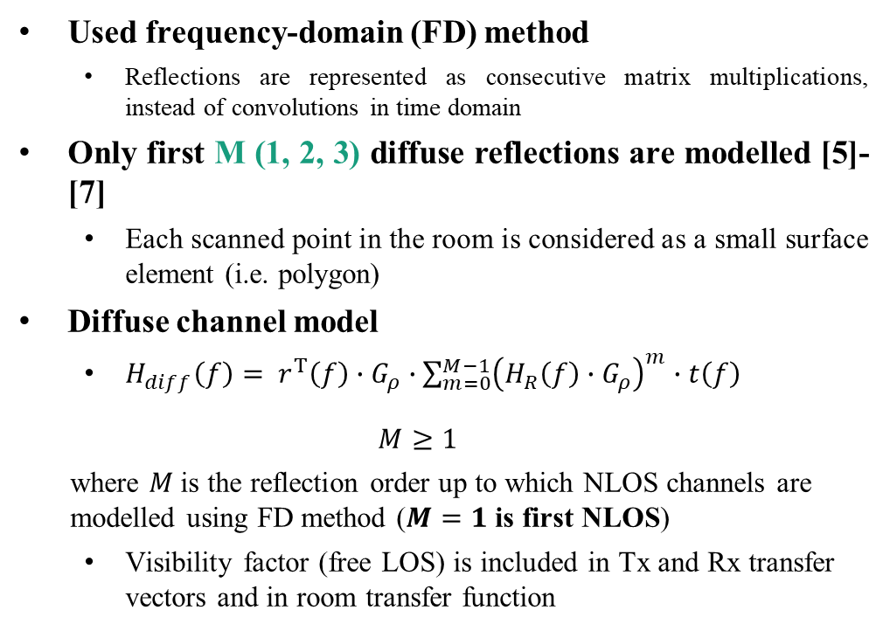
NLOS with initial reflections
Tx transfer vector between transmitter and all surface elements,
$t\left(f\right)={\left(H_{1, Tx}\left(f\right),H_{2, Tx}\left(f\right),…,H_{N, Tx}\left(f\right)\right)}^{T}$
Rx transfer vector from all surface elements to the Rx
$$r^{T}\left(f\right)= \left(H_{Rx, 1}\left(f\right),H_{Rx, 2}\left(f\right),…,H_{Rx, N}\left(f\right)\right)$$
Reflectivity matrix $G_{ρ}=\left[\begin{matrix}ρ_{1} & ⋯ & 0 \\ ⋮ & ⋱ & ⋮ \\ 0 & ⋯ & ρ_{N}\end{matrix}\right]$ → Diagonal matrix, each diagonal element $ρ_{k}$ is the reflectivity of $k^{th}$ surface.
Room intrinsic function
$H_{R}(f)=\left[\begin{matrix}H_{R_{1,1}}(f) & ⋯ & H_{R_{1,N}}(f) \\ ⋮ & ⋱ & ⋮ \\ H_{R_{N,1}}(f) & ⋯ & H_{R_{N,N}}(f)\end{matrix}\right]$
$H_{R_{i,k}}(f)$ represents the LOS transfer function from $k^{th}$ surface element to $i^{th}$surface element
Used frequency-domain (FD) method
Reflections are represented as consecutive matrix multiplications, instead of convolutions in time domain
Only first M (1, 2, 3) diffuse reflections are modelled [5]-[7]
Each scanned point in the room is considered as a small surface element (i.e. polygon)
Diffuse channel model
$H_{diff}\left(f\right)= r^{T}\left(f\right)∙G_{ρ}∙\sum_{m=0}^{M−1}{{\left(H_{R}\left(f\right)∙G_{ρ}\right)}^{m}}∙t\left(f\right)$
$$M≥1$$
where $M$is the reflection order up to which NLOS channels are modelled using FD method ($M=1$ is first NLOS)
Visibility factor (free LOS) is included in Tx and Rx transfer vectors and in room transfer function

Slide 11
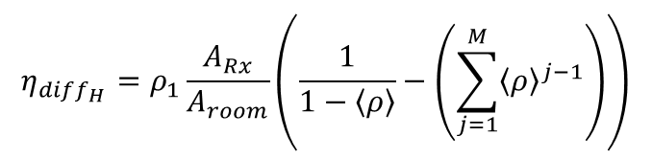
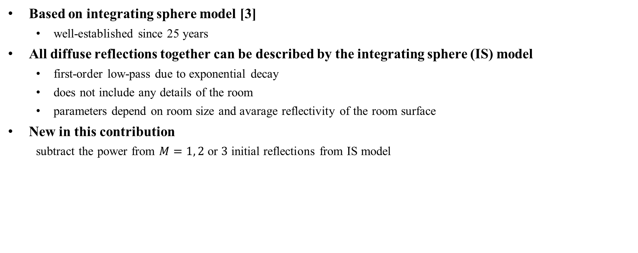

Higher order diffuse reflections
Based on integrating sphere model [3]
well-established since 25 years
All diffuse reflections together can be described by the integrating sphere (IS) model
first-order low-pass due to exponential decay
does not include any details of the room
parameters depend on room size and avarage reflectivity of the room surface
New in this contribution
subtract the power from $M=1, 2$ or $3$ initial reflections from IS model
$$H_{{diff}_{high}}=\frac{η_{{diff}_{H}}}{1+j2πfτ}e^{j2πf∆T}$$
$$η_{{diff}_{H}}=ρ_{1}\frac{A_{Rx}}{A_{room}}\left(\frac{1}{1−\left\langle ρ\right\rangle }−\left(\sum_{j=1}^{M}{{\left\langle ρ\right\rangle }^{j−1}}\right)\right)$$

Slide 12
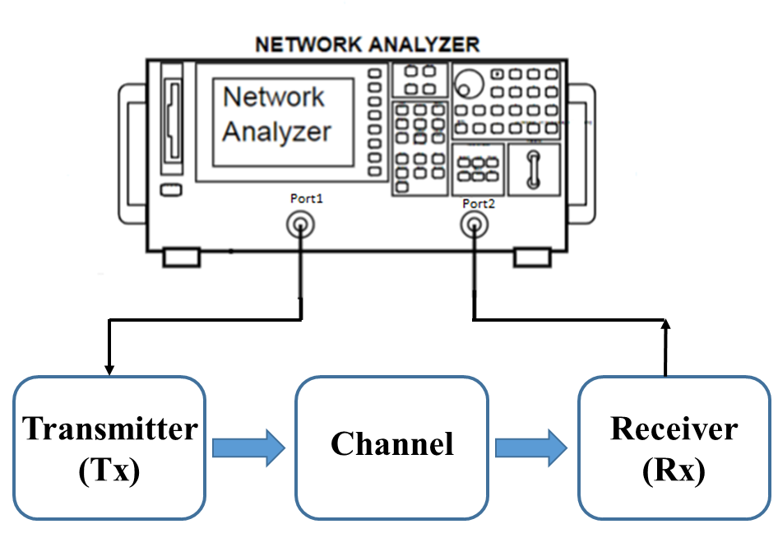
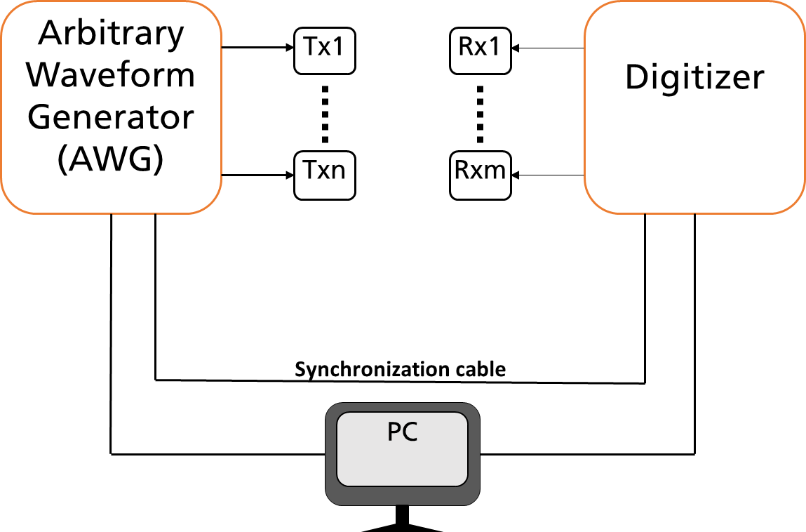
Channel measurements
SISO scenarios
Frequency sweep technique using VNA, narrowband
MIMO scenarios
8x8 channel sounder, OFDM-based, wideband
Performed all three steps
3D environment modelling using LIDAR
Channel modelling
Measurements using VNA/MIMO channel sounder
Metrics used
Mean-square error (MSE) between measured and modelled channel
Singular values
Throughput
SISO measurement using VNA
MIMO channel sounder

Slide 13
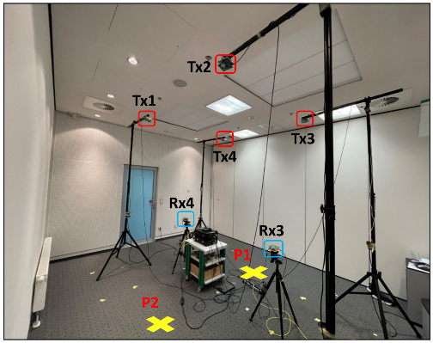
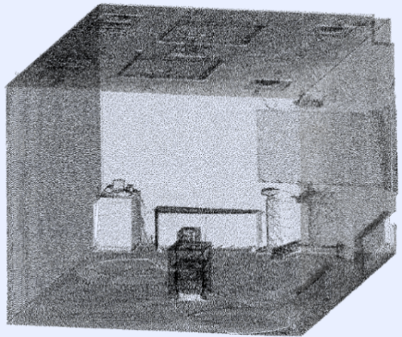
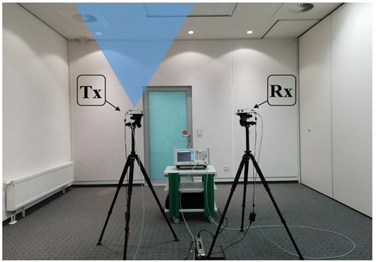
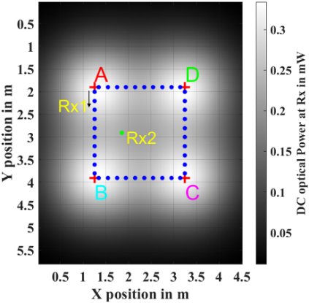
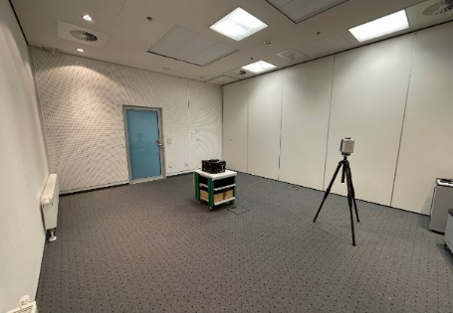
Empty room
MIMO Measurements
Simple scenario for testing all steps
LIDAR scan and reflectivity calculation
SISO & MIMO measurements
Performance evaluation
LIDAR scanning
Point cloud data of the room
SISO Measurements
Mobile scenario
d

Slide 14
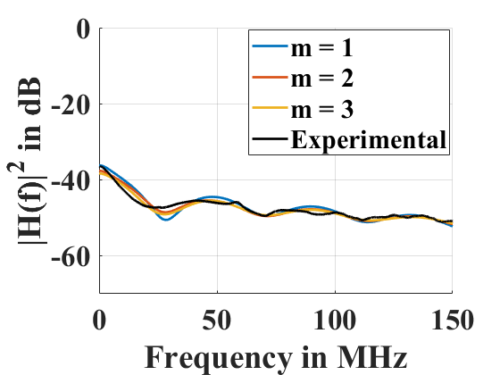
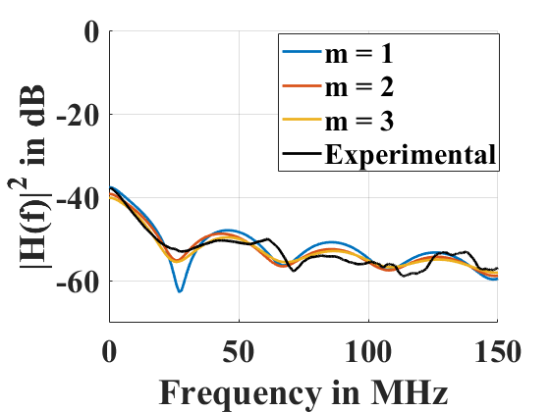
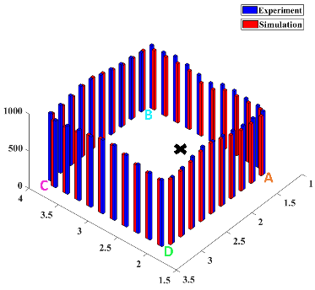
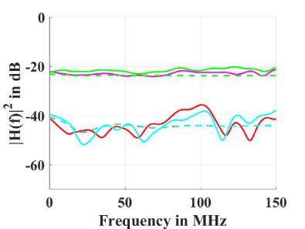
Empty room
SISO Scenario
Amplitude response of the channel for d = 2.5 m
Amplitude response of the channel for d = 3 m
Results
Simulation results compared to measurements
good agreement between measured and simulated channels
MSE < 5% for LOS signals with sufficient signal strength
MSE is higher for distant links, due to limited sensitivity of broadband MIMO channel sounder
Throughput results matched very well
Mostly determined by strong signals
Weak signals contribute less
Throughput is lower if users are nearer to each other
MIMO Scenario
Mobile Scenario
Amplitude Responses at Rx1
Throughput result

Slide 15
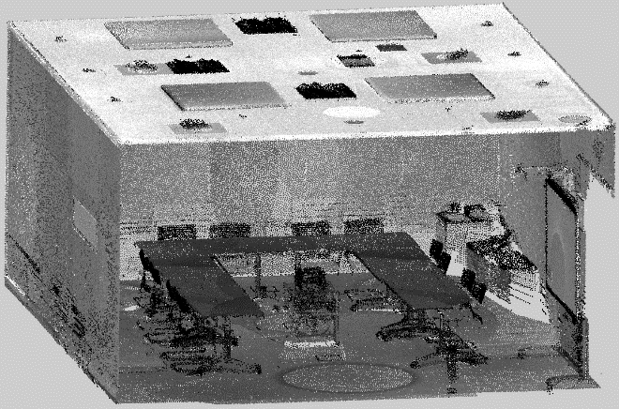
Conference room
Distributed MU-MIMO scenario
6 x 12 MIMO Measurements
LOS, downlink scenario, Tx infrastructure is always the same, 3 Rx configurations
Scenario 1: Rxs are far from each other
Scenario 2: 2 Rx pairs
Scenario 3: 4/6 Rxs are at one position
LIDAR scanning
Point cloud data of the room
6x12 MIMO Measurement Scenario

Slide 16
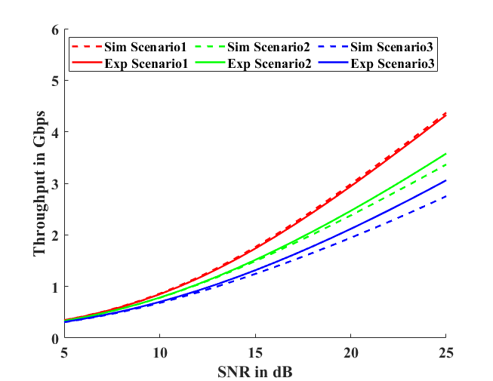
Conference room
Results
Channel responses
MSE < 5% for the signals with sufficient signal strength
Throughput results
average MSE < 1 % for all scenarios at low SNR
usual “fake capacity” for low-rank scenarios due to the noise in our measurements
Throughput results

Slide 17
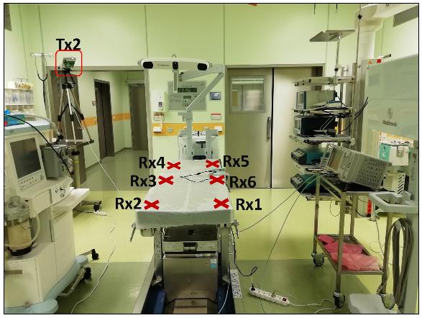
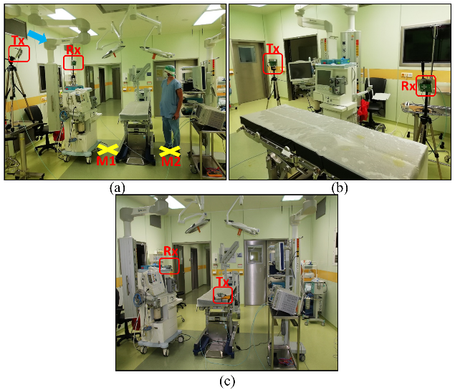
Medical Scenario
Measurement-based performance evaluation
Communication around operating table
Measured all channels in distributed MIMO matrix
Frequency sweep technique using VNA
Including reflections and blockages in the environment
Considered scenario as (virtually) distributed 6x4 MU-MIMO
Considered 5 different multiplexing schemes
LOS Scenario
Individual user throughput
Total Throughput
NLOS Scenario

Slide 18
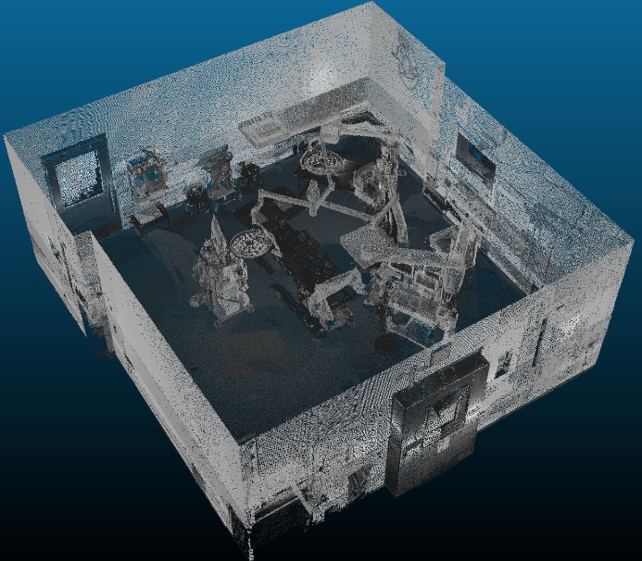
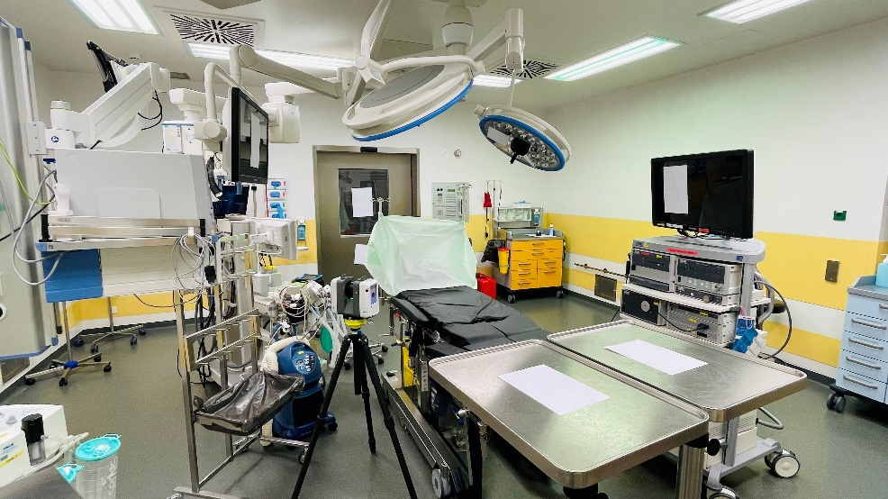
Medical Scenario
Channel modelling and coverage mapping for LiFi
Communication around operating table
Point cloud data acquisition
LIDAR placed at multiple positions
Point cloud data used for modelling
Tx1
Tx3
Tx2
With 3 Txs pointing towards floor
Combined Coverage map for all Txs

Slide 19
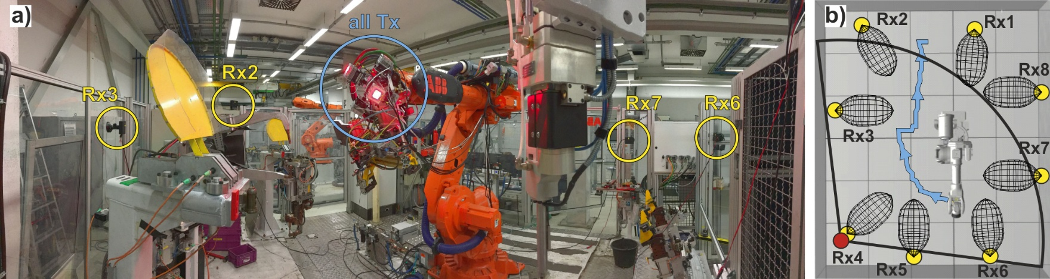
Industrial scenario
Measurements in a manufacturing plant
Using channel sounder system
Broadband distributed 8×6 MIMO channel measurements
Highlights potential of distributed MIMO OWC systems
i

Slide 20
Use case scenarios for UCM
Scenarios available for UCM
Conference room, office room, class room (data are available in both simulations and measurements)
Medical (Simulation data/LIDAR available)
Industry (Manufacturing hall, storage shelf: TBD)
Data format
Raw data versus time on Mentor
Incl. an interpolation routine
Documentation on channel modelling

Slide 21
Conclusions
Channel modelling
LIDAR based 3D scan and reflectance estimation
accurate, low complexity and efficient channel modelling approach
useful for large distributed MU-MIMO scenarios and mobile scenarios
Validation by measurements
good agreement between the results
Available use cases/reference scenarios
Medical, residential/office, industrial

Slide 22
References
V. Jungnickel et al. “A physical model of the wireless infrared communication channel”, In: IEEE Journal on Selected Areas in Communications 20.3 (2002), pp. 631–640.
H. Schulze, “Frequency-Domain Simulation of the Indoor Wireless Optical Communication Channel”. In: IEEE Transactions on Communications 64.6 (2016), pp. 2551–2562.
S. Katz et al. “Direct visibility of point sets”, ACM Trans. Graph. 26, 3 (July 2007), 24–es.
K. Tan and X. Cheng. “Surface reflectance retrieval from the intensity data of a terrestrial laser scanner”. In: Journal of the Optical Society of America A 33.4 (2016), pp. 771–778.
S. M. Mana et al., "An Efficient Multi-Link Channel Model for LiFi," PIMRC 2021, pp. 1-6.
S. M. Mana et al., "LIDAR-assisted Channel Modelling for LiFi”, 2022 OFC, San Diego, CA, USA, 2022.
S. M. Mana et al., "LIDAR-Assisted Channel Modelling for LiFi in Realistic Indoor Scenarios", IEEE Access, vol. 10, 2022.
S. M. Mana et al., “Experiments in Non-Line-of-Sight Li-Fi Channels”, GLC 2019.
S. M. Mana et al., "Distributed MIMO Experiments for LiFi in a Conference Room," CSNDSP 2020.
S. M. Mana et al., "LiFi Experiments in a Hospital," 2020 OFC, San Diego, CA, USA, 2020.
S. M. Mana et al,, "Distributed Multiuser MIMO for LiFi: Experiments in an Operating Room," JLT, vol. 39, no. 18, Sept.15, 2021.

