Slide 1
Follow-up on Access message for AMP
September 2025
Doc.: IEEE 802.11-25/1586r0
Date: 2025-9-12
Authors:
Name | Affiliation | Address | Phone | Email
Weijie Xu | OPPO |  |  | xuweijie@oppo.com
Ke Wang

Slide 2
Abstract
Doc.: IEEE 802.11-25/1586r0
This submission is to further discuss the first access message send by AMP device after being triggered. Generally, we will discuss:
  The information carried in AMP access message
  Frame format for AMP access message

Slide 3
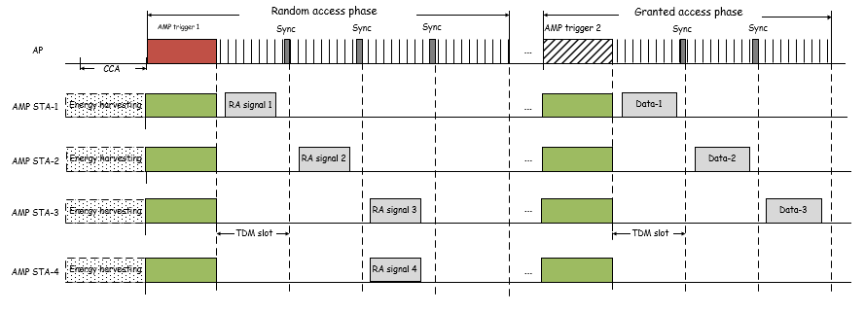
September 2025
Doc.: IEEE 802.11-25/1586r0
Background(1)
  In RFID, slot-aloha is used as the access procedure.
    It uses 2-step access, RN16 is the 1st message that RFID device send to the interrogator after being queried.
    The payload size of RN16 message is much smaller than that of a EPC code message. When there is collision, the system loss of using RN16 as the 1st message is smaller than that of directly sending EPC code.
      Figure: 2-step multiple access[2]
Slide 3
Weijie Xu (OPPO)

Slide 4
September 2025
Doc.: IEEE 802.11-25/1586r0
Background(2)
  On channel access, the following motions have been passed.
MM-8: 802.11bp supports a time-slot based random access mechanism for Active Tx non-AP AMP STAs:
  AMP AP transmits an AMP frame that indicates one or more time-slots.
  Further details (e.g., frame formats, how a STA chooses a random access time-slot etc.) are TBD.
MM-9: 802.11bp supports a time-slot based scheduled access mechanism for Active Tx non-AP AMP STAs:
  AMP AP transmits an AMP frame to assign one or more transmission time-slots.
  Further details (e.g., frame formats, how the time-slots are assigned etc.) are TBD.
MM-26: 802.11bp supports a two phases access mechanism for Active Tx non-AP AMP STAs, which includes:
  Based on the uplink frame received in the one or more random access time-slots indicated by an AMP trigger frame from an AMP AP, the AMP AP can transmit another AMP trigger frame to assign one or more transmission time-slots for non-AP AMP STA(s) in a scheduled phase.
Slide 4
Weijie Xu (OPPO)

Slide 5
September 2025
Doc.: IEEE 802.11-25/1586r0
Recap: Access message AMP non-AP STA
  For 2-phase random access, access message needs to be send to AMP AP in the 1st phase. In [1], access message for AMP non-AP STA was discussed. The following requirements for RN16-like access message were proposed:
    Carry access information → access ID etc.
    Sufficient capability, to avoid different AMP STAs to select same random code→ the longer the access ID, the higher capability
    Good decoding performance → the short, the better performance
Slide 5
Weijie Xu (OPPO)

Slide 6
September 2025
Doc.: IEEE 802.11-25/1586r0
Information carried in AMP Access message
  In two-phase random access, AMP non-AP STA can send a short access message instead of a large payload directly in the first access phase. Hence, compared with one-phase random access, the light-weight access in the 1st phase enable a much more robust access and the price paid for random access collision is much less.
  Therefore, it require an AMP access message with payload size as small as possible. Only essential information shall be carried in AMP access message.
    RN16-like access code
      its length can be configurable depending on application scenario, i.e. depending on the number of deployed AMP devices.
        8 bits for sparse case and 16bits for dense case
    Other essential information, e.g., capabilities, WPT related , security related…
Slide 6
Weijie Xu (OPPO)

Slide 7
September 2025
Doc.: IEEE 802.11-25/1586r0
Frame format for AMP Access message
  For frame format, besides the carried access information, does it needs to have other part, e.g., MAC header, FCS etc.?
    MAC Header includes fields such as frame control, Duration/ID, address, Qos Control etc. It seems these functions are not needed for AMP access.
      AMP Access message will be send by AMP STA only after being triggered to perform random access. Even without frame control, the frame format can be known by AMP AP based on the procedure sequence.
      AMP STA is an unknown STA trying to access, there is no needs to carry its ID/address. After being triggered by one AMP AP, it will send random access message in the allocated slots, there is no need to carry AMP AP’s address.
      In addition, there is no need to carry duration and QoS control etc.
    FCS may be needed to do CRC check.
  It is proposed to define a Frame format for AMP access message without MAC Header. The Frame format includes Frame body and FCS.
Slide 7
Weijie Xu (OPPO)

Slide 8
September 2025
Doc.: IEEE 802.11-25/1586r0
Summary
  For AMP access message, essential information shall be carried in AMP access message.
    RN16-like access code
      its length can be configurable depending on application scenario, i.e. depending on the number of deployed AMP devices.
        8 bits for sparse case and 16bits for dense case
    Other essential information, e.g., capabilities, WPT related , security related…
  A Frame format including Frame body and FCS is defined for AMP access message.
Slide 8
Weijie Xu (OPPO)

Slide 9
Reference
September 2025
Doc.: IEEE 802.11-25/1586r0
IEEE 802.11-25/0035r1, CDM access for AMP
IEEE 802.11-25/0031r0 Trigger based multiple access for AMP
IEEE 802.11-25/0046r0 Channel access for Active Tx non-AP AMP STAs
IEEE 802.11-25/0322r0 Access message for AMP

