Slide 1
Constant Envelope OFDM in
Optical Wireless Communications
Date: 2025-09-10
Authors:

Slide 2
Abstract
Optical Wireless Communication (OWC) offers high data rates and unlicensed spectrum but is strongly affected by LED nonlinearities such as clipping and saturation, which degrade OFDM signals with high Peak-to-Average Power Ratio (PAPR). To overcome this limitation, we investigate the use of Constant Envelope OFDM (CE-OFDM), a modulation scheme that reduces the PAPR to approximately 3 dB, allowing transmitters to operate at higher bias currents and thereby improving power efficiency, robustness to nonlinearities, and transmission reach.

Slide 3
Outline
Motivation
Theoretical background
Our Previous Works
Results in Light Communication
Conclusion

Slide 4
Motivation
Challenges in VLC systems:
  LEDs inherently present nonlinear behavior, especially when driven at higher bias currents.
  This nonlinearity manifests as clipping (when the signal exceeds the LED’s dynamic range) and saturation (when the LED output no longer increases proportionally with input current).
Impact on OFDM signals:
  OFDM is spectrally efficient and robust to multipath fading, but it suffers from a high Peak-to-Average Power Ratio (PAPR).
  High PAPR drives the LED further into its nonlinear region, producing signal distortions, intermodulation effects, and significant degradation in error performance.
Need for improvement:
  To fully exploit VLC systems, we require modulation formats that are robust against LED nonlinearities, while still ensuring high power efficiency and extended transmission reach.

Slide 5
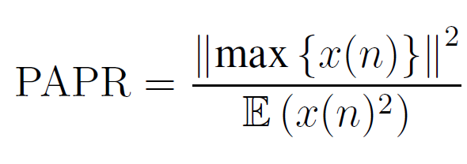
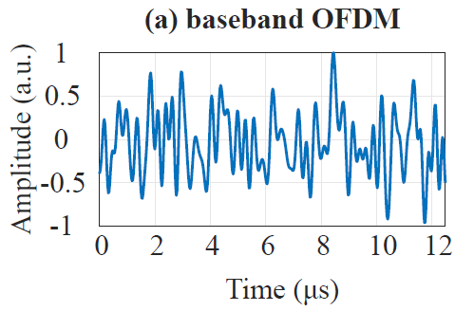
Orthogonal Frequency Division Multiplexing
Peak-to-Average Power Ratio
Per definition:
High PAPR is intrinsic in OFDM systems
Clipping of the signal leads to distortions
Distortion and distortionless techniques to reduce the PAPR.
  Peak power
  Average power

Slide 6
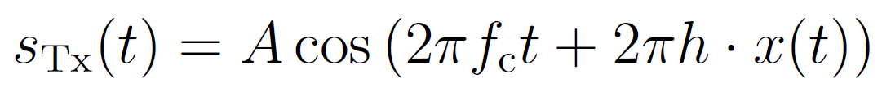
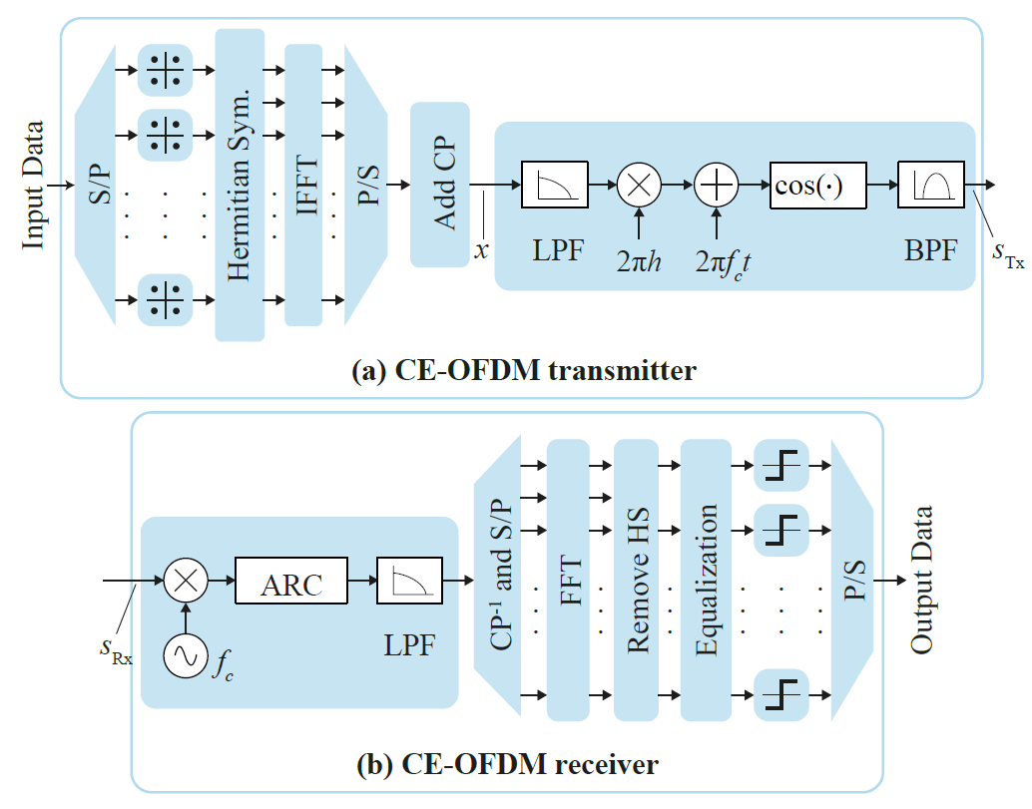
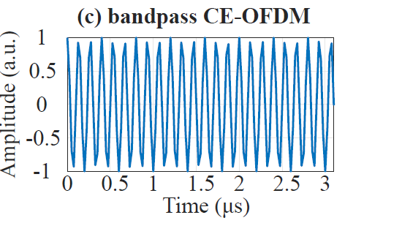
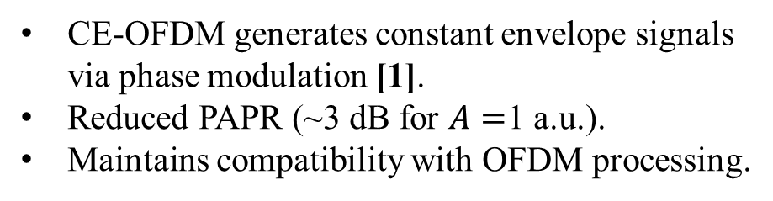
Constant-envelope OFDM (CE-OFDM)
  CE-OFDM generates constant envelope signals via phase modulation [1].
  Reduced PAPR (~3 dB for $A=$1 a.u.).
  Maintains compatibility with OFDM processing.

Slide 7
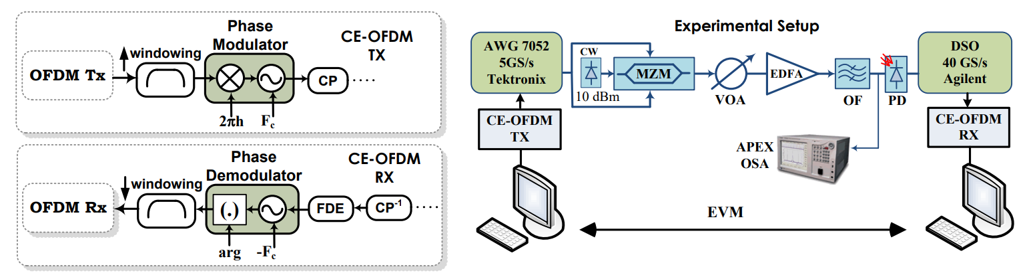
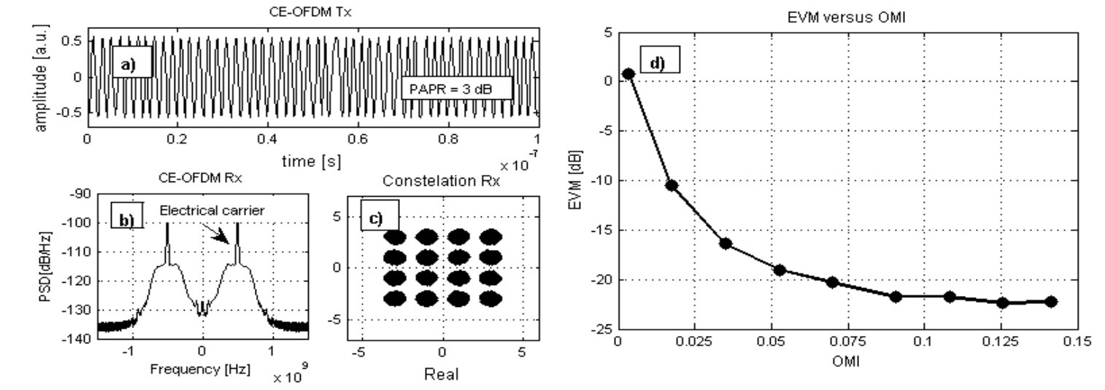
First PoC: Optical IMDD Systems
J. A. L. Silva, T. Alves, A. Cartaxo, and M. E. V. Segatto, "Experimental Demonstration of a Direct-Detection Constant Envelope OFDM system," in Advanced Photonics & Renewable Energy, OSA Technical Digest (CD) (Optica Publishing Group, 2010), paper SPThB2.

Slide 8
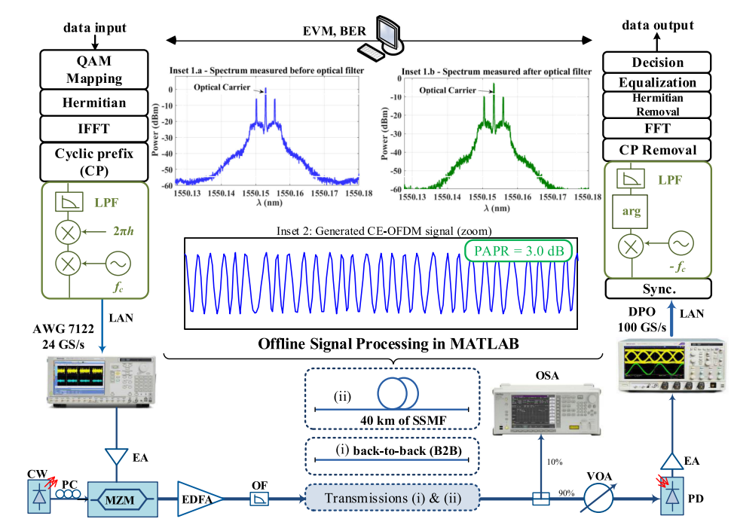
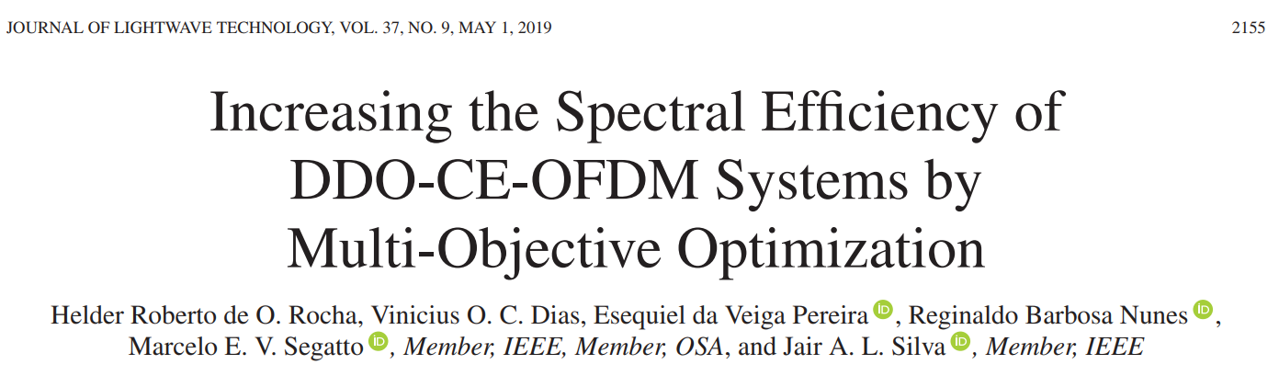
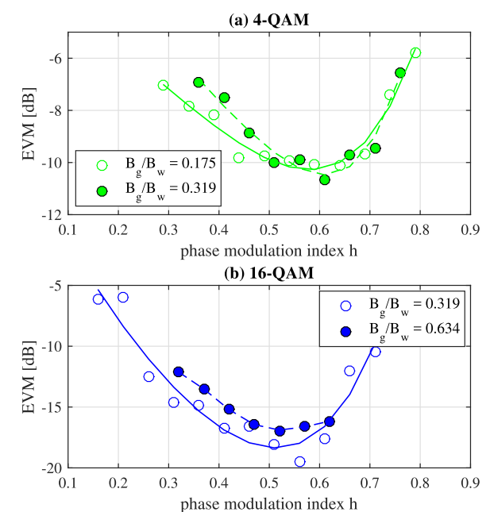
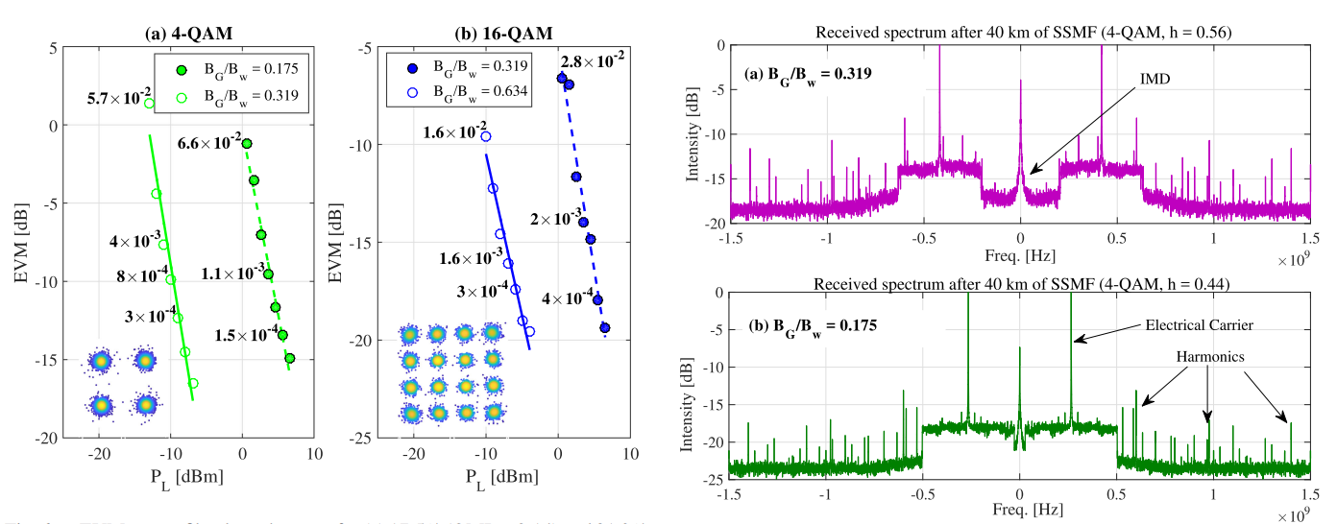
Addressing the Spectral Efficiency Issue in Optical IMDD

Slide 9
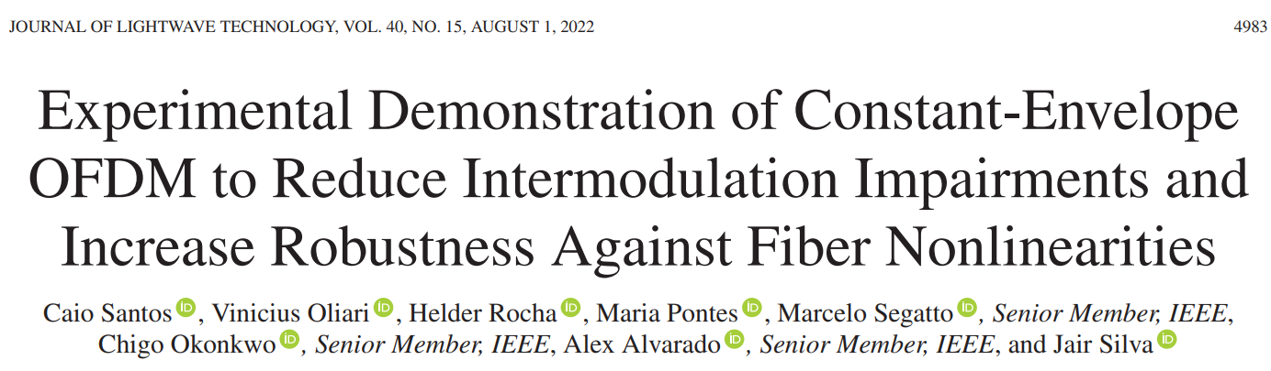
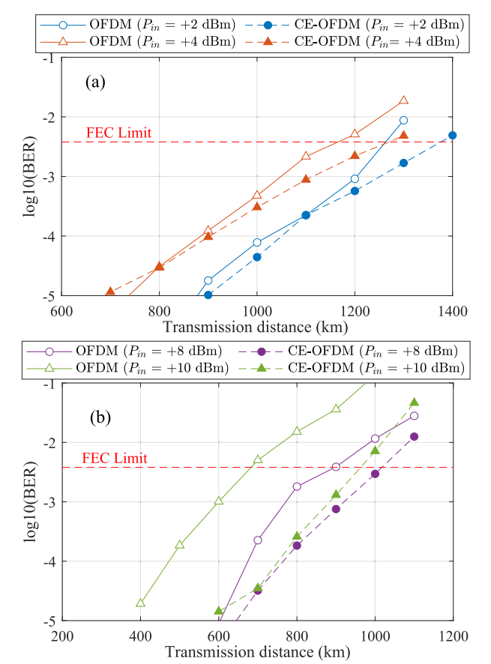
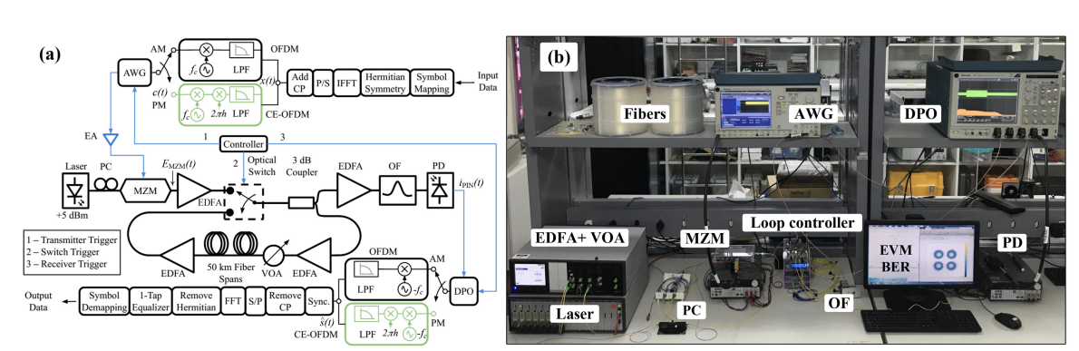
Addressing the Nonlinearities Impairments in Optical IMDD Systems

Slide 10
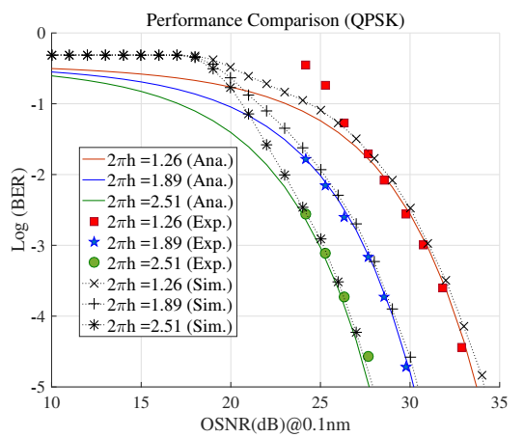
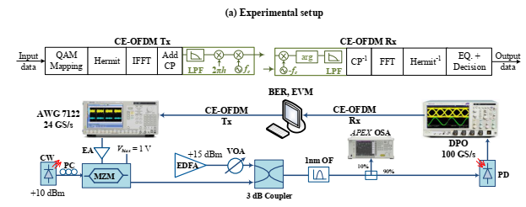

Closed-Form Expression for BER of CE-OFDM in Optical Intensity-Modulated Direct-Detection Systems

Slide 11
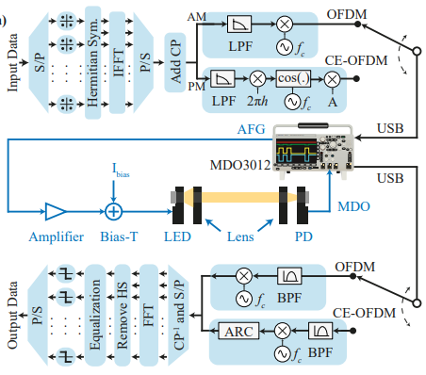
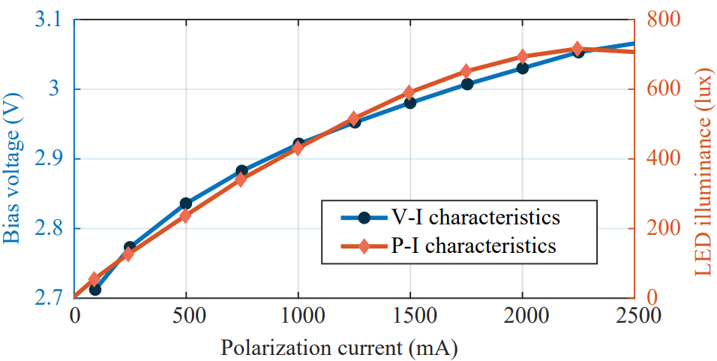
Increasing the Reach of Visible Light Communication Links Through Constant-Envelope OFDM Signals
How can CE-OFDM increase the reach of VLC Links compared with conventional OFDM?
By setting CE-OFDM as the modulation scheme of a VLC system, it is possible to increase the reach of the communication link compared with conventional OFDM.
xx

Slide 12
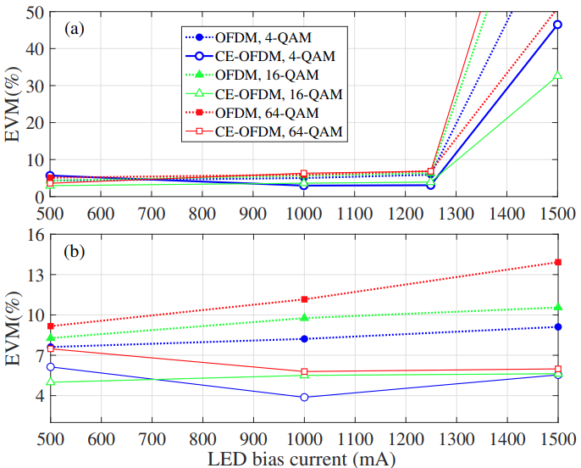
Influence of LED Bias Current on the Performance
Variation of EVM over the bias current across a VLC link of 1 m (a) and 4 m (b)
1 meter case
  CE-OFDM outperforms OFDM with bias ≳ 700 mA
  For 1500 mA, the EVM performance increase due to the receiver saturation as well as to the LED non-linearities
4 meters case:
  CE-OFDM outperforms the OFDM system in all scenarios.
A 1000 mA bias current was selected because CE-OFDM shows superior performance at this level over 4 meters.

Slide 13
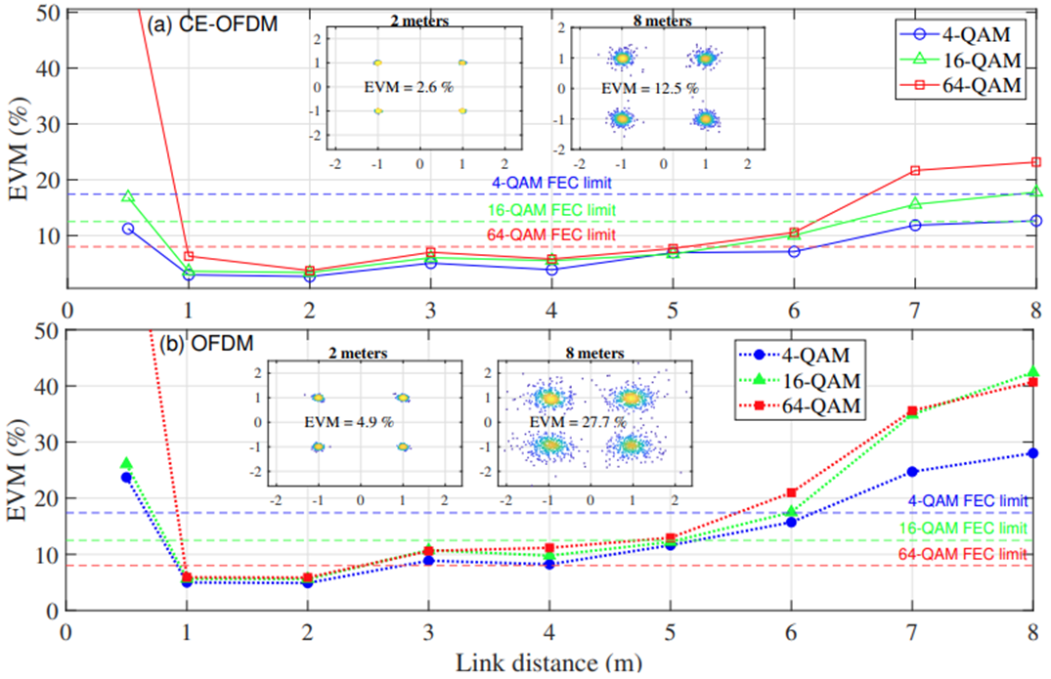
System Performance at Different VLC Link Lengths
Under 1 meter both systems presented saturation
Only CE-OFDM 4-QAM overcame the saturation
At 6 m, the CE-OFDM archived an improvement of 43% for 16-QAM
OFDM presents poor performance at distances greater than 5 m
At 8 m, only the CE-OFDM system with 4-QAM achieved a good performance
The CE-OFDM archived better results for longer distances because its low PAPR

Slide 14
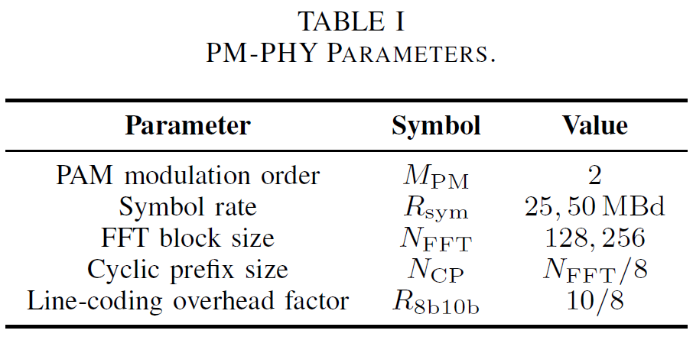
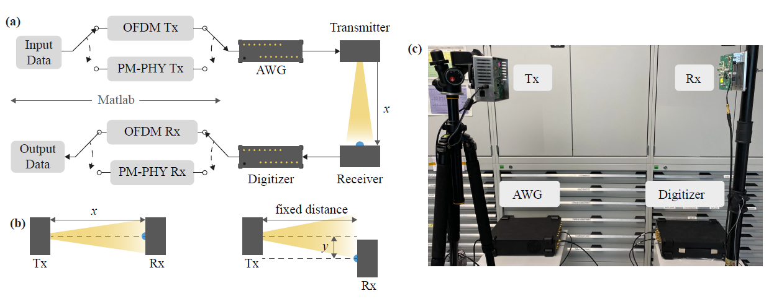
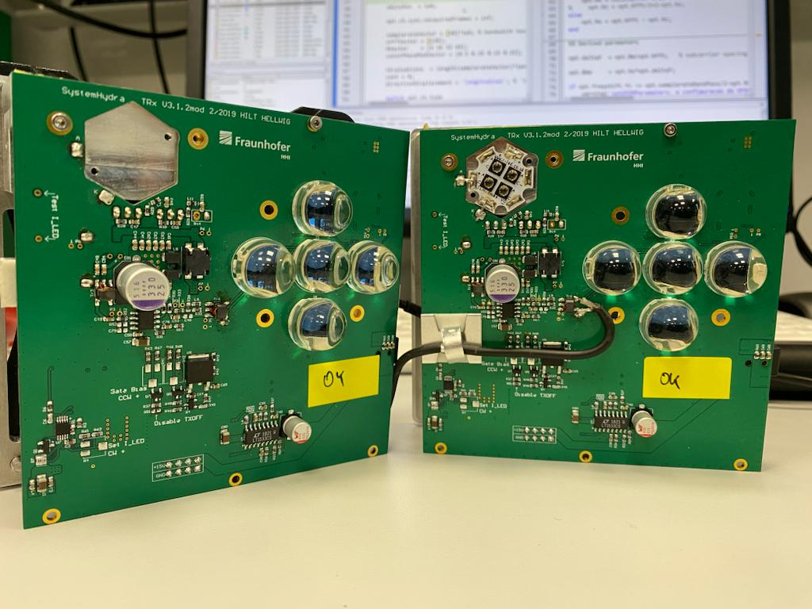
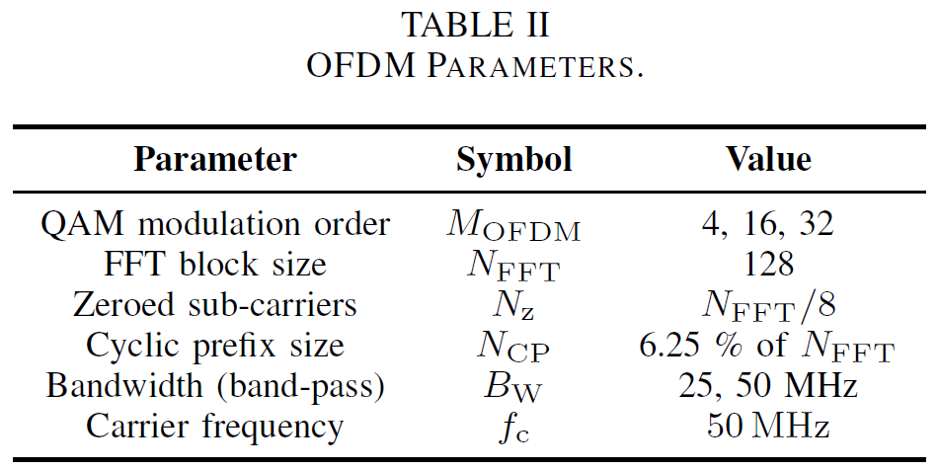
A Performance Comparison of (CE)OFDM and Pulsed PHY Modulations in Optical Wireless Communications
Experimental setup

Slide 15
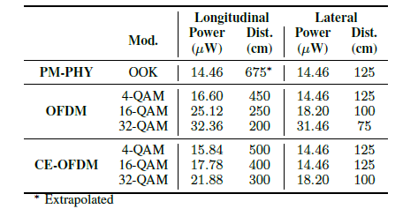
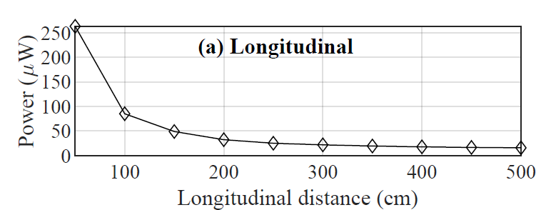
A Performance Comparison of (CE)OFDM and Pulsed PHY Modulations in Optical Wireless Communications

Slide 16
Conclusions
  The low PAPR (≈ 3 dB) of CE-OFDM signals led to EVM improvements across nearly all link lengths.
  CE-OFDM outperformed conventional OFDM signals in terms of required received power to achieve error rates below the FEC threshold.
  At longer ranges, using a constant-envelope waveform in VLC systems, EVM reduces by approximately 54% for 4-QAM at 8 m and by 43% for 16-QAM at 6 m, respectively. This achievement was possible due to the tolerance to nonlinearity assured by constant-envelope signals, and its robustness against noise.
  Future Directions
  The combination of PM-PHY and CE-OFDM modulation can be well-suited to enable rate adaptation across varying distances.
  CE-OFDM can a strong candidate to the 802.11br waveform standardization considering further aspects such as channelization.

Slide 17
References
[1] Thompson, Steve C., et al. "Constant envelope OFDM." IEEE transactions on communications 56.8 (2008): 1300-1312.
[2] Jair A. L. Silva, Adolfo V. T. Cartaxo, and Marcelo E. V. Segatto, "A PAPR Reduction Technique Based on a Constant Envelope OFDM Approach for Fiber Nonlinearity Mitigation in Optical Direct-Detection Systems," J. Opt. Commun. Netw. 4, 296-303 (2012)
[3] J. A. L. Silva, T. Alves, A. Cartaxo, and M. E. V. Segatto, "Experimental Demonstration of a Direct-Detection Constant Envelope OFDM system," in Advanced Photonics & Renewable Energy, OSA Technical Digest (CD) (Optica Publishing Group, 2010), paper SPThB2.
[4] Rocha, H. R. D. O., Dias, V. O., da Veiga Pereira, E., Nunes, R. B., Segatto, M. E., & Silva, J. A. (2019). Increasing the spectral efficiency of DDO-CE-OFDM systems by multi-objective optimization. Journal of Lightwave Technology, 37(9), 2155-2162.
[5] Santos, C., Oliari, V., Rocha, H., Pontes, M., Segatto, M., Okonkwo, C., Alvarado, A. and Silva, J., 2022. Experimental Demonstration of Constant-Envelope OFDM to Reduce Intermodulation Impairments and Increase Robustness Against Fiber Nonlinearities. Journal of Lightwave Technology, 40(15), pp.4983-4989.
[6] Oliari, V., Santos, C., Marciano, P., Rocha, H., Segatto, M., & Silva, J. (2019). Closed-form expression for BER of CE-OFDM in optical intensity-modulated direct-detection systems. IEEE Communications Letters, 23(10), 1796-1800.
[7] Camporez, H., Costa, W., Pontes, M., Segatto, M., Rocha, H., Silva, J., ... & Freund, R. (2023). Increasing the reach of visible light communication links through constant-envelope OFDM signals. Optics Communications, 530, 129179.
[8] Hinrichs, M., Costa, W., Rocha, H., Pontes, M., Segatto, M., Paraskevopoulos, A., ... & Silva, J. (2023, November). A performance comparison of OFDM and pulsed PHY modulations in optical wireless communications. In 2023 South American Conference On Visible Light Communications (SACVLC) (pp. 124-129). IEEE.

