Slide 1
Timestamp size for AMP TSF
September 2025
Doc.: IEEE 802.11-25/1583r0
Date: 2025-09-08
Authors:
Name | Affiliation | Address | Phone | Email
Chuanfeng He | OPPO |  |  | hechuanfeng@oppo.com
Weijie Xu |  |  |  | xuweijie@oppo.com
Sam Shi |  |  |  | Sam.Shi@INNOPEAKTECH.COM
Yinan Qi |  |  |  | v-qiyinan@oppo.com

Slide 2
Background
September 2025
Doc.: IEEE 802.11-25/1583r0
Currently the following motions about AMP TSF were agreed [1].
  MM-1: If AMP device is able to support AMP TSF, the maximum timing offset is ±10⁴ ppm.
  MM-23: 802.11bp defines short timestamp to enable AMP NON-AP STA to monitor DL frames in duty-cycle operation.
    The length of short timestamp is TBD.
  MM-26: 802.11bp specifies, for a short timestamp, coarse timing granularity larger than 1µs.
    The detailed timing granularity are TBD.
  FM-7: 802.11bp allows short timestamp to be carried in an AMP trigger Frame.
    Note: The presence of the short timestamp is configurable.
In this contribution, we want to discuss the length of 11bp short timestamp.
Chuanfeng He (OPPO)

Slide 3
September 2025
Doc.: IEEE 802.11-25/1583r0
Recap: Timestamp size for AMP TSF
  Factors to determine timestamp size for AMP TSF
    The timing granularity of AMP TSF
      Significantly relax the timing granularity requirement for AMP, e.g. to 1024us, is acceptable
        Since the TSF clock accuracy is 10^4 ppm, for a 200ms duty cycle period, 2ms drifting will happen. It is not necessary to maintain fine timing granularity(i.e. 1us).
    The range of AMP TSF timer
      The range of AMP TSF timer can be determined to cover the duration of whole operation duration (e.g., time spending for the whole inventory procedure).
        In [2], we raised the assumption on energy storage and the procedure of success UL PPDU transmission. One practical maximum operation duration is about 2.02s.
        During the operation duration, TSF timer is used to determine the service periods based on the Duty-cycle configuration and finish the solicited UL data Tx.
Slide 3
Chuanfeng He (OPPO)

Slide 4
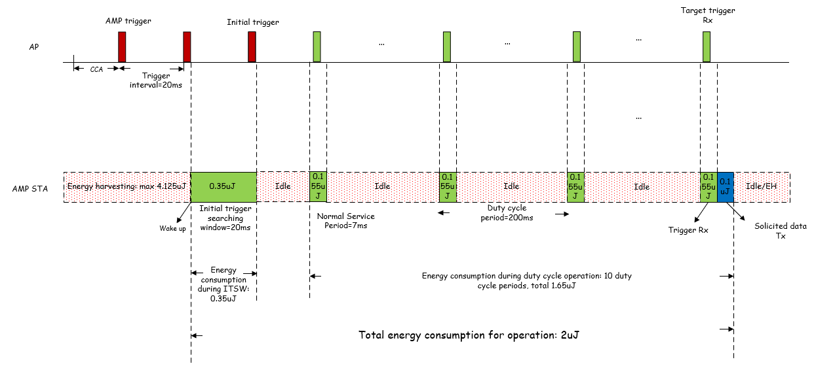
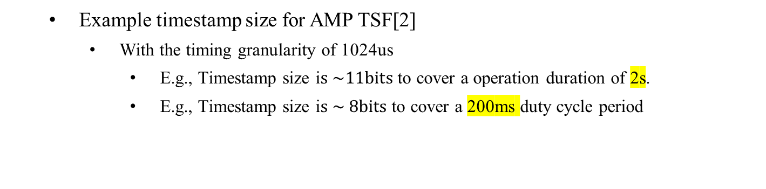
September 2025
Doc.: IEEE 802.11-25/1583r0
Recap: Short timestamp for AMP TSF
    Example timestamp size for AMP TSF[2]
      With the timing granularity of 1024us
        E.g., Timestamp size i$s \sim 11bits$to cover a operation duration of 2s.
        E.g., Timestamp size i$s \sim 8bits$to cover a 200ms duty cycle period
Slide 4
Chuanfeng He (OPPO)

Slide 5
September 2025
Doc.: IEEE 802.11-25/1583r0
Timestamp size for AMP TSF
  Principle of timestamp size design:
    The total operation duration of AMP device may be short due to limited energy storage and low latency for inventory like use. The TSF timer only needs to cover operation duration to make AMP STA timing synchronized and avoid timing ambiguity.
  Timing granularity
    A non-DMG STA’s TSF timer is accurate to within ± 100 ppm. A WUR STA’s TSF timer has the same TSF timer accuracy requirement as non-DMG STA.
    The timing granularity of A WUR STA is 32 µs with partial TSF timestamp.
    If we consider ± 10^4 ppm clock accuracy of an AMP STA, the timing granularity can be further relaxed, e.g. to 1024 µs or 4096 µs, which leads to 10 and 12 LSB bits saved respectively.
  Range of AMP TSF timer
    In [2], we raised the assumptions on energy storage and the procedure of success UL PPDU transmission. One practical maximum operation duration is about 2.02s, which can be used for the range of AMP TSF timer.
    In [3], We also proposed that the range of AMP TSF timer can cover the duration of a Duty-cycle period, in order to determine its specific AMP service period within the Duty-cycle period.
Slide 5
Chuanfeng He (OPPO)

Slide 6
September 2025
Doc.: IEEE 802.11-25/1583r0
Timestamp size for AMP TSF
  Timestamp size:
    Candidate timing granularity:
      1024 µs, 4096 µs
    Candidate range of AMP TSF timer
      Duty cycle period, e.g. 200ms
      Operation duration, e.g. 2, 4 seconds
    Timestamp size
      12 bits @ 1024 µs timing granularity and 4 seconds AMP TSF timer range
      11 bits @ 1024 µs timing granularity and 2 seconds AMP TSF timer range
      8 bits @ 1024 µs timing granularity and 200ms AMP TSF timer range
      6 bits @ 4096 µs timing granularity and 200ms AMP TSF timer range
  Proposals:
    802.11bp defines short timestamp with timing granularity of 1024-4096 µs.
    802.11bp defines AMP TSF timer with range of a duty cycle period, 2 or 4 seconds.
Slide 6
Chuanfeng He (OPPO)

Slide 7
September 2025
Doc.: IEEE 802.11-25/1583r0
Summary and Proposal
  In this submission, we discuss the principle of timestamp size design, which includes:
    Coarse timing granularity
    Limited Range of AMP TSF timer
  We try to give some candidate values of timing granularity and range of AMP TSF timer.
  We propose 11bp group to consider the candidate values, in order to make some progress on short timestamp.
    Candidate timing granularity:
      1024 µs, 4096 µs
    Maximum range of AMP TSF timer
      Duty cycle period, 2, 4 seconds
Slide 7
Chuanfeng He (OPPO)

Slide 8
September 2025
Doc.: IEEE 802.11-25/1583r0
Straw Poll #1
Do you agree with the following text:
  802.11bp defines short timestamp with the following candidate timing granularity:
    1024 µs,4096 µs
Yes
No
Abstain
Slide 8
Chuanfeng He (OPPO)

Slide 9
September 2025
Doc.: IEEE 802.11-25/1583r0
Straw Poll #2
Do you agree with the following text:
  802.11bp defines AMP TSF timer with the following candidate range:
    Duty cycle period
    2 seconds, 4 seconds
Yes
No
Abstain
Slide 9
Chuanfeng He (OPPO)

Slide 10
Reference
September 2025
Doc.: IEEE 802.11-25/1583r0
IEEE 802.11-24/1613r10, Specification framework for tgbp
IEEE 802.11-25/0813r0, Follow up on Duty-cycle operation for AMP
IEEE 802.11-25/0814r0, Follow up on TSF for trigger based AMP
IEEE 802.11-25/1251r0, Follow up on TSF for trigger based AMP communication
IEEE 802.11-25/0342r0, TSF for trigger based AMP communication

