Slide 1
Random UL access for AMP non-AP STAs
September 2025
Doc.: IEEE 802.11-25/1582r0
Date: 2025-09-08
Authors:
Name | Affiliation | Address | Phone | Email
Chuanfeng He | OPPO |  |  | hechuanfeng@oppo.com
Weijie Xu |  |  |  | xuweijie@oppo.com
Sam Shi |  |  |  | Sam.Shi@INNOPEAKTECH.COM
Yinan Qi |  |  |  | v-qiyinan@oppo.com

Slide 2
Background
September 2025
Doc.: IEEE 802.11-25/1582r0
The motions about random UL access mechanisms for non-AP AMP STAs were agreed.[1]
  MM-8: 802.11bp supports a time-slot based random access mechanism for Active Tx non-AP AMP STAs:
    AMP AP transmits an AMP frame that indicates one or more time-slots.
    Further details (e.g., frame formats, how a STA chooses a random access time-slot etc.) are TBD.
  MM-25: 802.11bp supports a time-slot based random access mechanism, which includes:
    Non-AP AMP STA randomly selects a time-slot among time-slots indicated by an AMP Trigger and the non-AP AMP STA transmits an uplink PPDU in the selected slot.
    How to do random selection is TBD.
  MM-27: Upon receiving the AMP Trigger frame indicating a time-slot based random access session, a non-AP AMP STA performs the following actions:
    Based on the Random Access Parameters, the non-AP AMP STA may transmit an uplink AMP PPDU carrying the uplink response in one of the slots allocated by the AMP Trigger frame.
  FM-9: An AMP AP transmits an AMP Trigger frame indicating a time-slot based random access session for non-AP AMP STAs. The frame carries:
    Random Access Parameters: Indicates parameters for random access
    Parameters for random access are TBD.
Chuanfeng He (OPPO)

Slide 3
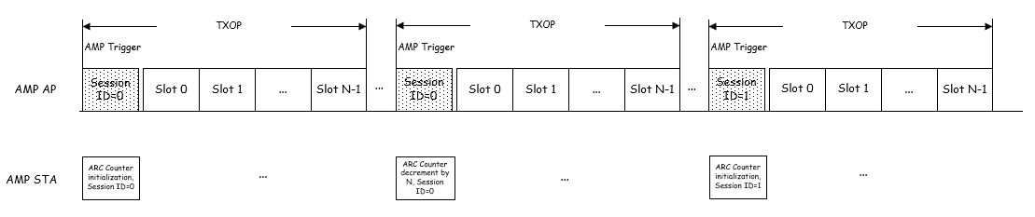
September 2025
Doc.: IEEE 802.11-25/1582r0
AMP Random Access
  AMP STA contends for uplink transmission based on Random Access Parameters and Counter.[2]
    AMP STA obtains random access parameters through AMP trigger frame
    AMP STA maintains an AMP Random Access Counter (ARAC) based on detected AMP trigger frame.
      ARA Counter initialization upon receiving an AMP trigger frame
        A new session ID different from the stored one is received in AMP trigger frame.
        ARA Counter initialization based on random access parameters in AMP trigger frame.
        Store new session ID after ARA Counter initialization.
      ARA Counter update upon receiving an AMP trigger frame
        A session ID same as the stored one is received in AMP trigger frame.
        If ARA Counter >N, ARA Counter is decreased by N
Slide 3
Chuanfeng He (OPPO)

Slide 4
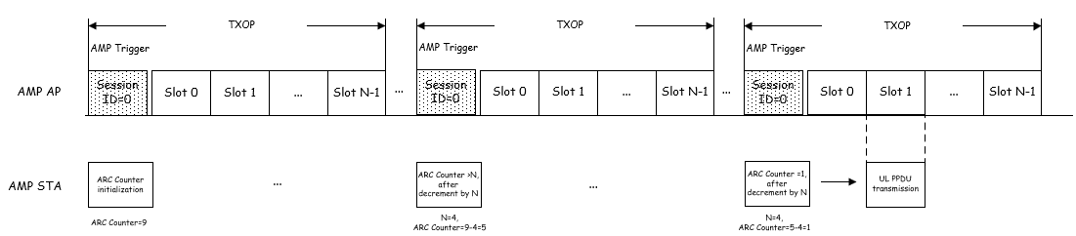
September 2025
Doc.: IEEE 802.11-25/1582r0
AMP Random Access
  AMP STA determines whether to transmit in a slot allocated by the AMP trigger frame based on ARA Counter.
    If ARA Counter < N,
      AMP STA transmits in a slot (whose index=ARAC) allocated by the AMP Trigger frame
    else,
      AMP STA does not respond the AMP trigger
      Update ARAC = ARAC – N.
    N can be the number of time slots allocated by the AMP trigger frame.
Slide 4
Chuanfeng He (OPPO)

Slide 5
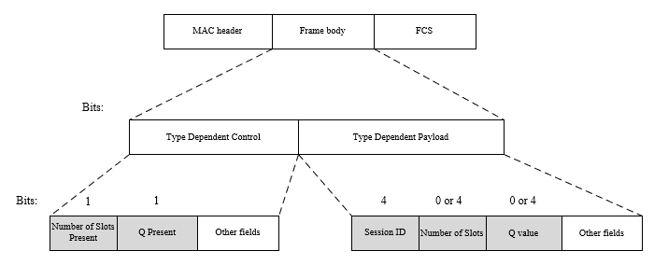
September 2025
Doc.: IEEE 802.11-25/1582r0
Random Access Parameters in AMP trigger
  Random access related fields in AMP trigger frame
    Session ID: to identify a random access session.
    Number of slots: to be ARA Counter decrement step.
    Q value: to initialize ARA Counter.
  For ARA Counter initialization, ARA Counter is initialized to a random value in [0, 2^{Q}-1].
  For ARA Counter decrement, ARA Counter is decreased by the number of slots.
Slide 5
Chuanfeng He (OPPO)

Slide 6
September 2025
Doc.: IEEE 802.11-25/1582r0
Summary
  We share our understanding on AMP random access scheme.
    Distribute the UL access among trigger sessions to reduce contention.
    Determine to join a trigger session based on a Counter.
    A new session ID is received in an AMP trigger frame
      The counter is initialized to a random value in a range derived by the Random Access.
    A stored session ID is received in an AMP trigger frame
      If counter value is lower than the number of slots allocated in AMP trigger frame, AMP STA joins the trigger session for UL PPDU TX.
      Else, the counter is decreased by the number of slots allocated in AMP trigger frame.
Slide 6
Chuanfeng He (OPPO)

Slide 7
September 2025
Doc.: IEEE 802.11-25/1582r0
Straw Poll #1
Do you agree with the following text:
  An AMP AP transmits an AMP Trigger frame indicating a time-slot based random access session for non-AP AMP STAs. The frame carries:
    Session ID: Identifies the random access session
    Q value: Derives the upper limits of the initial value of AMP random access counter
    Number of Slots: Indicate the number of slots that are allocated by the AMP Trigger frame for uplink transmissions.
    Other parameters are TBD.
Yes
No
Abstain
Slide 7
Chuanfeng He (OPPO)

Slide 8
September 2025
Doc.: IEEE 802.11-25/1582r0
Straw Poll #2
Do you agree with the following text:
  Upon receiving an AMP Trigger frame indicating a time-slot based random access session, an AMP non-AP STA will:
    If a new session ID is received in an AMP trigger frame
      Initialize AMP Random Access Counter to a random value in [0, 2^{Q}-1].
      Store new session ID after AMP Random Access Counter initialization.
    If a stored session ID is received in an AMP trigger frame
      If AMP Random Access Counter value is lower than N(number of slots indicated in the AMP trigger frame), the AMP non-AP STA joins the trigger session for UL PPDU TX.
      Else, the AMP Random Access Counter is decreased by N.
Yes
No
Abstain
Slide 8
Chuanfeng He (OPPO)

Slide 9
Reference
September 2025
Doc.: IEEE 802.11-25/1582r0
IEEE 802.11-24/1613r12, Specification framework for tgbp
IEEE 802.11-25/1240r0, AMP channel access
IEEE 802.11-25/0815r0, UL access mechanisms for Active Tx AMP STAs

