Slide 1
Further details of Duty-cycle operation
September 2025
Doc.: IEEE 802.11-25/1581r0
Date: 2025-09-08
Authors:
Name | Affiliation | Address | Phone | Email
Chuanfeng He | OPPO |  |  | hechuanfeng@oppo.com
Weijie Xu |  |  |  | xuweijie@oppo.com
Sam Shi |  |  |  | Sam.Shi@INNOPEAKTECH.COM
Yinan Qi |  |  |  | v-qiyinan@oppo.com

Slide 2
September 2025
Doc.: IEEE 802.11-25/1581r0
Background
Currently the following motions about duty cycle operation were agreed [1].
MM-4: If an AMP device is able to support TSF, it can monitor AMP DL Frame in a duty-cycle manner.
MM-24: 802.11bp defines one mechanism that a non-AP AMP STA can derive its specific AMP service period in order to monitor AMP DL Frame.
FM-7: 802.11bp allows short timestamp to be carried in an AMP trigger Frame.
Note: The presence of the short timestamp is configurable.
FM-8: 802.11bp allows duty-cycle configuration to be carried in an AMP trigger Frame.
Details of Duty-cycle configuration (e.g., AMP service period) are TBD.
Note: The presence of the duty-cycle configuration is configurable.
In this contribution, we want to discuss further details of duty cycle operation.
Details of Duty-cycle configuration.
How a non-AP AMP STA derives its specific AMP service periods.
How to indicate Duty-cycle configuration in AMP trigger frame.
Slide 2
Chuanfeng He (OPPO)

Slide 3
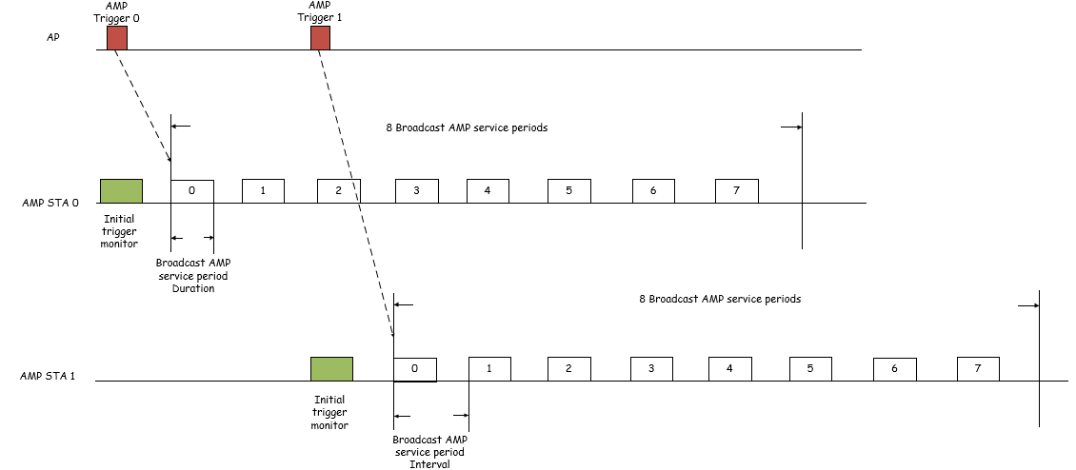
September 2025
Doc.: IEEE 802.11-25/1581r0
Duty-cycle operation procedure
AMP STA monitors an initial AMP trigger frame to obtain
Short timestamp: to align the TSF timer of AMP STAs detecting the AMP trigger frame[2].
Duty-cycle configuration parameters
Number of broadcast AMP service periods (N)
AMP service period duration
Broadcast AMP service period interval
Start time of first broadcast AMP service period
AMP STA derives the N broadcast AMP service periods according to Duty-cycle configuration parameters
The N broadcast AMP service periods are indexed from 0~N-1.
The start time is used to indicate the start time of first broadcast AMP service period of N.
Slide 3
Chuanfeng He (OPPO)

Slide 4
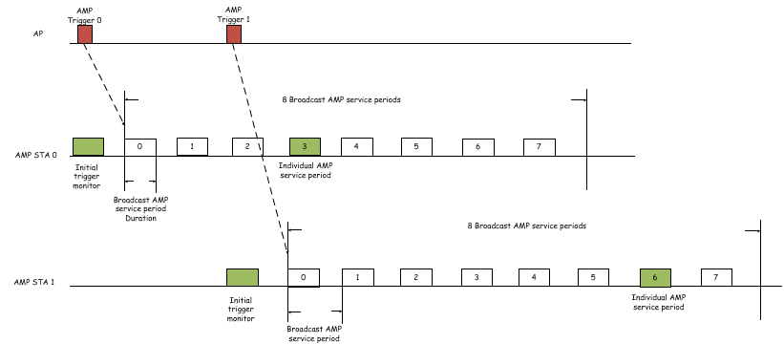
September 2025
Doc.: IEEE 802.11-25/1581r0
Duty-cycle operation procedure
AMP STA derives its individual AMP service period from the N broadcast AMP service periods.
E.g. AMP STA randomly selects one or more AMP service periods as its individual AMP service periods.
Slide 4
Chuanfeng He (OPPO)

Slide 5
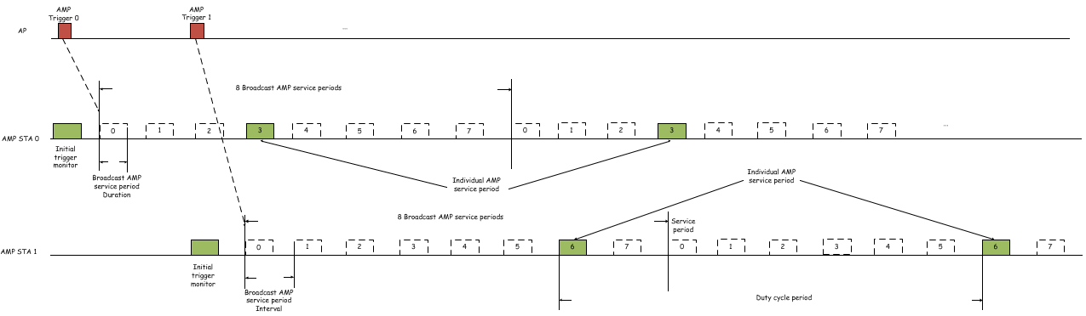
September 2025
Doc.: IEEE 802.11-25/1581r0
Duty-cycle operation procedure
The individual AMP service periods can further repeat every N broadcast AMP service periods.
The interval between the repeated individual AMP service periods is duty cycle period of AMP non-AP STA.
AMP STA monitors AMP trigger frame during its individual AMP service periods.
AMP STA 0 and 1 obtain a set of 8 broadcast AMP service periods associated with trigger 0 and 1 separately.
AMP STA 0 and 1 select AMP service period index 3 and 6, respectively.
AMP STA monitors DL AMP frame during its individual AMP service periods with same index in several repeated 8 service periods.
Slide 5
Chuanfeng He (OPPO)

Slide 6
September 2025
Doc.: IEEE 802.11-25/1581r0
AMP trigger frame
Duty-cycle configuration parameters are carried through AMP trigger frame.
The overhead of Duty-cycle configuration parameters should be low to reduce the total payload of AMP trigger frame.
Joint indication can be used to avoid the large overhead of separate indication.
A combination of Duty-cycle configuration parameters values are indicated by a codepoint.
There is a tradeoff between overhead and configuration flexibility.
The following table shows an example of joint indication of Duty-cycle configuration parameters.
Each entry in the table indicates a combination of Duty-cycle configuration parameters.
Codepoint | AMP SP Number | AMP SP duration | AMP SP interval
00 | 8 | 5ms | 50ms
01 | 8 | 5ms | 50ms
10 | 16 | 7ms | 100ms
11 | 16 | 7ms | 100ms
Slide 6
Chuanfeng He (OPPO)

Slide 7
September 2025
Doc.: IEEE 802.11-25/1581r0
Summary and proposals
In this submission, further details of Duty-cycle operation for AMP are discussed.
Duty-cycle configuration parameters
Individual AMP service period determination
To support Duty-cycle operation, it is proposed:
Duty-cycle configuration parameters indicated through AMP trigger frame
Number of broadcast AMP service periods (N)
AMP service period duration
Broadcast AMP service period interval
Start time of first broadcast AMP service period
AMP STA randomly selects one or more AMP service periods from a set of broadcast AMP service periods as its individual AMP service periods.
The set of broadcast AMP service periods includes N AMP service periods indicated through AMP trigger frame.
A combination of Duty-cycle configuration parameters values are indicated by a codepoint.
Slide 7
Chuanfeng He (OPPO)

Slide 8
September 2025
Doc.: IEEE 802.11-25/1581r0
Straw Poll #1
Do you agree with the following text:
AMP AP transmits an AMP trigger frame indicating Duty-cycle configuration parameters, which include:
Number of broadcast AMP service periods (N)
AMP service period duration
Broadcast AMP service period interval
Start time of first broadcast AMP service period
Yes
No
Abstain
Slide 8
Chuanfeng He (OPPO)

Slide 9
September 2025
Doc.: IEEE 802.11-25/1581r0
Straw Poll #2
Do you agree with the following text:
Upon receiving the AMP trigger frame indicating Duty-cycle configuration parameters, an AMP non-AP STA performs the following actions:
Determine a set of broadcast AMP service periods based on the Duty-cycle configuration parameters indicated in AMP trigger frame, which include:
The start time of the first broadcast AMP service period in the set.
The number of broadcast AMP service periods in the set.
The duration of each broadcast AMP service period.
The interval between the broadcast AMP service periods.
Select its individual AMP service period(s) from the set of broadcast AMP service periods.
How to select is TBD
The interval between individual AMP service periods is the Duty-cycle period of AMP non-AP STA.
Yes
No
Abstain
Slide 9
Chuanfeng He (OPPO)

Slide 10
September 2025
Doc.: IEEE 802.11-25/1581r0
Straw Poll #3
Do you agree with the following text:
AMP AP transmits an AMP trigger frame indicating a codepoint corresponding to a combination of Duty-cycle configuration parameters values.
Yes
No
Abstain
Slide 10
Chuanfeng He (OPPO)

Slide 11
Reference
September 2025
Doc.: IEEE 802.11-25/1581r0
IEEE 11-24/1613r12, Specification framework for tgbp
IEEE 11-25/1251r0, Follow up on TSF for trigger based AMP communication
IEEE 11-25/1252r0, Further details of Duty-cycle operation for AMP
IEEE 11-25/0813r0, Follow up on Duty-cycle operation for AMP
IEEE 11-25/0341r0, Details of Duty-cycle operation for AMP

