Slide 1
Follow-up on sync field for AMP PPDU
September 2025
Doc.: IEEE 802.11-25/1580r0
Date: 2025-09-12
Authors:
Name | Affiliation | Address | Phone | Email
Ke Wang | OPPO |  |  | v-qiyinan@oppo.com
Weijie Xu
Yinan Qi

Slide 2
DL SYNC field for non-Backscatter AMP (1)
Doc.: IEEE 802.11-25/1580r0
  Analysis of DL sync sequence
Source | Candidate Sequence | Auto-correlation | One-shot False-Alarm Rate for Differential decoder due to noise
Source [1] | 01011010010111000110001011101100 | AC=16/3+16/3 | 2*3.9221e-5
Source [2] | 10100101110011001010010111001100 | AC=8/2 | 2*1.8641e-5
Source [3] | 00101011011100011010011011101000 | AC=16/3+16/3 | 2*5.0982e-05
Our new sequence 1 | 00110011100010111010001011010110 | AC=16/2+16/3 | 2*3.7281e-5
Our new sequence 2 | 01011010010111010001100011100110 | AC=16/3+16/3 | 2*2.9416e-5

Slide 3
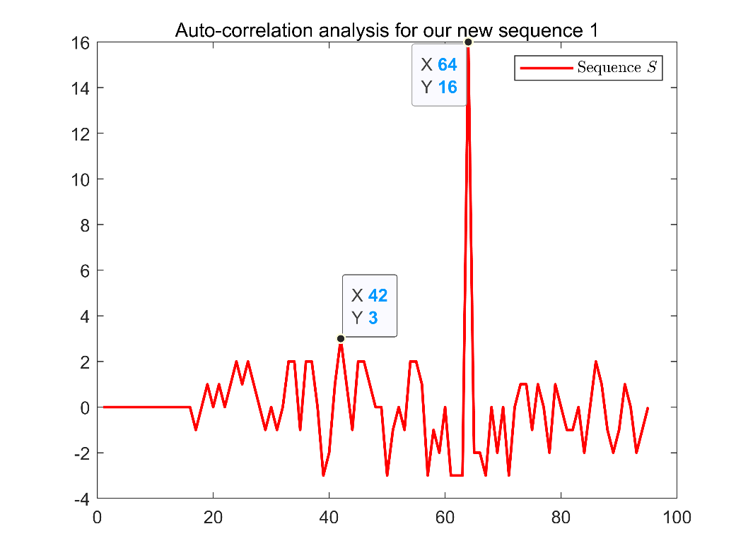
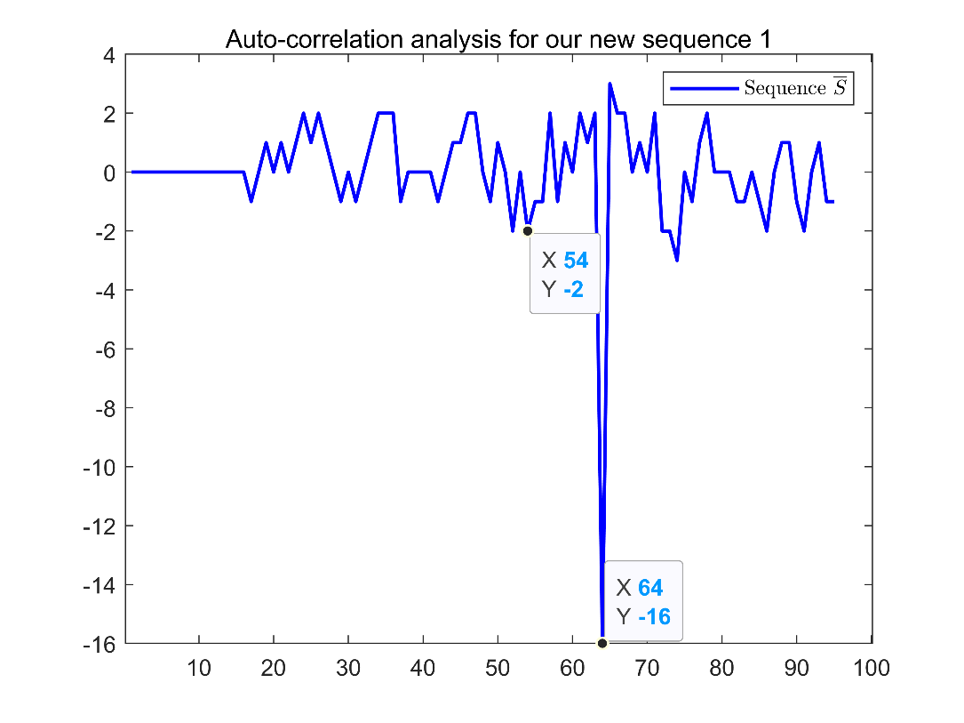
Auto-correlation analysis for correlation receiver
Doc.: IEEE 802.11-25/1580r0
  Main peak is 16.
  Max side lode peak is 3.
  Min side lode peak is -3.
  Main peak is -16.
  Max side lode peak before main peak is 2.
  Min side lode peak before main peak is -2.

Slide 4
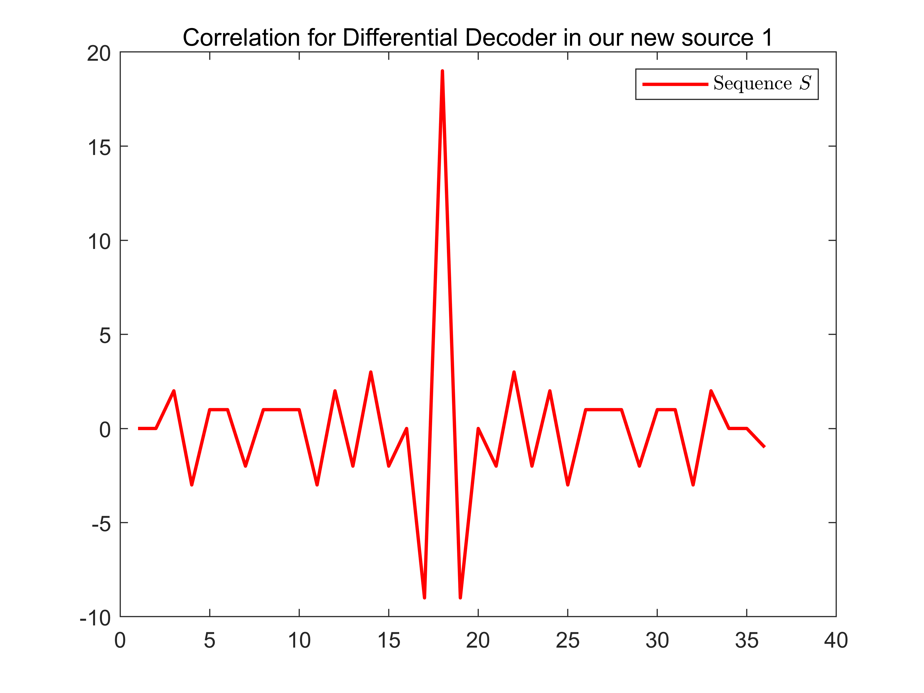
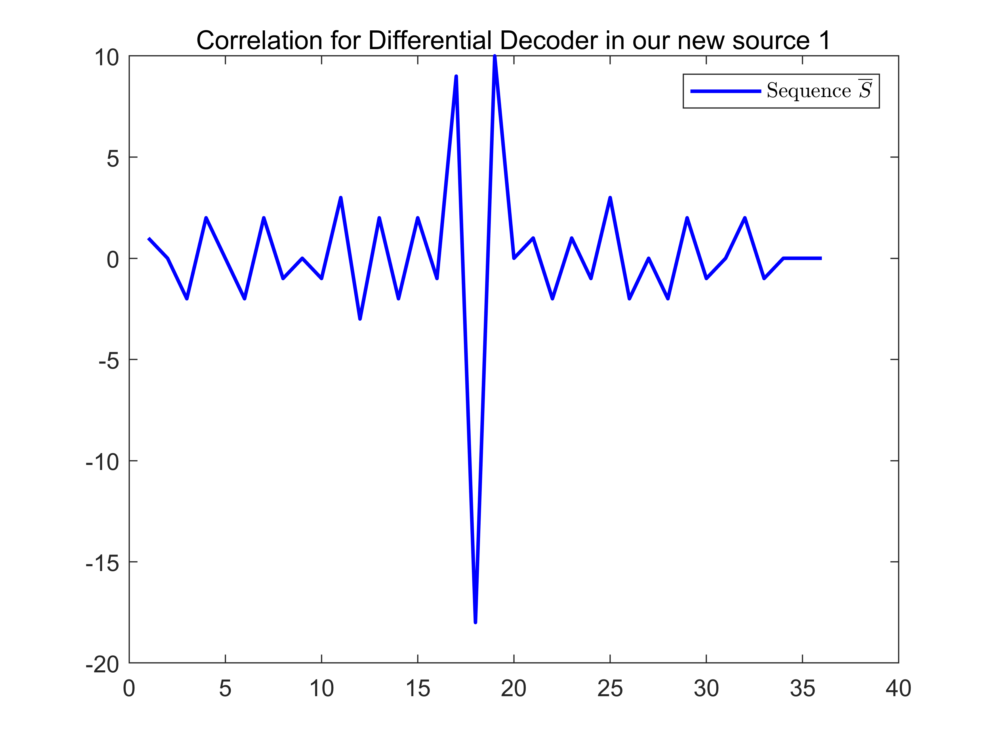
Auto-correlation analysis for differential decoder
Doc.: IEEE 802.11-25/1580r0
  Main peak is 19.
  Max side lode peak is one chip before main peak.
  All other side lode peaks are lower than 3.
  Main peak is -18.
  Max side lode peak is one chip before main peak.
  All other side lode peaks are lower than 3.

Slide 5
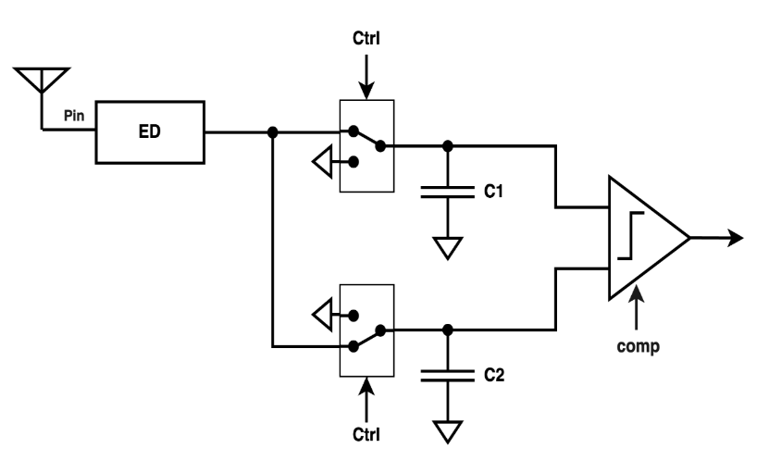
Special Segment
Doc.: IEEE 802.11-25/1580r0
  For correlation receiver, threshold based OOK symbol detection can be used to decode the special segment. However, threshold based OOK symbol detection can NOT be used by differential decoder since it is not able to sample and buffer DL sync signal.
  All “ones” and all “zeros” sequence can be used to differentiated with the Manchester codes data, but they can’t be used as the special segment for a differential decoder, since the output will be “X”s [6], which are uncertain values.
  In order to facilitate the differential decoder, the special segment needs to be Manchester coded, e.g., 101010…
Figure 5: Differential decoder receiver [4]

Slide 6
False Alarm
Doc.: IEEE 802.11-25/1580r0
  For correlation receiver, false alarm is mainly triggered in the data part[5] in higher SNR, as shown in the right Figure[5]
    This is because sync sequence has very good auto-correlation
    In lower noise, false alarm is mainly triggered by noise
  For differential decoder, false alarm can take place in both data part and in white noise case
    There is probability that random noise or data can be decoded into same or similar output sequence as the output sequence of sync sequence
  For both correlation decoder and differential decoder, the longer the sequence, the lower the false alarm rate.
    the length of the segment can be determined based on the original FAR(False alarm rate) P_FAR original and the target FAR (e.g. lower than 1%)

Slide 7
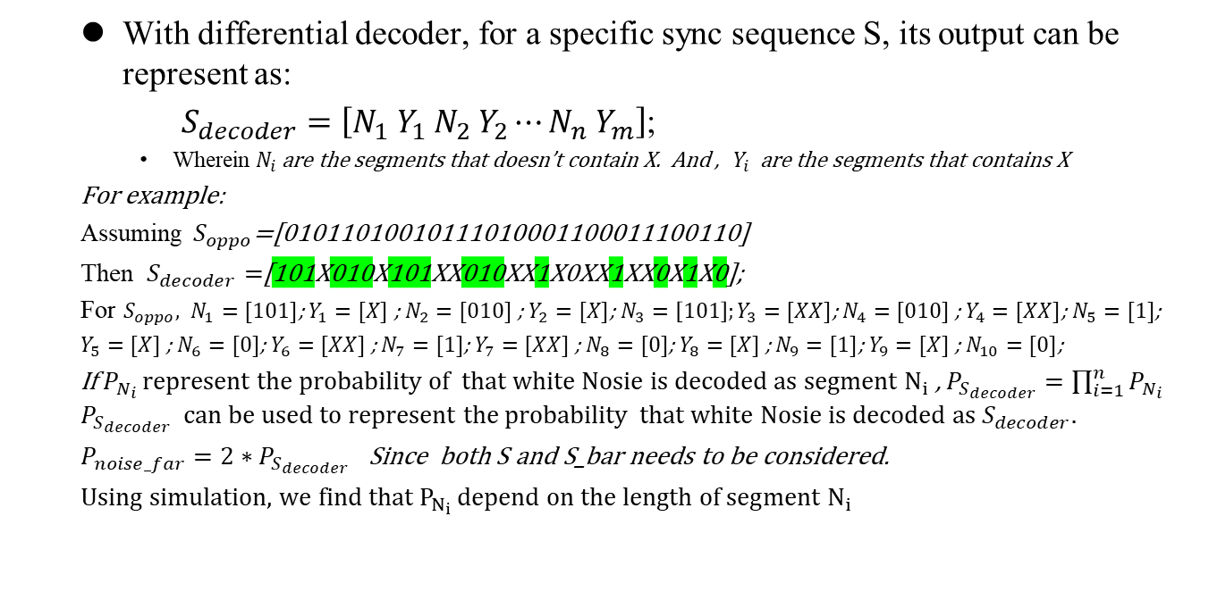
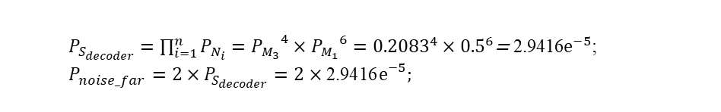
FAR due to noise for differential decoder
Doc.: IEEE 802.11-25/1580r0
  With differential decoder, for a specific sync sequence S, its output can be represent as:
  $S_{decoder}=\left[N_{1} Y_{1} N_{2} Y_{2}⋯N_{n} Y_{m}\right]$;
    Wherein $N_{i}$ are the segments that doesn’t contain X. And , $Y_{i}$ are the segments that contains X
  For example:
  Assuming $S_{oppo}$=[01011010010111010001100011100110]
  Then $S_{decoder}=$[101X010X101XX010XX1X0XX1XX0X1X0];
  For $S_{oppo}, N_{1}=[101]$; $Y_{1}=[X]$; $N_{2}=[010]$; $Y_{2}=[X]$; $N_{3}=\left[101\right];Y_{3}=[XX]$; $N_{4}=[010]$; $Y_{4}=[XX]$; $N_{5}=[1]$;
  $Y_{5}=[X]$; $N_{6}=[0]$; $Y_{6}=[XX]$; $N_{7}=[1]$; $Y_{7}=[XX]$; $N_{8}=[0]$; $Y_{8}=[X]$; $N_{9}=[1]$; $Y_{9}=[X]$; $N_{10}=[0]$;
  If $P_{N_{i} }$represent the probability of that white Nosie is decoded as segment $N_{i}$ , $P_{S_{decoder}}=\prod_{i=1}^{n}{P_{N_{i}}}$ $P_{S_{decoder}}$ can be used to represent the probability that white Nosie is decoded as $S_{decoder}$.
  $P_{noise_far}=2∗P_{S_{decoder}}$ Since both S and S_bar needs to be considered.
  Using simulation, we find that $P_{N_{i} }depend on the length of segment N_{i}$
M | M1 | M2 | M3 | M4 | M5 | M6 | M7 | M8
P | 0.5 | 0.33 | 0.2083 | 0.132 | 0.0846 | 0.0543 | 0.034 | 0.0222
  $P_{S_{decoder}}=\prod_{i=1}^{n}{P_{N_{i}}}={P_{M_{3}}}^{4}×$ ${P_{M_{1}}}^{6}={0.2083}^{4}×{0.5}^{6}$= 2.9416$e^{−5}$;
  $$P_{noise_far}=2×P_{S_{decoder}}=2×\text{2.9416}e^{−5};$$

Slide 8
Simulation
Doc.: IEEE 802.11-25/1580r0
  Simulation 1: False alarm handling in data portion for correlation receiver
    Case 3-1: 250kbps
    Case 3-2: 1Mbps
    This is to evaluate the needed length of special segment
  Simulation 2: Synchronization performance for correlation receiver
    Case 1-1: without special segment
    Case 1-2: segment detection using differential decoder
    Case 1-3 : segment detection based on threshold detection
    This is to evaluate the sync performance of the proposed sync sequences and the impact from the special segment
  Simulation 3: Synchronization performance for differential decoder
    Case 2-1: without special segment
    Case 2-2 :segment detection using differential decoder
    Case 2-3 : segment detection based on threshold detection
    This is to evaluate the sync performance of the proposed sync sequences and the impact from the special segment
  Simulation 4: False alarm handling in case of Noise

Slide 9
Simulation assumptions
Doc.: IEEE 802.11-25/1580r0
  Signal model: 5ms noise + legacy preamble + Sync field (sync sequence + special segment) + data
    Length of data is 100bits
  Channel: AWGN
  Clock set：0ppm
  Sync sequence length: 32
  Receiver type: correlation detector /differential decoder
  correlation decoder threshold: 0.04
  differential decoder threshold: 18
  Segment:
    12bits: 101010101010 (2us)
    8bits:10101010(1us)
    8bits:10101010(2us, in Appendix)
    6bits:101010(1us, in Appendix)
  Segment decoding method:
    1) based on detection threshold
    2) base on differential decoding

Slide 10
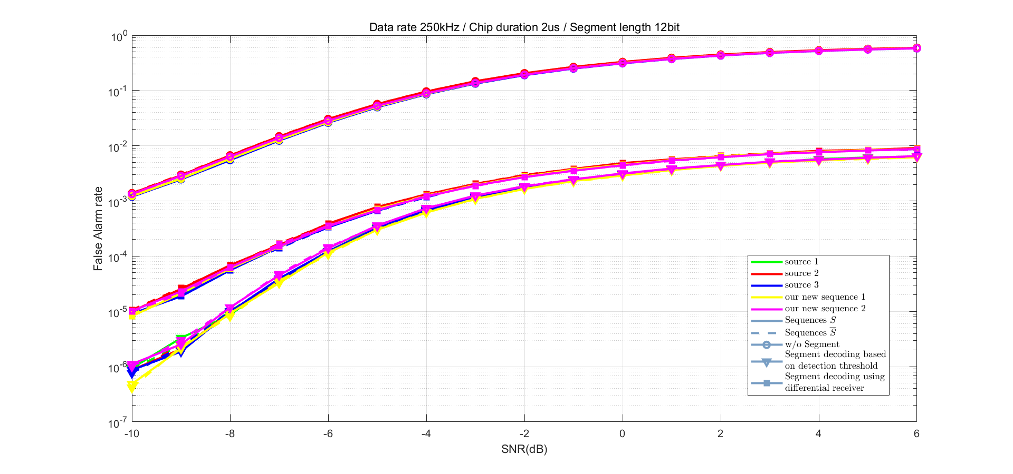
  False alarm handing in data portion(1)
Doc.: IEEE 802.11-25/1580r0
Observation: In case of 250kbps and without special segment, FAR is quite high (>50%) for sync detection in data portion. FAR can be reduced to less than 1% with 12 bits special segment (chip duration of 2us).

Slide 11
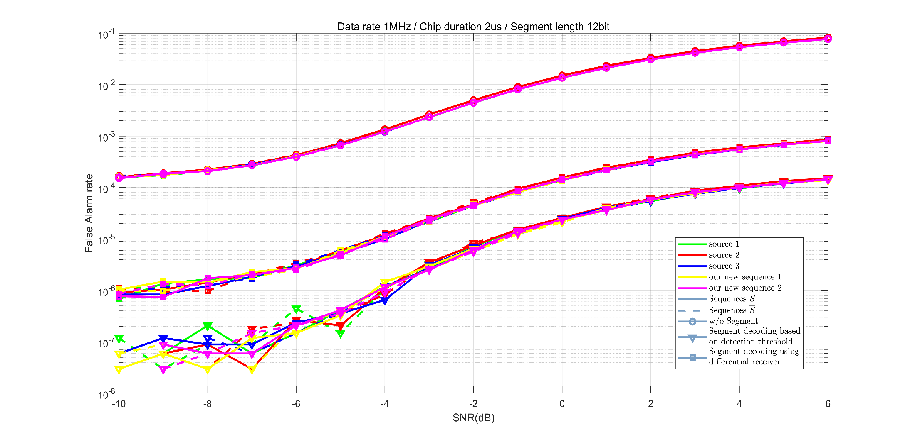
  False alarm handing in data portion(2)
Doc.: IEEE 802.11-25/1580r0
Observation: In case of 1MHz, FAR can be reduced to much lower than less than 1% with 12 bits special segment. This is because that the chip duration of the special segment (2us) is different with that of data portion(0.5us).

Slide 12
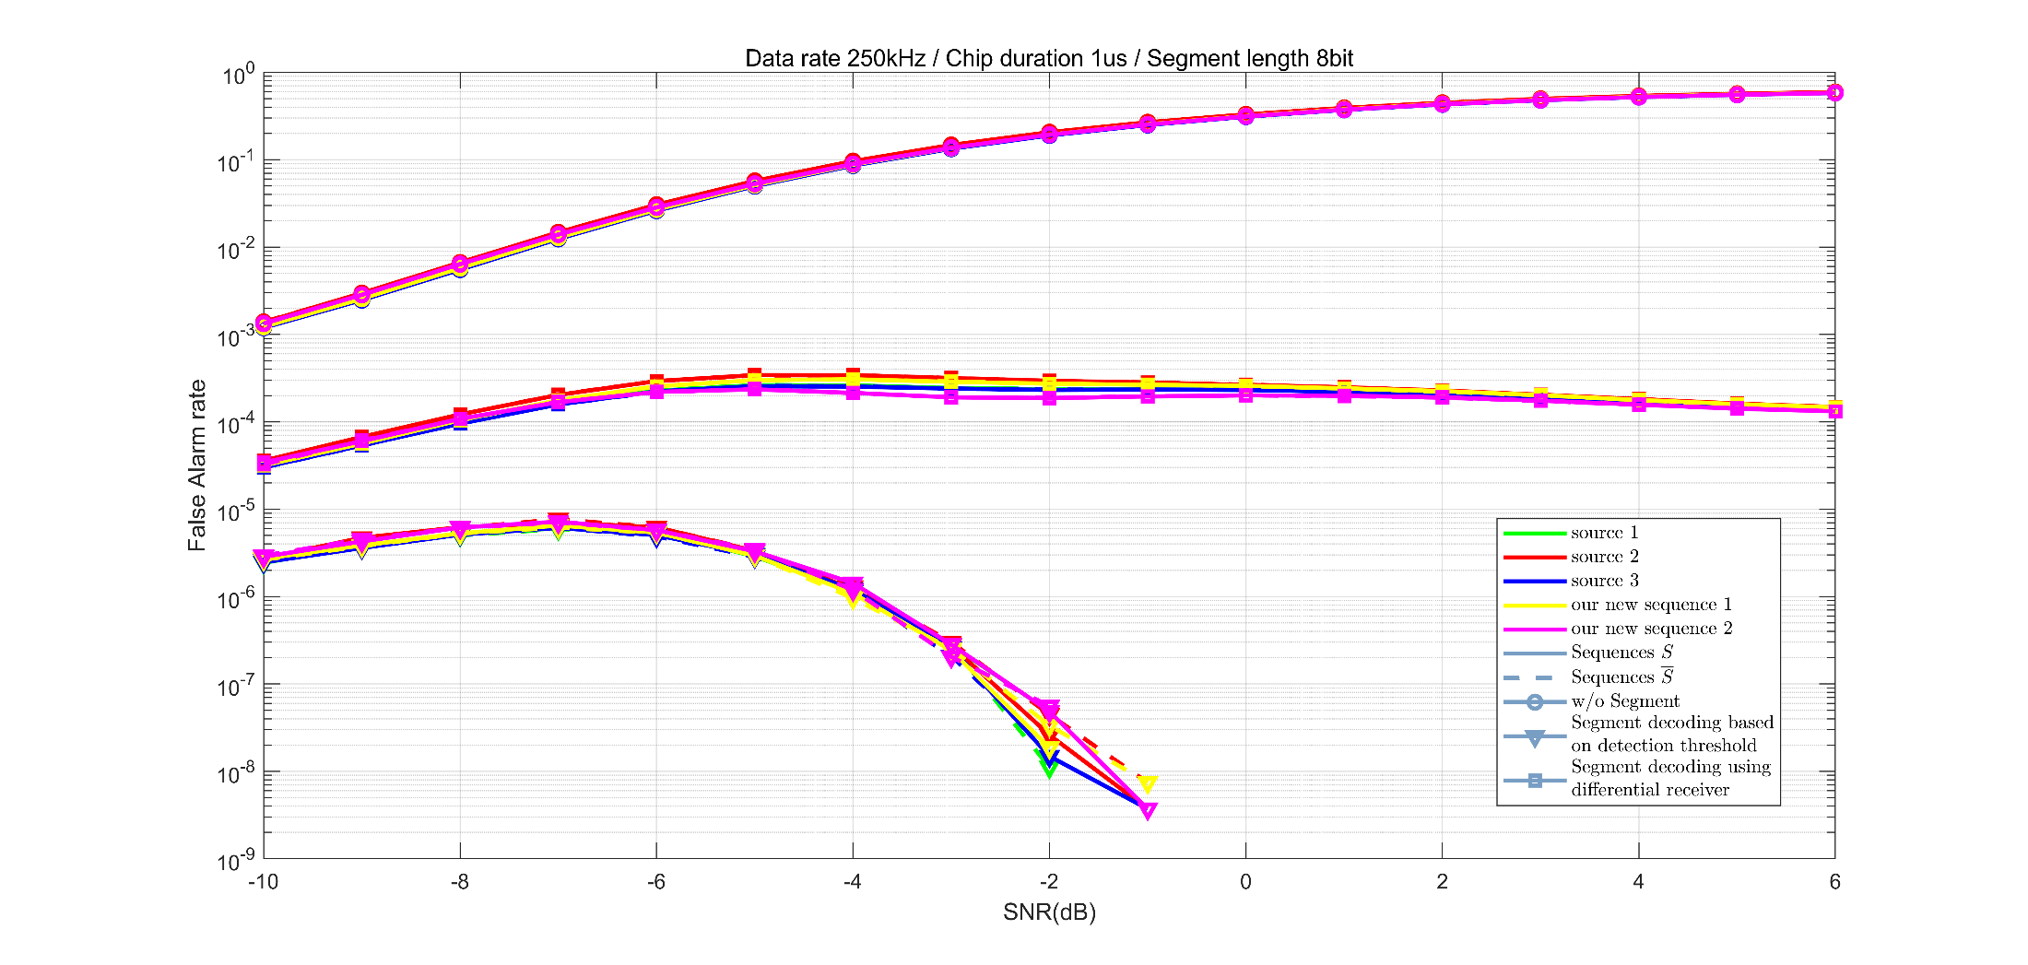
  False alarm handing in data portion(3)
Doc.: IEEE 802.11-25/1580r0
Observation: For data rate of 250kbps, if the chip duration of the special segment is changed from 2us to 1us, FAR can be reduced to much lower than 1% with 8 bits special segment(10101010).

Slide 13
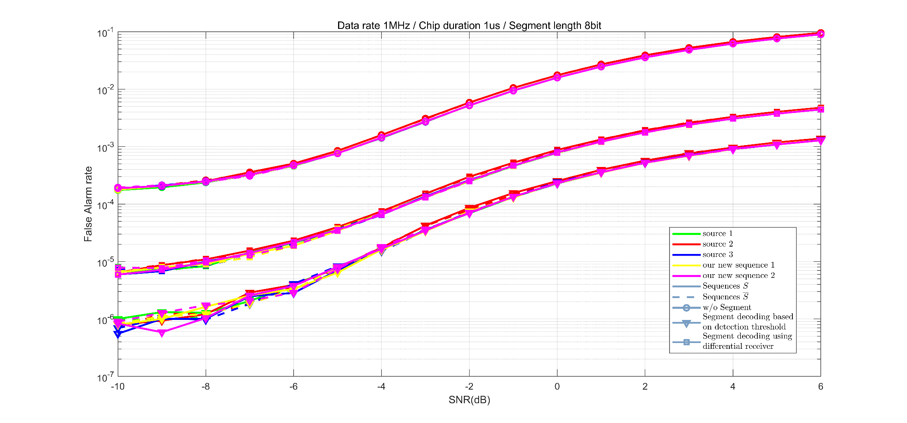
  False alarm handing in data portion(4)
Doc.: IEEE 802.11-25/1580r0
Observation: For data rate of 1Mbps, if the chip duration of the special segment is changed from 2us to 1us, FAR can be reduced to lower than 1% with 8 bits special segment(10101010).

Slide 14
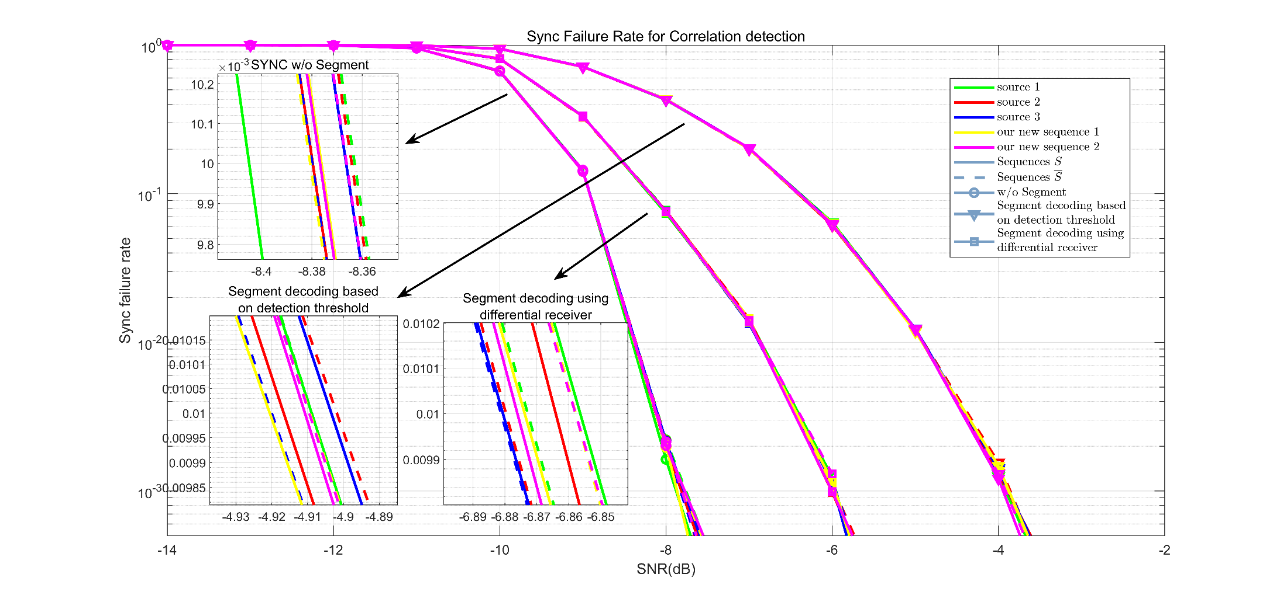
  Synchronization performance for correlation receiver(1)
Doc.: IEEE 802.11-25/1580r0
Observation: There is about 3.5dB loss for segment decoding based on threshold detection while 1.6dB loss for segment decoding using differential receiver.
  Note: Sync failure is defined as cases when the sync error is great than ¼ chip.
  Note: the segment is 12bit 101010101010 and chip duration is 2us.

Slide 15
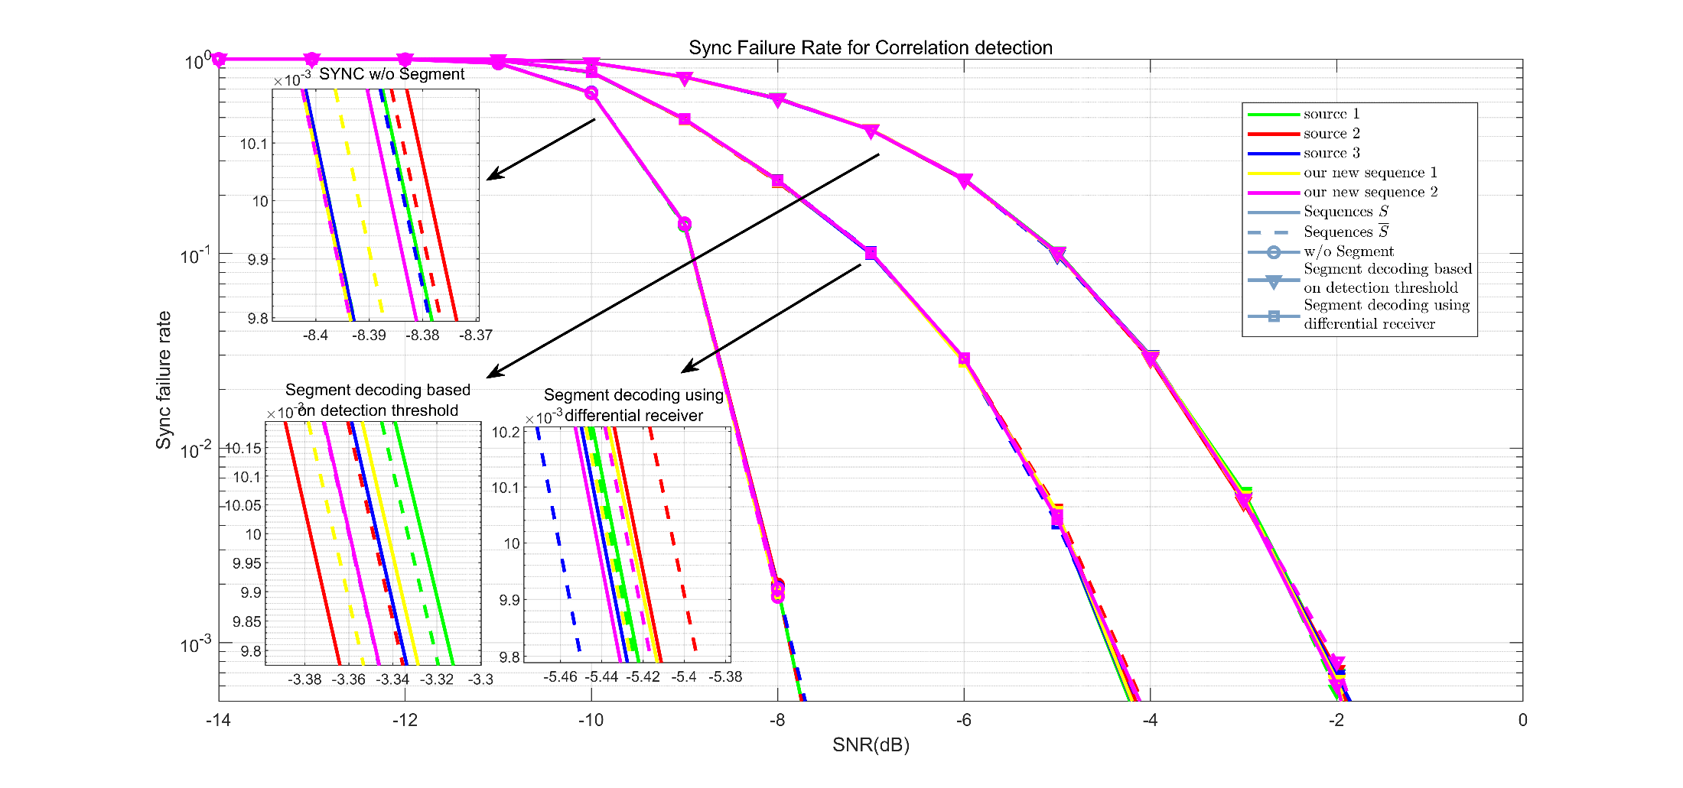
  Synchronization performance for correlation receiver(2)
Doc.: IEEE 802.11-25/1580r0
Observation: There is about 5dB loss for segment decoding based on threshold detection while 3dB loss for segment decoding using differential receiver.
  Note: Sync failure is defined as cases when the sync error is great than ¼ chip.
  Note: the segment is 8bit 10101010 and chip duration is 1us.

Slide 16
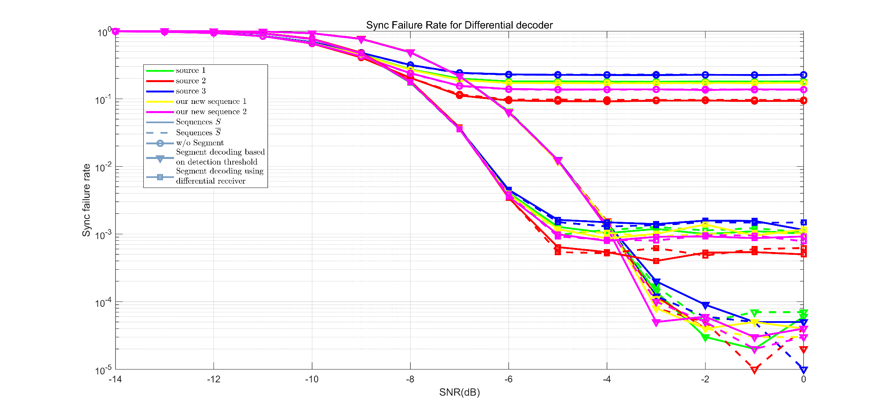
  Synchronization performance for differential decoder(1)
Doc.: IEEE 802.11-25/1580r0
Observation: Without special segment, there is a high sync failure floor for differential decoder. The Sync failure can be reduced to less than 1% with the special segment.
  Note: Sync failure is defined as cases when the sync error is great than ¼ chip.
  Note: the segment is 12bit 101010101010 and chip duration is 2us.

Slide 17
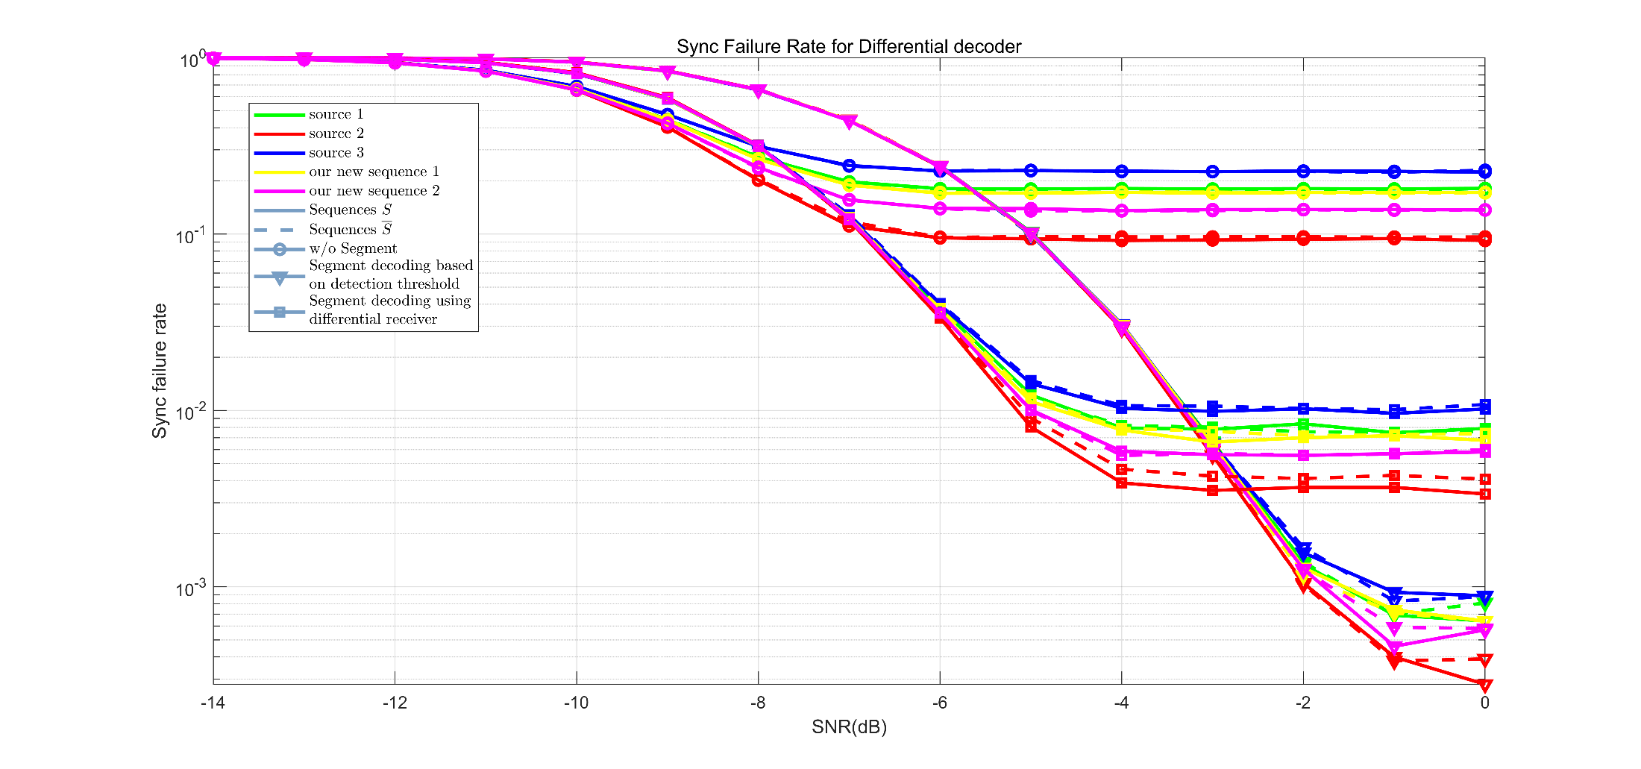
  Synchronization performance for differential decoder(2)
Doc.: IEEE 802.11-25/1580r0
Observation: Without special segment, there is a high sync error floor for differential decoder. The Sync failure can be reduced to less than 1% with the special segment.
  Note: Sync failure is defined as cases when the sync error is great than ¼ chip.
  Note: the segment is 8bit 10101010 and chip duration is 1us.

Slide 18
  Summary
Doc.: IEEE 802.11-25/1580r0
New DL sync sequence is proposed: 00110011100010111010001011010110
In order to support both correlation receiver and differential decoder, the special segment needs to be Manchester coded.
Both 12 bits special segment 101010101010 with chip duration of 2us, and 8 bits special segment 10101010 with chip duration of 1 us can reduced FAR to low than 1%.

Slide 19
  Straw Poll #1
Doc.: IEEE 802.11-25/1580r0
Do you agree to add the following content to the 802.11bp SFD?
  Special Segment in the DL sync field is Manchester coded.
  The special segment is constructed by a sequence of 101010101010.

Slide 20
Appendix
September 2025
Doc.: IEEE 802.11-25/1580r0

Slide 21
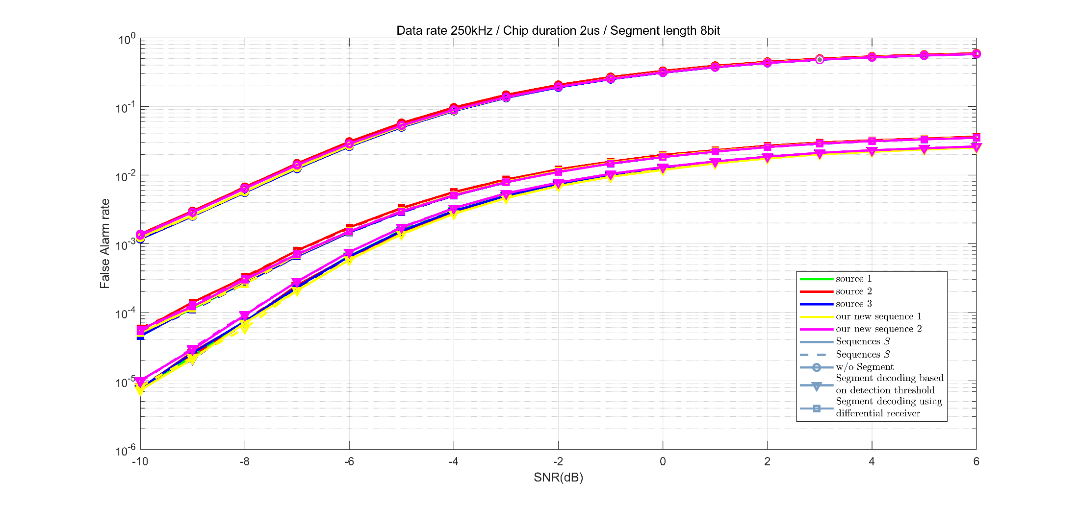
  False alarm handing in data portion(5)
Doc.: IEEE 802.11-25/1580r0
Observation: In case of 250kbps, with 8 bits special segment(chip duration of 2us), FAR is a little bit higher than 1%.

Slide 22
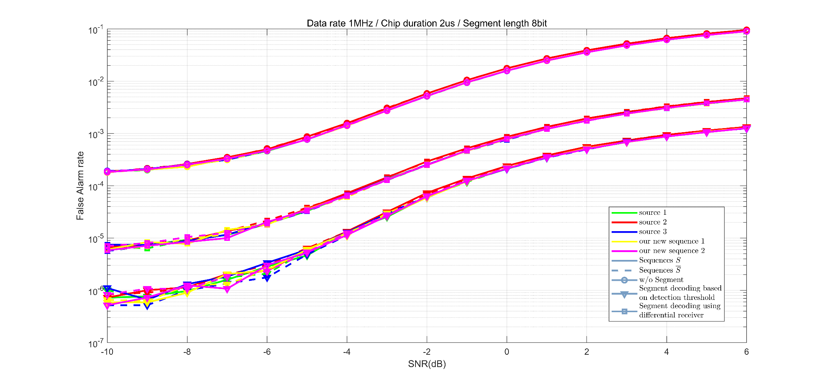
  False alarm handing in data portion(6)
Doc.: IEEE 802.11-25/1580r0

Slide 23
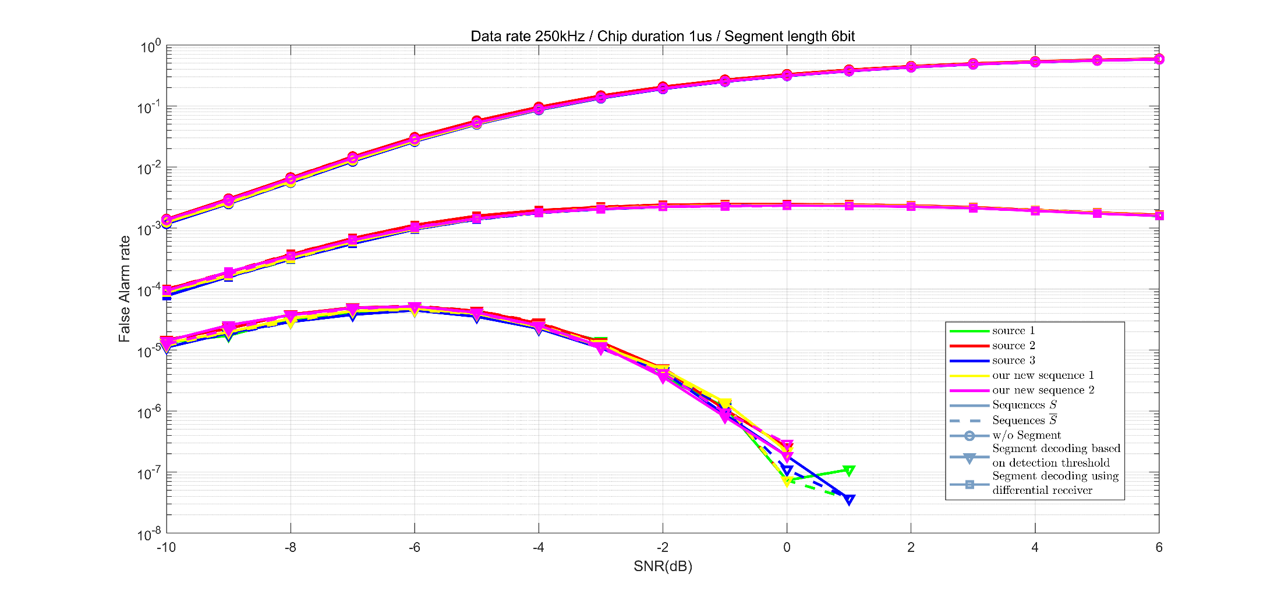
  False alarm handing in data portion(7)
Doc.: IEEE 802.11-25/1580r0

Slide 24
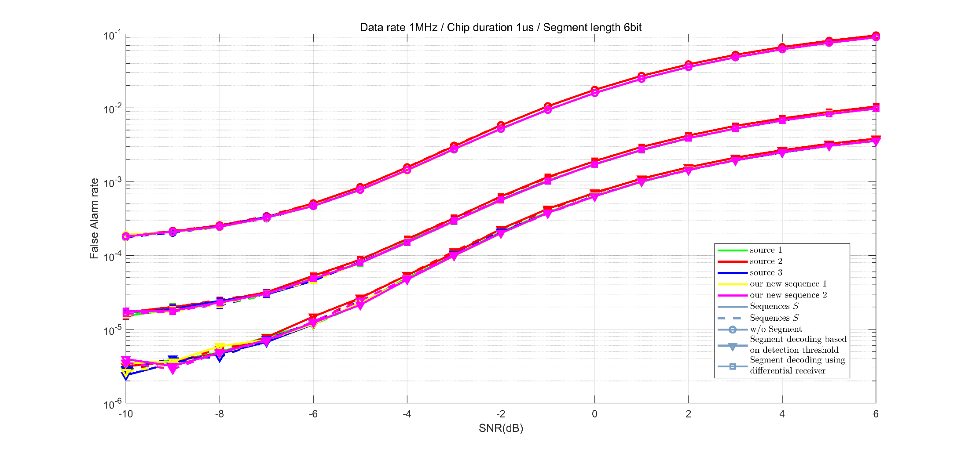
  False alarm handing in data portion(8)
Doc.: IEEE 802.11-25/1580r0

Slide 25
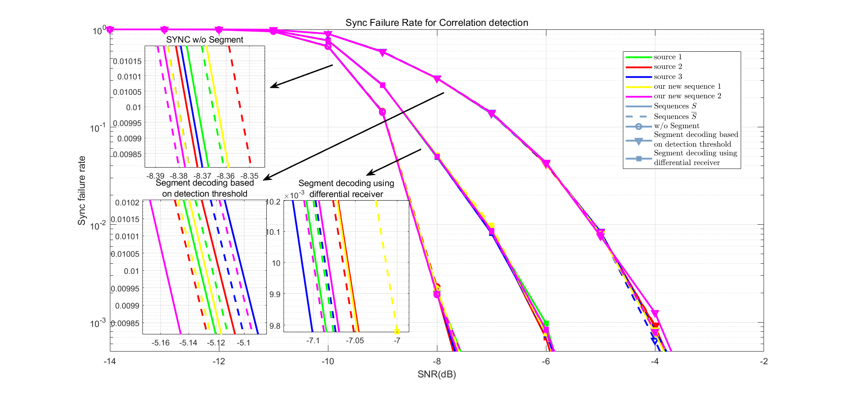
  Synchronization performance for correlation decoder(3)
Doc.: IEEE 802.11-25/1580r0

Slide 26
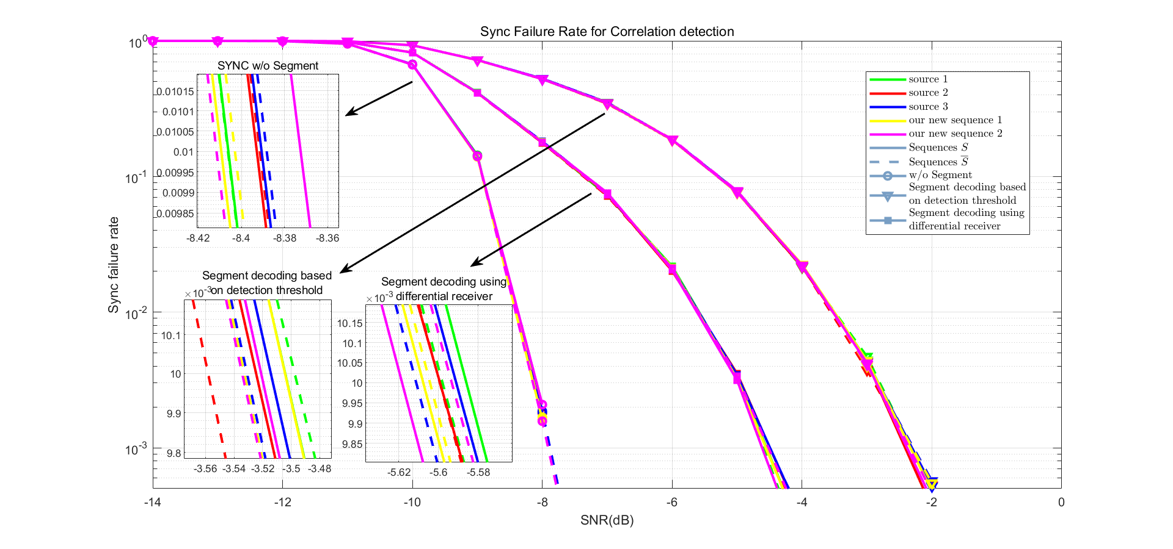
  Synchronization performance for correlation decoder(4)
Doc.: IEEE 802.11-25/1580r0

Slide 27
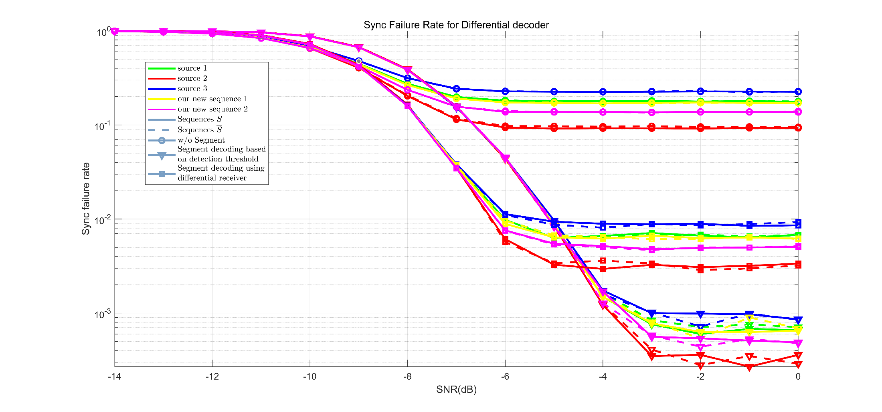
  Synchronization performance for differential decoder(3)
Doc.: IEEE 802.11-25/1580r0
Observation: Without special segment, there is a high sync error floor for differential decoder. The Sync failure can be reduced to less than 1% with the special segment.
  Note: Sync failure is defined as cases when the sync error is great than ¼ chip.
  Note: the segment is 8bit 10101010, every chip duration is 2us.

Slide 28
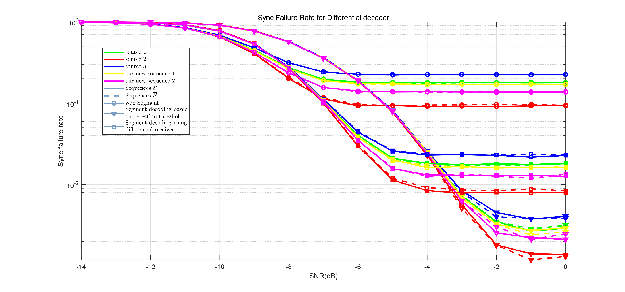
  Synchronization performance for differential decoder(4)
Doc.: IEEE 802.11-25/1580r0
Observation: With 6 bits special segment(chip duration of 1us), sync failure is a little bit higher than 1% for differential receiver.

Slide 29
Reference
July 2025
Doc.: IEEE 802.11-25/1265r3
IEEE 802.11-25/1222r0 AMP Downlink Sync Field Design for Transmission to Non-Backscatter STAs
IEEE 802.11-25/1248r1 Discussions on DL Sync Field for Non-Backscatter STAs: Part I
IEEE 802.11-25/1223r0 SYNC Field Design Discussion
IEEE 802.11-25/0705r0 An Analysis of SYNC Field for Downlink PPDU
IEEE 802.11-25/1580r0 Follow-up on Sync field for AMP PPDU
IEEE 802.11-25/1249r1 Discussions on DL Sync Field for Non-Backscatter STAs: Part II
Wang Ke (OPPO)

