Slide 1
On the Feasibility of LOS MIMO and the Number of Spatial Streams at 60GHz
Date: 2025-09-10
Authors:

Slide 2
Overview
Polarization MIMO typically yields rank 2 channel even in spatially sparse post-beamforming channel
Single-tap nearly-zero angular spread post-beamforming channel can still yield 2 additional dimensions through LOS MIMO at 60GHz …
  with moderate array separation of 7cm—10cm,
  over link distances of interest, i.e., 1.5m—10m,
  making LOS MIMO applicable to
    larger form-factor client devices (APs, laptops, XR HMDs, TVs, …)
    wireless fronthaul/backhaul between APs, link between non-collocated MLD APs

Slide 3
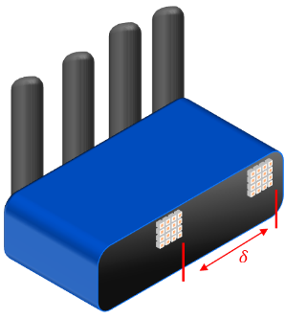
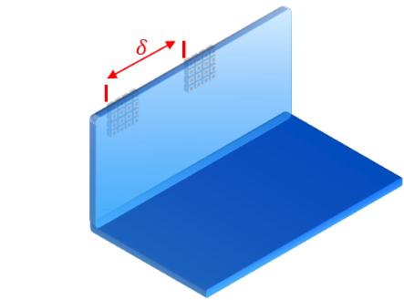



LOS channel matrix
Consider 2 antenna arrays per STA
  Array separation = $δ$ cm
  One digital chain per array, analog beamforming per array
  Identical beam per array, steered along LOS path towards peer STA
    both arrays within beamwidth (see [1] for conservative SDM-based analysis)
  Distance between STAs = $D$ m
What is the condition number of Rank 2 LOS channel with
array separation $δ$ and link distance $D$?
$$D$$

Slide 4
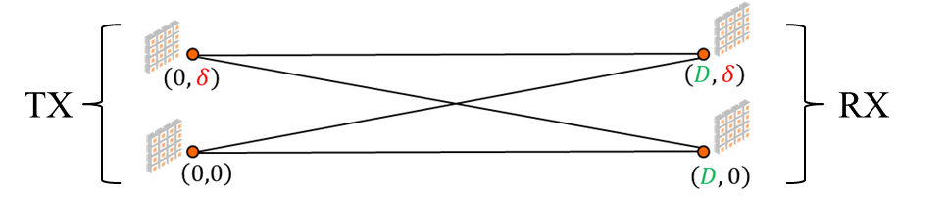

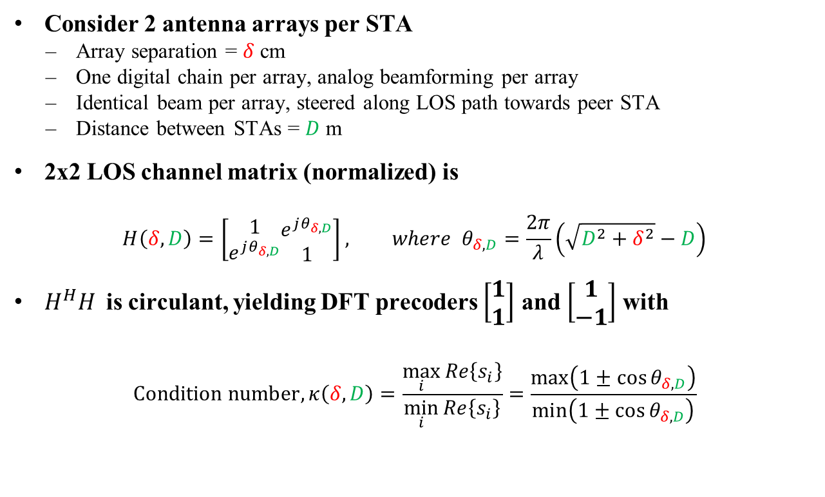




LOS channel matrix
Consider 2 antenna arrays per STA
  Array separation = $δ$ cm
  One digital chain per array, analog beamforming per array
  Identical beam per array, steered along LOS path towards peer STA
  Distance between STAs = $D$ m
2x2 LOS channel matrix (normalized) is
$$H\left(δ,D\right)=\left[\begin{aligned}1 \\ e^{jθ_{δ,D}}\end{aligned}\begin{aligned}e^{jθ_{δ,D}} \\ 1\end{aligned}\right], where θ_{δ,D}=\frac{2π}{λ}\left(\sqrt{D^{2}+δ^{2}}−D\right)$$
$H^{H}H$is circulant, yielding DFT precoders $\left[\begin{aligned}1 \\ 1\end{aligned}\right]$ and $\left[\begin{aligned}1 \\ \text{−}1\end{aligned}\right]$ with
$$\text{Condition} \text{number}, κ\left(δ,D\right)=\frac{\max_{i}{Re\left\{s_{i}\right\}}}{\min_{i}{Re\left\{s_{i}\right\}}}=\frac{\max\left(1±\cos{θ_{δ,D}}\right)}{\min\left(1±\cos{θ_{δ,D}}\right)}$$
$$s_{1}$$
$$θ_{δ,D}$$
$$1$$
$$s_{2}$$
$$s_{1}=1+e^{jθ}$$
$$s_{2}=1−e^{jθ}$$

Slide 5
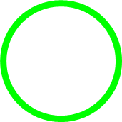

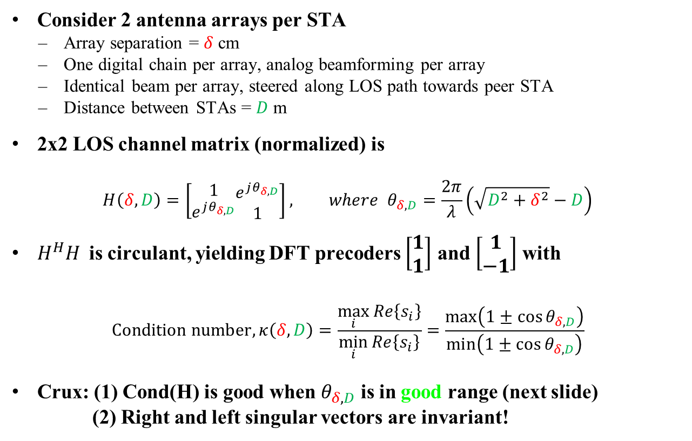
LOS channel matrix
Consider 2 antenna arrays per STA
  Array separation = $δ$ cm
  One digital chain per array, analog beamforming per array
  Identical beam per array, steered along LOS path towards peer STA
  Distance between STAs = $D$ m
2x2 LOS channel matrix (normalized) is
$$H\left(δ,D\right)=\left[\begin{aligned}1 \\ e^{jθ_{δ,D}}\end{aligned}\begin{aligned}e^{jθ_{δ,D}} \\ 1\end{aligned}\right], where θ_{δ,D}=\frac{2π}{λ}\left(\sqrt{D^{2}+δ^{2}}−D\right)$$
$H^{H}H$is circulant, yielding DFT precoders $\left[\begin{aligned}1 \\ 1\end{aligned}\right]$ and $\left[\begin{aligned}1 \\ \text{−}1\end{aligned}\right]$ with
$$\text{Condition} \text{number}, κ\left(δ,D\right)=\frac{\max_{i}{Re\left\{s_{i}\right\}}}{\min_{i}{Re\left\{s_{i}\right\}}}=\frac{\max\left(1±\cos{θ_{δ,D}}\right)}{\min\left(1±\cos{θ_{δ,D}}\right)}$$
Crux: (1) Cond(H) is good when $θ_{δ,D}$ is in good range (next slide)
(2) Right and left singular vectors are invariant!
Good
Poor
$$s_{1}$$
$$θ_{δ,D}$$
$$1$$
$$s_{2}$$

Slide 6
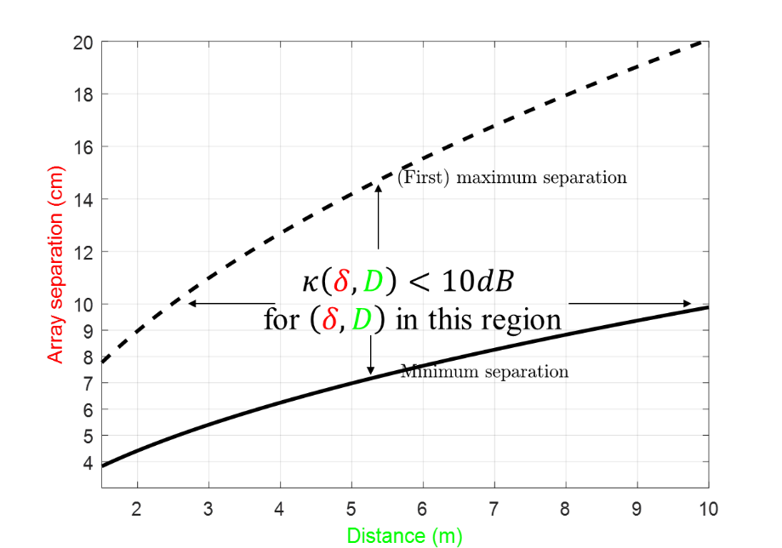

LOS channel matrix
At 60GHz ($λ=5mm$), we get Cond($H\left(δ,D\right)$) < 10dB
  Over link distance of interest $D≈1.5m to 10m$,
  with antenna separation of $δ≈7cm to 10cm$, feasible for larger formfactor such as AP, laptop, TV,…

Slide 7
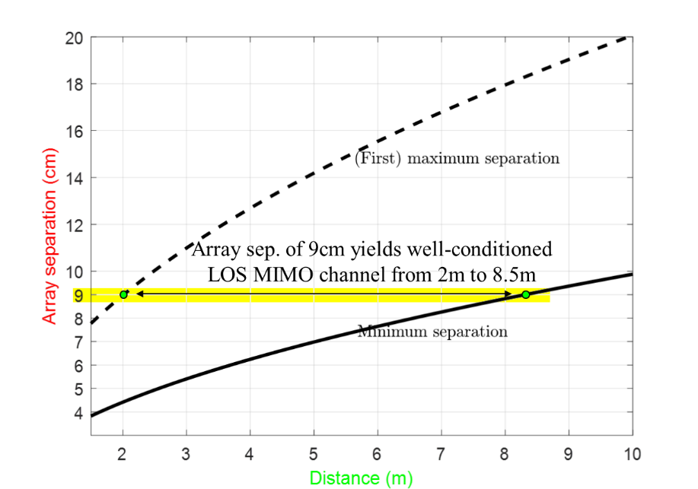
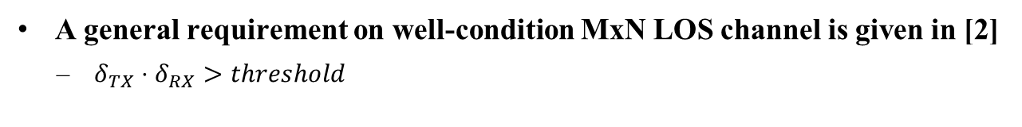
LOS channel matrix
At 60GHz ($λ=5mm$), we get Cond($H\left(δ,D\right)$) < 10dB
  Over link distance of interest $D≈1.5m to 10m$,
  with antenna separation of $δ≈7cm to 10cm$, feasible for larger formfactor such as AP, laptop, TV,…
A general requirement on well-condition MxN LOS channel is given in [2]
  $δ_{TX}⋅δ_{RX}>threshold$

Slide 8
Design Implications for IMMW
Larger formfactor devices can support up to 4 spatial streams
  2 from polarization MIMO, 2 from LOS MIMO
  TGbq should support up to 4 spatial streams
Lower cost devices could implement only two digital chains and depending on orientation/channel characteristics, exploit polarization MIMO or LOS MIMO
IMMW as fronthaul/backhaul between APs, in particular, in carpeted enterprise deployments
  This can prove a catalyst for mmWave adoption by APs, ahead of large-scale adoption in client devices
  Multiple non-collocated mAP in coverage of one sAP ➔ non-collocated MLD
    using mmWave for wireless backhaul (no need to densify wired connections)

Slide 9
Straw Poll
11bq amendment should support up to 4 spatial streams: up to 2 spatial streams using polarization MIMO and up to 2 using LOS MIMO.

Slide 10
References
[1] 11-24-0069, MIMO analysis for IMMW, Bo Gong
[2] R. Prüller, T. Pedersen and M. Rupp, "An Empirical Lower Bound on Singular Value Ratios for MIMO LOS Links," 2022 IEEE Conference on Antenna Measurements and Applications (CAMA), Guangzhou, China, 2022

