Slide 1
Further Details on Channel Access in 11bq
Date: 2025-09-17
Authors:
Name | Affiliation | Address | Phone | Email
Dongju Cha | LG Electronics | 19, Yangjae-daero 11gil, Seocho-gu, Seoul 137-130, Korea |  | dongju.cha@lge.com
Insun Jang
 |  |  |  | insun.jang@lge.com
Hongwon Lee
 |  |  |  | hongwon.lee@lge.com
Jinsoo Choi
 |  |  |  | js.choi@lge.com
Eunsung Park |  |  |  | esung.park@lge.com
Insik Jung |  |  |  | insik0618.jung@lge.com
HanGyu Cho |  |  |  | hg.cho@lge.com
Sanggook Kim |  | 10225 Willow Creek Rd, San Diego, CA, USA |  | sanggook.kim@lge.com

Slide 2
Introduction
In previous contribution [1], we shared our high level views on IMMW scheduling and channel access
  Mainly focused on periodic traffic: Scheduling service period(s) between STAs in mmWave link through sub-7GHz band
In this contribution, we share our thoughts on how to operate on-demand service period on mmWave link

Slide 3
mmWave Switch Delay
To reduce power consumption on mmWave link, STA may not be always in an awake state
  Go into doze state if it is outside of its scheduled service period
For mmWave STA, some time to complete preparation for channel access may be needed (be ready to receive and/or transmit frames)
  Refer this as mmWave Switch Delay in this contribution
  Delay needed to transit from doze to awake state may include
    a processing delay that occurs internally in MLD to process/decode the ICF/ICR exchange on sub-7GHz
    a hardware processing delay that occurs in mmWave STA to align it’s antenna or radio to its peer STA for frame exchange (under assumption that BFT has been done)

Slide 4
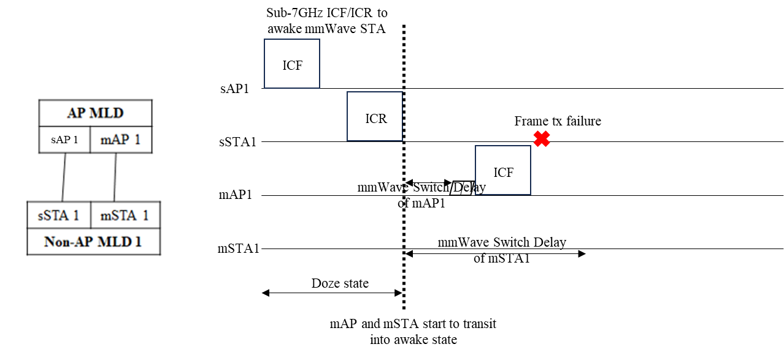
mmWave Switch Delay (Cont’d)
To guarantee successful channel access on mmWave link these may need to be considered
  Singaling its mmWave Switch Delay to peer STA
  After exchanging ICF/ICR on sub-7GHz, when transitter can initiate a TXOP?
  How to guarantee scheduled service period and on-demand service period without any problems?

Slide 5
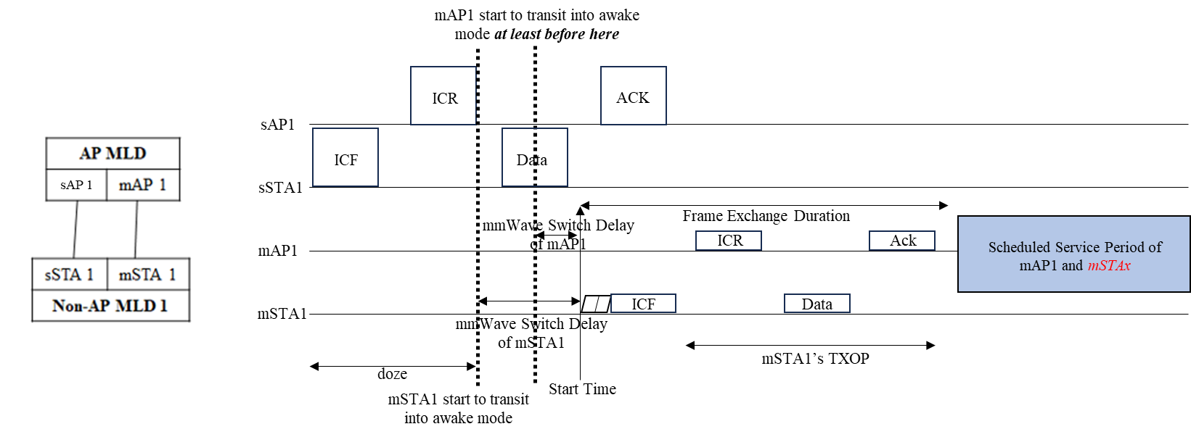
Case 1) On-demand service period w/ scheduling infomation
….
In case of non-AP STA requesting on-demand SP, ICF/ICR exchange on sub-7GHz may carry scheduling information (e.g., Start Time and Frame Exchange Duration), and it is to awake pair of STAs on mmWave band
  mAP1 and mSTA1 start to transit into awake mode considering its’ mmWave Switch Delay and Start Time of on-demand SP
  Complete transitting into awake mode at the start of Start Time

Slide 6
Case 1) On-demand service period w/ scheduling information (Cont’d)
….
For Case 1), following aspects need to be considered
On-demand SP not to be overlapped with pre-scheduled SP,
  mmWave non-AP STA requesting on-demand SP, may not be aware of pre-scheduled SP(s) between mAP and mSTAx (blue box in slide 5)
  To deal with this issue, scheduling info. may be needed to avoid on-demand SP from overlapping with pre-scheduled (or on-going) SP(s)
To guarantee that recipient has done switching to awake state and be ready to receive frame,
  Start Time need to be set considering mmWave Switch Delay of mmWave STAs
  mmWave STA starts to transit into awake mode at least before (Start Time – mmWave Switch Delay of mmWave STA)
  At the Start Time, both of transitter and receiver are ready to exchange frame
Notes:
P2P case고려하면 overlap될 수 있다.

Slide 7
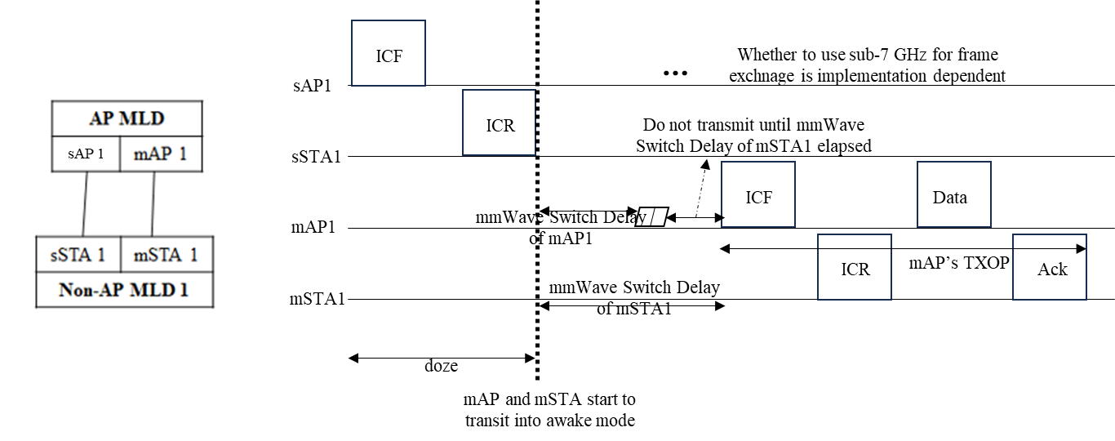
Case 2) On-demand service period w/o scheduling infomation
In case of AP requesting on-demand SP, ICF/ICR exchange on sub-7GHz may not carry scheduling information, but to awake pair of STAs on mmWave band
  mAP1 and mSTA1 start to transit into awake mode after transmitting and receiving ICR on sub-7GHz, respectively

Slide 8
Case 2) On-demand service period w/o scheduling information (Cont’d)
….
For Case 2), following aspects need to be considered
mmWave AP can manage its on-demand SP itself on mmWave link not to be overlapped with any pre-scheduled SP w/o exchanging scheduling info
To guarantee that recipient has done switching to awake state and be ready to receive frame,
  mmWave STA shall not initiate frame exchange until the recipient’s STA mmWave Switch Delay has been elapsed since TBD switch start time

Slide 9
Conclusion
In this contribution, we shared our thoughts on how to successfully operate on-demand service period in mmWave link in perspective of
  mmWave Switch Delay
  Scheduling information (e.g., Start Time, Frame Exchange Duration, etc.)
  Interoperate pre-scheduled SP w/ on-demand SP

Slide 10
SP1
Do you support the following text in TGbq?
  An mmWave STA shall indicate the following to its peer mmWave STA
    mmWave Switch Delay
      Time it needs to transit from doze to awake state
  How to signal is TBD

Slide 11
SP2
Do you support the following text in TGbq?
  When an mmWave STA switches to awake state, it shall not initiate a transmission to its peer mmWave STA until the peer mmWave STA’s mmWave Switching Delay has elapsed since TBD switch start time

