Slide 1
Further Consideration on HD-Map Downloads and Sensor-Data Sharing Use cases
Jing Ma (Toyota)

Slide 2
Abstract
Use cases of regional HD-Map download and sensor-data sharing were discussed [1, 2] and the drafted tech report[3].
Further consideration for the complementary use of WLAN connectivity between vehicles is discussed in this contribution
Jing Ma (Toyota)

Slide 3

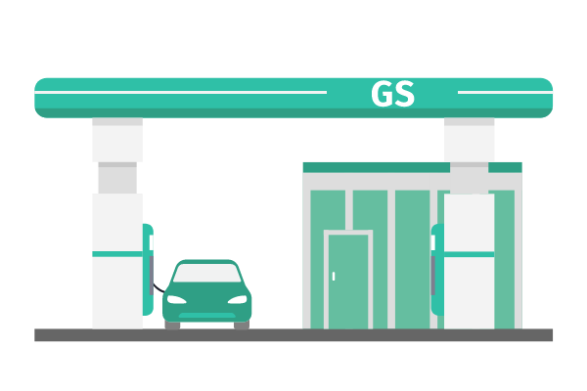





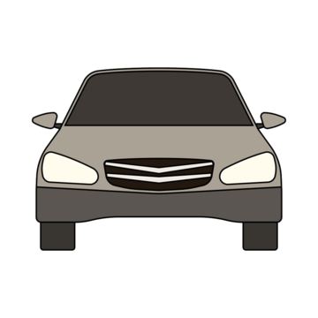


Recap: Regional HD-Map Download Use Case
 | Stationary or near-stationary Download | Local Dynamic Map Updates when drive-thru
DL data (example size) | - Full-region map refresh~8GB, - On-demand seg pull, incremental map updates (~300MB) | Temporary road warnings, construction zones, hazard notifications with time sensitive (10KB~50MB)
Encounter window | 15min or 3-5 min | 10~20s
Stationary/ Near-stationary Download
Local Dynamic Map when Drive-thru
Moving
(~60km/h)
Leave
(~10km/h)
Vehicle Parked
(stationary)
Arrive
(~10km/h)
Jing Ma (Toyota)
WLAN Disconnect
WLAN Connected
WLAN Disconnect
WLAN Connected

Slide 4

Recap: Sensor-Data Sharing Use Case
 | Bulk Sensor Data Upload While Stationary/Near-stationary | Time-Sensitive Event Reporting in Motion
UL data (example size) | - Extensive sensor data (LiDAR e.t.) (~5GB) - Driving behavior analytics (~300MB) | Uploading compact event reports, Traffic condition updates (10KB)
Encounter window | 15min or 3-5 min | 10~20s
Bulk Sensor Data Upload While Stationary/Near-stationary
Time-Sensitive Event Reporting in Motion
Moving
(~60km/h)
Leave
(~10km/h)
Vehicle Parked
(stationary)
Arrive
(~10km/h)
Jing Ma (Toyota)
WLAN Disconnect
WLAN Connected
WLAN Disconnect
WLAN Connected

Slide 5
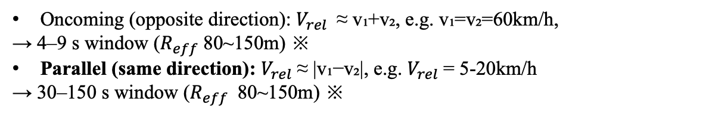
Further consideration on complementing HD-Map download & sensor-data sharing
Why
Short “drive-thru” WLAN encounter windows; Some vehicle miss APs; redundant AP unicasts
Event reports need low latency when WLAN AP is far
How (Using V2V connection)
Ferry re-distribution
A few “ferry” vehicles prefetch tiles at AP, then relay nearby cars via secure group + unicast
Aggregator uploads
vehicles that regularly see WLAN APs collect encrypted clips from neighbors, dedupe, and upload on their behalf at the next AP
Fast local signaling
Tiny event reports (~10 KB) hop V2V connection in short (e.g. ≤50 ms), keeping time-sensitive logic alive
Example: Ferry re-distribution for HD Map data
Encounter window = 2 * effective range ($R_{eff}$) / relative speed ($V_{rel}$)
Oncoming (opposite direction): $V_{rel}$≈ v₁+v₂, e.g. v₁=v₂=60km/h,
→ 4–9 s window ($R_{eff}$80~150m) ※
Parallel (same direction): $V_{rel}$≈ |v₁−v₂|, e.g. $V_{rel}$= 5-20km/h
→ 30–150 s window ($R_{eff}$80~150m) ※
Nearby vehicle
Ferry vehicle
Ferry vehicle
Moving
(~60km/h)
※ it is an operational envelope that matches typical lane-speed differences on urban arterials [4]
Jing Ma (Toyota)

Slide 6

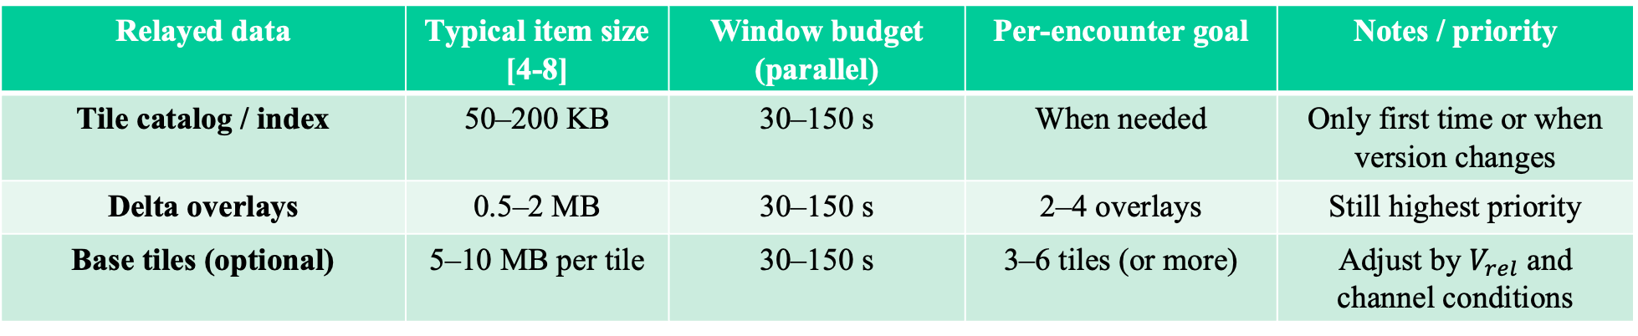

Further consideration on complementing HD-Map download & sensor-data sharing
Example: Ferry re-distribution for HD Map data
Example flow:
Discover peer & authenticate (e.g., token/cert)
Secure connect: mutual auth., etc..
Ferry vehicle announces service: HD-map relay capability & region
Ferry vehicle sends tile catalog/index;
Nearby vehicle receives and selects needed tiles
Ferry vehicle → nearby vehicle: delta overlays
Acknowledge + end
$V_{rel}$(5~20km/h)
Ferry vehicle
Ferry vehicle
Moving
(~60km/h)
$R_{eff}$(80~150m)
Relayed data | Typical item size [4-8] | Window budget (parallel) | Per-encounter goal | Notes / priority
Tile catalog / index | 50–200 KB | 30–150 s | When needed | Only first time or when version changes
Delta overlays | 0.5–2 MB | 30–150 s | 2–4 overlays | Still highest priority
Base tiles (optional) | 5–10 MB per tile | 30–150 s | 3–6 tiles (or more) | Adjust by $V_{rel}$ and channel conditions
Jing Ma (Toyota)

Slide 7
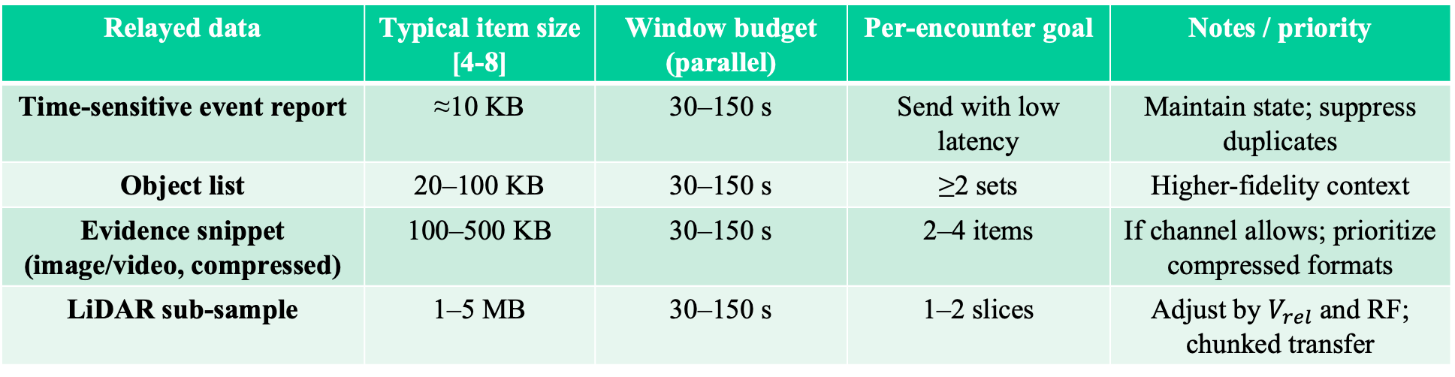
Further consideration on complementing HD-Map download & sensor-data sharing
Example: sensor-data relay
Example flow of sensor-data relay:
Discover (peer + service)
Secure join
Nearby vehicle →Aggregator (Event report)
Acknowledge
Aggregator forwards via cellular right away for time-sensitive event; bulk uploads at next AP
Nearby vehicle
Aggregator
Aggregator
Leave
(~10km/h)
Arrive
(~10km/h)
Relayed data | Typical item size [4-8] | Window budget (parallel) | Per‑encounter goal | Notes / priority
Time‑sensitive event report | ≈10 KB | 30–150 s | Send with low latency | Maintain state; suppress duplicates
Object list | 20–100 KB | 30–150 s | ≥2 sets | Higher‑fidelity context
Evidence snippet (image/video, compressed) | 100–500 KB | 30–150 s | 2–4 items | If channel allows; prioritize compressed formats
LiDAR sub‑sample | 1–5 MB | 30–150 s | 1–2 slices | Adjust by $V_{rel}$and RF; chunked transfer
Jing Ma (Toyota)

Slide 8
Discussion on requirements
 | Example numbers ※ | Notes
Discovery (service + peer) | ≤ 300 ms | Continuous scan, publish-subscribe; safety beacons acceptable for coarse presence
Secure link setup (auth + key) | ≤ 200 ms | Pre-provisioned cert/token; OWE/EAP‑TLS and so on
Usable window (typical) | ≈ 30–150 s
User-data goodput | ≥ 50–150 Mb/s | Chunk at 1–2 MB; parallel supports more base tiles/evidence
latency | ≤ 50 ms (time-sensitive event) | Event/control path should be snappy even when data path is busy, Supports byte‑range ACK and resume across encounters
Reliability (within range) | PDR ≥ 95% for events; PER ≤ 10⁻² for chunks | With FEC/ARQ; retransmission budget bounded by window
Concurrency | 1 sender → 2–7 receivers | Support group + unicast mix; fairness across receivers
Range (urban/suburban) | 50–150 m (target) | Keep PHY/MCS adaptive; prefer LOS when possible
※ The example numbers are aligned with the HD-Map download and Sensor-data sharing use case discussed in the draft [4]
Jing Ma (Toyota)

Slide 9
Discussion on candidate enablers
IEEE802 enablers:
  IEEE 802.11p/bd
  Beacon-based awareness; good for small messages (catalog/events); limited throughput for bulk.
  IEEE 802.11s mesh: Fits slow/convoy scenarios
  802.11ax/be features: MSCS/SCS for QoS, R‑TWT for predictable windows, MLO for parallel scan/transfer.
  802.11bn P2P enhancement
Non-IEEE802 enablers:
  Wi-Fi Aware (NAN) + Wi‑Fi Direct
  fast service discovery + secure unicast/group data path on 11ax/11be PHY; supports chunked resume.
  Wi‑Fi EasyMesh: AP‑centric; backhaul metrics/steering ideas inform AP selection & fairness policies.
Jing Ma (Toyota)

Slide 10
References
[1] 802.11-24/1526/r1, Automotive WLAN use case study
[2] 802.11-25/69/r1, Follow-up of Automotive WLAN use case study
[3] 802.11-25/1295/r1, Proposed Technical Report Text on Regional HD-Map Downloads and Sensor-Data Sharing Use Cases
[4] AECC, Operational Behavior of a High-Definition Map Application White Papers, May 26, 2020
[5] 5AGG, TR, C-V2X Use Cases and Service Level Requirements volume 1, 2023
[6]5AGG, TR, C-V2X Use Cases and Service Level Requirements volume 2, 2023
[7]5AGG, TR, C-V2X Use Cases and Service Level Requirements volume 3, 2023
[8] Study on the Median Opening Length of a Freeway Work Zone Based on a Naturalistic Driving Experiment
Jing Ma (Toyota)

