Slide 1
Millimeter-Wave Beam Training for IMMW:
Overview and Open Issues
Date: 2025-09-16
Authors:
Name | Affiliations | Address | Phone | Email
Xu Chen | Xiaomi |  |  | chenxu21@xiaomi.com
Xiandong Dong |  |  |  | dongxiandong@xiaomi.com
Wei Lin |  |  |  | linwei5@xiaomi. com
Xin Zuo |  |  |  | zuoxin@xiaomi.com
Tong Xiao |  |  |  | xiaotong5@xiaomi.com
Yajun Cheng |  |  |  | chengyajun@xiaomi.com

Slide 2
Background
11bq (IMMW) aims to expand non-standalone mmWave (42 ~ 71GHz) transmission, reusing sub-7GHz PHY/MAC and expanding multi-link operations to mmWave [1].
  therein, beamforming through proper antenna weight vector (AWV) configurations achieves directional transmission gains to overcome the significant channel attenuation in mmWave links (e.g., 20dB for 10 meters [2]).
There is no detailed discussion on the beamforming training (BFT) for IMMW. This motivates the current contribution, which includes
  overview of BFT protocols proposed by TG3c, TGad, TGay
  some open issues

Slide 3
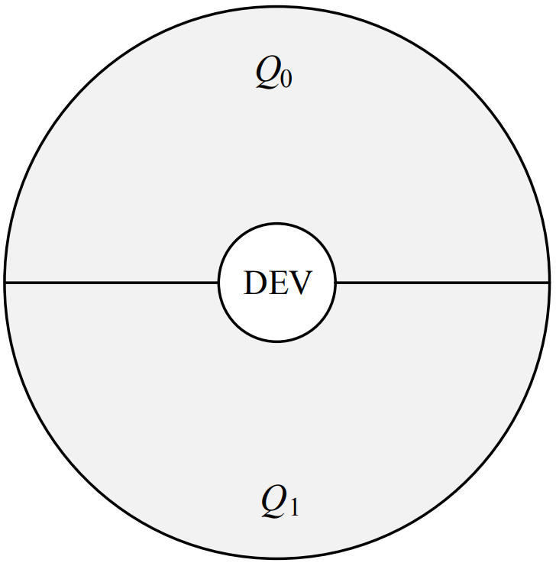
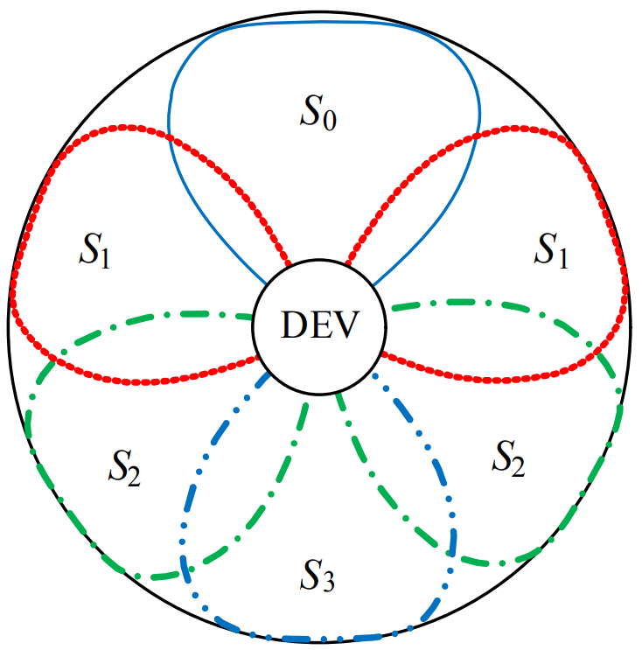
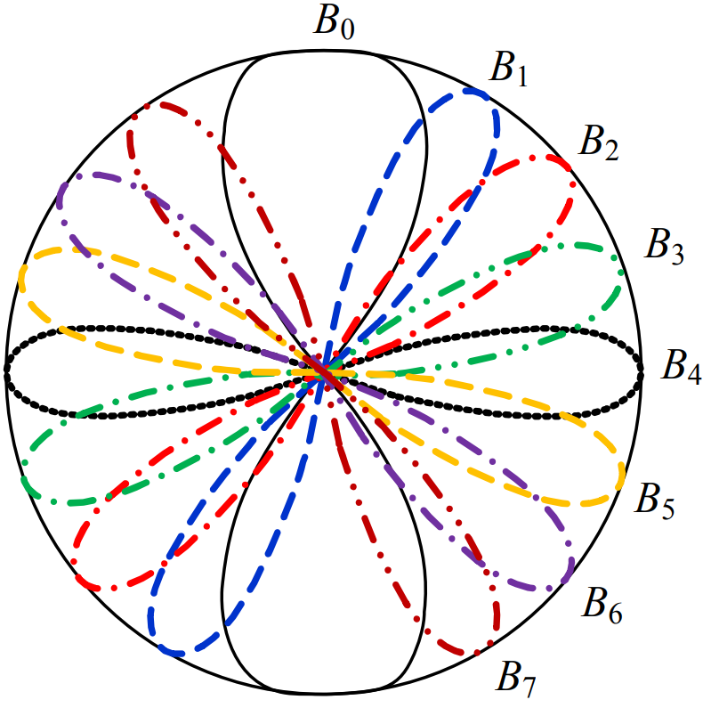
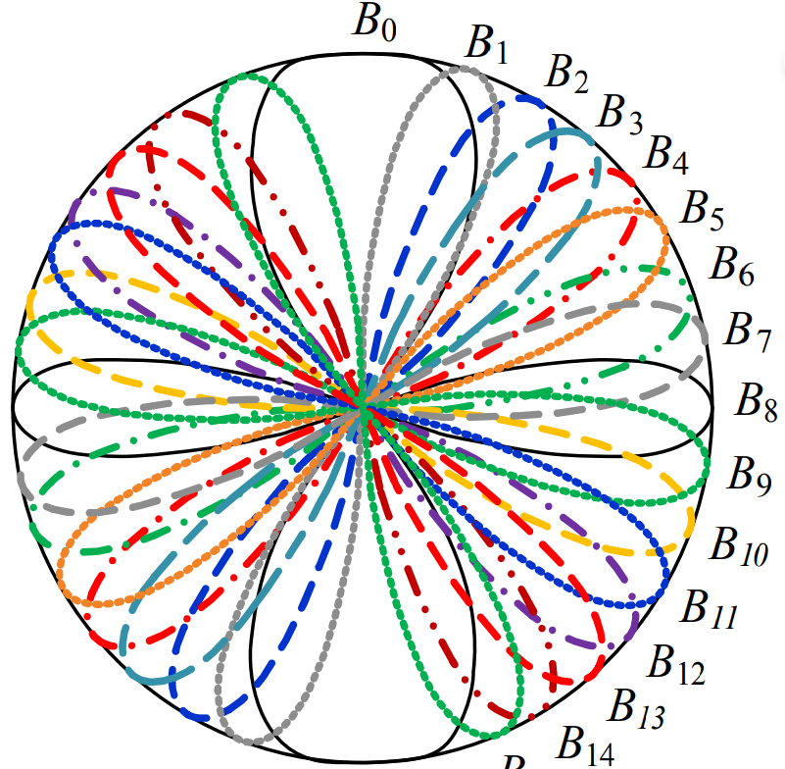
BFT in 15.3c
TG3c developed a Beam Switching/Steering and Tracking (BST) protocol that is applicable for diverse antenna configurations [3].
  define multi-level BFT with the resolution from coarse to fine as shown below;
  switch directions, needing the numbers of Tx & Rx directions instead of exact codebooks.
Superframe comprises beacon, contention access period (CAP), channel allocation time period (CTAP), all involving BFT.
Beacon
CAP
CTAP
Association CAP
Regular CAP
……
……
……
……
……
……
:
PNC/DEV switch Tx/Rx quasi-omni directions over beacon frames or association requests/response
DEVs communicate after some beamforming that involves sector + beam training;
Then, beam tracking trains beams into highest-resolution beams
Quasi-omni pattern
Sector
Beam
Highest-resolution beams

Slide 4
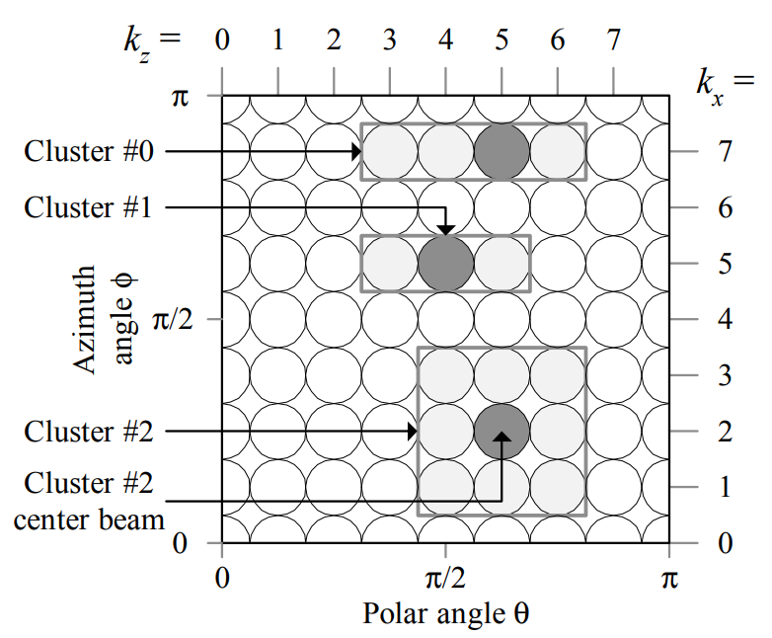
BFT in 15.3c
As an example, BFT between two DEVs in CTAP includes：
  sector-level training, to find the best sectors in bidirectional channels and map them into beams;
  beam-level training, to find the best beams in bidirectional channels;
  an optional beam tracking, to find the best HR beams using training sequences appended to data packets.
Sector-level training
Beam-level training
Beam tracking
DEV 1 switches Tx sectors
ACK
DEV 1 switches Tx beams
ACK
Packet
Packet
Packet
DEV 1
…
…
…
…
…
…
SIFS
…
GT
DEV 2 switches Rx sectors
DEV 2 switches Rx beams
Data packet sent by a center HR beam
Training sequence sent by adjacent HR beams
BFIFS
DEV 2 switches Tx sectors
DEV 2 switches Tx beams
DEV 2
…
…
Training phase
Feedback phase: announce first and/or second best sectors
Mapping phase：sector to beams
Training phase
Feedback phase: announce first and/or second best sectors
Mapping phase：beams to HR beams
…
…
DEV 1 switches Rx sectors
DEV 1 switches Rx beams

Slide 5
BFT in 11ad
11ad incorporated the concepts of quasi-omni, sectors and beams, and further clarified the roles of Initiator & Responder in BFT [4].
  sector-level sweep (SLS), determining the usable sector directions;
  beam refinement protocol (BRP), for iterative improvement of antenna configurations;
  beam tracking (BT) for fast AWV adjustment.
Superframe structure includes beacon header interval (BHI) and data transmission interval (DTI), during which SLS and BRP happen accordingly.
BHI
DTI
Association beamforming training
(A-BFT, optional)
Announcement transmission interval
(ATI, optional)
Any combination and ordering of contention-based access periods (CBAP) and service periods (SP)
Beacon transmission interval
(BTI)
……
……
……
……
Initiator (AP/PCP) Tx sector training with DMG beacon frames
Responder (STA) Tx or Rx sector training with SSW frames and SSW feedback exchanged in A-BFT slots
using sectors selected before
BRP as requested by SSW feedback in A-BFT
or SLS + BRP as scheduled into CBAP or SP
SLS with frames normally received in a quasi-omni mode

Slide 6
Sector-Level Sweep in 11ad
SLS has four phases: initiator sector sweep (ISS), responder sector sweep (RSS), SSW feedback, SSW ack.
  normally for transmit sector training, except for the case of Tx sectors being fixed;
  while one STA sweeps Tx sectors, the other STA keeps a quasi-omni Rx pattern;
  sequential training for multiple DMG antennas.
ISS
RSS
Feedback & Ack
SBIFS or LBIFS
CDOWN = 0
MBIFS
MBIFS
MBIFS
…
…
……
quasi-omni DMG antenna 1
quasi-omni DMG antenna 2
Initiator
SSW Feedback
Initiator switches Tx sectors / DMG antennas
Repeats if knowing multiple DMG antennas at Responder
SBIFS or LBIFS
CDOWN = 0
…
…
……
SSW ACK
Responder
quasi-omni DMG antenna 1
quasi-omni DMG antenna 2
Responder switches Tx sectors with changing DMW antennas or the best one
Repeats if knowing multiple DMG antennas at Initiator
with the best Tx/Rx sector/DMG antenna identified in ISS and RSS

Slide 7
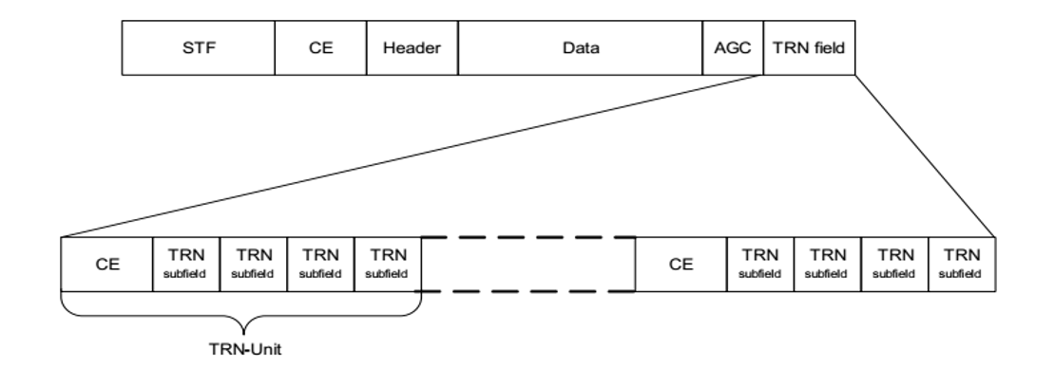
Beam Refinement Protocol in 11ad
BRP trains AWVs of DMG antennas iteratively, using BRP frames to which a TRN field is appended for temporary AWV changing. Each training round includes
  BRP setup subphase, exchanges the intent and initial info for the subsequent training process
    may be finished by using specified BRP frames or in the preceding SLS
  beam refinement transaction subphase, for both Tx & Rx beam training
    request/response-based approach
    based on the sectors selected in SLS or additional sector training (MIDC in the next slide)
Rx training response with TRN-R appended,
Tx training response with OK,
Tx training request
Tx training feedback,
Tx training starts with TRN-T appended
Rx training request
Initiator
TRN-R
TRN-T
Rx training request,
Tx training request,
Rx training response with TRN-R appended
Tx training starts with TRN-T appended,
Tx training response with OK
Tx training feedback
Responder
TRN-R
TRN-T
BRP PPDU with TRN
Beam refinement transaction

Slide 8
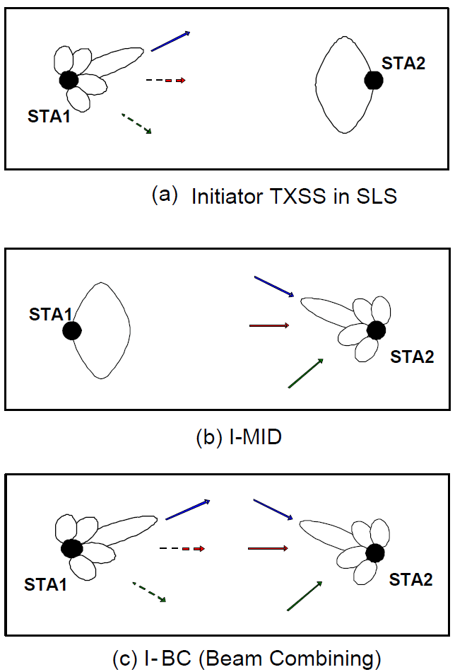
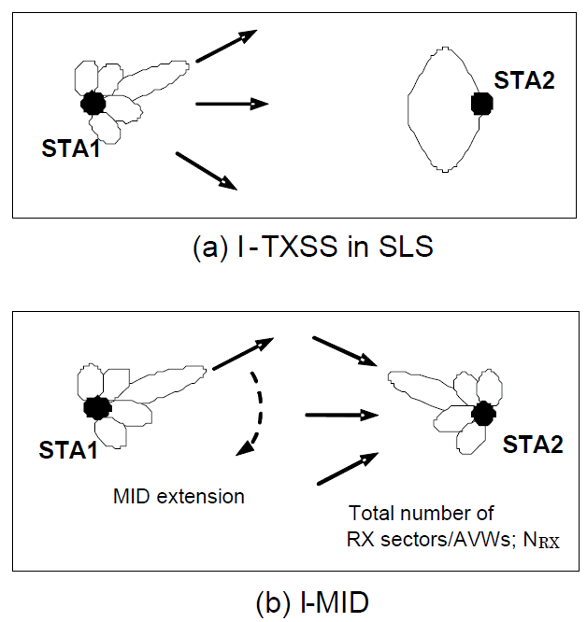
Beam Refinement Protocol in 11ad
Multiple sector ID capture (MIDC) is optionally added before executing beam refinement transaction, still using BRP frames, and it consists of two subphases or either of them.
  subphase 1: multiple sector ID detection (MID), an inverse of TxSS in SLS
    multiple BRP frames are transmitted through a quasi-omni pattern (or Tx sectors if MID only mode is chosen)
    the TRN fields appended to each BRP frame are received through a switching Rx AWV
  subphase 2: beam combining (BC), testing pairwise combinations of Tx and Rx sectors
  three options: MID + BC, BC only, MID only
BC only
MID + BC
MID only

Slide 9
Beam Tracking in 11ad
BT in 11ad allows for tracking changes in AWVs of DMG antennas without performing a complete BRP procedure.
  Initiator receive beam tracking
  Initiator transmit beam tracking
  Responder receive beam tracking
Solely changing the AWVs through which the TRN field are transmitted or received.
Initiator Rx tracking request
Initiator Rx tracking
Initiator Tx tracking request with TRN-T appended
Responder Rx tracking request with TRN-R appended
Initiator
ACK
ACK
Data
Data
TRN-T
Data
TRN-R
Responder
Initiator Rx tracking response with TRN-R appended
Initiator Tx tracking response with feedback
Responder Rx tracking
Data
TRN-R
ACK
ACK
Feedback
ACK

Slide 10
BFT in 11ay
Similar superframe structure and BFT are adopted [4]:
  BHI (BTI + A-BFT + ATI) and DTI (CBAP + SP)
    BTI fixed in the primary channel and A-BFT allocated to primary or secondary channels
    BRP in 11ad is applicable for 11ay before transmitting with CB or CA
Changes in BFT as opposed to 11ad due to new features of 11ay [4]:
  MIMO operations with SU-MIMO and MU-MIMO
  PPDU format
  channel bonding and channel aggregation
Beamforming protocols are introduced in 11ay
  MIMO beamforming
  Others: Beam tracking, hybrid beamforming, BFT for asymmetric links, BFT with dual-polarization TRN, group beamforming, first path beamforming

Slide 11
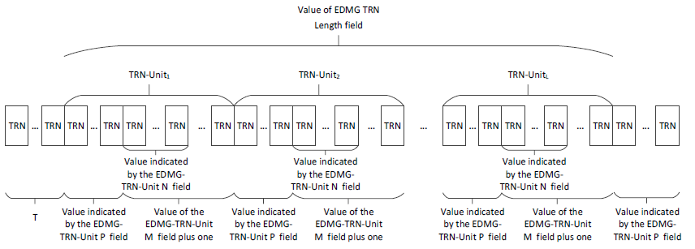
Training Frames in 11ay
Short SSW as training frames in SLS
  replace SSW that leads to dominant training costs, e.g., 63% time [5]
Improvements in BRP PPDUs
  no AGC field
    AGC field causes high overhead and its function can be realized by some TRN subfields [6]
  more comprehensive TRN structures
    TRN field fragmented into TRN units with TRN subfield-P, TRN subfield-M, TRN subfield-N defined for flexible BRP-TX, BRP-RX and BRP-TX/RX, as reviewed in [7]
    transmitted under MIMO and CA/CB
TRN field in BRP-Tx PPDU
Frame Control
Duration
RA
TA
SSW
SSW Feedback
FCS
SSW format (26 Bytes)
Bits：
16
16
48
48
24
24
32
Short SSW format (6 Bytes)
PPDU Type
Direction
Addressing Mode
Source AID
Destination AID
CDOWN
RF Chain ID
Short SSW Feedback
FCS
Short Scrambled BSSID
Unassociated
SISO Feedback Duration
Reserved
Bits：
1
1
1
8
8
11
3
10
1
4

Slide 12
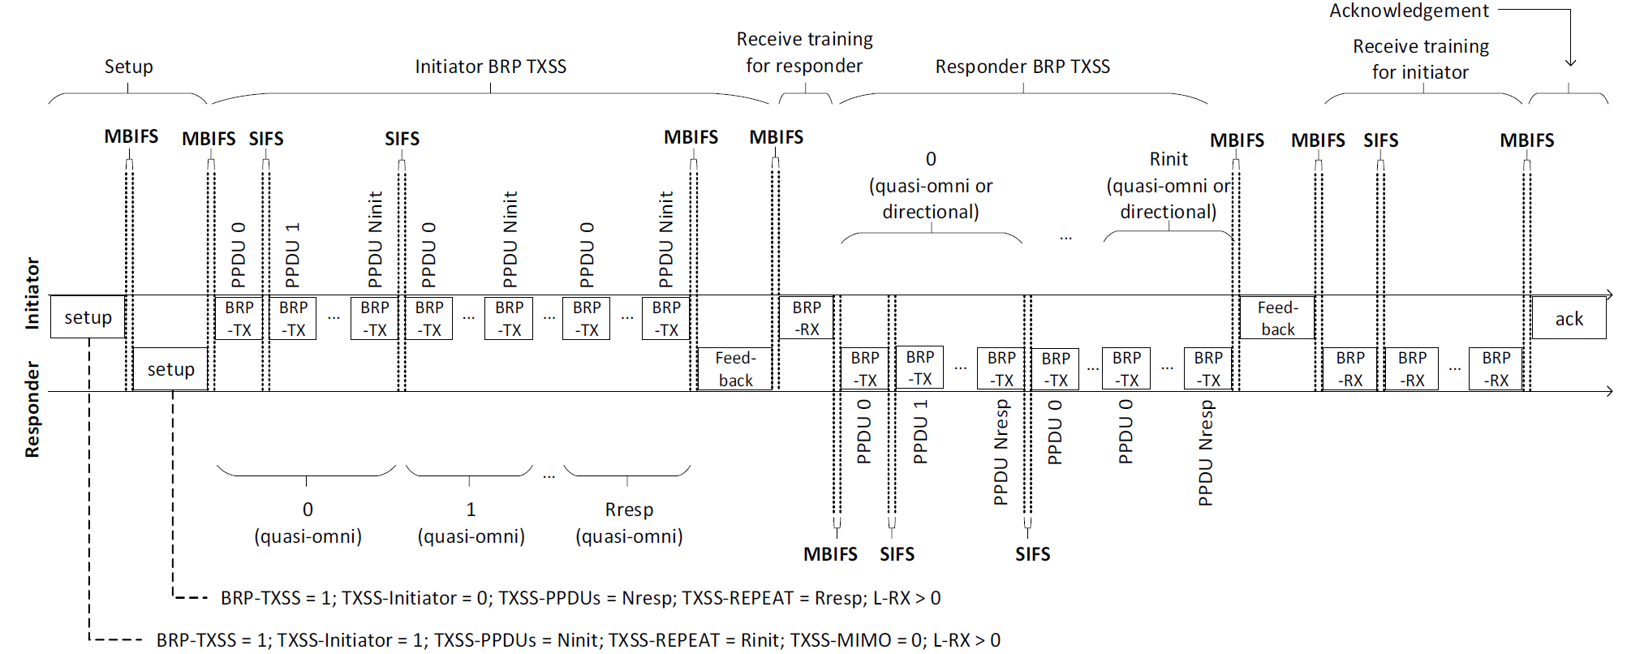
Sector-Level Sweep in 11ay
SLS procedures discussed in the 11ad part are applicable for sector training in 11ay, with the corresponding frames and signaling rules [4].
11ay further developed BRP transmit sector sweep (BRP TxSS).
  similar to SLS but use TRN for sector sweep over the entire channel (2.16GHz /4.32GHz /…)
  SISO using single Tx chain, MIMO using multiple Tx chains with spatial mapping
  may have as many as six-phases:
    setup (M)
    initiator BRP TxSS (M)
    Rx training for responder (M in SISO, N in MIMO)
    responder BRP TxSS (O in SISO, M in MIMO)
    Rx training for initiator (O in SISO, N in MIMO)
    Ack (M)

Slide 13
MIMO Beamforming in 11ay
SU/MU-MIMO beamforming is executed in DTI, given at least a control-mode link established yet, both consisting of two phases [4]:
  SISO phase, collecting candidate antennas/sectors for MIMO phase
    sector training using MIMO BRP TxSS in SU or initiator TxSS with SISO feedback in MU
    or only feedback process, given available training results from previous SLS or SISO BRP TxSS
  MIMO phase, determining best combinations of Tx & Rx sectors and DMG antennas
MIMO phase in SU-MIMO beamforming training
MIMO phase in nonreciprocal MU-MIMO beamforming (only downlink)
Initiator SU-MIMO BFT
MIMO BFT Setup
Initiator MU-MIMO beamforming training
MU-MIMO BF Feedback
MU-MIMO BF Selection
MIMO BFT Setup
MIMO BFT Feedback
Initiator
BRP
…
BRP
Initiator
…
BRP
…
BRP
Poll
Poll
MIMO BF Feedback
MIMO BFT Setup
MIMO BFT Feedback
…
Responder 1
Responder
BRP
BRP
MIMO BF Feedback
If antenna reciprocity satisfied，initiator will separately poll each responder to transmit BRP frames for training
Responder SU-MIMO BFT, which can be skipped if antenna reciprocity satisfied
Responder 2

Slide 14
Other BFT Protocols in 11ay
Beam tracking, additionally allows for baseband beamforming tracking
Hybrid beamforming, digital and analogue beamforming
First path beamforming
  find the best AWV corresponding to the LOS path (with the shortest time of flight)
etc.

Slide 15
Open Issues in IMMW
Will multi-level resolution beam training be used to IMMW?
  reliability vs. complexity
    resolution/gain: quasi-omni > sector > beam (if defined) > HR beam (if defined)
    full space scanning time: quasi-omni > sector > beam (if defined) > HR beam (if defined)
  combinations of antenna patterns
    cross-level training
    single-level training
Directional transmit
11ad/ay TxSS
11ad/ay BRP
11ad/ay Beacon/Association
11ay Beacon
11ad/ay BC
Quasi-omni receive
Directional receive
11ad/ay MID
Quasi-omni transmit

Slide 16
Open Issues in IMMW
How to setup/recover BFT in IMMW?
  if no mmWave beacon/association [8-10]
    11ad/ay rely on sector sweep, what about IMMW?
  how to deal with asymmetry links in IMMW?
    the difference could be worse in IMMW, between the uplink and downlink link budgets
  how to deal with the imbalanced reachability between IMMW and sub-7GHz?
    MLO could lend a hand by estimating via sub-7GHz [13]
    offloading announcement/feedback to sub-7GHz [14]
    more to consider...

Slide 17
Summary
In the contribution, the BFT protocols in 802.11 ad/ay and 802.15.3c are overviewed, based on which some issues in IMMW BFT are listed.

Slide 18
References
IEEE 802.11-24/0116r7, 802.11 IMMW Proposed PAR.
Y. Ghasempour, et al, "IEEE 802.11ay: Next-Generation 60 GHz Communication for 100 Gb/s Wi-Fi," IEEE Commun. Mag., vol. 55, no. 12, pp. 186-192, Dec. 2017.
IEEE 802.11-09/0355r0, IEEE 802.15.3c Beamforming Overview.
IEEE Std 802.11™-2024.
IEEE 802.11-16/0416-01-00, Short SSW Format for 11ay.
IEEE 802.11-17/0007r1, Training Field Structure Definition.
IEEE 802.11-25/1304r0, Discussion on TRN field in IMMW PPDU.
IEEE 802.11-24/0459r0, Multi-link Operation for IMMW.
IEEE 802.11-24/0587r0, Multi-Link Association Using mmWave Bands.
IEEE 802.11-23/2052r0, mmWave Operation without mmWave Beacon.
IEEE802.11-24/0823r1, Further Simplification to Promote IMMW Adoption.
IEEE802.11-25/1332r1, IMMW Range Extension.
IEEE 802.11-25/0300r1, Reachability of mmWave Link- Follow Up.
IEEE 802.11-25/0370r0, MLO Assisted Beam Training Protocols in IMMW.

Slide 19
Thank You

