Slide 1
Open Issues on Reusing Sub-7GHz PHY
Date: 2025-08-26
Authors:
Name | Affiliations | Address | Phone | Email
Wei Lin | Xiaomi |  |  | linwei5@xiaomi.com
Xiandong Dong
Xu Chen
Xin Zuo
Tong Xiao
Yajun Cheng

Slide 2
Background
Integrated mmWave (IMMW) enables non-standalone operation in the 42–71 GHz range using SU-OFDM, and leverages existing sub-7 GHz 802.11 OFDM PHY where applicable [1].
Several contributions have explored reusing the sub-7 GHz tone plan via upclocking (e.g., an 8x VHT tone plan), yielding channel bandwidths such as 160, 320, 640 MHz, etc. [2][3].
Candidate PPDU formats have been studied in [4] and [5], which inherit the main framework of the current sub-7GHz PPDU formats with necessary adjustments.
In this contribution, we discuss several open issues on reusing the sub-7GHz PHY
  L-STF & IMMW-STF
  L-LTF & IMMW-LTF
  Several Other Open Issues

Slide 3
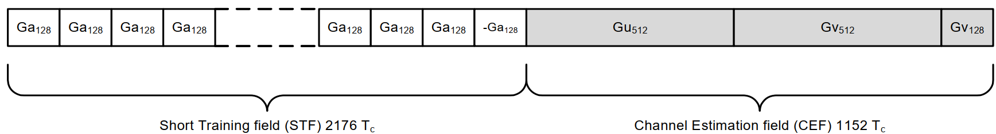
L-STF: Issues on Reusing of 11ac L-STF
The 11ac legacy short training field (L-STF) is an 8-µs waveform composed of ten 0.8-µs short periods (i.e., 2.5 × 3.2-µs OFDM IDFT intervals) per 20MHz BW.
  During this whole duration, the receiver can perform AGC setting, frame detection and synchronization, CFO estimation/correction, and sampling-clock timing acquisition, etc.
  Max. CFO Estimation Capability: 2πΔf ∙ T_{Period} ∈ (−π, π) ⇒ |Δf max| < 625kHz (~125 ppm @ 5GHz)
The 11ad/ay common STF field (Single Carrier) is an 1.236-µs waveform per 2.16GHz BW
  Common STF consists 16 repetitions of Ga₁₂₈(n) (each 72.7ns), followed by a single repetition of –Ga₁₂₈(n).
  Max. CFO Estimation Capability: 2πΔf ∙ T_{Period} ∈ (−π, π) ⇒ |Δf max| < 6.87MHz (~114.5 ppm @ 60GHz)

Slide 4
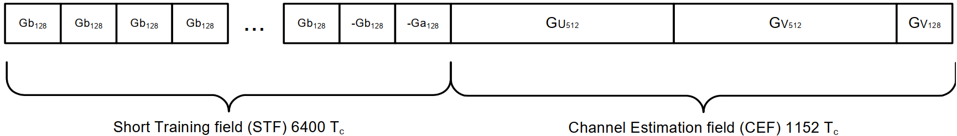
L-STF: Issues on Reusing of 11ac L-STF
The 11ad/ay Control STF field (Single Carrier) is an 3.636-µs waveform on 2.16GHz BW
  Control STF consists 48 repetitions of Gb₁₂₈(n) (each 72.7ns), followed by one –Gb₁₂₈(n) and one –Ga₁₂₈(n).
In IMMW, for example, with 8× upclocking of the VHT L-STF, the IMMW L-STF becomes a 1.0-µs waveform composed of ten 0.1-µs short symbols per 160MHz.
  Max. CFO Estimation Capability: 2πΔf ∙ T_{Period} ∈ (−π, π) ⇒ |Δf max| < 5MHz (~83 ppm @ 60GHz)
  If the 1ac L-STF is reused with 8× upclocking, the 0.1-µs period covers a ±5 MHz CFO; the sequence content may be reused from VHT L-STF/VHT-STF.
  However, the 1-µs total duration is shorter than the 11ad/ay common STF (1.236 µs) and control STF (3.636 µs).
  Is it necessary to increase the L-STF duration to give more time for AGC, detection, and CFO acquisition, etc.?

Slide 5
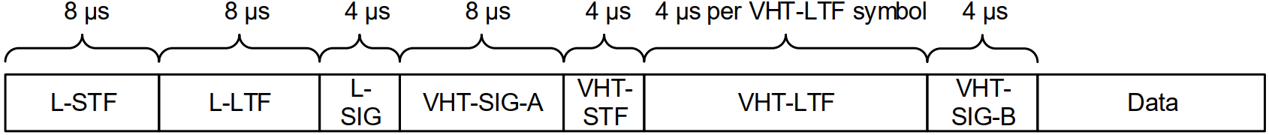
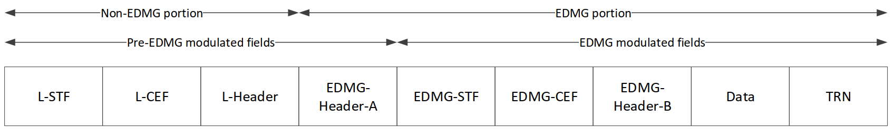
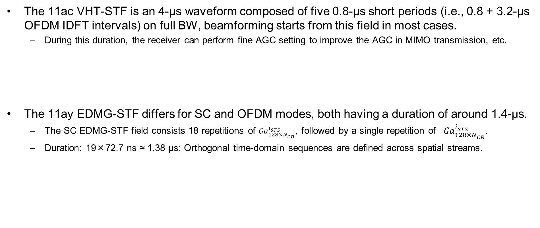
IMMW-STF: Issues on Reusing of 11ac VHT-STF
The 11ac VHT-STF is an 4-µs waveform composed of five 0.8-µs short periods (i.e., 0.8 + 3.2-µs OFDM IDFT intervals) on full BW, beamforming starts from this field in most cases.
  During this duration, the receiver can perform fine AGC setting to improve the AGC in MIMO transmission, etc.
The 11ay EDMG-STF differs for SC and OFDM modes, both having a duration of around 1.4-µs.
  The SC EDMG-STF field consists 18 repetitions of ${Ga}_{128×N_{CB}}^{i_{STS}}$，followed by a single repetition of $−{Ga}_{128×N_{CB}}^{i_{STS}}$.
  Duration: 19×72.7 ns ≈ 1.38 μs; Orthogonal time-domain sequences are defined across spatial streams.

Slide 6
IMMW-STF: Issues on Reusing of 11ac VHT-STF
The 11ay EDMG-STF differs for SC and OFDM modes; both have a duration of around 1.4-µs.
  The OFDM modulated EDMG-STF consists of 30 repetitions of a 48.48-ns period (30×48.48 ns ≈ 1.455 µs); and orthogonal frequency-domain sequences are defined per spatial stream.
  One rationale for the long duration of EDMG-STF is to provide sufficient processing time for header decoding (e.g., L-Header/EDMG-Header-A), and receiver settling before subsequent EDMG-LTF fields.
In IMMW, with 8×upclocking of the VHT-STF, the IMMW-STF becomes a 0.5-µs waveform composed of five 0.1-µs short symbols over full BW.
  This whole duration of 0.5-µs is ≈1/3 of the EDMG-STF (SC ≈1.38 µs, OFDM ≈1.455 µs).
  11ay headers are LDPC-coded, whereas IMMW SIGs may use BCC; thus processing latencies are different.
  Therefore, considering the processing delay of IMMW SIGs, IMMW-STF with 0.5-µs duration may be insufficient?
LSTF | LLTF | U-SIG | IMMW SIG | IMMW STF | IMMW LTF | Data | PE
LSTF | LLTF | U-SIG | IMMW SIG
… | … | … | …
LSTF | LLTF | U-SIG | IMMW SIG
Ref： 11-25-0360-00-00bq-high-level-thoughts-on-immw-phy-design, Rui Cao, et al.

Slide 7
L-LTF: Issues on Reusing of 11ac L-LTF
The 11ac L-LTF is an 8-µs waveform composed of two 3.2-µs IDFT periods and an additional 1.6-µs double GI, with 52 populated tones (-26:26 with DC tone nulled) per 20 MHz channel
  L-LTF can be used for single stream legacy channel estimation, fine synchronization / CFO adjustments, etc.
  Max. Fine CFO Estimation Capability: 2πΔf ∙ T_{Period} ∈ (−π, π) ⇒ |Δf max| < 156.25 kHz (~31.25 ppm @ 5GHz)
  Notice that VHT-LTF sequence includes 4 additional tones, and also includes pilot tones for MIMO phase tracking.

Slide 8
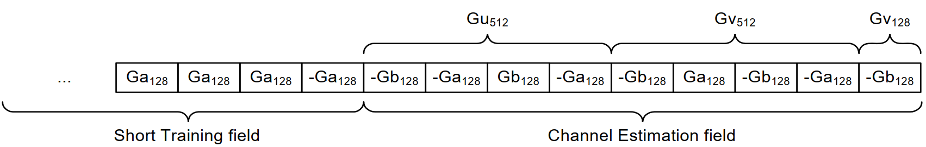
L-LTF: Issues on Reusing of 11ac L-LTF
The 11ad/ay common CEF field (Single Carrier) is a 0.655-µs waveform per 2.16GHz BW
  Common CEF consists of a concatenation of two sequences Gu₅₁₂(n) and Gv₅₁₂(n), followed by a Gv₁₂₈(n).
In IMMW, with 8×upclocking of the 11ac L-LTF, the IMMW L-LTF becomes a 1-µs waveform composed of two 0.4-µs IDFT periods and an additional 0.2-µs GI
  The duration of 1-µs IMMW L-LTF is longer than the common CEF of 11ad/ay (0.655-µs), need to increase or not?
  Since no L-SIG in IMMW, VHT-LTF sequence (56 populated tones) may be employed if single DC tone sufficient?
LSTF | LLTF | U-SIG | IMMW SIG | IMMW STF | IMMW LTF | Data | PE
LSTF | LLTF | U-SIG | IMMW SIG
… | … | … | …
LSTF | LLTF | U-SIG | IMMW SIG
Ref： 11-25-0360-00-00bq-high-level-thoughts-on-immw-phy-design, Rui Cao, et al.

Slide 9
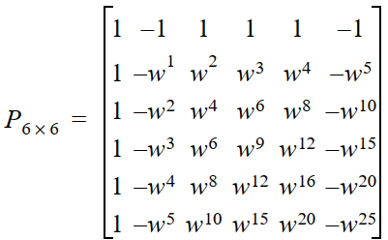
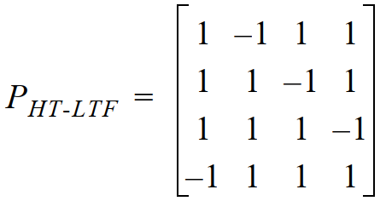

IMMW-LTF: Issues on Reusing of 11ac VHT-LTF
The 11ac VHT-LTF is composed of 1, 2, 4, 6, or 8 OFDM symbols (each 4-µs = 3.2-µs + 0.8-µs), which depends on total number of space-time streams over full BW
  VHT-LTF can be used for MIMO channel estimation, e.g., with 56 populated tones on 20MHz channel, where single stream pilots are included for phase tracking (i.e., 4 pilots in 20MHz channel).

Slide 10

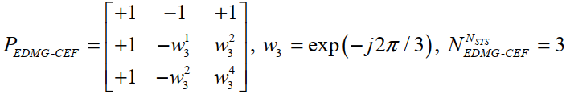

IMMW-LTF: Issues on Reusing of 11ac VHT-LTF
The 11ay OFDM EDMG-CEF is composed of 2, 3, 4, 6, or 8 OFDM symbols (each 0.267-µs = 0.194-µs + 72.72-ns),which depends on total number of space-time streams over full BW
  Up to 8 orthogonal OFDM EDMG-CEF frequency sequences are defined for various BWs (e.g., 2.16 GHz Channel)
  Similar to 11n HT-LTF, no single stream pilots included for phase tracking; 3 DC tones are defined for various BWs, which occupy 3×5.15625 MHz ≈ 15.47 MHz

Slide 11
IMMW-LTF: Issues on Reusing of 11ac VHT-LTF
In IMMW, with 8×upclocking of 11ac VHT-LTF, if maximum number of space-time streams is 2, the IMMW-LTF becomes 1 or 2 OFDM symbols (each 0.5-µs = 0.4 + 0.1) over full BW
  A single 0.5-µs IMMW-LTF symbol already exceeds the EDMG-CEF (OFDM) symbol duration (0.267-µs), and its 100-ns GI exceeds 11ay’s 72.72-ns GI → No need to further adjust?
  Since 11ay EDMG-CEF (similar to 11n HT-LTF) have no single stream pilots for phase tracking, do we need single stream pilots for IMMW-LTF to perform phase tracking?
  If the VHT-LTF single stream pilots are inherited, there would be 4 pilots in 160MHz, which may be insufficient?
  There are 3 DC tones (15.47 MHz) in 11ay OFDM tone plans over various BWs, thus one DC tone (2.5 MHz) in 160MHz is enough for IMMW?
  If the maximum number of space-time streams is 2, the 11ac P matrix may be reused?
LSTF | LLTF | U-SIG | IMMW SIG | IMMW STF | IMMW LTF | Data | PE
LSTF | LLTF | U-SIG | IMMW SIG
… | … | … | …
LSTF | LLTF | U-SIG | IMMW SIG

Slide 12
Other Open Issues on Reusing 11ac VHT PHY
In IMMW (with 8×upclocking of 11ac VHT PHY), several remaining open items are:
  Tone Plan: As we discussed, if the numerology of VHT pilots are inherited, there would be 4 pilots in 160MHz, which may be insufficient in 60GHz?
  GI: Reusing the 11ac GI gives 0.1-µs (normal) in IMMW, which already exceeds the longest 11ay GI (72.727-ns). Therefore, how long and how many GIs are required in IMMW?
  CSD: Reuse the 11ac Pre-VHT and VHT CSD patterns with 8× time scaling?
  PE: 11ac VHT PHY has no PE, but IMMW PHY may need PE to alleviate the Rx processing delay.
  SIGs: No L-SIG in IMMW, the IMMW SIGs (e.g., U-SIG, IMMW-SIG) need to be redefined anyway?
LSTF | LLTF | U-SIG | IMMW SIG | IMMW STF | IMMW LTF | Data | PE
LSTF | LLTF | U-SIG | IMMW SIG
… | … | … | …
LSTF | LLTF | U-SIG | IMMW SIG
Ref： 11-25-0360-00-00bq-high-level-thoughts-on-immw-phy-design, Rui Cao, et al.

Slide 13
Summary
In this contribution, we discussed several open issues on reusing the sub-7GHz PHY
  L-STF & IMMW-STF
  L-LTF & IMMW-LTF
  Several Other Open Issues

Slide 14
References
11-24-0116-07-immw-immw-draft-proposed-par, Laurent Cariou, et al.
11-25-0853-01-00bq-immw-tone-plan-discussions, Rui Cao, et al.
11-25-0854-00-00bq-considerations-on-numerology-for-immw, Insik Jung, et al.
11-25-0360-00-00bq-high-level-thoughts-on-immw-phy-design, Rui Cao, et al.
11-25-0365-01-00bq-ppdu-format-for-immw, Eunsung Park, et al.

Slide 15
Thank You

