Slide 1
Remaining Issues on WPT Protocols
September 2025
Doc.: IEEE 802.11-25/1566r1
Date: 2025-09-15
Authors:
Name | Affiliation | Address | Phone | Email
Yinan Qi | OPPO |  |  | v-qiyinan@oppo.com
Weijie Xu
Chuangfeng He
Ke Wang

Slide 2
Abstract
Doc.: IEEE 802.11-25/1566r1
In this contribution, we discuss the following issues:
  AMP non-AP STA reporting
  Energizer control
  Correspondence between energizer and AMP devices

Slide 3
July 2025
Doc.: IEEE 802.11-25/1566r1
AMP non-AP STA Reporting
  It has been agreed that energy harvest related information can be reported by the AMP non-AP STA
  EH capability
    Power source(s)
      Different power source has different properties, such as stability, reliability, controlling mechanism, etc.
      Report needs well-defined power source type
      Simplified report: indication of RF energy harvesting
      Such report can at least help AMP AP know whether or not to activate the energizers for WPT
  Energy storage capability
    Whether or not energy storage is supported;
      No storage simply means Tx power of the AMP non-AP STA is limited, e.g., lower than the harvested Rx power
Slide 3
Yinan Qi (OPPO)

Slide 4
July 2025
Doc.: IEEE 802.11-25/1566r1
AMP non-AP STA Reporting
  Energy storage capability
    Energy storage capacity;
    EH efficiency;
      Energy storage capacity and EH efficiency can be used to determine how long the AMP non-AP STA needs to be charged.
      For example, when the AMP non-AP STA is in IDLE status, it can be charged to make it ready for the following activities.
      With energy storage capacity and EH efficiency, AMP AP can roughly estimate how long the capacitor of the AMP non-AP STA is fully charged.
      Once AMP AP assumes the AMP non-AP STA is fully charged, the WPT Tx can be ended and the S1G channel is released.
    Such reporting can be discrete reporting
      E.g., EH efficiency: 20%, 40%, 60%, etc.
      No need to be accurate but can be very helpful
Slide 4
Yinan Qi (OPPO)

Slide 5
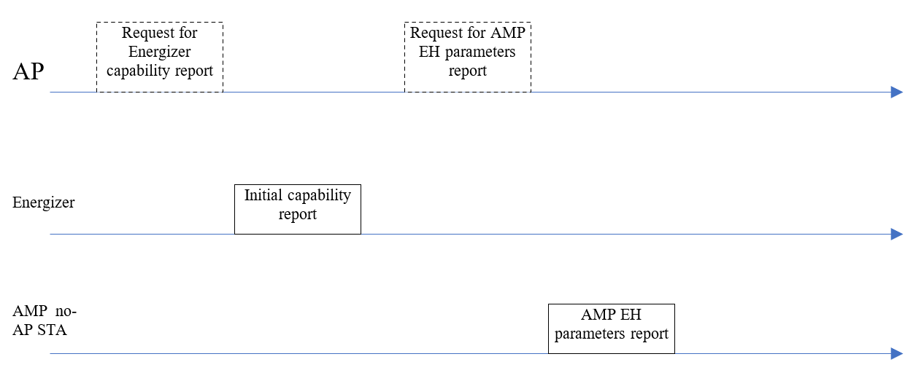
July 2025
Doc.: IEEE 802.11-25/1566r1
AMP non-AP STA Reporting
  AMP non-AP STA should report upon receiving the request from the AMP AP
    AMP AP knows if the AMP non-AP STA has the power to do reporting;
    AMP non-AP STA UL Tx should be triggered by the AMP AP
  The reporting can happen during the initial procedures such as association, authentication, etc.
Optional
Slide 5
Yinan Qi (OPPO)

Slide 6
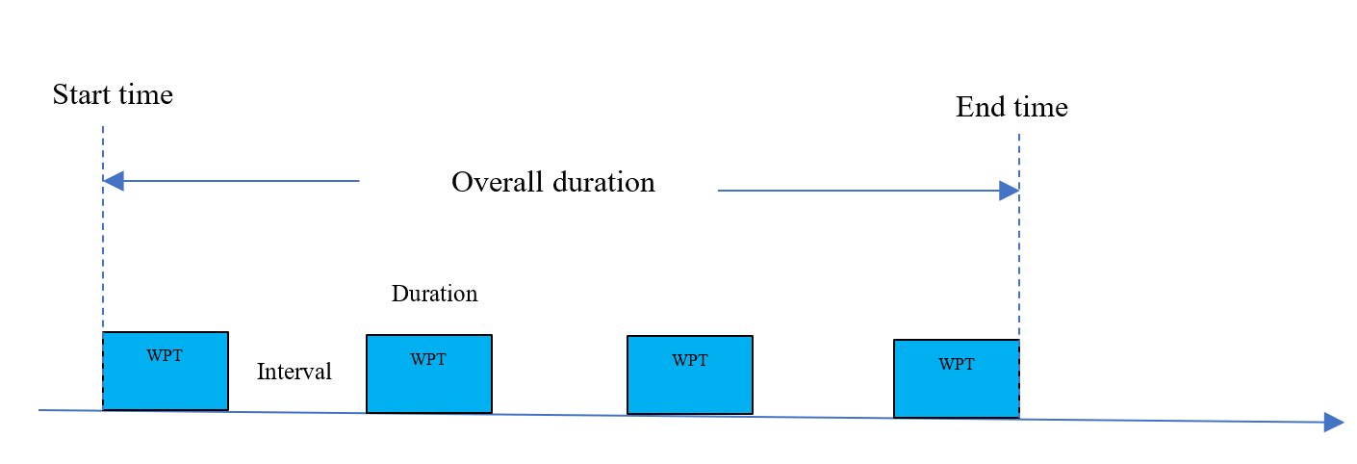
July 2025
Doc.: IEEE 802.11-25/0318r0
Wireless Energizer Control
  Agreed motion: Control information that is sent from the AMP AP to the AMP Energizer relating to the WPT waveform may include at least one or more of the following: Start Time, Duration, Interval, Transmit Power, and frequency related parameters.
    Start time gives the energizer the timing to start WPT signal transmission;
    Duration and interval gives the periodic Tx pattern of the WPT signal after start time [1]
    However, end time is missing. Without end time, the WPT signal will be transmitted forever and the S1G channel will not be released.
Slide 6
Yinan Qi (OPPO)

Slide 7
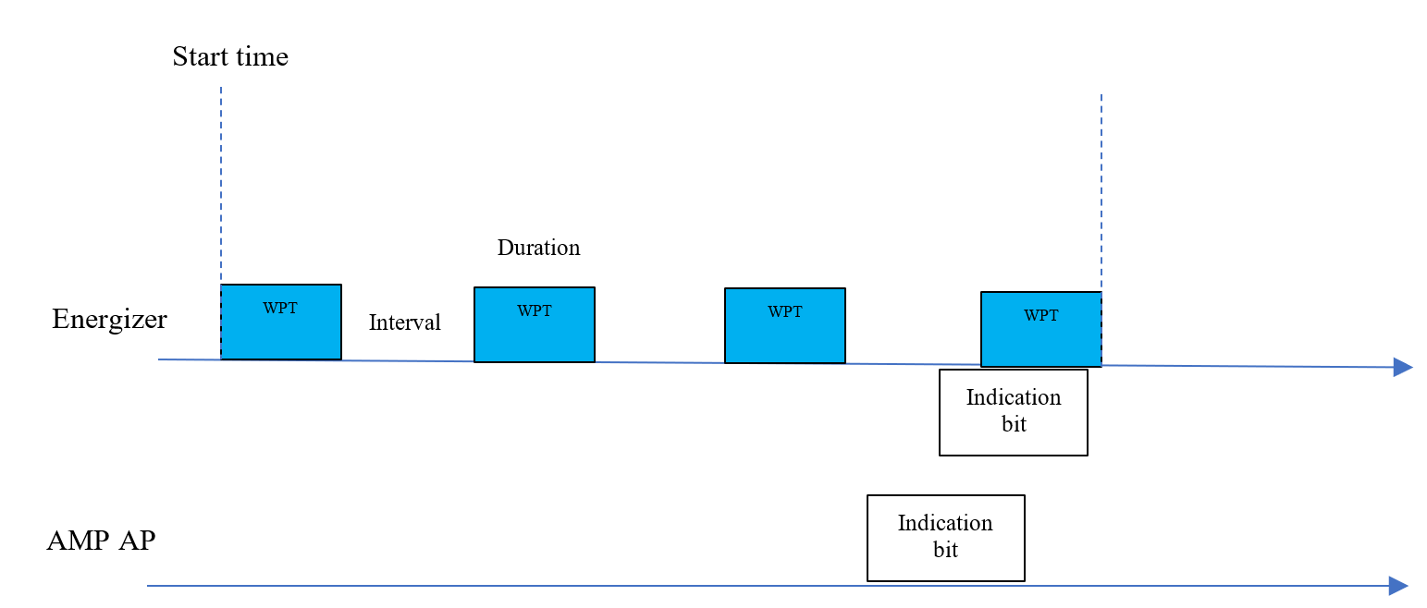
July 2025
Doc.: IEEE 802.11-25/0318r0
Wireless Energizer Control
  End time can be sent to the energizer together with start time, duration and interval.
  Alternatively, AMP AP can end WPT transmission by sending an indication bit to the energizer during the periodic WPT transmission procedure to end the WPT transmission.
  Both schemes should be supported:
    AMP AP has rough estimation how long the AMP non-AP STA should be charged → end time
    AMP AP knows the AMP non-AP STA is sufficiently charged based on feedback → indication bit
Slide 7
Yinan Qi (OPPO)

Slide 8
July 2025
Doc.: IEEE 802.11-25/0318r0
Wireless Energizer Control
  Additional energizer control parameters
    It has been agreed that the energizer may perform LBT before transmitting WPT signals in S1G.
    AMP AP should indicate if LBT should be performed by the energizer
      If yes, LBT parameters, e.g., detection threshold, contention window, etc.
Slide 8
Yinan Qi (OPPO)

Slide 9
July 2025
Doc.: IEEE 802.11-25/0318r0
Wireless Energizer Control
  Energizer capability reporting via legacy interface
    Energizer can autonomously report, e.g., once the energizer is connected to the AMP AP;
    Energizer reports when requested by the AP.
    Both reporting mechanisms can be supported
Optional
Slide 9
Yinan Qi (OPPO)

Slide 10
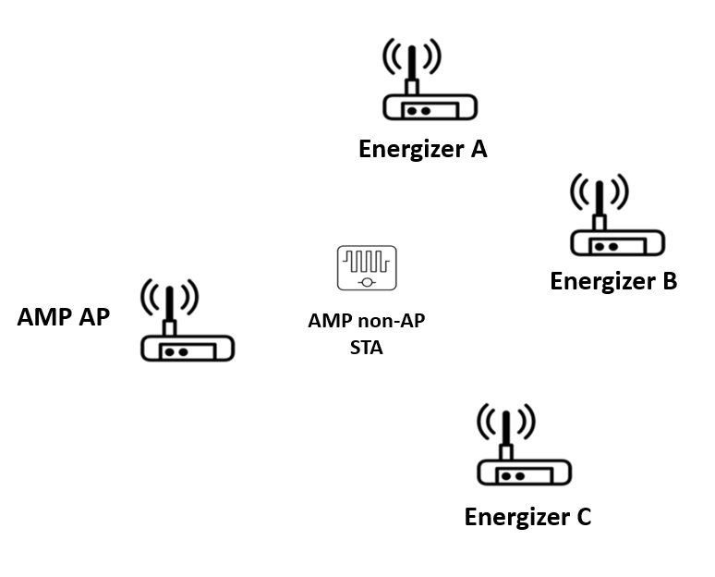
July 2025
Doc.: IEEE 802.11-25/0318r0
Wireless Energizer Control
  AMP AP should configure synchronized WPT Tx for multiple energizers
    The WPT signals are transmitted con-currently in synchronized manner in the sense that the starting time, duration of WPT Tx and interval between WPT Tx are the same for all the energizers.
    With such synchronized WPT Tx, the WPT signals are transmitted in the same time window and therefore the interference to other legacy systems is limited to this window only.
WPT Tx
Energizer A
Energizer B
Energizer C
Slide 10
Yinan Qi (OPPO)

Slide 11
July 2025
Doc.: IEEE 802.11-25/0318r0
General WPT Procedure: Charging Procedure
  WPT procedure:
    Initialization (cold start)
      Energizer → AMP AP: energizer capability reporting;
        Can be requested by the AMP AP or autonomously reported when the energizer is connected.
      AMP AP → Energizer: energizer control parameters;
      Energizer → AMP AP: Acks AP request
      Energizer: WPT signal transmission to charge the potential AMP non-AP STAs
      AMP AP → AMP non-AP STA: power and EH capability reporting
      AMP non-AP STA: power and EH capability reporting
    Once the initialization procedure is completed, the AMP non-AP STA is partially or fully charged and ready to Tx/Rx.
Slide 11
Yinan Qi (OPPO)

Slide 12
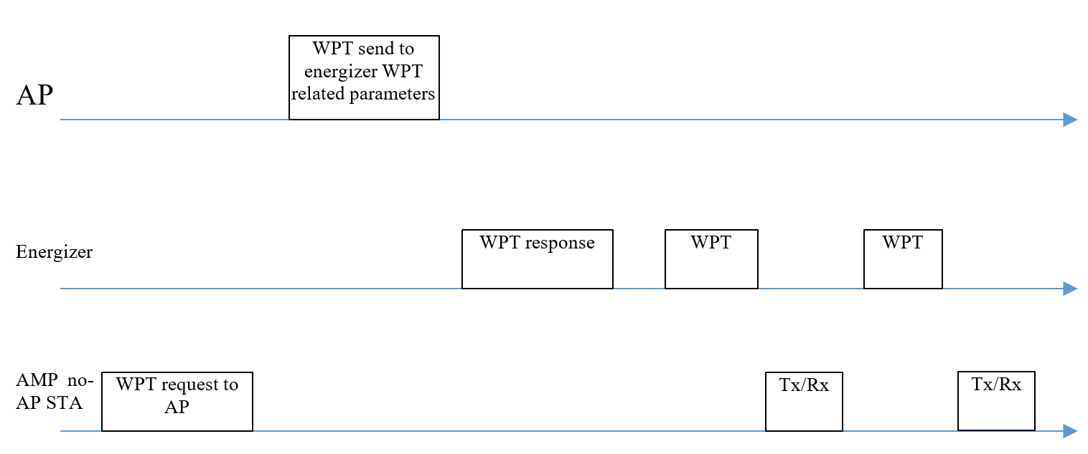
July 2025
Doc.: IEEE 802.11-25/0318r0
General WPT Procedure: Charging Procedure
  WPT procedure:
    WPT
      AMP non-AP STA → AMP AP: request WPT
        Energizer needs to charge AMP non-AP STA in the initial stage first
        This request is optional
      AMP AP → Energizer: energizer control parameters;
      Energizer → AMP AP: Acks AP request
      Energizer: WPT signal transmission to charge the potential AMP non-AP STAs
      AMP non-AP STA: Tx/Rx
      WPT and Tx/Rx procedures can repeat
Slide 12
Yinan Qi (OPPO)

Slide 13
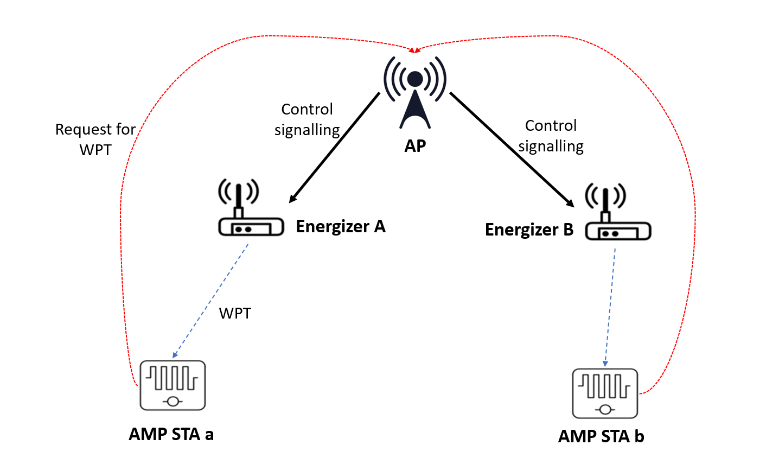
July 2025
Doc.: IEEE 802.11-25/0318r0
Correspondence Between Energizer and AMP non-AP STA
  Each energizer can correspond to one to multiple AMP non-AP STA.
    Excitation: essential to activate the correct energizer
      Some energizer may not be able to activate the AMP non-AP STA
    WPT: optimize the WPT and reduce the interference caused by the WPT signals
      Activate unnecessary energizers can cause strong interference and has negative impact on the legacy S1G systems.
 | Energizer A | Energizer B
AMP a | √ | X
AMP b | X | √
Slide 13
Yinan Qi (OPPO)

Slide 14
July 2025
Doc.: IEEE 802.11-25/0318r0
Correspondence Between Energizer and AMP non-AP STA
  How to establish correspondence
    Option 1:
      Energizer sends its ID when transmitting WPT signal;
      AMP non-AP STA report such ID to the AMP AP after the WPT signal is received and valid, i.e., strong enough to charge the capacitor;
      AMP AP establish correspondence.
    Option 2:
      AMP AP activate energizer(s)
      AMP AP triggers the target AMP non-AP STA(s)
      If the target AMP non-AP STA(s) is successfully triggered, AMP AP establish correspondence between the energizer(s) and target AMP non-AP STA(s)
    Option 2 is simpler but not as accurate as option 1.
Slide 14
Yinan Qi (OPPO)

Slide 15
Reference
July 2025
Doc.: IEEE 802.11-25/1566r1
[1] “Thoughts on the AMP WPT protocol,” IEEE 802.11-24/1208r1, July 2024

Slide 16
July 2025
Doc.: IEEE 802.11-25/1566r1
SP1
  Do you agree to capture the following text to TGbp SFD?
    AMP devices shall support to reporting at least following energy harvesting related information
        Indication of RF energy harvesting;
        Whether or not energy storage is supported;
        The amount of energy that can be stored.
Slide 16
Yinan Qi (OPPO)

Slide 17
July 2025
Doc.: IEEE 802.11-25/1566r1
SP2
  Do you agree to capture the following text to TGbp SFD?
    AMP devices reporting is requested by the AP and the reporting procedure should happen during the initial connection procedures, e.g., association or authentication.
Slide 17
Yinan Qi (OPPO)

Slide 18
July 2025
Doc.: IEEE 802.11-25/1566r1
SP3
  Do you agree to capture the following text to TGbp SFD?
    Energizer capability reporting can be either requested by the AP or autonomously done by the energizer and the reporting procedure should happen once the energizer is connected to the AMP AP.
Slide 18
Yinan Qi (OPPO)

Slide 19
July 2025
Doc.: IEEE 802.11-25/1566r1
SP4
  Do you agree to capture the following text to TGbp SFD?
    Control information that is sent from the AMP AP to the AMP Energizer relating to the WPT waveform may include End Time.
Slide 19
Yinan Qi (OPPO)

Slide 20
July 2025
Doc.: IEEE 802.11-25/1566r1
SP5
  Do you agree to capture the following text to TGbp SFD?
    Control information that is sent from the AMP AP to the AMP Energizer relating to the WPT waveform may include an indication bit to end the WPT transmission.
Slide 20
Yinan Qi (OPPO)

Slide 21
July 2025
Doc.: IEEE 802.11-25/1566r1
SP6
  Do you agree to capture the following text to TGbp SFD?
    When the energizers perform LBT, the LBT parameters, e.g., threshold, channel sensing time, contention window, etc., should be configured by the AMP AP.
    The LBT parameters should be considered additionally as control information that is sent from the AMP AP to the AMP Energizer relating to the WPT waveform.
Slide 21
Yinan Qi (OPPO)

Slide 22
July 2025
Doc.: IEEE 802.11-25/1566r1
SP7
  Do you agree to capture the following text to TGbp SFD?
    The WPT signals shall be transmitted con-currently in synchronized manner in the sense that the starting time, duration of WPT Tx and interval between WPT Tx are the same for all the energizers.
Slide 22
Yinan Qi (OPPO)

Slide 23
July 2025
Doc.: IEEE 802.11-25/1566r1
SP8
  Do you agree to capture the following text to TGbp SFD?
    The correspondence between energizer and AMP devices that determines which energizer to activate to charge target AMP devices should be supported.
Slide 23
Yinan Qi (OPPO)

