Slide 1
AMP TSF Discussion
Date: Sep 2025
Name | Affiliation | Address | Phone | Email
Ian Bajaj | Huawei | Singapore |  | ian.bajaj@huawei.com
Lei Huang
Rojan Chitrakar
Notes:
Jul 12, 2010
Page 1

Slide 2
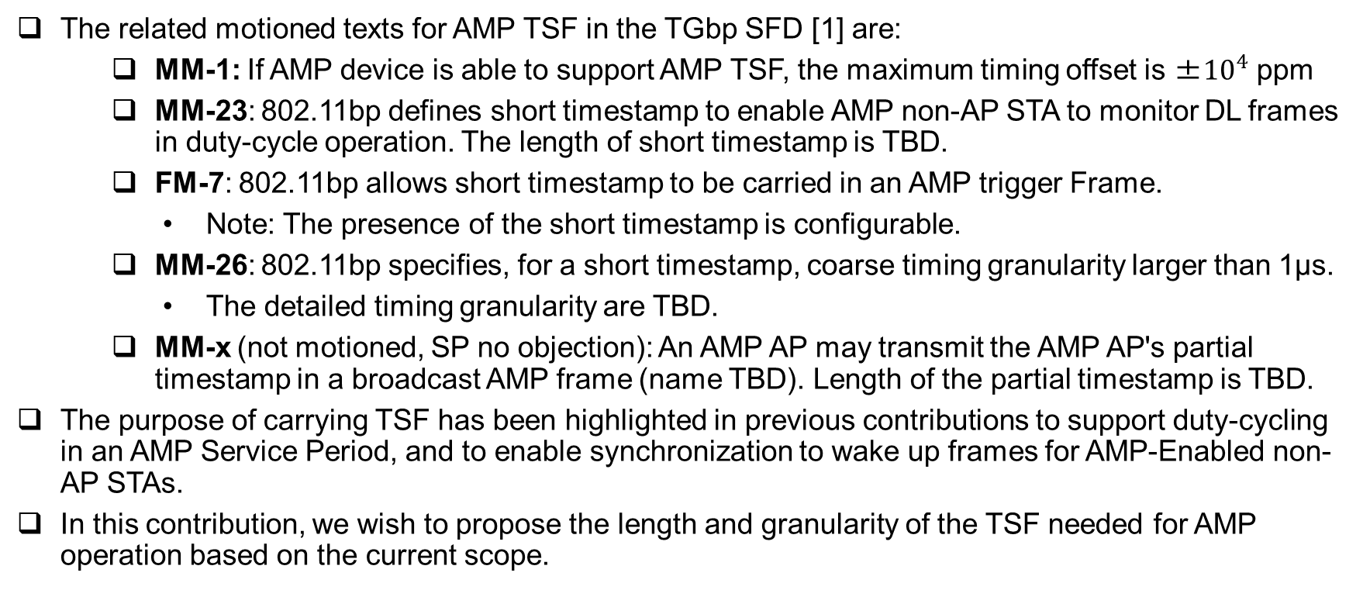
Background
The related motioned texts for AMP TSF in the TGbp SFD [1] are:
MM-1: If AMP device is able to support AMP TSF, the maximum timing offset is ±${10}^{4}$ ppm
MM-23: 802.11bp defines short timestamp to enable AMP non-AP STA to monitor DL frames in duty-cycle operation. The length of short timestamp is TBD.
FM-7: 802.11bp allows short timestamp to be carried in an AMP trigger Frame.
Note: The presence of the short timestamp is configurable.
MM-26: 802.11bp specifies, for a short timestamp, coarse timing granularity larger than 1µs.
The detailed timing granularity are TBD.
MM-x (not motioned, SP no objection): An AMP AP may transmit the AMP AP's partial timestamp in a broadcast AMP frame (name TBD). Length of the partial timestamp is TBD.
The purpose of carrying TSF has been highlighted in previous contributions to support duty-cycling in an AMP Service Period, and to enable synchronization to wake up frames for AMP-Enabled non-AP STAs.
In this contribution, we wish to propose the length and granularity of the TSF needed for AMP operation based on the current scope.

Slide 3
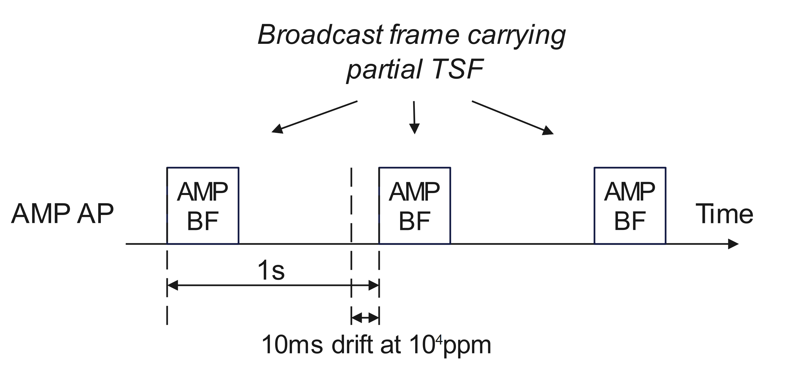
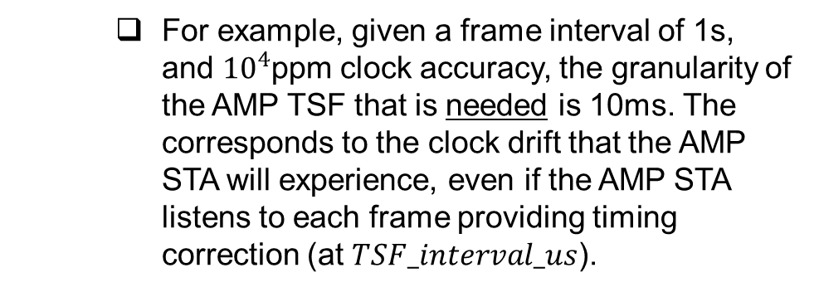

Granularity of AMP TSF (1/2)
The AMP TSF field (Broadcast/Trigger frame) can carry the partial TSF bits of the AMP AP’s TSF.
The granularity of the AMP TSF to be carried is dependent on the interval of the frame carrying the TSF and the clock accuracy of the AMP STA [2]: $TSF_interval_us∗CA$, where $CA$ is the clock accuracy of the AMP STA in ppm.
The clock accuracy may be determined as the combined maximum clock accuracy of all the AMP STAs in the AMP AP’s BSS plus the AMP AP’s own clock accuracy. The AMP STAs may indicate their clock accuracy to the AMP AP as part of capability exchange or during pairing with the AMP AP. Alternatively, the standard specified clock accuracies for AMP STAs can be used as a reference.
For example, given a frame interval of 1s, and $10^{4}$ppm clock accuracy, the granularity of the AMP TSF that is needed is 10ms. The corresponds to the clock drift that the AMP STA will experience, even if the AMP STA listens to each frame providing timing correction (at $TSF_interval_us$).

Slide 4
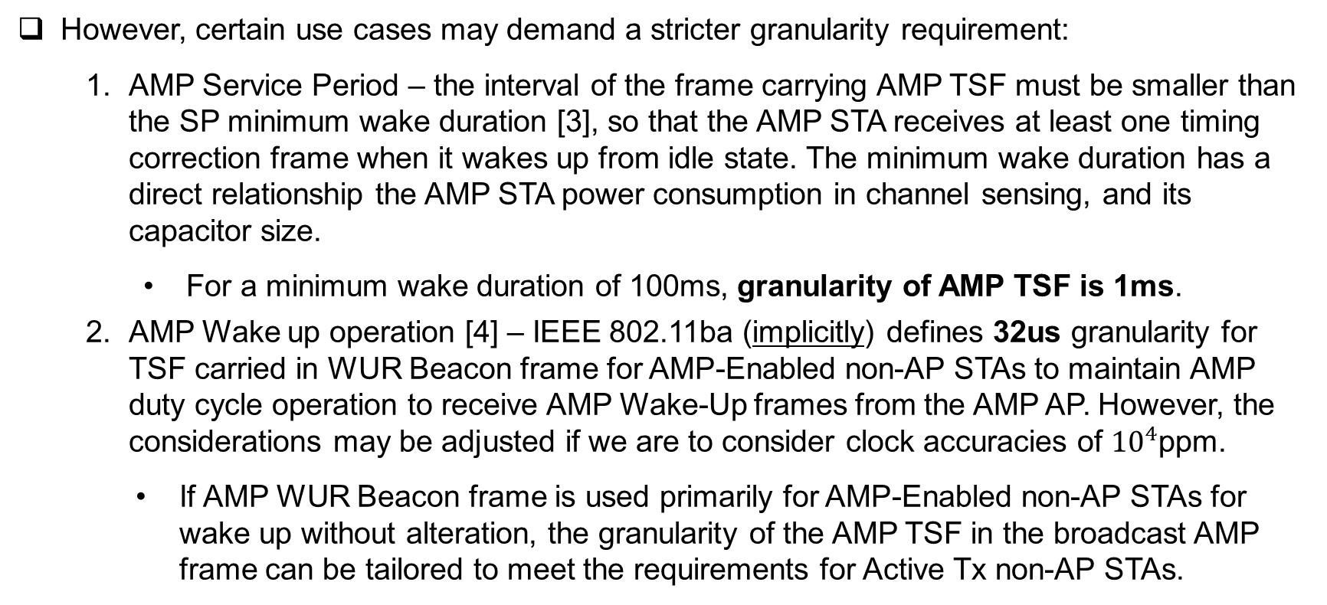
Granularity of AMP TSF (2/2)
However, certain use cases may demand a stricter granularity requirement:
AMP Service Period – the interval of the frame carrying AMP TSF must be smaller than the SP minimum wake duration [3], so that the AMP STA receives at least one timing correction frame when it wakes up from idle state. The minimum wake duration has a direct relationship the AMP STA power consumption in channel sensing, and its capacitor size.
For a minimum wake duration of 100ms, granularity of AMP TSF is 1ms.
AMP Wake up operation [4] – IEEE 802.11ba (implicitly) defines 32us granularity for TSF carried in WUR Beacon frame for AMP-Enabled non-AP STAs to maintain AMP duty cycle operation to receive AMP Wake-Up frames from the AMP AP. However, the considerations may be adjusted if we are to consider clock accuracies of ${10}^{4}$ppm.
If AMP WUR Beacon frame is used primarily for AMP-Enabled non-AP STAs for wake up without alteration, the granularity of the AMP TSF in the broadcast AMP frame can be tailored to meet the requirements for Active Tx non-AP STAs.

Slide 5
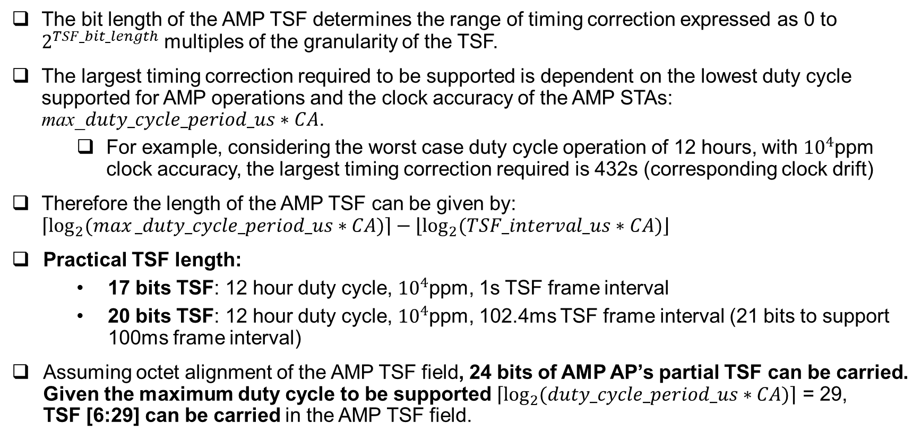
Length of AMP TSF
The bit length of the AMP TSF determines the range of timing correction expressed as 0 to $2^{TSF_bit_length}$ multiples of the granularity of the TSF.
The largest timing correction required to be supported is dependent on the lowest duty cycle supported for AMP operations and the clock accuracy of the AMP STAs: max_$duty_cycle_period_us∗CA$.
For example, considering the worst case duty cycle operation of 12 hours, with ${10}^{4}$ppm clock accuracy, the largest timing correction required is 432s (corresponding clock drift)
Therefore the length of the AMP TSF can be given by: $\left\lceil \log_{2}{(max⁡_duty_cycle_period_us∗CA)}\right\rceil −\left\lfloor \log_{2}{(TSF_interval_us∗CA)}\right\rfloor$
Practical TSF length:
17 bits TSF: 12 hour duty cycle, $10^{4}$ppm, 1s TSF frame interval
20 bits TSF: 12 hour duty cycle, $10^{4}$ppm, 102.4ms TSF frame interval (21 bits to support 100ms frame interval)
Assuming octet alignment of the AMP TSF field, 24 bits of AMP AP’s partial TSF can be carried. Given the maximum duty cycle to be supported $\left\lceil \log_{2}{(duty_cycle_period_us∗CA)}\right\rceil$ = 29, TSF [6:29] can be carried in the AMP TSF field.

Slide 6
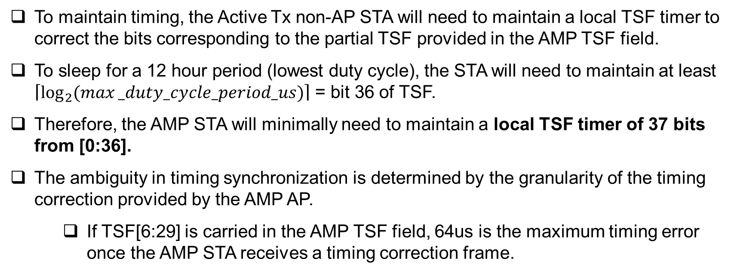
AMP STA Assumption
To maintain timing, the Active Tx non-AP STA will need to maintain a local TSF timer to correct the bits corresponding to the partial TSF provided in the AMP TSF field.
To sleep for a 12 hour period (lowest duty cycle), the STA will need to maintain at least $\left\lceil \log_{2}{(max⁡_duty_cycle_period_us)}\right\rceil$ = bit 36 of TSF.
Therefore, the AMP STA will minimally need to maintain a local TSF timer of 37 bits from [0:36].
The ambiguity in timing synchronization is determined by the granularity of the timing correction provided by the AMP AP.
If TSF[6:29] is carried in the AMP TSF field, 64us is the maximum timing error once the AMP STA receives a timing correction frame.

Slide 7
Summary
The granularity and the length of the AMP TSF was discussed.
The granularity depends on the interval of the frame carrying the AMP TSF and the clock accuracy of the AMP STAs. For a AMP TSF frame interval of 100ms, the timing correction granularity is 1ms, which is sufficient for timing synchronization for AMP operations.
The length depends on the maximum timing correction needed to support AMP operations (i.e. the drift given the worst case duty cycle), the clock accuracy of the AMP STAs, and the granularity of the timing correction. The maximum timing correction needed to support 12 hours of duty cycle requires bit 29 of the AP’s partial TSF, and given the granularity of 1ms, 20 bit length AMP TSF is required.
To preserve octet alignment for the AMP TSF field, the proposal is to carry 24 bits of the AMP AP’s partial TSF [6:29], which corresponds to a 64us timing granularity and supports 12 hours of timing correction.

Slide 8
SP1
Do you agree to add the following text to TGbp SFD?
The timing granularity of the AMP AP’s partial timestamp carried in a broadcast AMP frame is 64us.
[Reference: 11-25/0285r1, 11-25/0787r0, 11-25/1247r0, 11-25/1560r0, 11-25/1561r0]

Slide 9
SP2
Do you agree to add the following text to TGbp SFD?
The length of the AMP AP’s partial timestamp carried in a broadcast AMP frame is 24 bits.
[Reference: 11-25/0285r1, 11-25/0787r0, 11-25/1247r0, 11-25/1560r0, 11-25/1561r0]

Slide 10
SP3
Do you agree to add the following text to TGbp SFD?
IEEE 802.11bp defines the AMP TSF field to carry the AMP AP’s partial timestamp TSF [6:29] in a broadcast AMP frame.
[Reference: 11-25/0285r1, 11-25/0787r0, 11-25/1247r0, 11-25/1560r0, 11-25/1561r0]

Slide 11
SP4
Do you agree to add the following text to TGbp SFD?
The short timestamp when present in the AMP trigger frame carries the AMP TSF field, TSF[6:29] of the AMP AP’s partial TSF.
Other lengths of short timestamp configured to be present in the AMP trigger for some modes of operation is TBD.
[Reference: 11-25/0285r1, 11-25/0787r0, 11-25/1247r0, 11-25/1560r0, 11-25/1561r0]

Slide 12
References
[1] 11-24/1613r9, Specification Framework for TGbp
[2] 11-25/1247r0, AMP Beacon
[3] 11-25/1560r0, Use Case for AMP Service Period
[4] 11-25/0779r0, E2E Operation of AMP-enabled Non-AP STAs

