Slide 1
Use Case for AMP Service Period
Date: Sep 2025
Name | Affiliation | Address | Phone | Email
Ian Bajaj | Huawei | Singapore |  | ian.bajaj@huawei.com
Lei Huang
Rojan Chitrakar
Notes:
Jul 12, 2010
Page 1

Slide 2
Background
AMP Service Period [1] was defined in Motion MM-22 in the AMP SFD [2]: IEEE 802.11bp defines an AMP Service Period, that allows an Active Tx non-AP AMP STA to enter doze state after a minimum wake up time since the start of the AMP Service Period, if the Active Tx non-AP AMP STA does not receive any AMP DL PPDU from the AMP AP.
The following motioned texts in the AMP SFD define how some parameters related to the AMP Service Period are sent by the AMP AP, or derived by the AMP STA in one particular use case [3]:
  FM-7: 802.11bp allows short timestamp to be carried in an AMP trigger Frame.
    Note: The presence of the short timestamp is configurable.
  FM-8: 802.11bp allows duty-cycle configuration to be carried in an AMP trigger Frame.
    Details of Duty-cycle configuration (e.g., AMP service period) are TBD.
    Note: The presence of the duty-cycle configuration is configurable.
  MM-24: 802.11bp defines one mechanism that a non-AP AMP STA can derive its specific AMP service period in order to monitor AMP DL Frame.
In this contribution, we wish to highlight a different use case for AMP Service Period, and the corresponding implications for the signaling of the related parameters.

Slide 3
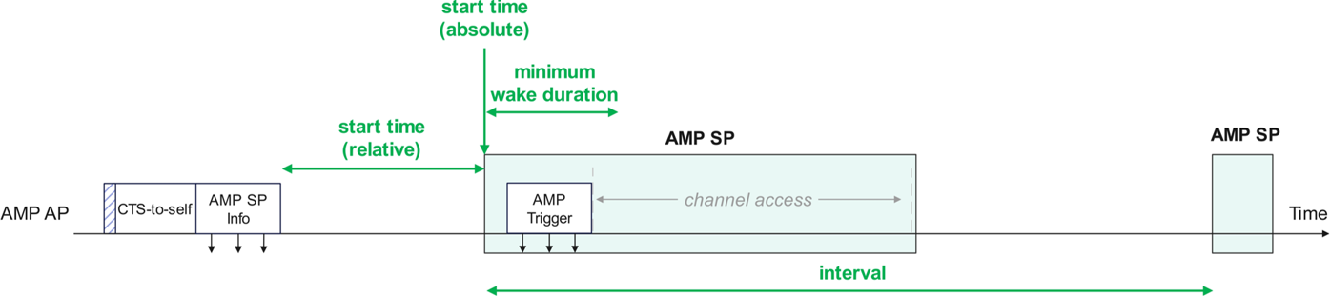
Recap on AMP Service Period in [1]
In [1], AMP Service Period was defined as a window that the AMP AP will gain a TXOP for any non-AP AMP STAs in its BSS, regardless of association.
At the start of the SP, within the SP minimum wake duration, the AMP AP will send for example, an AMP Trigger to enable channel access for the non-AP AMP STAs. If the non-AP AMP STAs do not receive any AMP DL PPDU from the AP, the non-AP AMP STA will return to idle mode for the SP interval duration (wake up at the start of the following SP).
The SP parameters, namely, SP start time, SP interval and SP minimum wake duration may be carried in an frame sent periodically by the AMP AP (shown here as SP Info frame). The SP start time maybe expressed as an absolute TSF time or a relative time from the end of frame carrying this field.

Slide 4
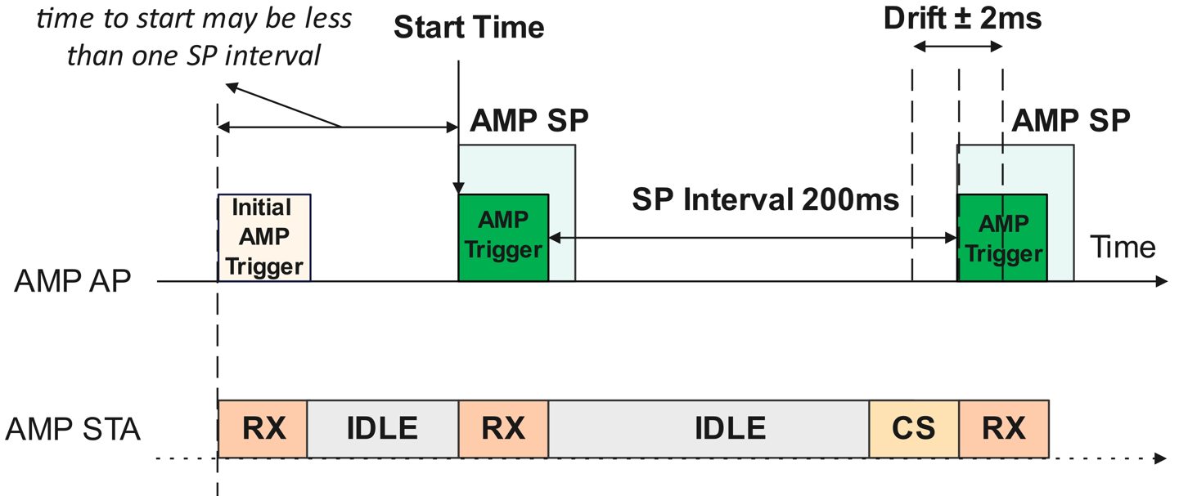
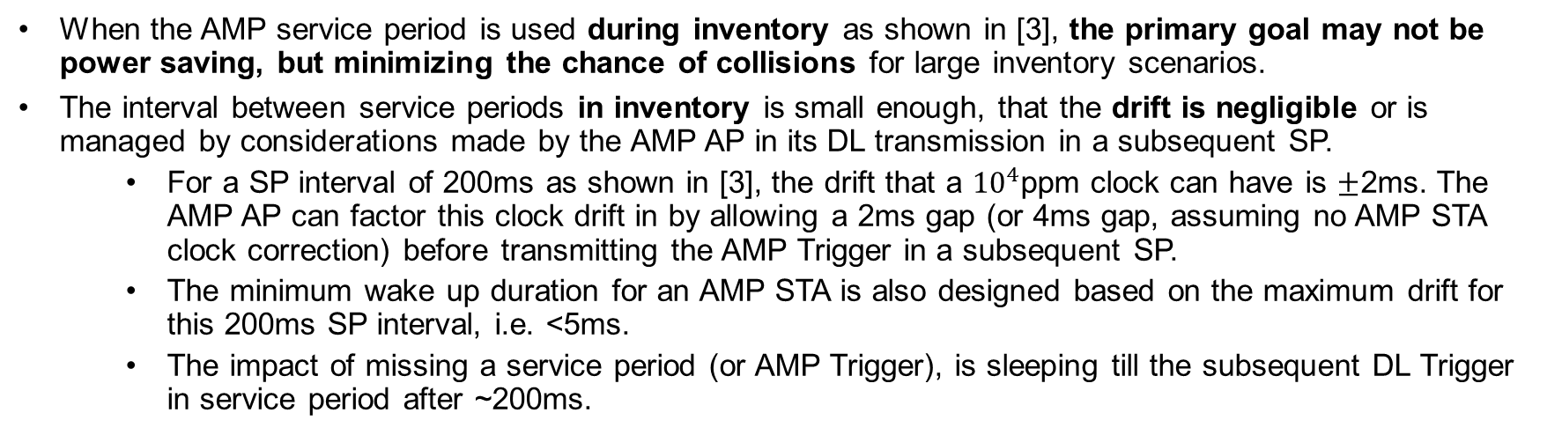
The implication of different use cases (1/2)
When the AMP service period is used during inventory as shown in [3], the primary goal may not be power saving, but minimizing the chance of collisions for large inventory scenarios.
The interval between service periods in inventory is small enough, that the drift is negligible or is managed by considerations made by the AMP AP in its DL transmission in a subsequent SP.
  For a SP interval of 200ms as shown in [3], the drift that a ${10}^{4}$ppm clock can have is $±$2ms. The AMP AP can factor this clock drift in by allowing a 2ms gap (or 4ms gap, assuming no AMP STA clock correction) before transmitting the AMP Trigger in a subsequent SP.
  The minimum wake up duration for an AMP STA is also designed based on the maximum drift for this 200ms SP interval, i.e. <5ms.
  The impact of missing a service period (or AMP Trigger), is sleeping till the subsequent DL Trigger in service period after ~200ms.
The SP parameters carried in the AMP Trigger may have smaller overhead
  Start time maybe less than equal to the Service Period interval, therefore a short TSF carried in the AMP Trigger is sufficient (TSF of 8 bits is sufficient for <200ms start time indication)
  SP interval of 200ms can also be expressed with fewer bits (at most 8 bits, fewer depending on the encoding used)

Slide 5
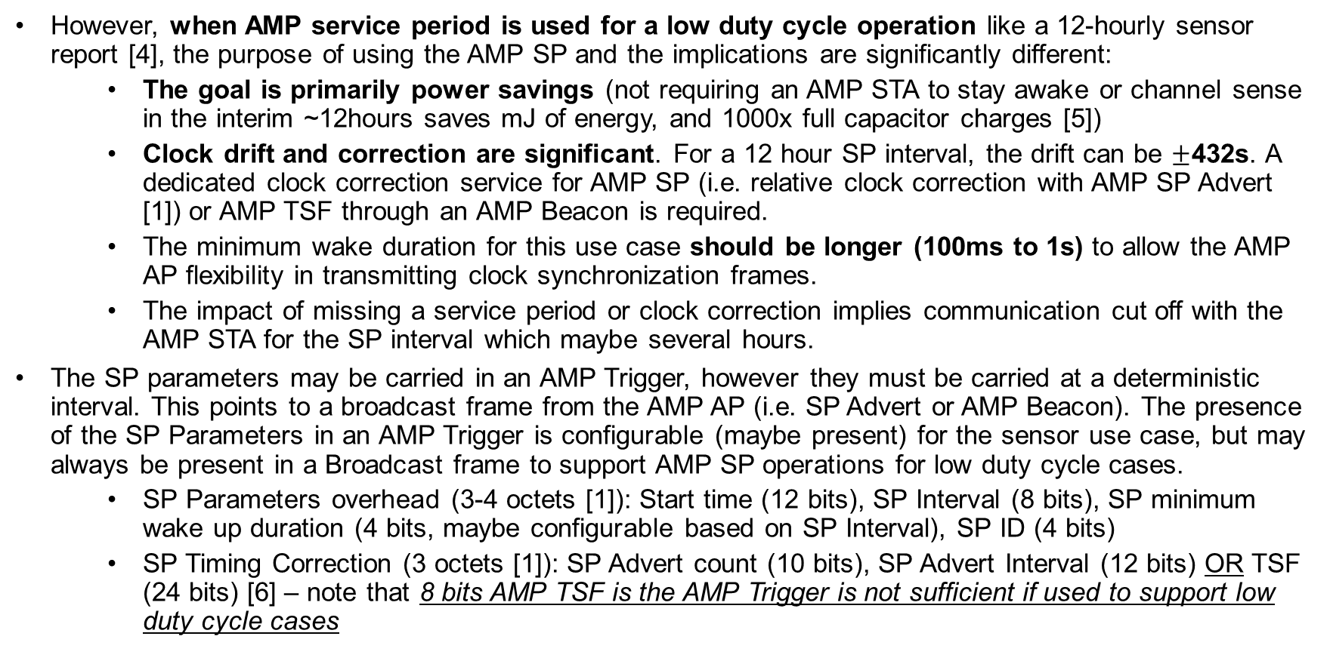
The implication of different use cases (2/2)
However, when AMP service period is used for a low duty cycle operation like a 12-hourly sensor report [4], the purpose of using the AMP SP and the implications are significantly different:
  The goal is primarily power savings (not requiring an AMP STA to stay awake or channel sense in the interim ~12hours saves mJ of energy, and 1000x full capacitor charges [5])
  Clock drift and correction are significant. For a 12 hour SP interval, the drift can be $±$432s. A dedicated clock correction service for AMP SP (i.e. relative clock correction with AMP SP Advert [1]) or AMP TSF through an AMP Beacon is required.
  The minimum wake duration for this use case should be longer (100ms to 1s) to allow the AMP AP flexibility in transmitting clock synchronization frames.
  The impact of missing a service period or clock correction implies communication cut off with the AMP STA for the SP interval which maybe several hours.
The SP parameters may be carried in an AMP Trigger, however they must be carried at a deterministic interval. This points to a broadcast frame from the AMP AP (i.e. SP Advert or AMP Beacon). The presence of the SP Parameters in an AMP Trigger is configurable (maybe present) for the sensor use case, but may always be present in a Broadcast frame to support AMP SP operations for low duty cycle cases.
  SP Parameters overhead (3-4 octets [1]): Start time (12 bits), SP Interval (8 bits), SP minimum wake up duration (4 bits, maybe configurable based on SP Interval), SP ID (4 bits)
  SP Timing Correction (3 octets [1]): SP Advert count (10 bits), SP Advert Interval (12 bits) OR TSF (24 bits) [6] – note that 8 bits AMP TSF is the AMP Trigger is not sufficient if used to support low duty cycle cases

Slide 6
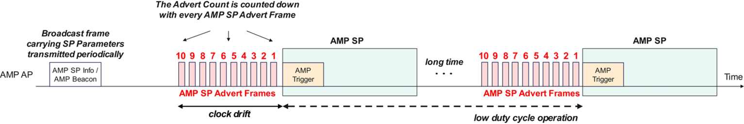
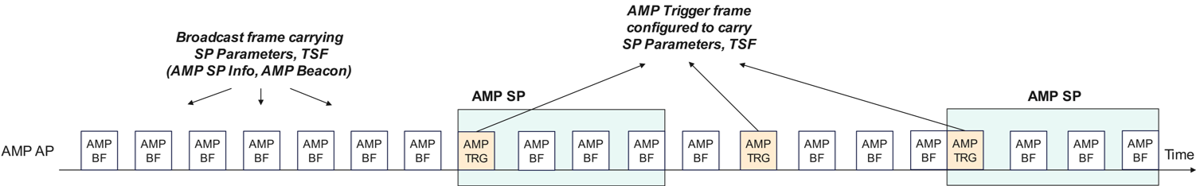
AMP Service Period Signaling for Low Duty Cycle Operations
Option #1
Broadcast frame carries SP Parameters at a relaxed periodicity
Timing correction frames (SP Advert) only transmitted prior to the start of the AMP SP at an interval < min. wake duration (burst frames with low overall channel utilization)
AMP Trigger frame reserved for channel access parameters
Option #2
No dedicated frame for AMP SP
Broadcast frame carries SP Parameters and TSF at an interval less than the minimum wake duration (constant channel utilization)
AMP Trigger frame is configured to carry SP Parameters, TSF
When considering very low duty cycle operations, the minimum wake duration for the AMP SP may be relaxed to 100ms to 1s to allow the AMP AP sufficient interval between timing correction frames: AMP SP Advert frames (in Option 1) or AMP BF frames (in Option 2)

Slide 7
Summary
AMP Service Period in the context of high and low duty cycle operations was discussed.
With inventory use cases [3], the goal of AMP Service Period was to minimize the collision for channel access procedure. With sensor use cases [1], the goal of AMP Service Period was to reduce power consumption and the frequency of WPT for energy harvesting.
Two options for signaling of AMP Service Period parameters and timing correction from the AMP AP were provided:
  Option 1 – Dedicated frames for SP Parameter Broadcast, and for SP Timing Correction (relaxed interval on broadcast frames, burst frames with lower channel utilization for timing correction)
  Option 2 – AMP Broadcast frame configured to carry the SP Parameters, and TSF for timing correction (e.g. AMP Trigger frame when soliciting UL from the AMP STAs, AMP Beacon when only transmitting DL information)

Slide 8
SP1a
Do you agree to add the following text to TGbp SFD?
IEEE 802.11bp defines an AMP SP frame as one type of AMP Frame to carry AMP Service Period information.
[Reference: 11-25/0039r0, 11-25/0285r1, 11-25/0787r0, 11-25/1244r0, 11-25/1560r0]

Slide 9
SP1b
Do you agree to add the following text to TGbp SFD?
IEEE 802.11bp defines an AMP SP Info frame as a Sub-Type of AMP SP Frame to carry the SP ID, SP Start Time, SP Interval, and SP Minimum Wake Duration. The SP ID serves to uniquely identify the AMP Service Period. The SP Interval is the time interval between two subsequent service periods with the same SP ID.
[Reference: 11-25/0039r0, 11-25/0285r1, 11-25/0787r0, 11-25/1244r0, 11-25/1560r0]

Slide 10
SP1c
Do you agree to add the following text to TGbp SFD?
IEEE 802.11bp defines an AMP SP Advert frame as a Sub-Type of AMP SP Frame to carry the SP Advert Interval, and SP Advert count, to provide timing correction for AMP STAs to wake up at the start of the service period.
  The SP Advert Interval is the periodicity of the AMP SP Advert frame.
  The SP Advert Count is a decremental counter, that is counted down in each subsequent AMP SP Advert frame
[Reference: 11-25/0039r0, 11-25/0285r1, 11-25/0787r0, 11-25/1244r0, 11-25/1560r0]

Slide 11
SP2a
Do you agree to add the following text to TGbp SFD?
IEEE 802.11bp allows AMP Service Period parameters to be carried in a broadcast AMP frame (name TBD).
Note: The presence of the AMP Service Period parameters is configurable.
[Reference: 11-25/0039r0, 11-25/0285r1, 11-25/0787r0, 11-25/1244r0, 11-25/1560r0]

Slide 12
SP2b
Do you agree to add the following text to TGbp SFD?
The AMP Service Period parameters to be carried in a broadcast AMP frame include SP ID, SP Start Time, SP Interval, and SP Minimum Wake Duration. The SP ID serves to uniquely identify the AMP Service Period. The SP Interval is the time interval between two subsequent service periods with the same SP ID.
[Reference: 11-25/0039r0, 11-25/0285r1, 11-25/0787r0, 11-25/1244r0, 11-25/1560r0]

Slide 13
References
[1] 11-25/0787r0, Follow-up on AMP Open Service Period
[2] 11-24/1613r9, Specification Framework for TGbp
[3] 11-25/0813r0, Follow up on Duty-cycle operation for AMP
[4] 11-23/1521r0, AMP Use Case in Smart Photovoltaics
[5] 11-25/0039r0, AMP Open Service Period
[6] 11-25/1247r0, AMP Beacon

