Slide 1
AMP-S1G DL and UL Data Rate
Date: 2025-09-15
Authors:
Name | Affiliation | Address | Email
Panpan Li | Huawei | Singapore | lipanpan25@huawei.com
Lei Huang
Lumin Liu
Bin Qian |  | Shenzhen, China

Slide 2
Introduction
DL data rate related text in 11bp SFD [1]:
  11bp shall support 250kHz in China
  The AMP-S1G Downlink PPDU shall support at least one the following data rates:
    62.5 kb/s
    Support of other data rates is TBD
After July meeting, we received feedback from group that a single unified DL rate is preferred for easy implementation.
This contribution will address this feedback for DL data rate.
This contribution will start discussion regarding UL data rate.

Slide 3
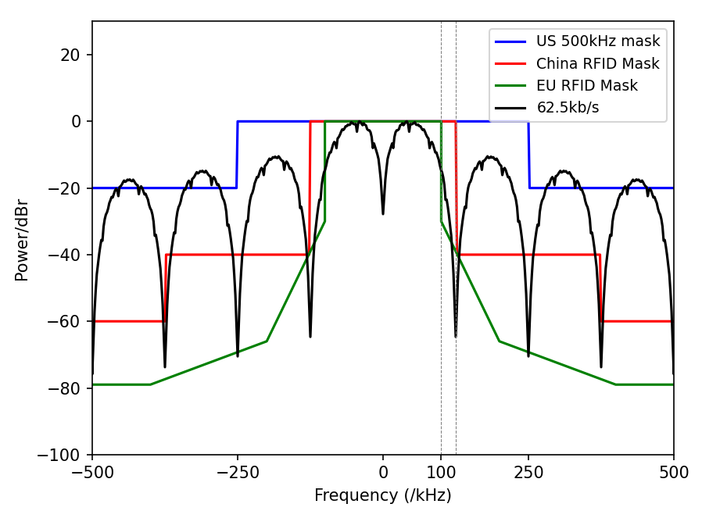
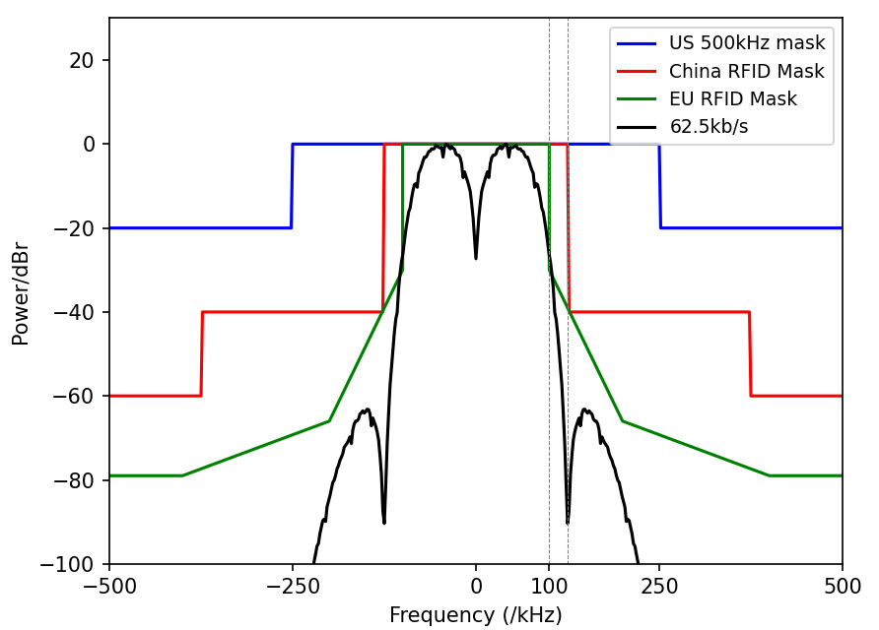
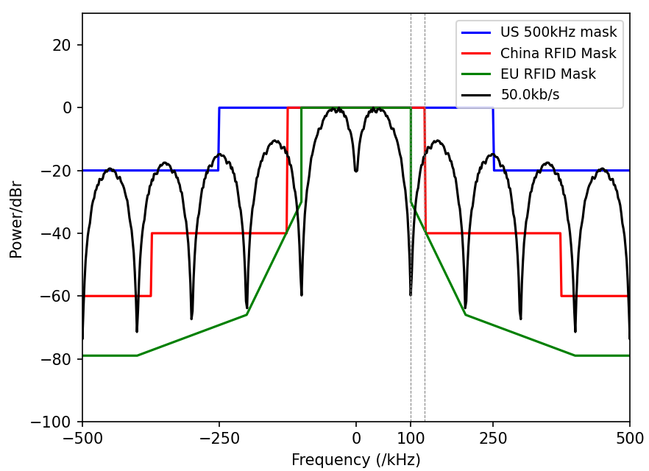
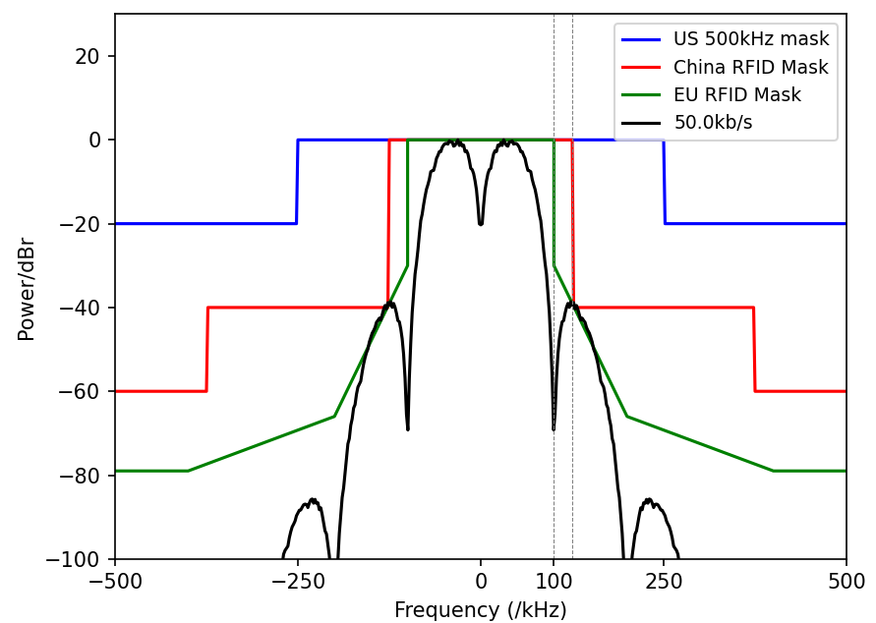
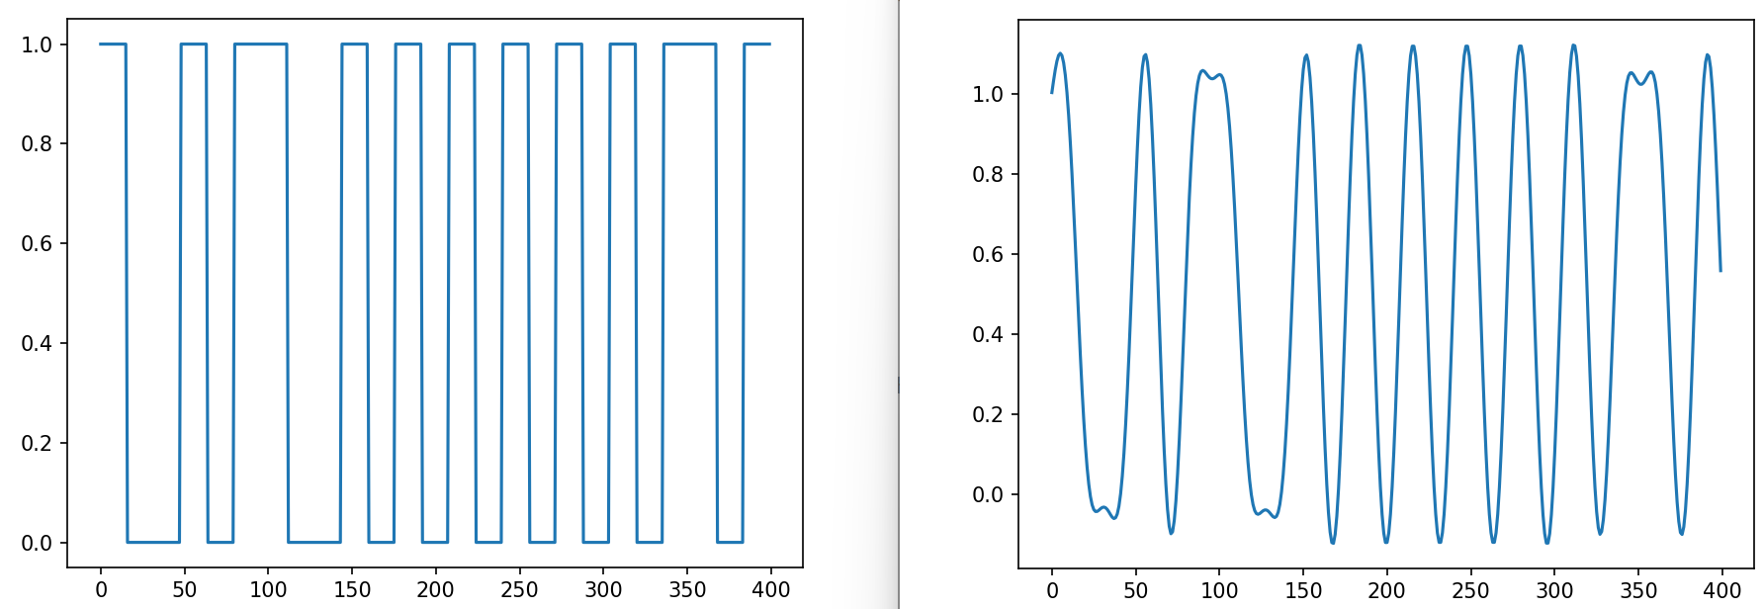
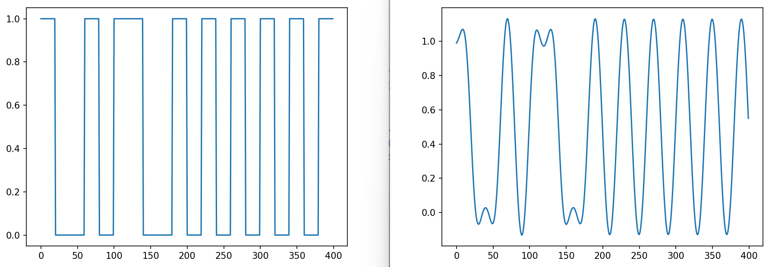
DL Data Rate: Consideration
In US, defining 250kHz BW makes 62.5kb/s feasible.
However, in EU, the maximum BW in 865-868 MHz is 200kHz, in which case, 50kb/s is the maximum allowed DL data rate.
We did some analysis to check how sharp the filter is needed to make 62.5 kb/s and 50kb/s to fit into the 200kHz mask.
62.5 kb/s
5 order Butterworth LPF, cut off rate=90kHz, Nyquist rate=1MHz
50 kb/s
4 order Butterworth LPF, cut off rate=90kHz, Nyquist rate=1MHz
62.5 kb/s
Without filter
50 kb/s
Without filter
PSD
Time-domain waveform

Slide 4
DL Data Rate: Proposal
It looks like similar complexity is needed to make 62.5 kb/s and 50 kb/s within the masks.
It should be possible to fit 62.5 kb/s into EU RFID mask with BW 200kHz.
AMP-S1G DL may converge to single unified data rate applicable to CN/EU/US:
  62.5kb/s

Slide 5
UL Data Rate: Consideration (1/2)
UHF RFID
  UHF RFID define DL data rate ranging 40-160 kb/s, and UL data rate ranging 40-640 kb/s. UHF RFID define transmit spectrum mask only for DL transmission, while ignoring UL transmission.
  China RFID certification applies to DL only. EU RFID regulation defines relaxed requirement for UL than DL [3].
AMP 2.4G backscatter supports two UL data rates, which are equal or higher than DL data rates.
AMP-S1G UL better define >= 2 data rates, which are equal or higher than DL (62.5 kb/s).

Slide 6
UL Data Rate: Consideration (2/2)
Max UL data rate consideration:
  [4]: AMP-S1G backscatter tag typically has similar capability as AMP 2.4G backscatter tag
    AMP-S1G tag Rx sampling rate: 2MHz
  Assume S1G backscatter tag have Tx sampling rate 2MHz, the maximum UL data rate supported is 1Mb/s.
Link Budget
  Backscatter signal RSSI at AP can be up to ~ -82 dBm
  Leakage after suppression : < -90 dBm
    Leakage before suppression : 10 dBm
    RF + digital suppression: >100dB
  AP noise: < -90dBm
    Thermal noise: -114dBm (1MHz), -111dBm (2MHz), -101 dBm (20MHz),
    Max 20dB noise figure
  AP Rx SINR @ ~10 dB

Slide 7
UL Data Rate: Simulation Assumptions
Parameter | UL
AP Tx sampling rate (MHz) | 20
AP Rx sampling rate (MHz) | 20
Receiver architecture | Envelope detector and Coherent detector
Data field size | 100 bits
Tx filter | NA
Rx filter | Case A: 20MHz filter Case B: narrow BW filter of B+5MHz, where B is the signal null-to-null BW
SNR | Average signal power divided by noise power in 20MHz
Other | Model interference and noise together as SNR

Slide 8
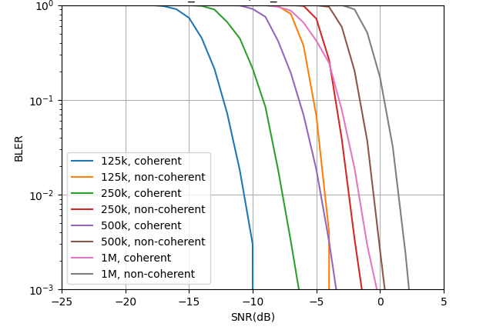
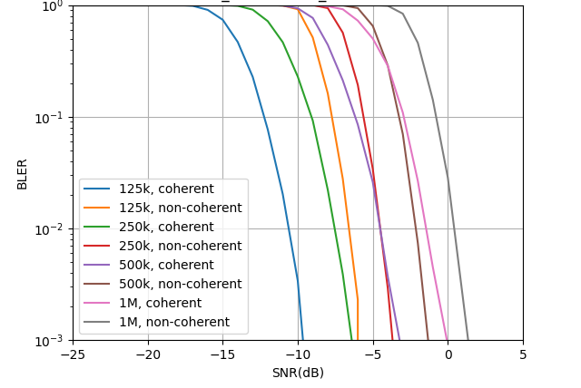
UL Data Rate: Simulation results
20MHz filter
Narrow BW filter
Part of results align with [6]
Part of results align with [7]

Slide 9
UL Data Rate: Proposal
According to simulation results
  Data rate 1Mb/s with 20MHz filter under non-coherent detector achieves 10% PER @ ~ 0 dB
  Date rates up to 1Mb/s are all feasible.
Suggest AMP-S1G UL support two data rates
  250 kb/s
  1 Mb/s
Above proposal makes AMP-S1G and 2.4G support same UL data rates, which may simplify implementation.

Slide 10
Summary
In this contribution, we propose AMP-S1G PHY for CN/EU/US support
  Single DL data rate: 62.5 kb/s
  Two UL data rates: 250 kb/s, 1 Mb/s

Slide 11
Reference
[1] 11-24-1322-09-00bp-tgbp-motion-dock
[2] Follow up on AMP-S1G PHY design
[3] ETSI EN 302 208 V3.4.1 (2023-12)
[4] 11-25-1225-00-00bp-initial-thought-on-amp-s1g-phy-design
[5] 11-25-0816-00-00bp-feasibility-study-of-mono-static-backscatter-in-sub-1-ghz
[6] 11-25-0798-00-00bp-amp-ook-simulation-methodology-and-baseline-results
[7] 11-25-1215-00-00bp-discussion-on-amp-active-transmission

Slide 12
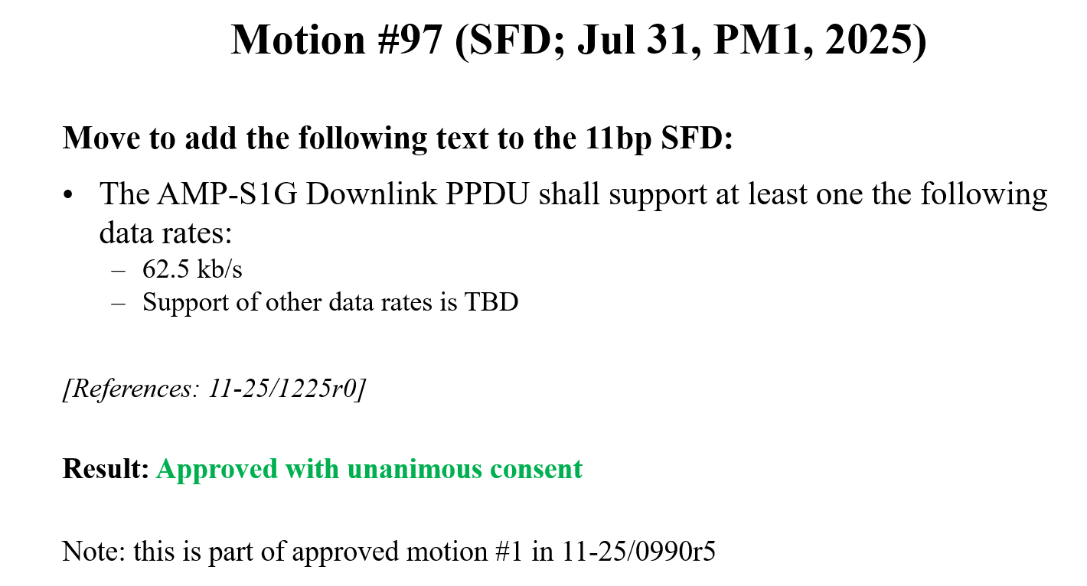
SP 1 (for SFD)
Do you agree to add the following text to TG bp SFD?
  The AMP-S1G Downlink PPDU shall support single data rate:
    62.5 kb/s
  Note: this motion is a revision of motion #97
  Yes
  No
  Abstain

Slide 13
SP 2 (for SFD)
Do you agree to add the following text to TG bp SFD?
  The AMP-S1G Uplink PPDU shall support the following data rates:
    250 kb/s
    1 Mb/s
  Yes
  No
  Abstain

