Slide 1
Follow up on AMP-S1G PHY design
Date: 2025-09-15
Authors:
Name | Affiliation | Address | Email
Panpan Li | Huawei | Singapore | lipanpan25@huawei.com
Lei Huang
Lumin Liu
Bin Qian |  | Shenzhen, China

Slide 2
Introduction
[1] propose to discuss the transmission BW and channelization for AMP-S1G based on RFID regulations.
  AMP-S1G channelization scheme for China is determined [2].
  However, the channelization schemes for EU/US are TBD.
11bp defines the AMP-S1G DL PPDU [2].
  However, whether including the 802.11 preamble (11ah preamble) in AMP-S1G DL PPDU is TBD.
This contribution is a follow up regarding following issues:
  802.11 preamble in AMP-S1G DL PPDU
  AMP-S1G channelization for EU
  AMP-S1G channelization for US

Slide 3
802.11 Preamble in AMP-S1G DL PPDU
After July meeting, we received various feedback from group regarding the coexistence with 11ah.
Due to spectrum availability and 11ah commercialization difference, different regions may have different coexistence requirement with 11ah.
Option 1: the existence of 11ah preamble to be region specific.
  China: 11ah is not applicable, so 11ah preamble is not needed.
  EU: 11ah is applicable, so transmit 11ah preamble
  US: 11ah is applicable, so transmit 11ah preamble
  Pros: better coex with 11ah
  Cons: limited number of AMP-S1G channels (because need to align the center frequency between AMP-S1G channels and 11ah channels)

Slide 4
802.11 Preamble in AMP-S1G DL PPDU
Option 2: exclude 11ah preamble for all regulation bodies
  Generating 11ah preamble is a heavy burden (11ah preamble is >600us OFDM symbols)
  AMP devices are likely operating with low duty cycles, thus the coexistence between 11ah and AMP devices may not be a big issue
  If we define less AMP channels, may cause less interference to 11ah (slide 9)
  In EU and US, part of 11ah channels will not be considered for AMP use, thus there is no coexistence issues in those channels
  In overlapping spectrum between 11ah channels and spectrum considered for AMP use, energy detection still can be used to achieve coexistence
  Pros: more AMP-S1G channels, simply implementation
  Cons: slightly higher collision probability in overlapping bands with 11ah

Slide 5
Recap: 11ah Channelization and UHF RFID spectrum for EU
863MHz
865MHz
868MHz
915.3MHz
916.4MHz
919.4MHz
920.9MHz
11ah 1MHz
11ah 2MHz
UHF RFID 200kHz
DL + UL
UL
UHF RFID 400kHz
Note 1: For EU, 200kHz in 865-868 MHz is a widely applicable BW, while 400kHz in 915-921 MHz is only applicable for several countries. In some countries parts of the upper band are allocated for the exclusive use of the military and government services.
Note 2: the 15 channels with 200kHz BW 865-868 MHz, only 4 of them are allowed for DL transmissions and 14 of them are allowed for UL transmissions. Similarly, in the 14 channels with 400kHz BW in 915-921MHz, only 4 channels are allowed for DL.

Slide 6
AMP-S1G Channelization for EU: Proposal
Option | Option 1 | Option 2
Motivation | AMP PPDU doesn’t include 11ah preamble Define max number of channels according to UHF RFID regulations | If 11ah preamble is needed Better align the centre frequencies between AMP-S1G channels and 11ah 1MHz channels.
Bands | 865-868MHz, 915.3-920.9MHz | 865-868MHz, 915.3-920.9MHz
BW | 200kHz, 400kHz | 200kHz, 400kHz
Centre frequency | 865.1+N*0.2, N=0,…,14; 915.5+N*0.4, N=0,…,13; | 865.5+N*0.2, N=0, 1, 2; 915.5, 915.9, 916.9, 917.9, 918.9, 919.9, 920.3, 920.7MHz
Number of channels | 15+14 | 3+8
Feature | Pros: more AMP-S1G channels Cons: slightly higher collision probability | Pros: better coex with 11ah Cons: Limited number of AMP-S1G channels, only 2 of which are allowed for DL transmission
We prefer Option 1

Slide 7
AMP-S1G Channelization for EU: Proposal
863MHz
865MHz
868MHz
915.3MHz
916.4MHz
919.4MHz
920.9MHz
11ah 1MHz
11ah 2MHz
UHF RFID 200kHz
DL + UL
UL
UHF RFID 400kHz
AMP-S1G
Option 1
AMP-S1G
Option 2

Slide 8
Recap: 11ah Channelization and UHF RFID spectrum for US
902MHz
904MHz
928MHz
11ah 1MHz
1
1
2
2
2
2
2
2
2
2
2
2
2
2
2
2
2
2
1
1
1
1
1
1
1
1
1: Type 1 channels
1
2
2
2
2
2
2
2
2
1
1
1
1
2: Type 2 channels
11ah 2MHz
1
1
1
1
1
1
1
1
1
1
1
1
type 2 channel CCA levels (i.e., thresholds) are defined to be higher than type 1 channel CCA levels.
11ah 4MHz
1
2
2
2
2
1
1
1
1
1
1
1
11ah 8MHz
2
2
1
1
1
1
11ah 16MHz
2
1

Slide 9
AMP-S1G Channelization for US
According to US S1G Regulation: FCC 15.247 [7]: 902-928Mhz
  Frequency hopping (FH) systems shall have,
    From 15.247 (a)(1)(i) The maximum allowed 20 dB bandwidth of the hopping channel is 500 kHz
    From 15.247 (b)(2) The max output power shall be 1 watt for systems with at least 50 hopping channels. Otherwise .25 watts
  Digital modulation techniques shall have,
    From 15.247 (a)(2) The minimum 6 dB bandwidth shall be at least 500 kHz
    From 15.247 (b)(3) The max output power shall be 1 watt
FH is commonly adopted by existing RFID devices.
Suggest AMP-S1G in US fall in FH range.
Suggest Max channel BW for US is 250kHz: align with China, data rate will also be aligned.

Slide 10
AMP-S1G Channelization for US: Proposal
Option | Option 1 | Option 2 | Option 3
Motivation | AMP PPDU doesn’t include 11ah preamble, define maximum number of channels according to regulations | If 11ah preamble is needed, better align the centre frequencies between AMP-S1G channels and 11ah 1MHz channels. | Define part of the spectrum Make sure >=50 AMP channels
Bands | 902-928MHz | 902-928MHz | 902-916MHz
BW | 250kHz | 250kHz | 250kHz
Centre frequency | 902.125+N*0.25, N=0,…,103 | 902.5+N, N=0,…,25 | 902.125+N, N=0,…,55
Number of channels | 104 | 26 | 56
Feature | Pros: more AMP-S1G channels Cons: slightly higher collision probability | Pros: better coex with 11ah Cons: Limited number of AMP-S1G channels | define >50 AMP-S1G channels (to achieve max output power) Leave 11ah three 4MHz channels
We prefer Option 3

Slide 11
AMP-S1G Channelization for US: Proposal
902MHz
928MHz
11ah 1MHz
11ah 2MHz
11ah 4MHz
11ah 8MHz
11ah 16MHz
AMP option 1
AMP option 2
AMP option 3

Slide 12
Summary
This contribution discussed the 802.11 preamble in AMP-S1G DL PPDU and the AMP-S1G channelization scheme for EU/US:
11ah preamble
  the existence of 11ah preamble to be region specific
  exclude 11ah preamble for all regulation bodies (prefer)
Channelization
  EU
    BW: 200 kHz, 400kHz
    Number of channels:
      15+14 (option 1 in slide 7, prefer)
      3+8 (option 2 in slide 7)
  US
    BW: 250 kHz
    Spectrum:
      Whole 26 MHz
      Subset of available spectrum (prefer)

Slide 13
Reference
[1] 11-24-1322-09-00bp-tgbp-motion-dock
[2] 11-25-1224-00-00bp-initial-thought-on-amp-s1g-channelization
[3] 11-25-1225-00-00bp-initial-thought-on-amp-s1g-phy-design

Slide 14
SP 1 (for SFD)
Do you agree to add the following text to TG bp SFD?
  1bp shall adopt the following channelization scheme for EU:
    Bands: 865-868MHz, 915.3-920.9MHz
    BW: 200kHz, 400kHz
    Channel center frequency: 865.1+N*0.2, N=0,…,14; 915.5+N*0.4, N=0,…,13;
  Yes
  No
  Abstain

Slide 15
SP 2 (information collection)
Which option do you prefer as AMP-S1G channelization scheme for US?
  Option 1: full set of channels as regulation allow
    Bands: 902-928MHz
    BW: 250kHz
    Chanel centre frequency: 902.125+N*0.25, N=0,…,103
  Option 2: align centre frequency with 11ah 1MHz channels
    Bands: 902-928MHz
    BW: 250kHz
    Chanel centre frequency: 902.5+N, N=0,…,25
  Option 3: first 14MHz of the full set of channels
    Bands: 902-916MHz
    BW: 250kHz
    Chanel centre frequency: 902.125+N, N=0,…,55

Slide 16
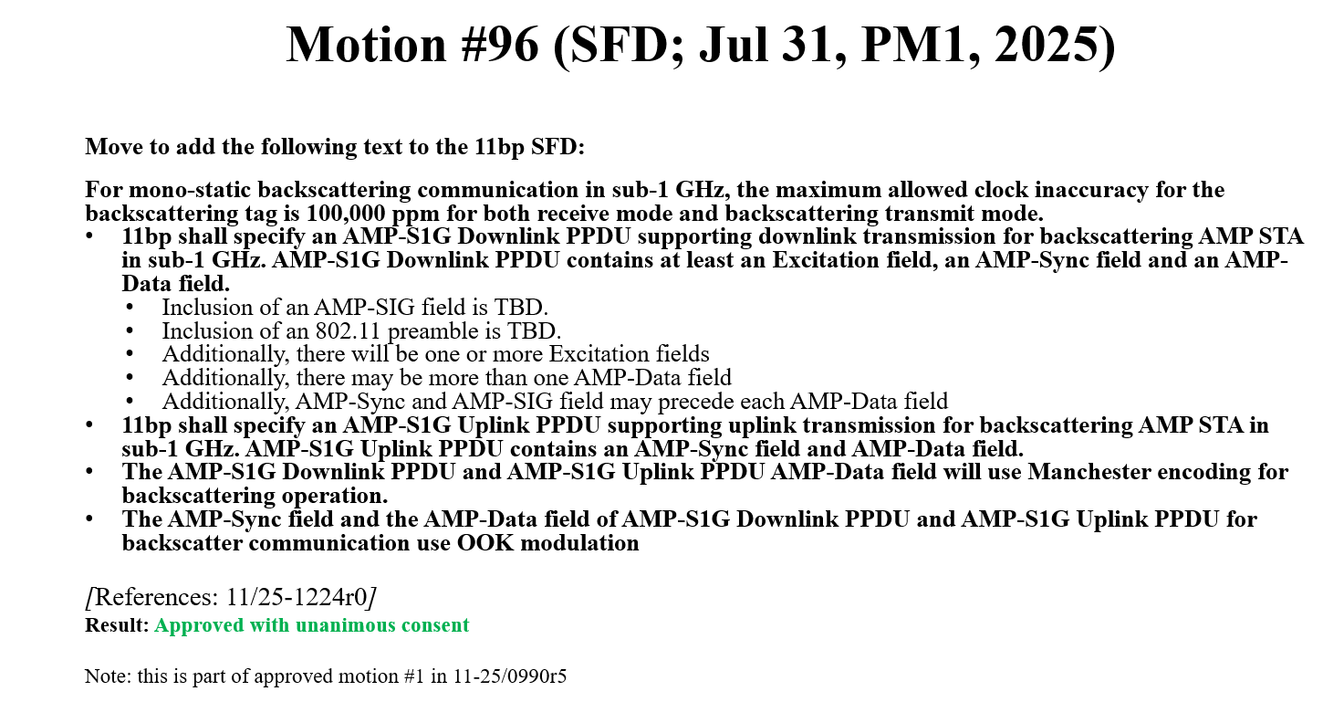
SP 3 (information collection)
Do you agree to add the following text to TG bp SFD?
  AMP-S1G Downlink PPDU doesn’t include the 802.11 preamble.
  Yes
  No
  Abstain

