Slide 1
Sync Design for AMP Backscatter Uplink Transmission
Sep. 2025
Date: 2025-09-12
Authors:
Name | Affiliations | Address | Phone | Email
Lumin Liu | Huawei | Singapore |  | liulumin1@h-partners.com
Bin Qian |  | Shenzhen, China
Lei Huang |  | Singapore
Panpan Li |  | Singapore
Notes:
September 2012

Slide 2
Introduction
Sep. 2025
In backscattering UL, AMP backscatter STAs modulate the excitation signal from AMP AP.
The clock error can be up to 100k ppm, which leads to ~10% chip duration difference.
Sync field for backscatter UL needs to indicate the start of the UL PPDU and is used to estimate the clock error.
The purpose of this contribution is to discuss
Baseline data PER performance for UL backscattering with up to 100k ppm clock error.
Sync sequence design, sync simulations and PPM estimation with up to 100k ppm clock error.

Slide 3
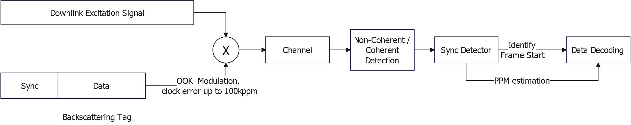
UL Backscattering Simulation Diagram
Sep. 2025
Block diagram
Settings
Scenario | 2.4G UL backscatter
Data rate | 250 kbps, 1 Mbps
Base waveforms | Square Pulse and OFDM with L-LTF
Detector | Non-coherent
Timing assumption | Ideal timing/ Per-bit Retiming
Channel | AWGN
Clock offset | -100k ppm ~ 100k ppm
Payload size | 100 bits

Slide 4
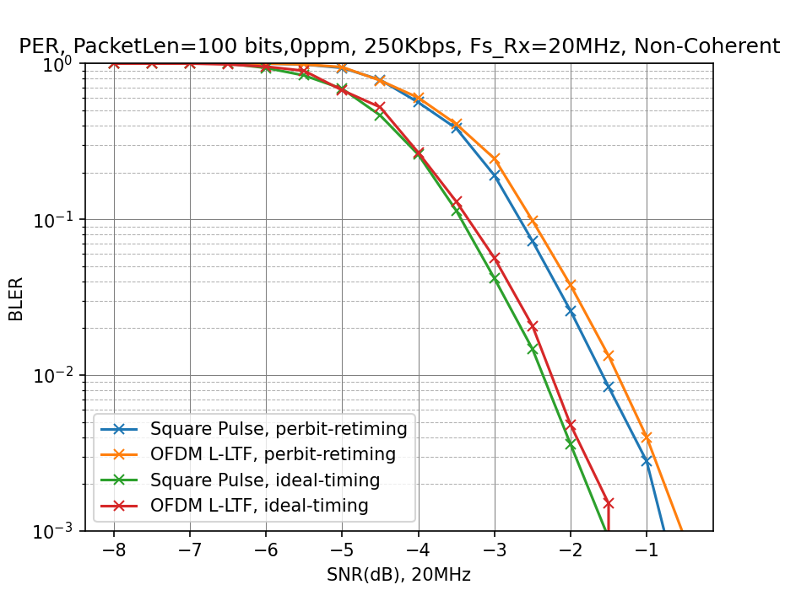
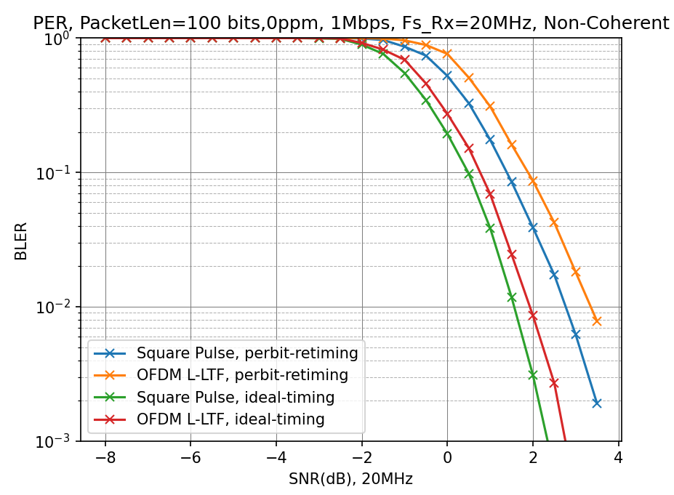
Data PER Baseline
Sep. 2025
0 ppm PER baseline, 10k trials.

Slide 5
Data PER Baseline
Sep. 2025
Ideal clock accuracy: 0 ppm
Simulation results are aligned with [1], [2].
waveform | platform | 250kbps, non-coherent |  | 1Mbps, non-coherent
 |  | Ideal Timing (10% PER) | non-Ideal Timing (10% PER) | Ideal Timing (10% PER) | non-Ideal Timing (10% PER)
Pulse | [1] | -3.50 | -2.60 | 0.30 | 1.40
 | [2] | -3.47 | -2.91 | 0.34 | 1.32
 | Ours | -3.44 | -2.9 (subject to timing algorithm) | 0.41 | 1.39 (subject to timing algorithm)
OFDM | [1] | -3.40 | -2.40 | 0.70 | 2.10
 | [2] | -3.32 | -2.84 | 0.73 | 2.04
 | Ours | -3.34 | -2.74 (subject to timing algorithm) | 0.73 | 1.89 (subject to timing algorithm)

Slide 6
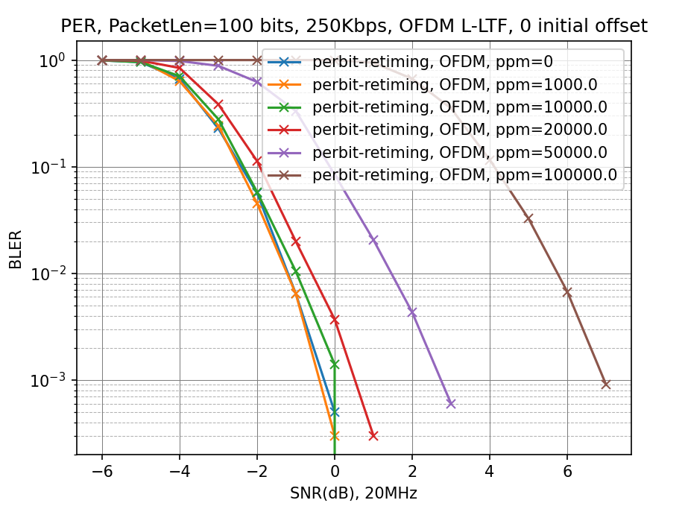
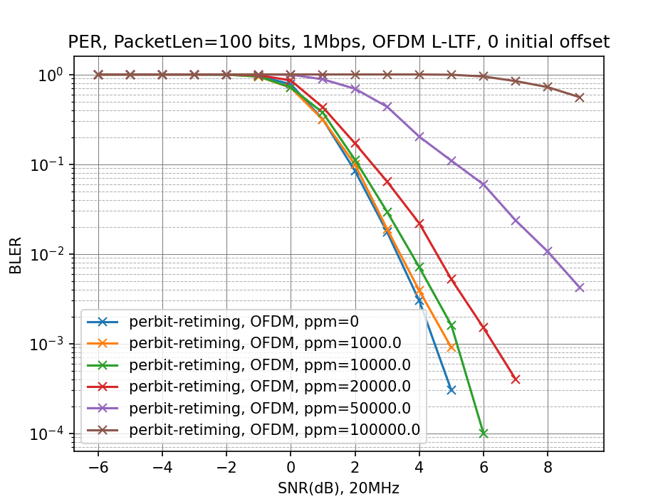
Data PER Baseline
Sep. 2025
Practical clock accuracy: up to 100k ppm
For clock error within 10k ppm, the PER performance is quite close to ideal clock.
For clock error up to 20k ppm, the PER performance is less than 1 dB worse.
For clock error up to 50k ppm and 100k ppm, the PER performance is degraded evidently.
PPM estimation needs to reduces the clock error within 20k ppm.
Similar conclusions are demonstrated in [3].

Slide 7
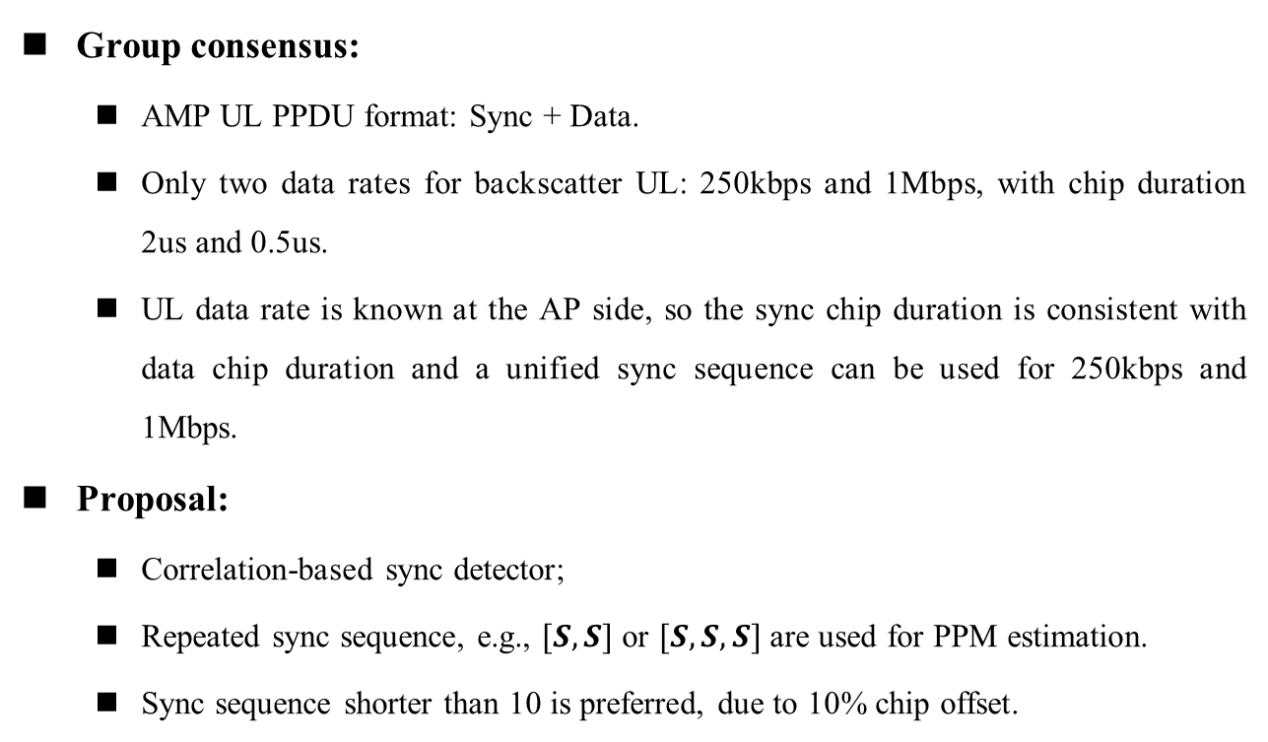
UL Sync Design
Sep. 2025
Group consensus:
AMP UL PPDU format: Sync + Data.
Only two data rates for backscatter UL: 250kbps and 1Mbps, with chip duration 2us and 0.5us.
UL data rate is known at the AP side, so the sync chip duration is consistent with data chip duration and a unified sync sequence can be used for 250kbps and 1Mbps.
Proposal:
Correlation-based sync detector;
Repeated sync sequence, e.g., $[S, S]$ or $[S, S, S]$ are used for PPM estimation.
Sync sequence shorter than 10 is preferred, due to 10% chip offset.

Slide 8
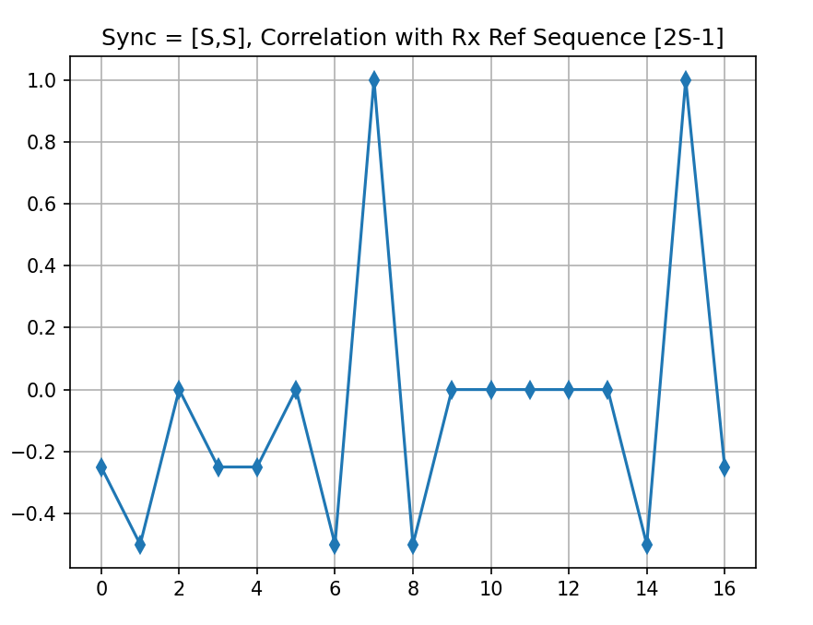
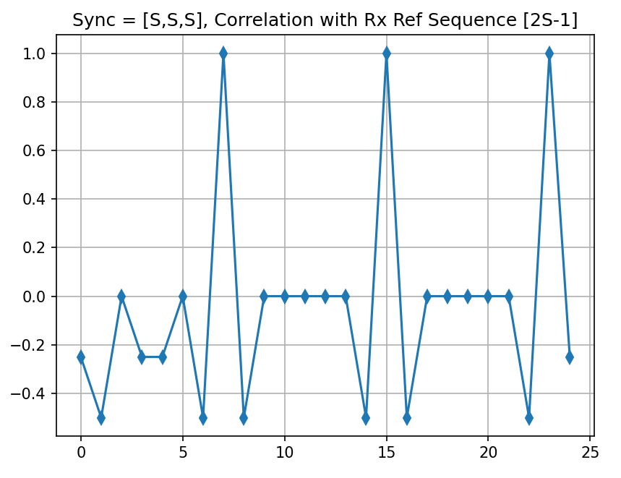
Sync Sequence Proposal
Sep. 2025
Proposed base sequence
S = [1, 1, 0, 1, 0, 1, 0, 0]
Good auto correlation property
Only negative sidelobe before peaks
Slope: 1.5
Slope: 1.5

Slide 9
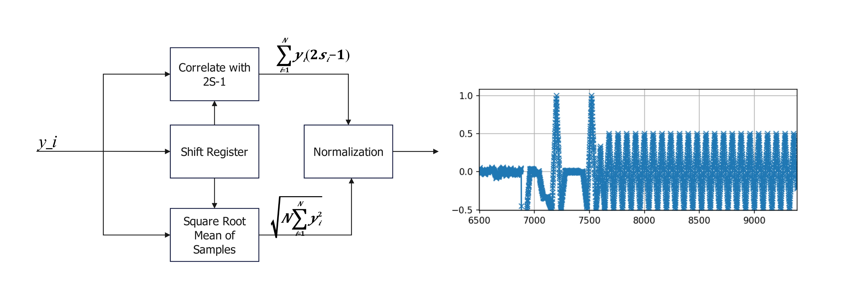
Sync Detection
Sep. 2025
Normalized correlation sync detector is used.
When the sync detector detects a value larger than the threshold:
Find the peak value in the following 1 chip, mark it as peak1.
Find the peak value which is within 7-chip to 9-chip duration, mark it as peak2.
If (peak1+peak2)/2 > threshold, the detector detects the sync.
The data decoding starts at peak2_idx + (peak2_idx-peak1_idx).

Slide 10
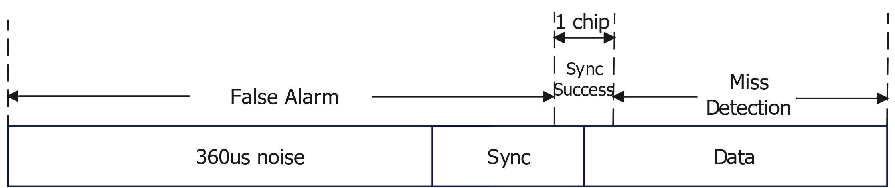
Sync Detection
Sep. 2025
To simulate the delayed response in backscatter UL, 360us noise is assumed before the UL PPDU.
Definition of false alarm, successful sync and miss detection:
False alarm: detected_sync_location – true_sync_location < -0.5* chip_duration
Sync success: -0.5*chip_duration< detected_sync_location – true_sync_location <0.5*chip_duration
Miss detection: detected_sync_location – true_sync_location <0.5*chip_duration

Slide 11
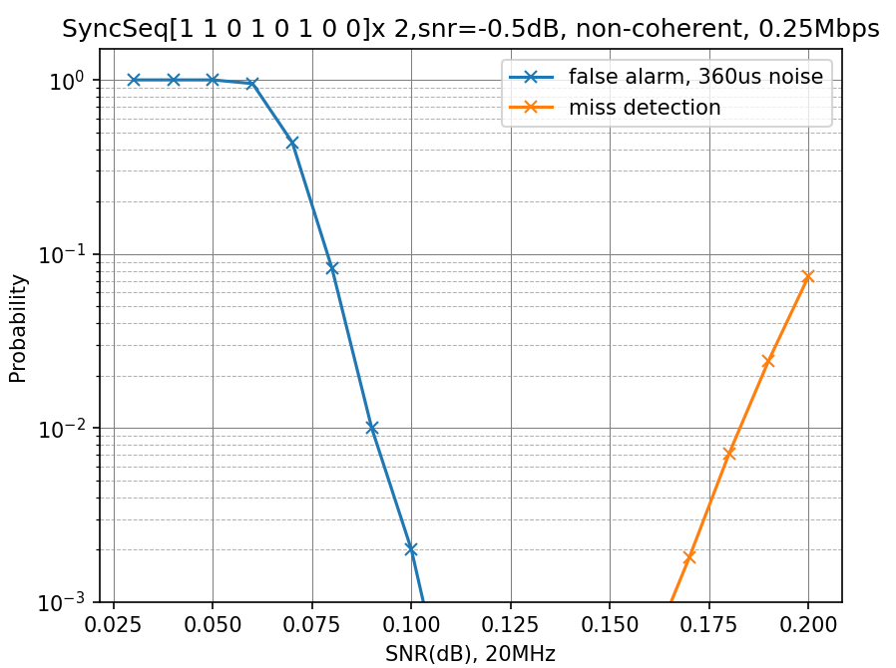
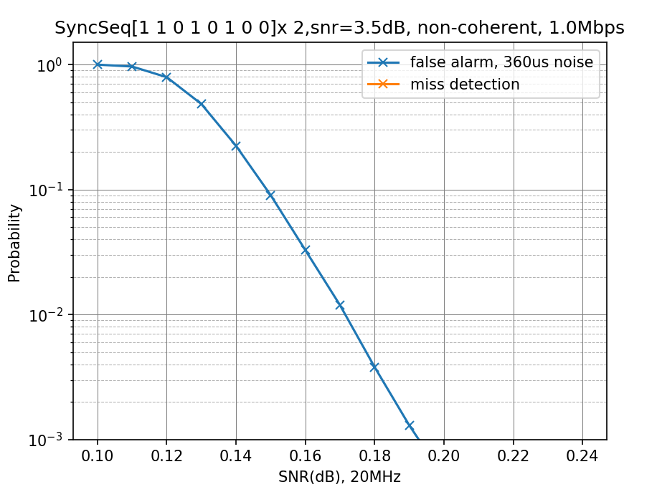
Detecting Threshold
Sep. 2025
Two repetitions, [S, S] (10k trials, 0 ppm) :
Detecting threshold is obtained with 1% false alarm rate.
0.09
0.171
0.09
Threshold
Threshold

Slide 12
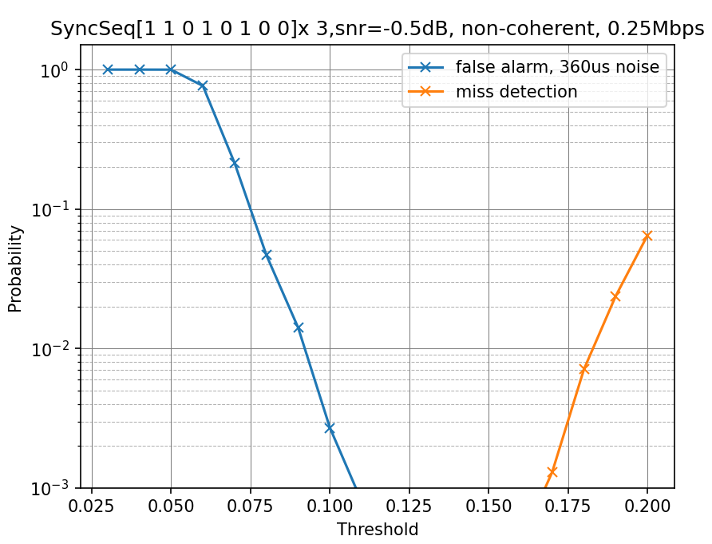
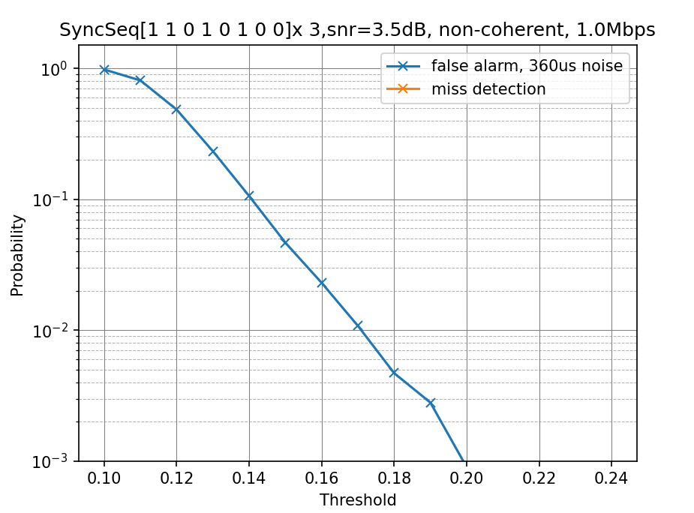
Detecting Threshold
Sep. 2025
Three repetitions, [S, S, S] (10k trials, 0 ppm) :
Detecting threshold is obtained with 1% false alarm rate.
0.092
0.171

Slide 13
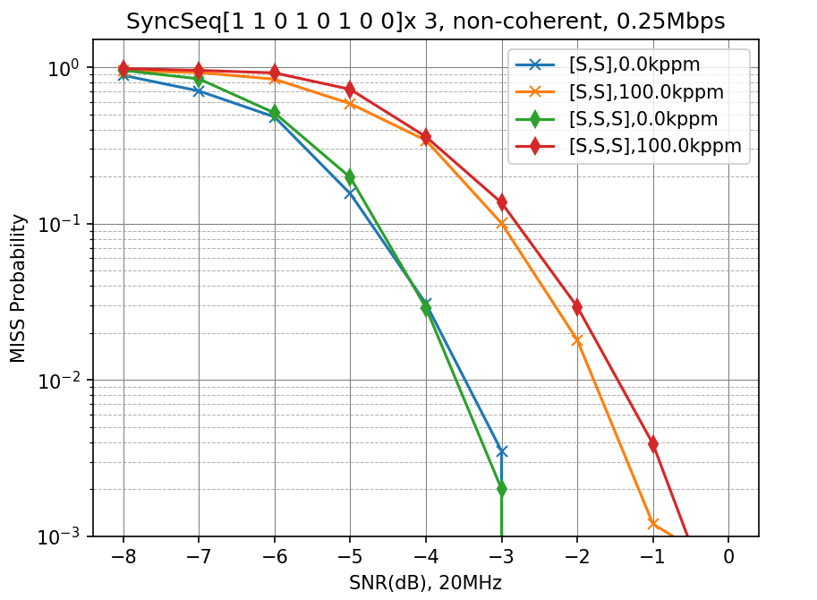
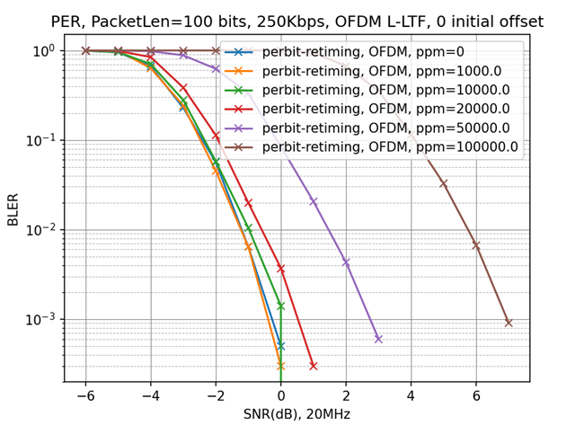
Sync Performance
Sep. 2025
250Kbps
2 repetitions and 3 repetitions provide similar sync detection performance.

Slide 14
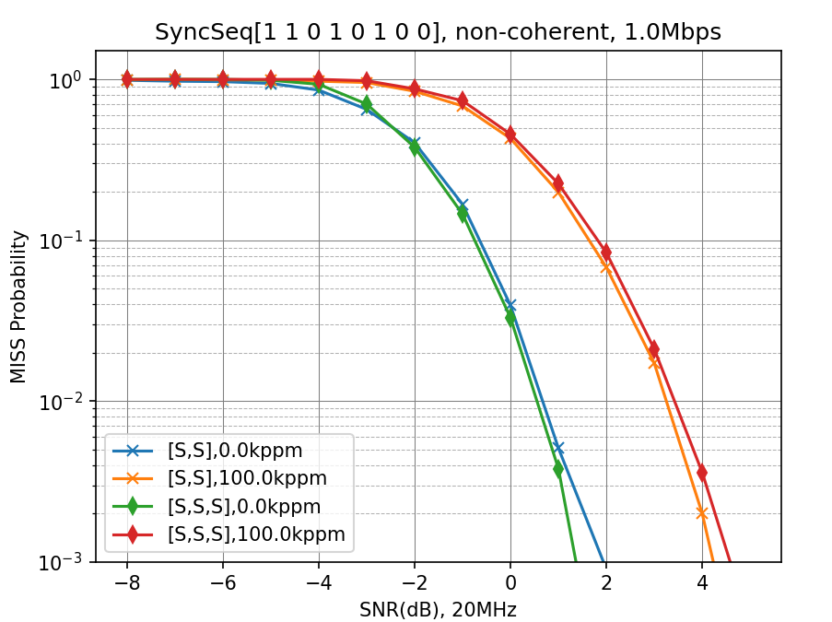
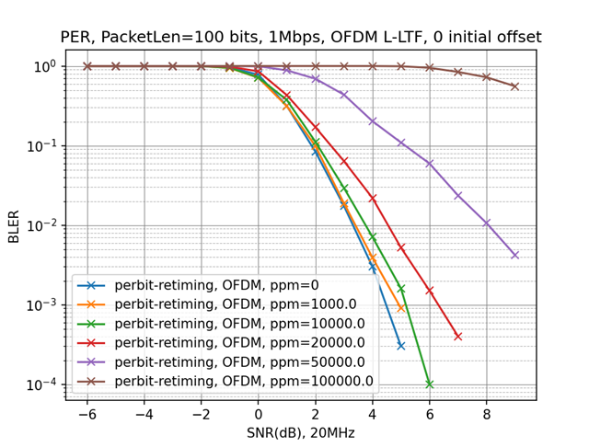
Sync Performance
Sep. 2025
1Mbps
2 repetitions and 3 repetitions provide similar sync detection performance.

Slide 15
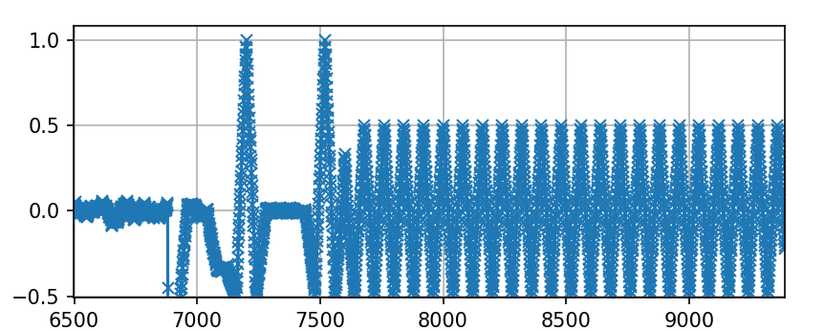

PPM Estimation
Sep. 2025
Large clock error leads to evident decoding performance loss, thus PPM estimation is needed at the AP side to calibrate the decoding algorithm.
PPM estimation is based on the relative peak intervals during sync detection.
Example: 250Kbps, Fs_Rx=20MHz, Sync = [S, S]
$$Estimated PPM=\left(\frac{320}{peak2 idx−peak1 idx}−1\right)∗1e6$$
peak1_idx
peak2_idx

Slide 16
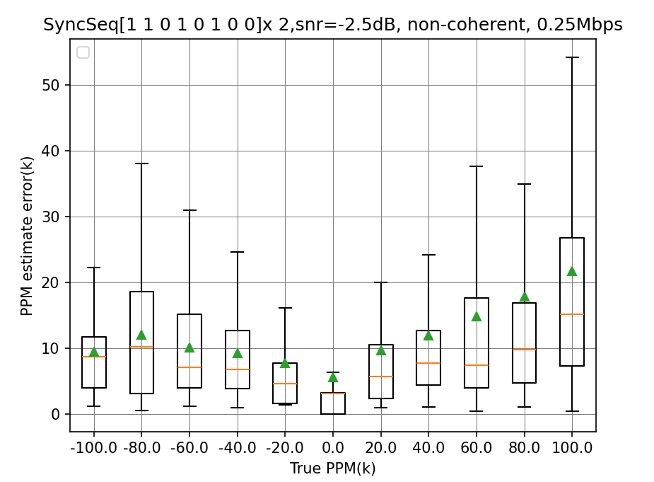
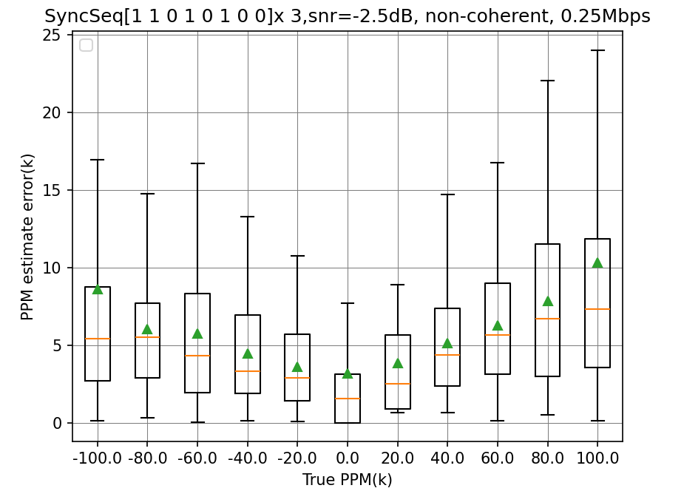
PPM Estimation
Sep. 2025
250Kbps, [S, S] and [S, S, S], PPM estimation at 10% PER SNR:
Green triangle dot represents the mean values of the absolute ppm estimation error.
Orange line represents the median values of the absolute ppm estimation error
With 3 repetitions, the mean estimation error can be reduced within 10k ppm.
Maximum
Upper quartile
Lower quartile
Minimum

Slide 17
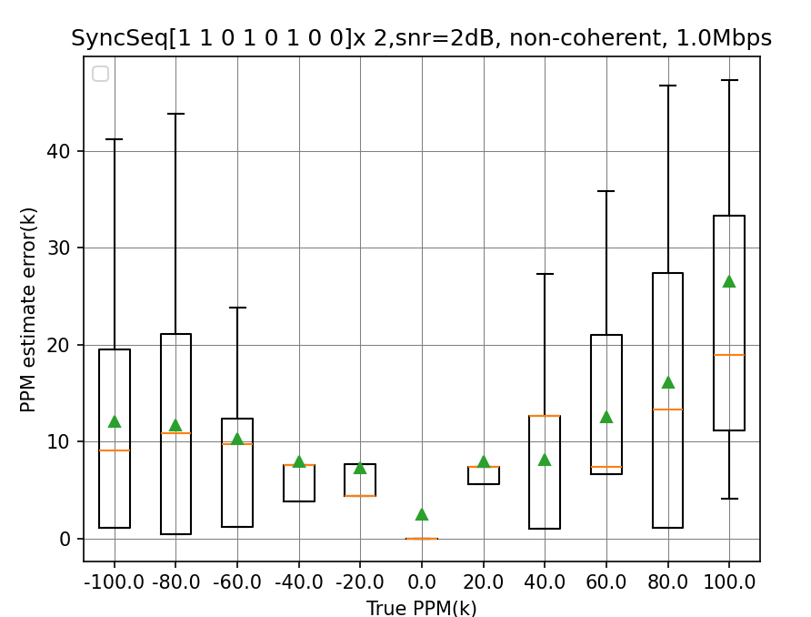
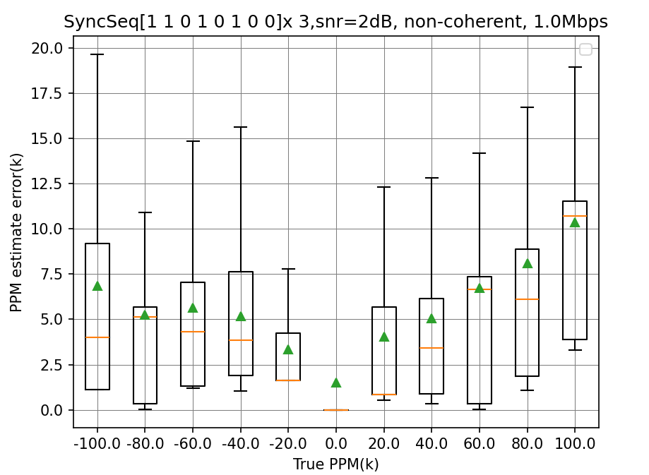
PPM Estimation
Sep. 2025
1Mbps, [S, S] and [S, S, S], PPM estimation at 10% PER SNR :
Green triangle dot represents the mean values of the absolute ppm estimation error.
Orange line represents the median values of the absolute ppm estimation error
With 3 repetitions, the estimation error can be reduced to 20k ppm.
Maximum
Upper quartile
Lower quartile
Minimum

Slide 18
AMP S1G Backscatter UL Sync
Sep. 2025
Suggest AMP S1G UL sync sequence same as AMP 2.4G UL sync for backscatter:
S1G and 2.4G have similar tag capabilities and the same clock requirement, the previous discussions in 2.4G still hold in S1G.
Suggest AMP S1G sync chip duration same as S1G data chip duration:
S1G backscatter UL data rate is TBD.
UL data rate is indicated by DL, which is known at AP side.
To reduce tag complexity, sync chip duration shall be same as data chip duration.

Slide 19
Summary
Sep. 2025
AMP 2.4G Backscatter UL Sync: repeated structure
Length 8 base sequence: [1 1 0 1 0 1 0 0].
3 repetitions are needed to provide reliable PPM estimation.
Clock error needs to be smaller than 20k ppm after PPM estimation.
The sequence can be adopted for both 2.4G and S1G.

Slide 20
References
Sep. 2025
[1] 11-25-0798-00-00bp-amp-ook-simulation-methodology-and-baseline-results
[2] 11-25-1223-00-00bp-sync-field-design-discussion
[3] 11-25-1231-01-00bp-backscattering-ul-sync-design-considerations

Slide 21
Straw Poll #1
Sep. 2025
Do you agree to add following content to TGbp SFD:
AMP Sync field for uplink backscattering transmission has a structure of [S, S, S] for both 2.4GHz and sub-1GHz.
S = [1 1 0 1 0 1 0 0].

Slide 22
Straw Poll #2
Sep. 2025
Do you agree to add following content to TGbp SFD:
The same chip duration shall be used for AMP backscattering uplink Sync field and AMP backscattering uplink data field in sub-1GHz.

Slide 23
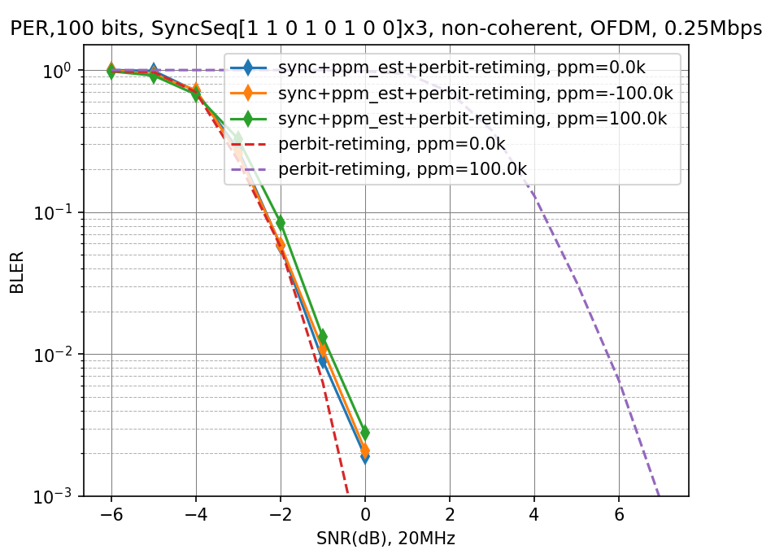
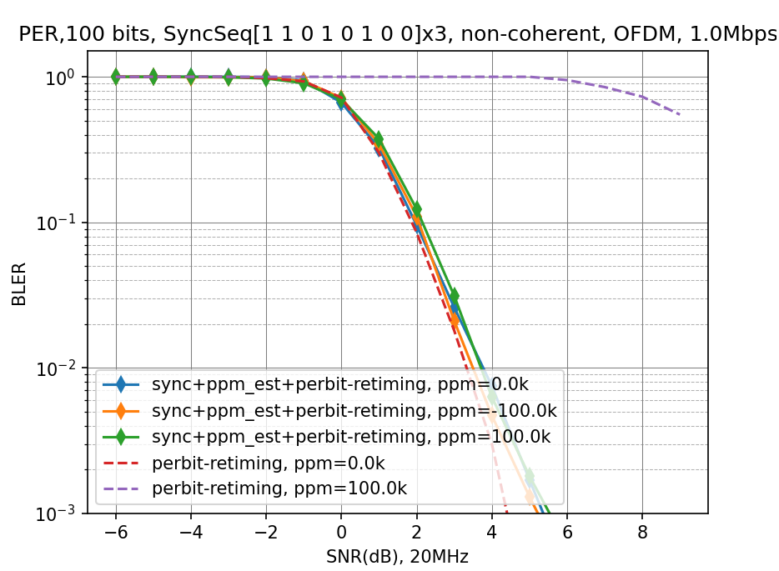
Appendix
Sep. 2025
Joint sync and data detection performance V.S. PER baseline
250Kbps & 1Mbps, three repetitions

