Slide 1
AMP Downlink Sync Field Proposal for Transmission to Non-Backscatter STAs
Date: 2025-09-15
Authors:
Name | Affiliations | email
Steve Shellhammer | Qualcomm | shellhammer@ieee.org
Bin Tian |  | btian@qti.qualcomm.com
Pooria Pakrooh |  | ppakrooh@qti.qualcomm.com
Manideep Dunna |  | mdunna@qti.qualcomm.com
Alice Chen |  | alicel@qti.qualcomm.com

Slide 2
Background
In [1] we described several Sync Sequences for the Downlink transmission to non-Backscatter STAs
We provided Length-24 and Length-32 sequences
These sequences support both the Correlation-based Sync Field detector and the Differential Decoder Sync Field detector

Slide 3
Introduction
Here we study the False Alarm rate for the Differential Decoder Sync Field detector, with Noise-Only input
We study both Length-24 and Length-32 sequences
We provide a summary of Margin for the Correlation-based Sync Field Detector
Plots from [1] are provided in the Backup Slides
We recommend the proposed sequence

Slide 4
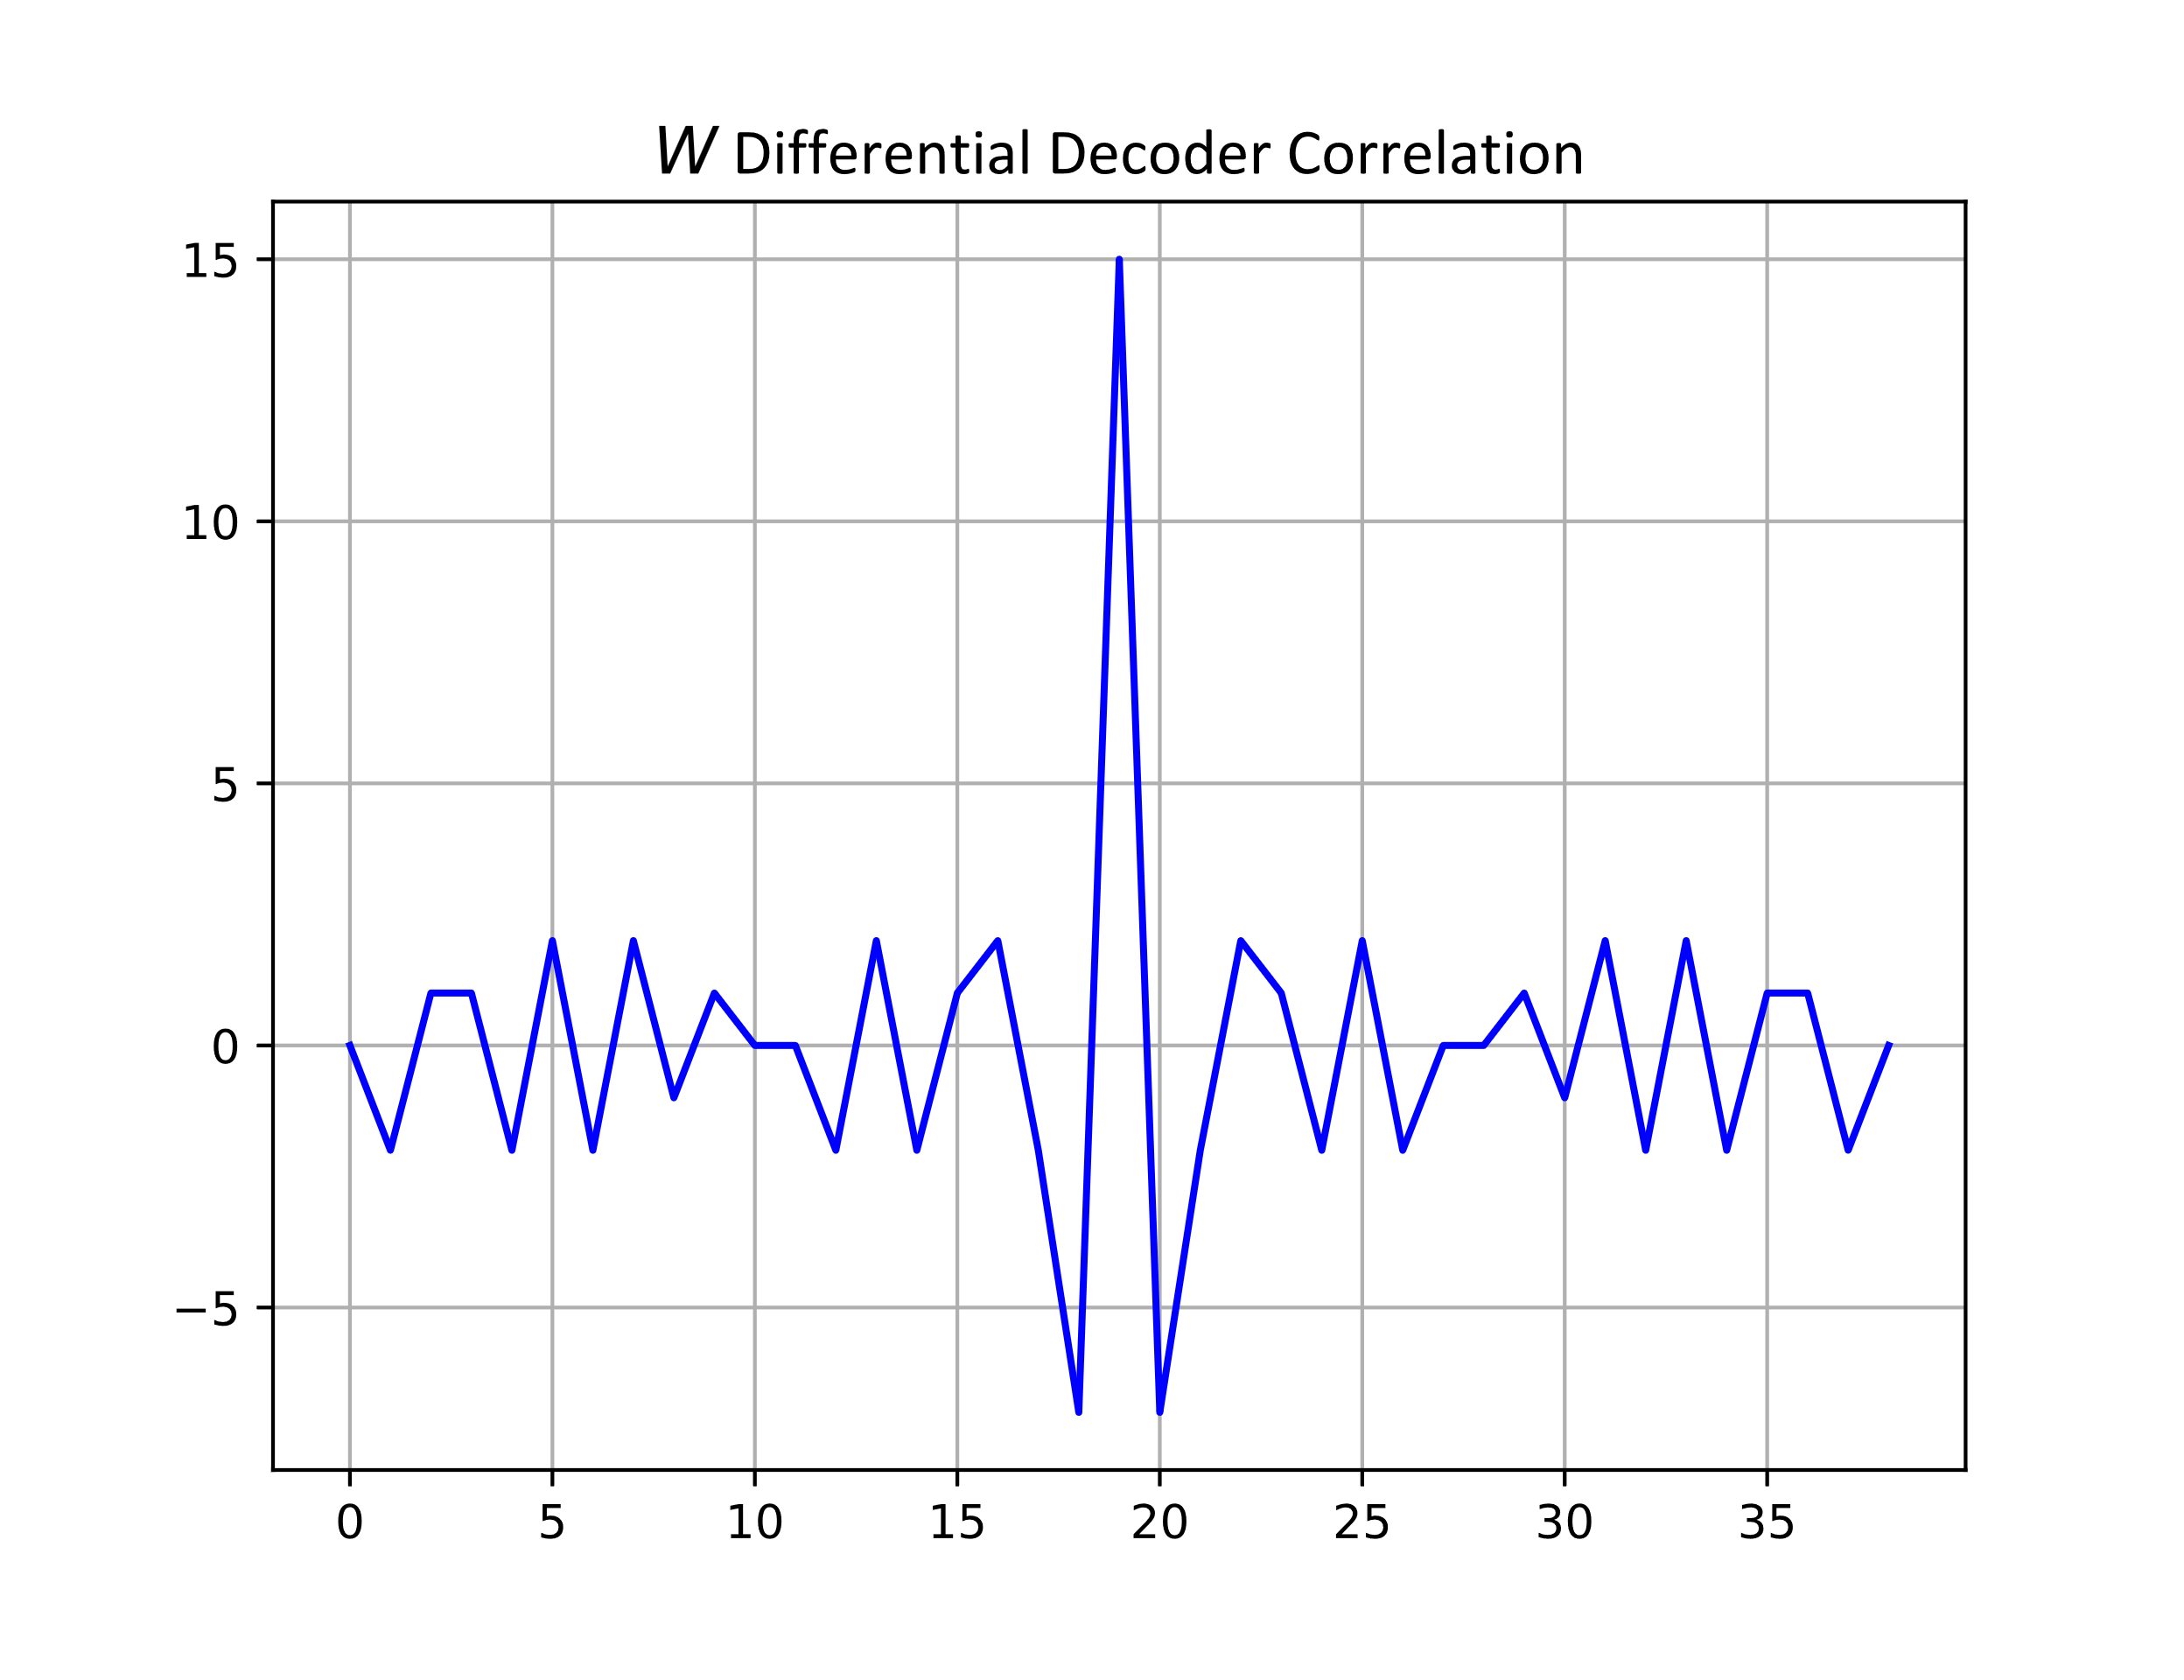
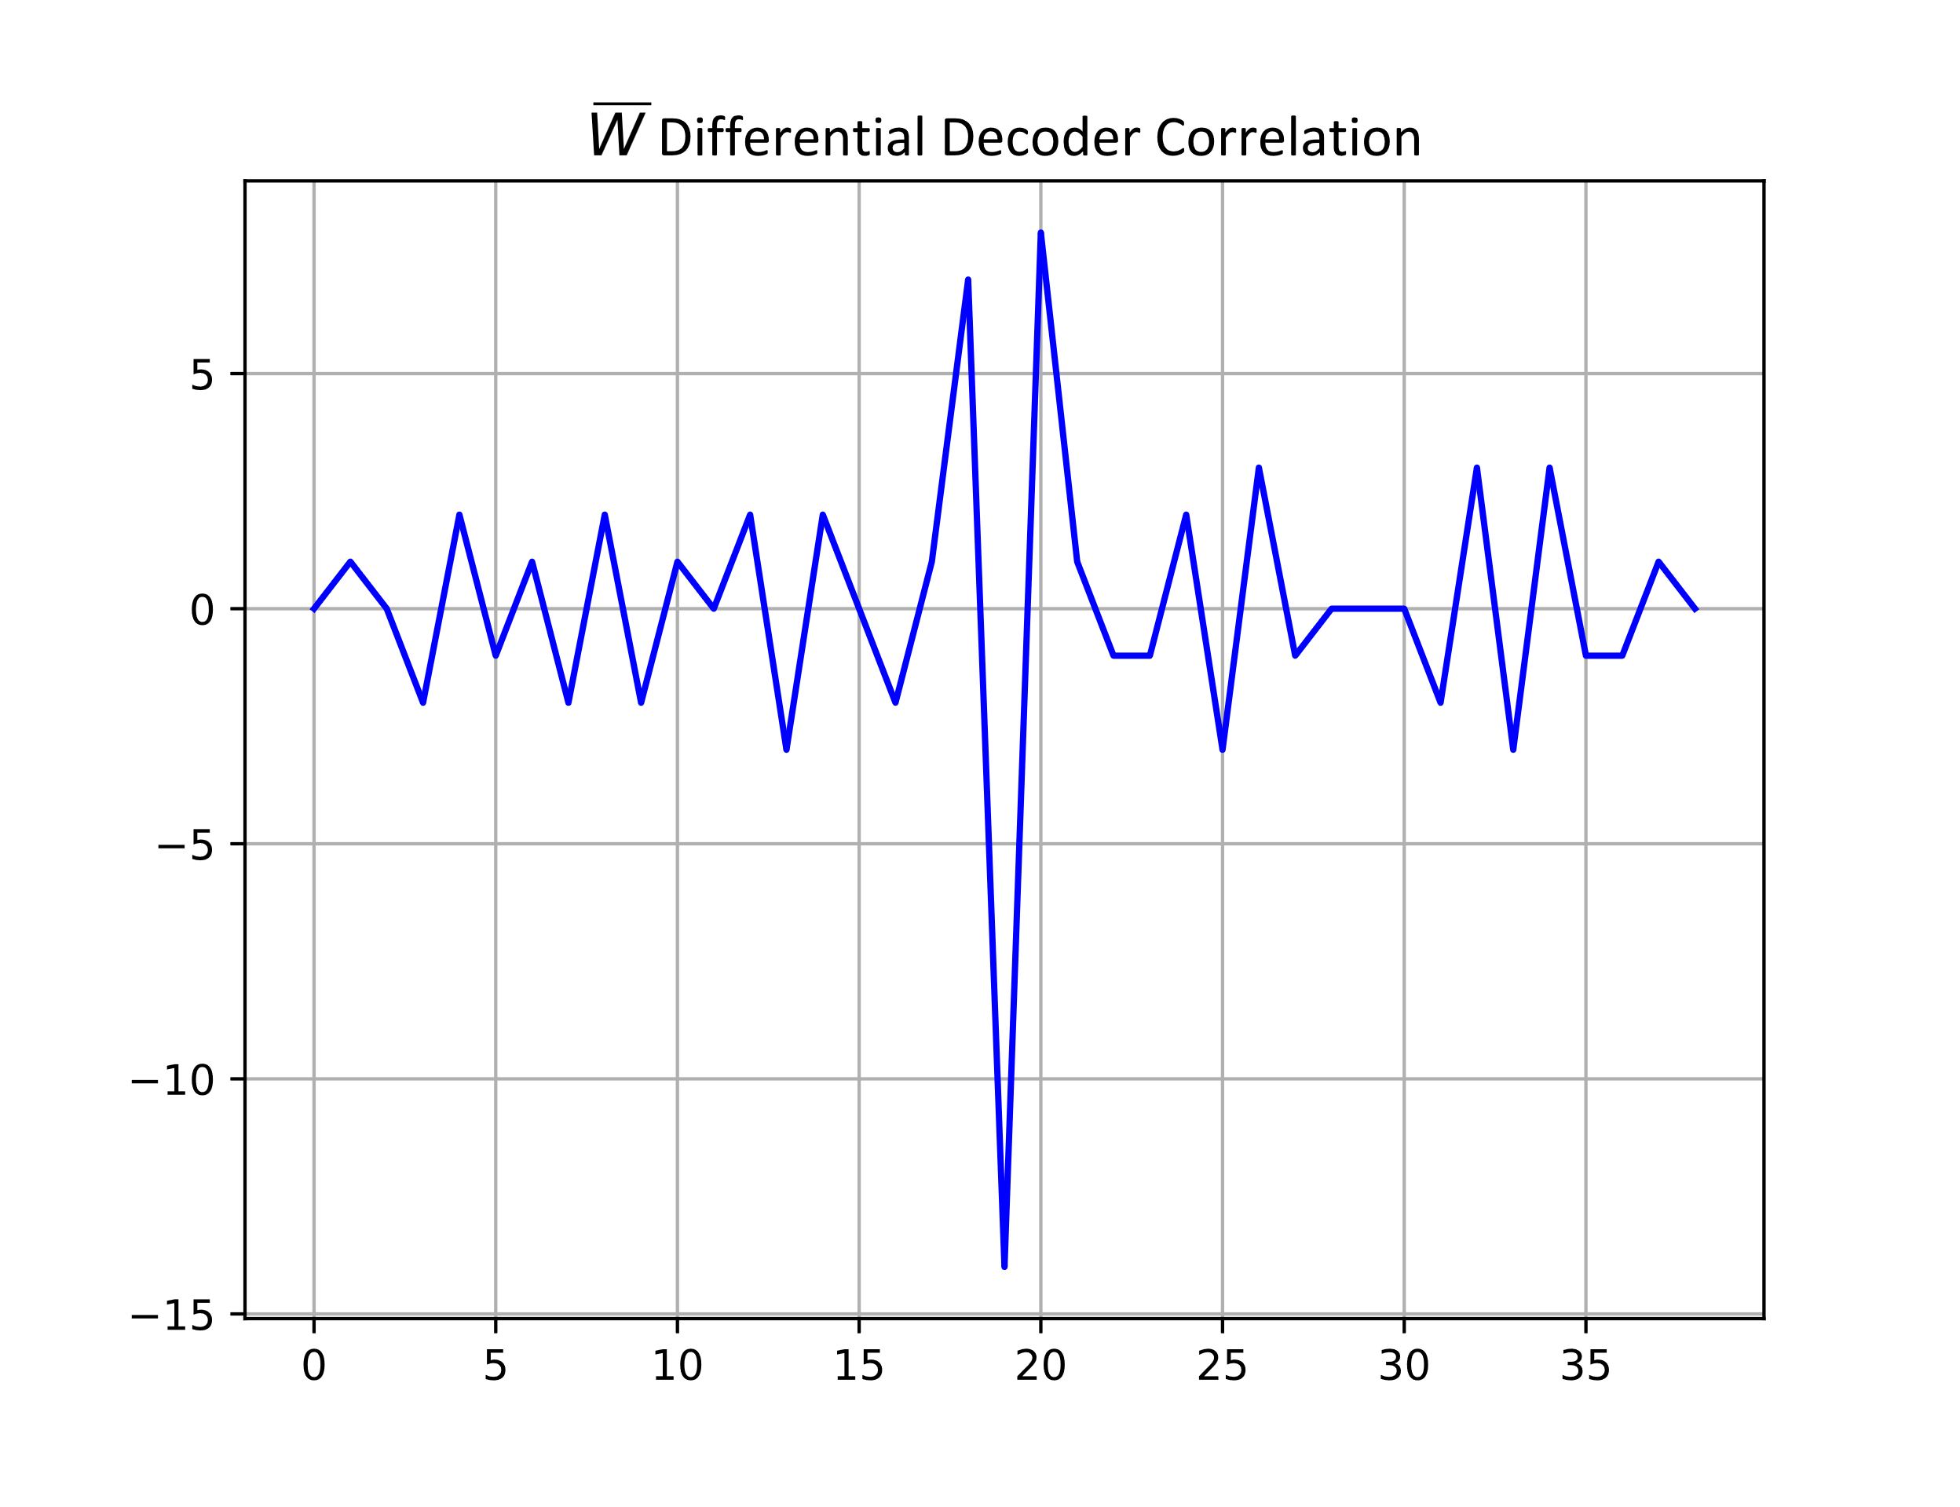

Length-24 Differential Decoder Sync Field Detector Correlation Plots
Maximum value = $15$
Minimum value = $−14$

Slide 5
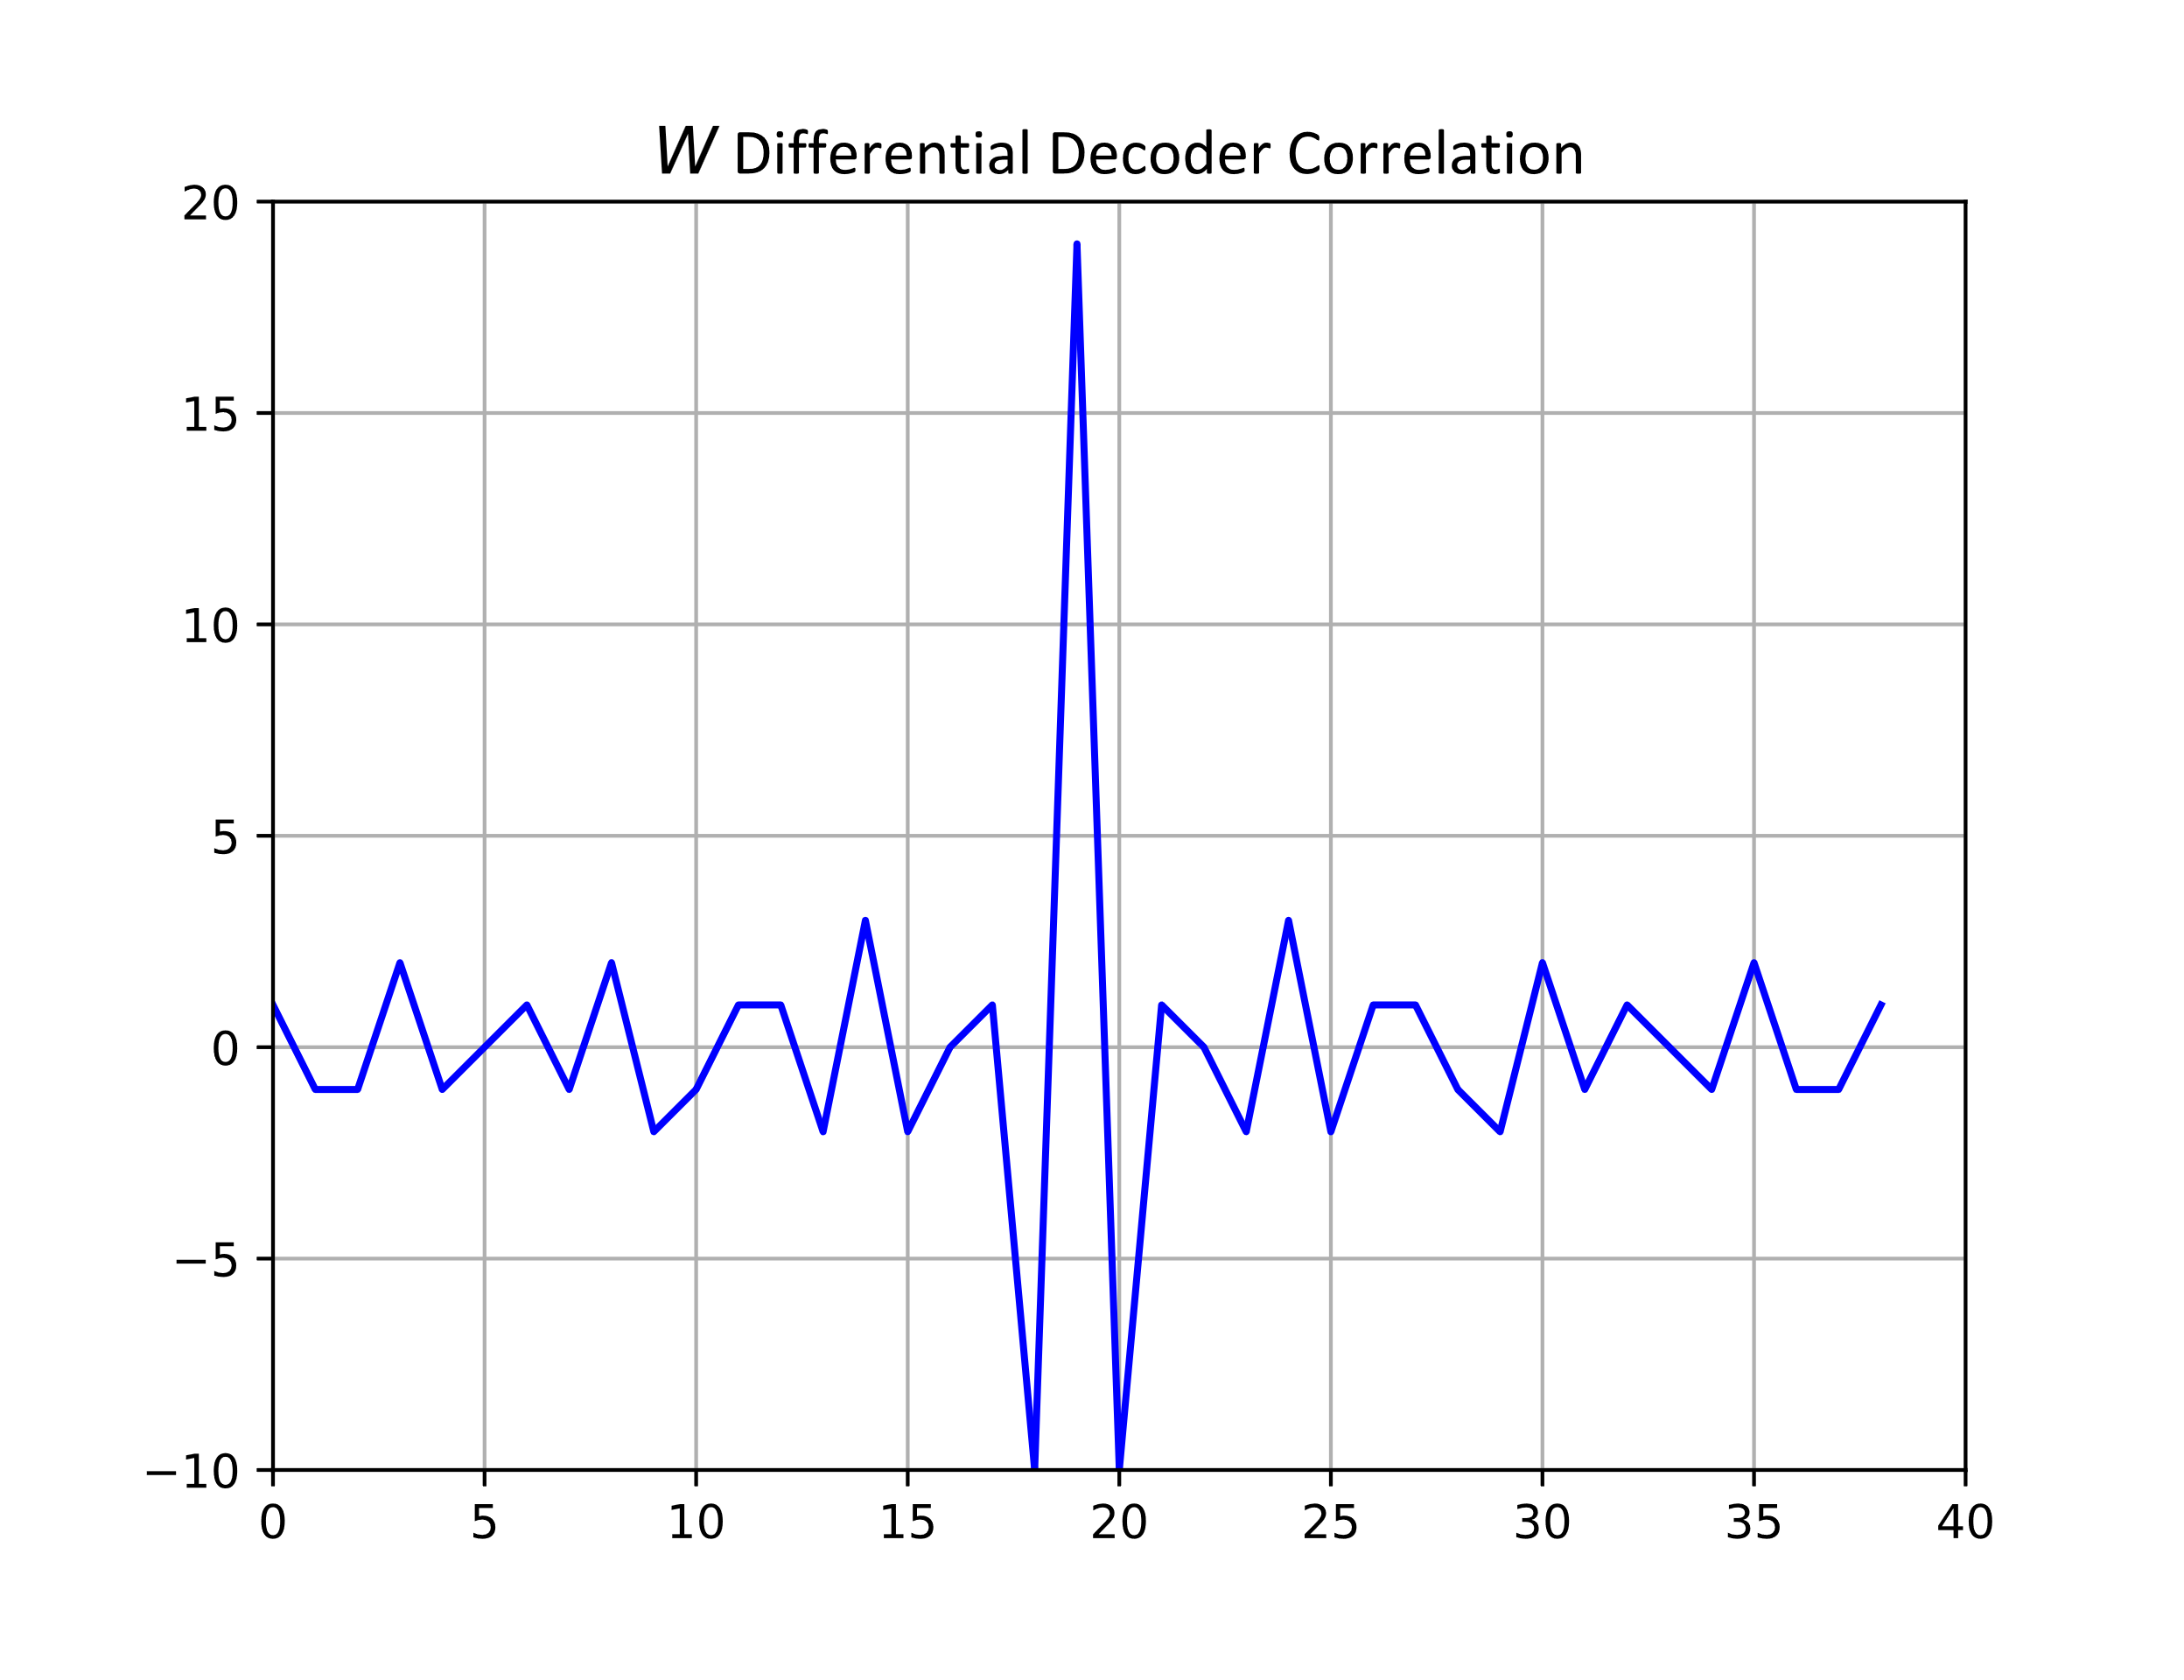
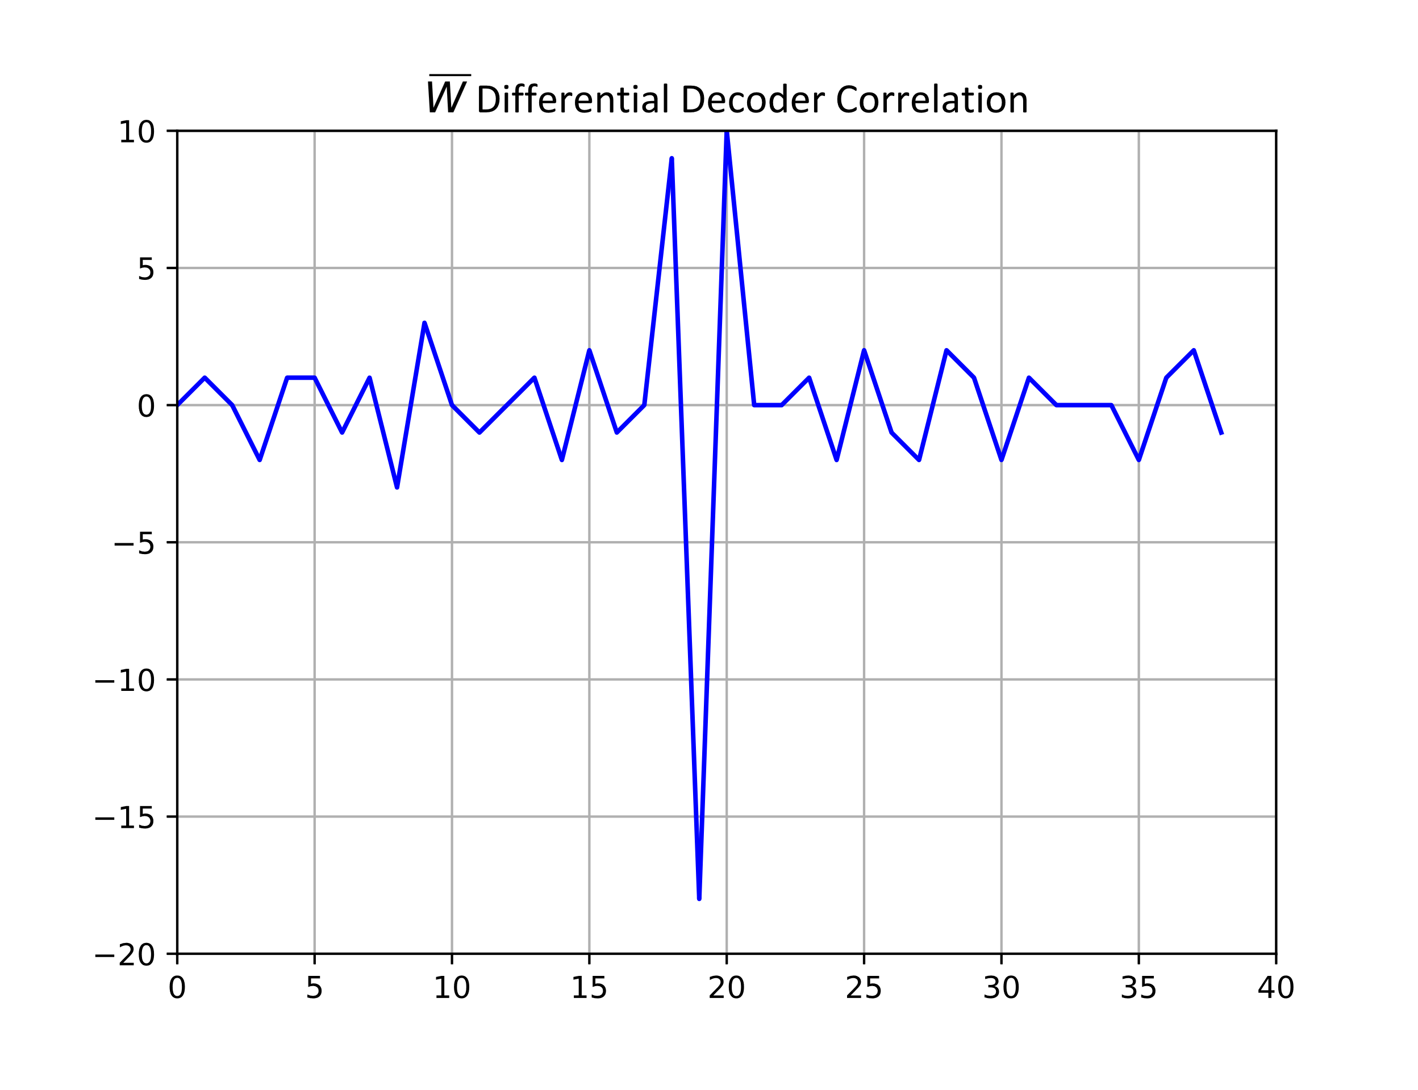

Length-32 Differential Decoder Sync Field Detector Correlation Plots
Maximum value = $19$
Minimum value = $−18$

Slide 6
False Alarm Rate – Simulation
Simulate 20,000 experiments with 5 ms of Random Noise
Pass it through the Differential Decoder
There are two Differential Decoders running in parallel with a half-chip (1 µs) time offset
Correlate the output of the Differential Decoder and compare to thresholds
Thresholds the max and min values of the correlation plot

Slide 7
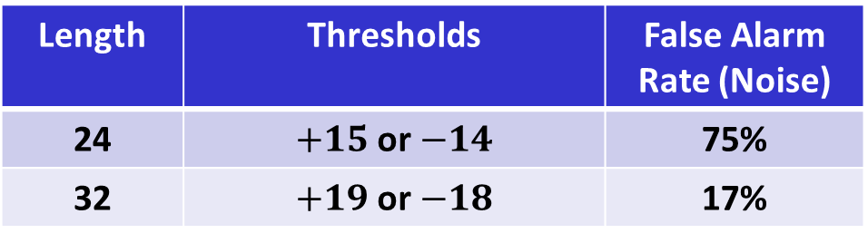
Summary – Differential Decoder Sync Field Detector
Length | Thresholds | False Alarm Rate (Noise)
24 | $+15$or $−14$ | 75%
32 | $+19$or $−18$ | 17%
The False Alarm Rate in Noise for the Length-24 Sync Field in the Differential Decoder Sync Field Detector is unacceptably high
The Special Segment can be used to further reduce the false alarm level to an acceptable level

Slide 8
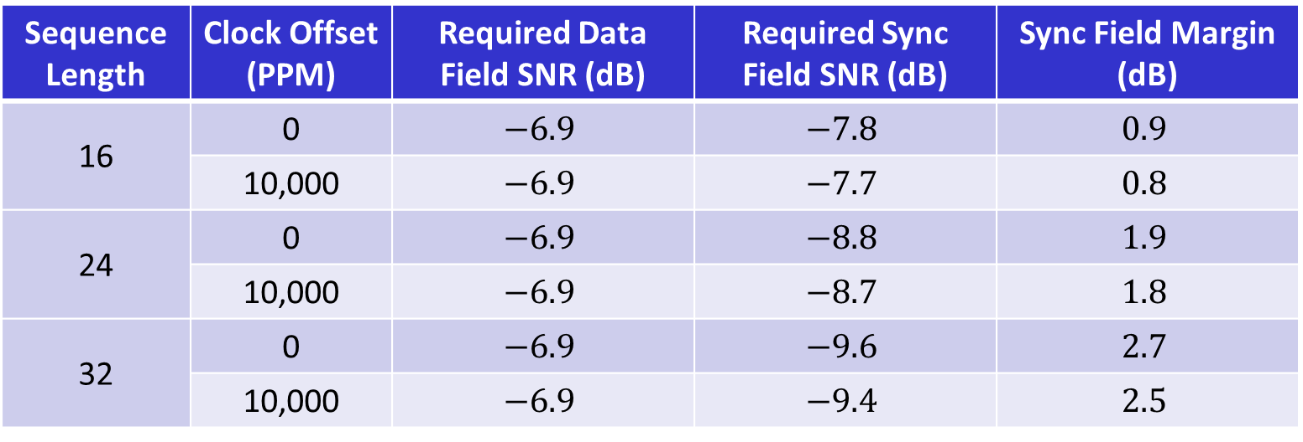
Sync Field Margin – Correlation-based Sync Field Detector [1]
Sequence Length | Clock Offset (PPM) | Required Data Field SNR (dB) | Required Sync Field SNR (dB) | Sync Field Margin (dB)
16 | 0 | $$−6.9$$ | $$−7.8$$ | $$0.9$$
 | 10,000 | $$−6.9$$ | $$−7.7$$ | $$0.8$$
24 | 0 | $$−6.9$$ | $$−8.8$$ | $$1.9$$
 | 10,000 | $$−6.9$$ | $$−8.7$$ | $$1.8$$
32 | 0 | $$−6.9$$ | $$−9.6$$ | $$2.7$$
 | 10,000 | $$−6.9$$ | $$−9.4$$ | $$2.5$$
Both Length-24 and Length-32 provide sufficient margin for the Correlation-based Sync Field Detector

Slide 9
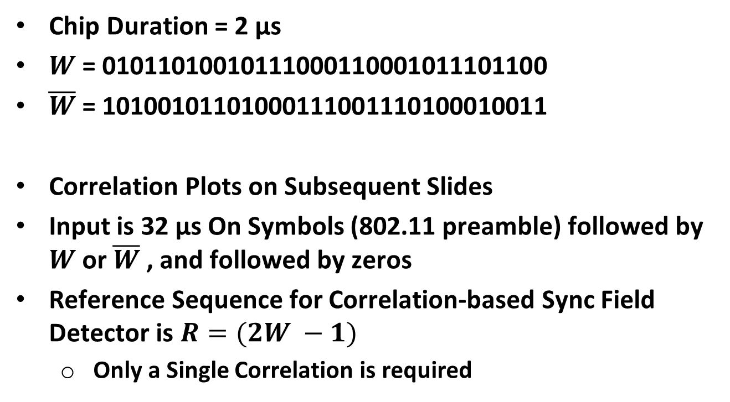
Proposal – Sync Field Design (Length 32 Chips) [1]
Chip Duration = 2 µs
$W$ = 01011010010111000110001011101100
$\overline{W}$ = 10100101101000111001110100010011
Correlation Plots on Subsequent Slides
Input is 32 µs On Symbols (802.11 preamble) followed by $W$ or $\overline{W}$ , and followed by zeros
Reference Sequence for Correlation-based Sync Field Detector is $R=(2W −1)$
Only a Single Correlation is required

Slide 10
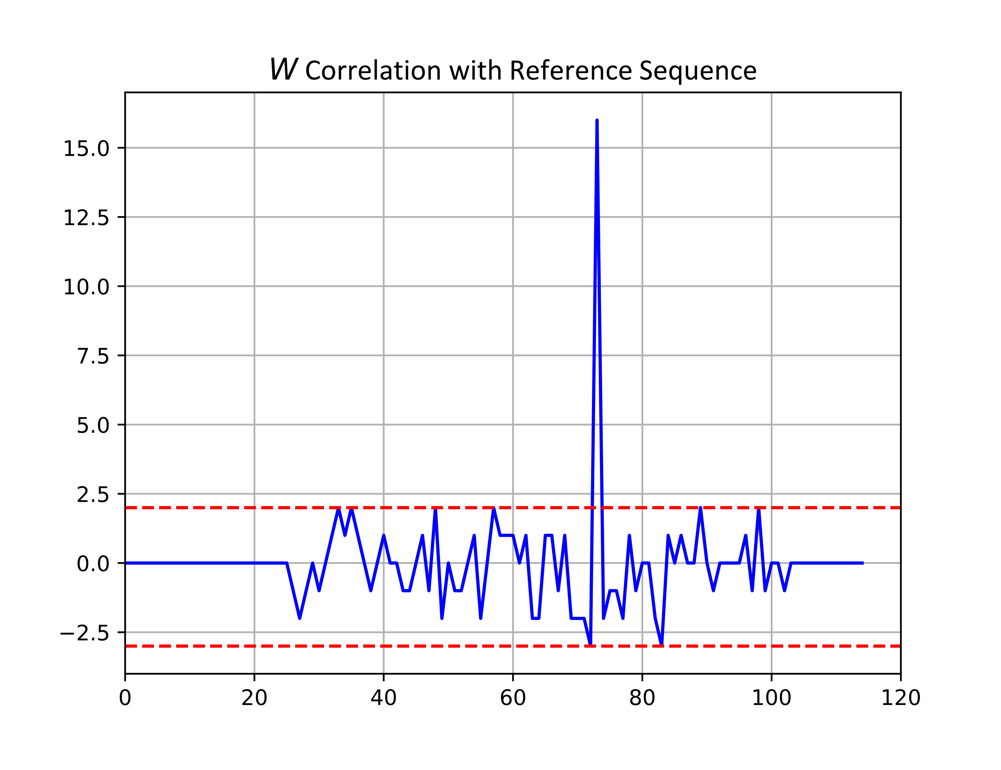
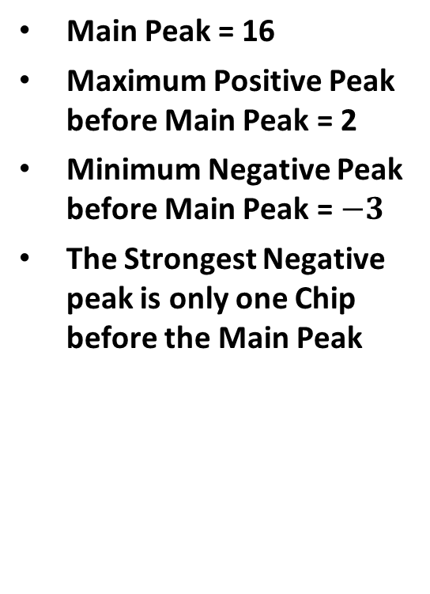
Correlation Plots – Correlation-Based Sync Field Detector
Main Peak = 16
Maximum Positive Peak before Main Peak = 2
Minimum Negative Peak before Main Peak = $−3$
The Strongest Negative peak is only one Chip before the Main Peak

Slide 11
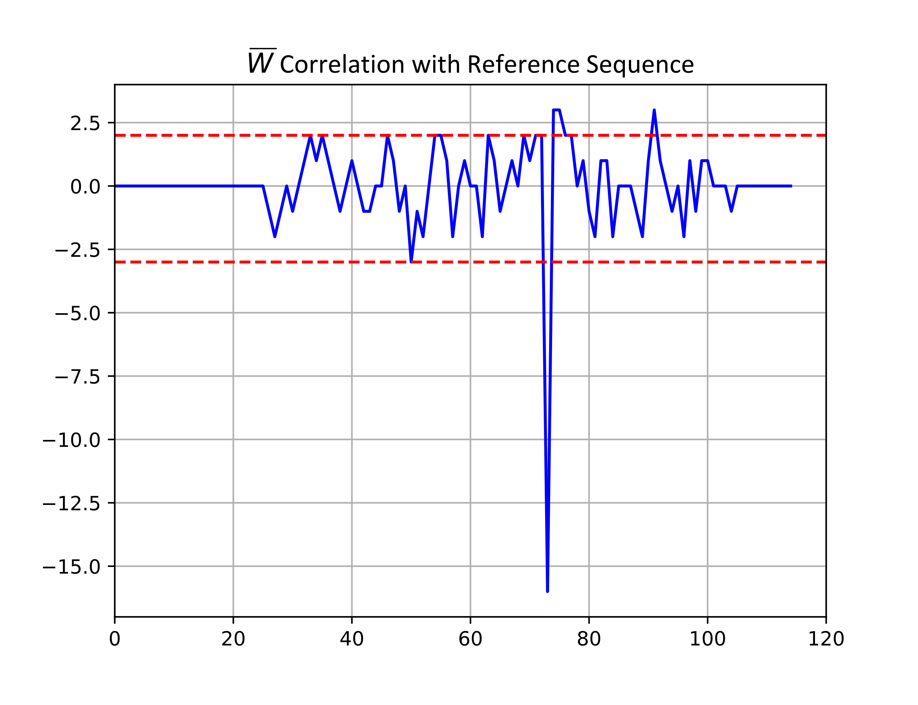

Correlation Plots – Correlation-Based Sync Field Detector
Main Peak = $−16$
Maximum Positive Peak before Main Peak = 2
Minimum Negative Peak before Main Peak = $−3$

Slide 12
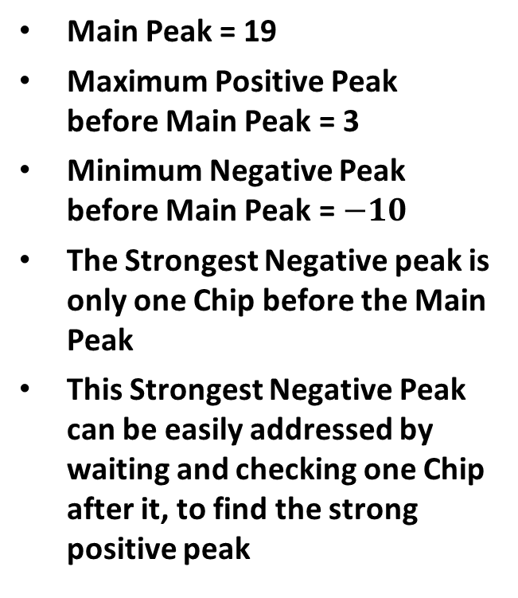
Correlation Plots – Differential Decoder Sync Field Detector
Main Peak = 19
Maximum Positive Peak before Main Peak = 3
Minimum Negative Peak before Main Peak = $−10$
The Strongest Negative peak is only one Chip before the Main Peak
This Strongest Negative Peak can be easily addressed by waiting and checking one Chip after it, to find the strong positive peak

Slide 13
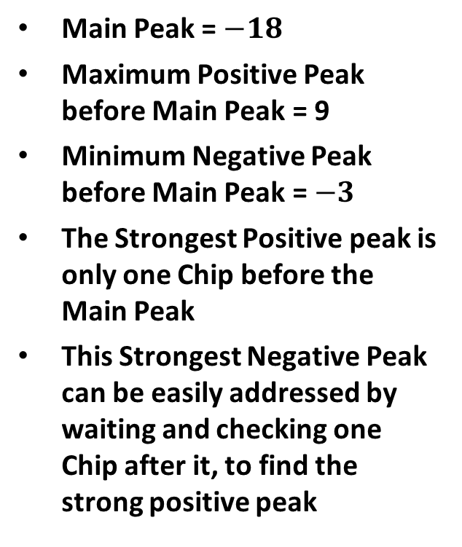
Correlation Plots – Differential Decoder Sync Field Detector
Main Peak = $−18$
Maximum Positive Peak before Main Peak = 9
Minimum Negative Peak before Main Peak = $−3$
The Strongest Positive peak is only one Chip before the Main Peak
This Strongest Negative Peak can be easily addressed by waiting and checking one Chip after it, to find the strong positive peak

Slide 14
Summary
Both Length-24 and Length-32 provide sufficient margin for the Correlation-based Sync Field Detector
The False Alarm Rate in Noise for the Length-24 Sync Field in the Differential Decoder Sync Field Detector is unacceptably high
The Length-32 sequence and has nice correlation properties as summarized in [1] and provided in Backup slides
Based on support for both the Correlation-based Sync Field detector and the Differential Decoder Sync Field detector, we are proposing the Length-32 sequence

Slide 15
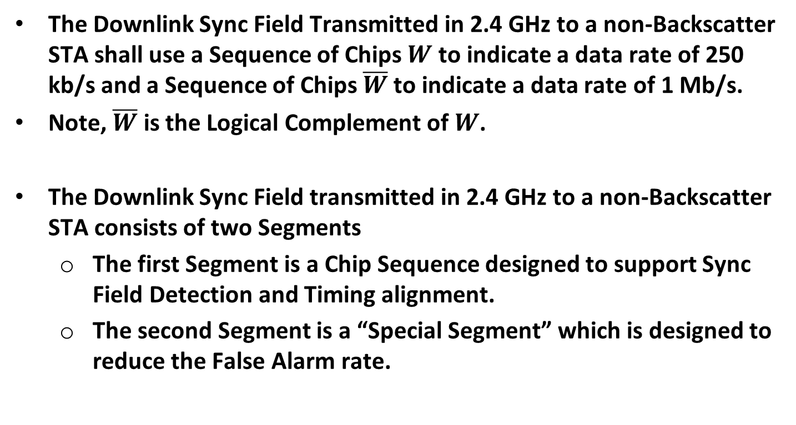
Reminder – Motions Passed in July
The Downlink Sync Field Transmitted in 2.4 GHz to a non-Backscatter STA shall use a Sequence of Chips $W$ to indicate a data rate of 250 kb/s and a Sequence of Chips $\overline{W}$ to indicate a data rate of 1 Mb/s.
Note, $\overline{W}$ is the Logical Complement of $W$.
The Downlink Sync Field transmitted in 2.4 GHz to a non-Backscatter STA consists of two Segments
The first Segment is a Chip Sequence designed to support Sync Field Detection and Timing alignment.
The second Segment is a “Special Segment” which is designed to reduce the False Alarm rate.

Slide 16
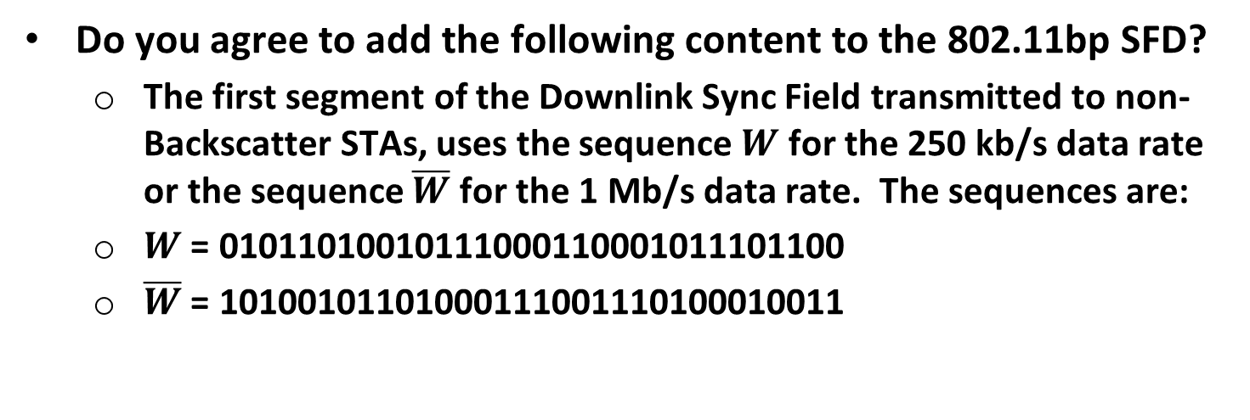
Straw Poll #1
Do you agree to add the following content to the 802.11bp SFD?
The first segment of the Downlink Sync Field transmitted to non-Backscatter STAs, uses the sequence $W$ for the 250 kb/s data rate or the sequence $\overline{W}$ for the 1 Mb/s data rate. The sequences are:
$W$ = 01011010010111000110001011101100
$\overline{W}$ = 10100101101000111001110100010011

Slide 17
References
Steve Shellhammer, et. al., AMP Downlink Sync Field Design for Transmission to Non-Backscatter STAs, IEEE 802.11-25/1222r1, July 2025

Slide 18
Backup Slides

Slide 19
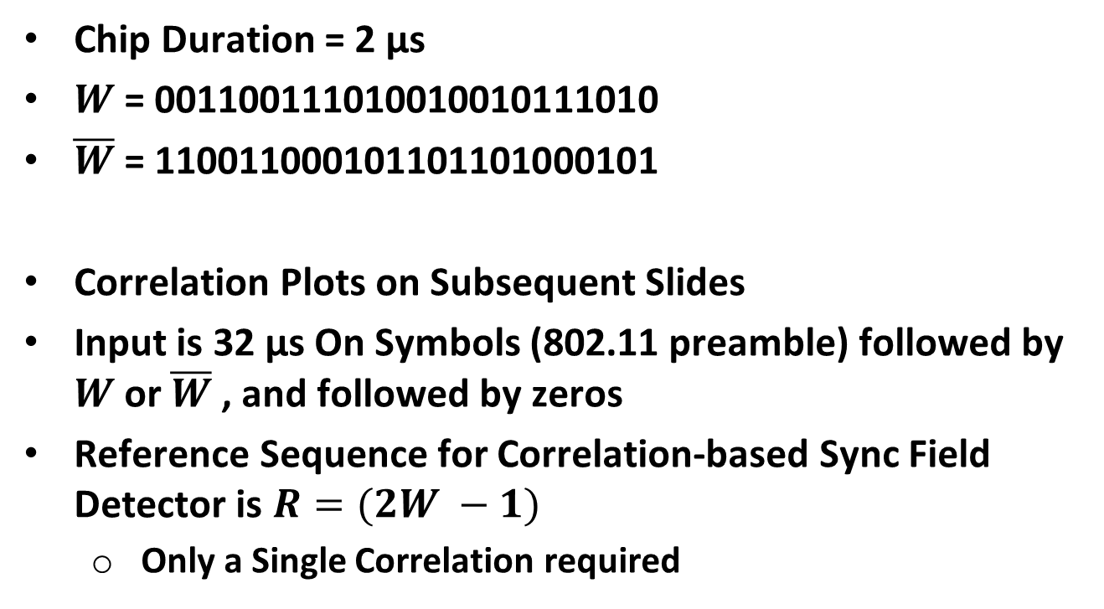
Shorter Sync Field Design (Length 24 Chips) [1]
Chip Duration = 2 µs
$W$ = 001100111010010010111010
$\overline{W}$ = 110011000101101101000101
Correlation Plots on Subsequent Slides
Input is 32 µs On Symbols (802.11 preamble) followed by $W$ or $\overline{W}$ , and followed by zeros
Reference Sequence for Correlation-based Sync Field Detector is $R=(2W −1)$
Only a Single Correlation required

Slide 20
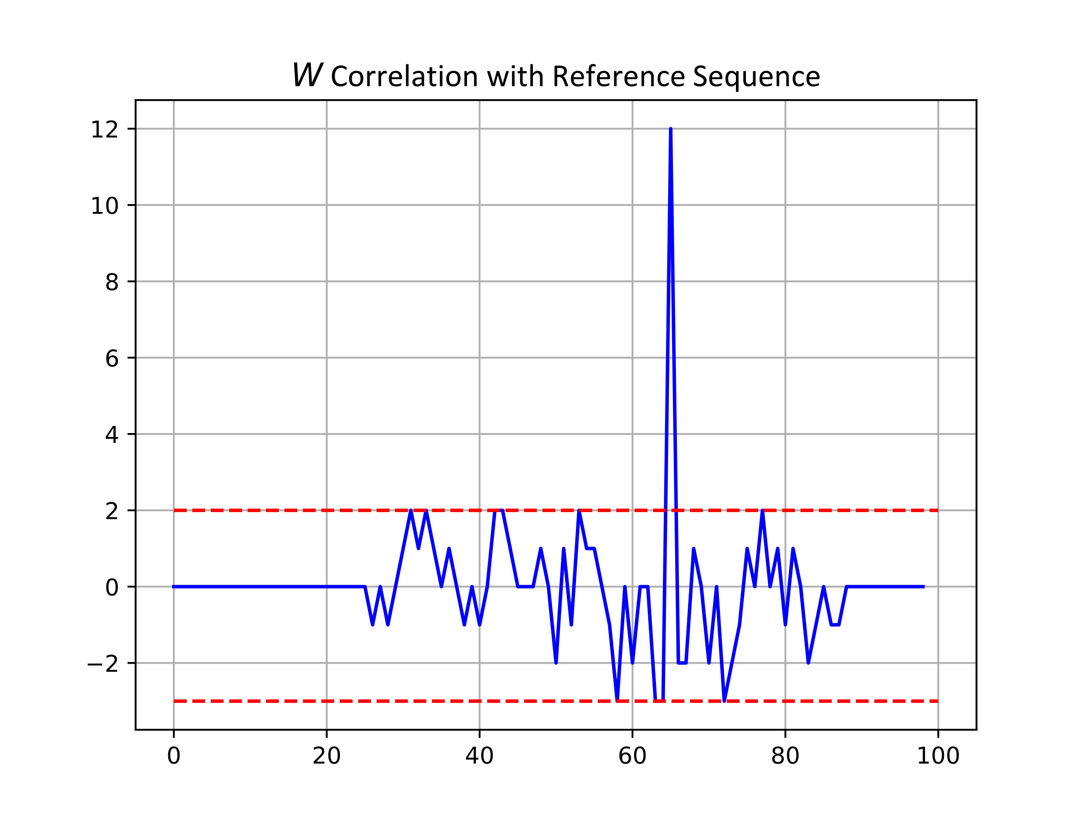

Correlation Plots – Correlation-Based Sync Field Detector
Main Peak = 12
Maximum Positive Peak before Main Peak = 2
Minimum Negative Peak before Main Peak = $−3$

Slide 21
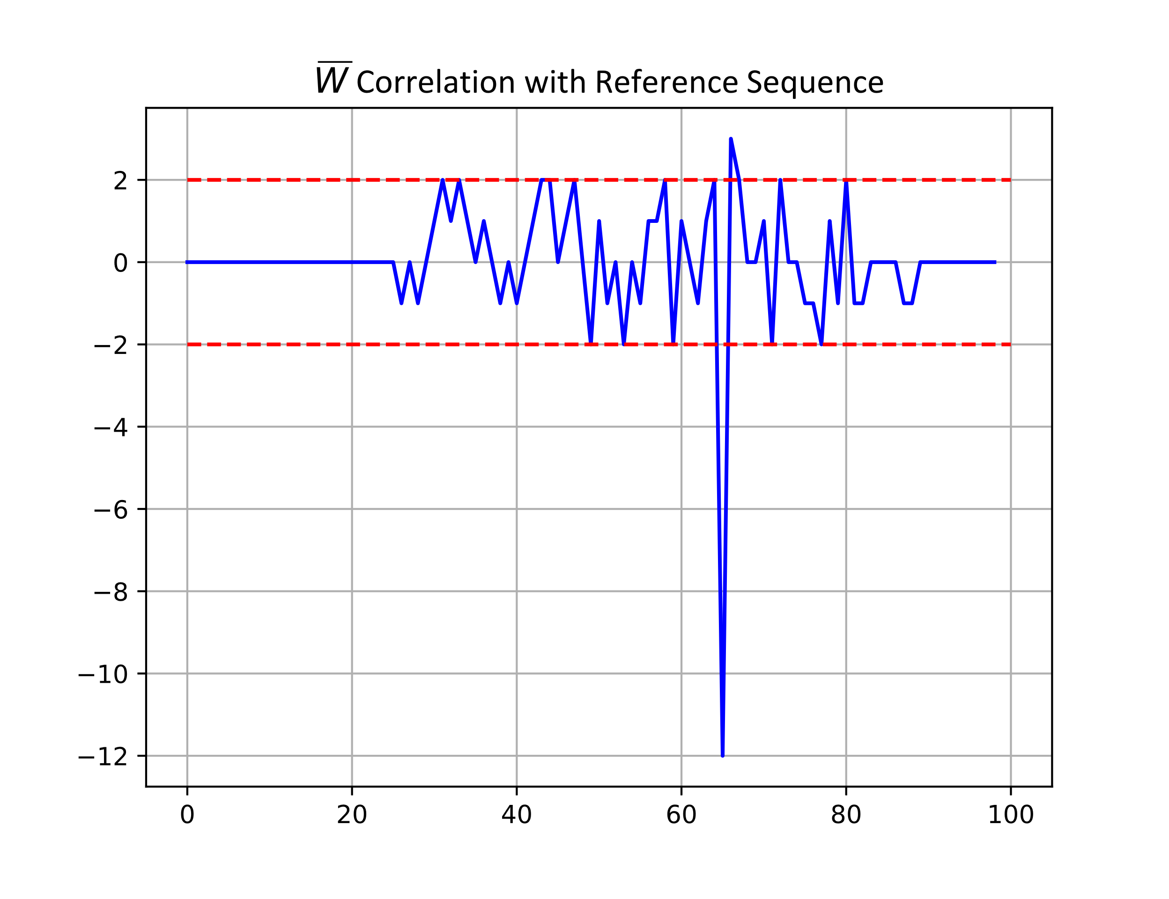

Correlation Plots – Correlation-Based Sync Field Detector
Main Peak = $−12$
Maximum Positive Peak before Main Peak = 2
Minimum Negative Peak before Main Peak = $−2$

Slide 22
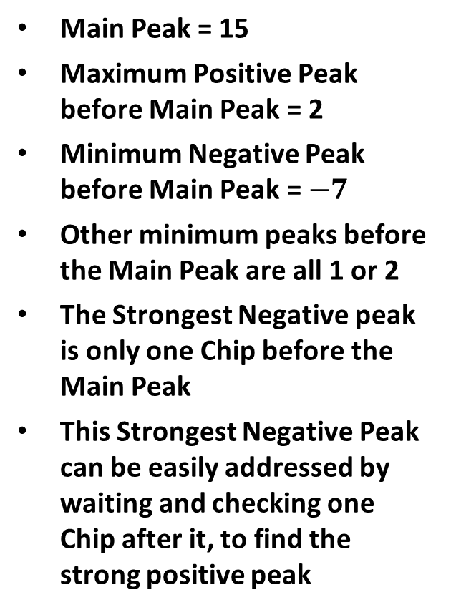
Correlation Plots – Differential Decoder Sync Field Detector
Main Peak = 15
Maximum Positive Peak before Main Peak = 2
Minimum Negative Peak before Main Peak = $−7$
Other minimum peaks before the Main Peak are all 1 or 2
The Strongest Negative peak is only one Chip before the Main Peak
This Strongest Negative Peak can be easily addressed by waiting and checking one Chip after it, to find the strong positive peak

Slide 23
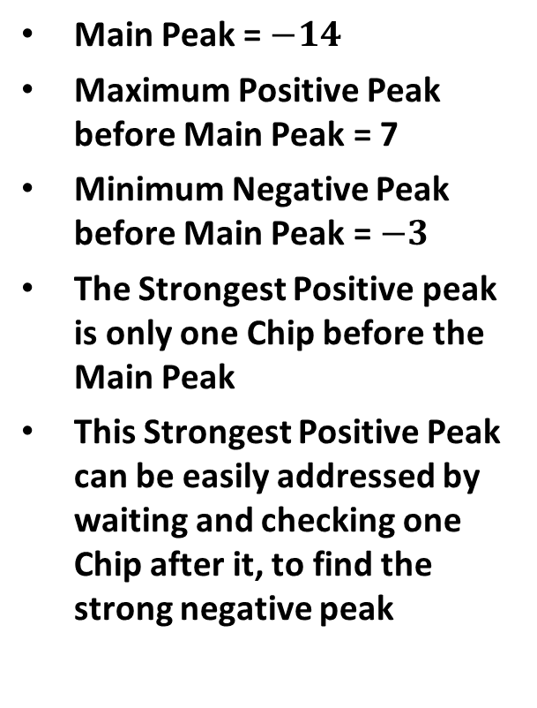
Correlation Plots – Differential Decoder Sync Field Detector
Main Peak = $−14$
Maximum Positive Peak before Main Peak = 7
Minimum Negative Peak before Main Peak = $−3$
The Strongest Positive peak is only one Chip before the Main Peak
This Strongest Positive Peak can be easily addressed by waiting and checking one Chip after it, to find the strong negative peak

