Slide 1
Millimeter Wave Beacon as Backbone of Beam Management
Date: 2025-10-10
Authors:

Slide 2
Overview
Overview of mmWave beam management procedures
Role of beacon in beam management
  Beacon has been staple of 802.11 BSS to handle, among other things, mobility and RRM
  A minimalist Beacon is well-suited to also handle beam-domain mobility in mmWave band

Slide 3
Overview of mmWave beam mgmt. procedures
PART I

Slide 4
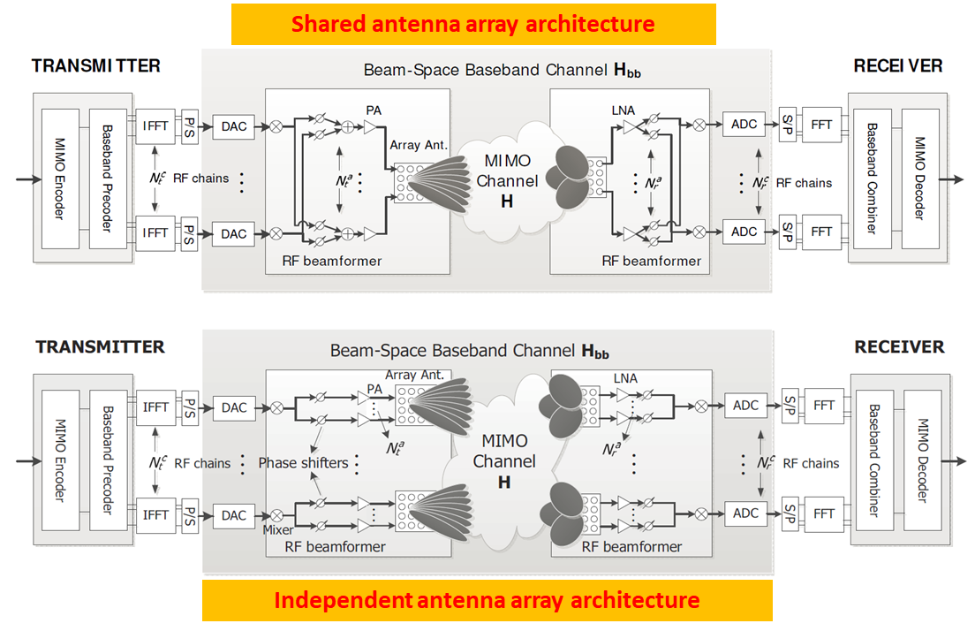
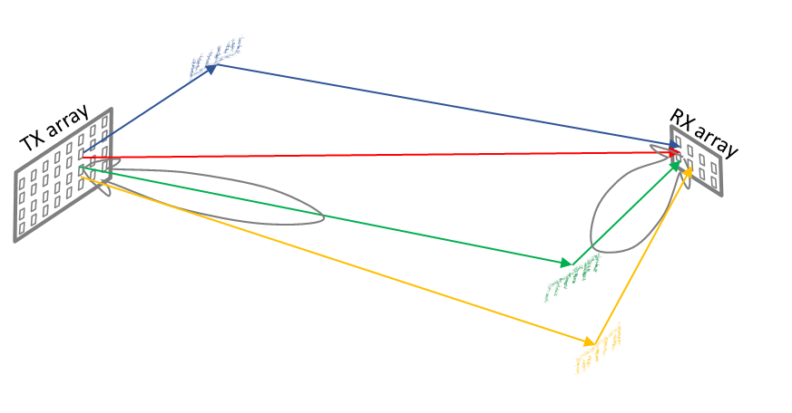

Overview of mmWave beam management procedures
A beam is $N_{\left(⋅\right)}^{a}×1$ wideband precoder or RX combiner, per RF chain
  beam is also described as a wideband spatial filter in other Standards
Why is wideband precoder sufficient [1]: Given spatial sparsity of mmWave channel, 1st RSV is almost same as beamforming along the dominant path
Communication relies on establishing a beam pair between two STAs

Slide 5
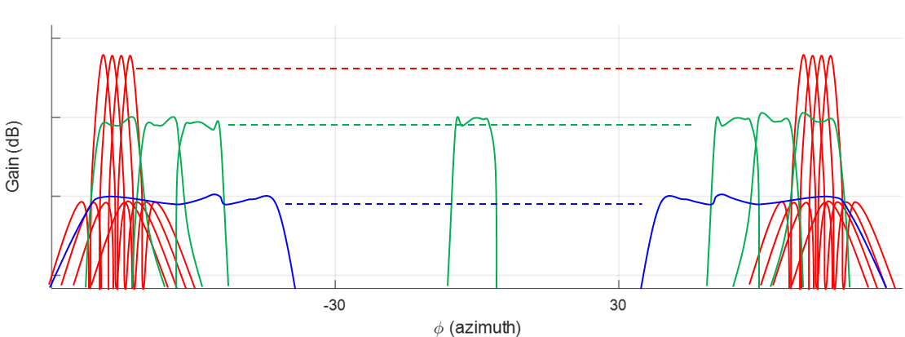
Overview of mmWave beam management procedures
Typical beam codebook has
  Narrow beams (NBs): smallest HPBW, highest gain
  Wide beams (WBs): Wider than NBs, e.g., 4 NBs in HPBW of one WB
  Pseudo-omni and extra-wide beams (EWBs): …
Beam mgmt. procedures: Finding the right beam pair for every situation
  Initial Beam acquisition + Steady-state emerging beams discovery
  Beam Tracking and Refinement
  Beam Failure Detection & Recovery
  Ancillary procedures: (i) Beam switch (ii) Beam measurement & reporting

Slide 6
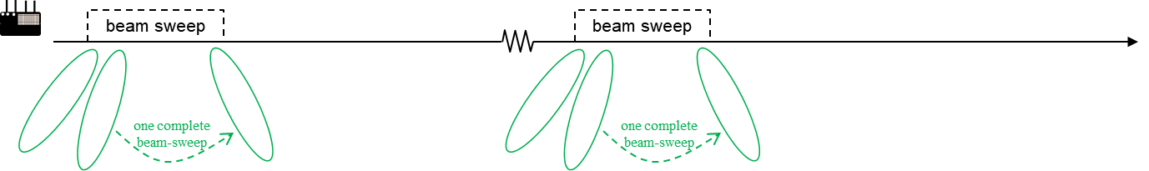
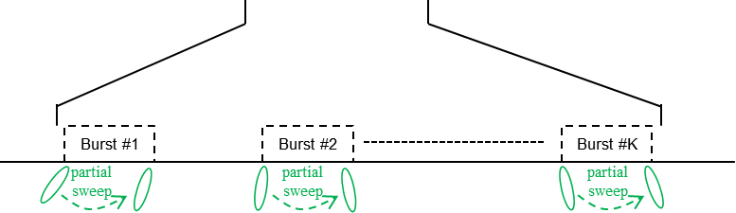
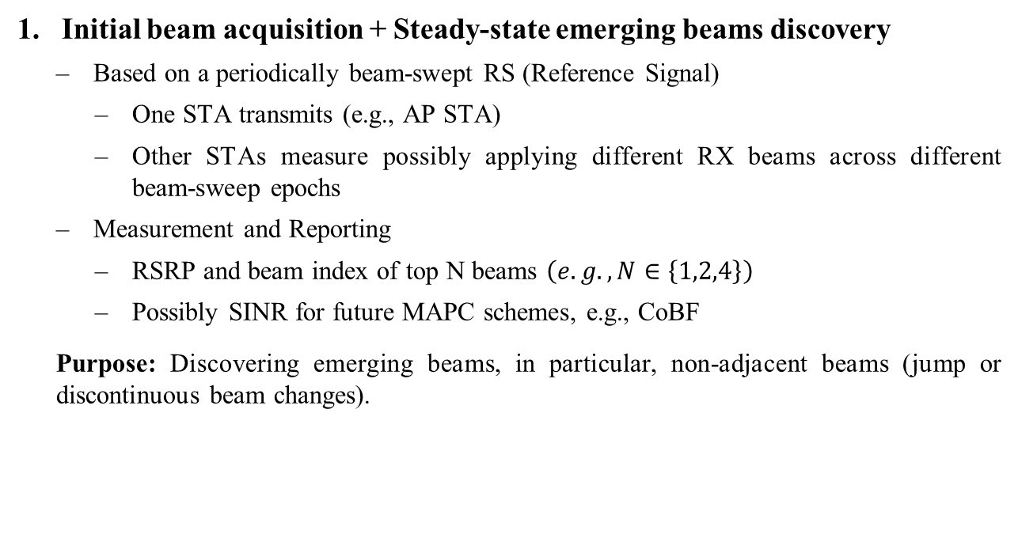
Overview of mmWave beam management procedures
Initial beam acquisition + Steady-state emerging beams discovery
  Based on a periodically beam-swept RS (Reference Signal)
    One STA transmits (e.g., AP STA)
    Other STAs measure possibly applying different RX beams across different beam-sweep epochs
  Measurement and Reporting
    RSRP and beam index of top N beams $\left(e.g., N∈\left\{1,2,4\right\}\right)$
    Possibly SINR for future MAPC schemes, e.g., CoBF
  Purpose: Discovering emerging beams, in particular, non-adjacent beams (jump or discontinuous beam changes).
More specifically, discovering beam pairs
Next-level detail: One beam-sweep may be broken into multiple bursts, to reduce interruption. [Probably not needed]

Slide 7
Overview of mmWave beam management procedures
Beam Tracking and Refinement
  …of an established beam pair between the AP and a STA
  TX-side tracking and refinement:
    TX (typically AP) transmits RS using multiple beams around the established TX beam being tracked or refined
      Tracking: AP transmits beams adjacent to the established TX beam
      Refinement: AP transmits narrower beams within and on shoulders of the established TX beam
    RX measures using the established RX beam
    Measurement and Reporting back to TX-side: RSRP and beam index of top N beams
  RX-side tracking and refinement: TX transmits multiple repetitions of RS using the established TX beam, while RX measures using multiple receive beams candidates around the established RX beam
  Purpose: After initial beam acquisition, all smooth/continuous changes in the beam are handled by Beam Tracking and Refinement procedure

Slide 8
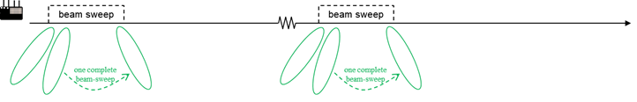
Overview of mmWave beam management procedures
Beam Failure Detection and Recovery
  Failure detection of an established beam pair between the AP and a STA
    Based on periodic RS transmission (typically by AP), using the established TX beam (or a WB representative of the established TX beam)
    RX measures using the established RX beam
  Beam Recovery
    Based on a periodically beam-swept RS
    Same as Steady-State Emerging Beam Discovery (see slide)

Slide 9
Overview of mmWave beam management procedures
RECAP
Steady-state emerging beams discovery + Initial beam acquisition
  Finding new/emerging clusters in angular space
  Based on a periodically beam-swept RS
Beam Tracking and Refinement
  Fine-tuning the beam to hit the discovered cluster
Beam Failure Detection and Recovery
  Realizing you’ve lost your last cluster and how to move on
  Based on a periodically beam-swept RS

Slide 10
Role of mmwave beacon in beam mgmt.
PART II

Slide 11
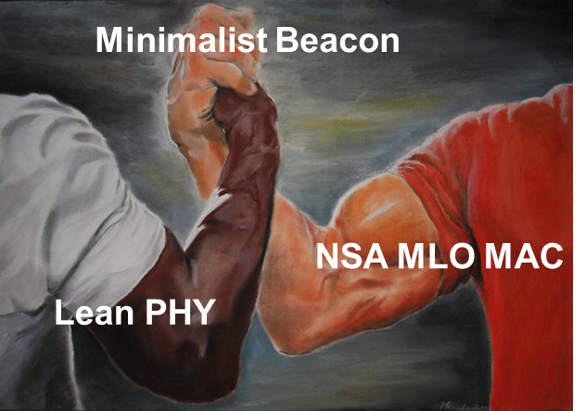

mmWave Beacon and Beam Management
How will a mmWave beacon transmission look like:
  Lean PHY, thanks no legacy bloat and ~8x up-clocking [2—4,9]
  +
  Minimalist Beacon, thanks to NSA MLO with Sub-7GHz link [5—7, many vociferous comments on beacon-like frame!]
  $⇒$ minimalist preamble with just a few data OFDM symbols tacked on
mSTF
mLTF
SIG/DATA
DATA/Pilots
DATA/Pilots
DATA/Pilots
DATA/Pilots
DATA/Pilots
DATA/Pilots
DATA/Pilots

Slide 12
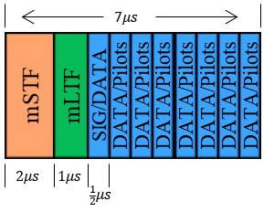
mmWave Beacon and Beam Management
How will a mmWave beacon transmission look like:
  Minimalist preamble with just a few data OFDM symbols tacked on
  To get some perspective, consider these example numbers:
    Disclaimer: These number are just an example, please see PHY contribution on numerology for detailed proposal

Slide 13
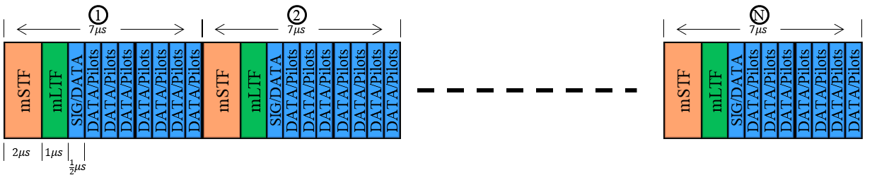
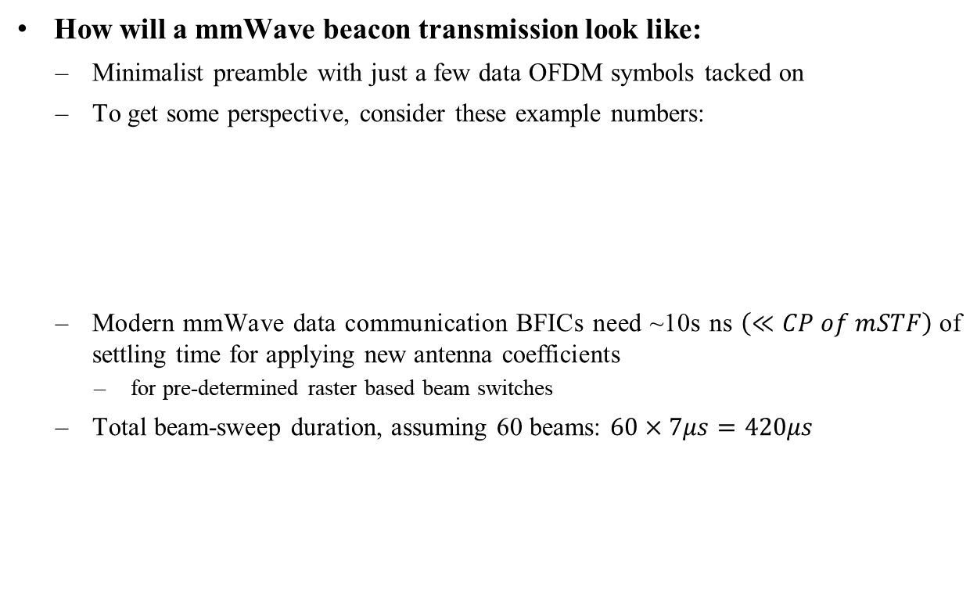
mmWave Beacon and Beam Management
How will a mmWave beacon transmission look like:
  Minimalist preamble with just a few data OFDM symbols tacked on
  To get some perspective, consider these example numbers:
  Modern mmWave data communication BFICs need ~10s ns $\left(≪CP of mSTF\right)$of settling time for applying new antenna coefficients
    for pre-determined raster based beam switches
  Total beam-sweep duration, assuming 60 beams: $60×7μs=420μs$
    Disclaimer: These number are just an example, please see PHY contribution on numerology for detailed proposal

Slide 14
Role of mmWave beacon in beam management
mSTF/mLTF/Pilots act as RS for beam management, for
  Initial+Steady-state emerging beam discovery,
  Beam failure detection, recovery beam discovery
  Up to implementation: Autonomous non-AP STA-side beam tracking & refinement
    Once decoded for one beam, data symbols of other beams also act as RS
    STA implementation can use these for autonomous beam tracking and refinement

Slide 15

Role of mmWave beacon in beam management
mSTF/mLTF/Pilots act as RS for beam management, for
  Initial+Steady-state emerging beam discovery,
  Beam failure detection, recovery beam discovery
  Up to implementation: Autonomous non-AP STA-side beam tracking & refinement
    Once decoded for one beam, data symbols of other beams also act as RS
    STA implementation can use these for autonomous beam tracking and refinement
Measurement and Reporting based on beacon
  For emerging beams discovery/maintaining beam candidates
    AP configures a STA to measure RSRP on beacon sweeps and maintain list of top $N∈\left\{1,2,4\right\}$ RSRP beams
    STA reports to AP the RSRP measurements performed on beacon sweep, to assist with AP’s beam management (can be reported through mSTA or sSTA, exploiting MLO)
  For beam failure detection
    AP identifies beacon beam associated with the currently in-use beam from the AP-side
    STA measures this beacon beam to monitor the health of the connection (and run various internal mobility management algorithms)

Slide 16
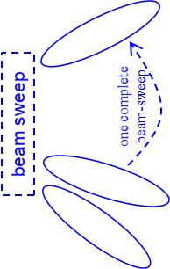
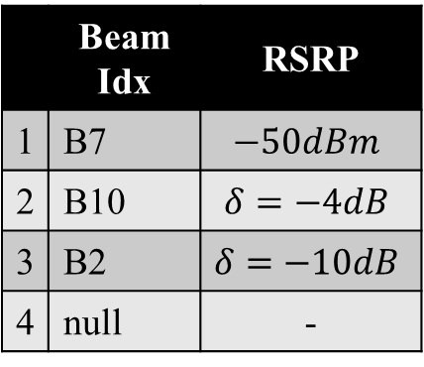
Some Steady-state examples
AP MLD
Non-AP MLD1
sAP
mAP
mSTA
sSTA
Non-AP maintains measurement record in steady-state
Beam report pull thru mSTA or sSTA
Beam report thru mSTA or sSTA

Slide 17
Some Steady-state examples
AP MLD
Non-AP MLD1
Non-AP MLD2
sAP
mAP
mSTA
sSTA
mSTA
sSTA
Non-AP maintains measurement record in steady-state
Beam report pull thru mSTA or sSTA
AP triggered reporting
Beam report thru mSTA or sSTA
Event-based self-reporting
Non-AP initiated Beam report thru mSTA or sSTA

Slide 18
Ancillary discussion (1/2)
Caveats
  Strictly speaking, from beacon beam-sweep, AP and STA discover AP’s TX beam and STA’s RX beam
    However, devices with beam reciprocity can determine an RX beam corresponding to the TX beam (and vice versa)
      Beam reciprocity is also called DL/UL beam correspondence in recent Standards [TS 38.102-2, Clause 6.6]
    Most, if not all, modern mmWave data communication [BFIC+antenna array] modules support beam reciprocity
    Beam reciprocity significantly reduces beam management overhead
      many APs may not even accommodate STAs without beam reciprocity, forcing such STAs to operate with pseudo-omni beams with reduced link budget
Related proposal
  TGbq should define beam management procedures that take advantage of beam reciprocity, for devices that support beam reciprocity
    Additionally, does TGbq also need to define beam management procedures for devices that do not support beam reciprocity?

Slide 19
Ancillary discussion (2/2)
Beam management beyond the beacon
  While piggybacking beam management on beacon is a natural choice and a baseline solution, further beam mgmt. specific RS should also be defined
    Future contribution: Other aperiodic and periodic/semi-persistent non-AP-STA-specific beam-swept RS
      For beam tracking and refinement
      For fast initial beam acquisition, failure recovery
      To support higher mobility
      Beam measurement triggering & reporting procedures
        within mmWave link as well as MLO-assisted (Sub-7GHz Anchor Link)

Slide 20
Beam mgmt. overview and role of mmWave beacon
SUMMARY
TGbq beam management toolkit should include following options:
Beam mgmt. procedure |  | Using |  | MLO dependent | Self-contained on mmWave link
 |  | Beacon | Non-AP STA specific RS
1. | Initial beam acquisition | Y | Y | Y | N
2. | Steady-state beam discovery/ maintaining beam candidates | Y | Y | Y | Y
3. | Beam tracking & refinement | N* | Y | Y | Y
4. | Beam failure detection and reporting | Y | Y | Y | N
5. | Beam recovery | Y | Y | Y | N
Discussed today
Future contribution

Slide 21
Conclusion
Beam sweep of a minimalist mmWave Beacon provides efficient bootstrapping for beam management
TGbq should define measurement and reports to exploit beacon for beam management, in particular, to support beam discovery, acquisition, failure detection, and recovery

Slide 22
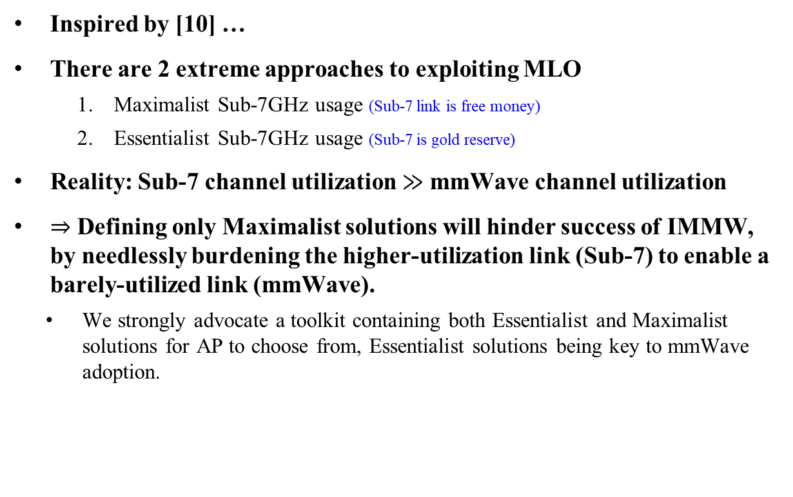
TGbq NSA MLO Design Principle?
Inspired by [10] …
There are 2 extreme approaches to exploiting MLO
    Maximalist Sub-7GHz usage (Sub-7 link is free money)
    Essentialist Sub-7GHz usage (Sub-7 is gold reserve)
  Reality: Sub-7 channel utilization $≫$ mmWave channel utilization
$⇒$ Defining only Maximalist solutions will hinder success of IMMW, by needlessly burdening the higher-utilization link (Sub-7) to enable a barely-utilized link (mmWave).
  We strongly advocate a toolkit containing both Essentialist and Maximalist solutions for AP to choose from, Essentialist solutions being key to mmWave adoption.

Slide 23
Straw Poll (1/4)
Do you agree that TGbq shall define beam mgmt. procedures for at least
  Initial beam acquisition and steady-state beam discovery
  Beam tracking and refinement of an already established beam
  Beam failure detection of an established beam and beam failure recovery

Slide 24
Straw Poll (2/4)
Do you agree that TGbq shall define beam management procedures that take advantage of beam reciprocity, for devices that support beam reciprocity
  TBD whether to define further procedures for devices without beam reciprocity.
  Note: Devices without reciprocity will still be supported by 11bq amendment but may experience reduced performance

Slide 25
Straw Poll (3/4)
Do you agree that TGbq shall define procedures, measurements and reports to support the use of mmWave beacon for beam management?

Slide 26
Straw Poll (4/4)
Do you agree that TGbq shall define
  an RSRP measurement performed on beacon and associated with a beam index.
  a measurement report containing RSRP measurements and associated beam indices, for up to N beams.
    N is TBD.
    TBD: Measurements other than RSRP

Slide 27
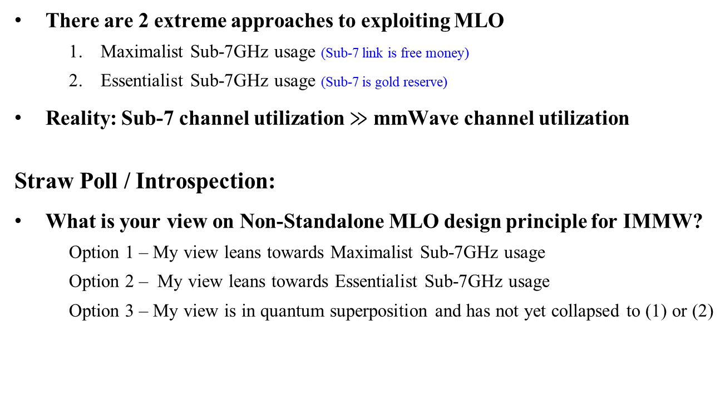
Food for thought
There are 2 extreme approaches to exploiting MLO
    Maximalist Sub-7GHz usage (Sub-7 link is free money)
    Essentialist Sub-7GHz usage (Sub-7 is gold reserve)
Reality: Sub-7 channel utilization $≫$ mmWave channel utilization
Straw Poll / Introspection:
What is your view on Non-Standalone MLO design principle for IMMW?
    Option 1 – My view leans towards Maximalist Sub-7GHz usage
    Option 2 – My view leans towards Essentialist Sub-7GHz usage
    Option 3 – My view is in quantum superposition and has not yet collapsed to (1) or (2)

Slide 28
References
[1] W. Roh et al., "Millimeter-wave beamforming as an enabling technology for 5G cellular communications," in IEEE Comm Mag, 2014
[2] 25/0365r1, PPDU Format for IMMW, Eunsung Park
[3.1] 25/0853r1, IMMW Tone Plan Discussions, Rui Cao
[3.2] 25/0360r1, High-level thoughts on IMMW PHY Design, Rui Cao
[4] 25/1301r0, On Reusing Existing PHY Spec in Sub7.25GHz Bands for IMMW, Jiqing Ni
[5] 25/1523r0, Minimalist Beacon for NSA mmWave, Peshal Nayak
[6] 25/0632, Anchor Link for ML Operation with mmWave Link, Peshal Nayak
[7] 25/1577, On-Demand Beaconing for NSA mmWave Operation, Peshal Nayak
[8] 3GPP, TS 38.101-2, Clause 6.6
[9] 25/1569, Open Issues on Reusing Sub-7GHz PHY
[10] 25/1341r1, Discussion on mmWave Link Management, Liuming Lu

