Slide 1
Sync Field Design for UL Active Transmission
Date: 2025-09-15
Authors:
Name | Affiliations | Address | Phone | Email
Shengquan Hu | Mediatek | 2840 Junction Ave. San Jose, CA, 95134 |  | Shengquan.hu@mediatek.com
You-Wei Chen |  |  |  | You-Wei.chen@mediatek.com
Jianhan Liu
Thomas Pare

Slide 2
Introduction
In July IEEE meeting, we present & shared our studies for the following two parts [1]:
  Part-I: Baseline data PER performance simulations (on AWGN)
  Part-II: Sync field design studies & simulations for DL/UL non-backscatter
In this presentation, we will focus on sync sequence design for UL active (non-backscatter) cases:
  Revisit previous studies
  Share more simulation results under multipath fading channels (B-LOS, D-NLOS)

Slide 3
Recap [1]: UL Performance Summary & Comparison
Except for a couple of cases, basically aligned with the results in Ref [2]
AWGN
waveform | platform | 250kbps, non-coherent |  | 1Mbps, non-coherent
 |  | Ideal Timing | non-Ideal Timing | Ideal Timing | non-Ideal Timing
Pulse | Ref [1] | -3.50 | -2.60 | 0.30 | 1.40
 | MTK | -3.47 | -2.91 | 0.34 | 1.32
OFDM | Ref [1] | -3.40 | -2.40 | 0.70 | 2.10
 | MTK | -3.32 | -2.84 | 0.73 | 2.04
waveform | platform | 250kbps, coherent |  | 1Mbps, coherent
 |  | Ideal Timing | non-Ideal Timing | Ideal Timing | non-Ideal Timing
Pulse | Ref [1] | -9.30 | -7.40 | -3.30 | -1.20
 | MTK | -9.31 | -8.42 | -3.27 | -1.88
OFDM | Ref [1] | -9.00 | -7.30 | -2.90 | -0.60
 | MTK | -9.19 | -7.63 | -2.90 | -0.60

Slide 4
Recap [1]: Performance Evaluation of UL Active Tx with BCC
BCC was proposed in [3, 4] for UL Active (non-backscatter) transmission
We evaluate BCC performance for UL active Tx with the following settings in the simulations:
  K=7, R=1/2, same encoding polynomial as defined in 802.11n, etc
  Both hard decision & soft decision are considered
  non-coherent
  Other settings are same as non-BCC UL simulations
Simulations show the significant gains with BCC vs w/o BCC for AWGN
waveform | platform | 250kbps, non-coherent |  | 1Mbps, non-coherent
 |  | Ideal Timing | non-Ideal Timing | Ideal Timing | non-Ideal Timing
OFDM | BCC off | -3.32 | -2.84 | 0.73 | 2.04
 | BCC on | -6.37 | -4.98 | -2.71 | -0.90
2~3dB performance gains are observed for UL data with BCC

Slide 5
Performance Evaluation of UL Active Tx for Fading Channels
Fading channels: B-LOS; D-NLOS;
Long term normalization
Ideal timing and Non-ideal timing with bit-retiming
Same as previous baseline simulations with 100bits packet
Non-BCC and BCC
B-LOS
waveform | platform | 250kbps, non-coherent |  | 1Mbps, non-coherent
 |  | Ideal Timing | non-Ideal Timing | Ideal Timing | non-Ideal Timing
OFDM | BCC off | 2.93 | 2.94 | 6.88 | 7.71
 | BCC on | 0.47 | 0.63 | 4.38 | 4.78
D-NLOS
waveform | platform | 250kbps, non-coherent |  | 1Mbps, non-coherent
 |  | Ideal Timing | non-Ideal Timing | Ideal Timing | non-Ideal Timing
OFDM | BCC off | 0.18 | 0.88 | 6.42 | 6.56
 | BCC on | -2.14 | -1.43 | 4.10 | 4.55
Same as AWGN, 2~3dB performance gains are observed with BCC for multipath fading channels

Slide 6
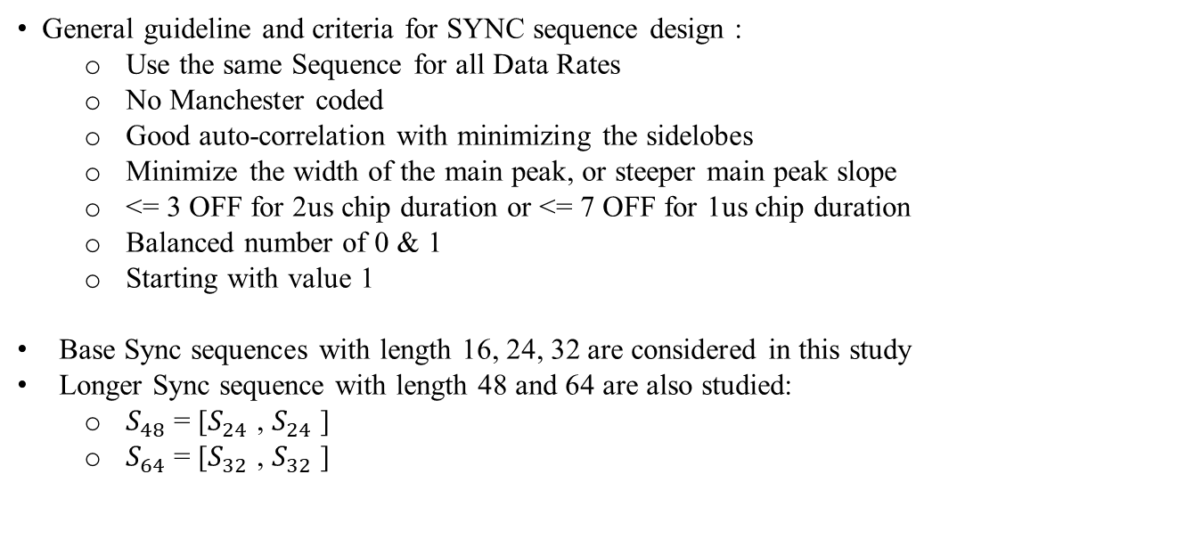
Recap [1]: General Considerations of UL Sync Sequence Design for Active Transmission
General guideline and criteria for SYNC sequence design :
  Use the same Sequence for all Data Rates
  No Manchester coded
  Good auto-correlation with minimizing the sidelobes
  Minimize the width of the main peak, or steeper main peak slope
  <= 3 OFF for 2us chip duration or <= 7 OFF for 1us chip duration
  Balanced number of 0 & 1
  Starting with value 1
Base Sync sequences with length 16, 24, 32 are considered in this study
Longer Sync sequence with length 48 and 64 are also studied:
  $S_{48}$ = [$S_{24}$ , $S_{24}$ ]
  $S_{64}$ = [$S_{32}$ , $S_{32}$ ]

Slide 7
Recap [1]: Base Sync Sequence with Length 16
S16,1=1 1 0 1 1 1 0 0 0 1 0 1 0 0 1 0
S16,2=1 1 1 1 0 1 1 0 0 0 1 0 1 0 0 0
S16,3=1 0 1 1 1 1 0 0 0 1 1 0 0 1 0 0
S16,4=1 1 0 1 0 1 0 1 1 0 1 1 0 0 0 0
S16,1~4 for Sync length-16
S16,2~4 can be used as base seq to construct Sync length 32 with [S₁₆,S₁₆]
S16,1
[S_{16,2}, S_{16,2}]

Slide 8
Recap [1]: Base Sync Sequence with Length 24
S24,1=1 1 1 1 0 0 1 0 1 0 0 1 0 1 0 1 0 1 0 0 1 1 0 0
S24,2=1 1 1 1 0 1 0 1 0 1 1 0 0 0 1 1 0 0 1 0 0 1 0 0
S24,3=1 1 1 1 1 0 1 0 0 1 1 0 0 1 1 0 0 0 0 1 0 1 0 0
S24,1~4 for Sync length-24
S24,2~3 can be used as base seq to construct Sync length 48with [S₂₄,S₂₄]
S24,1
[S_{24,3}, S_{24,3}]

Slide 9
Recap [1]: Base Sync Sequence with Length 32
S32,1=1 1 1 1 0 0 1 1 0 0 1 1 0 1 0 0 1 0 0 1 0 1 0 0 1 0 1 0 1 0 1 0
S32,2=1 1 1 1 1 1 0 0 1 0 1 0 0 1 0 0 1 1 0 1 0 0 0 1 1 0 0 0 1 0 1 0
S32,3=1 0 1 0 1 1 1 1 1 1 0 0 1 0 1 0 0 1 0 0 1 1 0 1 0 0 0 1 1 0 0 0
S32,1~3 for Sync length-32
S32,2~3 can be used as base seq to construct Sync length 64 with [S₃₂,S₃₂]
S32,1
[S_{32,2}, S_{32,2}]

Slide 10
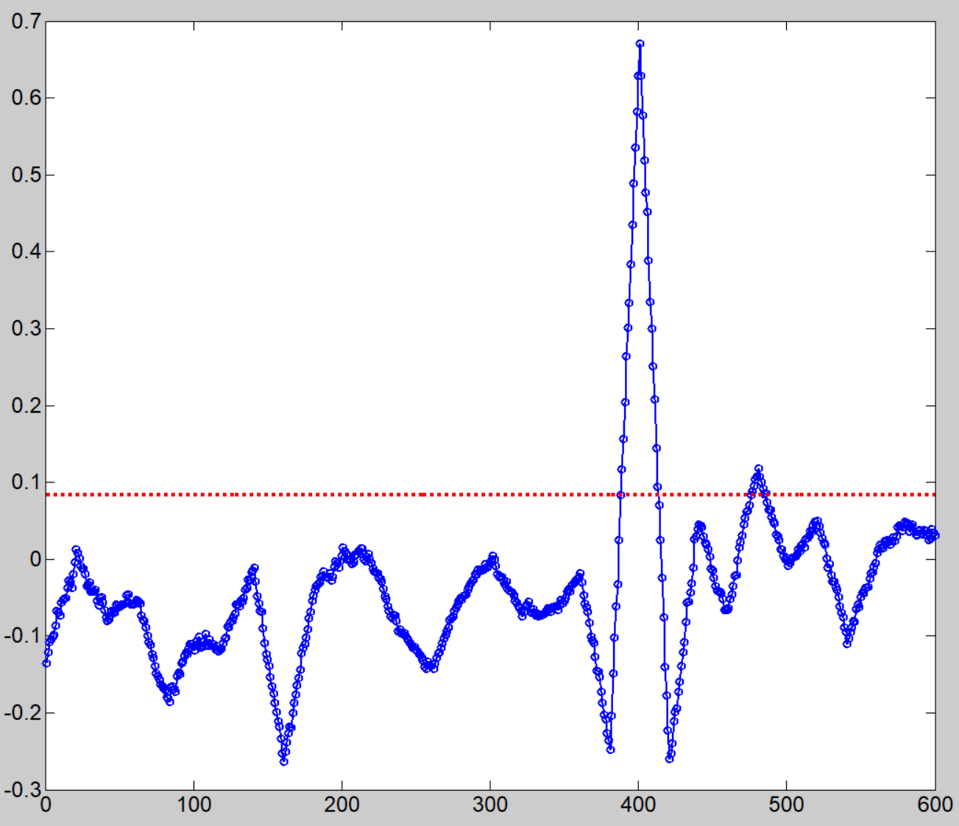
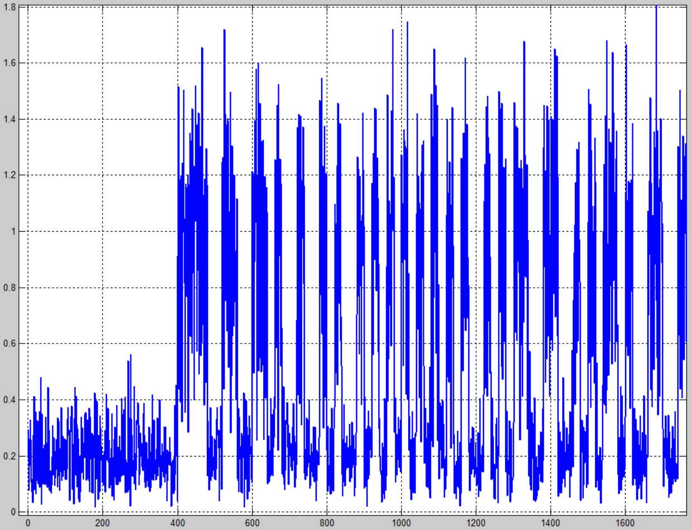
Recap [1]: SYNC Simulation for UL Non-Backscatter
UL AMP PPDU is transmitted as below for the simulations
false detection is evaluated over SIFS+Δus noise signal
Sync chip duration is same as data, but no Manchester coding
Sync error rate is evaluated starting from part of noise signal
Correlation based SYNC detector is used in the simulations
Sync detection threshold is chosen for target false error rate < 10^-2
Others with same simulation settings as UL data simulations
AWGN & B-LOS/D-NLOS
TBD us
SIFS=16us
AMP-SYNC
AMP-DATA
Peak Search Window
1st Hit
detTh

Slide 11
Recap [1]: Statistic of Detection Ratio for 250kbps
Sequence length-16, 24, 32, 48, 64 are considered
length-48 sequence with structure [S₂₄ S₂₄]
length-64 sequence with structure [S₃₂ S₃₂]
The detection thresholds are selected for each sequence length and used for Sync detection performance evaluation
The target Pfalse is considered as < 10^-2
2us chip for non-BCC, 250kbps
1us chip for BCC, 250kbps

Slide 12
Recap [1]: Statistic of Detection Ratio for 1Mbps
Sequence length-16, 24, 32, 48, 64 are considered
length-48 sequence with structure [S₂₄ S₂₄]
length-64 sequence with structure [S₃₂ S₃₂]
The detection thresholds are selected for each sequence length and used for Sync detection performance evaluation
The target Pfalse is considered as < 10^-2
0.5us chip for non-BCC, 1Mbps
0.25us chip for BCC, 1Mbps

Slide 13
Recap [1]: Performance of Failed Sync Detection: UL, 250kbps, AWGN
Failed Detect: threshold check failed (i.e. failed to meet “> detTh”)
Sequence length-16, 24, 32, 48, 64 are considered
For no-BCC:
  sync sequence length-16 reserves enough margin vs data SNR requirement
For BCC:
  sequence length-48 gives better margin vs data SNR requirements;
  length-32 may work for practical cases with data under non-ideal timing etc
2us chip, no BCC
1us chip, BCC
Data:
-6.37dB (ideal)
-4.98dB (non-ideal)
Data: -3.32dB (ideal)

Slide 14
Recap [1]: Performance of Failed Sync Detection: UL, 1Mbps, AWGN
Failed Detect: threshold check failed (i.e. failed to meet “> detTh”)
Sequence length-16, 24, 32, 48, 64 are considered
For no-BCC:
  sync sequence length-16 reserves enough margin vs data SNR requirement
For BCC:
  sequence length-48 gives better margin vs data SNR requirements;
  length-32 may work for practical cases with data under non-ideal timing etc
0.5us chip, no BCC
0.25us chip, BCC
Data: 0.73dB (ideal)
Data:
-2.71dB (ideal)
-0.9dB (non-ideal)

Slide 15
Recap [1]: Timing Error for UL Sync, 250kbps, AWGN
Timing error is measured when 1st hit is reached:
  Based on 1st hit position, further search main peak within 1 chip window
  The timing error is calculated: true peak index – estimated peak index (assume true/genie peak is known)
Simulation results show that 1-chip search window is good enough to achieve timing accuracy within [-25%, +25%] of chip
2us chip, no BCC
1us chip, BCC

Slide 16
Performance of Failed Sync Detection: UL, 250kbps, B-LOS
Failed Detect: threshold check failed (i.e. failed to meet “> detTh”), same thresholds used in AWGN simulations
Sequence length-16, 24, 32, 48, 64 are considered
For no-BCC:
  sync sequence length-16 reserves enough margin vs data SNR requirement
For BCC:
  sequence length-48 gives better margin vs data SNR requirements;
  length-32 may work for practical cases with data under non-ideal timing etc
2us chip, no BCC
1us chip, BCC
Data: ~0.5dB
Data: 2.93dB

Slide 17
Performance of Failed Sync Detection: UL, 1Mbps, B-LOS
Failed Detect: threshold check failed (i.e. failed to meet “> detTh”), same thresholds used in AWGN simulations
Sequence length-16, 24, 32, 48, 64 are considered
For no-BCC:
  sync sequence length-16 reserves enough margin vs data SNR requirement
For BCC:
  sequence length-48 gives better margin vs data SNR requirements;
  length-32 may work for practical cases with data under non-ideal timing etc
0.5us chip, no BCC
0.25us chip, BCC
Data: ~7dB
Data: ~4.5dB

Slide 18
Performance of Failed Sync Detection: UL, 250kbps, D-NLOS
Failed Detect: threshold check failed (i.e. failed to meet “> detTh”), same thresholds used in AWGN simulations
Sequence length-16, 24, 32, 48, 64 are considered
For no-BCC:
  sync sequence length-16 reserves enough margin vs data SNR requirement
For BCC:
  sequence length-48 gives better margin vs data SNR requirements;
  length-32 may work for practical cases with data under non-ideal timing etc
2us chip, no BCC
1us chip, BCC
Data: <1dB
Data: ~-2dB

Slide 19
Performance of Failed Sync Detection: UL, 250kbps, D-NLOS
Failed Detect: threshold check failed (i.e. failed to meet “> detTh”), same thresholds used in AWGN simulations
Sequence length-16, 24, 32, 48, 64 are considered
For no-BCC:
  sync sequence length-16 reserves enough margin vs data SNR requirement
For BCC:
  sequence length-48 gives better margin vs data SNR requirements;
  length-32 may work for practical cases with data under non-ideal timing etc
0.5us chip, no BCC
0.25us chip, BCC
Data: ~6.5dB
Data: <1dB

Slide 20
Timing Error for UL Sync, 250kbps, B-LOS/D-NLOS
Timing error is measured when 1st hit is reached:
  Based on 1st hit position, further search main peak within 1 chip window
  The timing error is calculated: true peak index – estimated peak index (assume true/genie peak is known)
Simulation results show that 1-chip search window is good enough to achieve timing accuracy within [-25%, +25%] of chip
1us chip, BCC, B-LOS
1us chip, BCC, D-NLOS

Slide 21
Summary
  In this contribution, we shared our studies & simulations for UL sync design for active (non-backscatter) transmission:
    More PER simulations further confirm BCC provides significant gains for UL active transmissions
    Sync sequence requires length >= 32 for UL data with BCC
      Length-48 is preferred with better margin
      Length-48 sync sequence can be constructed by repeating length-24 base sequence twice, i.e. S₄₈ = [S₂₄ S₂₄]

Slide 22
Reference
[1]. 11-25-1223-00-00bp-sync-field-design-discussion, by Shengquan Hu, etc
[2]. 11-25-0798-00-00bp-amp-ook-simulation-methodology-and-baseline-results, by Ruai Cao, etc
[3]. 11-25-1002r0, Comparison between FEC/no-FEC for UL of active TX AMP STA, Amichai Sanderovich, et al
[4]. 11-25-1215r0, Discussion on AMP Active Transmission, By Alice Chen, etc

Slide 23
SP#1
Do you agree to add the following to 802.11bp SFD?
  The Uplink Sync Field Transmission from a non-Backscatter STA for all data rates shall have a length 48

Slide 24
SP#2
Do you agree to add the followings to 802.11bp SFD?
    Length-48 sync sequence for UL non-backscatter transmission is constructed by repeating length-24 base sequence twice, i.e. S₄₈ = [S₂₄ S₂₄]
    The length-24 base sequence is given as below:
S₂₄=[1, 1, 1, 1, 1, 0, 1, 0, 0, 1, 1, 0, 0, 1, 1, 0, 0, 0, 0, 1, 0, 1, 0, 0]

