Slide 1
TGbi – Robust CPE MHA Blocks
Date: 2025-09-09
Authors:
Name | Affiliations | Address | Phone | email
D. Ficara | Cisco |  |  | dficara@cisco.com
J. Contreras | Cisco |  |  | jacontre@cisco.com
U. Campiglio | Cisco |  |  | ucampigl@cisco.com
J. Henry | Cisco |  |  | jhenry@cisco.com
F. Lovison | Cisco |  |  | flovison@cisco.com

Slide 2
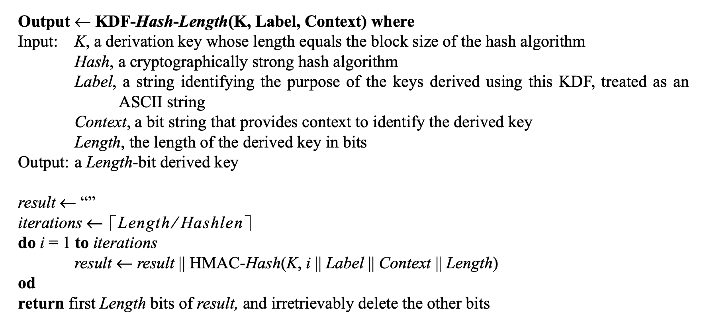
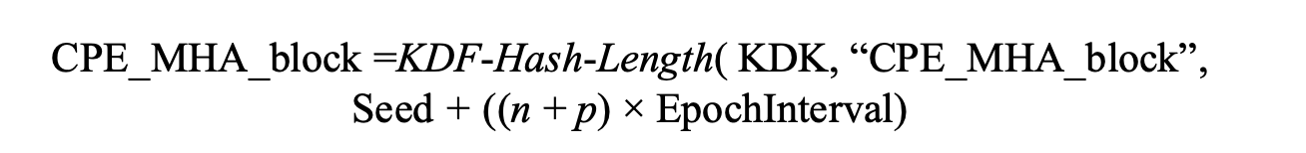
Current status
Seed is added to Context in KDF in our CPE_MHA_block computations and ΔΙΤ
In 10.71.3:
In 10.71.2.4:
Per-group Seed
Epoch Number
Epoch offset

Slide 3
Problem
CID 2071
When changing EPP Group only KDF’s Context changes
KDF's Context is a sum of integers, there’s some chance that eventually:
  Context[group X, epoch N_{X}, Seed_{X}] == Context[group Y, epoch N_{Y}, Seed_{Y}]
  And when this happens, it is likely that it will happen again and again
  Hence Common Subsequences of same FA Params (and hence MAC, SN/PN, etc..)
  Example:
  “If STA jumps from Group 1 to Group 2, in the next 100 epochs, it will re-use 7 FA params that it used in its life under Group 1”
Group | p | EpochInterval | Seed | Common Subsequence Length ( first 100 epochs)
1 | 0 | 14 | 89 | 7
2 | 1 | 5 | 65

Slide 4
Problem/example
5
G | E0 | E1 | E2 | E3 | E4 | E5 | E6 | E7 | E8 | E9 | E10 | E11 | E12 | E13 | E14 | E15 | E16 | E17 | E18 | E19
1 | 89 | 103 | 117 | 131 | 145 | 159 | 173 | 187 | 201 | 215 | 229 | 243 | 257 | 271 | 285 | 299 | 313 | 327 | 341 | 355
2 | 70 | 75 | 80 | 85 | 90 | 95 | 100 | 105 | 110 | 115 | 120 | 125 | 130 | 135 | 140 | 145 | 150 | 155 | 160 | 165
G | E21 | E22 | E23 | E24 | E24 | E25 | E26 | E27 | E28 | E29 | E30 | E31 | E32 | E33 | E34 | E35 | E36 | E37 | E38 | E39
1 | 369 | 383 | 397 | 411 | 425 | 439 | 453 | 467 | 481 | 495 | 509 | 523 | 537 | 551 | 565 | 579 | 593 | 607 | 677 | 691
2 | 170 | 175 | 180 | 185 | 190 | 195 | 200 | 205 | 210 | 215 | 220 | 225 | 230 | 235 | 240 | 245 | 250 | 255 | 260 | 265
14
Group | p | EpochInterval | Seed
1 | 0 | 14 | 89
2 | 1 | 5 | 65

Slide 5
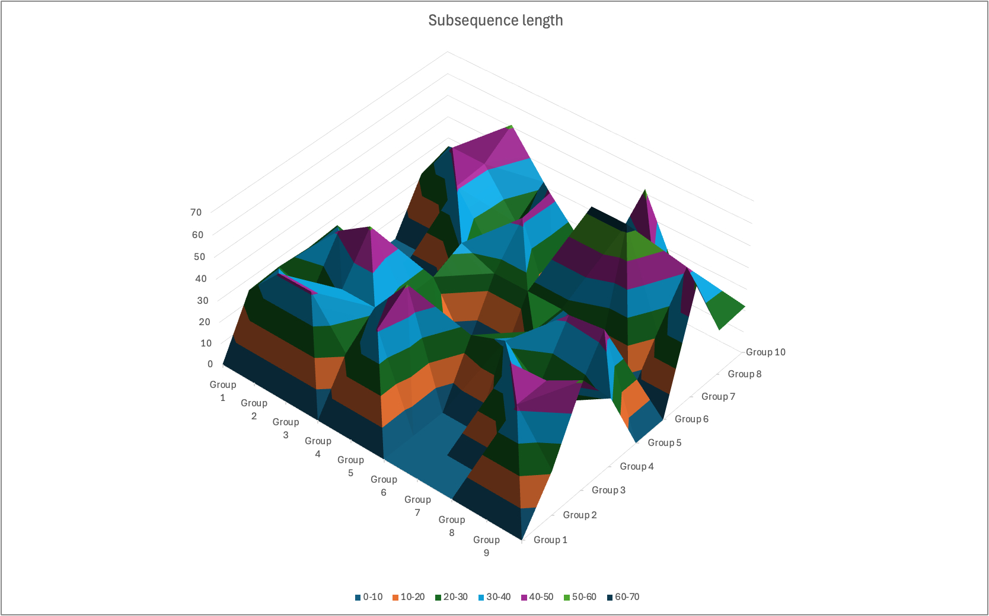
Problem/Example –fancier graph
Test with 1000 epochs and 10 groups, random params

Slide 6
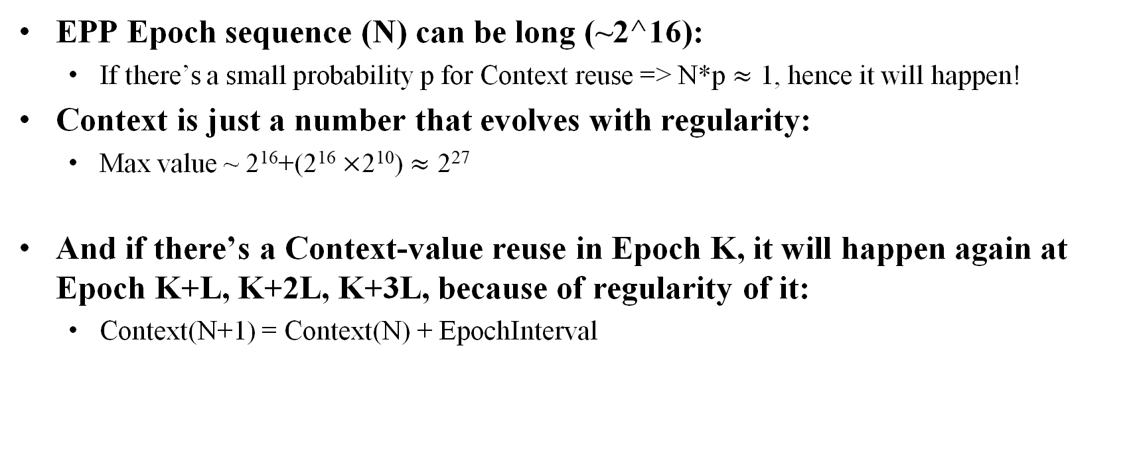
Problem/why?
EPP Epoch sequence (N) can be long (~2^16):
  If there’s a small probability p for Context reuse => N*p $≈$ 1, hence it will happen!
Context is just a number that evolves with regularity:
  Max value ~ 2¹⁶+(2¹⁶ $×$2¹⁰) $≈$ 2²⁷
And if there’s a Context-value reuse in Epoch K, it will happen again at Epoch K+L, K+2L, K+3L, because of regularity of it:
  Context(N+1) = Context(N) + EpochInterval

Slide 7
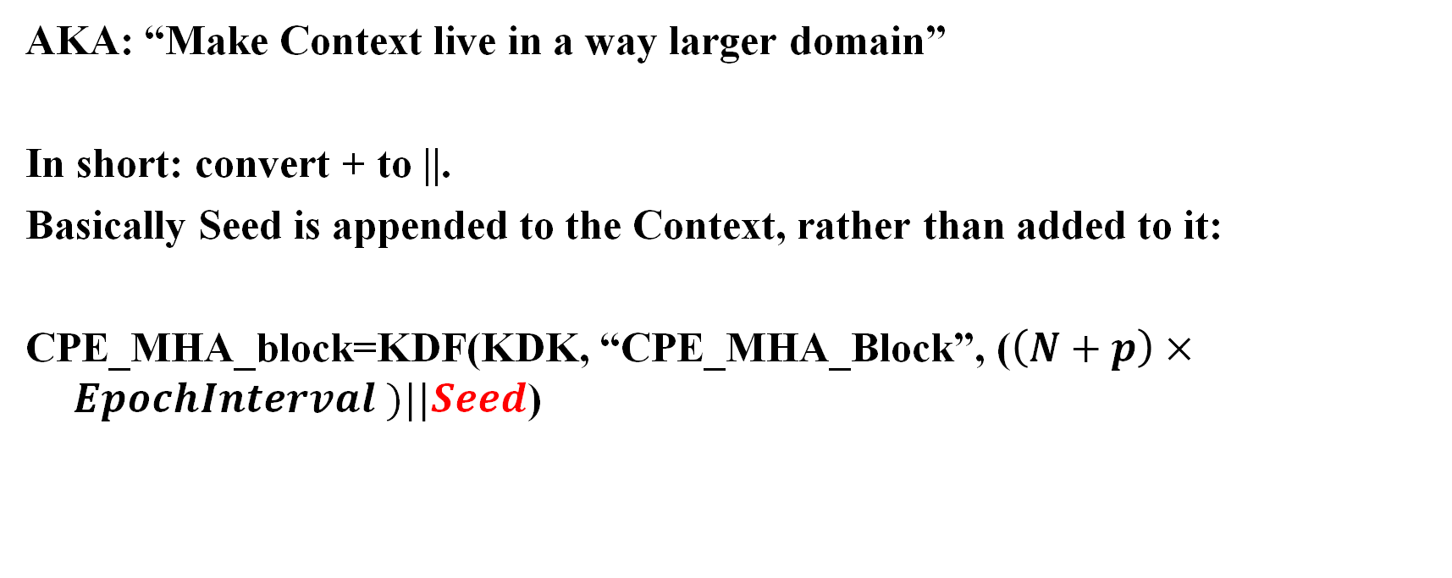
Proposal option 1
AKA: “Make Context live in a way larger domain”
In short: convert + to ||.
Basically Seed is appended to the Context, rather than added to it:
CPE_MHA_block=KDF(KDK, “CPE_MHA_Block”, ($\left(N+p\right)×EpochInterval )||Seed$)

Slide 8
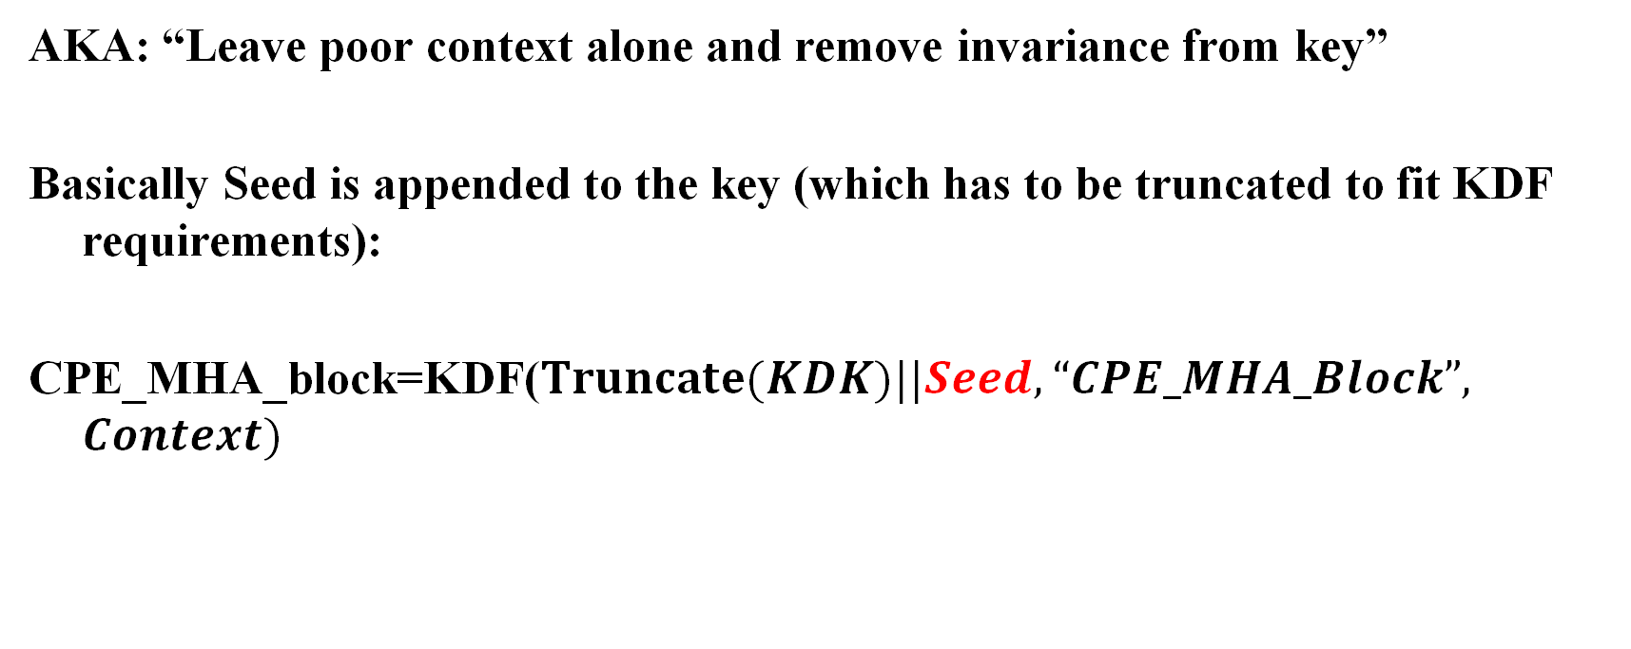
Proposal option 2
AKA: “Leave poor context alone and remove invariance from key”
Basically Seed is appended to the key (which has to be truncated to fit KDF requirements):
CPE_MHA_block=KDF($Truncate(KDK)||Seed, “CPE_MHA_Block”, Context)$

Slide 9
Results
From Group to Group | Common Subsequence Length (Current) | Common Subsequence Length (option 1) | Common Subsequence Length (option 2)
1 to 2 | 20 | 0 | 0
1 to 3 | 141 | 0 | 0
1 to 4 | 20 | 0 | 0
1 to 5 | 20 | 0 | 0
1 to 6 | 21 | 0 | 0
1 to 7 | 20 | 0 | 0

Slide 10
Option 1 vs Option 2: baseline (80211-2024) analysis
Option 1
Context is a function of 2+ params in:
Option 2
K is a function of 2+ params:
12.4.5.4
12.7.1.3
12.7.1.6.3
12.7.1.6.4
12.7.1.6.5
12.7.8.2
12.10.2
12.11.2.5.3
12.13.8
14.6.7
11.21.6.4.5.4
12.4.4.2.2
12.4.4.3.1
12.7.8.2
12.10.2

Slide 11
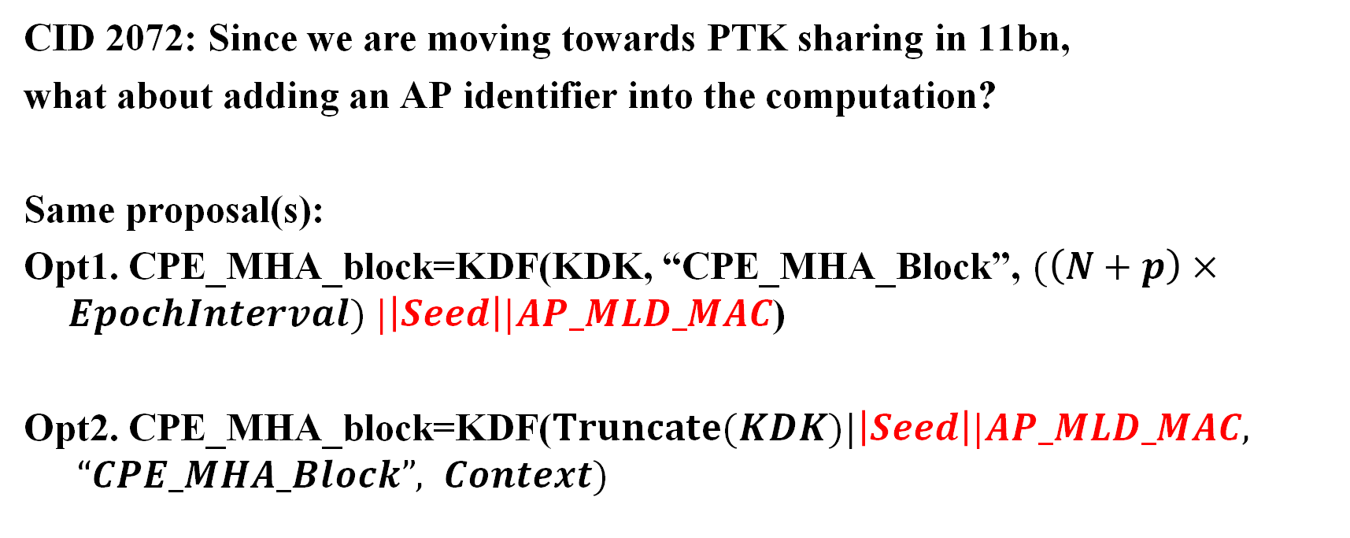
Problem 2
CID 2072: Since we are moving towards PTK sharing in 11bn,
what about adding an AP identifier into the computation?
Same proposal(s):
Opt1. CPE_MHA_block=KDF(KDK, “CPE_MHA_Block”, $(\left(N+p\right)×EpochInterval) |\left|Seed\right||AP_MLD_MAC$)
Opt2. CPE_MHA_block=KDF($Truncate(KDK)|\left|Seed\right||AP_MLD_MAC, “CPE_MHA_Block”, Context)$

Slide 12
Straw Poll #1
Do you agree that CPE_MHA_block and DeltaIT computation must avoid the appearance of common subsequences of FA Params when a STA moves between two different EPP Groups?
Yes
No
Abstain

Slide 13
Straw Poll #2
Do you agree that CPE_MHA_block computation and DeltaIT must include Seed via :
Option 1 – in the KDF's Context
Option 2 – in the KDF's K param
Abstain

Slide 14
Straw Poll #3
Do you agree that CPE_MHA_block computation and DeltaIT must include AP_MLD_MAC via :
Option 1 – in the KDF's Context
Option 2 – in the KDF's K param
Abstain

Slide 15
Appendix – Example Python code
from hashlib import sha256
import hmac, random
def hmac_sha256(key, message):
return hmac.new(key, message.encode('utf-8'), sha256).digest()
def kdf(kdk, label, context):
return hmac_sha256(kdk, label + str(context))
def mha_block(kdk, seed, n, p, interval):
return kdf(kdk, "CPE_MHA_block", seed + (n + p) * interval)
def mha_block_opt1(kdk, seed, n, p, interval):
a = bytes(str((n + p) * interval), 'utf-8')
b = bytes(str(seed), 'utf-8')
return kdf(kdk, "CPE_MHA_block", a + b)
def mha_block_opt2(kdk, seed, n, p, interval):
return kdf(kdk + bytes(str(seed), 'utf-8'), "CPE_MHA_block", (n+ p) * interval)
Current
Option 1
Option 2

Slide 16
Appendix – Example Python code/2
random.seed(4242)
#STA's KDK
kdk = b'secret'
n_groups = 8
n_epochs = 1000
sta_mha_blocks = [[] for _ in range(n_groups)]
sta_mha_blocks_opt1 = [[] for _ in range(n_groups)]
sta_mha_blocks_opt2 = [[] for _ in range(n_groups)]
for k in range(n_groups):
interval = random.randint(10, 50)
offset = random.randint(0, 3)
seed = random.randint(100, 700)
print(f"Group {k}: Interval = {interval}, Offset = {offset}, seed = {seed} ")
for i in range(n_epochs):
sta_mha_blocks[k].append(mha_block(kdk, seed, i, offset, interval).hex())
sta_mha_blocks_opt1[k].append(mha_block_opt1(kdk, seed, i, offset, interval).hex())
sta_mha_blocks_opt2[k].append(mha_block_opt2(kdk, seed, i, offset, interval).hex())
Generate 8 groups and the CPE_MHA_block for 1000 epochs

Slide 17
Appendix – Example Python code/3
def subsequence_len(a, b):
"""
Compute how long the longest common subsequence is between two lists.
"""
base = 0
count = 0
for i in range(len(a)):
for j in range(base, len(b)):
if a[i] == b[j]:
count += 1
base = j + 1
return count
for i in range(n_groups):
for j in range(i + 1, n_groups):
print("Group ", i," to ", j, ":", subsequence_len(sta_mha_blocks[i], sta_mha_blocks[j]),
subsequence_len(sta_mha_blocks_opt1[i], sta_mha_blocks_opt1[j]),
subsequence_len(sta_mha_blocks_opt2[i], sta_mha_blocks_opt2[j]))
Compute common subsequences

