Slide 1
AMP Frame Format – Follow Up
Date: 13 September 2025
Name | Affiliation | Address | Phone | Email
Rojan Chitrakar | Huawei | Singapore |  | rojan.chitrakar@huawei.com
Lei Huang
Ian Bajaj
Mahmoud Hasabelnaby
Notes:
Jul 12, 2010
Page 1

Slide 2

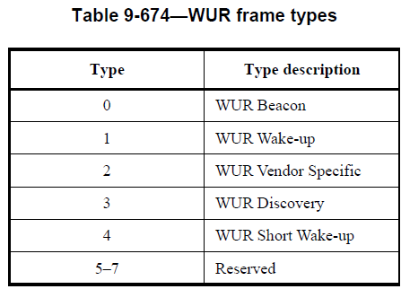
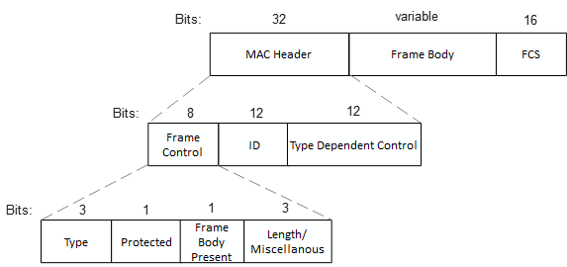
AMP Frame Format - General
1) Convergence on the basic components of AMP Frame format [6]:
A MAC header
A variable-length frame body, which if present, contains information specific to the frame type
An FCS, which contains either a TBD-bit CRC or a 16-bit MIC
  Whether FCS is always present or not for backscatter PPDUs is TBD
2) There may be an indication in AMP PPDU to differentiate between backscatter and non-backscatter AMP frames [6].
3) Some preference for non-backscatter AMP frames to reuse WUR frame format [6].
Only 3 Type values left for AMP.
A single ID field with size of 12 bits.
3-bits Length field to indicate the size of the Frame Body field between 2 and 16 octets in length.
Possible/necessary to reuse WUR frames for AMP?
WUR frame format

Slide 3
Discussion
If we need to retain the WUR frame format defined by 11ba for AMP WUR frames, the AMP frame design will be constrained by the WUR frame format since there is a hard requirement to confirm to the WUR frame format.
Proposal: 802.11bp supports three categories of AMP frames:
AMP WUR frames: for communication with AMP Enabled non-AP STAs
Non-backscatter AMP frames: for communication with Active Tx non-AP AMP STAs
Backscatter AMP frames: for communication with backscatter non-AP AMP STAs
It is unlikely that the differentiation between the three frame categories can be made in the AMP PHY. Hence MAC level indication is required.
  Target: retain the WUR frame format defined by 11ba for AMP WUR frames while allowing flexibility for non-WUR AMP frames

Slide 4
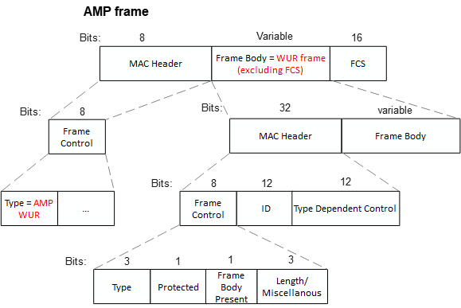
Option 1: Encapsulating WUR frames [7]
One AMP frame type value is assigned for AMP WUR frames, that indicates the encapsulation of the WUR frame in the Frame Body field of an AMP frame.
The WUR frame (excluding the FCS) is carried in the Frame Body and follows the format defined in 802.11ba.
FCS carries CRC or MIC computed over the entire AMP frame.
Backscatter and non-backscatter AMP frames can be differentiated using different Type values.
Pros: 100% reuse of the 802.11ba frame format, except for the FCS field.
Cons: One octet overhead of the AMP Frame Control field.

Slide 5
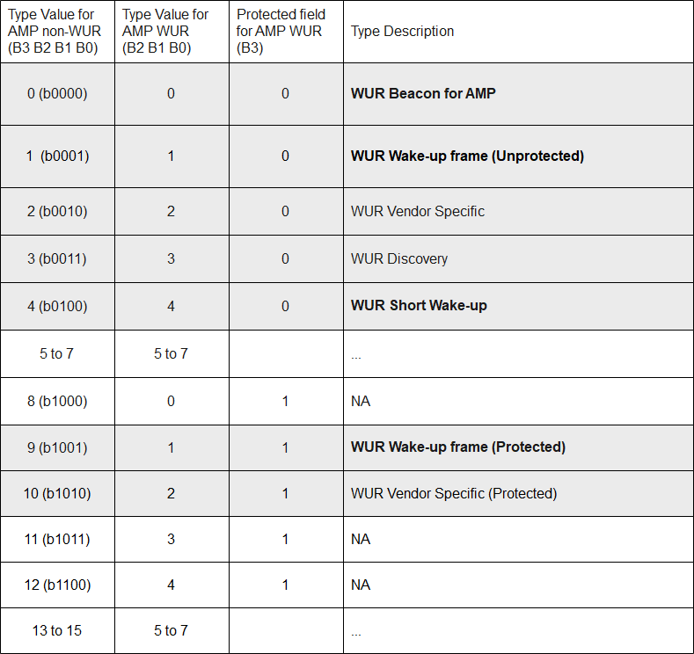
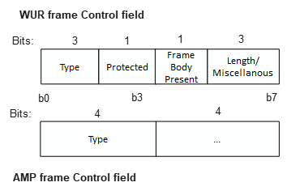
Option 2: Using Type field (1/2)
802.11ba encoding
Assuming we use the first 4 bits of the FC as Type field for AMP frames, we can differentiate WUR frames based on the combination of WUR frame Type field (b0 – b2) and the Protected field (b3).
We suggest to limit the types of WUR frames to be supported in AMP to a sub-set (e.g., 3). Further unused combination of WUR frame Type and Protection field can be used for non-WUR AMP frames.
AMP Vendor specific frames can be defined that can be reused for WUR.
Pros: 100% reuse of the 802.11ba frame format
Cons: 1) Not all WUR frames can be supported. 2) Limited Type values for non-WUR AMP frames.

Slide 6
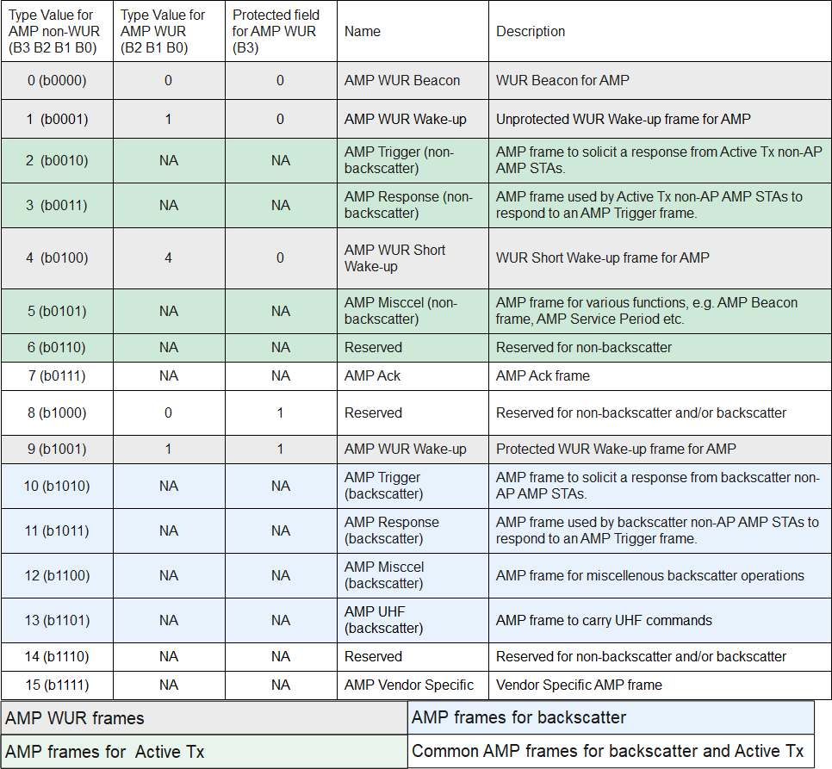
Option 2: Using Type field (2/2)
Example of Type value allocation:
  4 types for AMP WUR
    WUR Beacon
    Unprotected WUR Wake-up
    Protected WUR Wake-up
    WUR Short Wake-up
  4 types exclusively for Active Tx
    AMP Trigger
    AMP Response
    AMP Miscel
    1 Reserved
  4 types exclusively for backscatter
    AMP Trigger
    AMP Response
    AMP Miscel
    AMP UHF
  1 type common to Active Tx and backscatter
    AMP Ack
  1 type common to all
    AMP Vendor Specific
  2 Reserved

Slide 7
AMP WUR frames
If the Type field indicates a valid AMP WUR frame (e.g., 0, 1, 4, 9), an AMP enabled non-AP STA proceeds to parse the frame as per the WUR frame format. If supported, Vendor Specific AMP frame may be accepted.
An AMP enabled non-AP STA discards AMP frames with Type field set to other values.
WUR frame format

Slide 8
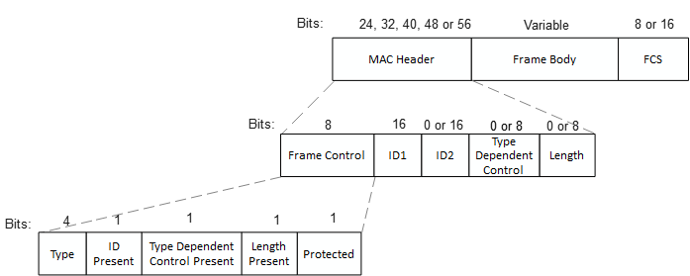
Non-backscatter AMP frames (1/2)
MAC Header:
Frame Control (8 bits):
Frame Type (4 bits): Indicates various AMP frame types
ID Present (1 bit): Presence of a second ID field
Type Dependent Control Present (1): Presence of Type Dependent Control field.
Length Present (1 bit): Presence of Length field
Protected (1 bit): Protection enabled or not
ID1 (16 bits): Carries Receiver ID in frames with two ID fields, or either Receiver or Transmitter ID in frames with single ID field.
ID2 (16 bits): If present, carries Transmitter ID.
Type Dependent Control field (8 bits): If present, carries additional control fields, e.g., sub-type, presence bits for optional fields in the Frame Body field etc.
Length (8 bits): If present, indicates the length of the Frame Body field in octets (i.e., max size = 256 octets).

Slide 9
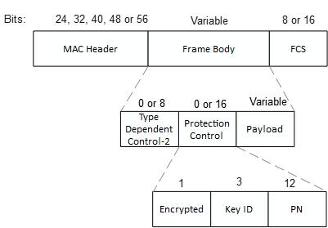
Non-backscatter AMP frames (2/2)
Frame Body:
Type Dependent Control-2 field (8 bits): If present, carries additional control fields, e.g., additional presence bits for optional fields in the Frame Body field etc. Presence is indicated in the Type Dependent Control field.
Protection Control (16 bits): If present carries parameters related to frame protection:
  Encrypted (1 bit): 0: Authenticated; 1: Frame Body is Encrypted
  Key ID (3 bits): ID of the security Key
  PN (12 bits): PN used for protected AMP frames.
Payload field: If present, carries the payload of the frame.
FCS:
Unprotected AMP frames: Carries the CRC (either CRC-8 or CRC-16).
Protected AMP frames: Carries the 16-bits MIC (e.g., 16 LSBs of the MIC generated using the applicable data confidentiality and integrity protocols).

Slide 10
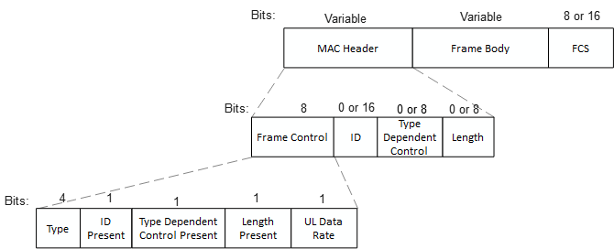
Backscatter AMP frames (1)
MAC Header:
Frame Control (8 bits):
Frame Type (4 bits): Indicates various AMP frame types
ID Present (1 bit): Presence of the ID field
Type Dependent Control Present (1): Presence of Type Dependent Control field.
Length Present (1 bit): Presence of Length field
ID (16 bits): If present, carries either Receiver or Transmitter ID.
Type Dependent Control field (8 bits): If present, carries additional control fields, e.g., sub-type, UL data rate etc.
Length (8 bits): If present, indicates the length of the Frame Body field in octets (i.e., max size = 256 octets).
Frame Body: If present, carries the payload of the frame.
FCS: Carries the CRC (either CRC-8 or CRC-16).

Slide 11
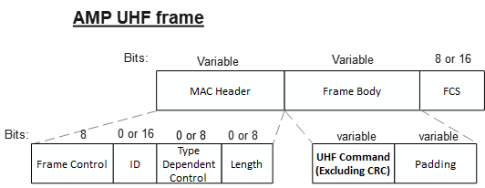
Backscatter AMP frames (2)
AMP UHF frame:
Backscatter AMP frame used to carry UHF commands
UHF Command field: carries the UHF command as defined by the UHF RFID standard, excluding CRC if any.
Padding field: a number of padding bits to make the Frame Body field octet aligned.
FCS: Carries the CRC (either CRC-8 or CRC-16) computed over the MAC Header and the Frame Body field.

Slide 12
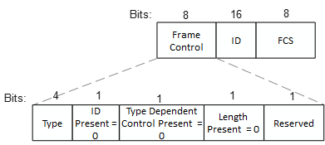
AMP Ack frame
Can be used for both backscatter and non-backscatter
Frame Control (8 bits):
Frame Type (4 bits): Set as AMP Ack
All 4 remaining bits set as 0.
ID (16 bits): Always present and carries Receiver ID.
FCS: Carries the 8-bits CRC (CRC-8).

Slide 13
Summary
We proposed that 802.11bp defines three categories of AMP frames:
  AMP WUR frames: for communication with AMP Enabled non-AP STAs
  Non-backscatter AMP frames: for communication with Active Tx non-AP AMP STAs
  Backscatter AMP frames: for communication with backscatter non-AP AMP STAs
We discussed two possible options to incorporate WUR frames for AMP usage:
  One AMP frame type value is assigned for AMP WUR frames, that indicates the encapsulation of the WUR frame in the Frame Body field of an AMP frame.
  Differentiate WUR frames based on the combination of WUR frame Type field (b0 – b2) and the Protected field (b3).
Backscatter and non-backscatter AMP frames can be differentiated using different Type values.
Format of the AMP Ack frame can be the same for both backscatter and non-backscatter.

Slide 14
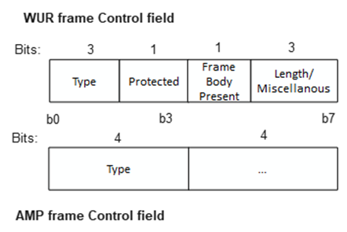
SP 1
Do you agree to add to 11bp SFD:
The Type field is the first 4 bits of the Frame Control field of AMP frames and differentiates between:
  AMP WUR frames: AMP frames for communication with AMP Enabled non-AP STAs
    The frame format of AMP WUR frames inherit from WUR frames defined by IEEE 802.11ba.
  Non-backscatter AMP frames: AMP frames for communication with Active Tx non-AP AMP STAs
  Backscatter AMP frames: AMP frames for communication with backscatter non-AP AMP STAs

Slide 15
SP 2
Do you agree to add to 11bp SFD:
The size of the ID field(s) in AMP frames for communication with Active Tx non-AP AMP STAs and Backscatter non-AP AMP STAs is 16 bits.

Slide 16
SP 3
Do you agree to add to 11bp SFD:
The size of the Type Dependent Control field, if present in the MAC Header field of AMP frames for communication with Active Tx non-AP AMP STAs and Backscatter non-AP AMP STAs is 8 bits.

Slide 17
SP 4
Do you agree to add to 11bp SFD:
The length of the Frame Body field, if present in AMP frames for communication with Active Tx non-AP AMP STAs and Backscatter non-AP AMP STAs, is indicated in octets by a Length field in the MAC Header
  The size of the Length field is TBD bits.

Slide 18
SP 5
Do you agree to add to 11bp SFD:
A second ID field may be present to indicate Transmitter ID in AMP frames for communication with Active Tx non-AP AMP STAs.

Slide 19
SP 6
Do you agree to add to 11bp SFD:
A Protected field is present in the Frame Control field of AMP frames for communication with Active Tx non-AP AMP STAs to indicate whether the AMP frame is protected by a security algorithm.
  If the AMP frame is protected, a Protection Control field is carried in the Frame Body of the AMP frame. The size of the Protection Control field is TBD bits.
  The security algorithm is TBD.

Slide 20
SP 7
Do you agree to add to 11bp SFD:
11bp defines one type of AMP frames for communication with Backscatter non-AP AMP STAs to carry a UHF command.
  The UHF command, excluding CRC if any, is carried in the Frame Body field of the AMP Frame.
  NOTE – The UHF commands are defined by the EPC® Radio-Frequency Identity Generation-2 Ver-2 UHF RFID Standard.

Slide 21
References
[1] 24/1811r0, Frame format discussion (Liwen Chu et. al.)
[2] 25/0817r0, Channel access for Active Tx non-AP AMP STAs – follow up (Rojan Chitrakar et. al.)
[3] 25/0818r0, Channel access for Backscatter non-AP AMP STAs – way forward (Rojan Chitrakar et. al.)
[4] 24/1198, UL Data Rate for AMP (Yinan et. al.)
[5] 25/0398r0, AMP frames (Alfred Asterjadhi et. al)
[6] 25/0776r2, AMP frames – follow up (Alfred Asterjadhi et. al)
[7] 25/1246r0, AMP WUR Frame Format (Ian Bajaj et. al.)

