Slide 1
AMP Channel Access – follow up
Date: 13 September 2025
Name | Affiliation | Address | Phone | Email
Rojan Chitrakar | Huawei | Singapore |  | rojan.chitrakar@huawei.com
Lei Huang
Ian Bajaj
Qingrui Pan
Notes:
Jul 12, 2010
Page 1

Slide 2
Recent related Motions in SFD
FM-9: An AMP AP transmits an AMP Trigger frame indicating a time-slot based random access session for non-AP AMP STAs. The frame carries:
Random Access Parameters: Indicates parameters for random access
Parameters for random access are TBD.
MM-27: Upon receiving the AMP Trigger frame indicating a time-slot based random access session, a non-AP AMP STA performs the following actions:
Based on the Random Access Parameters, the non-AP AMP STA may transmit an uplink AMP PPDU carrying the uplink response in one of the slots allocated by the AMP Trigger frame.
In this contribution we clarify what the key Random Access Parameters are.

Slide 3
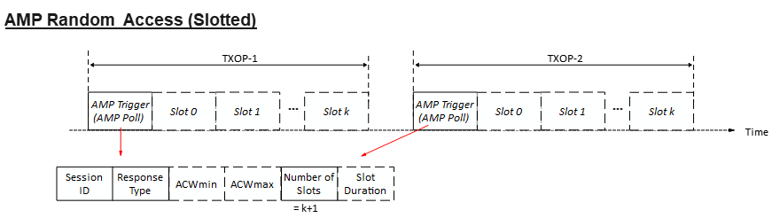
Recap [5]: AMP Random Access (Slotted)
In a slotted (or multi-slot) random access, the AMP Trigger frame allocates two or more consecutive slots for uplink transmissions in a TXOP. The AMP Trigger frame indicates:
Session ID: Identifies a random access session.
Response Type: Type of the solicited uplink response e.g., ID, EPC, Sensor Data, Unspecified etc.
ACW (AMP Contention Window):
ACWmin: Smallest ACW
ACWmax: Largest ACW
Number of Slots (N): The number of slots immediately after the AMP Trigger frame that are allocated for uplink transmissions.
Slot Duration: Duration of a time-slot.
Non-AP AMP STA’s actions:
1) Upon receiving an AMP Trigger frame with a new session ID :
ACW is initialized to ACWmin
ABO Counter (ABOC) is initialized to a random value in [0, ACW]
Contend for uplink transmission
2) Upon receiving an AMP Trigger frame (with a known session ID) and the STA hasn’t transmitted yet:
Contend for uplink transmission
3) Upon receiving an AMP Trigger frame (with a known session ID) after an unsuccessful* transmission:
ACW = min (2*ACW + 1, ACWmax)
ABO counter is initialized to a random value in [0, ACW]
Contend for uplink transmission
Contend for uplink transmission:
If ABO Counter < N (Number of Slots), the non-AP AMP STA transmits in a slot (= ABOC) allocated by the AMP Trigger frame.
Else, STA cannot transmit. ABO counter = ABO counter – N;
* Non-AP AMP STAs that have successfully transmitted do not contend again in the same session

Slide 4
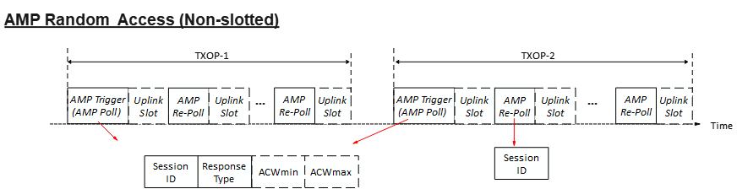
Recap [5]: AMP Random Access (Non-slotted)
In a non-slotted (or single-slot) random access, every slot for uplink transmission begins with a downlink AMP frame (e.g., an AMP Trigger frame). The AMP Trigger frame indicates:
Session ID: Identifies a random access session.
Response Type: Type of the solicited uplink response e.g., ID, EPC, Sensor Data, Unspecified etc.
ACW (AMP Contention Window):
ACWmin: Smallest ACW
ACWmax: Largest ACW
Slot Duration: (Optional) Duration of a time-slot.
Note: Number of Slots is not required for non-slotted uplink access and is assumed to be 1, i.e., N = 1.
A variant of AMP Trigger frame (AMP Re-Poll) is used to continue the random access within a TXOP and indicates:
Session ID: Identifies the random access session.
Non-AP AMP STA’s actions:
1) Upon receiving an AMP Poll frame with a new session ID :
ACW is initialized to ACWmin
ABO Counter (ABOC) is initialized to a random value in [0, ACW]
Contend for uplink transmission
2) Upon receiving an AMP Poll frame or an AMP Re-Poll frame with a known session ID:
Contend for uplink transmission
3) Upon receiving an AMP Poll frame (with a known session ID) after an unsuccessful* transmission:
ACW = min (2*ACW + 1, ACWmax)
ABO counter is initialized to a random value in [0, ACW]
Contend for uplink transmission
Contend for uplink transmission:
If ABO Counter = 0, STA transmits in the slot.
Else, STA cannot transmit. ABO counter = ABO counter – 1;
* STA that have successfully transmitted do not contend again in the same session

Slide 5
Discussion
The number of non-AP AMP STAs in some deployments (smart agriculture, smart manufacturing, warehouse etc.) can be hundreds to thousands. [1]
AMP Random access should be scalable, from a few STAs to hundreds or even thousands of STAs.
The non-AP AMP STAs in some deployments (logistics, warehouse, retail etc.) can be mobile, with speeds of 1.5 – 2 m/s. [1]
AMP Random access should be efficient, able to complete within reasonable time (e.g., in seconds).
The non-AP AMP STAs may experience high level of interference (esp. in DL) in some deployments. [6]
AMP Random access should be robust, able to continue despite occasional or even frequent DL failures.
We will discuss the important parameters of the proposed random access scheme based on the above qualities.

Slide 6
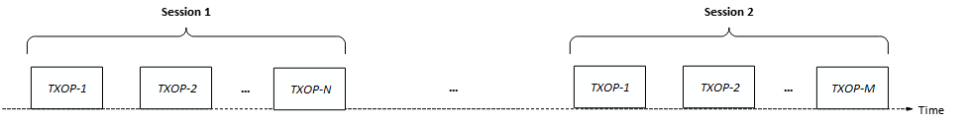
Session ID
The number of available time-slots for uplink transmission during a random access TXOP is not expected to be high. E.g., @250 Kbps for DL & UL and 3ms TXOP limit, the number of uplink time-slots may be:
2 (for uplink AMP frame of 20 Octets)
5 (for uplink AMP frame of 10 Octets)
9 (for uplink AMP frame of 6 Octets)
The chances of all STAs successfully completing their uplink transmissions via random access in a single TXOP may be very low. Hence, a random access session needs to continue across two or more TXOPs.
The Session ID field in AMP Trigger frames, when set to the same value, identifies TXOPs (or AMP Trigger frames) of the same random access session. One random access session may represent one inventory round, or one reading cycle etc. The Session ID is used to stop a STA that has already successfully transmitted in a random access session from contending for access repeatedly.

Slide 7
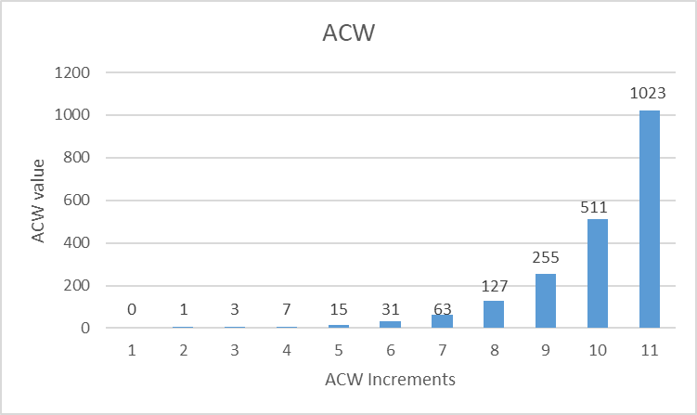
AMP Contention Window (ACW)
The concept of Contention window (CW) is the foundation for random backoff procedure in 802.11 CSMA/CA and is proven to work well in different traffic loads. A version adapted for frequency domain, OFDMA contention window (OCW) was introduced for UORA in 802.11ax. We propose to adapt the CW based random access for AMP.
AMP AP indicates two ACW parameters in an AMP Trigger frame:
ACWmin: Determines the upper bound for the slot index range for the initial uplink transmission attempt.
ACWmax: Determines the upper bound for the slot index range for retransmission attempts.
May be encoded in an exponent form. ACWmin = 2^{ACWEmin} – 1; ACWmax = 2^{ACWEmax} – 1;
A non-AP AMP STA maintains an ACW and an ABO Counter (ABOC)
ACW is initialized to ACWmin and ABO Counter (ABOC) is initialized to a random value in [0, ACW]. The ABOC determines the slot index of the STA’s uplink transmission.
If a STA’s uplink transmission is unsuccessful, ACW is updated to (2*ACW + 1) until it reaches ACWmax and ABO Counter (ABOC) is initialized to a random value in [0, ACW] for the next retransmission. This helps to reduce collisions by spreading out the transmission attempts.
STAs that have successfully transmitted do not contend again in the same session.
AMP AP can adjust the ACWmin and ACWmax based on deployment scenarios. Some evaluation results are shared in [7].

Slide 8
Slot Duration and Number of slots
In the slotted (or multi-slot) random access, an AMP Trigger frame also indicates:
Number of Slots (N): The number of slots immediately after the AMP Trigger frame that are allocated for uplink transmissions.
Slot Duration: Duration of each time-slot. The duration should be sufficient for the expected transmission time of the uplink response at the selected uplink data rate and any guard intervals etc.
In non-slotted (or single-slot) random access, since an uplink time-slot is always indicated by a downlink transmission from the AMP AP, the Number of slots and Slot Duration parameters may not be required in the AMP Trigger frame.

Slide 9
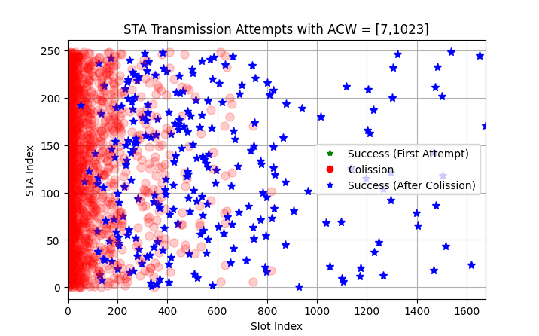
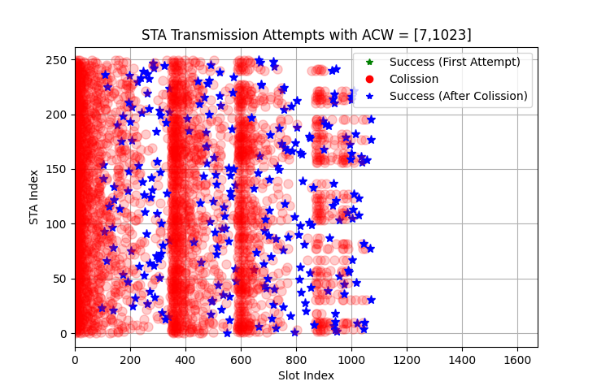
Recontend
An inventory round for 250 tags
The doubling of the ACW is very effective in spreading out the retransmission attempts even with a very bad choice of the initial ACWmin, ACWmax values, as shown in the top figure. Given enough time (~ 2s in this example), the AMP AP is able to read 100% of the tags (250).
AMP AP may attempt to improve the time efficiency by instructing the non-AP AMP STAs to recontend with a smaller contention window (i.e., initialize ACW to ACWmin and chose a new ABO Counter in [0, ACWmin]). The AMP AP may signal recontend by setting a “Recontend” bit to 1 in the AMP Trigger frame.
Recontend allows non-AP AMP STAs that are still contending for access, to reset their ACW (to ACWmin) & pick a new ABOC and potentially chose an earlier slot.
The AMP AP may use the recontend feature to decide when to terminate the random access session (e.g., if there is no uplink responses within ACWmin slots after a recontend). Or, the AMP AP may also use the feature earlier in the session to reduce the total read time (as shown in the bottom figure).
recontend

Slide 10
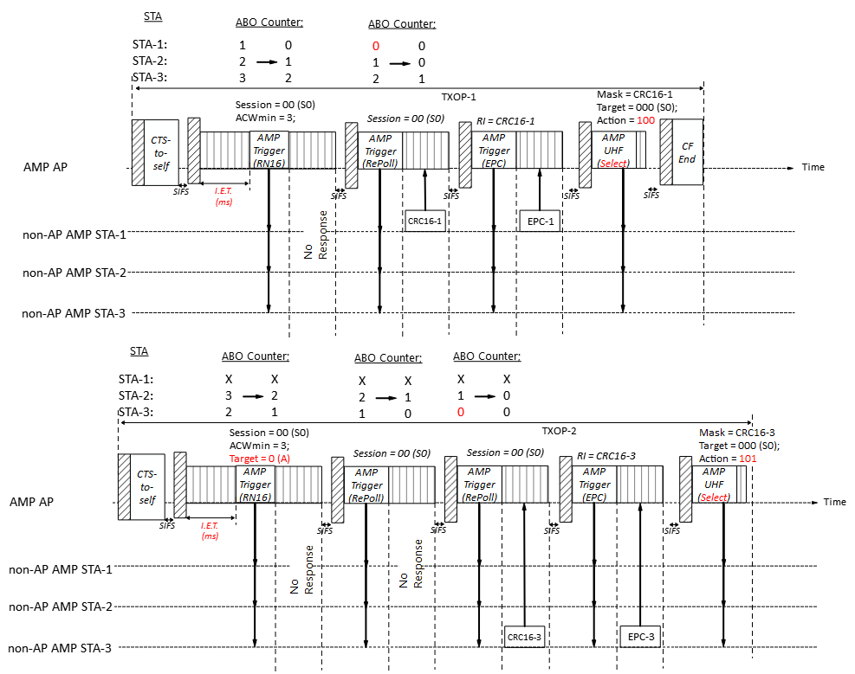
Example for backscatter
The non-slotted (or single-slot) version is suitable for backscatter communication.
For backscatter non-AP AMP STAs that do not have any persistent memory, even if just one EPC can be read in one TXOP, the persistent flags (e.g., Inventoried flags) and UHF Select commands can be used to progressively filter out STAs that have been read and continue the random access for remaining STAs in subsequent TXOPs.
E.g., in TXOP-1, AMP AP reads STA-1’s EPC and cause it to set its Inventoried flag S0 to B.
In TXOP-2, the AP limits the random access to STAs with Inventoried flag S0 = A (i.e., STA-2 and STA-3), hence filtering out STA-1.

Slide 11
Summary
We highlighted that our proposed random access scheme is scalable (i.e., applicable for a few STAs to hundreds or even thousands of STAs) while also being efficient (i.e., able to complete within reasonable time).
We also discussed the important parameters of the proposed random access scheme:
Session ID
ACW
Number of Slots and Slot Duration
We also shared the recontend feature that an AMP AP may use to instruct non-AP AMP STAs to reset their contention counter. Recontend may be used by AMP APs to decide when to terminate a random access session and/or to improve the time efficiency of the random access.

Slide 12
SP 1
Do you agree to add to amend FM-9 in the11bp SFD as:
An AMP AP transmits an AMP Trigger frame indicating a time-slot based random access session for non-AP AMP STAs. The frame carries following parameters:
Session ID: Identifies the random access session
ACW: Indicates the upper limit of the random access contention window
ACWmin: Indicates the minimum value of the upper limit of the random access contention window
ACWmax: Indicates the maximum value of the upper limit of the random access contention window
Encoding of parameters is TBD.
Other parameters are TBD.

Slide 13
SP 2
Do you agree to add to amend MM-27 in the11bp SFD as:
Upon receiving an AMP Trigger frame indicating a time-slot based random access session, a non-AP AMP STA performs the following actions:
If it is a new random access session, the non-AP AMP STA initializes ACW and randomly chooses an ABO Counter (ABOC) in the range [0, ACW]. Else, if it a known random access session and the non-AP AMP STA’s previous transmission in the session was unsuccessful, the non-AP AMP STA updates the ACW to (2*ACW+1) and randomly chooses an ABOC in the range [0, ACW].
If the ABOC is less than the number of slots (N) allocated by the AMP Trigger frame, the non-AP AMP STA transmits an uplink AMP PPDU carrying the uplink response in one of the slots allocated by the AMP Trigger frame. Else, ABO Counter is decremented by N.

Slide 14
References
[1] IEEE 802.11-23/0436r0, Technical Report on support of AMP IoT devices in WLAN
[2] 11-25/0817r0, Random access for Active Tx non-AP AMP STAs (Rojan Chitrakar)
[3] 11-25/0818r0, Channel access for Backscatter non-AP AMP STAs – way forward (Rojan Chitrakar)
[4] 11-25/917r0, Multiple TXOP discussion (Liwen)
[5] 11-25/1240r0, AMP Channel Access (Rojan Chitrakar)
[6] 11-25/1259r0, Some Issues for Access of AMP Devices (Amichai)
[7] 11-25/1542, AMP Random Access simulation (Qingrui Pan)

