Slide 1
AMP DL SYNC Design for Backscattering Operation
Date: 2025-09-13
Authors:

Slide 2
Introduction
DL SYNC for backscattering tags was discussed in [1, 2]
  Operating at high Rx power: ~-20dBm
  100k ppm: chip-by-chip detection
  Differentiate from UHF RFID waveform
  One data rate 250kbps in 2.4GHz band
Sub-1GHz mono-static backscattering [3]
  DL 62.5kbps data rate is agreed
  Other rates pending discussion
  SYNC design is TBD
SYNC design should be considered both bands to support multi-band tag.

Slide 3
AMP Backscattering Tag Sync Rx
Low power operating tag
  Low operating clock: 2MHz or lower, typical 1.28MHz when starting
    High clock ppm: 100k ppm (+/-10% inaccuracy)
  Tag Rx algorithm is simple and low-complexity
    e.g. counter-based ON-OFF duration detection
AMP tag to support both UHF RFID and AMP protocol
  Dual-mode Tag (AMP 2.4GHz + UHF Tag)
  Tri-mode Tag (AMP 2.4GHz + AMP sub-1GHz + UHF Tag)
  Single mode Tag should also be considered

Slide 4
Backscattering DL SYNC Consideration
“Orthogonal” to UHF RFID waveform
  UHF RFID operation has no TXOP limitation, e.g. 24 hours operation
  AMP Tag should NOT false triggered by UHF RFID waveform
  AMP waveform should also avoid false triggering UHF RFID function
“Orthogonal” between 2.4GHz and S1G bands
  AMP tag can distinguish the operating band from SYNC [1]
  This enables single antenna design
Single SYNC sequence for both bands
  Easier Tag Rx state machine
  Easier to find a good sequence that satisfy all requirement
Per-bit synchronization

Slide 5
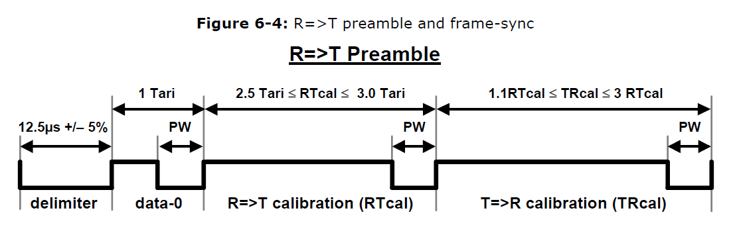
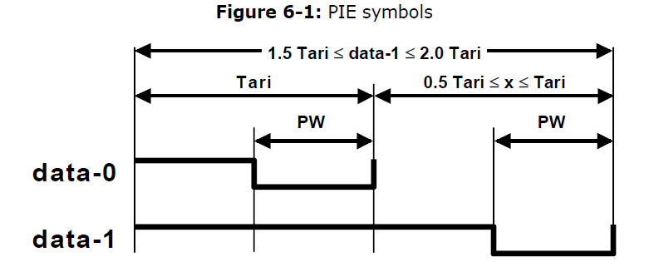
UHF RFID Waveform
Pulse width (PW): [max(0.265*Tari, 2µs), 0.525*Tari]
Tari: [6.25µs, 25µs]
Data-1: 1.5 Tari to 2 Tari

Slide 6
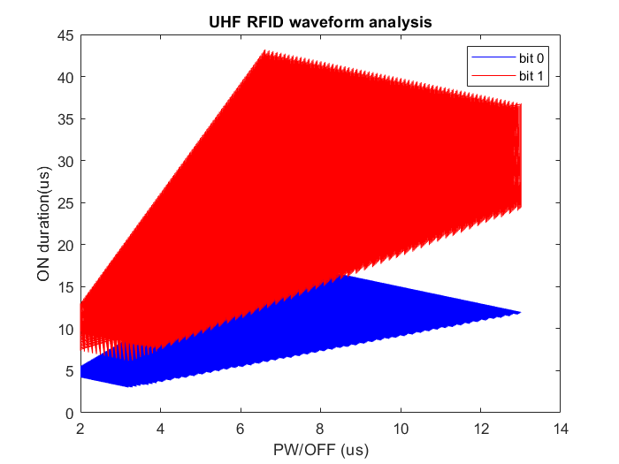
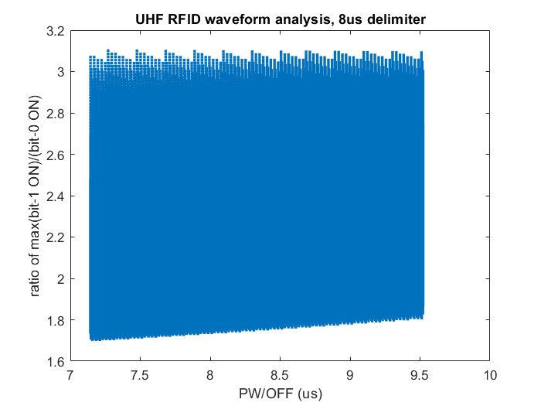
PW-OFF vs ON Analysis
Data-0 ON duration can be in the range (2.94, 18.6) us

Slide 7
AMP Waveform Recap
2.4GHz DL: chip duration of 2us
Sub-1GHz DL:
  Chip duration of 8us: agreed 62.5kbps rate (July)
  Other potential rates: 50kbps, 125kbps, …
Suggest to limit to one rate for S1G DL
  Fixed chip duration will make it easier to distinguish between different bands
  Fixed chip duration will make it easier to distinguish from UHF RFID wide-range of ON-OFF combinations

Slide 8
Backscattering DL SYNC
SYNC sequence (8 chips): 0 1 1 1 1 0 1 0
  “Delimiter” OFF: 1 chip
    Indicates the start of DL PPDU (after Excitation field)
    Indicate the band: AMP 2.4G (2us) vs AMP S1G (8us) or UHF (12.5us)
  “Qualifier” ON: 4 chips
    To differentiate AMP S1G from UHF RFID
    Disqualify false trigger from Manchester data portion
  “Manchester ON”: 1 chip
    To mitigate false trigger from UHF RFID PIE data
  Last transition provides timing for Data Manchester decoding
1 OFF
“delimiter”
4 ON
“Qualifier”
1 OFF
1 ON
1 OFF

Slide 9
Illustration of Waveforms
2.4G SYNC
S1G SYNC
UHF preamble
UHF data
2us
8us
2us
8us
32us
8us
12.5us
(2.94, 18.6) us
PW
1~2 Tari, 3us to 43us
PW

Slide 10
Preamble Performance Analysis
1.28MHz clock rate
+/-100k ppm
Counter based design
1 OFF
“delimiter”
4 ON
“Qualifier”
1 OFF
1 ON
1 OFF
 | “delimiter” OFF | “Qualifier” ON | Manchester ON “Qualifier” ON - Manchester ON*4
AMP 2.4G | 2 us | 8 us
 | [2, 3] | [9, 12] | [2, 4]
AMP S1G | 8 us | 32 us | 8 us
 | [9, 12] | [36, 46] | [1, 4]
UHF RFID preamble | 12.5 us (+/-5%) | Up to 18.6 us
 | [13 19] | Up to 27
UHF RFID data | Can be 2 or 8 us | Can be 8us or 32us
 |  |  | [-14, -3] if matches 2us delimiter [-38, -3] if matches 8us delimiter

Slide 11
Summary
Further investigated the DL SYNC for backscattering
  Revisit the SYNC design considering new sub-1GHz backscattering
  More detailed analysis of UHF RFID waveform properties
Updated SYNC structure:
  Enable simple SYNC detection at the tag with single sequence
  Support the multi-mode tag operation without mis-classification
  Mitigate the false trigger from UHF RFID waveform

Slide 12
SP
Do you agree to add the following to 11bp SFD?
  The AMP SYNC in DL PPDU for backscattering operation is [0 1 1 1 1 0 1 0] for both 2.4GHz and sub-1GHz bands?
  The SYNC chip duration for sub-1GHz is 8us

Slide 13
Reference
[1] 11-25/0075, Further Thoughts on AMP DL PPDU for Mono-static Backscattering
[2] 11-25-1230-00-00bp-AMP DL SYNC design considerations
[3] 11-25-1225-00-00bp-initial-thought-on-amp-s1g-phy-design

Slide 14
Appendix

Slide 15
Preamble mis-classification
Delimiter:
  (([2 4 8 12.5*0.95 16]*0.9)*1.28) => [2 4 9 13 18]
  (([2 4 8 12.5*1.05 16]*1.1)*1.28) => [3 6 12 19 23]
Qualifier:
  (18.375*1.01*1.1*1.28) => 27
  ([24 32 40]*0.9*1.28) => [27 36 46]

