Slide 1
AMP Random Access Simulation
Date: 13 September 2025
Name | Affiliation | Address | Phone | Email
Qingrui Pan | Huawei | Singapore |  | panqingrui@h-partners.com
Rojan Chitrakar
Lei Huang
Ian Bajaj
Notes:
Jul 12, 2010
Page 1

Slide 2
Simulation Configuration
Network Topology: Single AMP AP with multiple non-AP AMP STAs in the deployment
Performance Metric: Total TXOP/slot count for 100% inventory using the slotted random access mechanism presented in [2].
Configuration Parameters:
  Downlink (DL) Data Rate: 250 kbps; Uplink (UL) Data Rate: 250 kbps
  TXOP Limit: 3 ms; Slots per TXOP: 5
  Number of non-AP AMP STAs: 10, 50, 150, 250
  AMP Trigger (excluding preamble): 80 bits (320 µs)
  AMP Response (excluding preamble): 80 bits (320 µs)
  Slot Duration: The duration of an AMP Response(352 µs) plus a Guard interval of 20 µs.
  Effect of clock drift (i.e., inter-slot collision) is not considered
  Fixed time gap of 3ms between two consecutive TXOPs.

Slide 3
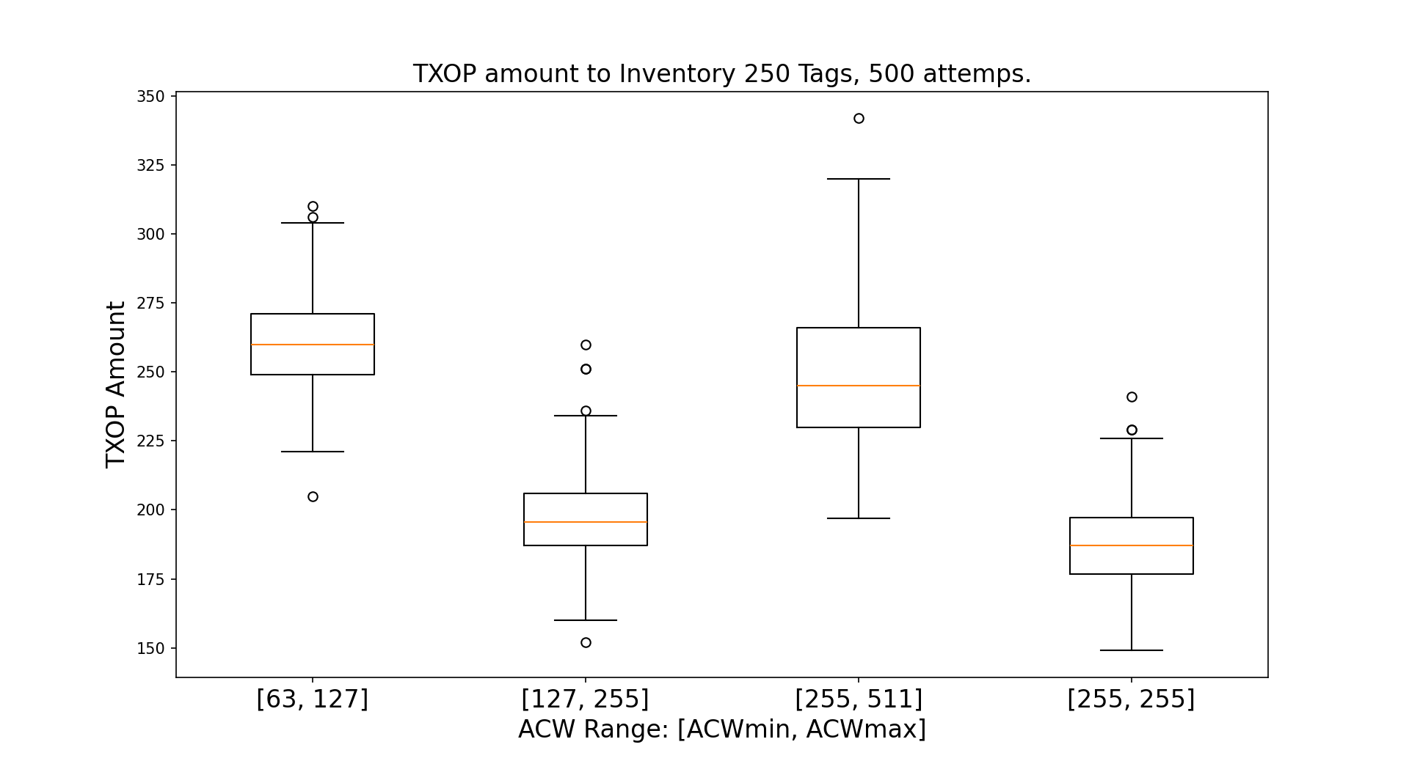
Impact of ACW range: [ACWmin, ACWmax]
A boxplot of the TXOP count for a 100% inventory of 250 STAs across 500 experimental attempts.
Observation: The median TXOP count is at its minimum when the ACW parameters, ACWmin​ and ACWmax​, are configured to values that most closely align with the actual number of contending STAs.
Component | Statistical Meaning
Middle Line | Median (50th percentile)
Box Height | Interquartile Range (IQR = Q3​−Q1​)
Top of Box | Third Quartile (Q3​)
Bottom of Box | First Quartile (Q1​)
Dots/Circles | Outliers
Notes:
ACW of STA starts at ACWmin, in case of unsuccessful transmission, ACW is updated to ACW*2+1, until it reaches ACWmax.

Slide 4
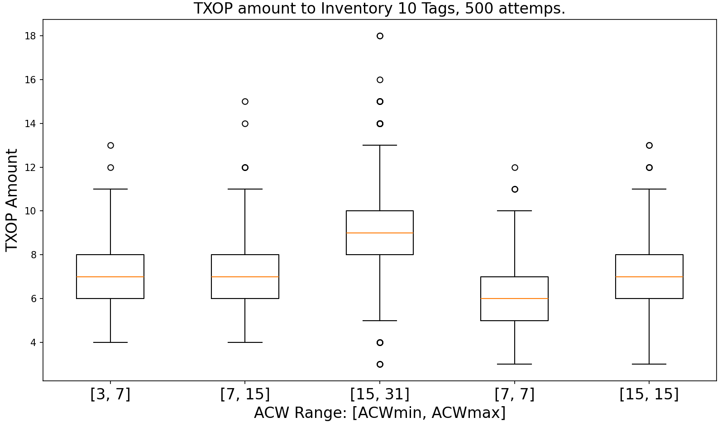
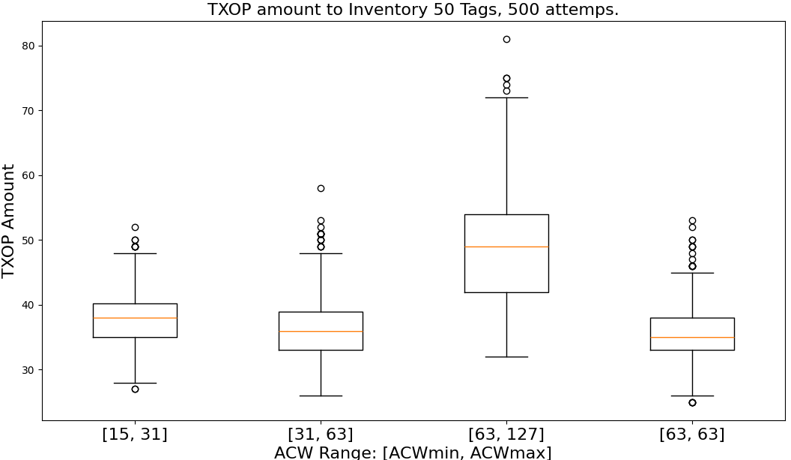
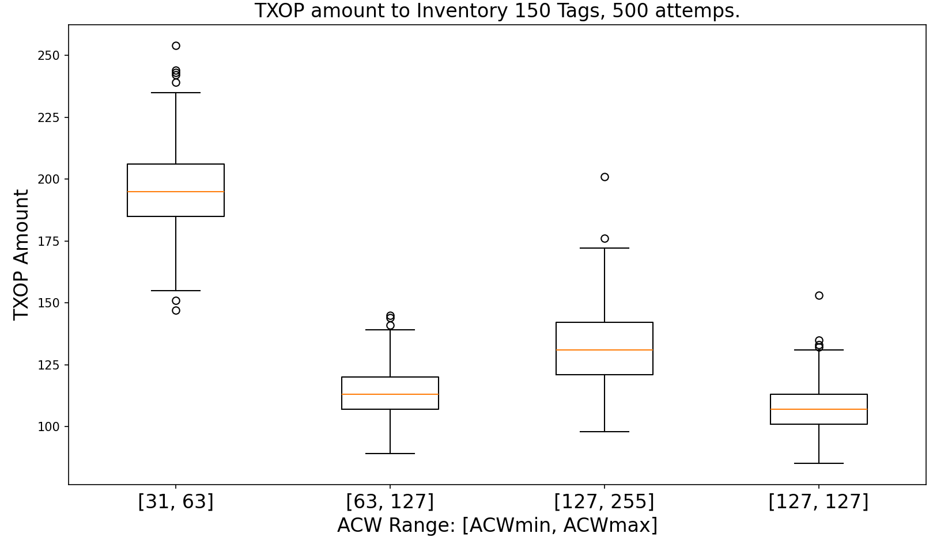
Impact of ACW range: [ACWmin, ACWmax]
10 STAs
Best ACW:
  ACWmin=7,
  ACWmax=7
Smallest Median TXOPs: 6
50 STAs
Best ACW:
  ACWmin=63,
  ACWmax=63
Smallest Median TXOPs: 35
150 STAs
Best ACW:
  ACWmin=127,
  ACWmax=127
Smallest Median TXOPs: 108
250 STAs
Best ACW:
  ACWmin=255,
  ACWmax=255
Smallest Median TXOPs: 187

Slide 5
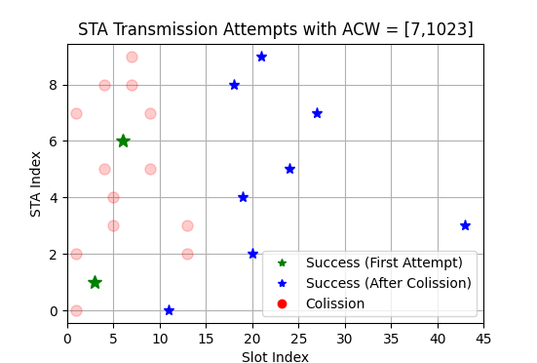
Further Optimization: known/unknown STA number
ACW-based random access provides stable performance, which allows for a 100% inventory of the contending STAs to be achieved under the current assumptions.
  When the actual number of contending STAs is known, an AMP AP can select appropriate ACW parameters to optimize time efficiency.
  When the actual number of contending STAs is unknown, the AP can utilize the “recontention mechanism” to optimize time efficiency. ; the STAs that are still contending will reset their ACW to ACWmin and pick a new ABO. [X2]
The efficiency optimization in these two different cases is visualized through the inventory process, as follows:
Example: 10 STAs, ACW=[7, 1023]
Legend:
  Green star: An STA successfully transmits on its first attempt.
  Red circle: A collision occurs in a given slot, where more than one STA transmits simultaneously, resulting in a 100% failure for those transmissions.
  Blue star: An STA successfully transmits after multiple retransmission attempts.
Plot Axis Descriptions
  X-axis: The absolute slot index of the transmission. 5 slots per TXOP.
  Y-axis: The index of the STAs: 0 to 9

Slide 6
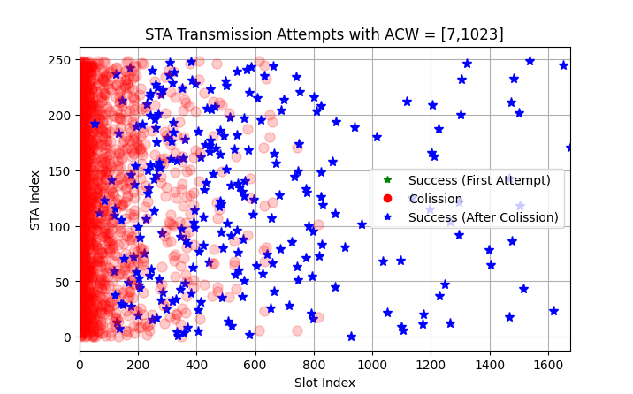
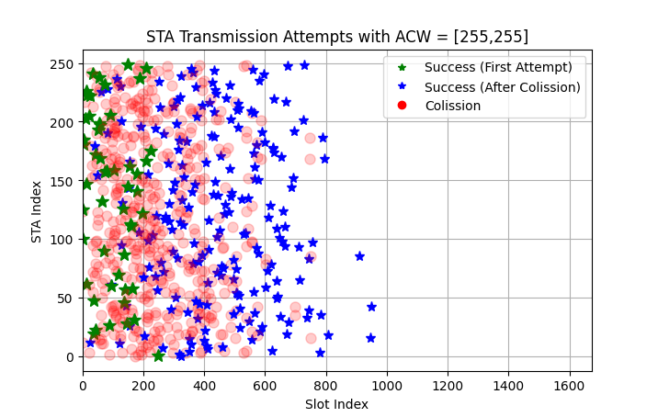
Known STA Amount Example: general and optimized ACW
Scenario: 250 STAs
This section visualizes the inventory process under different ACW configurations: a general setting and an optimized setting.
  General Settings: suitable for a wider range of STA amounts
  Optimized Settings: specifically tuned for better time efficiency when the number of STAs is known
The general setting demonstrates the channel access scheme to be robust, successfully achieving a 100% inventory.
When the target number of STAs is known, the time efficiency can be significantly optimized.
  The total duration for a TXOP is calculated as:
    (TXOP_count * 3ms) + ((TXOP_count - 1) * 3ms).
Upper Figure (General Setting):
  ACW parameters: ACW min​ = 7, ACW max​ = 1023
  TXOP count: 335
  Total slots: 335×5=1675 slots
  Total duration: 2007 ms
Lower Figure (Optimized Setting):
  ACW parameters: ACW min​ = 255, ACW max​ = 255
  TXOP count: 192
  Total slots: 192×5=960 slots
  Total duration: 1149 ms
  42% time efficiency improvement

Slide 7
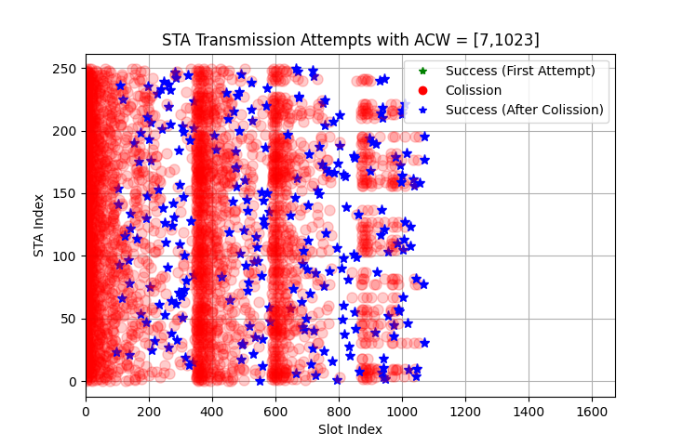
Unknown STA Amount Example: general ACW and Recontend
Scenario: 250 STAs
This section visualizes the inventory process with and without the Recontend mechanism.
Upper Figure (without Recontend Setting):
  AP End criteria:
    End on N continuous idle TXOPs: This can be susceptible to misinterpretation if the channel is idle due to chance rather than a completed inventory.
Lower Figure (With Recontend Setting):
  ACW parameters: ACW min​ = 7, ACW max​ = 1023
  Recontend force STAs reset ACW to ACWmin, and reset ABOcounter
  AP End Criteria:
    The AP ends the inventory process when it observes a continuous period of idle slots equal to the ACWmin​ value.
  TXOP count: 192+2=194
  Total slots: 194×5=970 slots
  Total duration: 1161 ms
  42% time efficiency improvement
Recontention

Slide 8
Summary
Objective: Evaluate the performance of an ACW-based random access scheme in a network with a single AP and multiple non-AP STAs. The primary performance metric is the total TXOP/slot count required to achieve a 100% inventory.
Key Findings:
  The median TXOP count is minimized when the ACWmin and ACWmax parameters are configured to values that closely match the number of contending STAs.
  The ACW-based random access scheme is robust, consistently achieving a 100% inventory even with general, non-optimized settings.
  Known STA Count: When the number of STAs is known, optimizing the ACW range can improve inventory time efficiency as demonstrated in the example (42%).
  Unknown STA Count: When the number of STAs is unknown, employing the Recontend mechanism can improve inventory time efficiency as demonstrated in the example(42%).

Slide 9
References
[1] 11-25/1240r0, AMP Channel Access (Rojan Chitrakar)
[2] 11-25/1546r0, AMP Channel Access follow-up (Rojan Chitrakar et. al.)

