Slide 1
Thoughts on Bistatic Backscatter
Date: 2025-09-15
Authors:
Name | Affiliation | Address | Phone | Email
Nelson Costa | HaiLa Technologies | Suite 403, 460 Saint-Catherine St. W. Montreal, QC. Canada |  | nelson@haila.io
Kamran Nishat |  |  |  | kamran@haila.io
Vytas Kezys |  |  |  | vytas@haila.io
Patricia Bower |  |  |  | pbower@haila.io

Slide 2
Abstract
In the following, we discuss a few outstanding issues related to bistatic backscatter.

Slide 3
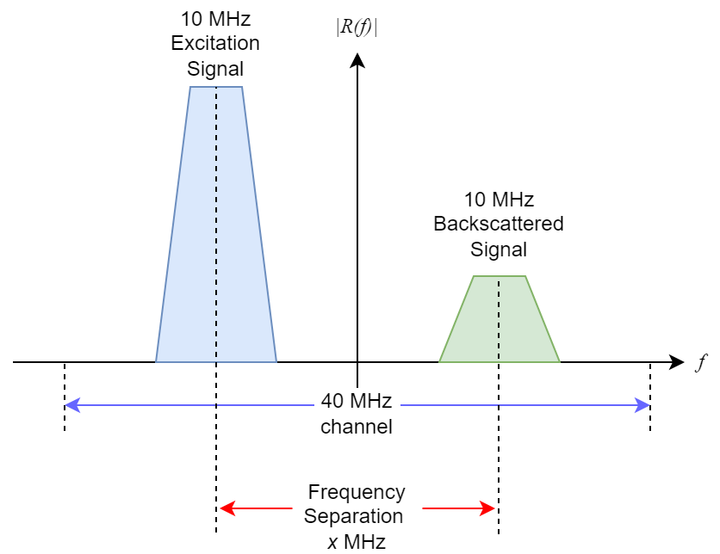
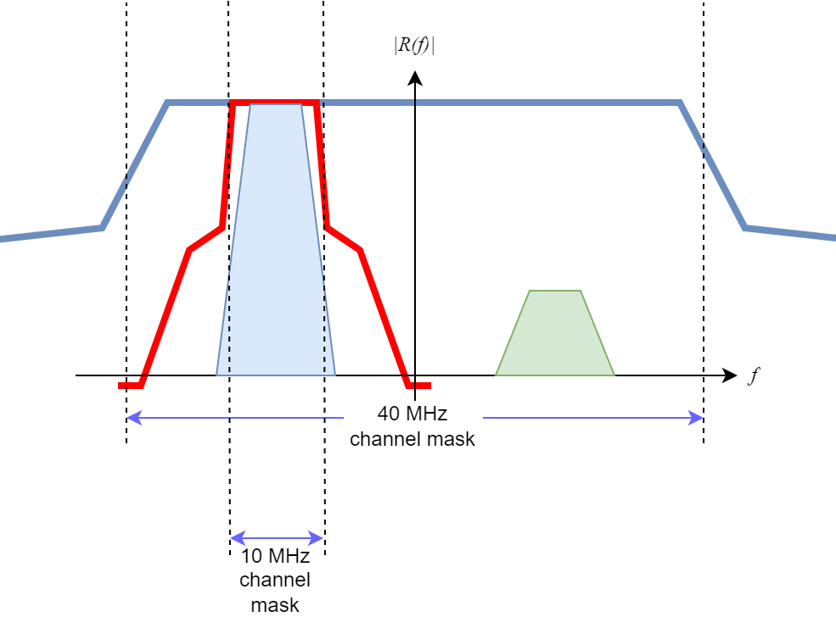
Frequency Occupancy in 40 MHz Channel
For bistatic backscatter, there are two important factors.
  Frequency separation between the carrier waveform and backscattered waveform (frequency separation).
  The spectral mask of the carrier waveform, which determines the leakage into the backscattered channel (level of self-interference).
There are two transmission masks already defined in 802.11 [1]
  One 40 MHz mask for coexistence with other devices (Clause 21).
  One 10 MHz mask for interference mitigation at the receiver (Clause 17).
The 10 MHz mask is applicable to the 10 MHz L-LTF; any other waveform may require a new mask definition.

Slide 4
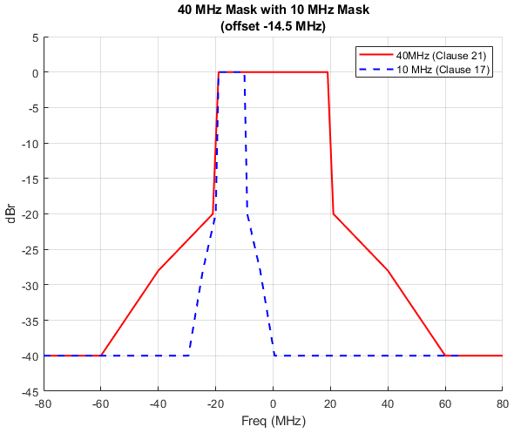
Transmit Masks and Center Frequency in 40 MHz
Using the existing mask definitions, we can get up to 29 MHz separation between the carrier and backscattered waveforms.
The location of the excitation subfield must also be defined.
For interference mitigation, we may opt for stricter mask definition for the 10 MHz carrier waveform.
  Overlap with the backscattered signal is an important consideration.
  We may want to include more attenuation beyond the 15 MHz offset knee.
15 MHz Offset Knee

Slide 5
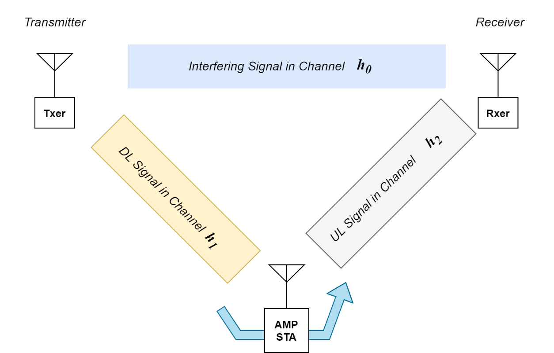
Carrier Waveform Selection: Properties
For bistatic backscatter, we should consider the following properties for a carrier waveform.
Training sequence:
  In a bistatic topology, the receiver must distinguish between the direct interfering path, and the reflected backscatter path.
  We first discussed this in [3].
  Channel training can facilitate active cancellation at the receiver.
  Channel training is required for beamforming.

Slide 6
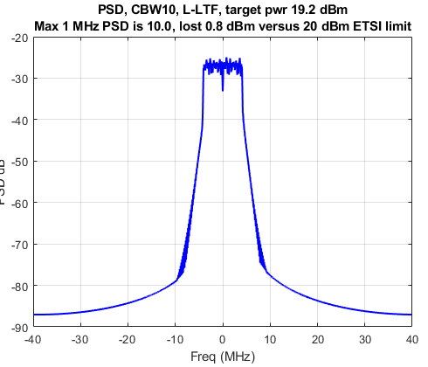
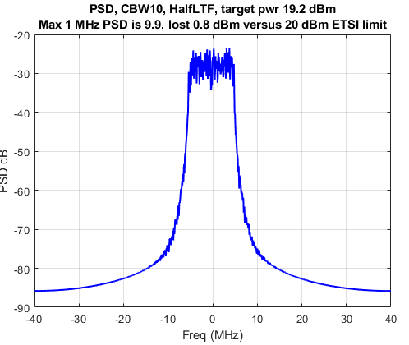
Carrier Waveform Selection: Properties (2)
Bandwidth
  10 MHz bandwidth (or slightly less) to maximize emissions limits in different regulatory environments, like ETSI.
  In [2], we presented two candidate 10 MHz waveforms.
    The Clause 17 10 MHz L-LTF, adopted for use with TGbp.
    A new “Half LTF” waveform, constructed by using the inner 33 carriers of the 20 MHz L-LTF.
  Both of these waveforms had similar performance with respect to the ETSI PSD limit.
Clause 17 10 MHz L-LTF | 10 MHz “HalfLTF”
Max 1 MHz PSD | 10.0 dBm | 9.9 dBm
Avg power @ 1 MHz PSD limit | 19.2 dBm | 19.2 dBm
Backed off from 20 dBm limit (lost) | 0.8 dBm | 0.8 dBm
PAPR | 3.5 dB | 4.6 dB

Slide 7
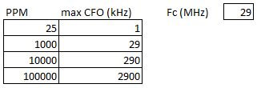
Clock Accuracy and Carrier Waveform Demodulation
If we want to use the carrier waveform as a training sequence, the receiver must be able to demodulate it.
This sets an upper limit on the clock accuracy for the backscatter AMP STA.
  The CFO on the resulting frequency shift at the backscatter AMP STA cannot exceed the receiver’s ability to correct for it.
  For example, if we were to use a standard L-LTF, we can correct for ±250 kHz.
  Any newly proposed carrier waveform for bistatic should take this into consideration.

Slide 8
Clock Accuracy and Carrier Waveform Demodulation
Take the example where the backscatter AMP STA shifts the carrier waveform by 29 MHz.
Of all the proposed clock accuracies, 1000 PPM falls within the ± 250 kHz limit.

Slide 9
Sync Sequence, Receiver Sensitivity
Sync sequence design in the downlink is an important consideration for the receiver at the AMP STA.
Backscatter AMP STAs capable of doing bistatic backscatter are “more capable” than those used for monostatic backscatter.
We believe there should be a separate DL sync sequence to differentiate bistatic backscatter.
  Monostatic backscatter is targeting receiver sensitivity of -20 dBm [7].
  Bistatic backscatter AMP STAs will be capable of better sensitivities.
The goal would be to reuse some of what has already been proposed for active Tx DL sync sequences.

Slide 10
PSK Backscatter Modulation
Using PSK modulation on backscatter has already been the subject of multiple presentations.
  [4-5] discussed how we can implement frequency shifting and PSK modulation using the same circuit topology.
  [6] discussed the advantages of, and how we may implement multi-level PSK in backscatter.
A backscatter AMP STA that is capable of frequency shifting has the added benefit of supporting PSK modulation.
Link margin advantage
  +3 dB on backscatter efficiency.
  +3 dB at receiver sensitivity.

Slide 11
PSK Backscatter Modulation (2)
It is possible to use PSK modulation within the current TGbp framework for the DL carrier waveform.
  The AMP STA can apply a phase shift on the entire OFDM symbol in the DL carrier waveform.
  For example, assuming a 4 µs OFDM symbol, this would imply a 250 kbps with BPSK, or 500 kbps with QPSK, as UL data rates.
One concern still to be addressed
  Timing error:
    What is the effect of timing error given the maximum payload size? (What is the max payload?)
    What is the required clock accuracy at the Backscatter AMP STA?
    How do we recover timing at the infrastructure receiver, where we are not complexity nor power consumption constrained?
    Can we reuse clock drift estimation and correction methods [7]

Slide 12
Conclusion
In this presentation, we discussed several outstanding issues related to bistatic backscatter.
Frequency occupancy within the 40 MHz:
  Maximum frequency separation is important for self-interference mitigation.
  We can modify the Clause 17 10 MHz transmit mask definition to help with self-interference.
Carrier waveform selection:
  Several 10 MHz waveforms have been analyzed in previous contributions.
  We recommend either of two preferred candidates (10 MHz L-LTF, “Half LTF”)
Sync sequence for bistatic backscatter:
  We believe there should be a unique DL sync sequence for bistatic backscatter.
  This is to help differentiate between other modes, and to account for a “more capable” backscatter AMP STA.

Slide 13
Conclusion (2)
PSK modulation on backscatter:
  A frequency shifting backscatter AMP STA has the ability to do PSK modulation on backscatter.
  PSK modulation on backscatter can provide up to a 6 dB link margin advantage.
  Clock accuracy is the biggest factor in feasibility. This will be addressed in a future contribution.

Slide 14
Straw Poll 1
Do you agree add the following to the TGbp SFD?
  11bp defines at least one 10 MHz carrier waveform for bistatic backscatter.
    References: 11-25/1228, 11-25/1229

Slide 15
Straw Poll 2
[Informational, but informs which of the next two SPs to run]
Which of the following would you agree to adopt as a 10 MHz carrier waveform for bistatic backscatter?
  a) The Clause 17 10 MHz "half-clocked" L-LTF.
  b) The “Half LTF” waveform, which uses the innermost 33 carriers from the 20 MHz L-LTF.
  References: 11-25/1228, 11-25/1229

Slide 16
Straw Poll 3
(option a) Do you agree add the following to the TGbp SFD?
11bp defines one carrier waveform for bistatic backscatter that would be based on the Clause 17 10 MHz “half-clocked” L-LTF.
  Note: Following Motion #39, the carrier waveform would consist of the repeated base waveform, multiplied by a pseudo-random phase.
  References: 11-25/1228, 11-25/1229

Slide 17
Straw Poll 4
(option b) Do you agree add the following to the TGbp SFD?
11bp defines one carrier waveform for bistatic backscatter that would be based on the innermost 33 carriers of the 20 MHz L-LTF.
  Note: Following Motion #39, the carrier waveform would consist of the repeated base waveform, multiplied by a pseudo-random phase.
  References: 11-25/1228, 11-25/1229

Slide 18
Straw Poll 5
Do you agree add the following to the TGbp SFD?
IEEE 802.11bp defines at least 1 base sequence used for AMP DL SYNC field for bistatic backscatter in 2.4GHz frequency band.

Slide 19
References
[1] IEEE 802.11-2024.
[2] N. Costa et al., Interference Mitigation in Bistatic Backscatter, Part 1, 11-25/1228, July 2025.
[3] N. Costa et al., Channel Correction in Long Range Backscatter, 11-24/2114, January 2025.
[4] N. Costa et al., PSK Modulation for Long Range Backscatter, 11-25-0266, March 2025.
[5] N. Costa et al., Single Side Band Backscatter Modulation, 11-25/0265, March 2025.
[6] Hou et al., Uplink BPSK Modulation for AMP Backscatter, 11-25/1028, June 2025.
[7] Cao et al., AMP DL SYNC Design, 11-25/1230, July 2025.
[8] Cheng et al., Backscattering UL SYNC design considerations, 11-25/1231, July 2025.

