Slide 1
EU CRA A backscatter perspective
Date: 2025-09-08
Authors:

Slide 2
Abstract
EU Cybersecurity Resilience Act (CRA) is coming into effect in 2026. Achieving compliance is expected to be challenging for energy constrained devices such as AMP non-AP STA devices in general:
Achieving compliance for backscatter devices is expected to be extremely challenging
802.11bp could play a crucial role in helping device achieve regulatory compliance
This document presents 802.11bp key features that could significantly help achieving compliance

Slide 3
Agenda
Quick review of IoT cybersecurity regulations around the world
Review of EU CRA requirements typically applicable to AMP non-AP STA devices
Identify key 802.11bp features that could help AMP non-AP STA devices achieve global cybersecurity compliance

Slide 4
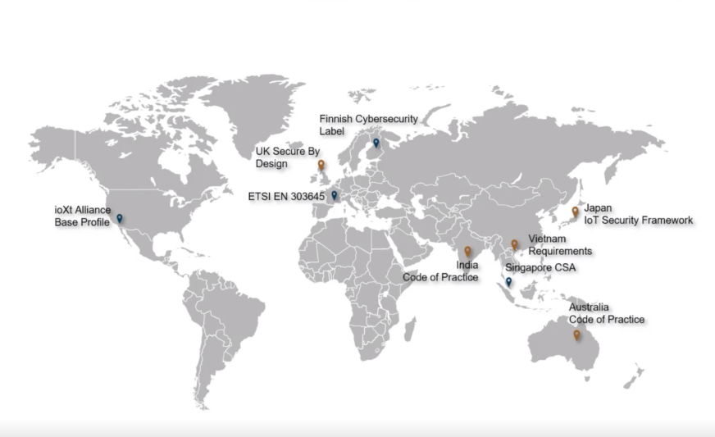
Cybersecurity Regulations Around the world
Cybersecurity Regulations Around the world
Image courtesy of Doulos

Slide 5
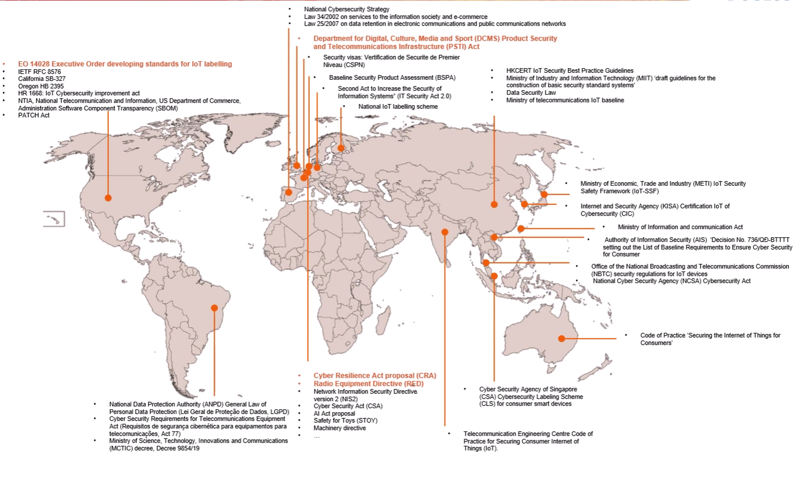
Cybersecurity Regulations Around the world (cont)
Image courtesy of Doulos

Slide 6
Cybersecurity Regulations Around the world (cont)
PSTI in the UK market Consumer connectable products security regime
EU Radio Equipment directive (RED) Regulatory Framework for placing radio equipment on the market. (Privacy protection, personal data…)
EU Cyber Resilience Act (CRA) cybersecurity rules to enhance the security of hard and software products [2]
US Cyber Trust Mark Cybersecurity Labelling Program for Smart Devices (Certification Program)
US NIST8425 a set of Recommended Cybersecurity Requirements for Consumer grade products

Slide 7
EU Cybersecurity Resiliency Act (CRA)
EU CRA covers digital products placed on the EU market
Any Hardware capable of executing binary code or any executable binary code (software)
Mandatory for directly or indirectly internet connectable products with digital elements
Calls for cyber-secure product development and Design (Security by Design)
H2 2026 Application of vulnerability/ incident reporting
Q4 2027: Application of all products and process requirements

Slide 8
EU CRA core requirements typically applicable to AMP non-AP STA devices
Default configuration should be secure
Secure software update capability (hard to achieve without non volatile memory)
Secure access control and authentication
Confidentiality and integrity of stored, processed and transmitted data
Minimized attack surface

Slide 9
Can 802.11bp help? (1)
Strengthen the secure by design principle
Enforce per device credentials and identity uniqueness
Provide authenticated access
Provide basic device provisioning features in 802.11bp and hooks to upper layers provisioning services to help achieve secure access to 11bp devices that are likely headless simple devices without UI.

Slide 10
Can 802.11bp help? (2)
Access control management and authentication
Use of AMP STA DevID aka 802.1AR (more precisely part of it) to enforce AMP STA authentication?
Define an AMP non AP STA device identity that is suitable for cryptographic purposes

Slide 11
Can 802.11bp help? (3)
Pick the correct security protocols and cryptographic suites
Consider power/computation constraints

Slide 12
Useful frame types
Authentication frames
Credentials update frames
Provisioning frame types (see [1])
Event reporting frames

Slide 13
Conclusion
Cybersecurity regulations all over the world are setting mandatory requirements on IoT devices
802.11bp can help achieve regulatory compliance faster and make IoT devices more secure
In light of the reviewed regulatory requirements, we do believe that we need a secure mode of operation for backscatter AMP non-AP STA

Slide 14
References
Guido et al. A novel application—Simplified device provisioning IEEE 802.11-25/1320r
EU Cybersecurity Resiliency Act. available at https://www.european-cyber-resilience-act.com/Cyber_Resilience_Act_Articles.html

