Slide 1
Discussion on BFT Types for 11bq
Date: 2025-09-14
Authors:
Name | Affiliation | Address | Phone | Email
Eunsung Park | LG Electronics | 19, Yangjae-daero 11gil, Seocho-gu, Seoul 137-130, Korea |  | esung.park@lge.com
Insun Jang |  |  |  | insun.jang@lge.com
Hongwon Lee |  |  |  | hongwon.lee@lge.com
Insik Jung |  |  |  | insik0618.jung@lge.com
Dongju Cha |  |  |  | dongju.cha@lge.com
Jinsoo Choi |  |  |  | js.choi@lge.com
HanGyu Cho |  |  |  | hg.cho@lge.com
Sanggook Kim |  | 10680 Treena St 550, San Diego CA 92131 |  | sanggook.kim@lge.com

Slide 2
Introduction
Because of the channel property of the mmWave band, beamforming is essential to a PPDU transmission for a reliable performance
Beamforming training (BFT) procedures have been discussed in [1] while 11bq has yet to define specific BFT types
In this contribution, we discuss BFT types
  Sector level sweep (SLS)
  Beam refinement protocol (BRP)

Slide 3
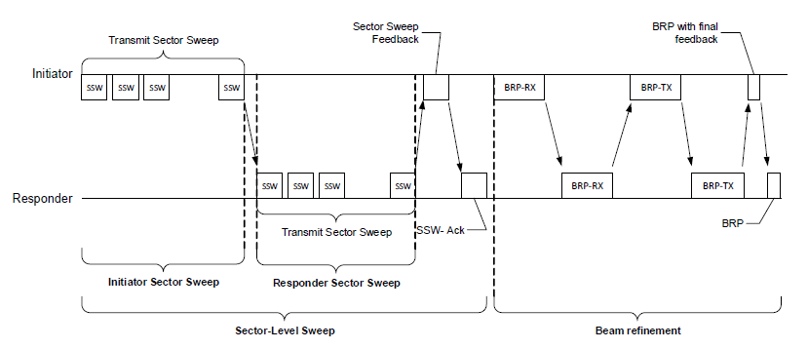
Recap on DMG BFT
An example of BFT
  SLS includes ISS and RSS to train initiator and responder links
    I-TXSS / I-RXSS / R-TXSS / R-RXSS
  BRP improves TX / RX antenna configuration by using TRN fields
    [2] discussed TRN fields used in BRP-TX / -RX / -RX/TX PPDU

Slide 4
Sector Level Sweep (1/2)
We propose to define a mechanism (similar to SLS) which finds the best TX/RX sectors between two STAs for beamforming in 11bq
  This mechanism is necessary to make communication possible in a mmWave band
  We can consider the followings for this mechanism
    I/R-TXSS: Initiator/responder transmits PPDUs to responder/initiator to find initiator’s/responder’s best transmit sector
    I/R-RXSS: Initiator/responder transmits PPDUs to responder/initiator to find responder’s/initiator’s best receive sector
    Names can be changed
  If we use TX/RX reciprocity, either RXSS or TXSS can be excluded

Slide 5
Sector Level Sweep (2/2)
We also propose to use NDP like PPDU for this SLS like mechanism
  This PPDU consists of STF, LTF and SIG(s) and there is no Data part
  SIG(s) can contain several information such as PPDU type, BFT type and sector related information, etc.
Details on how to transmit and configure the NDP like PPDUs should be further discussed
  For TXSS, different sectors can be applied to PPDUs while the same sector can be used in all PPDUs for RXSS

Slide 6
Beam Refinement Protocol (1/2)
We propose to define a mechanism (similar to BRP) which refines the TX/RX antenna configuration (or antenna weight vector (AWV)) in 11bq
  This mechanism may be required to guarantee a reliable performance for a PPDU transmission
  11ad / 11ay defines multiple sector ID Detection (MID) and beam combining (BC) subphases for BRP but we need more discussion on whether to directly adopt them or define a new protocol in 11bq
    MID: a quasi-omni transmit pattern is tested against a number of receive AWVs
    BC: a small set of transmit and receive AWVs are tested in pairwise combinations

Slide 7
Beam Refinement Protocol (2/2)
We also propose to define TRN fields for TX / RX / RX/TX beam refinement
  TRN fields can be also added into NDP like PPDU as well as PPDU for data transmission for various purposes, e.g., overcoming asymmetric links, beam tracking, etc.
  Name can be changed
Details on the procedure of this mechanism and the structure of TRN fields should be further discussed

Slide 8
Conclusion
We have proposed to support mechanisms similar to SLS and BRP in 11bq
  Details should be further discussed

Slide 9
Straw Poll #1
Do you support the following in 11bq?
  11bq defines a mechanism which find the best TX/RX sectors between two STAs for beamforming
    Details on the procedure of this mechanism are TBD
Y/N/A:

Slide 10
Straw Poll #2
Do you support to define the following mechanisms in 11bq?
  I-TXSS: Initiator transmits PPDUs to responder to find initiator’s best transmit sector
  I-RXSS: Initiator transmits PPDUs to responder to find responder’s best receive sector
  R-TXSS: Responder transmits PPDUs to initiator to find responder’s best transmit sector
  R-RXSS: Responder transmits PPDUs to initiator to find initiator’s best receive sector
  Details on the structure of the PPDUs and how to transmit PPDUs are TBD
  Names can be changed
Y/N/A:

Slide 11
Straw Poll #2-1
Do you support to define the following mechanisms in 11bq?
  I-TXSS: Initiator transmits PPDUs to responder to find initiator’s best transmit sector
  R-TXSS: Responder transmits PPDUs to initiator to find responder’s best transmit sector
  Details on the structure of the PPDUs and how to transmit PPDUs are TBD
  Names can be changed
Y/N/A:

Slide 12
Straw Poll #2-2
Do you support to define the following mechanisms in 11bq?
  I-RXSS: Initiator transmits PPDUs to responder to find responder’s best receive sector
  R-RXSS: Responder transmits PPDUs to initiator to find initiator’s best receive sector
  Details on the structure of the PPDUs and how to transmit PPDUs are TBD
  Names can be changed
Y/N/A:

Slide 13
Straw Poll #3
Do you support the following in 11bq?
  NDP like PPDU is used for a mechanism which finds the best TX/RX sectors between two STAs for beamforming
    This PPDU consists of STF, LTF and SIG(s) and there is no Data part
    Other fields (e.g., PE, TRN) are TBD
    Details on the PPDU structure are TBD
Y/N/A:

Slide 14
Straw Poll #4
Do you support the following in 11bq?
  SIG(s) for NDP like PPDU used for a mechanism which finds the best TX/RX sectors between two STAs for beamforming contains PPDU type, BFT type and sector related information
    How to indicate PPDU type and BFT type is TBD
    Details on sector related information are TBD
    Other information is TBD
Y/N/A:

Slide 15
Straw Poll #5
Do you support the following in 11bq?
  11bq defines a mechanism which refines TX/RX antenna weight vectors between two STAs for beamforming
    Details on the procedure of this mechanism are TBD
Y/N/A:

Slide 16
Straw Poll #6
Do you support the following in 11bq?
  TRN fields are used for a mechanism which refines TX/RX antenna weight vectors between two STAs for beamforming
    Details on TRN fields are TBD
    Name can be changed
Y/N/A:

Slide 17
References
[1] 11-25-0841-00-00bq-some-considerations-for-mlo-based-bft-announcement
[2] 11-25-1304-00-00bq-discussion-on-trn-field-in-immw-ppdu

