Slide 1
Enable SCS Context (Re)Negotiation
Aug. 2025
Date: 2025-08-20
Authors:
Notes:
September 2012

Slide 2
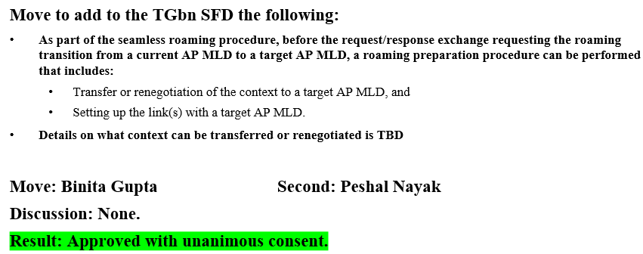
Introduction
For the seamless roaming, we had reached consensus that the context can be transferred or renegotiated during the roaming prepared.
Currently, the context transfer for the BA agreement and the SCS context have been defined in 11bn D1.0. However, the SCS context renegotiation part is missing.
In this contribution, we will show the context renegotiation is better than the context transfer.

Slide 3
Context Transfer vs. Context Renegotiation
There is no essential difference between the context transfer and the context renegotiation. The context transfer can be regarded as a special case of the context renegotiation.
  The current AP MLD on behalf of the non-AP MLD negotiates with the target AP MLD.
  Seem the sole benefit is no need to include the related signaling (e.g. BA parameters and SCS parameters) within the Link Reconfiguration Request frame.
Furthermore, the context transfer cannot be used for the following cases:
  The non-AP MLD wants to negotiate a new SCS profile which is different from the one negotiated with the current AP MLD
  The current AP MLD doesn’t support the SCS mechanism but the target AP MLD supports the SCS mechanism. In this case, the non-AP MLD can negotiate a SCS context for an existing traffic stream.

Slide 4
Proposal
SCS
Hence, the context negotiation is more flexible than the context transfer.
Furthermore, we had already allowed the BA context renegotiation in 11bn D1.0 [2]. There is no reason to only allow the SCS context transfer and prohibit the SCS context renegotiation.
  The original intention to introduce the roaming preparation is to establish the transmission context before the roaming execution as much as possible.
Propose to include one or more SCS Descriptor elements within the UHR Link Reconfiguration Request frame to allow the non-AP MLD can establish a SCS context or negotiate a new SCS profile for an existing traffic stream.
  Correspondingly, include the status code in the UHR Link Reconfiguration Response frame

Slide 5
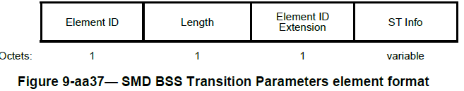
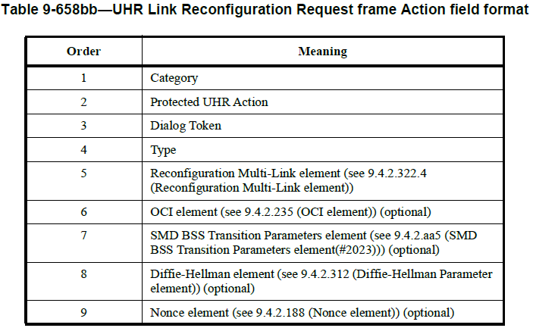
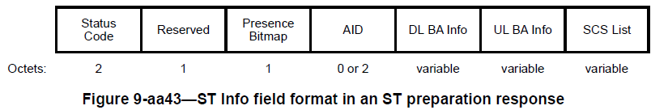
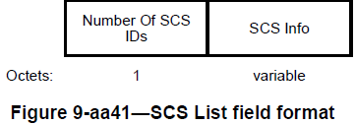

Proposal (Cont.)
Details
10 | One or more SCS Descriptor elements (optional)
Status Code

Slide 6
References
[1] 11-24-0480-00-00bn-details-on-context-transfer-and-data-forwarding-under-ft-protocol
[2] Draft P802.11bn_D1.0

Slide 7
SP
Do you support that the SCS context can be (re)negotiated during the roaming preparation?

