Slide 1
A Simplified Data Forwarding Method
Aug. 2025
Date: 2025-08-15
Authors:
Notes:
September 2012

Slide 2
Introduction
The data forwarding is very important to realize the zero-packet loss and achieve the seamless roaming. Because the DL data retrieval has the following drawbacks:
  The UL transmission shall be suspended during the DL data retrieval period. This will significantly degrade the UL delay performance.
  Furthermore, it will also cause the source to reduce its sending rate if the TCP ACK is not received in time.
Hence, the DL data retrieval should be as short as possible especially when the data forwarding is supported.

Slide 3
Motivation
For the data forwarding, we have reached the following consensus:
Based on the feedback from implementation guys, it’s not easy for the current AP MLD to get unacknowledged A-MSDUs from the existing chip architecture. Because the A-MSDU operation is realized by the hardware.
In this submission, we try to propose a simplified data forwarding method to address the above implementation challenge.
The following information is allowed to be carried for MSDU/A-MSDU for each Data frame that is within WinStartO and WinEndO that needs retransmission and that is forwarded from the current AP MLD to the target AP MLD:
TID
SN
PN
NOTE – The same PN space is used by the current AP MLD and the target AP MLD.

Slide 4
Proposal
When the current AP MLD receives the roaming execution request from the non-AP MLD, the following operation rules are applied
  The current AP MLD shall not release MSDUs behind the first hole even these MSDUs has been successfully received by the non-AP MLD.
  When the DL data retrieval is terminated,
    The current AP MLD shall forward all the MSDUs within the transmit buffer to the target AP MLD in order.
    The non-AP MLD shall deliver the received MSDUs within the reordering buffer to the next MAC process in order until the first hole and discard received MSDUs behind the first hole.
Advantages.
  The current AP MLD only needs to support the MSDU forwarding and doesn’t need to support the A-MSDU forwarding. And the target AP MLD doesn’t require to transmit the exact same A-MSDU as the current AP MLD.
  More importantly, the target AP MLD is allowed to negotiate a completely new BA agreement, including a new SSN and a smaller/larger buffer size, which can be done during the roaming preparation phase, rather than the roaming execution phase.

Slide 5
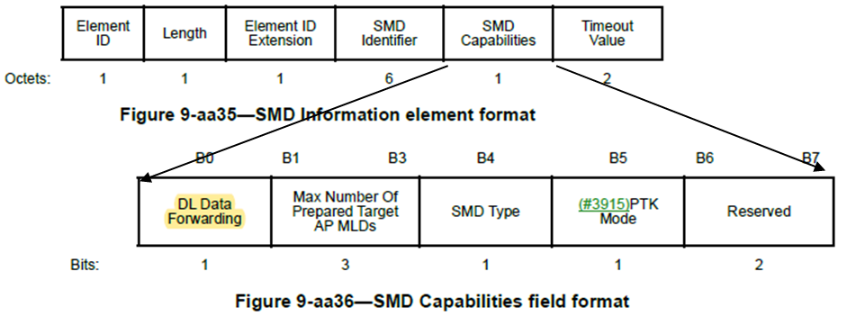
Signaling
The above method can be defined a new data forwarding mode using a reserved bit within the SMD Capabilities field of the SMD Information element. E.g.
  DL Data Forwarding
    Including MSDU/A-MSDU forwarding. The non-AP MLD doesn’t need to flush its reordering buffer.
  DL MSDU Forwarding Only

Slide 6
In-order delivery
The target AP MLD shall guarantee the MSDUs are delivered to the upper layer of the non-AP MLD in the same order as the one when these MSDUs arrived at the MAC SAP of the current AP MLD.
  In other words, the target AP MLD shall prioritize the transmission of MSDUs forwarded from the current AP MLD over the MSDUs directly from the DS.
The target AP MLD shall not transmit MSDUs forwarded from the current AP MLD if the target AP MLD has decides to start the transmission of MSDUs which are directly from the DS. To achieve this,
  The current AP MLD should inform the target AP MLD when the data forwarding is finished.
  The target AP MLD also can inform the current AP MLD to stop the data forwarding if it doesn’t want to wait for the ending of the data forwarding and starts to transmit MSDUs from the DS.

Slide 7
Example
DS
Note #N of MSDU#N represents the arrival order of MSDUs
End of data
forwarding
MSDU#201
MSDU#200
In-order data forwarding
MSDU#200
Current AP MLD’s transmit buffer
…
…
Target AP MLD’s transmit buffer
MSDU#101
MSDU#101
MSDU#100
MSDU#100
Non-AP MLD’s reordering buffer
WinStart_B
WinStart_B
MSDU#100
MSDU#101
SN#2025
MSDU#100
MSDU#101
MSDU#102
MSDU#101
SN#0
MSDU#102
MSDU#103
SN#2026
MSDU#103
MSDU#104
SN#1
MSDU#104
SN#2027
When the DL data retrieval is terminated, then the non-AP MLD discards received MSDUs behind the first hole
MSDU#105
MSDU#106
MSDU#107
SN#2
Old Buffer Size
MSDU#105
MSDU#106
New Buffer Size
MSDU#108
MSDU#109
SN#2028
SN#3
MSDU#107
SN#2029
…
Holes
MSDU#108
MSDU#109
…
SN#2030

Slide 8
Summary
In order to realize the zero-packet loss, a simplified data forwarding scheme is proposed
  By using the proposed scheme, the current AP MLD doesn’t need to support the A-MSDU forwarding.
  And the target AP MLD can reset the DL SSN and do the A-MSDU operation by itself.

Slide 9
References
[1] 11-25-1101-08-00bn-pdt-cr-mac-on-seamless-roaming-part-5

Slide 10
SP
Do you support to define a simplified data forward mode in which MSDUs without TID, SN and PN are forwarded to the target AP MLD?

