Slide 1
Pushing the Limits: Unlocking the Potential of Faster-than-Nyquist Signaling
Date: 2025-09-15
Authors:

Slide 2
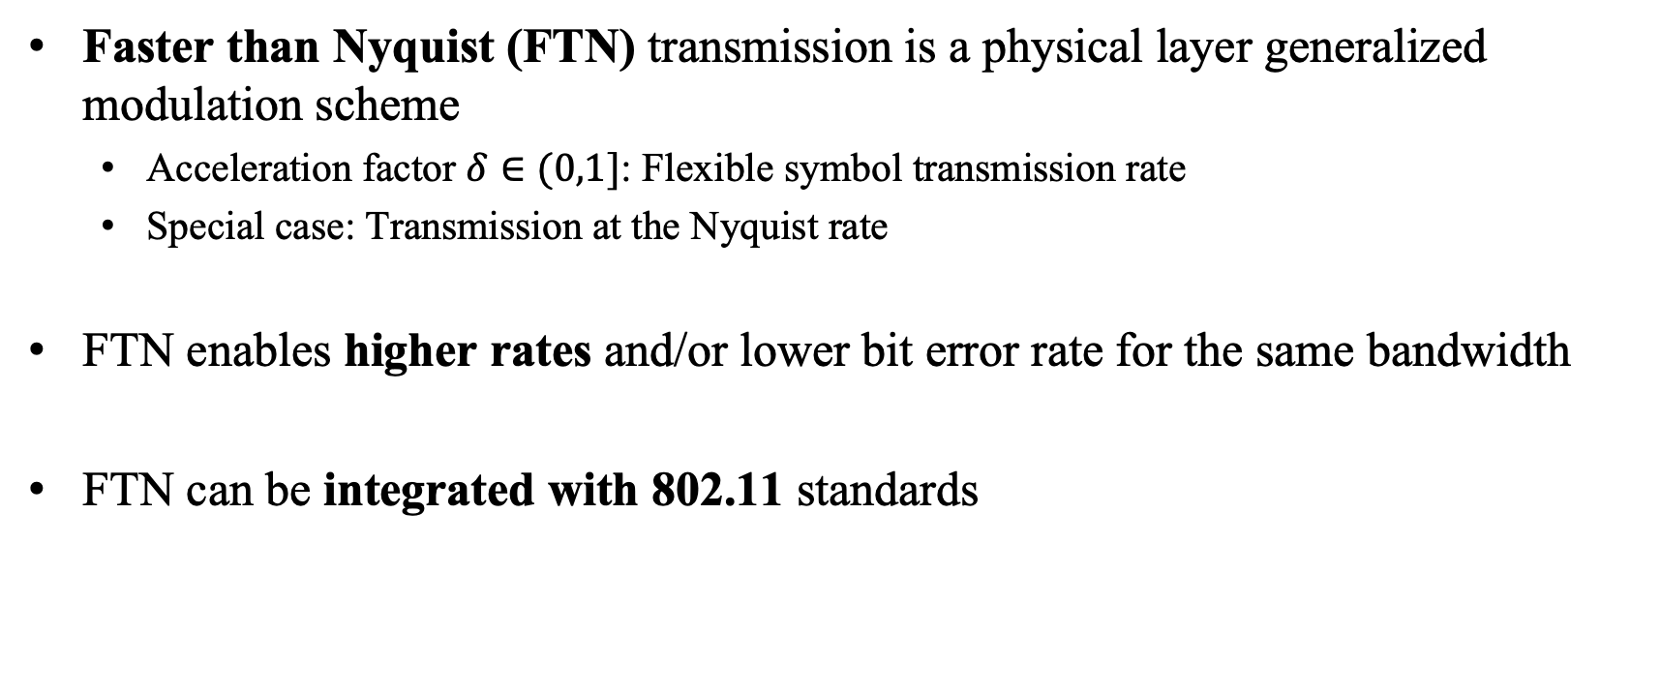
Abstract
Faster than Nyquist (FTN) transmission is a physical layer generalized modulation scheme
  Acceleration factor $δ∈(0,1]$: Flexible symbol transmission rate
  Special case: Transmission at the Nyquist rate
FTN enables higher rates and/or lower bit error rate for the same bandwidth
FTN can be integrated with 802.11 standards

Slide 3
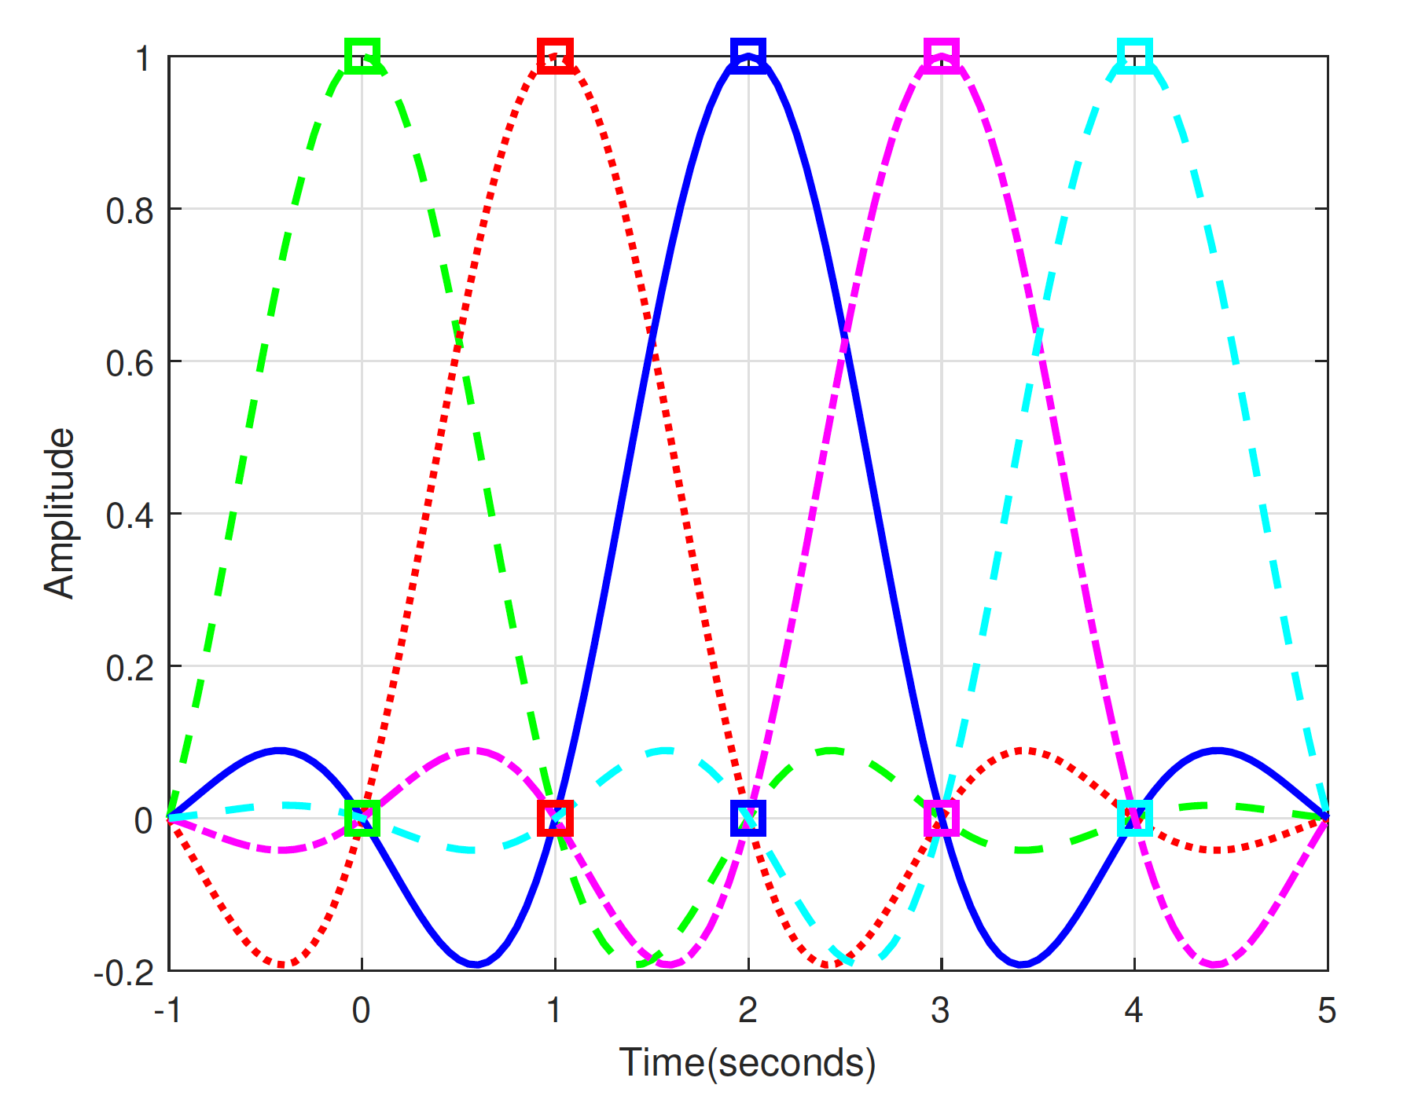
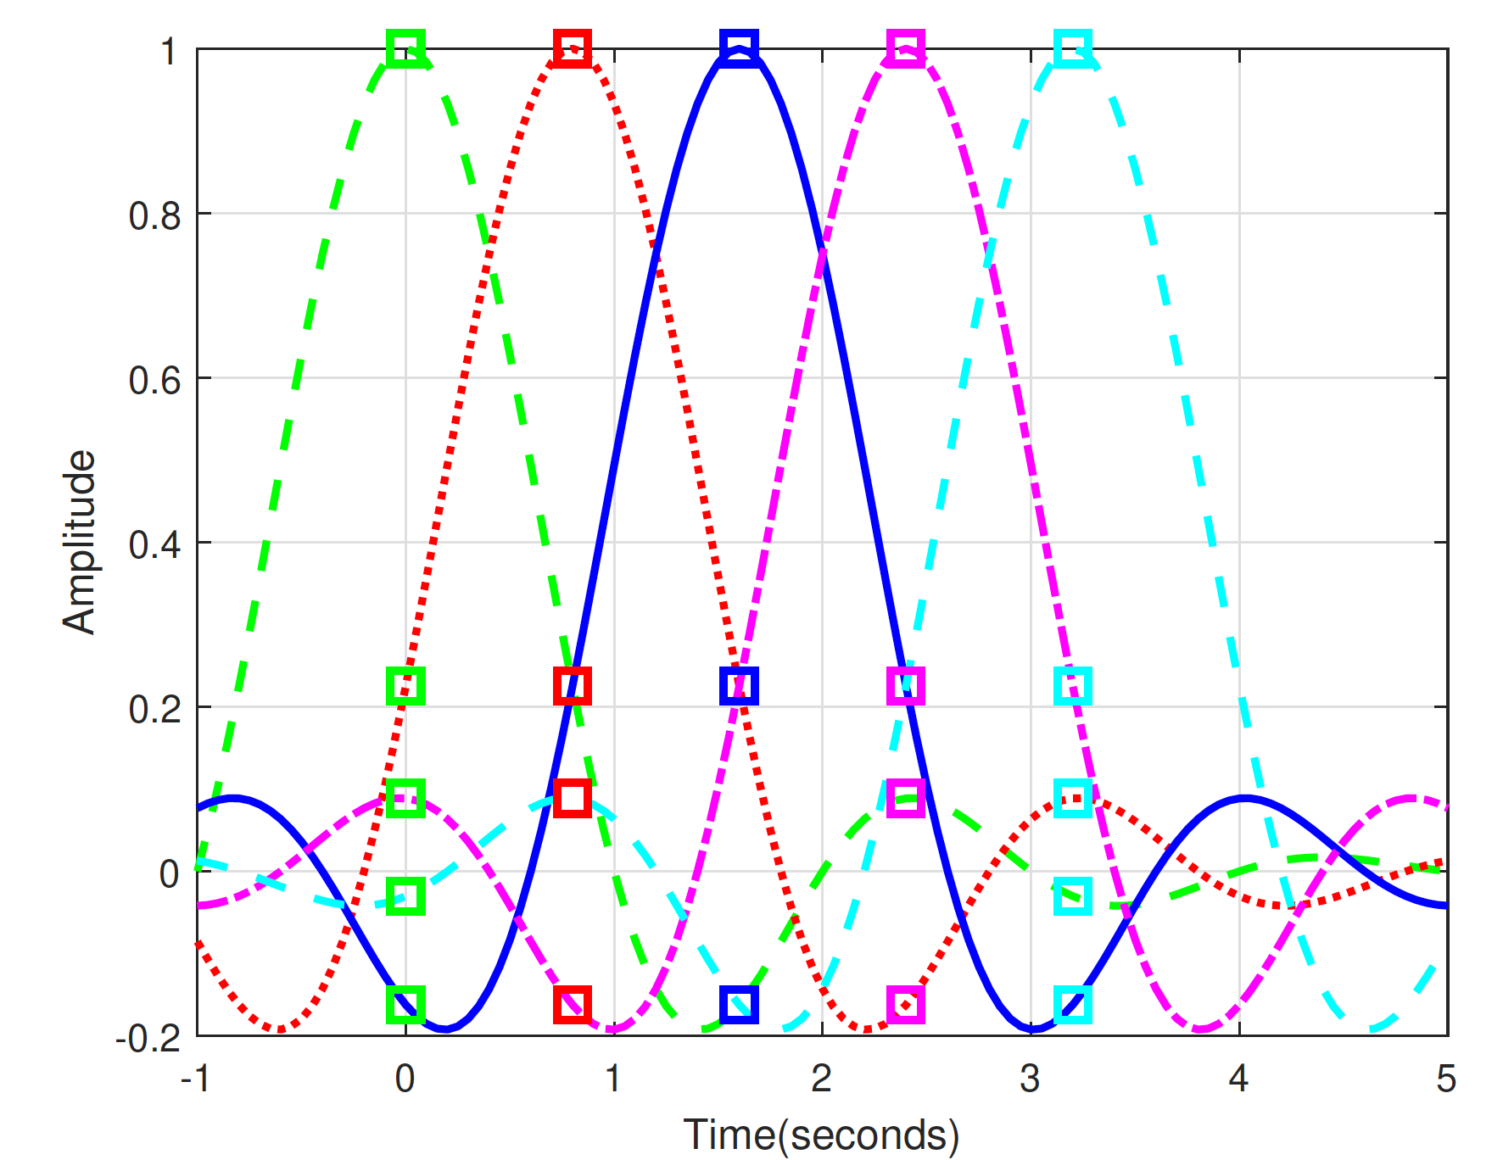
FTN: Introduction
Melda Yuksel, METU

Slide 4
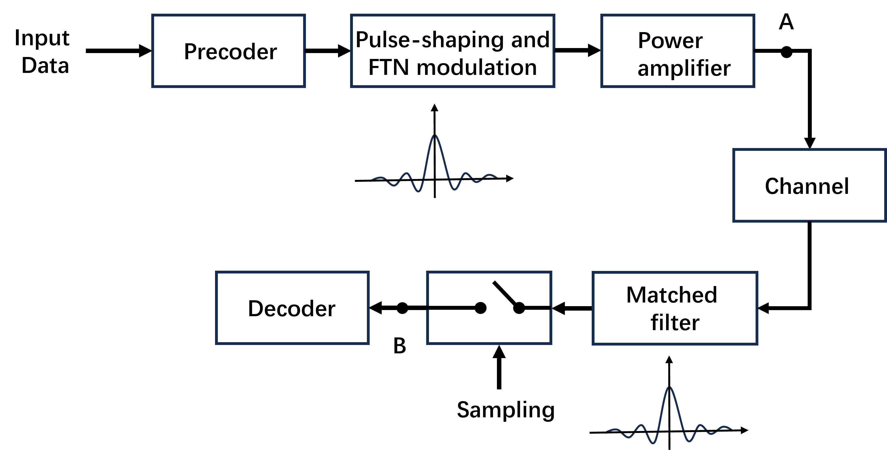
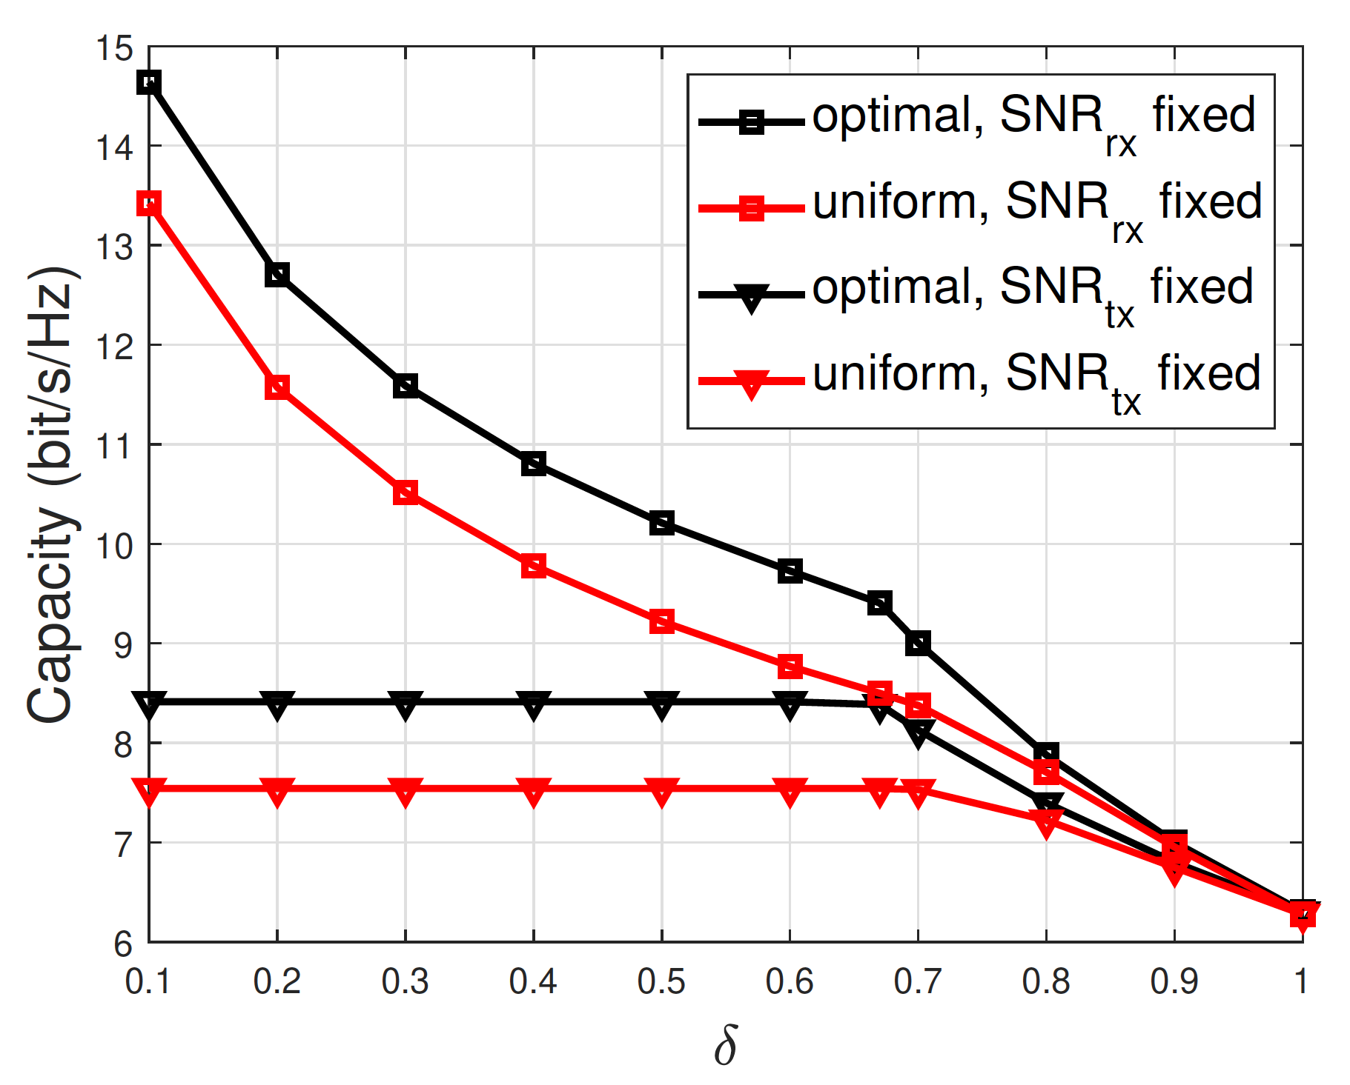
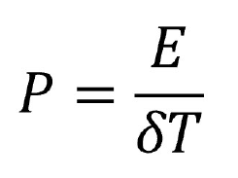
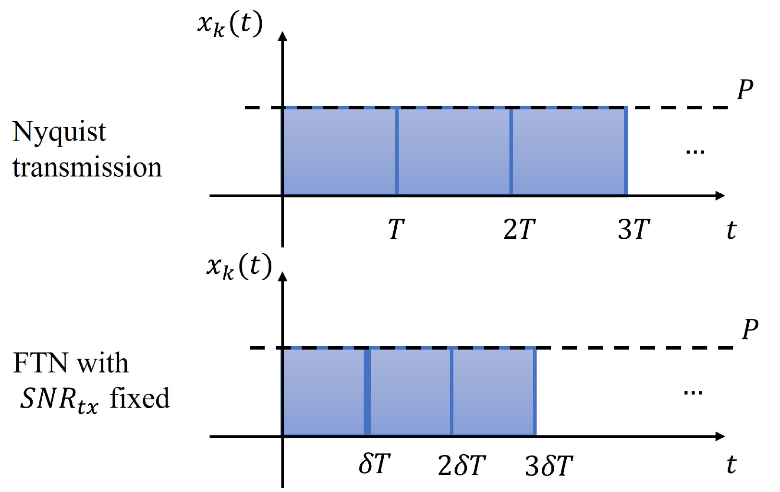
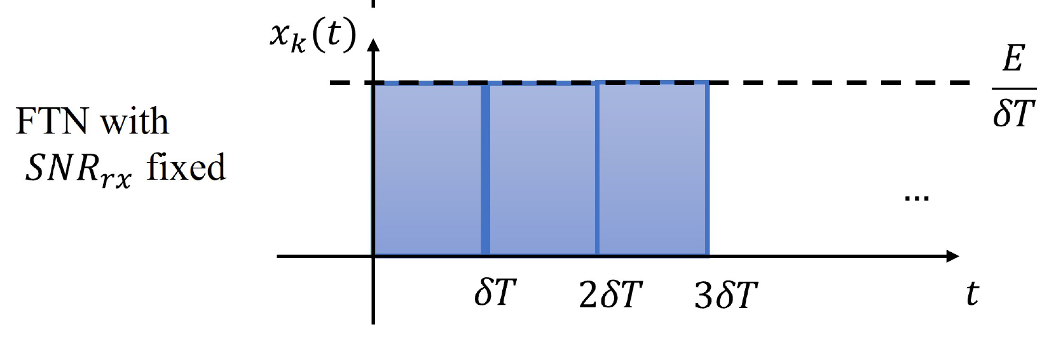
Capacity of FTN

Slide 5
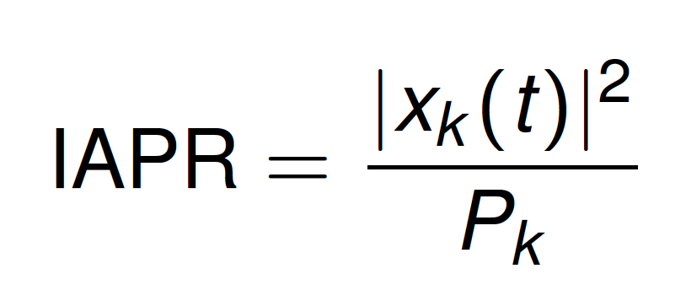
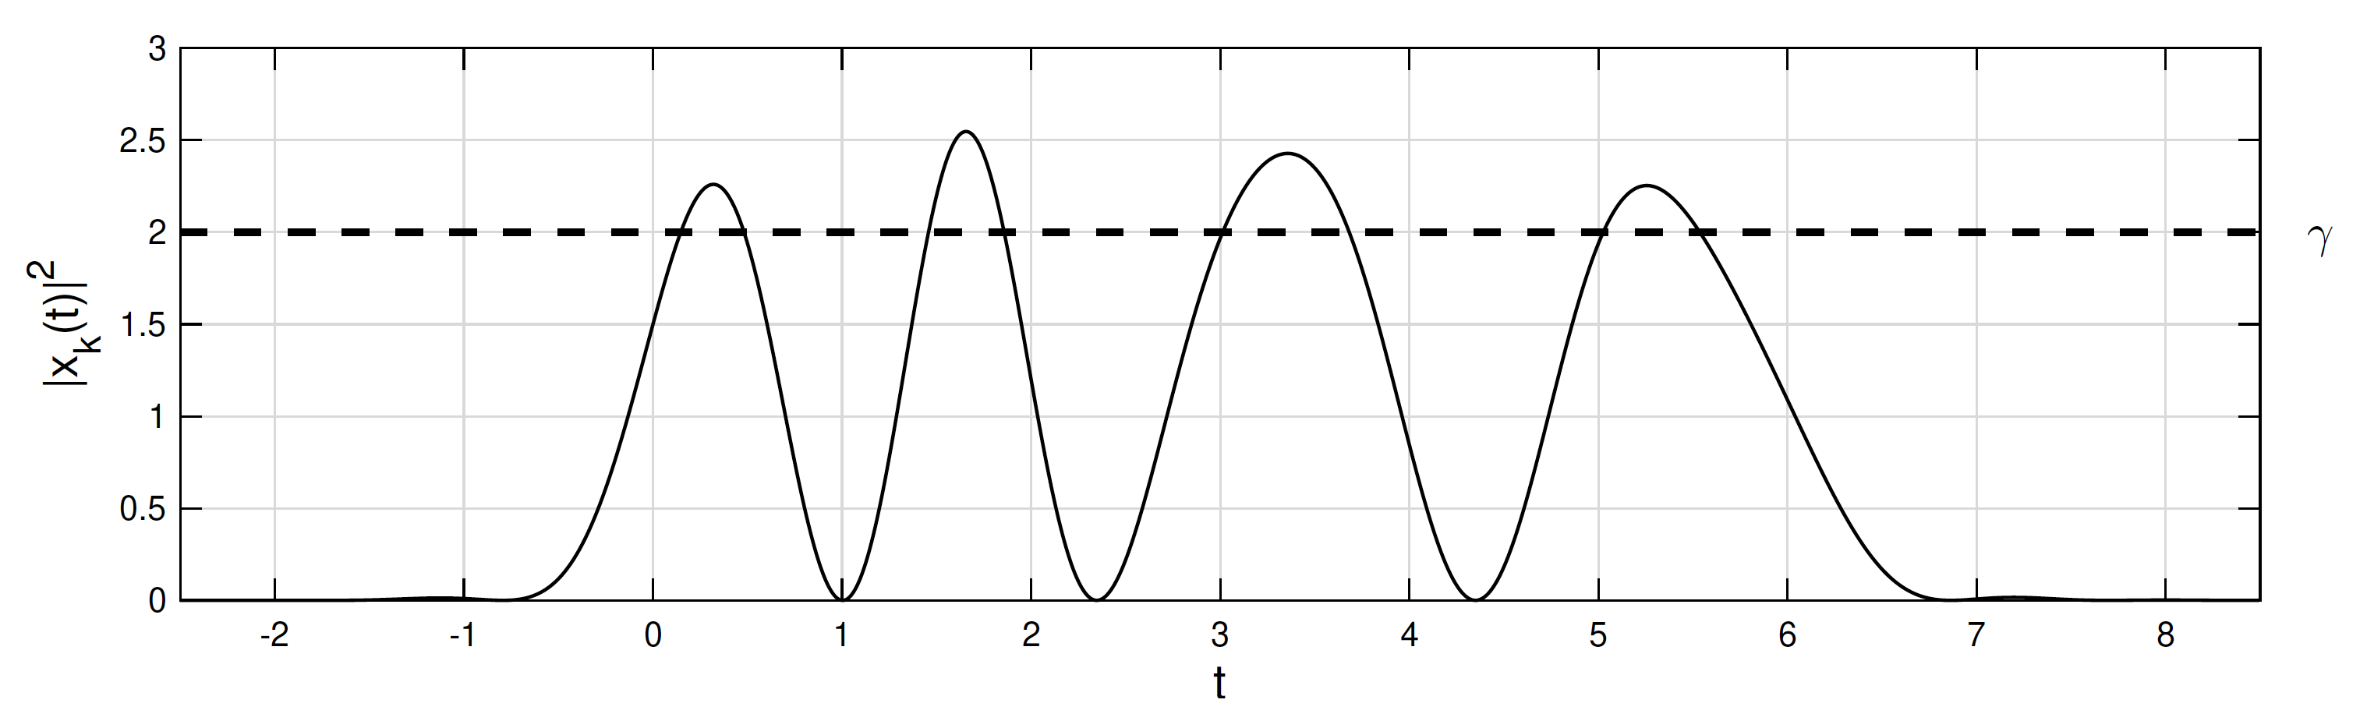
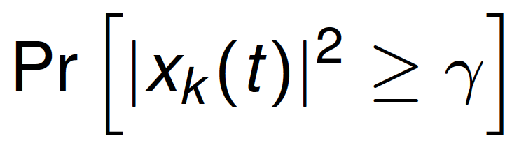
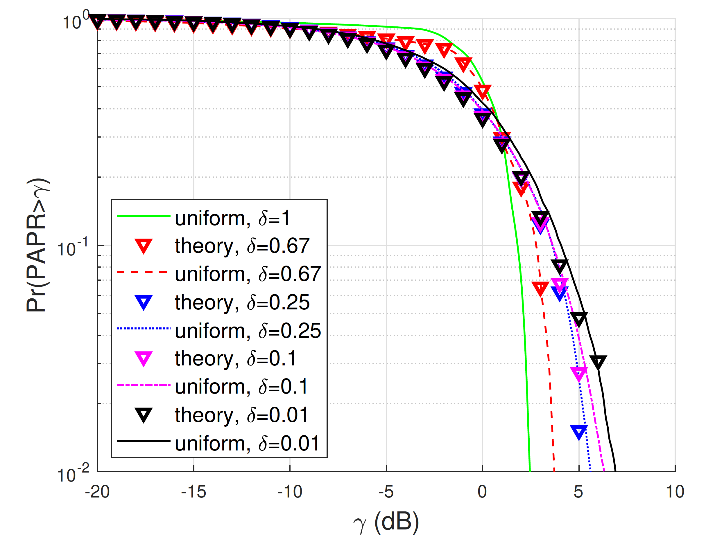
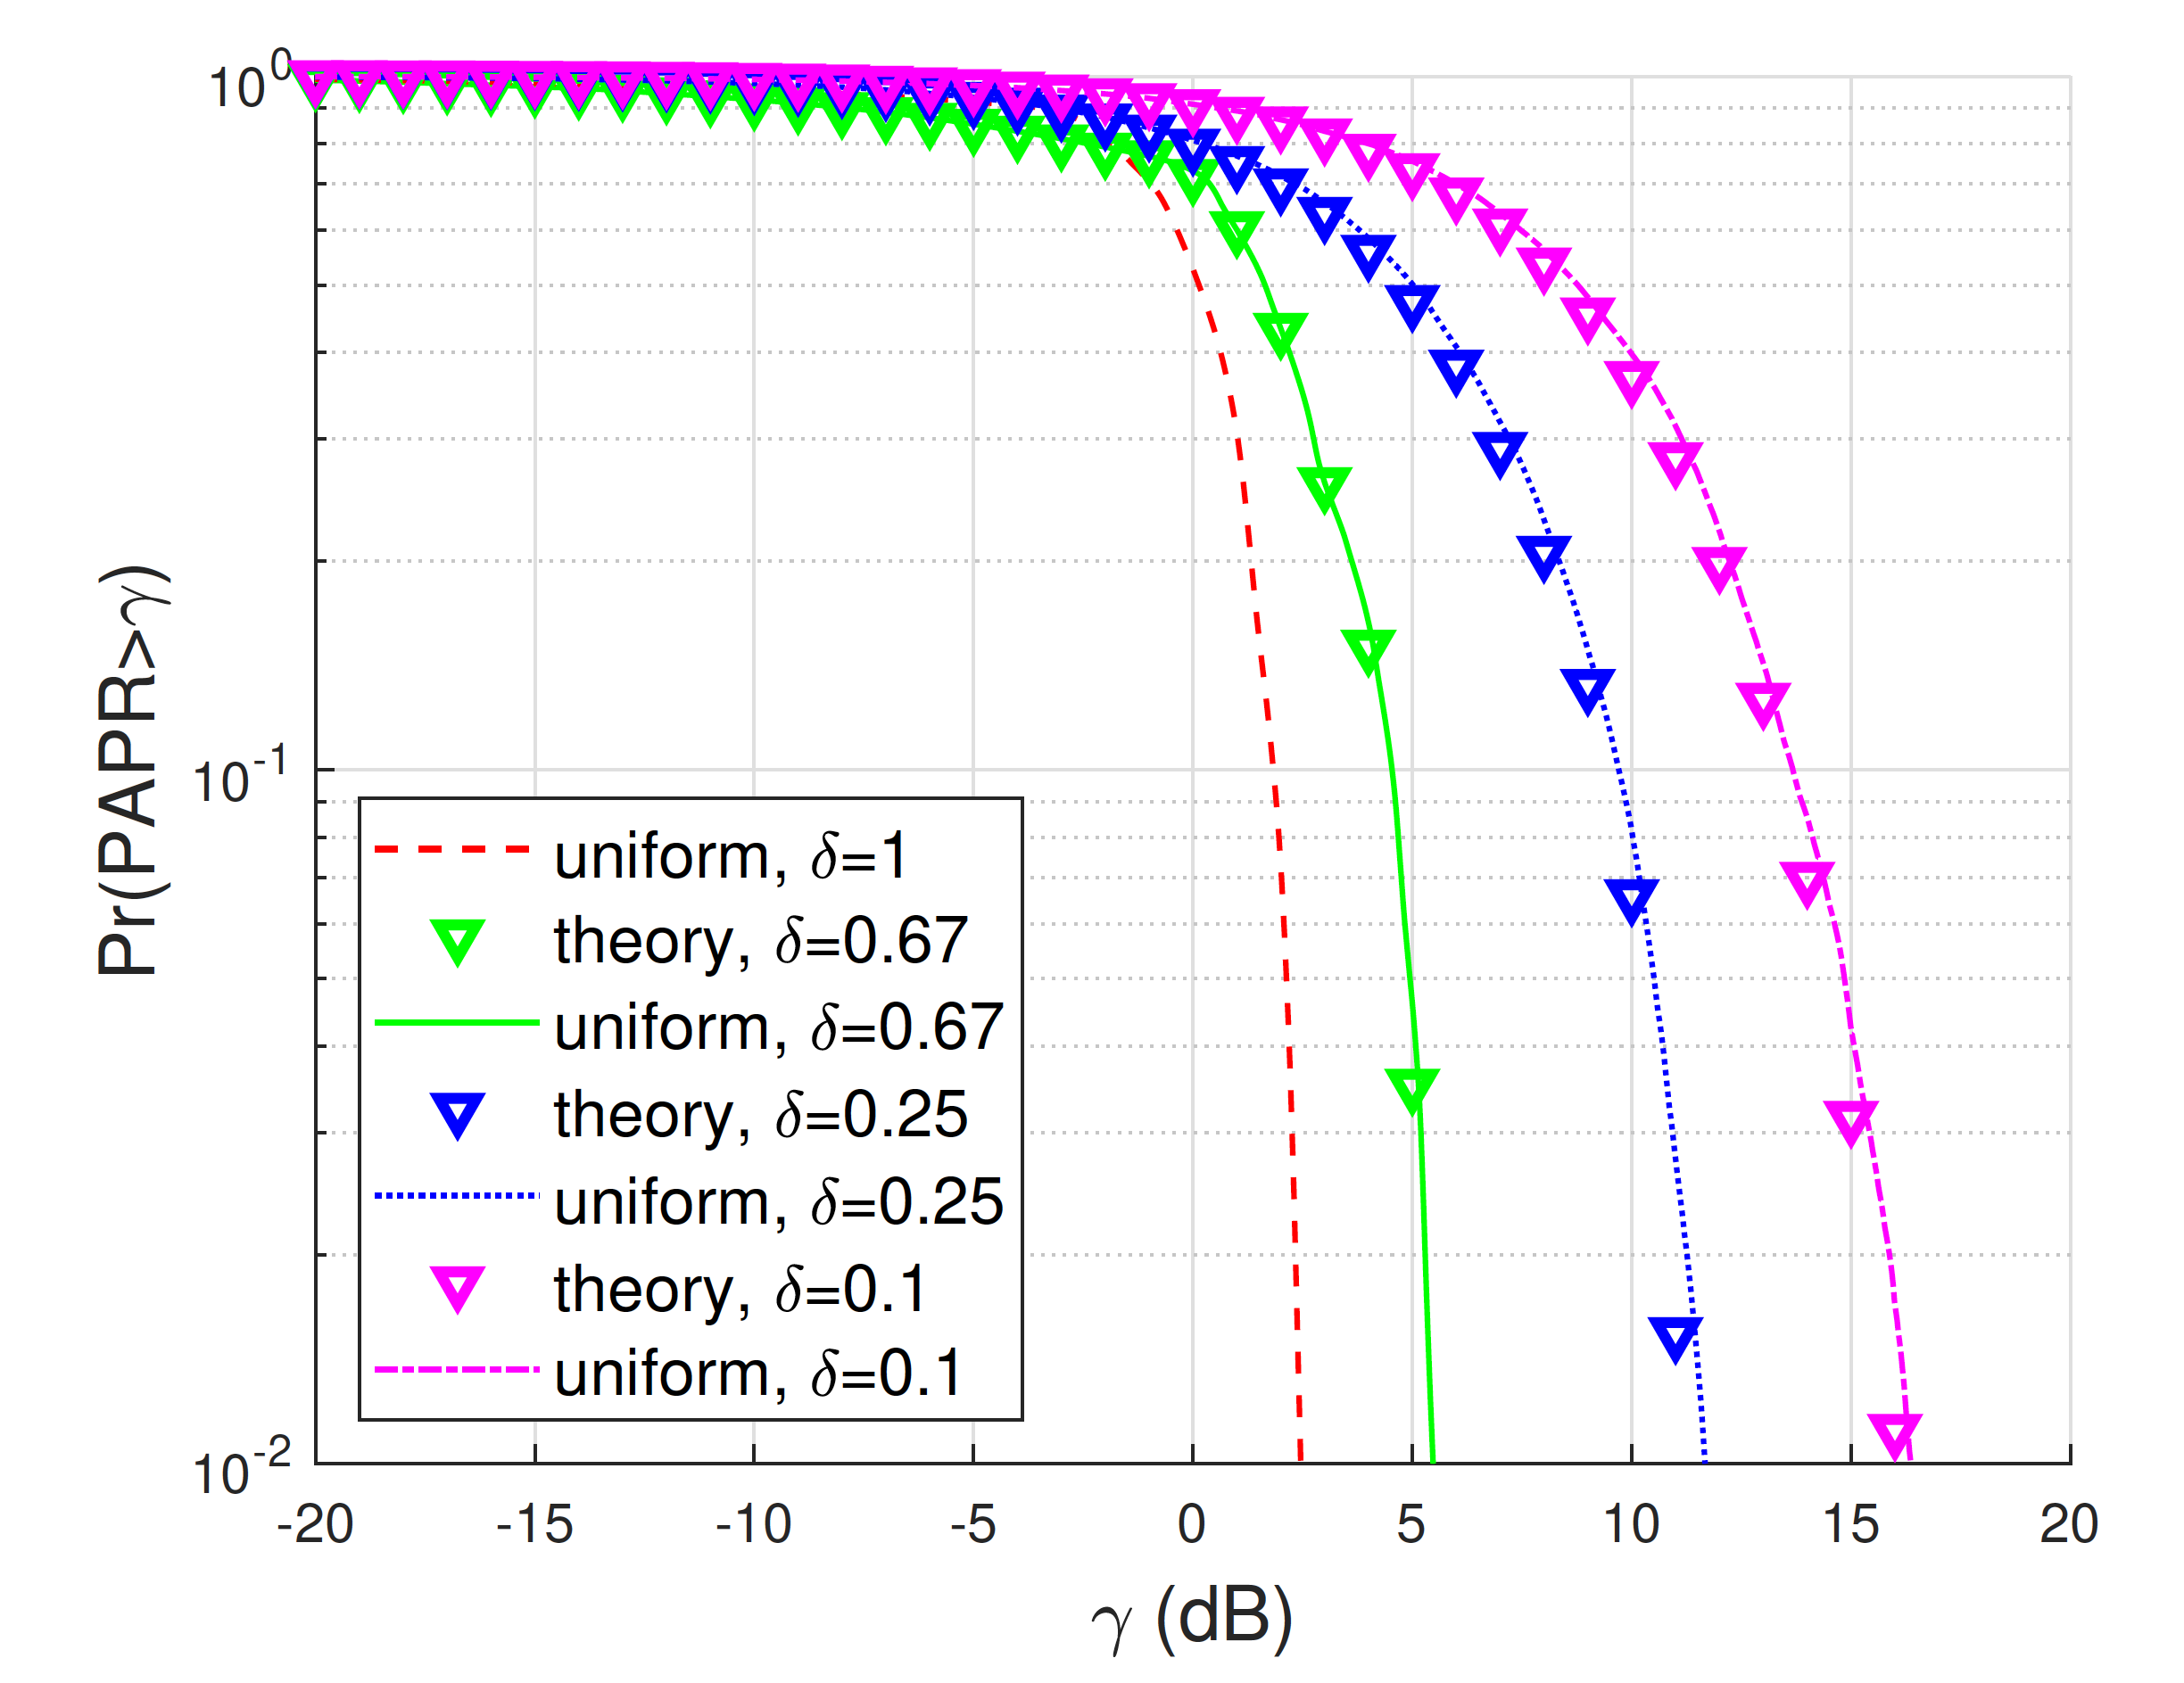
Instantaneous to Average Power Ratio of FTN
QPSK modulation
SNR_{tx} fixed
SNR_{rx} fixed

Slide 6
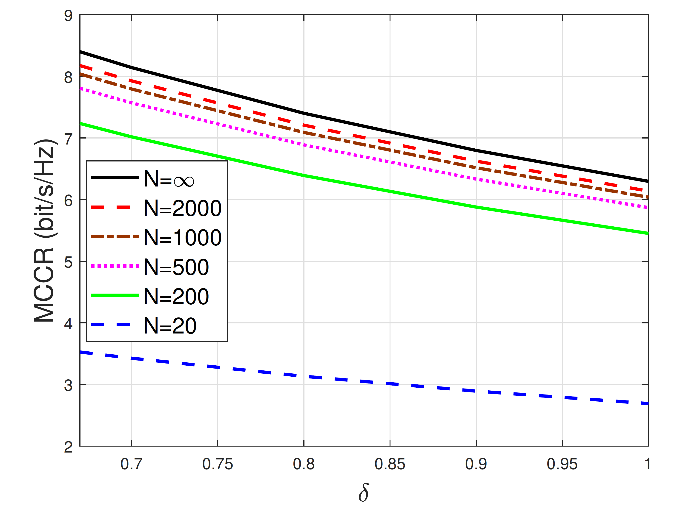
Finite-Blocklength Transmission with FTN
MCCR: maximum channel coding rate
N: blocklength
SNRtx = 20 dB
Probability of error = 10⁻⁶
RRC roll-off factor = 0.5

Slide 7
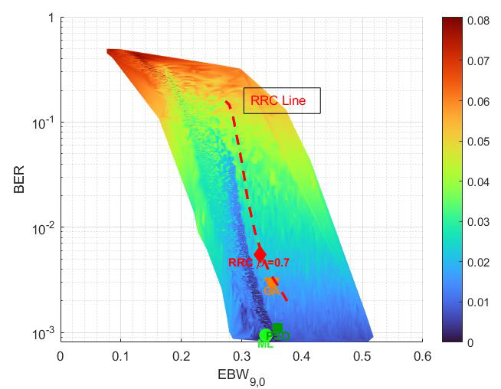
Optimal Pulse Shaping for FTN
Constrained optimization
BER ≤ constant 1
Bandwidth ≤ constant 2
IAPR ≤ constant 3
Instantaneous to average power ratio
90% bandwidth

Slide 8
FTN: Integration with 802.11
At the PHY Layer
FTN in time-domain: reduced OFDM symbol spacing
FTN in frequency-domain for subcarrier packing
  Similar to spectrally efficient FDM
As optional PHY modes
Why?
Spectral Efficiency: higher throughput without extra bandwidth
Tbps-class WLAN in beyond-7 generations
Hardware readiness: sophisticated equalizers already in use

Slide 9
References
[1] Z. Zhang, M. Yuksel and H. Yanikomeroglu, "Faster-Than-Nyquist Signaling for MIMO Communications," in IEEE Transactions on Wireless Communications, vol. 22, no. 4, pp. 2379-2392, April 2023.
[2] Z. Zhang, M. Yuksel, G. M. Guvensen and H. Yanikomeroglu, "Capacity Region of Asynchronous Multiple Access Channels With FTN," in IEEE Communications Letters, vol. 27, no. 7, pp. 1719-1723, July 2023.
[3] Z. Zhang, M. Yuksel, H. Yanikomeroglu, B.K. Ng, C.-T. Lam, “MIMO Asynchronous MAC with Faster-than-Nyquist (FTN) Signaling”, IEEE Globecom 2023.
[4] Z. Zhang, M. Yuksel, H. Yanikomeroglu, Benjamin Ng, and Chan-Tong Lam, “Maximum channel coding rate of finite block length MIMO faster-than-Nyquist signaling”, IEEE Wireless Communications and Networking Conference (WCNC), 24–27 March 2025, Milan, Italy.
[5] Z. Zhang, M. Yuksel, G. M. Guvensen, and H. Yanikomeroglu, “Capacity and IAPR analysis for MIMO faster-than-Nyquist signaling with high acceleration rate”, Early access, IEEE Transactions on Wireless Communications.
[6] Z. Zhang, M. Yuksel, G. M. Guvensen and H. Yanikomeroglu, “IAPR analysis for MIMO FTN signaling with Gaussian symbols”, IEEE International Symposium on Personal, Indoor and Mobile Radio Communications (PIMRC) 2025, Invited Paper, 1–4 September 2025, Istanbul, Türkiye.
[7] Z. Zhang, M. Yuksel, Shuangyang Li, G. M. Guvensen, and H. Yanikomeroglu, “Pushing the limits: Unlocking the potential of faster than Nyquist signaling”, under review in IEEE Communications Magazine (submission: 04 Aug 2025).

Slide 10
Thank You
Melda Yuksel, METU

