Slide 1
On the Impact of Unavailability on DUO non-AP STAs
Date: 2025-09-15
Authors:

Slide 2
Recap
There are interests to define dynamic unavailability for the mobile AP [1].
To improve the opportunistic power saving on non-AP STAs side, there is a motivation to let AP to signal its dynamic unavailability information to non-AP STAs [2].
In this presentation, we discuss the impacts of AP’s dynamic unavailability to DUO non-AP STAs and emphasis the needs to signal AP’s dynamic unavailability information.

Slide 3
Introduction
DUO STA can report the unavailability caused by IDC interference, e.g., co-existence of Bluetooth, LTE/5G, UWB, etc., which is on a different radio.
  DUO non-AP STA may indicate its unavailability either in an ICR frame, as a response to the received ICF from AP, or in an unsolicited BSRP NTB Trigger frame.
IDC interference prediction could provide millisecond-scale notice in advance.
  For slot-based protocols (Bluetooth, LTE), the predication could be done a few to hundred of milliseconds before the actual IDC interference occur.
  Ideally, DUO non-AP STA may signal the unavailability in current or next TXOP.
  In reality, DUO non-AP STA may batch or throttle the unavailability report to reduce network overhead, such as cancellation or amendment of previous unavailability reports.
DUO STA may report up to ~65 ms definite unavailability duration time.
  Unavailability Duration field indicates definite unavailability duration ranges from 1 to 1022 in units of 64 μs.

Slide 4
Problem Statement
AP may have dynamic unavailable durations, which non-AP STAs are not aware of in advance.
  E.g., AP is a mobile AP and has dynamic unavailability caused by IDC interference.
  E.g., AP process dynamic channel scanning to actively monitor channels to identify optional channels with less interference.
AP’ dynamic unavailable duration may overlap with non-AP STA’s unavailable duration or right before the non-AP STA’s unavailable duration.
  Non-AP STA may unnecessarily report its unavailability if its unavailable duration is within AP’s unavailable duration.
  Non-AP STA may fail to report its unavailability during AP’s unavailable duration, which causes AP send DL PPDU during non-AP STA’s unavailable duration.

Slide 5
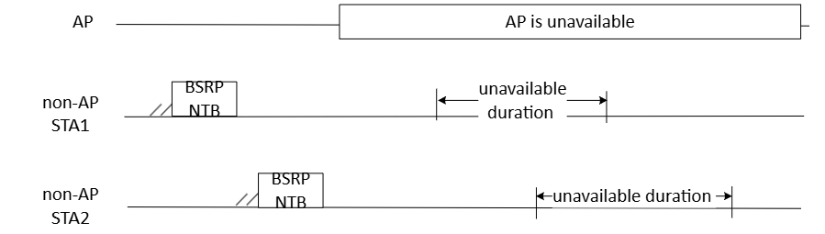
Scenario 1: Wasted Unsolicited Report
DUO non-AP STA is not aware of AP’s unavailable duration in advance and reports its unavailability using BSRP NTB frame.
DUO non-AP STA’s unavailable duration is within AP’s unavailable duration, during which AP does not send DL frames.
The unsolicited unavailability reports from non-AP STAs are not needed and got wasted.

Slide 6
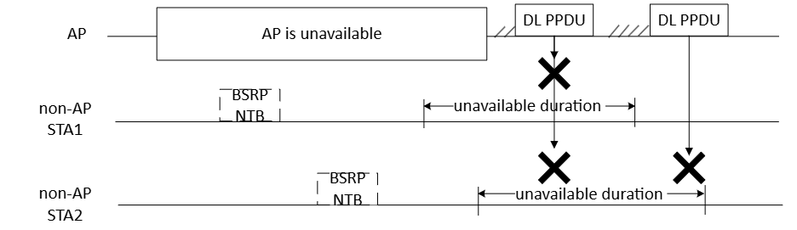
Scenario 2: Failed Unsolicited Report
DUO non-AP STA fail to signal AP its unavailability during AP’s unavailable duration.
DUO non-AP STA’s unavailable duration overlaps with or is right after the end point of AP’s unavailable duration
AP may send DL frame to DUO non-AP STA during STA’s unavailable duration.

Slide 7
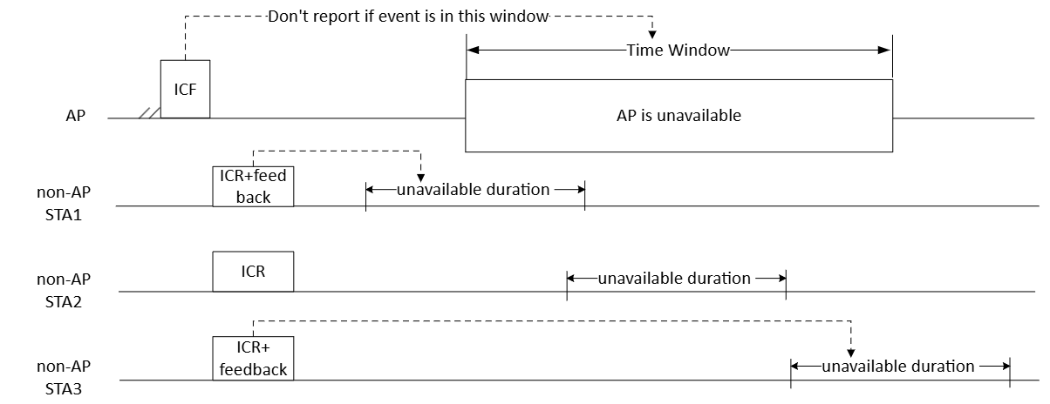
Proposed Solution
Let AP signal DUO non-AP STAs with more indication before AP’s unavailable duration starts.

Slide 8
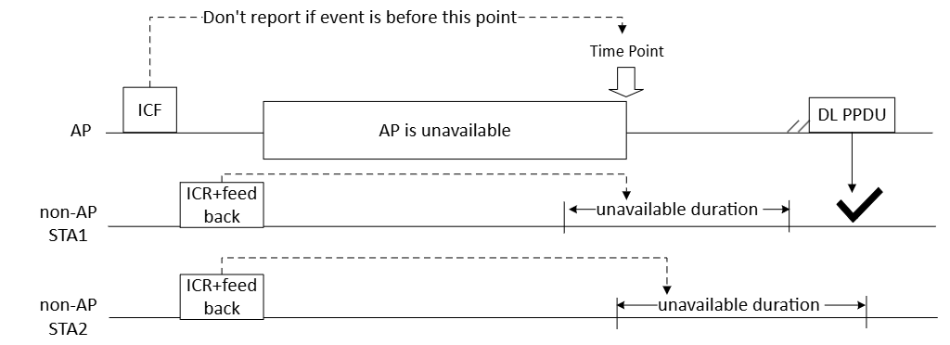
Cont.
Let AP signal DUO non-AP STAs with more indication before AP’s unavailable duration starts.

Slide 9
Summary
AP may have dynamic unavailable durations that non-AP STAs are not aware of.
  This may cause DUO non-AP STAs unnecessarily transmit unavailability reports or fail to transmit unavailability reports.
We propose to let AP send non-AP STAs with the indication of AP’s dynamic unavailability information.
  The indication could be a time window during which AP is unavailable.
  The indication could be a time point after which or before which AP is unavailable.
Based on the AP’s indication, DUO non-AP STAs decide whether or not to report their unavailability information and when to report.

Slide 10
SP1
Do you agree to let AP send non-AP STAs the indication of AP’s dynamic unavailability information?
  The indication could be a time window during which AP is unavailable.
  The indication could be a time point after which or before which AP is unavailable.

Slide 11
References
[1] IEEE802.11-25/1495r0 Mobile AP Unavailability
[2] IEEE802.11-25/0833r0 AP-assisted Opportunistic Power Saving

