Slide 1
On the Impact of Unavailability on DUO non-AP STAs
Date: 2025-09-15
Authors:

Slide 2
Introduction
DUO STA can report the unavailability caused by IDC interference, e.g., co-existence of Bluetooth, LTE/5G, UWB, etc., which is on a different radio.
DUO non-AP STA may indicate its unavailability either in an ICR frame, as a response to the received ICF from AP, or in an unsolicited BSRP NTB Trigger frame.
IDC interference prediction could provide millisecond-scale notice in advance.
For slot-based protocols (Bluetooth, LTE), the predication could be done a few to hundred of milliseconds before the actual IDC interference occur.
Ideally, DUO non-AP STA may signal the unavailability in current or next TXOP.
In reality, DUO non-AP STA may batch or throttle the unavailability report to reduce network overhead, such as cancellation or amendment of previous unavailability reports.
DUO STA may report up to ~65 ms definite unavailability duration time.
Unavailability Duration field indicates definite unavailability duration ranges from 1 to 1022 in units of 64 μs.

Slide 3
Problem Statement
AP may have dynamic unavailable duration, which may overlap with non-AP STA’s unavailable duration or right before the non-AP STA’s unavailable duration.
E.g., AP is a mobile AP and AP’s unavailable duration may be caused by IDC interference or channel scanning, etc.
Currently, AP doesn’t signal non-AP STA about its dynamic unavailability information.
Non-AP STA may unnecessarily report its unavailability if its unavailable duration is within AP’s unavailable duration.
Non-AP STA may fail to report its unavailability during AP’s unavailable duration, which causes AP send DL PPDU during non-AP STA’s unavailable duration.

Slide 4
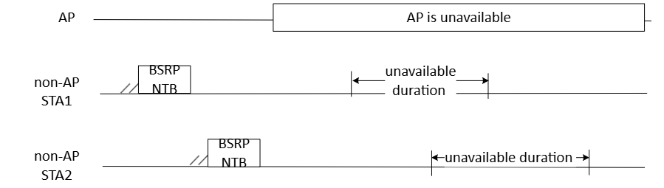
Scenario 1: Wasted Unsolicited Report
DUO non-AP STA is not aware of AP’s unavailable duration in advance and reports its unavailability using BSRP NTB frame.
DUO non-AP STA’s unavailable duration is within AP’s unavailable duration, during which AP does not send DL frames.
The unsolicited unavailability reports from non-AP STAs are not needed and got wasted.

Slide 5
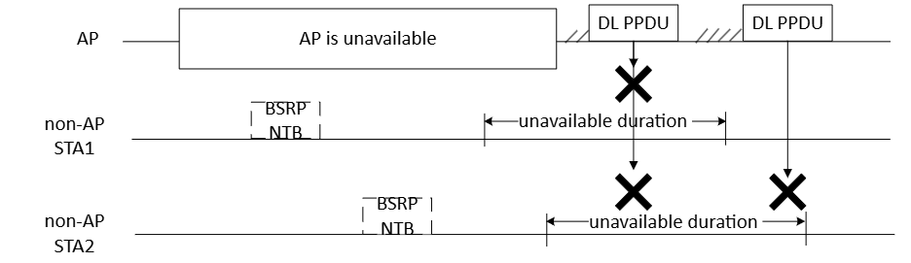
Scenario 2: Failed Unsolicited Report
DUO non-AP STA fail to signal AP its unavailability during AP’s unavailable duration.
DUO non-AP STA’s unavailable duration overlaps with or is right after the end point of AP’s unavailable duration
AP may send DL frame to DUO non-AP STA during STA’s unavailable duration.

Slide 6
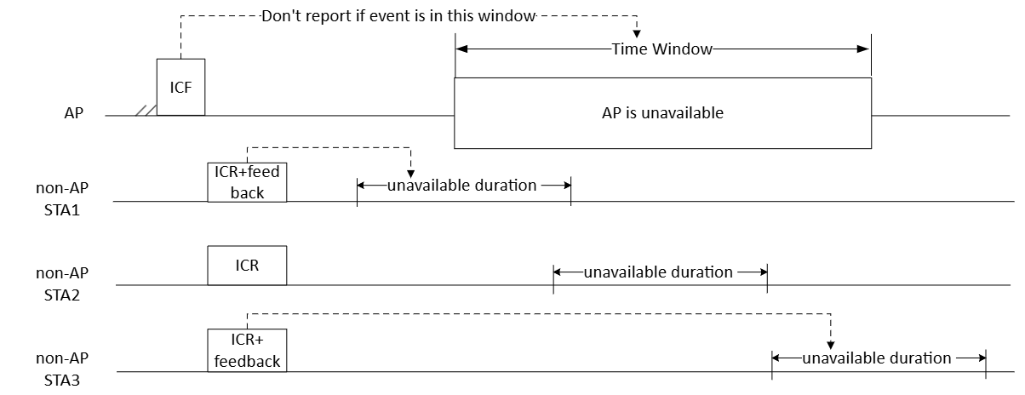
Proposed Solution
Let AP signal DUO non-AP STAs with more indication before AP’s unavailable duration starts.

Slide 7
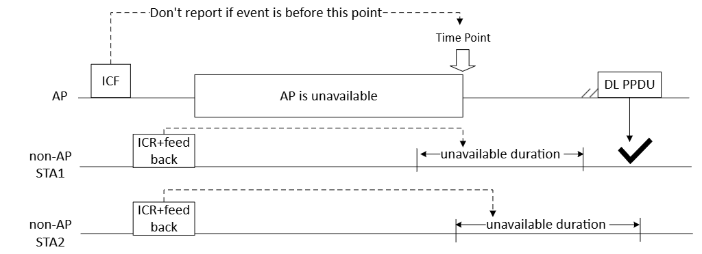
Cont.
Let AP signal DUO non-AP STAs with more indication before AP’s unavailable duration starts.

Slide 8
Summary
AP may have dynamic unavailable durations that DUO non-AP STAs are not aware of.
This may cause DUO non-AP STAs unnecessarily transmit unavailability reports or fail to transmit unavailability reports.
We propose to let AP send DUO non-AP STAs with the indication of AP’s unavailability information.
The indication could be a time window during which AP is unavailable.
The indication could be a time point after which or before which AP is unavailable.
Based on the AP’s indication, DUO non-AP STAs decide whether or not to report their unavailability information and when to report.

Slide 9
SP1
Do you agree to let AP send DUO non-AP STAs the indication of AP’s unavailability information?
The indication could be a time window during which AP is unavailable.
The indication could be a time point after which or before which AP is unavailable.

