Slide 1
Considerations for the IMMW Channel Access
Date: 2025-10-14
Authors:
Name | Affiliations | Address | Phone | Email
Yurong Qian | ZTE |  |  | qian.yurong@zte.com.cn
Zisheng Wang
Qisheng Huang
Bo Cao
Chun Huang
Yun Li
Bo Sun | Sanechips
Shuang Fan
Yayu Gao | Huazhong University of Science and Technology
Yueyang Zou
Wei Wang

Slide 2
Introduction
Several contributions have explored IMMW channel access mechanisms.
[1] proposes that a STA can initiate frame exchange within a negotiated TWT SP or at a dynamically agreed start time negotiated via sub-7 GHz with its peer STA.
[2] suggests scheduling dedicated SPs for mSTA pairs.
[3] discusses adjusting EDCA parameters for dedicated SPs to account for low collision probabilities.
[4] introduces a virtual channel contention mechanism to mitigate potential interference.
However, these proposals overlook the inter-BSS interference problem.
In this contribution, we present our consideration of the inter-BSS interference problem in IMMW channel access and evaluate its impact through simulations.

Slide 3
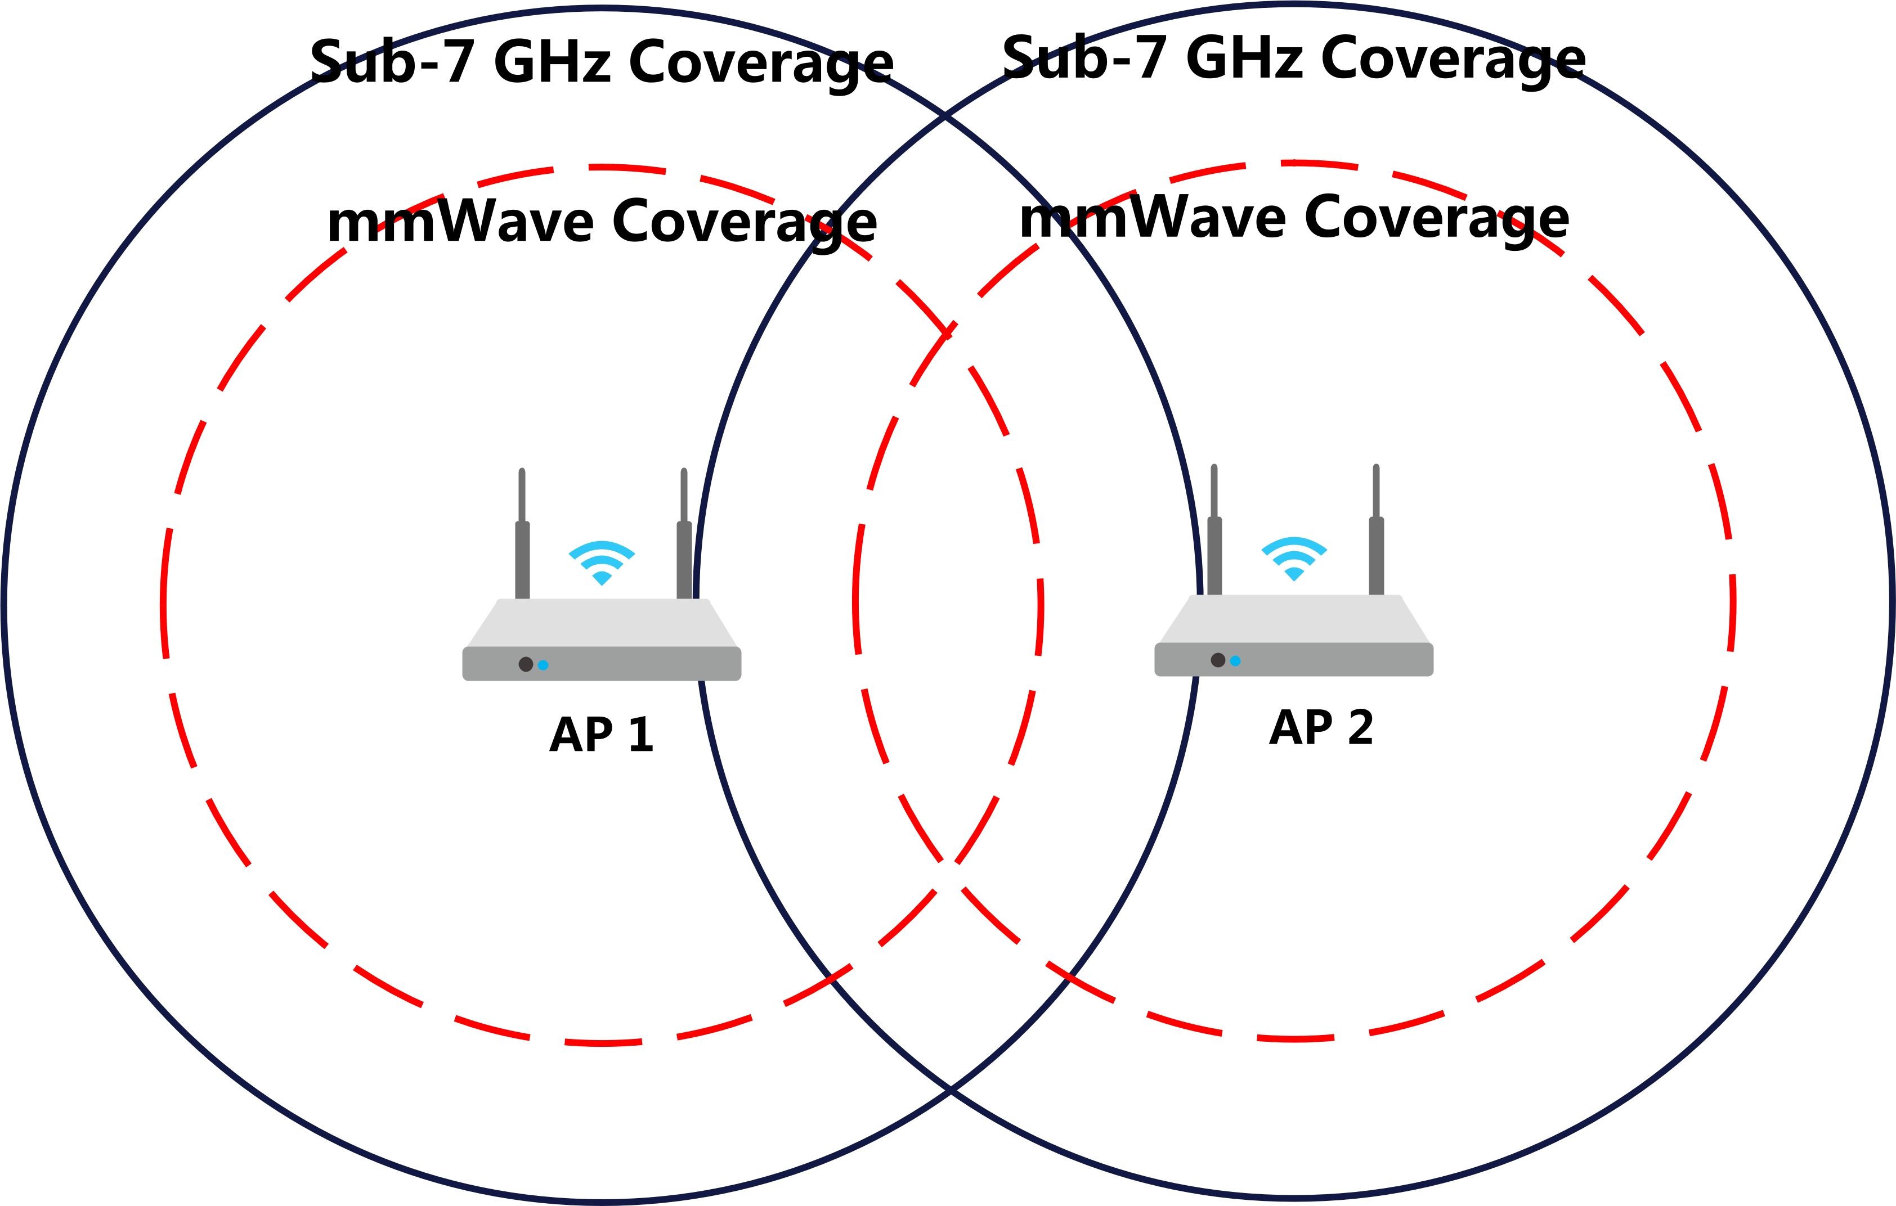
Background: Hidden Node Problem in mmWave Link
The hidden node problem significantly impairs WLAN performance by causing packet collisions, which reduce throughput and increase latency.
Intra-BSS hidden node issues can be effectively mitigated through enhanced management methods within the BSS, such as scheduling dedicated resources for STAs or conducting pre-negotiation between the AP and STAs.
In contrast, inter-BSS hidden node challenges are more complex due to the absence of coordination between BSSs and the transmission characteristics of mmWave.
The characteristics of mmWave transmission exacerbate hidden node problem.
High attenuation in mmWave link restricts coverage to short ranges compared to Sub-7 GHz link, increasing hidden node occurrences relative to lower-frequency bands.
While AP 1 and AP 2 can detect each other on the sub-7 GHz link, they may cannot on mmWave link.

Slide 4
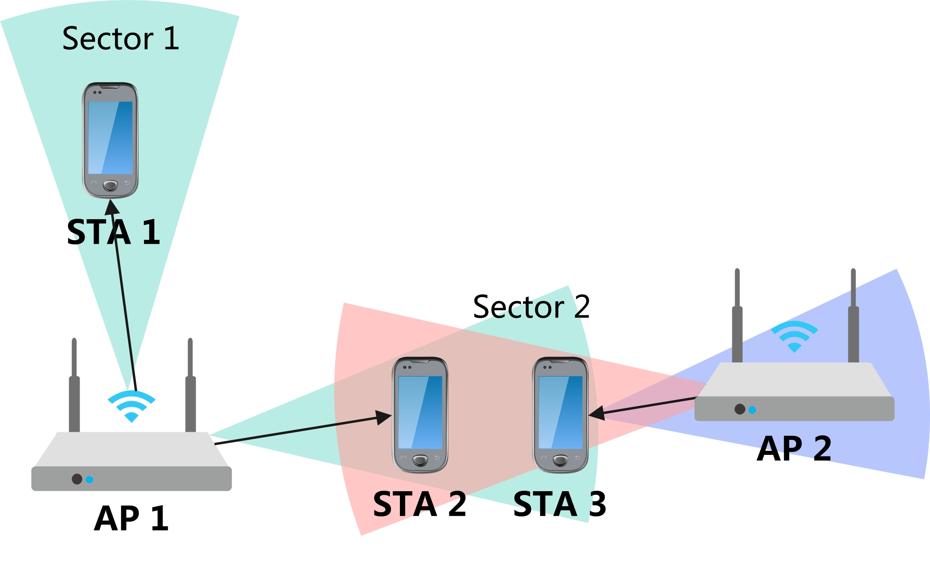
Background: Inter-BSS interference Problem
The characteristics of mmWave transmission exacerbate inter-BSS interference problem.
Challenges in channel protection arise due to the disparity between directional and omnidirectional transmission ranges.
Directional data transmission achieves greater distances than omnidirectional transmission, rendering omnidirectional CTS frames ineffective for channel protection.
To achieve effective channel protection, CTS frames must be transmitted across all directions, not solely the transmission beam’s direction, incurring substantial overhead and complexity.
Directional transmission introduces significant challenges in maintaining medium synchronization.
For example, when AP 1 serves STA 1 in Sector 1, it fails to acquire medium state information for Sector 2, such as missing NAV settings.
Upon switching to Sector 2, AP 1 lacks synchronization with the medium in that sector, increasing the likelihood of potential interference with ongoing transmissions.

Slide 5
Background: Device Constraints
Collisions may decrease with narrower bandwidths, but achieving such precise beams is challenging due to practical limits.
Cost and size constraints in WLAN mmWave devices, particularly for mobile APs and non-AP STAs, prevent the implementation of extremely narrow beamforming.
Achieving a beam accuracy of 11 degrees typically requires around nine antennas.
In most use cases, deployments often involve multiple APs.

Slide 6
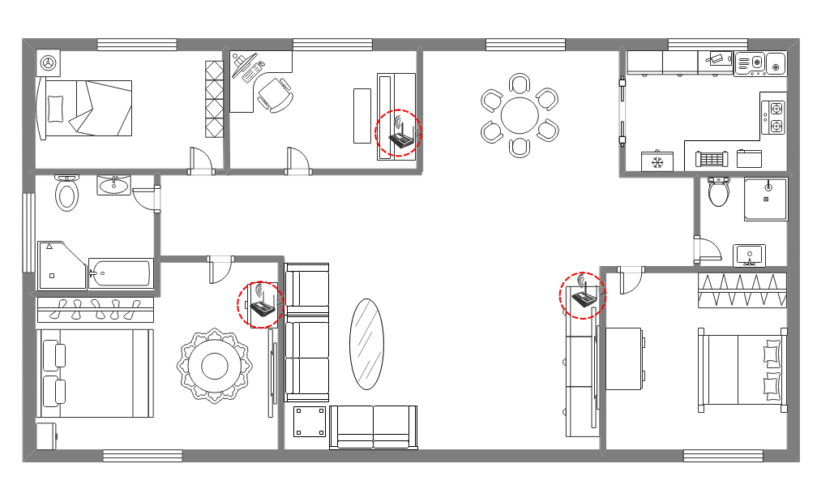
Typical Application Scenarios: Residential Environments
In residential settings, such as FTTR, 2–3 AP are typically deployed in high-traffic areas with short distances.
The short distance between APs results in lower path loss.
[6] indicates that mmWave signals face significant challenges in indoor-to-outdoor penetration at high frequencies but attenuation is relatively low in indoor wall penetration.
Indoor walls (e.g., glass, wood, plasterboard) exhibit losses of 4–16 dB, insufficient to eliminate inter-BSS interference. [6]
The experiment in [7] shows that for the wall panel, the attenuation is around 3dB/cm.

Slide 7
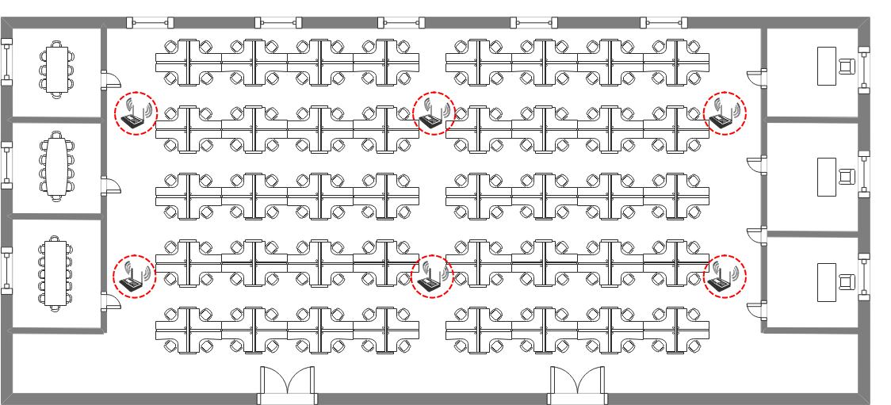
Typical Application Scenarios: Commercial Environments
In commercial settings, such as offices, factories, and shopping malls, APs are densely deployed with minimal obstructions, leading to strong inter-AP interference.

Slide 8
Further Considerations for IMMW Channel Access
Given the challenges outlined, inter-BSS interference represents a critical factor in the design of IMMW channel access mechanisms.
Due to cost and size constraints, mmWave devices may cannot achieve sufficiently narrow beamforming to eliminate interference from neighboring nodes.
In typical application scenarios, such as residential and commercial environments, inter-BSS interference remains significant and cannot be overlooked.
Future channel access protocols should incorporate mechanisms to mitigate inter-BSS interference.

Slide 9
Simulation Setup
Simulation parameter:
Transmit Power: 10 dbm
Transmit Antenna Gain (G_tx): 0 dB
Number of Transmit Antennas (Nt): 16
Beamforming Gain (G_bf): 10 * log10(Nt) dB
Transmit Link Loss (L_tx): 0 dB
Bandwidth: 2.16 GHz
Frequency: 60 GHz
Pathloss: PL_free_space = 20*log10(distance) + 20*log10(f_GHz) + 32.45 - Gt_dB - Gr_dB
Noise Power: -100 dBm
Packet Length: 1024 bytes
Antenna configuration:
Uniform Linear Array (ULA)
Maximum Ratio Transmission (MRT) beamforming

Slide 10
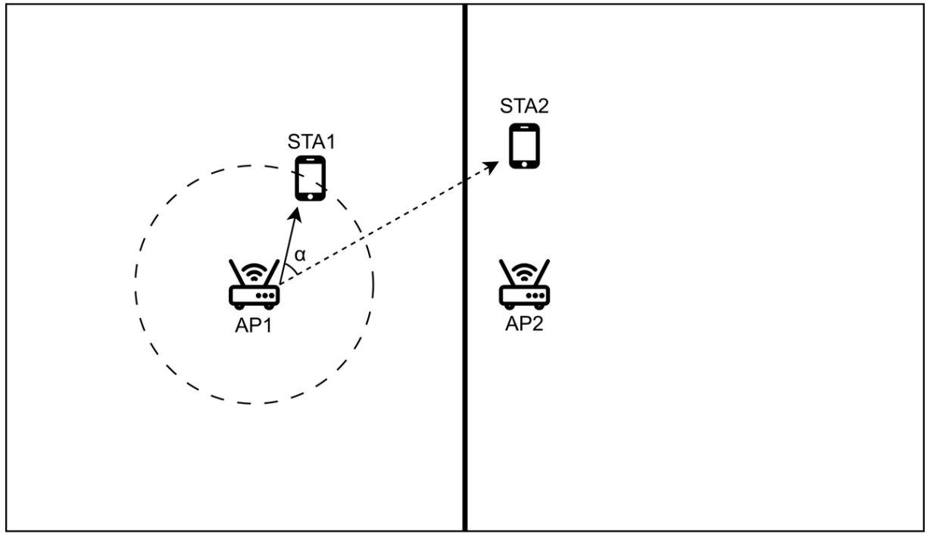
Simulation Case 1
Simulation scenario:
Residential Environment
Number of APs: 2
Number of STA per BSS: 1
AP1-STA2 distance: 2 m
AP2-STA2 distance: 8m
The positions of AP1, AP2, and STA2 are fixed. STA1 is randomly positioned around AP1.
Obstruction: A single wall between BSS1 and BSS2.
Three wall material models are considered, with respective penetration losses: 15 dB (glass), 20 dB (wood), and 25 dB (partition wall).
The angle at AP1 between the links to STA1 and STA2 is denoted as α ∈[0, 2π).

Slide 11
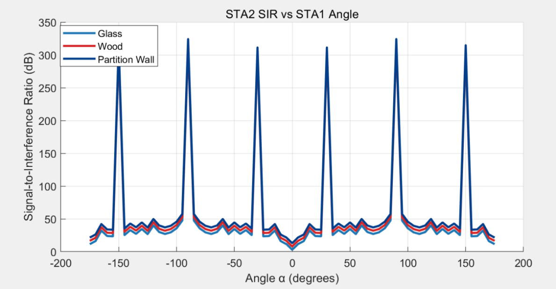
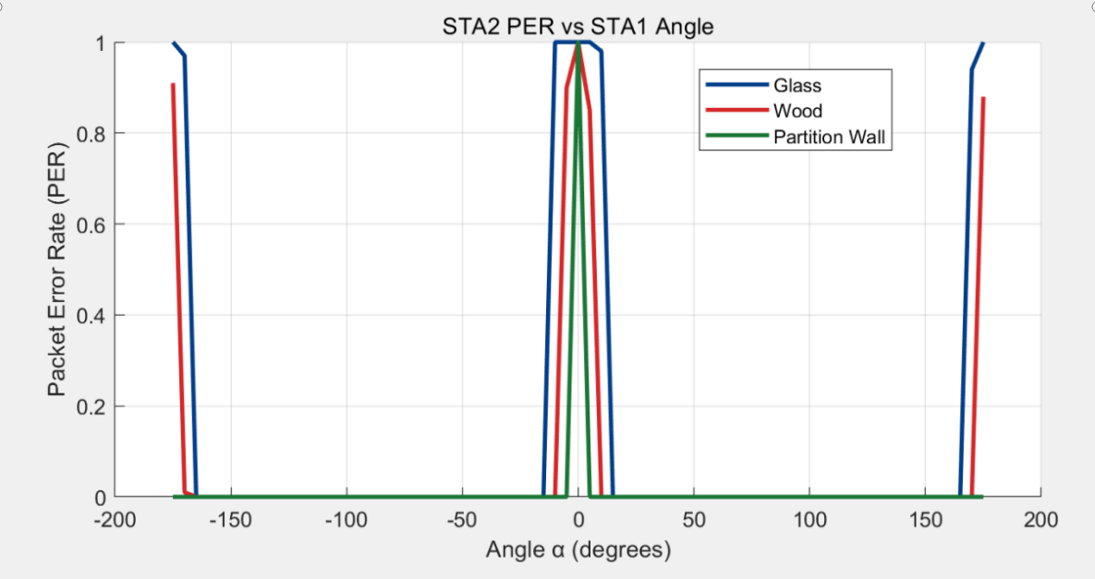
Simulation Result 1
At peak interference angles (α ≈ 0° and 180°),the SINR at STA2 drops sharply, resulting in the PER up to approaches 100%.
Wall obstructions alone are insufficient to mitigate inter-BSS interference, leading to substantial performance impairments in residential mmWave networks.

Slide 12
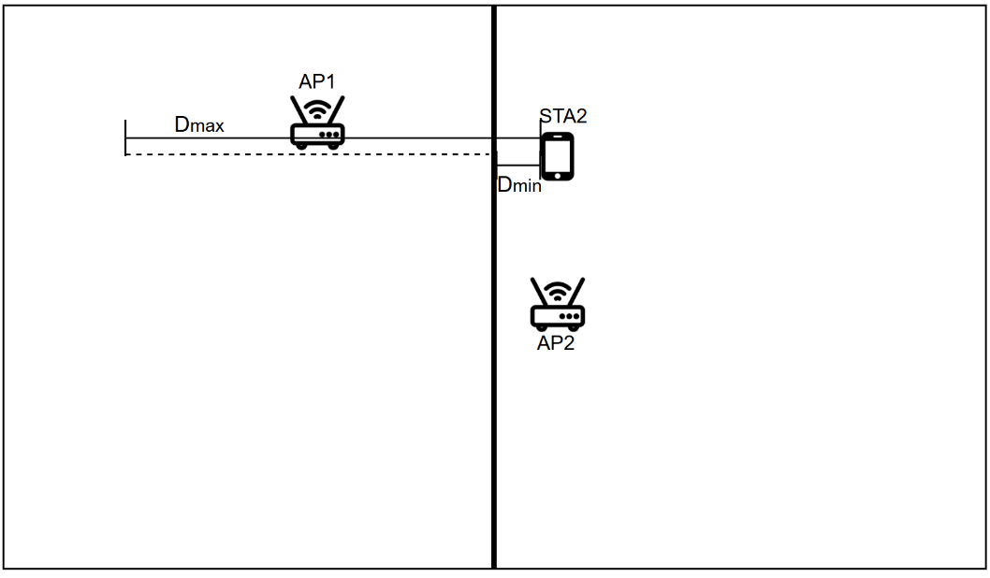
Simulation Case 2
Simulation scenario:
Residential Environment
Number of APs: 2
Number of STA per BSS: 1
AP2-STA2 distance: 8m
AP1-STA2 distance: [1, 15] m
Angle α: 0 degrees
The positions of AP2 and STA2 are fixed, while the distance between AP1 and BSS2 varies.
Obstruction: A single wall between BSS1 and BSS2.
Three wall material models are considered, with respective penetration losses: 15 dB (glass), 20 dB (wood), and 25 dB (partition wall).

Slide 13
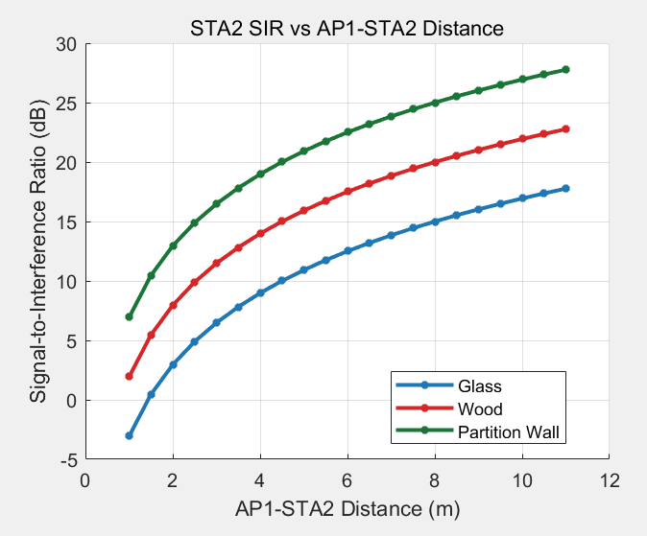
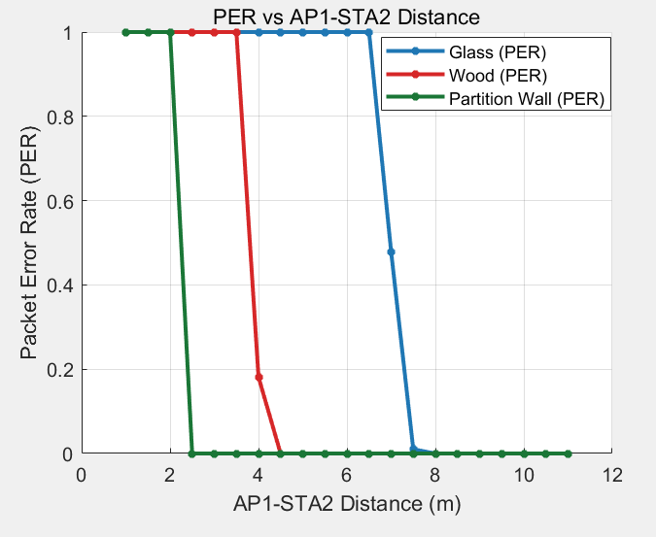
Simulation Result 2
The PER reaches 100% at a closer inter-BSS distance, even with wall obstruction—a common residential scenario.
Inter-BSS interference remains non-negligible when a STA is positioned within the main lobe of an OBSS AP.

Slide 14
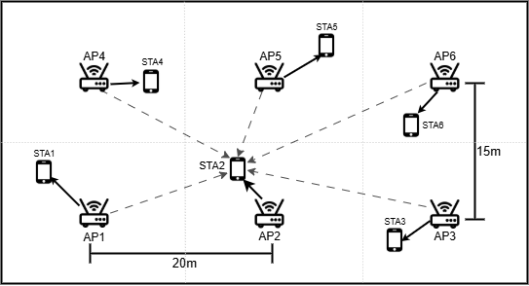
Simulation Case 3
Simulation scenario:
Commercial Environment
Number of APs: 6
Number of STAs per BSS: 1
Intra-BSS distance: [2, 4] m
Distance between AP1 and STA2: 5m
Obstruction: None (open environment)
Each STA is randomly positioned around its associated AP.

Slide 15
Simulation Result 3
STA number | STA Position 1 | SINR (dB) | BER | STA Position 1 | SINR (dB) | BER | STA Position 1 | SINR (dB) | BER
1 | (-17,-7.3) | 27.61 | 0 | (-18.9,-3.9) | 14.32 | 58.11% | (-17.3,-10.2) | 30.89 | 0
2 | (0.2,-4.5) | 9.71 | 100% | (3.3,-6.9) | 13.46 | 100% | (1.8,-6.4) | 37.07 | 0
3 | (17,-7.8) | 9.73 | 100% | (17.3,-6) | 20.21 | 0 | (21.8,-4.2) | 12.79 | 100%
4 | (-17,7.7) | 18.37 | 55.96% | (-18.5,9.4) | 18.14 | 0 | (-17.7,9.1) | 28.92 | 0
5 | (-0.1,4.5) | 9.72 | 100% | (1.2,3.8) | 15.11 | 0 | (3,6.7) | 35.36 | 0
6 | (17,7.7) | 15.8 | 100% | (18.7,10.6) | 39.38 | 0 | (19.1,5) | 20.25 | 0
Three sets of simulations under varied topological conditions consistently demonstrated more severe inter-BSS interference than that in residential scenarios.
STAs face a high PER probability even when inter-BSS are much farther apart than the intra-BSS distance.
Inter-BSS interference emerges as a more formidable impediment in open environments characterized.

Slide 16
Summary
This contribution provides an analysis of inter-BSS interference problem in the mmWave link.
The simulations reveal significant inter-BSS interference in residential environments, demonstrating that wall obstructions are insufficient to fully mitigate this interference.
In open settings such as offices and campuses, inter-BSS interference becomes increasingly pronounced and cannot be overlooked.
The results offer compelling evidence that future IMMW channel access protocols should account for this critical issue.

Slide 17
THANK YOU

Slide 18
Reference
[1] 25/0428r1, “mmWave Link MAC: TXOP Protection, Medium Access, Power Save”
[2] 25/0294r0, “A Service Period Based Integrated mmWave Link Operation Scheme”
[3] 25/0433r2, “Channel Access for IMMW”
[4] 25/1327r0, “Virtual Channel Contention for IMMW”
[5] 25/1312r0, “IMMW Channel Access Considerations”
[6] M. Khatun, C. Guo, D. Matolak and H. Mehrpouyan, "Indoor and Outdoor Penetration Loss Measurements at 73 and 81 GHz," 2019 IEEE Global Communications Conference (GLOBECOM), Waikoloa, HI, USA, 2019, pp. 1-5.
[7] K. Du, O. Ozdemir, F. Erden and I. Guvenc, "Sub-Terahertz and mmWave Penetration Loss Measurements for Indoor Environments," 2021 IEEE International Conference on Communications Workshops (ICC Workshops), Montreal, QC, Canada, 2021, pp. 1-6.

