Slide 1
Considerations for the IMMW Channel Access
Date: 2025-09-01
Authors:
Name | Affiliations | Address | Phone | Email
Yurong Qian | ZTE |  |  | qian.yurong@zte.com.cn
Zisheng Wang
Qisheng Huang
Bo Cao
Chun Huang
Yun Li
Yaodong Zhang
Bo Sun | Sanechips
Shuang Fan

Slide 2
Introduction
Several contributions have explored IMMW channel access mechanisms.
  [1] proposes that a STA can initiate frame exchange within a negotiated TWT SP or at a dynamically agreed start time negotiated via sub-7 GHz with its peer STA.
  [2] suggests scheduling dedicated SPs for mSTA pairs.
  [3] discusses adjusting EDCA parameters for dedicated SPs to account for low collision probabilities.
  [4] introduces a virtual channel contention mechanism to mitigate potential interference.
  However, these proposals overlook the inter-BSS interference problem.
In this contribution, we present our consideration of the inter-BSS interference problem in IMMW channel access.

Slide 3
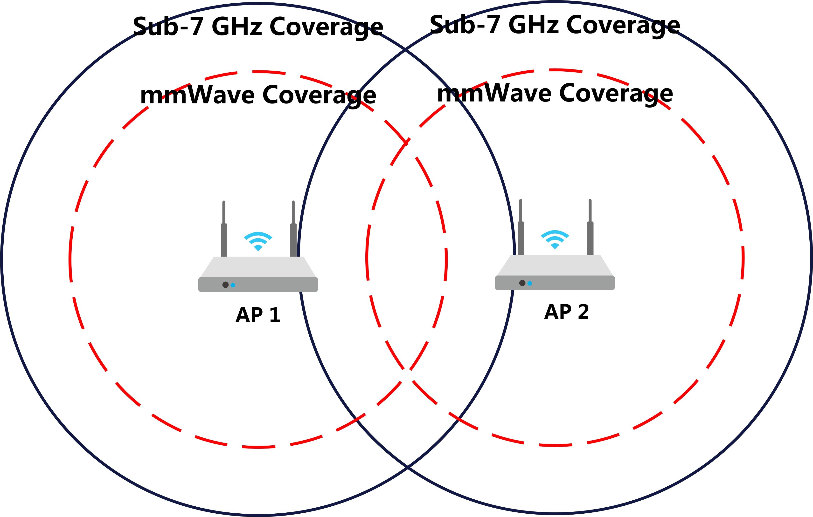
Background: Hidden Node Problem in mmWave Link
In WLAN distributed channel access, hidden nodes arise when devices cannot detect each other’s transmissions, leading to severe network performance degradation.
  This results in packet collisions, data loss, increased retransmissions, reduced throughput, and degraded QoS.
The characteristics of mmWave transmission exacerbate hidden node problem.
  High attenuation in mmWave link restricts coverage to short ranges compared to Sub-7 GHz link, increasing hidden node occurrences relative to lower-frequency bands.
    While AP 1 and AP 2 can detect each other on the sub-7 GHz link, they may cannot on mmWave link.

Slide 4
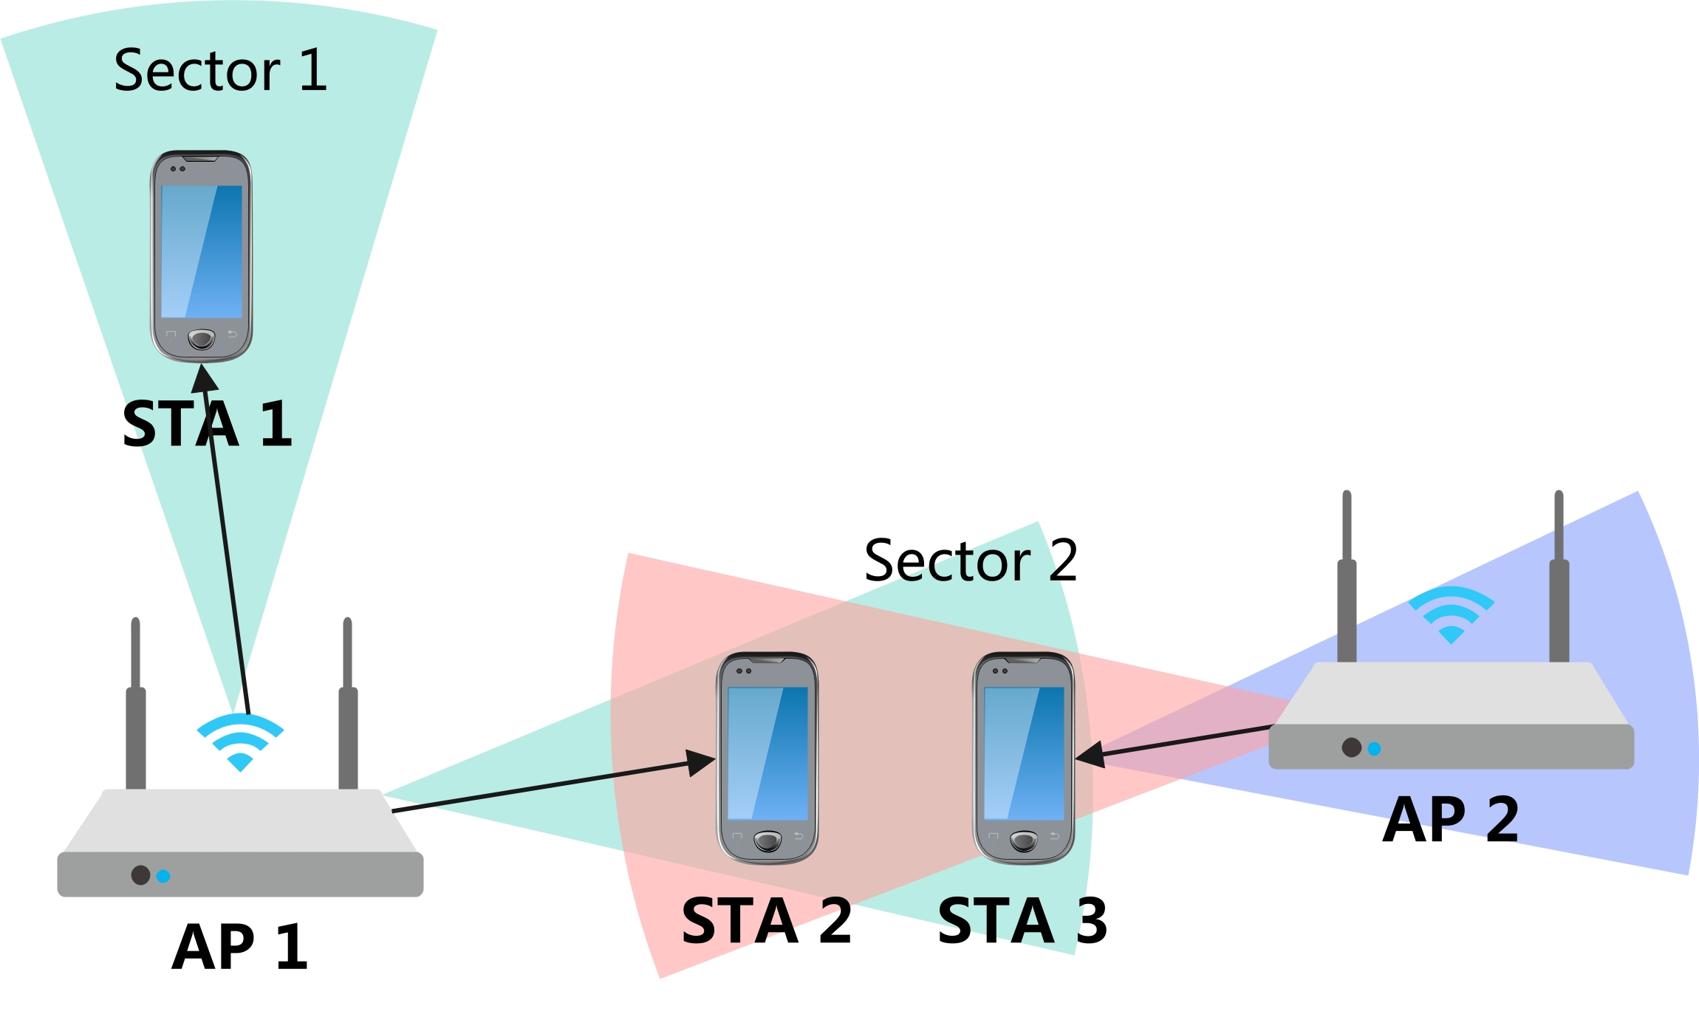
Background: Inter-BSS interference Problem
  The characteristics of mmWave transmission exacerbate inter-BSS interference problem.
  Challenges in channel protection arise due to the disparity between directional and omnidirectional transmission ranges.
    Directional data transmission achieves greater distances than omnidirectional transmission, rendering omnidirectional CTS frames ineffective for channel protection.
    To achieve effective channel protection, CTS frames must be transmitted across all directions, not solely the transmission beam’s direction, incurring substantial overhead and complexity.
  Directional transmission introduces significant challenges in maintaining medium synchronization.
    For example, when AP 1 serves STA 1 in Sector 1, it fails to acquire medium state information for Sector 2, such as missing NAV settings.
    Upon switching to Sector 2, AP 1 lacks synchronization with the medium in that sector, increasing the likelihood of potential interference with ongoing transmissions.

Slide 5
Background: Device Constraints
  Collision may low if sufficient narrow band is given, however, however, achieving sufficiently narrow beams is challenging due to practical limitations.
  Cost and size constraints in WLAN mmWave devices, particularly for mobile APs and non-AP STAs, prevent the implementation of extremely narrow beamforming.
  Achieving a beam accuracy of 11 degrees typically requires around nine antennas.
  In most use cases, deployments involve multiple APs, necessitating careful consideration of inter-BSS interference.

Slide 6
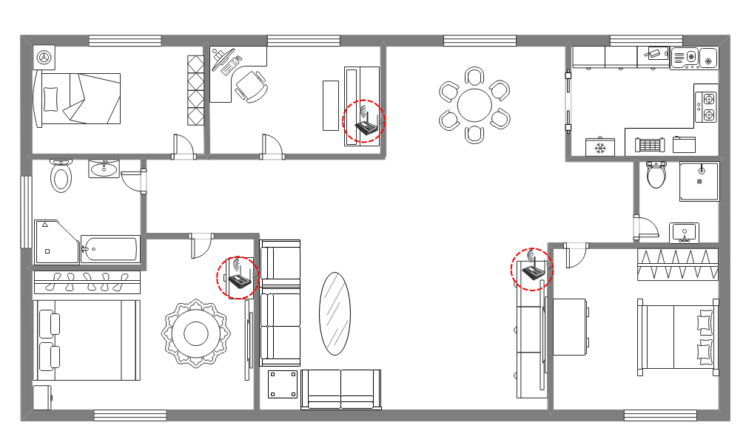
Typical Application Scenarios: Residential Environments
In residential settings, such as FTTR, 2–3 AP are typically deployed in high-traffic areas with short distances.
  The short distance between APs results in lower path loss.
  [6] indicates that mmWave signals face significant challenges in indoor-to-outdoor penetration at high frequencies but attenuation is relatively low in indoor wall penetration.
  Indoor walls (e.g., glass, wood, plasterboard) exhibit losses of 4–16 dB, insufficient to eliminate inter-BSS interference. [6]
  The experiment in [7] shows that for the wall panel, the attenuation is around 3dB/cm.

Slide 7
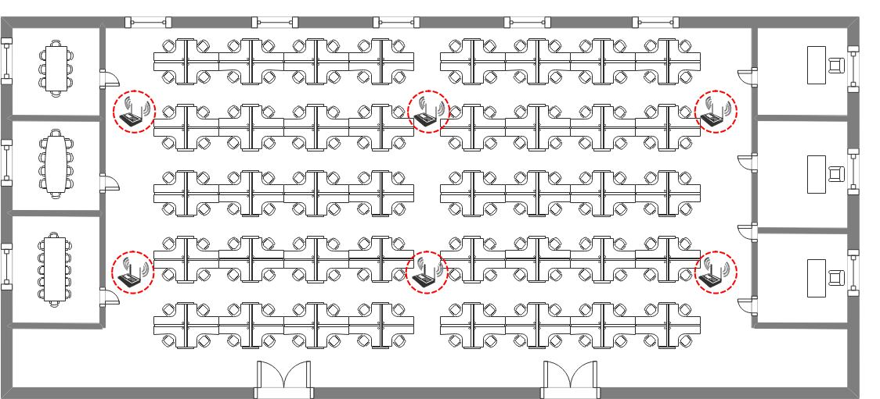
Typical Application Scenarios: Commercial Environments
In commercial settings, such as offices, factories, and shopping malls, APs are densely deployed with minimal obstructions, leading to strong inter-AP interference.

Slide 8
Further Considerations for IMMW Channel Access
Given the challenges outlined, inter-BSS interference represents a critical factor in the design of IMMW channel access mechanisms.
Due to cost and size constraints, mmWave devices may cannot achieve sufficiently narrow beamforming to eliminate interference from neighboring nodes.
In typical application scenarios, such as residential and commercial environments, inter-BSS interference remains significant and cannot be overlooked.
Future channel access protocols should incorporate mechanisms to mitigate inter-BSS interference.

Slide 9
Summary
This contribution provides an analysis of inter-BSS interference problem in the mmWave link.
It should be considered in the design of future IMMW channel access protocols.

Slide 10
THANK YOU

Slide 11
Reference
[1] 25/0428r1, “mmWave Link MAC: TXOP Protection, Medium Access, Power Save”
[2] 25/0294r0, “A Service Period Based Integrated mmWave Link Operation Scheme”
[3] 25/0433r2, “Channel Access for IMMW”
[4] 25/1327r0, “Virtual Channel Contention for IMMW”
[5] 25/1312r0, “IMMW Channel Access Considerations”
[6] M. Khatun, C. Guo, D. Matolak and H. Mehrpouyan, "Indoor and Outdoor Penetration Loss Measurements at 73 and 81 GHz," 2019 IEEE Global Communications Conference (GLOBECOM), Waikoloa, HI, USA, 2019, pp. 1-5.
[7] K. Du, O. Ozdemir, F. Erden and I. Guvenc, "Sub-Terahertz and mmWave Penetration Loss Measurements for Indoor Environments," 2021 IEEE International Conference on Communications Workshops (ICC Workshops), Montreal, QC, Canada, 2021, pp. 1-6.

