Slide 1
On The Interoperability Between NPCA and P-EDCA
Date: 2025-03-08
Authors:
Name | Affiliations | Address | Phone | Email
Salvatore Talarico | Nokia |  |  | salvatore.talarico@nokia.com
Klaus Doppler
Mika Kasslin
Prabodh Varshney
Qing Xia
Okan Mutgan
Behnam Dezfouli
Mikhail Liubogoshchev
Mika Kasslin
Behnam Dezfouli
Juhyung Lee
Juhyung Lee
Kerstin Johnsson
Eda Genc
Mario Costa

Slide 2
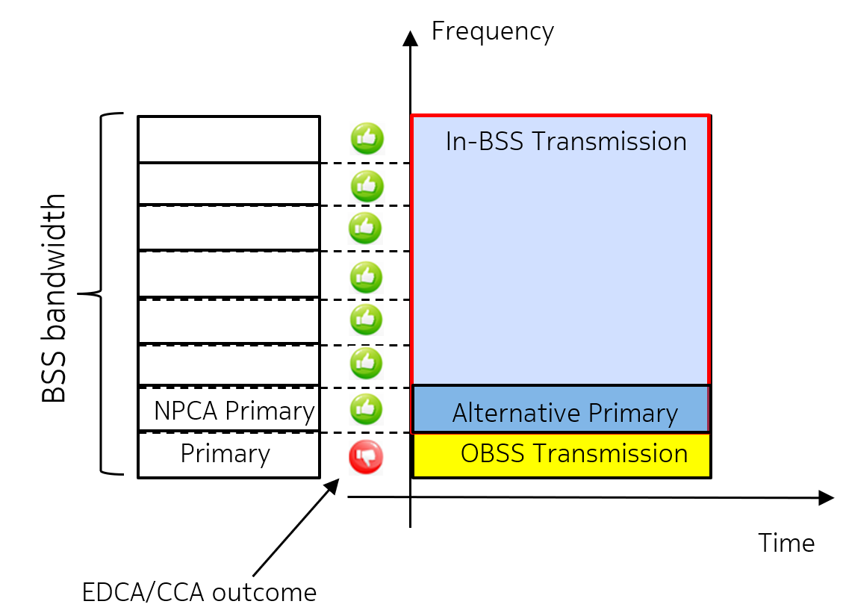
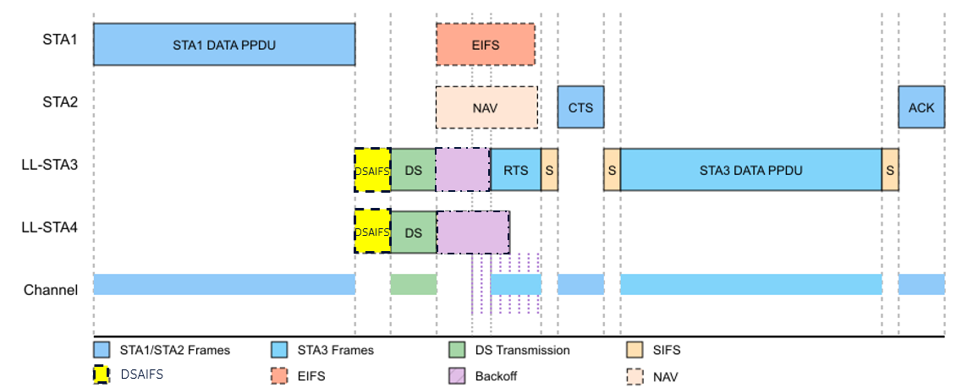
Introduction
As IEEE P802.11bn™/D1.0 Draft has been finalized [1], the baseline design of both NPCA [2] and P-EDCA [3] have been included.
While these features have been individually designed, it is also important to discuss their possible interoperability and the related impact.
Figure 1a – General illustration of the NPCA procedure
Figure 1b – General illustration of the P-EDCA procedure

Slide 3
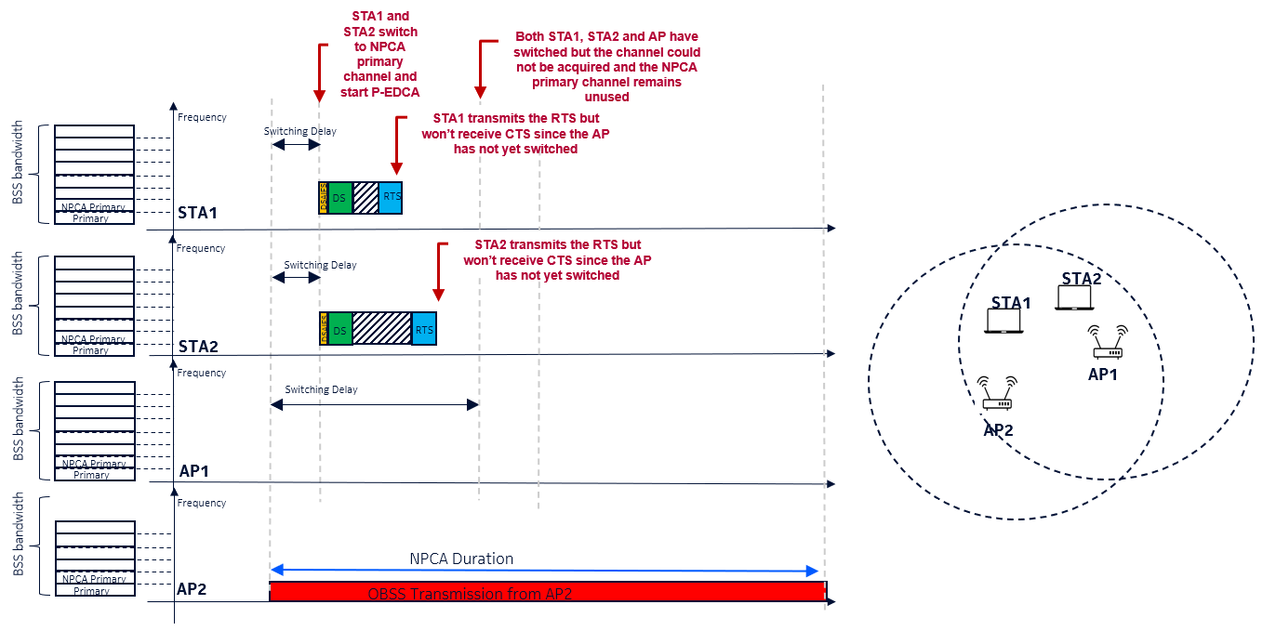
Problem Statement
P-EDCA is based upon the hand-shake (RTS-CTS exchange) between LL non-AP STAs and the AP. However, if their NPCA switching delay is different then this hand-shake could not be completed or may be completed in an optimized way (e.g., when the QSRC is set to be different than 0).

Slide 4
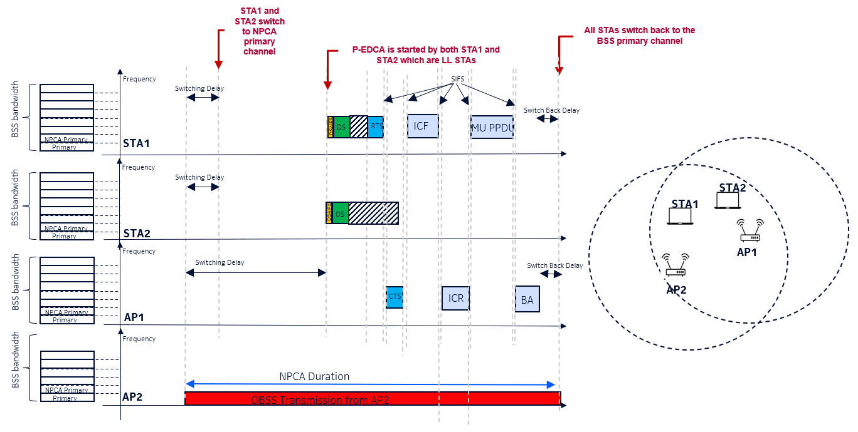
Discussion On The Way Forward (1/2)
Option 1: P-EDCA and NPCA are never enabled together
  No gain for special cases where P-EDCA and NPCA can be effectively used together and would complement to each other
Option 2: P-EDCA is enabled only for STAs for which the NPCA Switching Delay is such that they switch to the NPCH (non-primary channel) within a certain time range (e.g. after or together with the other participating NPCA STAs)
  It may limit the use of P-EDCA when AP has a long switching delay compared to STAs and may require some additional signaling so that STAs can properly enabled/disabled NPCA
Option 3: P-EDCA is triggered following a specific timeline (e.g., P-EDCA starts once all participating NPCA STAs have switched to the NPCH)
  This solution (similarly as option 1 and 2) is not proper when legacy devices or UHR devices using legacy EDCA are present, as they would effectively access the channel earlier.

Slide 5
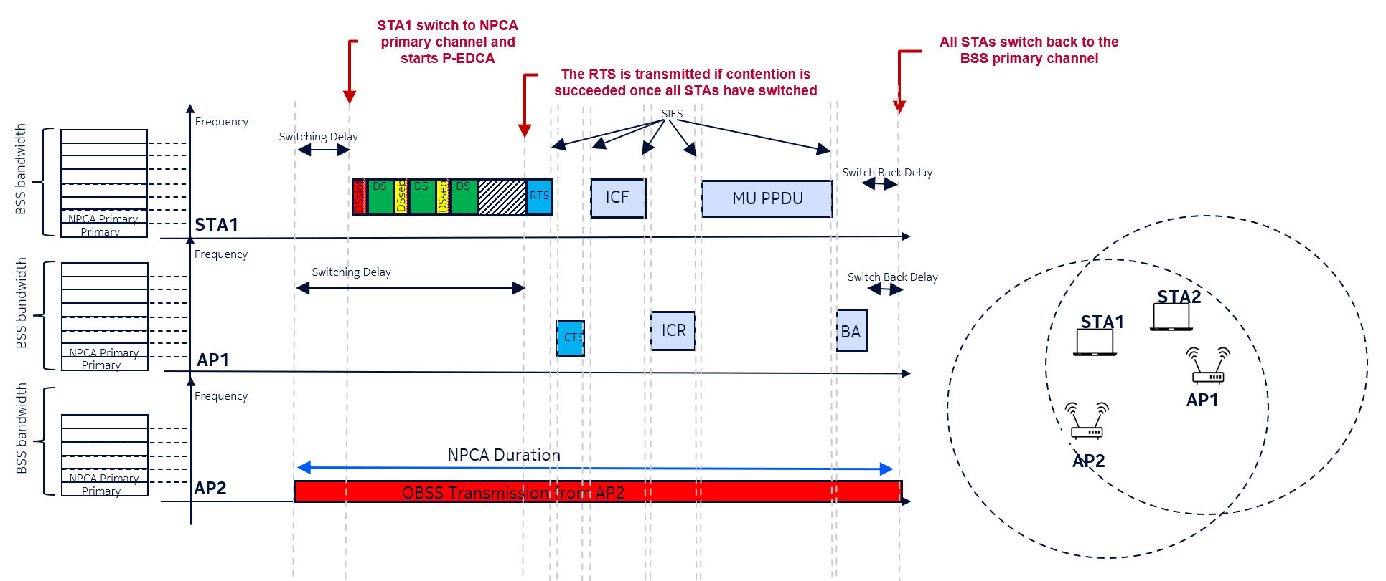
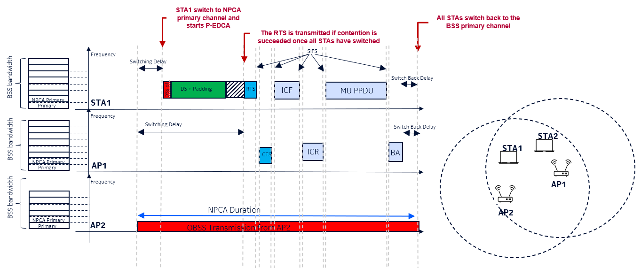
Discussion On The Way Forward (2/2)
Option 4: Enhance P-EDCA via repeated DS or enhanced DS
  This solution requires more spec impact, but will allow NPCA and P-EDCA to be properly used together
Option 5: The QSRC threshold is mandated to be selected so that RTS continues to be transmitted until all participating NPCA STAs have switched
  This requires a proper estimation of the contention windows and additionally may lead to an overflow of RTS transmissions. Furthermore, the RTS and CTS handshake would be likely postponed in time compared to the optimal location.

Slide 6
Summary
In this contributions, we discussed the impact of NPCA on P-EDCA and the issue that arise when both features are concurrently used when NPCA capable STAs have different NPCA Switching Delays.
To address this issue multiple options are discussed to trigger a way forward.

Slide 7
References
[1] IEEE P802.11bn™/D1.0 Draft Standard for Information technology— Telecommunications and information exchange between systems Local and metropolitan area networks— Specific requirements Part 11: Wireless LAN medium access control (MAC) and physical layer (PHY) specifications, Amendment 6: Enhancements for ultra high reliablity (UHR)”, August 2025.
[2] IEEE 802.11-24/1762, “PDT-MAC-NPCA”, Matthew Fischer.
[3] IEEE 802.11-24/0627, “CC50 CR for P-EDCA”, Dmitry Akhmetov.

