Slide 1
Further Considerations on Co-BF Transmission Sequence
Date: 2024-09-16
Authors:
Name | Affiliations | Address | Phone | Email
Mahmoud Hasabelnaby | Huawei |  |  | Mahmoud.Hasabelnaby@huawei.com
Junghoon Suh
Abdallah Hussein
Osama Aboul-Magd
Yan Xin

Slide 2
    Background: Co-BF Transmission Phase Sequence [1]
The Co-BF transmission phase consists of an initial 3-way handshaking between the two APs participating in Co-BF followed by the actual data transmission and BA info collection.
The Co-BF transmission sequence begins with a Co-BF Invite and Response frame exchange between the two coordinating APs. This exchange ensures that
  the shared AP is available and willing to participate in the Co-BF transmission phase.
  Share information about their scheduled non-AP STAs so that the other AP can pick the correct CSI and perform the signal nulling effectively.
  Agree on all the needed parameters for joint Co-BF DL transmission.
Within this Co-BF Invite and Response frame exchange, it is also necessary to indicate whether ICF/ICR frames between each AP and its scheduled non-AP STAs are included in the sequence prior the actual DL transmission and their durations if they exist.
This is crucial because, in various scenarios, some scheduled non-AP STAs may not be able to receive their DL PPDUs immediately due to being:
  eMLSR STA: The non-AP STA may need to first activate its communication link before it can receive the transmission.
  Power-Saving Mode: Some non-AP STAs may be in a low-power state and require time to transition to full operational capability.
Finally, the sharing AP sends a Co-BF Sync. frame as a synchronization reference for the coordinated AP and provide needed parameters for joint Co-BF DL transmission.

Slide 3
    Motivation
The current sequence in [1] is designed to support only a single Co-BF DL transmission, which may be inefficient in various scenarios, such as:
  If there is a failure in the transmission (due to errors, interference, etc.), the entire large DL PPDU must be retransmitted, which can be inefficient in environments with high error rates and OBSS interference.
    In dense OBSS scenarios, interference is unpredictable, so shorter, multiple PPDUs reduce retransmission overhead and allow quicker recovery.
  The pending downlink (DL) traffic at both the Sharing AP and the Shared AP for the scheduled non-AP STAs may exceed the PPDU size or the Block Ack (BA) buffer size is limited. In such cases, supporting multiple Co-BF DL transmissions within a single TXOP may be preferred.
  Different QoS flows (e.g., voice vs. bulk data) may have different PPDU sizes, latency requirements, or priorities. Supporting only a single Co-BF DL transmission can make it harder to efficiently schedule mixed QoS traffic because the AP has to lump everything into one shot.
    In real networks, STAs often have mixed traffic: low-latency voice/video + large bulk data. One large PPDU forces the AP to aggregate frames with different priorities, which can increase delay for latency-sensitive traffic.
    Multiple Co-BF DL transmissions allow better scheduling granularity: urgent traffic can be prioritized in the 1st DL PPDU transmission, and bulk data can be sent in the 2nd DL PPDU transmission.
In this contribution, we provide the required changes in the Co-BF transmission sequence, including the Co-BF Invite, Response, and Sync frames, to support multiple Co-BF downlink transmissions within a single TXOP to better utilize the overhead cost and increase net gain.

Slide 4
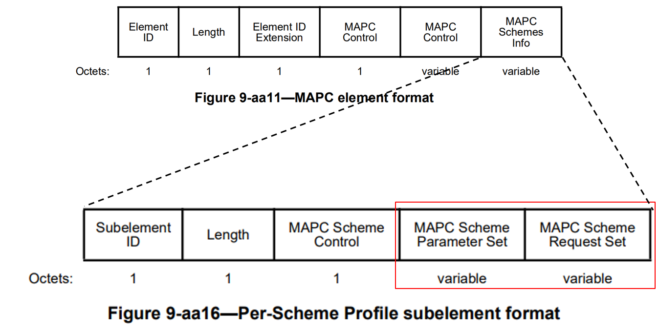
    Multiple Co-BF DL Transmissions Support Indication in the Co-BF Profile
We propose to include a Multiple Co-BF DL Transmission Support field (e.g., 1 bit) within the Co-BF Profile, which is carried in the MAPC Element exchanged in the MAPC Negotiation Request and Response frames.
The value of this field indicates whether a single or multiple Co-BF DL PPDU transmissions are permitted within a single shared TXOP. For example, a value of 0 specifies that only a single Co-BF DL PPDU transmission is allowed, whereas a value of 1 specifies that multiple Co-BF DL PPDU transmissions are permitted.
In addition, the Co-BF Profile may also include the maximum number of Co-BF DL PPDU transmissions allowed within a single TXOP.

Slide 5
    Multiple Co-BF DL Transmissions Support Indication per TXOP
In addition to indicating support for multiple Co-BF DL transmissions during the Co-BF agreement phase, a per-TXOP confirmation of multiple Co-BF DL support is required by both the Sharing AP and Shared AP within the shared TXOP.
This confirmation is exchanged in the Co-BF Invite and Response frames and accounts for dynamic factors at the time of the Co-BF transmission invitation, including, but not limited to,
  the availability of the Sharing AP and Shared AP and their associated non-AP STAs,
  the amount of buffered data for the scheduled non-AP STAs and their respective QoS requirements.
  the duration of the TXOP granted by the Sharing AP, as well as its willingness to utilize the full or partial TXOP with the Shared AP using Co-BF.
For example, even if the Sharing AP and Shared AP previously agreed to support multiple Co-BF DL PPDU transmissions during the Co-BF agreement phase, the Sharing AP may opt to allow only a single DL PPDU transmission at the time of the Co-BF Invite frame due to TXOP duration constraints. Similarly, the Shared AP may elect to support only a single DL PPDU transmission if its associated non-AP STAs are unavailable.

Slide 6
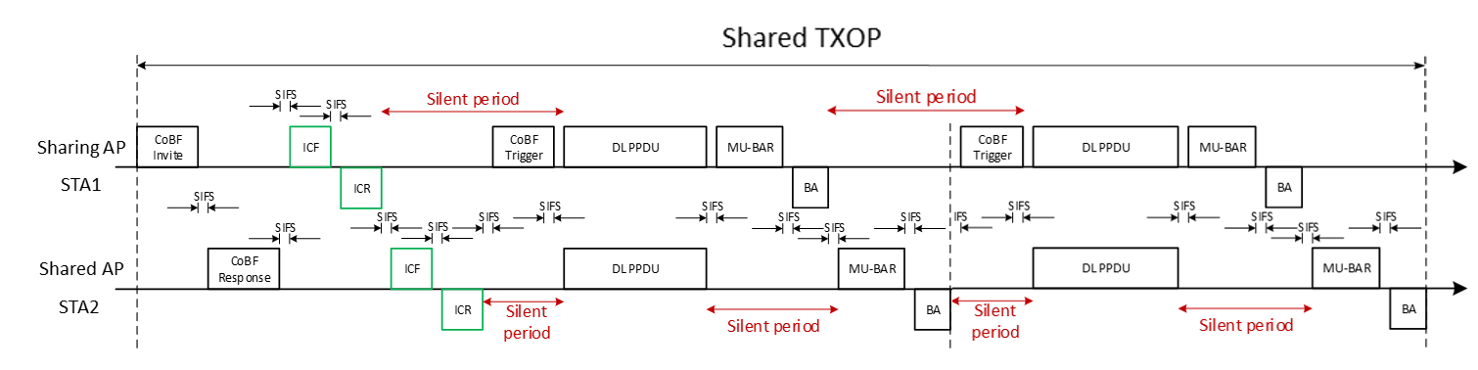
    Multiple Co-BF DL Transmissions Indication in the Co-BF Invite Frame
We propose to allow the Sharing AP to explicitly indicate to the Shared AP in the Co-BF Invite frame whether multiple Co-BF DL transmissions are allowed within the shared TXOP, and if so, how many are supported. For example:
  1-bit indication field: 0 = single Co-BF DL transmission; 1 = two Co-BF DL transmissions.
    For simplicity, the maximum number of allowed Co-BF DL PPDU transmissions may be set to two.
  1-bit indication field: 0 = single Co-BF DL transmission; 1 = more Co-BF DL transmissions.
    This requires adding a More Co-BF DL PPDUs field in the Co-BF Sync frame, where a value of 0 indicates the upcoming PPDU is the last DL PPDU, and a value of 1 indicates that more DL PPDUs are pending.
  Multi-bit field (e.g., 2 bits): 0 = single, 1 = two, 2 = three Co-BF DL transmissions, ….
Other transmission parameters included in the Co-BF Invite frame (e.g., the scheduled STA IDs, their NSS, minimum and maximum number of OFDM Data Symbols, GI+LTF size, etc.) may be applied to all supported Co-BF DL transmissions within the shared TXOP.
More Co-BF DL TX Allowed or not

Slide 7
    Recommended Number of Co-BF DL Transmissions Indication in the Co-BF Response Frame
The Shared AP indicates the following to the Sharing AP within the Co-BF Response frame:
  Recommended Number of Supported Co-BF DL transmissions per TXOP.
    1-bit field: 0 = No recommendation; 1 = one Co-BF DL transmission.
    Multi-bit field (e.g., 2 bits): 0 = No Recommendation, 1 = 1, 2 = two, 3 = three Co-BF DL transmissions, …
      Note: The Sharing AP must adopt the recommended number of supported Co-BF DL transmissions declared by the Shared AP if it is less than the number allowed by the Sharing AP.
      In general, the number of supported Co-BF DL transmissions in a single TXOP shall be the minimum of the numbers declared by the Sharing AP and the Shared AP.
  Other transmission parameters included in the Co-BF Response frame (e.g., the scheduled STA IDs, their NSS, suggested number of OFDM Data Symbols, etc.) may be applied to all supported Co-BF DL transmissions within the shared TXOP.

Slide 8
    Further Considerations on Multiple Co-BF DL PPDU Transmissions
  If the Sharing AP or Shared AP has transmitted all buffered data for one of the scheduled non-AP STAs while additional Co-BF DL PPDU transmission(s) remain in the shared TXOP, the corresponding User Info field for that non-AP STA is included in the subsequent Co-BF Sync frame(s) for the remaining Co-BF DL PPDU transmission(s) in the shared TXOP.
  In such cases, the Sharing AP or Shared AP will set the More Data subfield in the MAC Control field for that non-AP STA to zero, indicating that no additional PPDUs for that non-AP STA are pending in the shared TXOP.
  If the BA is successfully received, the Sharing AP or Shared AP may transmit a dummy signal or zero energy for the UHR-STF/LTF and data portion (including any required padding and FCS) in every sub-carrier on the spatial stream assigned to that non-AP STA during the subsequent Co-BF DL transmission(s) within the shared TXOP.

Slide 9
    Updating the Extended Time-out Period Rule
  In case of multiple Co-BF DL transmissions are allowed within a single TXOP, the duration of the extended time-out period for scheduled eMLSR/DPS non-AP STAs shall be sufficient to cover any inactivity period within the Co-BF sequence.
    For eMLSR/DPS STAs associated with the Sharing AP:
      Extended time-out period = Max Duration (from the end of the ICR1 to the beginning of the data PPDU1, from the end of the BA1 to the beginning of the subsequent data PPDU).
    For eMLSR/DPS STAs associated with the Shared AP:
      Extended time-out period = Max Duration (from the end of the ICR2 to the beginning of the data PPDU1, from the DL PPDU until the beginning of the MU-BAR2, from the end of the BA2 to the beginning of the data PPDU2).
  These extended timeout values may be calculated based on the worst case scenarios based on the available information after the Co-BF Invite and Response frame exchange.

Slide 10
    Updating the Extended Time-out Period Rule
eMLSR/DPS non-AP STAs may continue using this extended timeout period until their associated AP sets the More Data subfield in the MAC Control field of the MAC header to zero, indicating that no additional PPDUs are pending. In this case:
  eMLSR/DPS non-AP STAs associated with the Sharing AP will reset their timeout period configuration to the default value immediately after successfully decoding that DL PPDU.
  eMLSR/DPS non-AP STAs associated with the Shared AP will reset their timeout period configuration to the default value after successfully acknowledging that DL PPDU.

Slide 11
    Multiple Sync. Frames are needed
A Co-BF Sync. frame may be needed before transmitting each concurrent Co-BF DL transmission for the following reasons:
  Each Co-BF Sync. frame includes a More Co-BF DL PPDUs field in the Co-BF Sync frame, where a value of 0 indicates the upcoming PPDU is the last DL PPDU, and a value of 1 indicates that more DL PPDUs are pending.
  Each Co-BF Sync. frame provides the required or customized PHY-related information for the subsequent Co-BF DL transmission. This may be useful, for instance, in case the Length of the PPDU 1 is different from that of PPDU 2.
  Each Co-BF Sync. frame includes a Sharing AP’s MU-BAR/BA Duration field to indicate the duration needed by the Sharing AP to collect its ACK/BA.
    This explicit duration indication assists the Shared AP in determining the appropriate timing to initiate its MU-BAR/BA exchange (if such an exchange is present), particularly in cases where the Sharing AP’s MU-BAR frame is replaced by a basic trigger aggregated with the DL PPDU.
      In such scenarios, the Shared AP may encounter difficulty in overhearing the duration of the BA frames transmitted by the non-AP STAs associated with the Sharing AP. Accordingly, providing an explicit indication of this duration within the Co-BF Sync frame simplifies coordination and facilitate more reliable Co-BF transmissions.

Slide 12
Summary
In this contribution, we provided the required changes in the Co-BF transmission sequence, including the Co-BF Invite, Response, and Sync frames, to support multiple Co-BF downlink transmissions within a single TXOP.
Note that this contribution is also valid for supporting multiple Co-SR downlink transmissions within a single TXOP.

Slide 13
References
11-25/0412r3, “CoBF Frame Sequences and Signaling Details”.
11-25/0574r5, “CoBF Sequence Optimization”.
11-25/2124r2, “Frame-Sequence-for-CSR-and-CBF”.

