Slide 1
Thoughts on DPS
Date: 2025-08-26
Authors:
Name | Affiliations | Address | Phone | Email
Chun Huang | ZTE |  |  | huang.chun2@zte.com.cn
Zisheng Wang
Jay Yang
Yurong Qian
Bo Cao
Yun Li
Yan Li
Qisheng Huang

Slide 2
Introduction
Tgbn has approved the support the following features to enhance the in-device co-ex and power saving performance for WLAN STAs [1]
  Dynamic power save (DPS) operation
  Dynamic Unavailability Operation (DUO) mode
  Non-AP STA periodic unavailability operation (PUO) mode
TDLS allows STA transmit though direct link while associated with their BSS, which also includes power saving in the form of TDLS peer PSM and TPU.
[2]~[3] has discussed the In-device Co-ex and P2P
In this contribution, we discuss the topic of the coexistence scenarios of the above features with TDLS/P2P links.

Slide 3
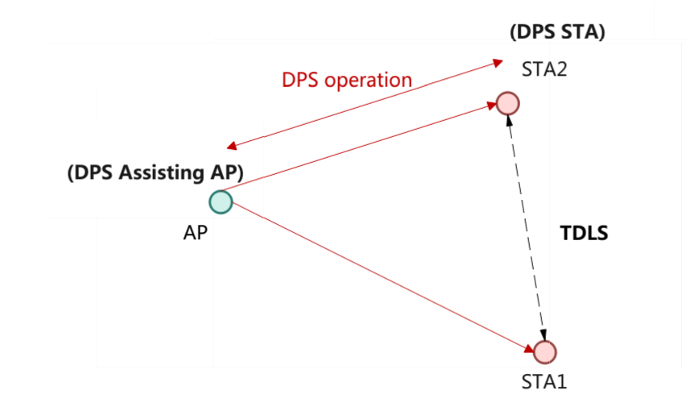
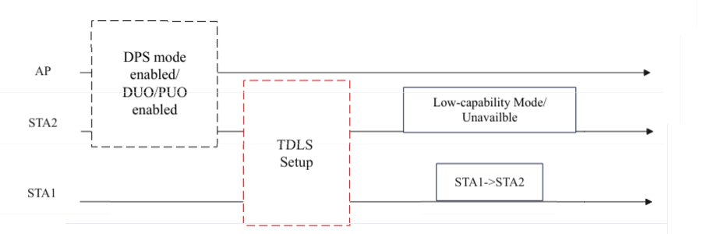
Motivation
A STA may have TDLS links and enable DPS, PUO, or DUO modes with an assisting AP.
A STA may enter a LC mode or become unavailable during operation. If the peer STA fails to detect this state change, subsequent P2P communication may be disrupted.

Slide 4
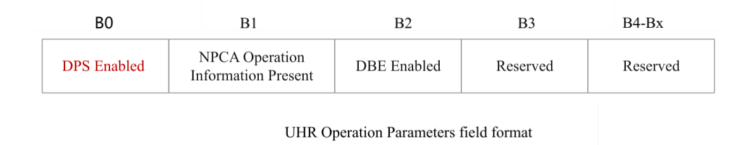
Indication of the DPS mode
During TDLS link establishment, STA shall carry information indicating whether it has enabled DPS mode
The DPS Enabled field is set to 1 under one of the following conditions
  the AP sending a frame containing the UHR Operation Parameters field is a mobile AP (for non-mobile AP) and dynamic power save (DPS) is enabled at the AP
  the STA sending a frame containing the UHR Operation Parameters field through TDLS link has one or more TDLS Link and DPS is enabled at the STA

Slide 5
Coexistence of DPS and P2P
If a DPS non-AP STA has enabled DPS with the ICF Required field set to 1 and has P2P direct links, then the peer STA shall initiate any frame exchange with a DPS STA by sending an ICF through direct links.
A non-AP STA shall transmit a frame that is addressed to a peer STA to notify its DPS parameter activation, deactivation, and updates, if the non-AP STA has established any of the following:
— An association with the peer STA
— A TDLS direct link with the peer STA
A UHR non-AP STA has P2P Links may enable the DPS mode if one of the following conditions is true:
  — The UHR non-AP STA with ICF_required = 0;
  — The UHR non-AP STA with ICF_required set to 1; and all peer STA with DPS support set to 1.

Slide 6
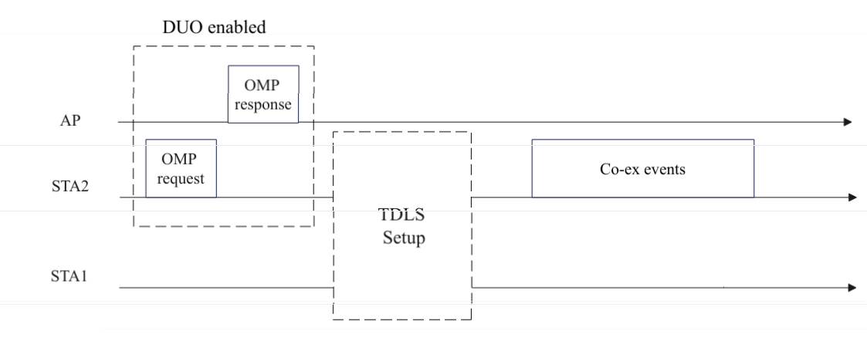
Indication of the PUO/DUO mode
During TDLS link establishment, STA shall carry information indicating whether it has enabled DUO/PUO mode
A UHR non-AP STA has enabled its DUO mode shall transmit a frame that is addressed to a peer STA to notify its DUO parameters
— An association with the peer STA
— A TDLS direct link with the peer STA
If a P2P non-AP STA enables DUO mode and enters its unavailable time
  the AP shall not share TXOP to the P2P group
  to which the non-AP STA belongs.
  the peer STA (STA2) shall not schedule for
  transmission any PPDU through P2P links

Slide 7
Summary
In this contribution, we discuss the topic of the coexistence scenarios of the DPS/DUO/PUO with TDLS links/P2P links and analyze the potential incompatibility issues.

Slide 8
THANK YOU ☺

Slide 9
SP1
Do you support the proposed changes in 25/1460:
A STA that has P2P direct links may operate in DPS mode.
During TDLS link establishment, STA shall carry information indicating whether it has enabled DPS mode.

Slide 10
SP1
Do you support the proposed changes in 25/1460:
A STA that has P2P direct links may operate in DUO mode.
During TDLS link establishment, STA shall carry information indicating whether it has enabled DUO mode.

Slide 11
Reference
[1] IEEE P802.11bn/D1.0
[2]24/509 Thoughts on in-device coexistence and P2P for 11bn, Rubayet Shafin (Samsung Electronics)
[3]24/675 In-device Co-ex and P2P--Follow up, Rubayet Shafin (Samsung Electronics)

