Slide 1
Co-BF Sounding within a single TXOP
Date: 2025-08-26
Authors:
Name | Affiliations | Address | Phone | Email
Chun Huang | ZTE |  |  | huang.chun2@zte.com.cn
Zisheng Wang
Jay Yang
Yurong Qian
Yan Li
Yun Li
Bo Cao
Qisheng Huang

Slide 2
Introduction
Tgbn has agreed to support the following Co-BF Sounding methods
  Sequential CoBF Sounding
  Joint CoBF Sounding
In addition, the Tgbn points that Co-BF Sounding can be done in the same or different TXOPs
  The UHR Co-BF sequential NDP sounding sequences initiated by a pair of UHR Co-BF beamformers are allowed to be done in the same TXOP or different TXOPs.
  The UHR Co-BF joint NDP sounding sequences initiated by a pair of UHR Co-BF beamformers are allowed to be done in the same TXOP or different TXOPs。
In this contribution, we discuss the topic related to Co-BF sounding within a TXOP.

Slide 3
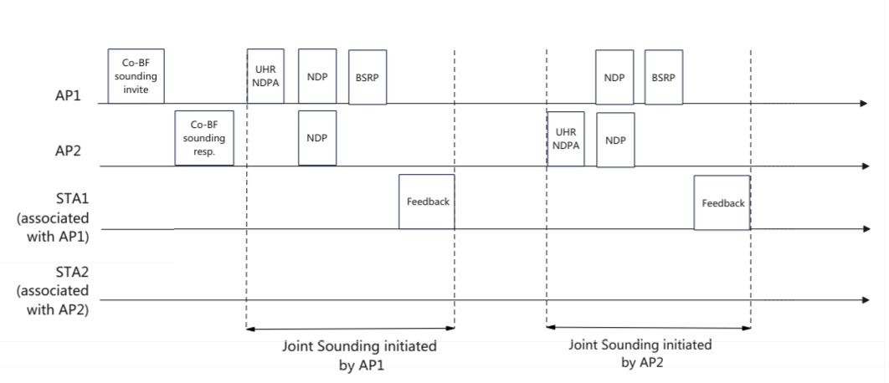
Motivation
If the TXOP is obtained by AP1, thus OBSS AP2 can’t directly initiate transmission in the same TXOP.
Additional mechanism are required to ensure sounding procedure initiated by two APs can be performed within AP1’s TXOP.

Slide 4
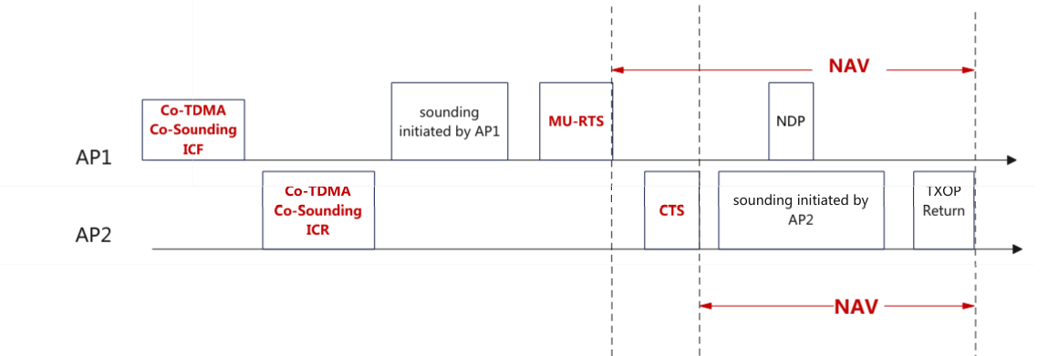
Option 1: Modify the existing Co-TDMA procedure
Joint Co-SR and Co-sounding signaling in ICF/ICR, ICF is unicast and addressed specifically to AP2
Adjust MU-RTS/CTS duration for subsequent coordination
  To protect the NDP frames that AP1 may transmit during the Co-sounding process, the protection can extend until the end of allocation duration.

Slide 5
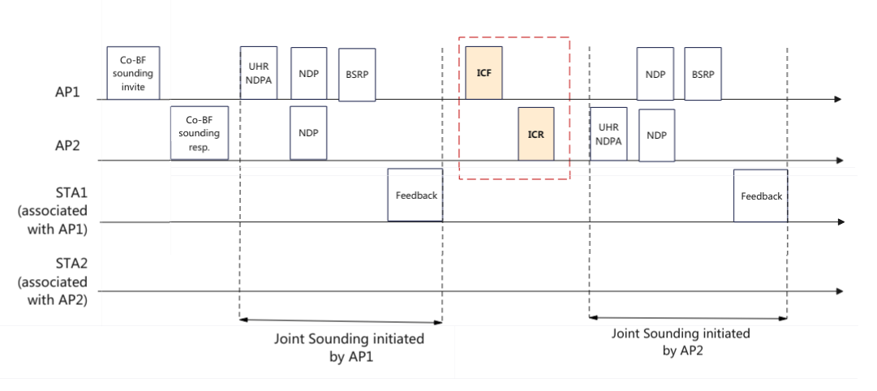
Option 2: Introduce new frame exchanges
Invite Frame: Invites AP2 to initiate co-sounding in the current TXOP.
Response Frame: Indicates agreement or rejection to the request.

Slide 6
Summary
Analyze the issue when the UHR Co-BF sounding procedures initiated by a pair of UHR Co-BF beamformers are done in the same TXOP, and provide two option to address it.
  Option 1: Modify the existing Co-TDMA procedure.
  Option 2: Introduce new frame exchanges

Slide 7
THANK YOU ☺

Slide 8
SP1
In order to support Co-BF Sounding, do you agree to introduce a mechanism that enables a pair of Co-BF beamformer APs initiate and complete Co-Sounding within a single TXOP?

Slide 9
Reference
[1] IEEE P802.11bn/D1.0

