Slide 1
TPE Signaling for DBE
Date: 2025-09-08
Authors:

Slide 2
Introduction
11bn D1.0 [1] defines DBE feature that enables s a UHR AP to dynamically enable operation over an expanded bandwidth (> BSS BW) for UHR non-AP STAs that support DBE mode.
For operation in 6 GHz band, client devices must follow regulatory/local limits defined for allowed max transmit powers. This max transmit power information is provided by the AP in the TPE (Transmit Power Envelop) information element in Beacon and Probe Response frames.
For DBE operation, the AP needs to provide max transmit powers limits for operation over the DBE BW, such that STAs can follow any applicable regulatory/local limits when operating over the DBE BW.
Here we propose options for AP to indicate TPE information for the DBE BW.

Slide 3
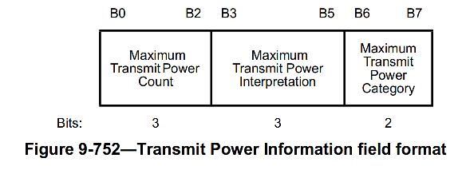
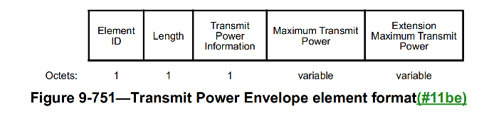
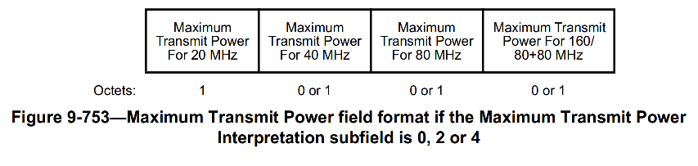
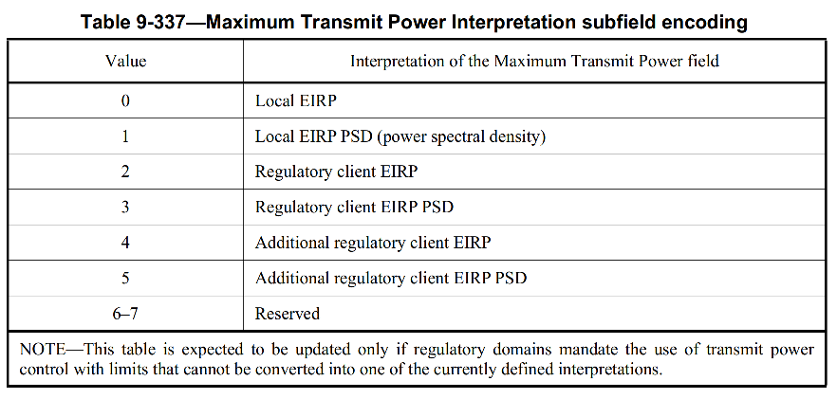
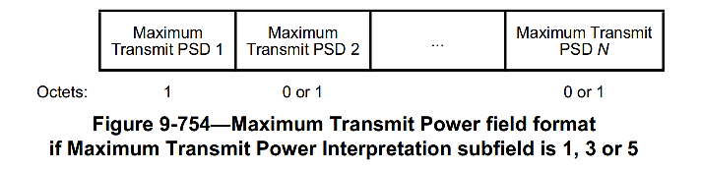
Background - TPE element (1)
Per baseline, one TPE element is included in Beacon for each distinct combination of “Maximum Transmit Power Interpretation” and “Maximum Transmit Power Category” fields (defined in Table E-14, with two possible values)
  Extension Maximum Transmit Power provides max transmit power for 320 MHz or Max Transmit PSD values covering 320 MHz
Multiple TPE elements can be included based on regulatory requirements (see E.2.7 (6 GHz band)) – e.g. 1/2/4/6 … TPE elements can be included
Notes:
See reference clauses:﻿
9.4.2.160 Transmit Power Envelope element
E.2.7 6 GHz band)
﻿11.7.5 Specification of regulatory and local maximum transmit power levels
﻿10.22.4 Operation with the Transmit Power Envelope element

Slide 4
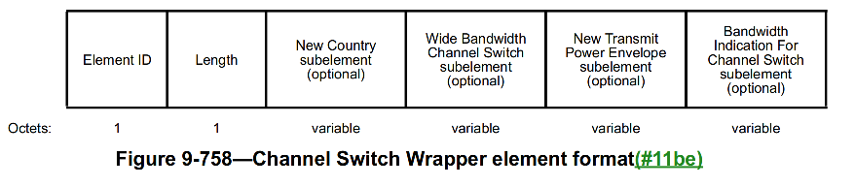
Background - TPE element (2)
Size of TPE element:
  For 320 MHz BW, for an EIRP based TPE element (when Maximum Transmit Power Interpretation subfield is 0, 2 or 4 (EIRP)), TPE IE size = 2 + 1 + 4 + 1 = 8 octets
  For 320 MHz BW, for an EIRP PSD based TPE element (when Maximum Transmit Power Interpretation subfield is 1, 3 or 5 (EIRP PSD)), TPE IE size = 2+ 1 + 8 + 1 + 8 = 20 octets
Given that multiple TPE elements can be included (EIRP and/or EIRP PSD based), overall TPE info size in beacon can become significant and would contribute to beacon bloating
For a Channel Switch operation, TPE information for the new channel is provided in a Channel Switch Wrapper element using one or more New Transmit Power Envelop subelements (that has same format as TPE IE)
Notes:
﻿

Slide 5
Considerations for TPE Info for DBE BW
TPE info for DBE BW is needed by the non-AP STAs only when DBE mode is enabled (and not always).
Providing TPE info for expanded DBE BW always in the beacon would add to beacon bloating:
  Scenario: BSS BW = 40 MHz, Max DBE BW = 320 MHz, Assume TPE elements included for ‘Local EIRP’, ‘Regulatory client EIRP’, ‘Local EIRP PSD’, and ‘Regulatory client EIRP PSD’
  Always including TPE info for DBE BW will add extra (3+3+15+15) = 36 octets to the beacon (across 4 TPE IEs)
  If more TPE elements are included e.g. for Maximum Transmit Power Category = 0 & 1 (Subordinate device), then beacon bloating impact would be twice(72 octets)
In UHR, reducing beacon bloating is one of the goal (reason for not including UHR Capability and minimizing parameters in UHR Operation). Hence, strongly desired to not bloat beacon with TPE info for max DBE BW always and only provide this info when DBE mode is being enabled.
Providing TPE Info for DBE BW should not cause any legacy client compatibility/interop issues, hence strongly preferred to not change TPE elements in beacon
  This can be achieved by including TPE Info for DBE BW in a DBE wrapper
TPE Info for DBE BW can change due to regulatory reasons while DBE mode is enabled, hence need to support critical updates for such TPE info changes

Slide 6
Options for TPE Information for DBE BW (1)
Option 1 (preferred): Provide TPE info for DBE BW as part of DBE CU announcement
  Follow similar scheme as CSA, provide TPE info for DBE BW in one or more ‘DBE TPE subelement’ as part of DBE CU announcement.
  ‘DBE TPE subelement’ provides complete TPE Info for entire DBE BW
    Alternatively, only delta TPE Info is provided w.r.t. to TPE element in beacon (less preferred)
  Less beacon bloating impact, since TPE info for DBE BW is carried only as part of DBE CU notification
  No legacy STAs impact, since No changes to TPE element in beacon.
Option 2: Provide TPE info for DBE BW in a separate DBE TPE Wrapper element
  Variant of option 1, TPE info for DBE BW is provided in a DBE TPE Wrapper element in Beacon, Probe Response, instead of embedded within the DBE CU announcement
  The DBE TPE Wrapper element is only included in beacon when DBE CU is being announced
  Benefits of Option 1 also apply here
NOTE: These do not change TPE elements in beacon and hence avoid any legacy interop issues (frequent changes to TPE elements + providing TPE info for >BSS BW is not tested for legacy STAs).

Slide 7
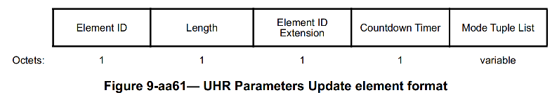
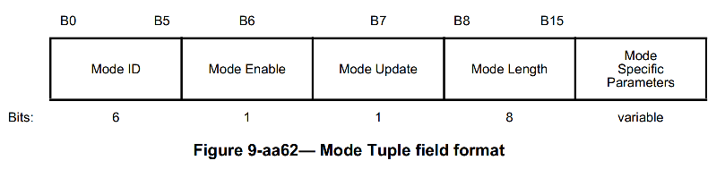
Options for TPE Information for DBE BW (2)
Option 1 (preferred): Provide TPE info for DBE BW as part of DBE CU announcement
  Add one or more DBE Transmit Power Envelope subelement(s) in the Mode Specific Parameters field for DBE, when TPE Info needs to be provided for DBE BW (per regulatory rules)
  Format for ‘DBE Transmit Power Envelope subelement’ is same as the Transmit Power Envelope element
  (optionally) Use a Reserved bit in Mode Specific Parameters to indicate if ‘DBE Transmit Power Envelope subelement’ are included

Slide 8
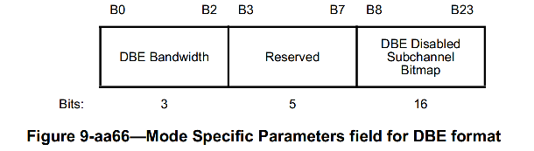
Options for TPE Information for DBE BW (3)
Option 2: Provide TPE info for DBE BW in a separate DBE TPE Wrapper element
  DBE TPE Wrapper element is included in the beacon, probe response when DBE CU is announced and TPE Info needs to be provided for DBE BW (per regulatory rules)
  Includes one or more DBE Transmit Power Envelope subelement(s)
  Use a Reserved bit in Mode Specific Parameters to indicate if ‘DBE TPE Wrapper element’ is included
  DBE TPE Wrapper element provides complete TPE Info for the entire DBE BW,
    Alternate Option (less preferred): Only delta TPE Info is provided w.r.t. TPE element in beacon (for BSS BW)
    Adds 3 octets of overhead for new element

Slide 9
Options for TPE Information for DBE BW (4)
Option 3 (not preferred): Provide TPE info for DBE BW as part of TPE element(s) in Beacon
  When DBE mode is enabled, TPE element(s) in Beacon, Probe response are modified to also provide TPE info for DBE BW
  Modified TPE element(s) are carried in Beacon for the entire duration when DBE mode is enabled, and changed back (to provide TPE Info for BSS BW) when DBE mode is disabled
  Potential legacy compatibility/interop issues, since frequent changes to TPE elements + providing TPE info for >BSS BW is not tested for legacy STAs
  High beacon bloating impact, since TPE info for DBE BW is carried for entire time when DBE mode is enabled
  In a variation Option 3b: same as above, but provide TPE info for DBE BW in TPE element(s) in beacon, probe response only when DBE CU announcement is performed
    Once DBE mode is enabled/DBE BW updated, then TPE Info in beacon, probe response changed back to TPE for BSS BW. This reduces beacon bloating impact
    However, there is potential legacy compatibility/interop issues concerns
  Hence, we propose to not use Option 3, due to potential legacy compatibility/interop issues

Slide 10
Changes to TPE Info for DBE BW
After DBE mode is enabled, TPE info for the DBE BW can change for regulatory reasons
This needs to be signaled as a DBE parameter critical update using UHR CU advance notification
  Set Mode Update = 1
  With Option 1 solution, in the Mode Specific Parameters for DBE, include one or more updated DBE Transmit Power Envelope subelements

Slide 11
Conclusion
For DBE operation in 6GHz band, AP needs to provide max transmit powers limits for DBE BW, so STAs can follow any applicable regulatory/local max transmit power limits when operating over the DBE BW.
Providing TPE info in beacon always for DBE BW would cause beacon bloating (not desired)
Also, providing TPE Info for DBE BW should not cause any legacy compatibility/interop issues
We propose two possible options for providing TPE info for DBE BW, avoiding any legacy compatibility/interop issues:
  Option 1 (preferred): AP provides TPE info for DBE BW as part of DBE critical update announcement in one or more DBE TPE subelement
  Option 2: AP provides TPE info for DBE BW in a separate DBE TPE Wrapper element in beacon during the DBE critical update announcement period
To avoid potential legacy compatibility/interop issues, must not use Option 3 (i.e. not provide TPE info for DBE BW as part of TPE element(s) in Beacon)
Any changes to TPE Info for DBE BW while DBE mode is enabled need to be indicated using DBE CU advance notification

Slide 12
Straw Poll
Which option do you support to provide TPE information for DBE BW by the AP?
Option 1: AP provides TPE info for DBE BW as part of DBE critical update announcement in one or more DBE TPE subelement included in Mode Specific Parameters for DBE
  DBE TPE subelement has the same format as the Transmit Power Envelope element
  DBE TPE subelement(s) provide complete TPE Info for entire DBE BW
Option 2: AP provides TPE info for DBE BW in a separate DBE TPE Wrapper element during the DBE critical update announcement
  The DBE TPE Wrapper element is only included in beacon, probe response when DBE CU is being announced
  The DBE TPE Wrapper element includes one or more DBE Transmit Power Envelope subelement(s)
  Use a Reserved bit in Mode Specific Parameters to indicate if ‘DBE TPE Wrapper element’ is included
  DBE TPE Wrapper element provides complete TPE Info for the entire DBE BW

Slide 13
References
[1] Draft P802.11bn Draft 1.0
[2] 11-24/0209 “Specification Framework for TGbn”

