Slide 1
TXOP Protection for coTDMA
Date: 2025-08-10
Authors:
Name | Affiliations | Address | Phone | email
Dana Ciochina | Sony Group Corporation |  |  | Dana.Ciochina@sony.com
Thomas Handte |  |  |  | Thomas.Handte@sony.com
Daniel Verenzuela
Yusuke Tanaka |  |  |  | Yusuke.YT.Tanaka@sony.com
Kosuke Aio
Ryuichi Hirata
Alfred Lin

Slide 2
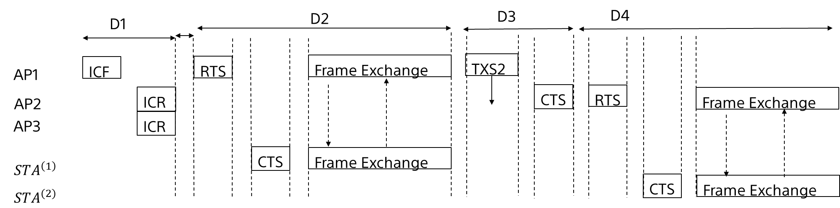
Introduction
Various aspects of the cTDMA have been discussed and agreed
The following frame sequence has been proposed and accepted
Several design considerations such as the short NAV or individual duration allocation indication may lead however to:
  increased probability of not being able to successfully start either the first part of the TXOP (between the coordinating AP and its associated STAs ) or the shared part of the TXOP
  increased latency for associated STAs
  inefficient use of the shared part of the allocation

Slide 3
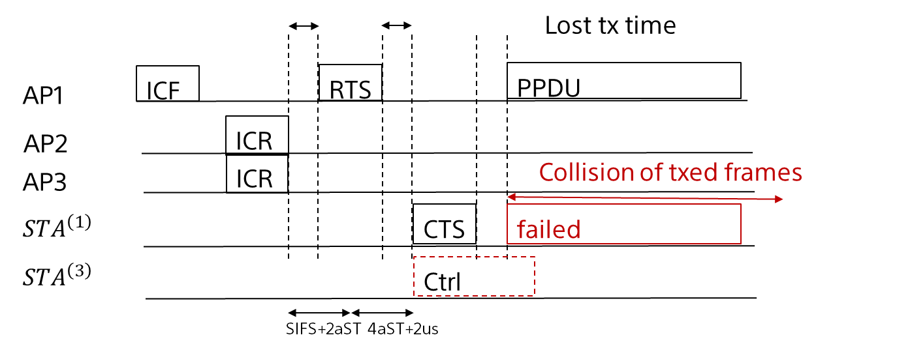
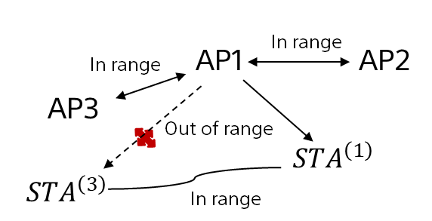
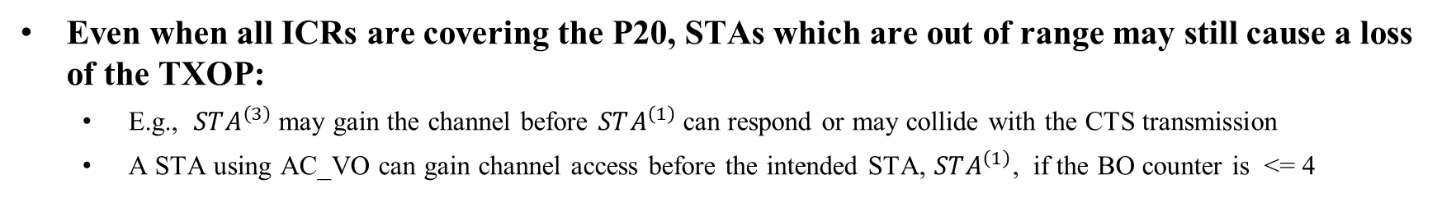

Vulnerability of the Intended Frame Exchange
Even when all ICRs are covering the P20, STAs which are out of range may still cause a loss of the TXOP:
  E.g., $STA^{\left(3\right)}$may gain the channel before $STA^{\left(1\right)}$can respond or may collide with the CTS transmission
  A STA using AC_VO can gain channel access before the intended STA, $STA^{\left(1\right)}$, if the BO counter is <= 4
Vulnerability Example
Example Scenario
$STA^{\left(i\right)}$associated with APi

Slide 4
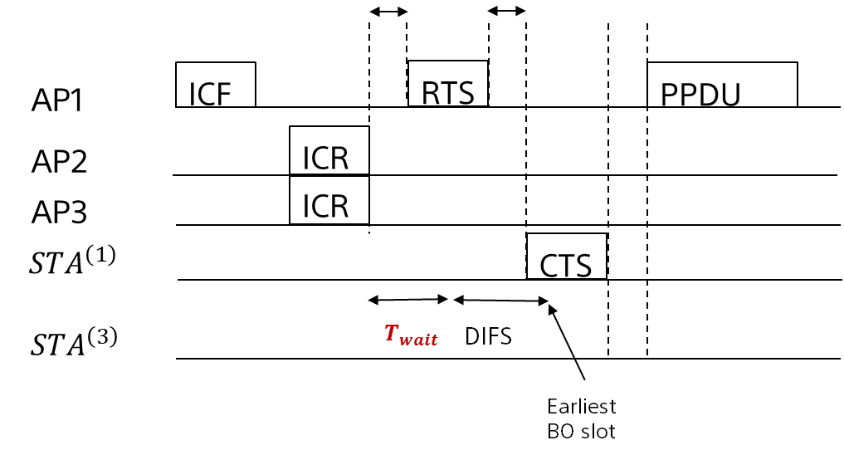
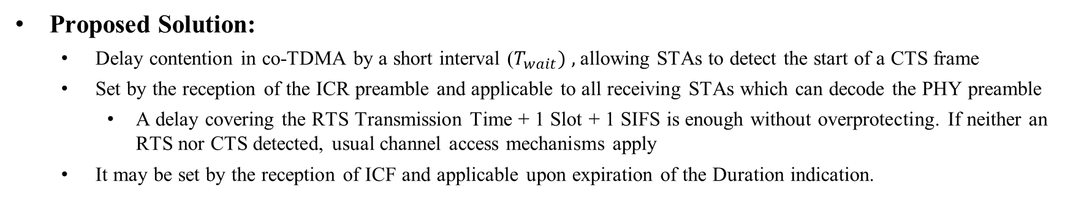

Protection of the Intended Frame Exchange
Proposed Solution:
  Delay contention in co-TDMA by a short interval ($T_{wait}) ,$allowing STAs to detect the start of a CTS frame
  Set by the reception of the ICR preamble and applicable to all receiving STAs which can decode the PHY preamble
    A delay covering the RTS Transmission Time + 1 Slot + 1 SIFS is enough without overprotecting. If neither an RTS nor CTS detected, usual channel access mechanisms apply
  It may be set by the reception of ICF and applicable upon expiration of the Duration indication.
Solution
Example Scenario
$STA^{\left(i\right)}$associated with APi

Slide 5
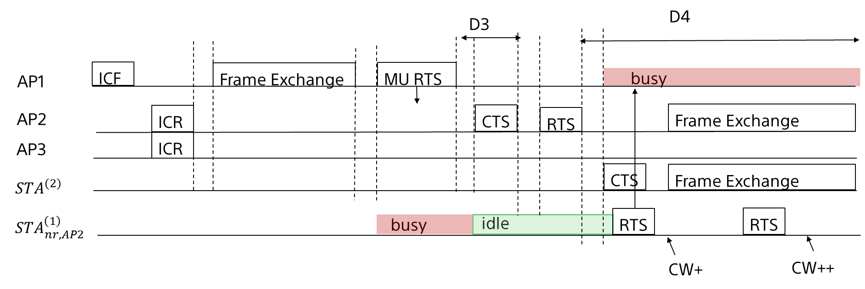
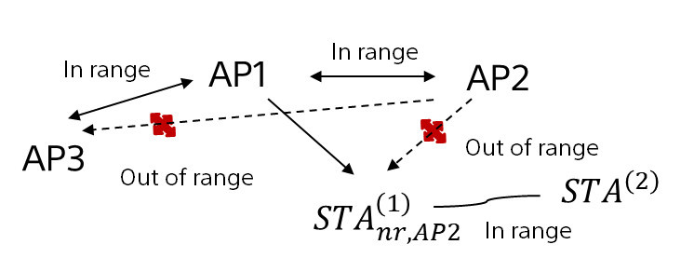

Vulnerability of the Shared Allocation
In [1], MU RTS TXS 2 starting the shared allocation contains a short duration information
    An Allocation Duration in the frame is only determined by the intended AP, (AP2 in the depicted example)
As a consequence, the following problems may arise
    STAs associated with AP1, out of range of AP2/STA2 do not know about AP1 unavailability
      May either access and interfere or increase unnecessarily their contention windows
    A polled AP (i.e. AP3 in the Fig) which is not in range of AP2/STA2 cannot know remaining TXOP duration
      In case of remaining TXOP time, it will need to prepare a transmission with adjusted duration parameters upon trigger by AP1
Vulnerability of the Shared Allocation
Example Scenario
$STA^{\left(i\right)}$associated with APi

Slide 6
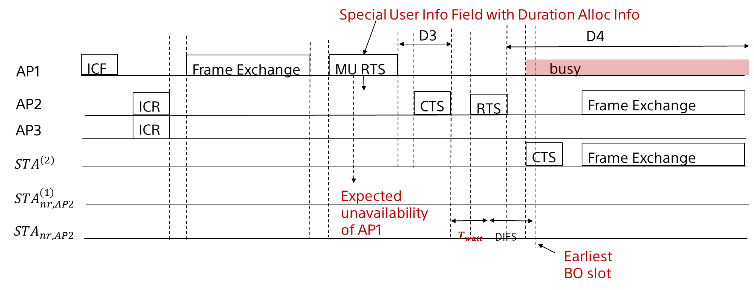


Proposed Solution for the Shared Allocation Protection
A potential solution for i) has been proposed in [1] based on the MU EDCA Timer
  However, MU EDCA parameters are applicable on individual STAs i.e., STAs which successfully responded in a TB PPDU
ii) has not been discussed
Proposed solution for both i) and ii) problems
  Include the Duration Allocation of the follow up TXOP in a Special User Field of the MU RTS TXS2
    STAs associated to AP1 can interpret as unavailability time for the AP1 to respond
    APs may use to prepare for a follow up transmission with a duration fitting the remaining TXOP duration (derived from Max Alloc Info in ICF and the Duration Allocation in the MU RTS) or access the channel
    Any STA delays contention by an interval allowing the detection of the RTS or CTS of the shared allocation
$STA^{\left(i\right)}$associated with APi

Slide 7
Summary
We proposed to...
  ... introduce a short waiting interval for delaying the contention inside co-TDMA TXOPs
    Applicable upon reception of ICR and the MU RTS starting the shared allocation
  ... transmit a duration information based on the allocation duration of the shared part of a co-TDMA TXOP, such that it can be understood by all STAs which can decode the frame
    In particular, the STAs, associated to the coordinated AP and the coordinating APs
The proposed solutions
  decrease the probability that the intended or the shared part of a TXOP obtained in a cTDMA context cannot be started
  work locally within the obtained TXOP and do not lead to overprotection
While the co-TDMA allocation is designed to work on a best effort basis, it does bring additional overhead
  This justifies small changes to allow a more robust and efficient use of the medium

Slide 8
References
[1] 11-25-1082 PDT on CoTDMA, Sanket Kalamkar
[2] 11-24-1701 NAV Protection for CTDMA, Si Chan Noh

