Slide 1
ICR Configuration in co-TDMA
Date: 2025-08-10
Authors:
Name | Affiliations | Address | Phone | email
Dana Ciochina | Sony Group Corporation |  |  | Dana.Ciochina@sony.com
Thomas Handte |  |  |  | Thomas.Handte@sony.com
Daniel Verenzuela
Yusuke Tanaka |  |  |  | Yusuke.YT.Tanaka@sony.com
Kosuke Aio
Ryuichi Hirata
Alfred Lin

Slide 2
Introduction
Various aspects of the co-TDMA have been discussed and agreed on, particularly on:
  Framework
  Frame sequence
  Fairness and sequential NAV protection
  Control frame details
A transmission of the ICF over a wide bandwidth, corresponding to the one needed in the obtained TXOP is desirable
In [1] it was proposed that ICF should be sent over the overlapping bandwidth of the coordinated APs
  It was left for further discussion
  The transmission of the ICR was not discussed in detail
Assuming the ICF is sent as suggested above and baseline behavior is followed, some issues may arise, when leaving the medium idle for long time
We address these issues and propose some fixes with minimal impact on the existing framework

Slide 3
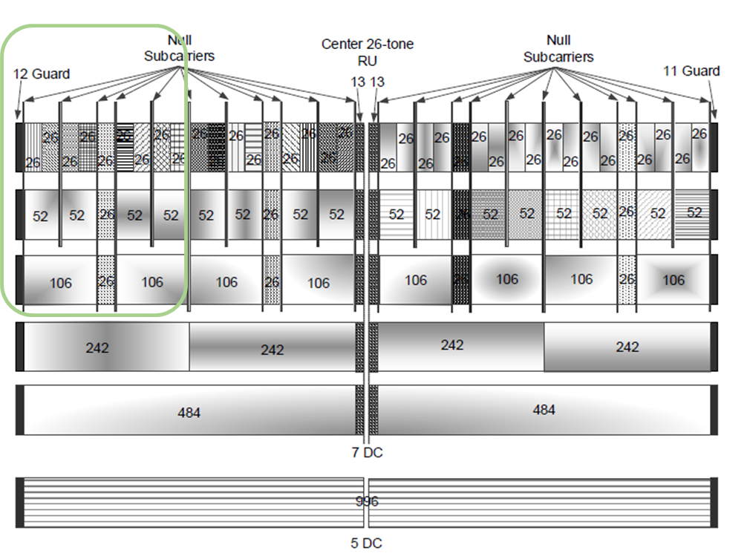
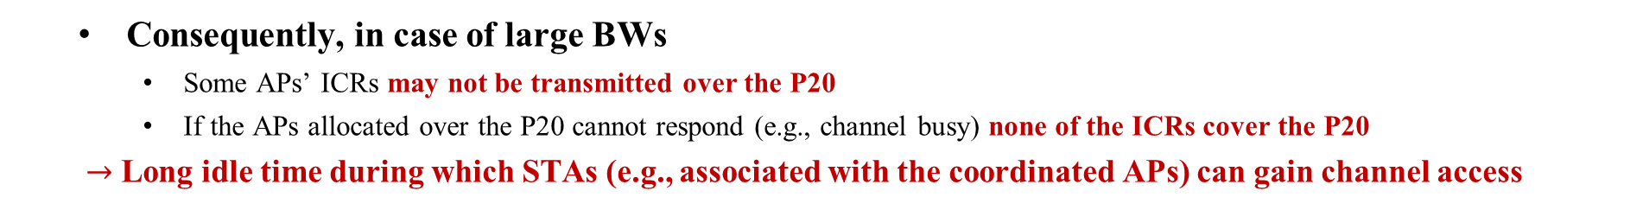
ICR Transmission in TB PPDU
According to the baseline, the following rules apply for TF and TB PPDU:
    The requesting Trigger Frame shall collectively elicit TB PPDU responses such that at least one scheduled RU is allocated for each 20 MHz channel occupied by the eliciting PPDU
    In the HE TB PPDU, the pre-HE modulated fields, which include L-STF, L-LTF, L-SIG, RL-SIG and HESIG-A fields, are sent only on the 20 MHz channels where the STA’s HE modulated fields are located.
  To satisfy the conditions above, if ICF is on wide bandwidth
    With single RU Allocation, there will be ICR responses not covering the P20 if BW>20MHz
    With mRU Allocation, there will be ICR responses not covering the P20 if BW>40MHz
  Consequently, in case of large BWs
    Some APs’ ICRs may not be transmitted over the P20
    If the APs allocated over the P20 cannot respond (e.g., channel busy) none of the ICRs cover the P20
  $→$ Long idle time during which STAs (e.g., associated with the coordinated APs) can gain channel access

Slide 4
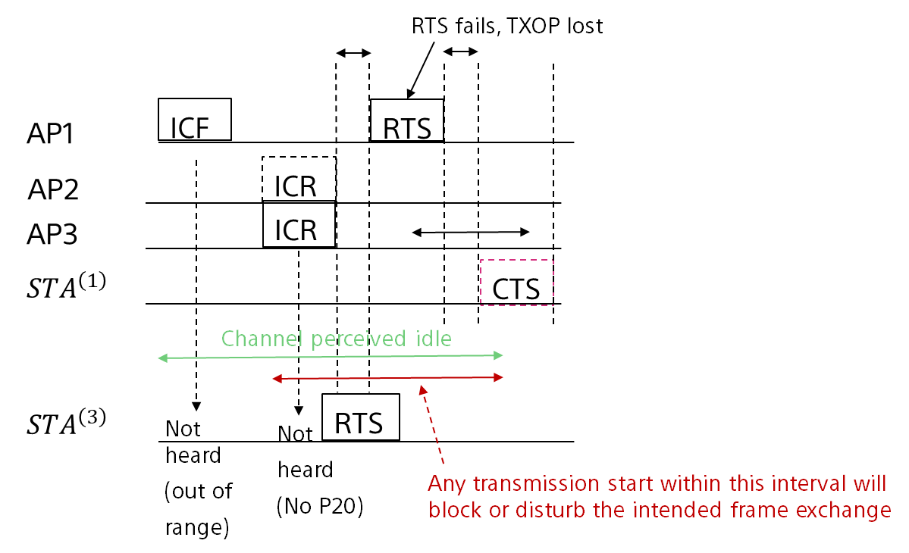
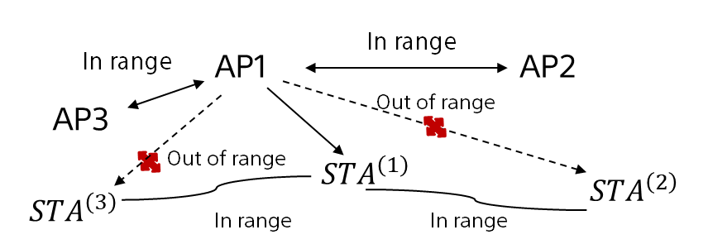

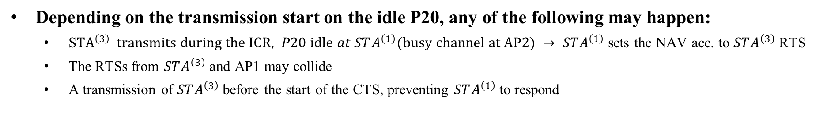
Consequence of no transmission over P20
STAs associated with the coordinated APs may start a transmission at any point from the start of the ICR until start of CTS.
Non-AP STA Transmission Effects
Example scenario
Allocated on P20
Allocated on S20
$STA^{\left(i\right)}$associated with APi
Depending on the transmission start on the idle P20, any of the following may happen:
  S${TA}^{\left(3\right)} transmits during the ICR, P20 idle at STA^{\left(1\right)}(busy channel at AP2) → STA^{\left(1\right)}$sets the NAV acc. to $STA^{\left(3\right)}$ RTS
  The RTSs from $STA^{\left(3\right)}$ and AP1 may collide
  A transmission of $STA^{\left(3\right)}$ before the start of the CTS, preventing $STA^{\left(1\right)}$to respond

Slide 5
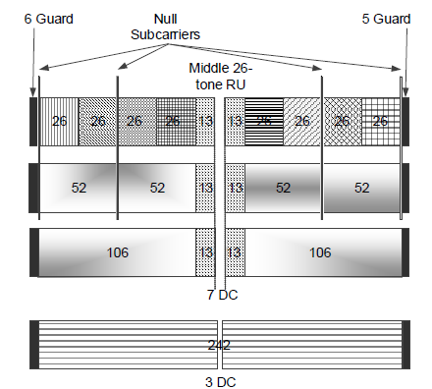

Solution 1a: ICR in smaller bandwidth than ICF
Required change:
  Relax the condition that TB PPDU responses should be such that at least one scheduled RU is allocated for each 20 MHz channel occupied by the eliciting PPDU
  Essentially elicit a response with a bandwidth of 20 or 40 MHz
    40MHz can be covered by e.g.,
      Using MRUs (one of the polled APs having one small RU in the secondary 20 and another one in the P20)
      in HE for >= 80MHz e.g., by using the inner RUs, which cover two 20MHz channels e.g., the inner 242 tone Rus, or 106 tone RU3 and 6..
  Can be enabled by settings within the BSRP frame: UL BW field to 20MHz or 40MHz and corresponding RU Allocation
Advantage
  No change to PHY, minimal change in MAC
Notes:
  ICR is a short frame therefore the response over the 20MHz only has a
  very small impact over airtime

Slide 6
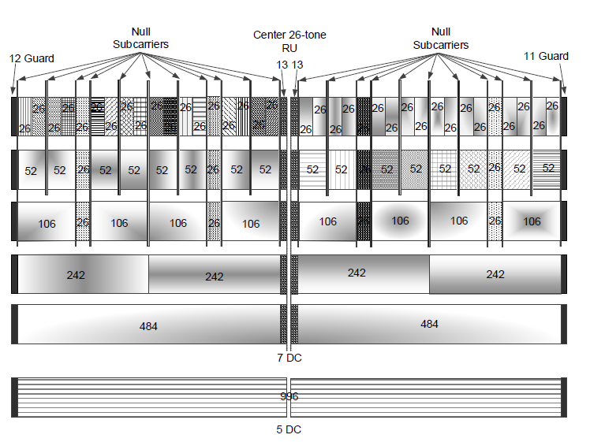
Solution 1b: STA-Assisted ICR Response
Goal: ICRs collectively cover the same BW as ICF
Approach:
  Poll in the ICF the non-AP STAs, intended for the follow up transmission, in addition to the APs
  RUs of the polled APs within the P20 (or P40)
  RUs of non-AP STAs covering the rest
Challenges
  mRU support may be needed either at AP or non-AP STAs for some setups (e.g. BW>80MHz, one non-AP STA), essentially limiting to EHT
  There may not always be an appropriate RU Allocation depending on e.g., puncturing requirements
Advantages
  Scheme does not depend on the secondary channel conditions at the polled APs
  Early indication of STA availability for the follow up frame exchange

Slide 7
Further Solutions to Enable P20 Responses
2a. Duplicate over the 20MHz corresponding to the P20, regardless of the RU Allocation
  or duplicate over the full overlapping bandwidth - It was argued against this design in .ax
  unexpected power difference between the legacy preamble and remaining PPDU part that the AGC needs to correct
    The larger the bandwidth, the lower the difference
    Tx power can be scaled during the payload transmission to compensate the difference
2b. ICR transmission in UL MU MIMO
  Potentially cumbersome if only for this operation
    APs should support a transmission conformant with UL MU MIMO
      E.g., Single stream pilot 2xHELTF, 4xHELTF or no pilot 1xHELTFs, global CSD,
  Full requested bandwidth should be idle at the polled APs in order to respond
  Max 4 APs may be polled, in most implementations

Slide 8
Summary
If the ICF in co-TDMA is sent over the full bandwidth that is intended to be used in the TXOP and baseline behavior is to be followed, ICRs from some of the coordinated APs end up not covering the primary 20
  Leading to potentially long channel idle times at STAs associated with the coordinating APs and outside of the range of a coordinated AP
A solution to ensure that the P20 is covered by the ICR transmission of all coordinating APs should be included in .bn
  We proposed several solutions for this with minimal impact on existing framework
    Solutions 1a and 1b require no PHY changes and can be implemented with minimal MAC adjustments

Slide 9
References
[1] 11-25/0182 PDT MAC CoTDMA, Sanket Kalamkar

Slide 10
SPs
Do you agree that the ICF in CTDMA should elicit the ICR responses such that each of the ICR responses cover the primary 20 channel?

Slide 11
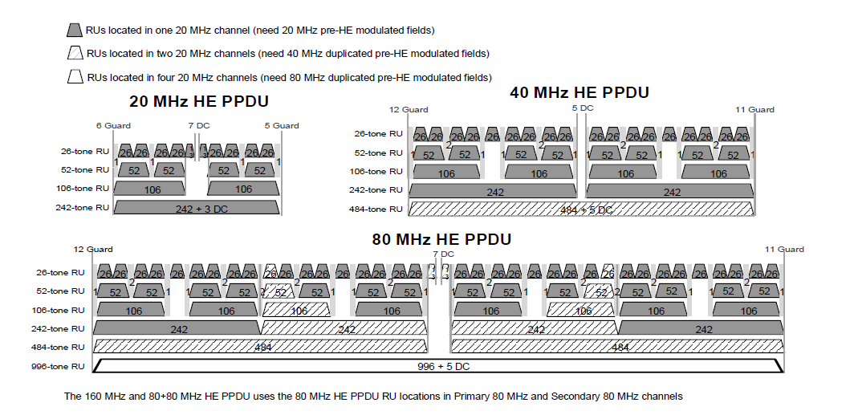
Appendix

