Slide 1
MAPC security follow up

Slide 2
Introduction
In this contribution, we would like to discuss rekey(i.e., PTK) procedure for MAPC

Slide 3
Background
        According to baseline, a STA should establish a new PTKSA prior to the expiration of the old one(due to the PTKSA lifetime) ,which is regarded as PTKSA rekey
          The regular PTKSA rekey procedure is 4-way handshake to generate a new PTKSA with the same PMKSA and new random parameters from both sides
                EAPOL-key frames(i.e., data frame) are used during 4-way handshake
          In 11bn D1.0, MAPC PASN has defined for authentication and protection of MAPC frames(i.e., PMKSA and PTKSA should be generated and managed)

Slide 4
Motivation
        When it comes to MAPC security case, the PTKSA rekey should also be taken into consideration due to expiration of PTKSA lifetime and PN exhaustion
        But unfortunately, the regular 4-way handshake is not applicable for MAPC PTKSA rekey, because data frame is not allowed between AP and peer AP
        Therefore, 11bn needs to define a new procedure to exchange new random parameters between AP and peer AP to generate a new PTKSA with the same PMKSA

Slide 5
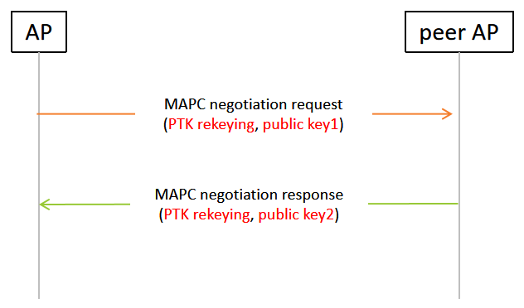
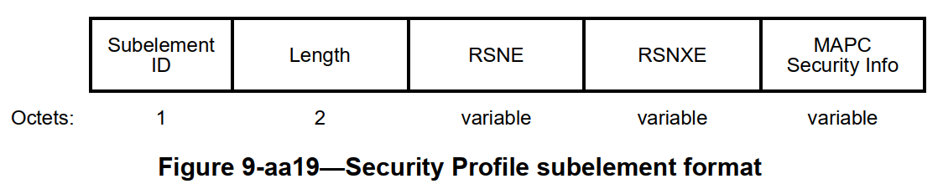
Proposal for MAPC rekey
        OPTION 1
        MAPC PTKSA rekey is achieved by two MAPC authentication frames with following additional requirement:
          one bit to indicate if it is PTK rekeying or not
          public key(i.e., random parameter) should be carried in MAPC Security info for new PTKSA derivation
should be MAPC authentication frame in the figure

Slide 6
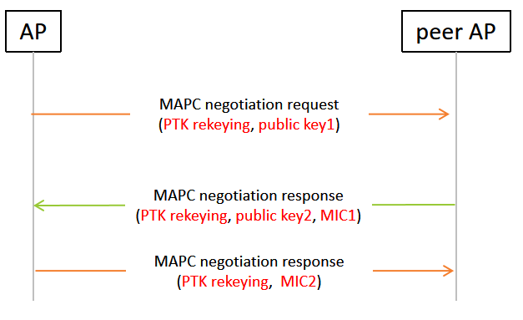
Proposal for MAPC rekey
        OPTION 2
        MAPC PTKSA rekey is achieved by three MAPC authentication frames as similar as the regular PASN frame exchange with following additional requirement:
          one bit to indicate if it is PTK rekeying or not
          public key(i.e., random parameter) should be carried in MAPC Security info for new PTKSA derivation
          MIC in 2nd and 3rd frame for integrity check
should be MAPC authentication frame in the figure

Slide 7
Summary
Analyze the regular PTKSA rekey procedure
Propose to reuse current MAPC authentication frames for MAPC PTKSA rekey
  Option 1 : two frames for public key exchange
  Option 2 : three frames for public key exchange and integrity check (i.e., MIC)

Slide 8
THANK YOU ☺

Slide 9
SP 1
Do you support to define MAPC PTKSA rekey by reusing two MAPC authentication frames, with following additional requirement:
          one bit to indicate if it is PTK rekeying or not
          public key carried in MAPC authentication frames for new PTKSA derivation

Slide 10
SP 2
Do you support to define MAPC PTKSA rekey by reusing three MAPC authentication frames(as similar as MAPC PASN authentication frame exchange), with following additional requirement:
          one bit to indicate if it is PTK rekeying or not
          public key carried in 1st and 2nd frame for new PTKSA derivation
          MIC carried in 2nd and 3rd frame for integrity check

