Slide 1
P2P group communication follow up
Date: 2025-08-21
Authors:

Slide 2
Introduction
Based on D1.0, the P2P Group ID is described as follows：
‘…The AP, if it accepts the SCS request, shall include a P2P Group Information field in the QoS Characteristics element in the SCS Response frame with the AID12 field in the P2P Group Information field indicating the AID12 value assigned for the P2P group by the AP. The AP shall not assign the same AID12 value assigned for the P2P group to any other non-AP STA or any other P2P group.’
Considering that AID12 is a limited assignable resource, we propose a method for P2P Group ID updating, and reallocation to achieve flexible management of P2P Group IDs.

Slide 3
P2P Group ID update and reallocate
TXSPG non-AP STA requests Group ID from AP and could also send the SCS request frame (or TBD frame) to the AP to assist AP in managing P2P Group IDs.
For Non-AP STA:
This frame can be used to indicate,
Group Status, such as active or inactive, disbanded or not
Request for group ID update or reclaim
For AP:
Based on the received information, AP can achieve:
Group ID update for the TXSPG non-AP STA
Real time access to which group IDs can be reclaimed and reassigned
will reclaim and reallocate

Slide 4
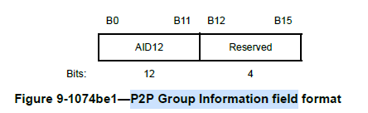
Group status and group ID request (1/2)
There are two options to indicate information for P2P group ID management.
Option 1: Use reserved bits of P2P Group Information field to indicate group state
P2P Group state
value | Group state
0 | Active
1 | Inactive
2 | disband
If no SCS request is received before the timer expires, the P2P group ID should be reclaimed. When the group returns to the active state, TXSPG non-AP STA should request an ID for P2P group again.
Group IDs can be reclaimed and reassigned
AP can manage group IDs according to the group state info.

Slide 5
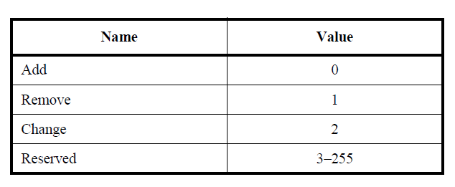
Group status and group ID request (2/2)
There are two methods to indicate information for P2P group ID management.
Option 2: use the request type field to indicate the Group ID request
Based on D1.0,
‘The AID12 subfield is reserved when the QoS Characteristics element that carries the P2P Group Information field is contained in an SCS Descriptor element in an SCS Request frame with the Request Type field set to 0 (Add).’
P2P Group ID assign
P2P Group ID reclaim
P2P Group ID update (if needed), additional 1 bit may be required to differentiate between QoS Characteristics updates
AP can manage group IDs according to the request type.

Slide 6
Summary
In this contribution, we propose a management method for P2P group IDs to achieve updating, reclaiming, and reallocating of P2P group IDs.
TXSPG non-AP STA can indicate the following information to AP to assist in group ID management,
Group state
Group ID request type

Slide 7
SP
Do you support to define a mechanism in 11bn to allow a TXSPG non-AP STA, one of the P2P group members, to assist AP in group ID management.
Note:
The non-AP STA sends a frame containing assisting information to AP.
The assisting information indicated by the non-AP STA to AP may include group status, update or reclaim request types for group ID, etc.
Result:
Y: , N: , A:

Slide 8
References
IEEE 802.11bn D1.0

