Slide 1
A Scalable Low-Complexity Provisioning Method and Its Improvement for Secure AMP Communication
Date: 2025-8-8
Authors:

Slide 2
Background
Motion 64, 65, 66 specified a secure AMP communication method using PMK, SNonce, ANonce, and PTK (11-24/1998, 11-24/2112, 11-25/0860, 11-24/1203). The method has low computation complexity (only hash and symmetric cryptography algorithms are used), requiring a high-entropy shared secret (PMK) for mutual authentication and PTK generation for encrypted data exchanges between an AMP AP and an AMP non-AP STA.
If there are m AMP APs and n AMP non-AP STAs and if every AMP AP needs secure access to every AMP non-AP STA, a total of m x n different PMKs are needed to prevent eavesdropping and impersonating attack, and every AMP non-AP STA needs to store m PMKs. This is a big burden for PMK provisioning, management, and storage.
This contribution proposes a scalable low-complexity provisioning method and an improvement to the low-complexity secure communication method specified in Motion 64, 65, 66. It can reduce the provisioning burden from m x n to m + n. Every AMP non-AP STA only needs to store one PMK.
Notes:
https://unit42.paloaltonetworks.com/iot-threat-report-2020/

Slide 3
Problem statement
Use case: n products (each with a built-in AMP non-AP STA tag) need to go through m - 1 transitions. At each transition, the delivering person and the receiving person must use their reading devices (AMP AP) to independently verify the existence of n products with security assurance. m x n unique PMKs are needed to prevent missing products at all transitions.
  If a tag Ai and a tag Aj use the same PMK in communications with a reading device R, the product with tag Ai can be counted twice and the product with tag Aj can be missing.
  If a reading device Ri and a reading device Rj use the same PMK in communications with a tag A, the owner of Ri who knows the PMK between Ri and A can provision the PMK into another tag A’ and replace the product with the tag A by the tag A’ only, without being detected by the owner of Rj.
Notes:
https://unit42.paloaltonetworks.com/iot-threat-report-2020/

Slide 4
A Scalable Provisioning Solution
A dedicated configurator C (an AMP AP identified by C_ID) runs the provisioning protocol based on 11-25/1086 and 11-25/0819 with every tag (AMP non-AP STAs denoted as A1, A2, …, An), generating and saving <A1_ID, PMK1_ID, PMK1>, <A2_ID, PMK2_ID, PMK2>, …, <An_ID, PMKn_ID, PMKn> in C’s memory.
  A1_ID is Tag A1’s ID; A2_ID is Tag A2’s ID; …; and An_ID is Tag An’s ID.
  Each tag only needs to store one PMK, e.g., Tag A1 only saves <PMK1_ID, PMK1> in its non-volatile memory.
  Totally n runs of 11bp provisioning protocol, between C and n tags.
C sends a data block {<A1_ID, PMK1_ID, hash(R1_ID || PMK1)>, <A2_ID, PMK2_ID, hash(R1_ID || PMK2)>, …, <An_ID, PMKn_ID, hash(R1_ID || PMKn)>} to reading device R1 using a method out of scope of 11bp.
  hash(R1_ID || PMK1) is used as the PMK between R1 and A1; hash(R1_ID || PMK2) is used as the PMK between R1 and A2; …; and hash(R1_ID || PMKn) is used as the PMK between R1 and An.
  Similarly, C sends a data block {<A1_ID, PMK1_ID, hash(R2_ID || PMK1)>, <A2_ID, PMK2_ID, hash(R2_ID || PMK2)>, …, <An_ID, PMKn_ID, hash(R2_ID || PMKn)>} to reading device R2. C repeats this process to reading device R3, R4, …, Rm.
  Totally m block transfers from C to m reading devices.
The PMK used for secure communication between Ri and Aj is hash(Ri_ID || PMKj).
  These PMKs are different from each other. Knowing one cannot derive another (C shall never reveal PMK1, PMK2, …, PMKn to anyone).
  m x n PMKs are obtained by m + n provisioning operations.
Notes:
https://unit42.paloaltonetworks.com/iot-threat-report-2020/

Slide 5
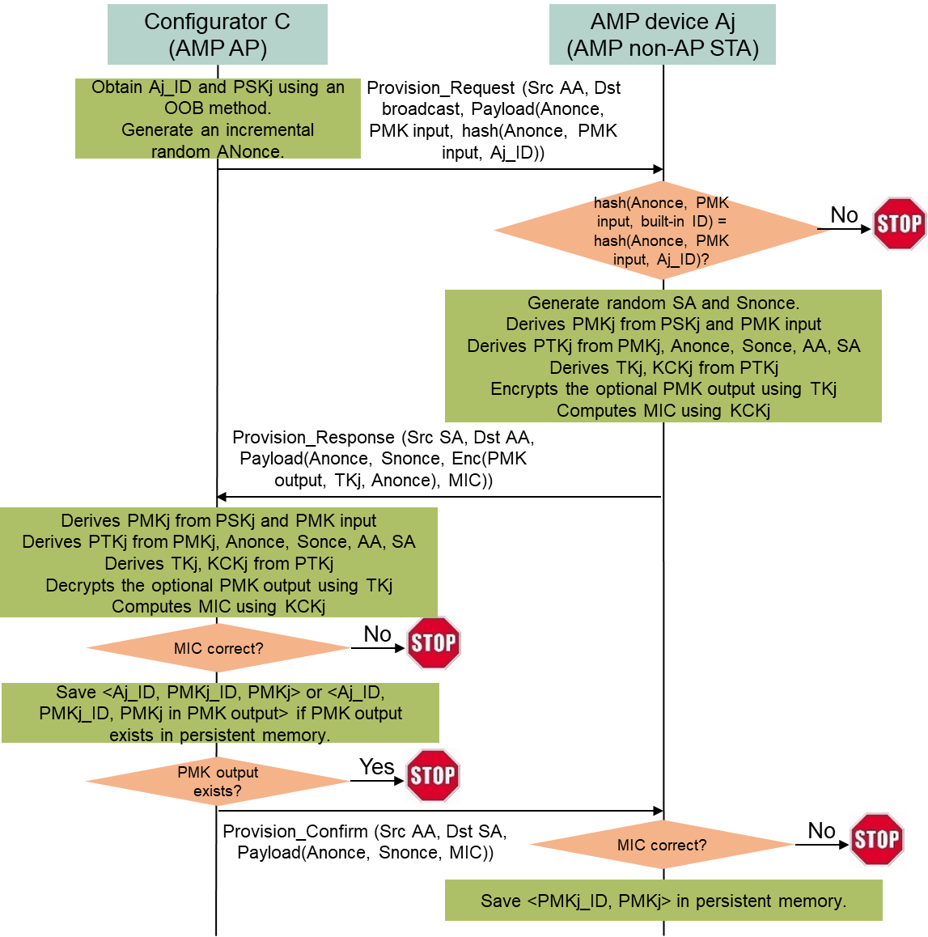
Provisioning Protocol
11bp provisioning protocol based on 11-25/1086 and 11-25/0819 (C to Aj)
C and Aj share a high-entropy secret PSKj. PSKj is only used for initializing and updating PMKj between them. C obtains PSKj using an OOB method.
C broadcasts a Provisioning Request frame with a source address AA, a broadcast destination address, and a payload containing an incremental Anonce, PMK input data, and hash(Anonce, PMK input data, Aj_ID). PMK input data includes an PMKj_ID and algorithm-specific parameters for generating PMK. Aj_ID is a permanent long ID built in Aj.
Every AMP device received the broadcast Provision Request frame computes hash(Anonce, PMK input data, built-in ID). Only Aj finds the computed hash matches the received hash(Anonce, PMK input data, Aj_ID).
Aj generates a random source address SA and Snonce, generates PMKj based on PSKj and PMK input data, computes PTKj based on PMKj, Anonce, Snonce, AA, and SA, derives TKj, KCKj from PTKj, encrypts an optional PMK output data using TKj as the key and Anonce as the nonce, computes a MIC using KCKj, then sends back a Provisioning Response frame with a source address SA, a destination address AA, and a payload containing Anonce, Sonce, an optional encrypted PMK output data, and the MIC. The optional PMK output data includes a confirmed PMKj_ID and a generated PMKj (it exists if Aj cannot save PMKj in persistent memory, so Aj has to generate a PMKj based on a never-revealed device-specific built-in secret and PMKj_ID).
C generates PMKj based on PSKj and PMK input data, computes PTKj based on PMKj, Anonce, Snonce, AA, and SA, derives TKj, KCKj from PTKj, and verifies the MIC using KCKj. If there is no optional PMK output data, C saves <Aj_ID, PMKj_ID, PMKj> in its persistent memory; if an optional PMK output data exists, C decrypts the PMK output data, then saves <Aj_ID, PMKj_ID, PMKj from PMK output data> in its persistent memory for future secure communication with Aj. C then sends an optional Provision Confirm frame with a source address AA, a destination address SA, a payload containing Anonce, Snonce, and a MIC to Aj (the Provision Confirm frame is not needed if Aj cannot save PMKj in persistent memory).
Aj verifies the MIC of the received Provisioning Confirm frame. If the MIC is correct, Aj saves <PMKj_ID, PMKj> in its persistent memory for future secure communication with any AMP AP knowing PMKj_ID and PMKj. If Aj cannot save PMKj into persistent memory, this step is not needed.
Provisioning from C to Ri using a method out of 11bp scope
C sends <Aj_ID, PMKj_ID, hash(Ri_ID || PMKj)> to Ri. The PMK between Ri and Aj is hash(Ri_ID || PMKj).
Notes:
https://unit42.paloaltonetworks.com/iot-threat-report-2020/

Slide 6
Secure AMP Communication Improvement
Setup
  The PMK used for secure communication between Ri and Aj is hash(Ri_ID || PMKj).
  Ri has <Aj_ID, PMKj_ID, hash(Ri_ID || PMKj> in its permanent memory.
  Aj has <PMKj_ID, PMKj> in its persistent memory or can derive PMKj using PMKj_ID and a never-revealed device-specific built-in secret.
PMK, ANonce, SNonce, PTK-based secure AMP communication method
  Ri sends a random ANonce and a hint field (PMKj_ID.Ri_ID) to Aj.
  Aj finds PMKj using PMKj_ID (Aj could be provisioned with multiple PMKs). Aj generates a random SNonce, derives PTKj from hash(Ri_ID || PMKj), AA, SA, ANonce, and SNonce, generates a MIC using KCKj derived from PTKj, and sends back SNonce and the MIC to Ri.
  Ri derives PTKj from hash(Ri_ID || PMKj), AA, SA, ANonce, and SNonce, and starts encrypted data communication with Aj using TKj derived from PTKj after validating the MIC.
The existence of the hint field is optional.
Notes:
https://unit42.paloaltonetworks.com/iot-threat-report-2020/

Slide 7
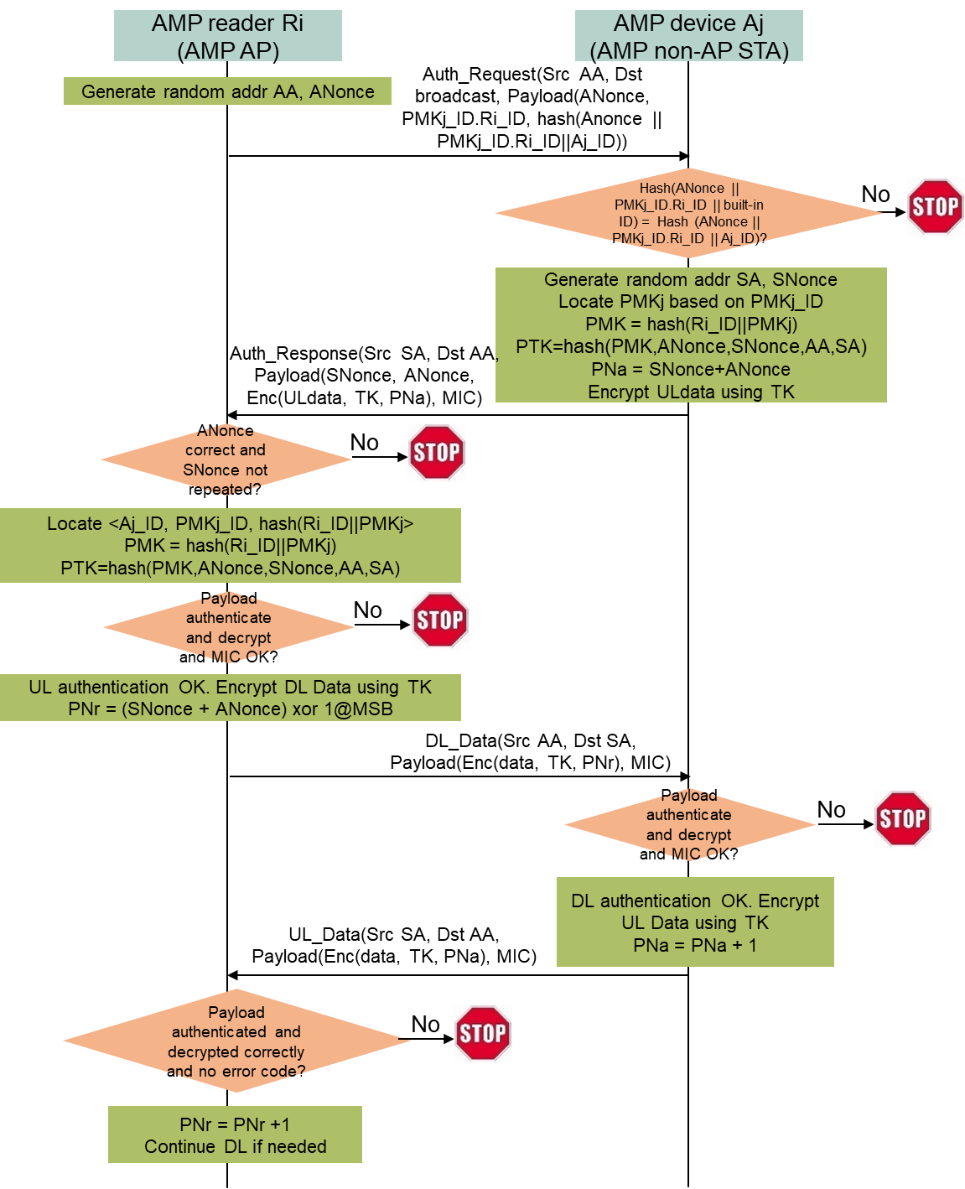
Improved secure AMP communication
Secure communication protocol (between Ri and Aj) without the need of pairing
Ri generates a random MAC address AA and ANonce, broadcasts an Authentication Request frame with a source address AA, a broadcast destination address, and a payload containing ANonce, PMKj_ID.Ri_ID, and hash(Anonce || PMKj_ID.Ri_ID || Aj_ID), where PMKj_ID.Ri_ID hints Aj on how to derive PMK for scalability.
Every AMP device received the broadcast Authentication Request frame checks if hash(Anonce || PMKj_ID.Ri_ID || built-in ID) matches the received hash(Anonce || PMKj_ID.Ri_ID || Aj_ID). Only Aj finds a match and responds.
Aj generates a random MAC address SA and SNonce, locates or derives PMKj from its persistent memory using PMKj_ID, computes PMK = hash(Ri_ID || PMKj) and PTK from hash(PMK, ANonce, SNonce, AA, SA), generates UL data if needed, encrypts the UL data using TK derived from PTK as the encryption key and Anonce+Snonce as the starting UL PN, and sends back ANonce, SNonce, Enc(UL data, TK, ANonce+SNonce), and a MIC in an Authentication Response frame with a source address SA and a destination address AA.
If Ri finds SA in the received Authentication Response frame collides with another non-AP STA’s short address, Ri restarts the authentication protocol until the received SA is unique.
Ri locates <Ai_ID, PMKj_ID, hash(Ri_ID || PMKj> from its permanent memory based on Aj_ID and PMKj_ID, computes PTK from hash(Ri_ID || PMKj), ANonce, SNonce, AA, and SA, verifies if TK derived from PTK can authenticate and decrypt the Access Response frame correctly and/or if KCK derived from PTK can validate the MIC (UL authentication), then sends an encrypted DL Data frame to Aj using TK as the encryption key and (Anonce+Snonce XOR 1@MSB) as the starting DL PN.
Aj verifies if TK can authenticate and decrypt DL Data frame correctly and/or if KCK can validate the MIC (DL authentication), then Ri and Aj can continue exchanging UL Data frame and DL Data frame encrypted by TK.
Notes:
https://unit42.paloaltonetworks.com/iot-threat-report-2020/

Slide 8
Conclusion
A scalable low-complexity provisioning method is proposed to address the mesh use case that m AMP APs communicate with n AMP non-AP STAs. It can configure m x n different PMKs with only m + n provisioning operations. Every AMP non-AP STA only needs to be configured one PMK.
The corresponding improvement for the PMK, ANonce, SNonce, PTK-based secure AMP communication method is to add a hint field containing a configurator’s ID and an AMP AP’s ID in the first authentication message sent by the AMP AP to an AMP non-AP STA, such that the AMP non-AP STA can derive a PMK from the PMK provisioned by the configurator for secure communication with the AMP AP.
The provisioning protocol is updated from 11-25/1086 and adapted to 11-25/0819 for harmonization purpose.
Notes:
https://unit42.paloaltonetworks.com/iot-threat-report-2020/

Slide 9
SP1
Do you agree to add the following text in the TGbp SFD --- 802.11bp shall specify a provisioning protocol that can initialize or update a PMK identified by a PMK ID with mutual authentication using a PSK shared between a configuration AMP AP and an AMP non-AP STA, where the PSK is built in the AMP non-AP STA and obtained by the configuration AMP AP using an OOB method and the AMP non-AP STA can have an option to send back an encrypted PMK_ID and PMK using an encryption key derived from PSK-based mutual authentication?
Note:
  The secure AMP communication method is defined in Motion 64, 65, 66.
  Whether to include backscatter non-AP STAs in this method is TBD.
Reference: 11-25/1437, 11-25/1086, 11-25/0831.
Notes:
https://unit42.paloaltonetworks.com/iot-threat-report-2020/

Slide 10
SP2
Do you agree to add the following text in the TGbp SFD --- 802.11bp shall specify an optional data field identifying a PMK ID and an AMP AP ID in the first authentication message in which the AMP AP sends ANonce to an AMP non-AP STA, such that the AMP non-AP STA can derive a PMK for secure communication with the AMP AP from a pre-configured PMK identified by the PMK ID for scalability purpose?
Note:
  The secure AMP communication method is defined in Motion 64, 65, 66.
  Whether to include backscatter non-AP STAs in this method is TBD.
Reference: 11-25/1437, 11-25/1086, 11-25/0831.
Notes:
https://unit42.paloaltonetworks.com/iot-threat-report-2020/

Slide 11
Reference
Amichai Sanderovich, Sagi Kupferman, Yuval Amran, “Considerations for AMP Devices”, doc: IEEE 802.11-23/1140r0, July 10, 2023.
Joerg Robert, Clemens Korn, “Power Consumption Calculation”, doc: IEEE 802.11-23/1232r0, July 11, 2023.
Chuangfeng He, “Authentication and Security transaction for AMP”, doc: IEEE 802.11-24/1203r0, July 12, 2024.
Hui Luo, Rakesh Taori, “Secure transaction methods with low computation complexity for AMP”, doc: IEEE 802.11-24/1998r1, Jan 7, 2025.
Sanket Kalamkar, George Cherian, Alfred Asterjadhi, “Secure E2E Operation for AMP”, doc: IEEE 802.11-24/2112r0, Dec. 16, 2024.
Hui Luo, Rakesh Taori, Guy-Armand Kamendje, Nelson Costa, “Low-Complexity Provisioning Methods for Low-Complexity Secure AMP Communications”, doc: IEEE 802.11-25/0831r1, May 14, 2025.
Rojan Chitrakar, Lei Huang, Ian Bajaj, “AMP security follow up”, doc: IEEE 802.11-25/0819r0, May 11, 2025.
Hui Luo, Rakesh Taori, Guy-Armand Kamendje, Nelson Costa, “Low-Complexity Provisioning Methods for Low-Complexity Secure AMP Communications – Follow Up”, doc: IEEE 802.11-25/1086r2, July 28, 2025.
NIST, FIPS 203 “Module-Lattice-Based Key-Encapsulation Mechanism Standard”, https://nvlpubs.nist.gov/nistpubs/fips/nist.fips.203.pdf, August 13, 2024.
Levent Ertaul, Anup Mudan, Nausheen Sarfaraz, “Performance Comparison of AES-CCM and AES-GCM Authenticated Encryption Methods”, 2018, https://mcs.csueastbay.edu/~lertaul/AESCCMCAMREADY.pdf
B. Kieu-Do-Nguyen, T. -T. Hoang, C. -K. Pham and C. Pham-Quoc, "A Power-efficient Implementation of SHA-256 Hash Function for Embedded Applications," 2021 International Conference on Advanced Technologies for Communications (ATC), Ho Chi Minh City, Vietnam, 2021, pp. 39-44, doi: 10.1109/ATC52653.2021.9598264. (0.018uJ per 32B by SHA256)
Mark D. Aagaard, Nusa Zidaric, “ASIC Benchmarking of Round 2 Candidates in the NIST Lightweight Cryptography Standardization Process”, 2021, https://eprint.iacr.org/2021/049.pdf (AES128 GCM: 12 bits per cycle; 0.28uJ/0.98uJ per 16B block by ASCON/AES128)
Notes:
https://unit42.paloaltonetworks.com/iot-threat-report-2020/

