Slide 1
A Scalable Low-Complexity Provisioning Method and Its Improvement for Secure AMP Communication
Date: 2025-8-8
Authors:

Slide 2
Background
Motion 64, 65, 66 specified a secure AMP communication method using PMK, SNonce, ANonce, and PTK (11-24/1998, 11-24/2112, 11-25/0860, 11-24/1203). The method has low computation complexity (only hash and symmetric cryptography algorithms are used), requiring a high-entropy shared secret (PMK) for mutual authentication and PTK generation for encrypted data exchanges between an AMP AP and an AMP non-AP STA.
If there are m AMP APs and n AMP non-AP STAs and if every AMP AP needs secure access to every AMP non-AP STA, a total of m x n different PMKs are needed to prevent eavesdropping and impersonating attack, and every AMP non-AP STA needs to store m PMKs. This is a big burden for PMK provisioning, management, and storage.
This contribution proposes a scalable low-complexity provisioning method and an improvement to the low-complexity secure communication method specified in Motion 64, 65, 66. It can reduce the provisioning burden from m x n to m + n. Every AMP non-AP STA only needs to store one PMK.
Notes:
https://unit42.paloaltonetworks.com/iot-threat-report-2020/

Slide 3
Problem statement
Use case: n products (each with a built-in AMP non-AP STA tag) need to go through m - 1 transitions. At each transition, the delivering person and the receiving person must use their reading devices (AMP AP) to independently verify the existence of n products with security assurance. m x n unique PMKs are needed to prevent missing products at all transitions.
  If a tag Ai and a tag Aj use the same PMK in communications with a reading device R, the product with tag Ai can be counted twice and the product with tag Aj can be missing.
  If a reading device Ri and a reading device Rj use the same PMK in communications with a tag A, the owner of Ri who knows the PMK between Ri and A can provision the PMK into another tag A’ and replace the product with the tag A by the tag A’ only, without being detected by the owner of Rj.
Notes:
https://unit42.paloaltonetworks.com/iot-threat-report-2020/

Slide 4
A Scalable Provisioning Solution
A dedicated configurator C (identified by C_ID) runs the provisioning protocol described in 11-25/1086 with every tag (denoted as A1, A2, …, An), generating and saving <A1_ID, PMK1>, <A2_ID, PMK2>, …, <An_ID, PMKn> in C’s permanent memory.
  A1_ID is Tag A1’s ID; A2_ID is Tag A2’s ID; …; and An_ID is Tag An’s ID.
  Each tag only needs to store one PMK, e.g., Tag A1 only saves <C_ID, PMK1> in its non-volatile memory.
  Totally n runs of 11bp provisioning protocol, between C and n tags.
C sends a data block {<A1_ID, hash(R1_ID || PMK1)>, <A2_ID, hash(R1_ID || PMK2)>, …, <An_ID, hash(R1_ID || PMKn)>} to reading device R1 using a method out of scope of 11bp.
  hash(R1_ID || PMK1) is used as the PMK between R1 and A1; hash(R1_ID || PMK2) is used as the PMK between R1 and A2; …; and hash(R1_ID || PMKn) is used as the PMK between R1 and An.
  Similarly, C sends a data block {<A1_ID, hash(R2_ID || PMK1)>, <A2_ID, hash(R2_ID || PMK2)>, …, <An_ID, hash(R2_ID || PMKn)>} to reading device R2. C repeats this process to reading device R3, R4, …, Rm.
  Totally m block transfers from C to m reading devices.
The PMK used for secure communication between Ri and Aj is hash(Ri_ID || PMKj).
  These PMKs are different from each other. Knowing one cannot derive another (C shall never reveal PMK1, PMK2, …, PMKn to anyone).
  m x n PMKs are obtained by m + n provisioning operations.
Notes:
https://unit42.paloaltonetworks.com/iot-threat-report-2020/

Slide 5
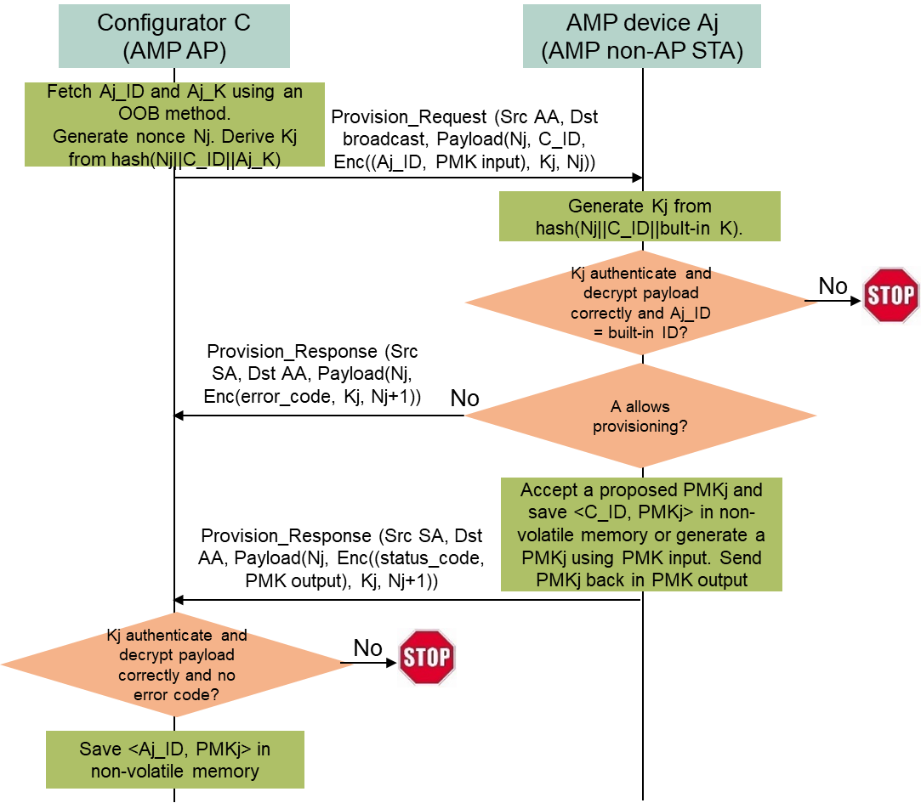
Provisioning Protocol Recap
11bp provisioning protocol proposed in 11-25/1086 (from C to Aj)
C fetches Aj’s ID Aj_ID and a device-specific secret Aj_K for provisioning purpose using an OOB method.
C broadcasts a Provisioning Request frame, containing an incremental random nonce Nj, C_ID, and Enc((Aj_ID, PMK input), Kj, Rj). PMK input is either a proposed PMK or some input for generating a PMK. Kj is an encryption key derived from hash(Nj || C_ID || Aj_K). Nj is a nonce used by an encryption algorithm such as AES-128. Enc((Aj_ID, PMK input), Kj, Nj) means encrypting Aj_ID and PMK data using Kj as the key and Nj as the nonce.
Every AMP device received the broadcast Provision Request frame derives its own version of Kj from hash(Nj || C_ID || built-in provisioning secret), then checks if it can authenticate and decrypt the payload using Kj and if the decrypted Aj_ID matches its built-in ID. Only Aj finds a match and responds.
Aj checks if it allows provisioning. If not, Aj returns an error code (e.g., Aj already has a PMK with C_ID); otherwise, Aj sends back an OK status code and a generated PMKj if the PMK input is not a proposed PMKj. The returned content is encrypted using Kj and sent in a Provisioning Response frame. Aj saves <C_ID, PMKj> for future use.
C checks if it can authenticate and decrypt the payload using Kp. If everything is OK, C saves <Aj_ID, PMKj> in its permanent memory for future use.
Provisioning from C to Ri using a method out of 11bp scope
C sends <Aj_ID, hash(Ri_ID || PMKj)> to Ri, specifying the PMK between Ri and Aj is hash(Ri_ID || PMKj).
Notes:
https://unit42.paloaltonetworks.com/iot-threat-report-2020/

Slide 6
Secure AMP Communication Improvement
Setup
  The PMK used for secure communication between Ri and Aj is hash(Ri_ID || PMKj).
  Ri has C_ID and <Aj_ID, hash(Ri_ID || PMKj> in its permanent memory.
  Aj has <C_ID, PMKj> in its non-volatile memory.
PMK, ANonce, SNonce, PTK-based secure AMP communication method
  Ri sends a random ANonce and a hint field (C_ID.Ri_ID) to Aj.
  Aj finds PMKj using C_ID (Aj could be provisioned by multiple configurators, C_ID is one of them). Aj generates a random SNonce, derives PTK from hash(hash(Ri_ID || PMKj), AA, SA, ANonce, SNonce), generates a MIC using KCK derived from PTK, and sends back SNonce and the MIC to Ri.
  Ri derives PTK from hash(hash(Ri_ID || PMKj), AA, SA, ANonce, SNonce), and starts encrypted data communication with Aj using TK derived from PTK after validating the MIC.
The existence of the hint field is optional.
Notes:
https://unit42.paloaltonetworks.com/iot-threat-report-2020/

Slide 7
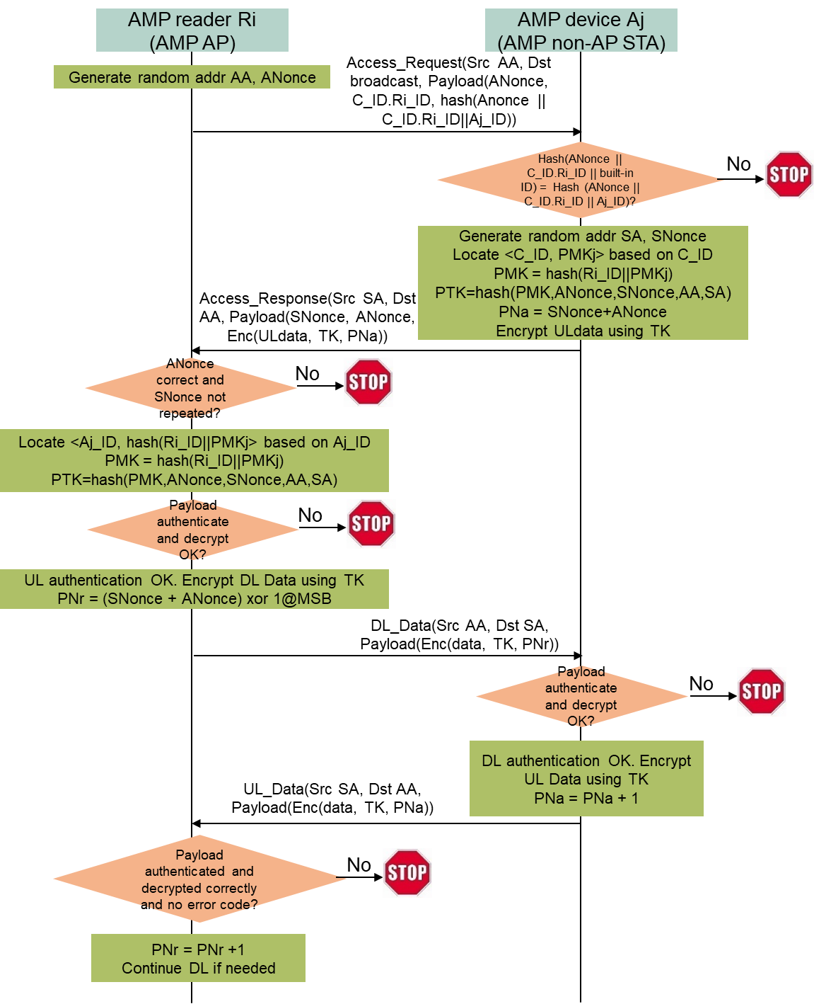
Improved secure AMP communication
Secure communication protocol (between Ri and Aj)
Ri generates a random MAC address AA and ANonce, broadcasts an Access Request frame containing ANonce, C_ID.Ri_ID, and hash(Anonce || C_ID.Ri_ID || Aj_ID), where C_ID.Ri_ID hints Aj on how to derive PMK.
Every AMP device received the broadcast Access Request frame checks if hash(Anonce || C_ID.Ri_ID || built-in ID) matches the received hash(Anonce || C_ID.Ri_ID || Aj_ID). Only Aj finds a match and responds.
Aj generates a random MAC address SA and SNonce, locates <C_ID, PMKj> from its permanent memory based on the received C_ID, computes PMK = hash(Ri_ID || PMKj) and PTK from hash(PMK, ANonce, SNonce, AA, SA), generates UL data if needed, encrypts the UL data using TK derived from PTK, and sends back ANonce, SNonce, and Enc(UL data, TK, ANonce+SNonce) in an Access Response frame.
Ri locates <Ai_ID, hash(Ri_ID || PMKj> from its permanent memory based on Aj_ID, computes PTK from hash(hash(Ri_ID || PMKj), ANonce, SNonce, AA, SA), verifies if TK derived from PTK can authenticate and decrypt the Access Response frame correctly (UL authentication), then sends an encrypted DL Data frame to Aj.
Aj verifies if TK can authenticate and decrypt DL Data frame correctly (DL authentication), then Ri and Aj can continue exchanging UL Data frame and DL Data frame encrypted by TK.
Notes:
https://unit42.paloaltonetworks.com/iot-threat-report-2020/

Slide 8
Conclusion
A scalable low-complexity provisioning method is proposed to address the mesh use case that m AMP APs communicate with n AMP non-AP STAs. It can configure m x n different PMKs with only m + n provisioning operations. Every AMP non-AP STA only needs to be configured one PMK.
The corresponding improvement for the PMK, ANonce, SNonce, PTK-based secure AMP communication method is to add a hint field containing a configurator’s ID and an AMP AP’s ID in the first authentication message sent by the AMP AP to an AMP non-AP STA, such that the AMP non-AP STA can derive a PMK from the PMK provisioned by the configurator for secure communication with the AMP AP.
Notes:
https://unit42.paloaltonetworks.com/iot-threat-report-2020/

Slide 9
SP1
Do you agree to add the following text in the TGbp SFD --- 802.11bp shall specify an optional data field identifying a configurator ID and an AMP AP ID in the first authentication message that the AMP AP sends ANonce to an AMP non-AP STA, such that the AMP non-AP STA can derive a PMK for secure communication with the AMP AP from a PMK provisioned by the configurator?
Note:
  The secure AMP communication method is defined in Motion 64, 65, 66.
  Whether to include backscatter non-AP STAs in this method is TBD.
Reference: 11-25/1437, 11-25/1086, 11-25/0831.
Notes:
https://unit42.paloaltonetworks.com/iot-threat-report-2020/

Slide 10
Reference
Amichai Sanderovich, Sagi Kupferman, Yuval Amran, “Considerations for AMP Devices”, doc: IEEE 802.11-23/1140r0, July 10, 2023.
Joerg Robert, Clemens Korn, “Power Consumption Calculation”, doc: IEEE 802.11-23/1232r0, July 11, 2023.
Chuangfeng He, “Authentication and Security transaction for AMP”, doc: IEEE 802.11-24/1203r0, July 12, 2024.
Hui Luo, Rakesh Taori, “Secure transaction methods with low computation complexity for AMP”, doc: IEEE 802.11-24/1998r1, Jan 7, 2025.
Sanket Kalamkar, George Cherian, Alfred Asterjadhi, “Secure E2E Operation for AMP”, doc: IEEE 802.11-24/2112r0, Dec. 16, 2024.
Hui Luo, Rakesh Taori, Guy-Armand Kamendje, Nelson Costa, “Low-Complexity Provisioning Methods for Low-Complexity Secure AMP Communications”, doc: IEEE 802.11-25/0831r1, May 14, 2025.
Hui Luo, Rakesh Taori, Guy-Armand Kamendje, Nelson Costa, “Low-Complexity Provisioning Methods for Low-Complexity Secure AMP Communications – Follow Up”, doc: IEEE 802.11-25/1086r2, July 28, 2025.
NIST, FIPS 203 “Module-Lattice-Based Key-Encapsulation Mechanism Standard”, https://nvlpubs.nist.gov/nistpubs/fips/nist.fips.203.pdf, August 13, 2024.
Levent Ertaul, Anup Mudan, Nausheen Sarfaraz, “Performance Comparison of AES-CCM and AES-GCM Authenticated Encryption Methods”, 2018, https://mcs.csueastbay.edu/~lertaul/AESCCMCAMREADY.pdf
B. Kieu-Do-Nguyen, T. -T. Hoang, C. -K. Pham and C. Pham-Quoc, "A Power-efficient Implementation of SHA-256 Hash Function for Embedded Applications," 2021 International Conference on Advanced Technologies for Communications (ATC), Ho Chi Minh City, Vietnam, 2021, pp. 39-44, doi: 10.1109/ATC52653.2021.9598264. (0.018uJ per 32B by SHA256)
Mark D. Aagaard, Nusa Zidaric, “ASIC Benchmarking of Round 2 Candidates in the NIST Lightweight Cryptography Standardization Process”, 2021, https://eprint.iacr.org/2021/049.pdf (AES128 GCM: 12 bits per cycle; 0.28uJ/0.98uJ per 16B block by ASCON/AES128)
Notes:
https://unit42.paloaltonetworks.com/iot-threat-report-2020/

