Slide 1
A WPT Device Option
Date: 2025-08-17
Authors:

Slide 2
Abstract
This contribution proposes a WPT device recommendation to be stated by amendment - in order to improve coexistence and interoperability while maintaining simplicity and maximizing market acceptance.

Slide 3
Preface – WPT
Several proposals have been made with regards to WPT signalling and format.
This proposal focuses on the S1G channels for WPT, without going into WPT signalling or frame formats

Slide 4
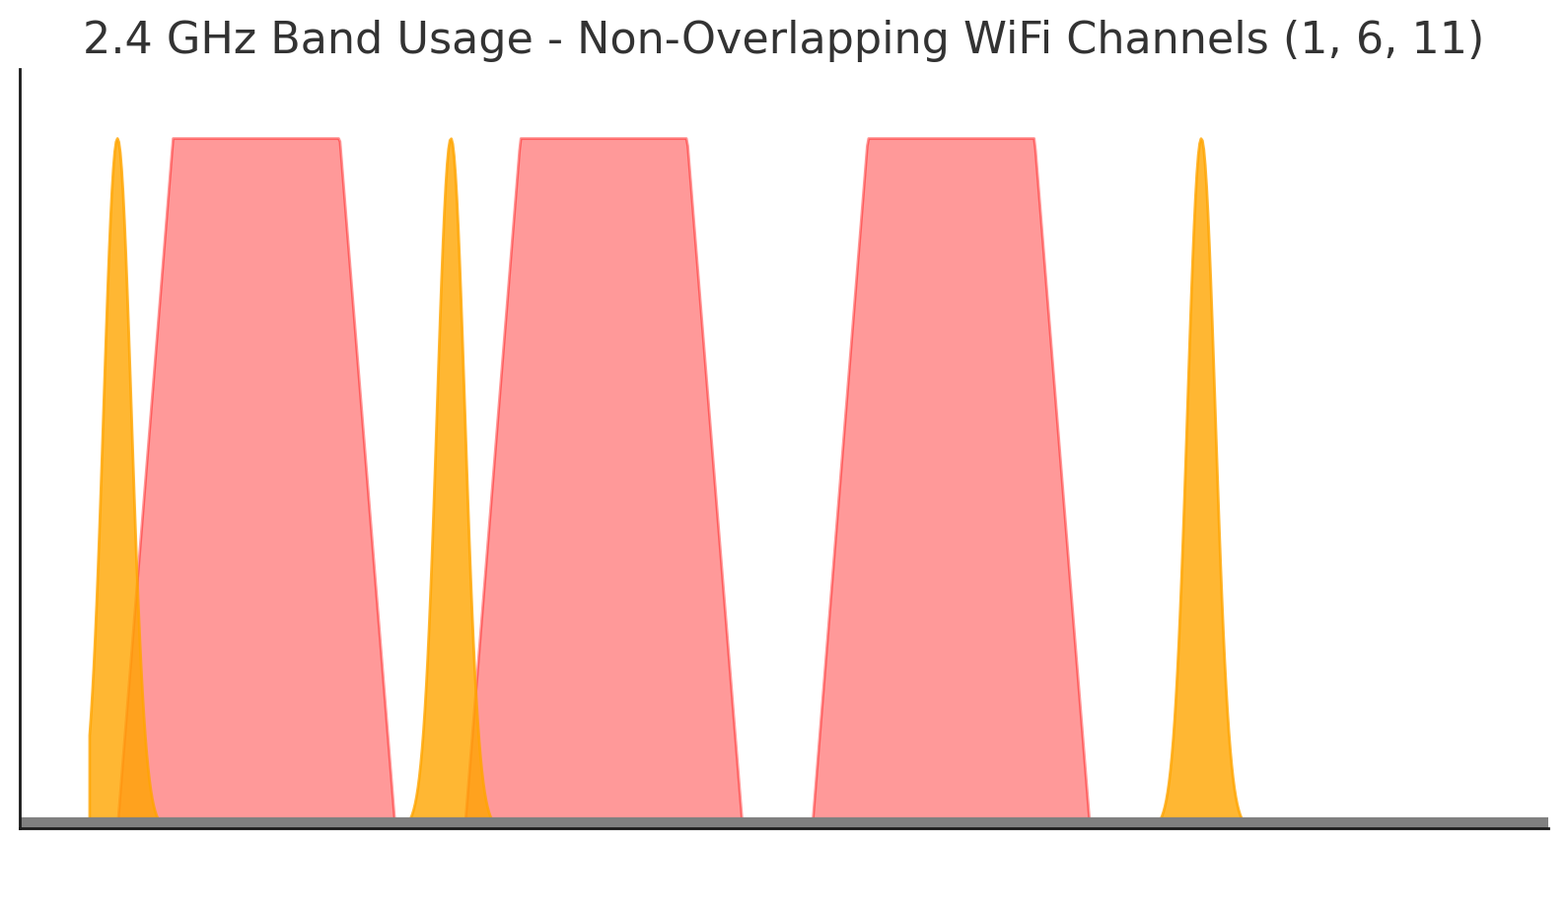
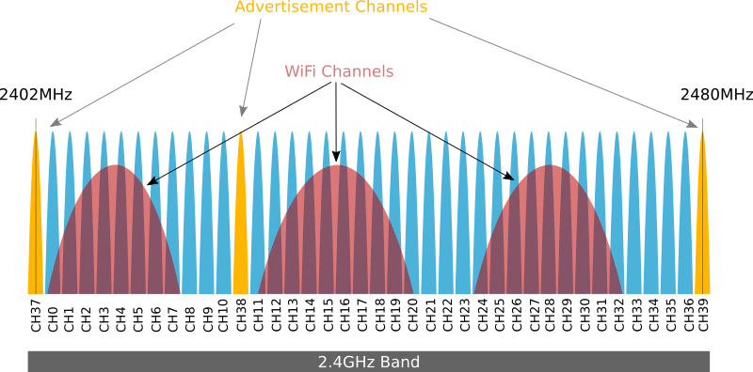
Example: BLE Advertising Channels
BT-SIG specified only 3 predefined channels on the 2.4GHz ISM band for advertising beacons
In order to minimize interference to WiFi networks and maximize coexistence, 2 channels were allocated
on band edges, one in between
non-overlapped wifi channels
Massive successful deployments of WiFi
and BLE on 2.4GHz suggest this
approach provides good coexistence
WiFi channels
BLE Advertising channels
source: https://www.argenox.com/library/bluetooth-low-energy/ble-advertising-primer/

Slide 5
Suggestion
Few channelization options on S1G were discussed in [1] - for several localities
Each geographic location has its own set of channels and regulatory limits
Many regulatory variations are out there for S1G
WPT can follow a similar approach as taken by BT-SIG, and recommend the use of very limited number of channels
For example, select a single channel per regulatory domain. E.g. the closest channel to 900MHz

Slide 6
Single Channel: Pros/Cons
PROS:
  Fix WPT channel makes the detection and thus avoidence of interference from WPT transmission by other systems like 802.11ah/LORA/RFID fast and easy (e.g. utilizing DFS)
  No more than 1 channel is needed for WPT transmission since it is indifferent to interference
  As in 2.4GHz, band edge WPT transmission will better coexist with S1G channels compared to middle band WPT transmission
  Using the closest to 900MHz channel will make the design of a multi-band harvester antenna easier at the tag
  Band edge is usually harder for the transmission of data - due to stricter emission limits on out-of-band
CONS:
  Single channel is inflexible, perhaps need to define more than 1 for unforseen deployment issues across the variuos regulatory domains

Slide 7
Example
Based on the channelization analysis in [1], the proposed approach will lead to the following recommendations:
In US
In China
In EU
Multi-band harvester with 52MHz BW @ tag
EU1
EU2

Slide 8
Summary
A channelization option for WPT was discussed
Proposed approach is orthogonal to other WPT features such as waveform, or frame format and relies on the WPT indifference to interference
Suggested approach can significanly enhance coexitence with other S1G systems while simplifying tag design
Using recommendation is optional and thus do not limit energizer implementation

Slide 9
SP#1
Add to the SFD the following:
802.11bp amendment will recommend the use of a single S1G channel for WPT transmission for each regulatory domain
Y:
N:
A:

Slide 10
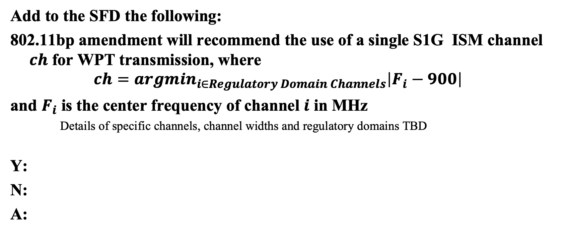
SP#2
Add to the SFD the following:
802.11bp amendment will recommend the use of a single S1G ISM channel $ch$ for WPT transmission, where
$$ch={argmin}_{i∈Regulatory Domain Channels}\left|F_{i}−900\right|$$
and $F_{i}$ is the center frequency of channel $i$ in MHz
    Details of specific channels, channel widths and regulatory domains TBD
Y:
N:
A:

Slide 11
References
[1] 11-25-1224-00-00bp-initial-thought-on-amp-s1g-channelization, Huawei

