Slide 1
802.11 WG September 2025 Session Report
Date: 2025-10-08
Authors:

Slide 2
Abstract
This document is a digest of the closing reports of all 802.11 sub-groups for presentation at the September 2025 closing plenary meeting. Liaison reports (including liaison reports from the opening plenary) are also included.

Slide 3
Attendance Data

Slide 4
Updated following July session
31 Dec 2029

Slide 5
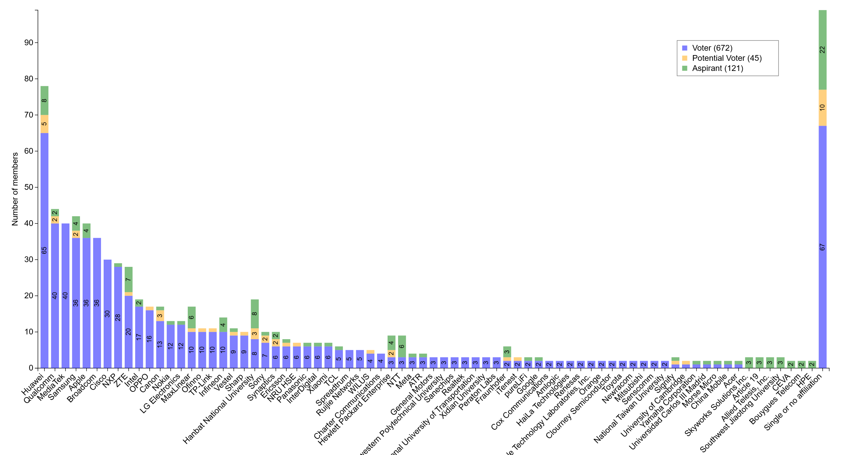
M4.1.7 Members by affiliation

Slide 6
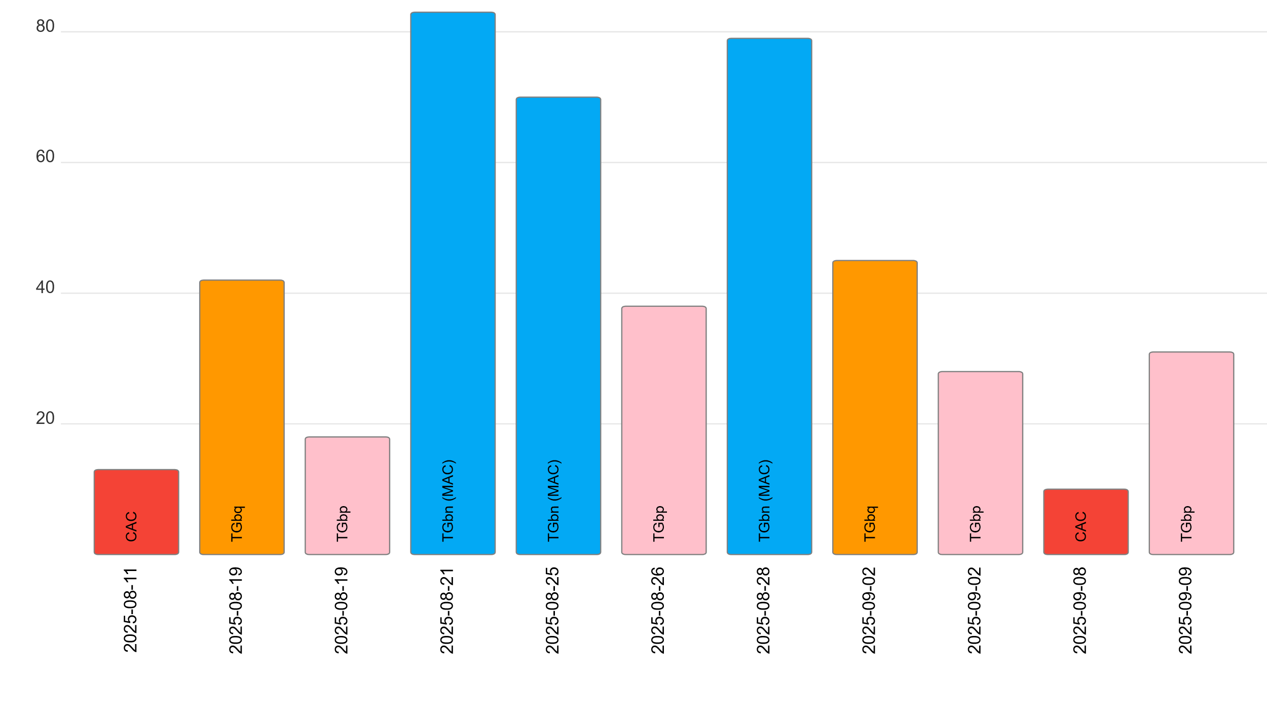
M4.1.7 Telecon attendance (July to September)

Slide 7
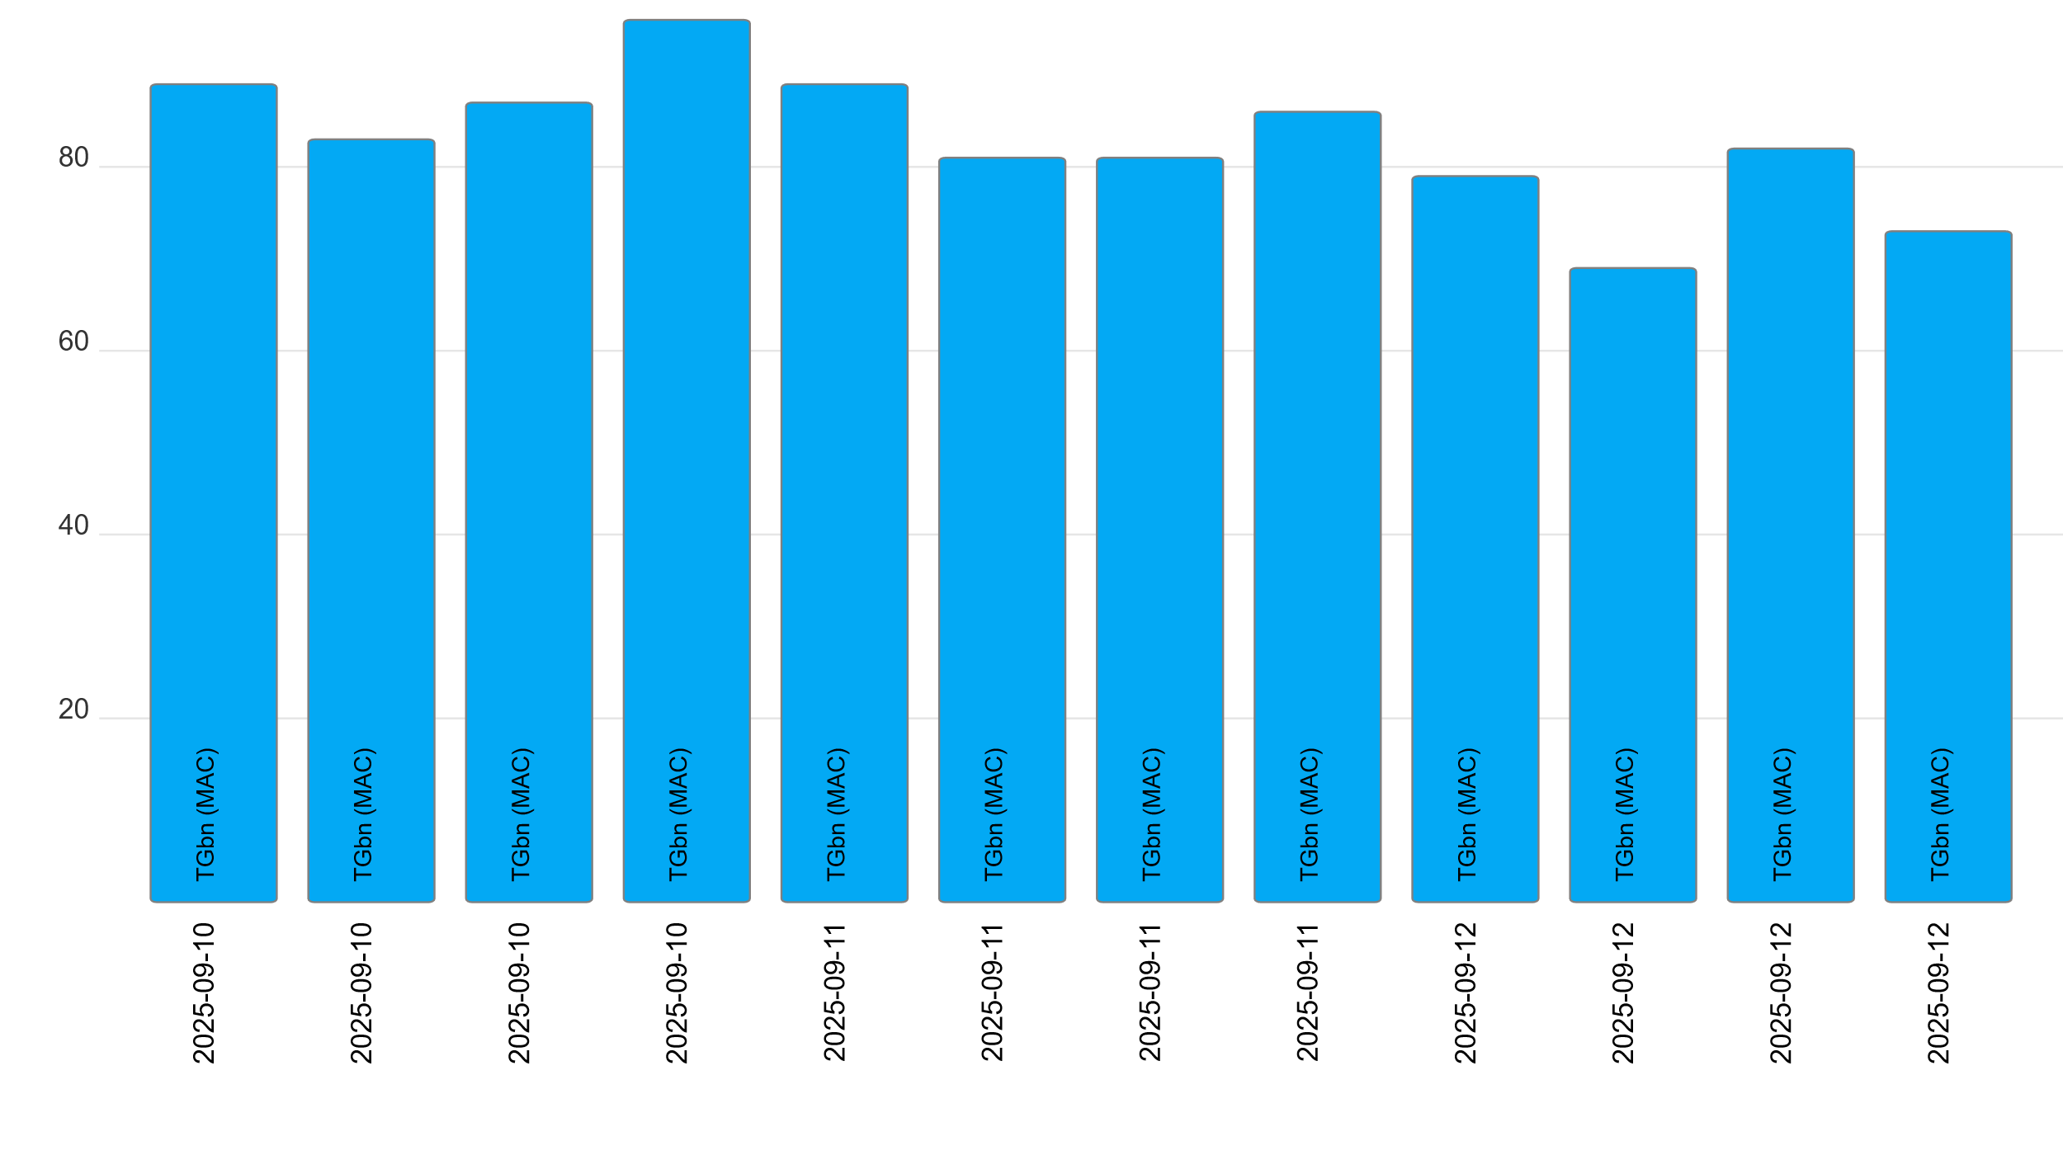
M4.1.7 TGbn MAC ad-hoc attendance (September 10-12)

Slide 8
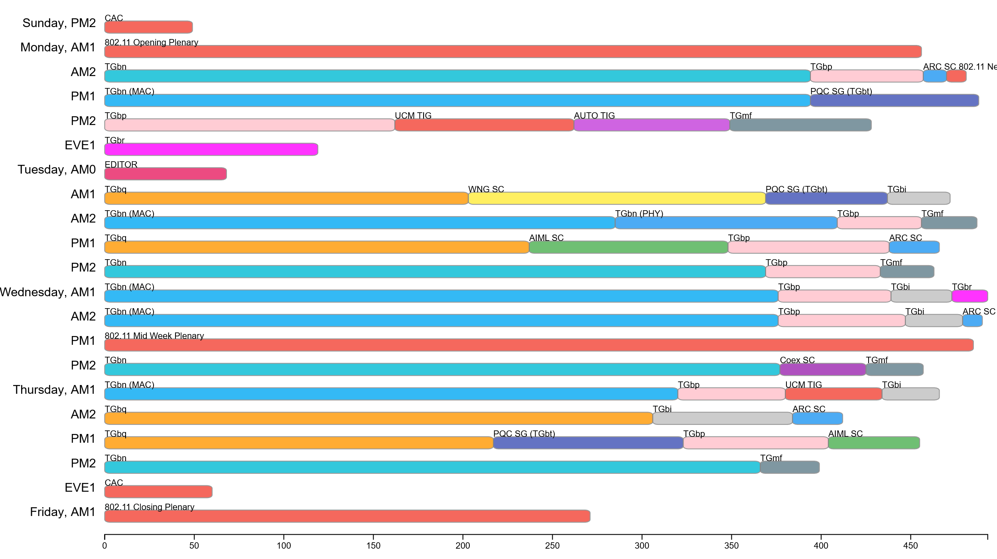
September Session: Attendance by breakout

Slide 9
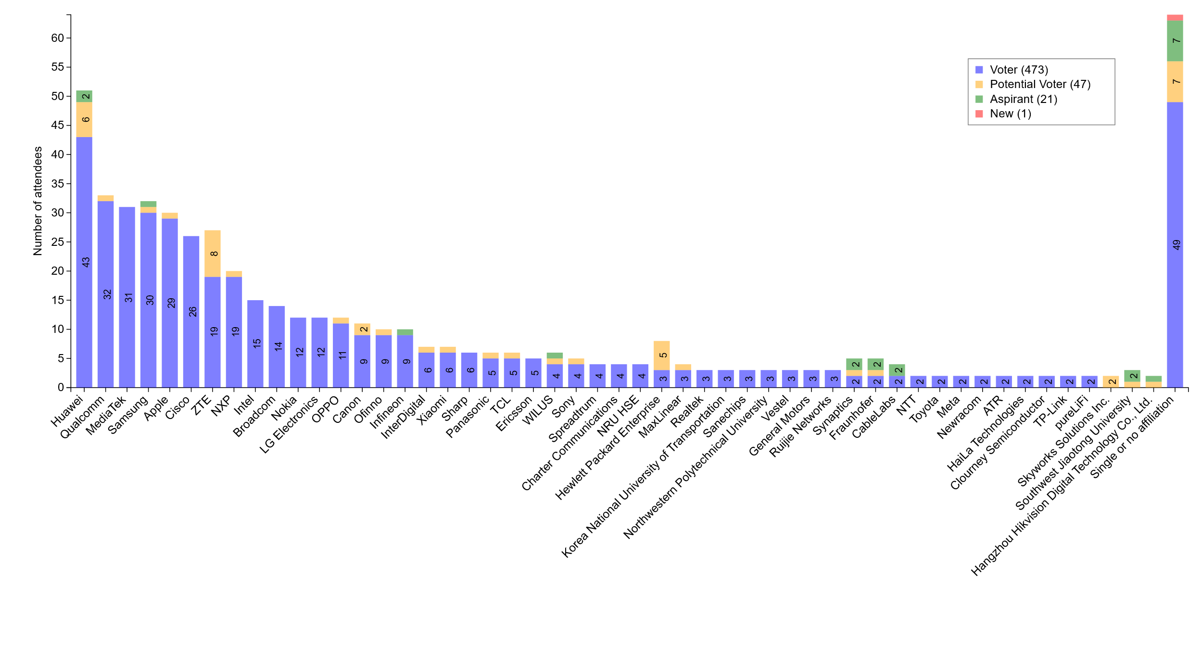
September session: Attendance by affiliation

Slide 10
Subgroup Closing Reports

Slide 11
Editors September 2025 closing report
Date: 16 September 2025
Authors:
Name | Company | Address | Phone | Email
Edward Au | Huawei Technologies |  |  | edward.ks.au@gmail.com
Carol Ansley | Cox |  |  | Carol.Ansley@cox.com

Slide 12
Work Completed
Reviewed status from each task group
Reviewed draft development snapshot and amendment ordering
Reviewed ANA managed number spaces, including the following 2 additions:
  9.6.13.20 Table 9-540 Optional subelement IDs for WNM Sleep Mode parameters
  9.4.2.35 Figure 9-417 BSSID Information field format
Kicked-start the IEEE P802.11bi/D2.0 mandatory draft review (MDR)

Slide 13
Plans for November 2025 plenary
Completed the pre-publication review of IEEE Draft Std 802.11bf-2025
A teleconference call is scheduled for IEEE P802.11bi/D2.0 MDR
  Monday, 27 October, 4:00pm ET to 6:00pm ET

Slide 14
September 2025 AIML SC Closing Report
Date: 2025-09-18
Authors:

Slide 15
Work Completed
  2 Meeting Slots
    Tuesday PM 1
    Thursday PM1
    Agenda: 11-25/1404r3
    SP and Motion Booklet: 11-24/765r7
  Achievements
    Approved minutes of AIML SC for July 2025 Plenary: 11-25/1438r0
    8 Contributions
      Technical presentations
        Unified AutoEncoder based CSI Feedback in MU-MIMO for Next Generation WLANs - Follow Up
      Approved majority of AIML SC 1st Annual Report elements
        Still needs integration and editing
        Will be finalized in Nov 2025 Bangkok session

Slide 16
Plans for November 2025
One teleconference planned
  Tuesday Oct 21 2025: 10 AM ET for 1.5 hours
Approve Sept 2025 Interim Minutes
Finalize AIML SC 1st Annual Report
Technical presentations
  Additional results, exploration and feasibility for existing use cases
  Additional AIML use cases
  Technical report drafts

Slide 17
ARC Closing Report
Date: 2025-09-18
Authors:

Slide 18
Annex G update/replacement
  Continued discussion on the proposal to replace Annex G with tutorial/informational material on:
  11-23/0880r12, 11-25/0738r0, 11-25/0193r5
  “Frame exchange sequence” (and its relationship to/meaning for other behaviors like power save/doze, off-channel scanning, etc.)
  Relation of frame exchange sequence to medium protection (NAV, etc.) – Almost reached consensus, but then it unraveled.
  The definition/extent of an instance of the Wireless Medium
    Relation of wireless medium to beamforming, sectorization, MU operation, etc.
We are uncovering (subtle) gaps in the baseline spec, also
Will continue discussion in November.

Slide 19
Std 802 update impacts on 802.11
Continued discussion (from July sessions and telecons) based on: 11-25/0923r5.
Reached some fundamental agreements on updates to “Access Domain” concept.
Still several other concepts to discuss.
Also in queue:
  Review of 11-25/0150r4
  Generate specific proposal, to REVmf, for suggested changes.
Will continue in November

Slide 20
(New topic) Beyond 11bn support for L4S
In response to the WBA liaison, requesting L4S support (11-24/1569r0)
Noted, and support, the additions in 802.11bn D1.0 to support L4S.
But there are 4 areas potentially beyond those additions. Some of which are probably only informational:
  See 11-25/1539r0
  Detection/reporting of congestion on uplink (by a non-AP STA)
  When congestion is indicated at an AP’s MLME interface, where does that indication go?
  Queuing behavior can influence latency
  MAC-level media access delays can influence latency
Have some suggestions to clarify the proposed liaison response to WBA (11-25/1411r0), in a contribution being worked off-line
Will continue this discussion in November, also.

Slide 21
Organizational and Plans
Agenda is here: 11-25/1428r3
One teleconference planned.
  Oct 27 (Monday), 1:00-3:00 PM ET
Plans for November:
Continue Annex G replacement
Continue EPD/LPD clean-up, other Std 802 alignment
Continue discussion on L4S support
Pick up MLME “state machine” topic?
Four meeting slots requested in November

Slide 22
Coex SC Closing Report
Date: 2025-09-18
Authors:

Slide 23
Coex SC’s week at a glance
Coex SC met once this week
Informative Items:
Availability and terms of use of ETSI BRAN documents
Open SA Ballot Pools
Technical discussion topics
5/6 GHz NB Device Observations
Coex SC Scope cleanup

Slide 24
Information Items
  Availability and terms of use of ETSI BRAN documents
  Local mirror in 802.11 members’ area
  Discussion / on-screen display permissible, but
  No modifications, no copy and paste into your own submission, etc
  See also: slide #10 of 11-25/1418r2
  SA Ballot Group formations for technology of potential interest to 802.11
  P802.15.4ab
  Deadline: 16 Oct 2025, 23:59 UTC-12
  See also: slide #11 of 11-25/1418r2

Slide 25
Technical Discussions
  5/6 GHz NB Device Observations (11-25/1683r0)
  Experiments with commercial off-the-shelf equipment showing influence of 802.11 connections and BT connections on each other
  Focus on channel access scheme (LBT evaluation) rather on complex use case scenarios
  Coex Scope Clean-Up (11-25/1655r2)
  Original scope from 2017 with revisions in 2020 and 2021 included references to outdated amendments (e.g.: 11ax)
  Not suitable for inclusion in public web page
  Coex members worked on a “cleaned-up charter / scope statement” as discussed and agreed in the session (see next slide)

Slide 26
Standing Committee on Coexistence
(cleaned-up charter)
Purpose
The Standing Committee (SC) is established to review and address matters related to the coexistence of IEEE 802.11 with other technologies operating in the same or adjacent spectrum, including other IEEE 802 technologies.
Responsibilities
Review and Discussion: The SC reviews and discusses materials and issues concerning coexistence between IEEE 802.11 and other relevant technologies including but not limited to other 802 technologies
Advisory Role: The SC provides advice and recommendations to the IEEE 802.11 Working Group (WG) and its subgroups on matters of coexistence.
Support in Inter-Group Coordination: The SC provides the competence to support to the IEEE 802.11 WG in formulating and developing responses to comments received from other IEEE 802 WGs regarding coexistence between IEEE 802.11 and their respective, other WGs’ technologies.
Reporting: The SC reports on its activities and discussions to the IEEE 802.11 WG, e.g., by providing summaries of key discussion items during the WG closing plenary.
Source: slide #11 of 11-25/1655r2
To be affirmed by WG motion

Slide 27
Plans for November
One dot11 Coex (only) slots
One slot – Wed PM2
One joint session with 802.15.4ab Tuesday PM3/EVE
Attention: if there are no announced submissions for the joint slot by Sunday 14.00h local meeting time, the slot will be cancelled
Topics:
Update on ETSI BRAN
Technical submissions (tba)
Note: coexistence-related topics are welcome. Please contact the Chair

Slide 28
Telcos
No telco scheduled.
May be announced with 10-day notice. Member feeling the need for telco and have submissions ready for discussion are asked to approach the Chair.

Slide 29
References for this week
Agenda for this week: 11-24/1416
Snapshot Slide: 11-24/1417
Meeting / Chair’s Slide Deck: 11-24/1418
Closing report: 11-24/1419
Meeting minutes: 11-25/1487

Slide 30
WNG SC Closing Report
Date: 2025-09-19
Authors:

Slide 31
Summary
Final Agenda
  https://mentor.ieee.org/802.11/dcn/25/11-25-1425-01-0wng-agenda-for-wng-sc-2025-september.pptx
Minutes
  https://mentor.ieee.org/802.11/dcn/25/11-25-1671-00-0wng-wng-meeting-minutes-2025-09-waikoloa.docx
Presentations at the September 2025 meeting
  “ Pushing the Limits: Unlocking the Potential of Faster-than-Nyquist Signaling,” Melda Yuksel (Middle East Technical University)
    https://mentor.ieee.org/802.11/dcn/25/11-25-1529-00-0wng-pushing-the-limits-unlocking-the-potential-of-faster-than-nyquist-signaling.pptx
  “Interference-Alignment-in-CoBF-with-Sequential-Sounding,” Aiguo Yan (Samsung)
    https://mentor.ieee.org/802.11/dcn/25/11-25-1513-00-0wng-interference-alignment-in-cobf-with-sequential-sounding.pptx
  “Interference-Alignment-in-CoBF-with-Joint-Sounding,” Aiguo Yan (Samsung)
    https://mentor.ieee.org/802.11/dcn/25/11-25-1514-00-0wng-interference-alignment-in-cobf-with-joint-sounding.pptx
Plans for November
  TBD: call for presentations will be sent out in October
No motions in the SC, No straw polls

Slide 32
IEEE 802 JTC1 Standing Committee
September 2025 (mixed-mode) closing report
Date: 2025-09-19
Author:

Slide 33
The IEEE 802 JTC1 SC reviewed the PSDO process status, including IPR issues holding up 802.11
Agenda - ec-25/0182r02; Minutes – ec-25/0221
WG | Completed | In-process
802.1 | 58 | 10
802.3 | 32 | 8
802.11 | 13 | 0
802.15 | 5 | 6
802.16 | 0 | 0
802.19 | 0 | 0
802.21 | 3 | 0
802.22 | 4 | 0
All | 111 | 30
802.11 IPR issue
We will be submitting IEEE 802 standards with negative LoAs under IEEE policy to see if different LoAs are submitted under ISO’s policy.
Next steps:
  Send IEEE 802.11-2024 to JTC 1/SC 6 for information. IEEE-SA Staff has the action to make this happen.

Slide 34
The IEEE 802 JTC1 SC will undertake its usual work at its mixed-mode meeting in Bangkok in November ’25
IEEE 802 JTC1 SC plans for November 2025 …
  Execute PSDO process
    The following standard is currently in ballot: IEEE 802.1DG (60-day pre-ballot).
  Monitor ISO/IEC JTC 1/SC 6 activities
  Review real responses to IEEE 802 LMSC chair’s letter from IEEE SA President, if any

Slide 35
REVmf Closing Report – September 2025
Date: 2025-09-18
Authors:

Slide 36
Work Completed
Agenda doc: https://mentor.ieee.org/802.11/dcn/25/11-25-1433-05-000m-revmf-agenda-september-2025-session.pptx
Initiated comment resolution on REVmf D1.0 from LB 289 (~130 comments out of 589)
Additionally:
  During the TGme rewards yesterday, I accidentally missed giving an award to Graham Smith.
    Graham made significant contributions in refactoring Clause 6 and removing WEP.

Slide 37
Plans for November
Adhoc
  Cambridge, UK – Sep 30, Oct 1,2
Teleconferences scheduled
  Monday Oct 6, 27 at 10am ET
November: 5 meeting slots
Objectives:
  Continue comment resolution from LB 289 on D1.0.
  Begin to roll in P802.11bk and P802.11bf in preparation for LB recirculation on D2.0

Slide 38
TGmf Timeline
Nov 2024 – PAR Approval
Nov 2024 – Initial meeting, contributions on REVme D7.0
Jan/Mar 2025 – Contributions on REVme D7.0/IEEE 802.11-2024
Mar - May July 2025 – Publication of 802.11-2024 and roll-in of TGbh and TGbe
May 2025 Aug 2025– Initial D1.0 WG Letter ballot
Jan 2026 – D2.0 Recirculation LB (include roll-in of TGbk and TGbf)
Jul 2026 – D3.0 Recirculation
Jan 2027 – D4.0 Initial SA Ballot (include roll-in of TGbi)
Jul 2027 – D5.0 Recirculation SA Ballot
Nov 2027 – D6.0 Recirculation SA Ballot
Jan 2028 – D6.0 Recirculation SA Ballot (clean recirculation)
Mar 2028 – 802 LMSC/RevCom/SASB Approval

Slide 39
TGmf Adhoc Motion
Authorize TGmf to hold an ad-hoc meeting on Dec 11-12, 2025, at IEEE SA HQ in Piscataway, NJ, for the purpose of letter ballot 289 comment resolution.
Moved: Jon Rosdahl
Second: Stephen McCann
Results: Unanimous. Approved.

Slide 40
TGbi Closing Report
Date: 2025-09-18
Authors:
Name | Affiliation | Address | Phone | Email
Carol Ansley | Cox Communications |  | +1 404 229 1672 | carol@ansley.com

Slide 41
IEEE 802.11 TGbi
TGbi met 5 times during this interim session.
We worked through 9 submissions covering over 200 comment resolutions.
We have 6 teleconferences planned before the November meeting with a goal to complete comment resolution by the November meeting.
  Telecons: Wednesday, 2 hours (10am-noonEDT): Oct. 1, 8, 29
  Additional telecons, 3 hours (9am-12:30pm EDT), Oct. 13, 14, 15
We also passed a motion to send a request to NESCOM to change the PAR title for our amendment to “Enhanced service with privacy protection”.
An interim draft, D2.1, is planned that will incorporate resolutions for most of the editorial comments. The MDR will use the Draft 2.1 version to avoid duplication of editorial comments.

Slide 42
Timeline – MDR Update
TG use case start: March 2021
Use case completion: February 2022
Features identified: September 2022
Comment collection: May 2024
LB initial: January 2025
LB re-circ: August 2025
MDR: August 2025 October 2025
Ballot Pool: September 2025
SA ballot: January 2026
SA re-circ: March 2026
802.11/LMSC approval: May 2026
RevCom/SASB approval: July 2026

Slide 43
TGbn September Closing Report
Date: 2025-09-18
Authors:

Slide 44
TGbn (Ultra High Reliability)
TGbn had scheduled 9 sessions during the September interim
  Discussed ~60 technical submissions and a couple proposed draft texts (PDTs)
    Completed: All backlogged submissions and all newly requested submissions except one
    Topics: NPCA, Roaming, Coexistence, Channel Access, Co-BF, Co-SR, MAPC, DSO, DBE, DRU, DPS, P-EDCA, DUO, C-TDMA, ELR, Sounding, etc.
  Approved 7 technical motions, which will be used to create TGbn draft 1.1, which:
    Will align TGbn draft with REVmf D1.0 and is expected to be published after LB291 has closed
  Approved a 3-day TGbn MAC/PHY ad-hoc in North America (location TBD)
    Will be held the week before the January F2F meeting.
Agenda is available in 11-25/1432r9,
Motions are available in 11-25/0014r37.
Goals for November 2025:
  Resolve comments from LB291

Slide 45
Teleconference Plan
Sept. 22 – Oct. 09 (Monday-Thursday) Holiday/CC
October 13 (Monday) – MAC/PHY 19:00-21:00 ET
October 16 (Thursday) – Joint 10:00-12:00 ET
October 20 (Monday) – MAC/PHY 19:00-21:00 ET
October 23 (Thursday) – MAC/PHY 10:00-12:00 ET
October 27 (Monday) – MAC/PHY 19:00-21:00 ET
October 30 (Thursday) – Joint* 10:00-12:00 ET
November 03-07 (Monday-Friday) Holiday/Ad-hoc
*TGbn joint session during which there can be motions, subject to WG chair approval and with 10-day advanced notice.

Slide 46
TGbn Timeline And Status
  PAR approved July 2023
  First TG meeting Nov 2023
  D0.1 Jan 2025
  D1.0 Letter Ballot July 2025
  D2.0 LB May 2026
  D3.0 LB Jan 2027
  Initial SA ballot (D4.0) May 2027
  Final 802.11 WG approval Mar 2028
  802 EC approval Mar 2028
  RevCom and SASB approval May 2028

Slide 47
IEEE 802.11 Sep 2025 Interim
TGbp Closing Report
Chair: Bo Sun (Sanechips)
Elected Vice Chairs: Steve Shellhammer (Qualcomm)
Rakesh Taori (Infineon)
Secretary : Sebastian Max (Ericsson)
Tech Editor: Yinan Qi (OPPO)

Slide 48
TGbp’s Progress during this week
9 TGbp meetings were planned and held during Sep interim session, with the agenda included in 11-25/1430r8.
TGbp approved the updated SFD documents incorporating approved motions in Jul 2025.
34 tech contributions and 18 PDT proposals were presented and discussed.
Lots of technical Motions for SFD improvement were approved.
  Still lots of SPs are pending due to lack of time, which will be proceeded in following teleconferences.
TGbp approved the tech editor to generate 11bp D0.1 based on 17 approved PDT proposals
The 11bp timeline was updated (CC move to D0.2) without milestone change.
3 teleconferences were planned after Sep interim session.
Goal of future TGbp work:
  Continue developing SFD based on tech consensus;
  Continue developing PDT proposals based on approved SFD;
  Generate D0.1, and keep improving the spec draft based on PDT input, towards D0.2.

Slide 49
TGbp Timeline Plan (updated)
  PAR approved Mar 2024
  First TG meeting May 2024
  D0.1 (ready for CC) Sep, 2025
  D1.0 Letter Ballot Feb, 2026 → Mar, 2026
  D2.0 LB recirculation Nov, 2026
  Form SA Ballot Pool Mar 1 to Mar 31, 2027
  Initial SA Ballot (D4.0) Aug, 2027 → Jul, 2027
  Final 802.11 WG approval Jan 2028
  802 EC approval Mar 2028
  RevCom and SASB approval May 2028

Slide 50
TGbp Teleconference Plan
  Oct 14th (Tuesday), 10:00am, ET, 2 hours; Webex
  Oct 28th (Tuesday), 10:00am, ET, 2 hours; Webex
  Nov 4th (Tuesday), 9:00am, ET, 2 hours; Webex

Slide 51
Task Group BQ September 2025 Closing Report
Date: 2025-09-18
Author:

Slide 52
Work Completed
Reviewed technical contributions
Conducted straw polls of selected contributions

Slide 53
Plans for November 2025 plenary
Teleconferences scheduled for technical contributions/straw polls
  Tuesday, 14 October, 10:00am ET to 12:00pm ET
  Tuesday, 21 October, 10:00am ET to 12:00pm ET
  Tuesday, 28 October, 10:00am ET to 12:00pm ET
Objectives in the wireless interim
  Review and discuss technical contributions/straw polls

Slide 54
Enhanced Light Communications Study Group (ELC)
September 2025 Closing Report
Date: 2025-9-19
Authors:

Slide 55
TGbr activities at the September 2025 meeting
  Content
  TGbr considered several contributions:
    ELC Capability field (doc. 11-25/1648r0)
    PAPR reduction with Constant Envelope OFDM (doc. 11-25/1585r0)
    Multi-optical bands and MLO (doc. 11-25/ 1677r0)
  Discussions are on-going around channelisation, alignment with MLO capabilities and more.
  Meeting agenda is available in doc. 11-25/1587
  Motions and straw polls are available in doc. 11-25/0968
  Minutes of the meeting are available in doc. 11-25/1695

Slide 56
TGbr moving forward
Mar-2025 PAR approved
May-2025 Create SFD and consider technical contributions
Jul-2025 Continue consider technical contributions and develop SFD
Nov-2025 agree main features (PHY) and close SFD for PHY
Jan-2026 start draft development (PHY)
Jul-2026 complete PHY (D0.1)
Sep-2026 agree main features (MAC) and close SFD for MAC
Nov-2026 start draft development (MAC)
Jan-2027 complete MAC (D0.2), start internal CC
Jul-2027 complete D0.x, start CC in 802.11 WG
Nov-2027 D1.0 for WG letter ballot
Jan-2028 D2.0
Mar-2028 D3.0
May-2028 start SA ballot
Nov-2028 submit to RevCom
2029 publish

Slide 57
September 2025 TGbt Closing Report
Date: 2025-09-18
Authors:

Slide 58
Work Completed
  3 Meeting Slots
    Monday PM1, Tuesday AM1 and Thursday PM1
    Agenda: 11-25/1605r3
  Achievements
    First TGbt meeting
    TGbt Officer Elections
    Vice Chair (Pending WG conf): Mark Hamilton (Ruckus/CommScope), Alex Lungu (Samsung)
    Secretary: Blanca Wong Mosquera (Cisco)
    Editor: Jay Yang (ZTE)
    TGbt timeline (next slide)
    Six contributions
    1 Motion run

Slide 59
TGbt Timeline
  PAR approved Sep. 2025
  First TG meeting Sep. 2025
  Initial WG Letter Ballot (D1.0) Mar. 2026
  D2.0 LB Sept. 2026
  D3.0 LB Jan. 2027
  Initial SA Ballot (D4.0) May. 2027
  D5.0 LB Sept. 2027
  Final 802.11 WG approval/TGbn alignment Mar. 2028
  802 EC approval Mar. 2028
  RevCom and SASB approval June. 2028

Slide 60
Work Completed
  Technical presentations (6)
PQC timeline discussion: Jay Yang (ZTE) 11-25-1596r1
PQC element length issue discussion: Jay Yang (ZTE) 11-25/1597r0
An Improved PQC PAKE: Chu-Meng Wang (ZTE) 11-25/1635r1
Hybrid PQC: Yong Liu (Apple) 11-25/1595r0
Proposed Text for CNSA 2.0: Po-Kai Huang (Intel) 11-25/1634r2
draft-text-pqc-protocols: Dan Harkins (HPE) 11-25/1592r2
Reference
Authentication Frame Fragmentation flow: Mike Montemurro 11-25/1659r0

Slide 61
Plans for Oct/Nov 2025
Teleconferences planned
  Three – schedule TBD
November Plenary
  Three slots requested
Call for contributions and continue to work toward a draft 0.1 document

Slide 62
Automotive TIG Closing Report
Date: 2025-09-19
Authors:

Slide 63
Summary
Final Agenda
  https://mentor.ieee.org/802.11/dcn/25/11-25-1426-00-auto-agenda-for-automotive-tig-2025-september.pptx
Presentation of submissions
  “Further Consideration on HD-Map Downloads and Sensor-Data Sharing Use cases,” Jing Ma (Toyota)
    https://mentor.ieee.org/802.11/dcn/25/11-25-1571-01-auto-further-consideration-on-hd-map-downloads-and-sensor-data-sharing-use-cases.pptx
  “Proposed automotive TIG technical report text for streaming use case,” Azin Neishaboori (General Motors)
    https://mentor.ieee.org/802.11/dcn/25/11-25-1427-01-auto-proposed-automotive-tig-technical-report-text-for-streaming-use-case.docx
  “Technical Report Gap Analysis Follow-Up,” Azin Neishaboori (General Motors)
    https://mentor.ieee.org/802.11/dcn/25/11-25-1477-00-auto-technical-report-gap-analysis-follow-up.docx
Minutes
  https://mentor.ieee.org/802.11/dcn/25/11-25-1682-00-auto-minutes-2025-09-14-auto-tig-meeting-waikoloa-hawaii.docx
Plans for November
  Contributions to final report draft – working toward completion by January 2026 meeting
  One meeting slot anticipated in November
No motions or teleconferences

Slide 64
UCM TIG Closing report for September 2025
Date: 2025-09-19
Authors:
Notes:
September 2012

Slide 65
UCM TIG Closing report for September 2025
Agenda: 11-25/1601r4, Minutes: 11-25/1701
2 meeting slots in September
Achievements in September
Officer election: Vice Chair: Charlie Petterson, Secretary: Tuncer Baykas
Presentation and discussion of UCM TIG scope
  Introducing the Unified Channel Model (UCM) TIG, Volker Jungnickel, 11-25/1628r0
  Collected and summarized feedback from on-site WG members (11-25/1601r4, slides 20-23)
UCM TIG timeline (next slide) discussion and approval
Technical presentations
  UCM TIG Unified Channel Model Use Cases proposal, Yanchun Li 11-25/1475r0
  A Spatially Consistent Small-Scale Fading Model for Multiple Frequency Bands, Stephan Jaeckel 11-25/1627r0

Slide 66
UCM TIG Timeline
Sept. 2025: UCM TIG scope, Initial Q&A with WG members, Develop timeline
Nov. 2025: Table of content, initial TIG document with use cases, model description,
First overview of relevant (i.e. multi-band MIMO) measurement results
Jan. 2026 Initial model with known parameters, gap analysis w.r.t. validation in the identified use cases, links to open software
Mar. 2026 Complete TIG draft report for WG review, start comment collection
May 2026 Resolve c.c. comments, finalize TIG report

Slide 67
UCM TIG Closing report for September 2025
Goals for November
Start to create UCM TIG report
  Agree on ToC and identify key contributors
Finish officer election
Continue technical contributions
  SoA channel models in 802.11, other SDOs and research community
  Identify use cases where existing models do not work
  Write-up formal description of the UCM
  Review existing measurement results for relevant use cases
3 Teleconferences: WEDNESDAY Oct. 8, Oct. 22 and Nov. 4, 10-11 a.m. ET
  Continue technical presentations and discussions
  Identify missing items and issue Call for Contributions at the November meeting
Any contribution in the charter of UCM TIG is welcome!

Slide 68
Liaison Reports

Slide 69
IEEE 802.11-IETF Liaison Report
Date: 2025-09-17
Authors:

Slide 70
IETF Meetings
Upcoming Meetings:
  November 1-7, 2025 – Montreal, QC, CA
  March 14-20, 2026 – Shenzhen, CN
IETF meeting fee waivers
http://www.ietf.org
  Newcomer training: https://www.ietf.org/about/participate/get-started/
  April 2016: Wireless Tutorial (Donald Eastlake), 802.11 & 802.15 tutorials (Dorothy Stanley, Charlie Perkins), see 11-16/500, September 2016: Pat Thaler & Juan Carlos – 802.1E (Privacy Considerations) and 802c (Local MAC address usage) https://datatracker.ietf.org/group/edu/materials/

Slide 71
IETF- IEEE 802 Liaison Activity
Joint meetings, agenda and presentations
  http://www.iab.org/activities/joint-activities/iab-ieee-coordination/
  Proceedings: https://datatracker.ietf.org/iabasg/ietfieee/meetings/
  Coordination topics include: Layer 2/Layer 3 Interaction for Time-Sensitive Traffic, Development of YANG models in the IEEE 802, Capability Discovery, MADINAS
  IETF-IEEE 802 coordination teleconferences: June 26, 2025 (next Oct. 2025)
  Joint in-person leadership meeting: July 26, 2025
  DETNET-TSN Workshop: July 26, 2025

Slide 72
IETF protocol use with 802.11 technology
Nothing recently

Slide 73
BOFs at IETF 124 November 1-7, 2025
See https://datatracker.ietf.org/wg/bofs/
webbotauth | Web Bot Auth
expat | TLS Exported Attestation
fantel | Fast Notification for Traffic Engineering and Load Balancing
ptth | Protocol for Transposed Transactions over HTTP

Slide 74
IETF/IRTF groups being (re-)chartered
See https://datatracker.ietf.org/group/chartering/
ccamp | Common Control and Measurement Plane
ccwg | Congestion Control Working Group
cose | CBOR Object Signing and Encryption
dconn | Domain Connect
dnsop | Domain Name System Operations
httpbis | HTTP
quic | QUIC
seal | Secure Evidence and Attestation Layer
settle | SEcure access To Tls Local rEsources

Slide 75
YANG Model Catalog
YANG catalog development
  A YANG model catalog and registry that allows users to find models relevant to their use cases from the large and growing number of YANG modules being published.
  YANG Catalog was developed through a collaboration between the IETF and the Broadband Forum, and contains many data models, including from other Standards Development Organizations (SDOs) such as the IEEE, as well as some vendor-specific data models. Interest and participation from other SDOs, equipment vendors, open-source projects and network operators is encouraged.
Newly created: IEEE 802 YANG Standing Committee
  Scott Mansfield is the chair
See https://yangcatalog.org/ and https://1.ieee802.org/yangsters/

Slide 76
IoT-related work
6LO
  Working Group website: https://datatracker.ietf.org/wg/6lo/
  Focus: IPv6 over Networks of Resource-constrained Nodes
Updates
  Waiting for write-up: Generic Address Assignment Option for 6LowPAN Neighbor Discovery: https://datatracker.ietf.org/doc/draft-ietf-6lo-nd-gaao/ (September 2025)
  Revised: Path-Aware Semantic Addressing (PASA) for Low power and Lossy Networks: https://datatracker.ietf.org/doc/draft-ietf-6lo-path-aware-semantic-addressing/ (August 2025)
  RFC Editor’s queue: IPv6 Neighbor Discovery Prefix Registration: https://datatracker.ietf.org/doc/draft-ietf-6lo-prefix-registration/ (August 2025)

Slide 77
IoT-related work (cont.)
ROLL: Working Group website: https://datatracker.ietf.org/wg/roll/
  Focus: Routing over Low Power and Lossy Networks
CORE: (Constrained RESTful Environments) Working Group website: http://datatracker.ietf.org/wg/core/
  Focus: framework for resource-oriented applications intended to run on constrained IP networks.
IoT Directorate:
  Reviews IETF drafts that are IoT related
  See: https://datatracker.ietf.org/group/iotdir/about/

Slide 78
EAP Method Update (EMU)
See https://datatracker.ietf.org/wg/emu/
  This working group has been chartered to provide updates to some commonly used Extensible Authentication Protocol methods including of EAP-TLS, EAP-AKA, EAP-AKA’ (for 5G), EAP-SIM, etc.
  The group should document any recently gained new knowledge on vulnerabilities or the possible implications of pervasive surveillance or other new concerns.
Updates
  IESG Evaluation with1 DISCUSS: The eap.arpa domain and EAP provisioning: https://datatracker.ietf.org/doc/draft-ietf-emu-eap-arpa/ (September 2025)
  In IESG Evaluation with 3 DISCUSS: Bootstrapped TLS Authentication with Proof of Knowledge (TLS-POK): https://datatracker.ietf.org/doc/draft-ietf-emu-bootstrapped-tls/ (September 2025)
  Waiting for Write-up: Using the Extensible Authentication Protocol (EAP) with Ephemeral Diffie-Hellman over COSE (EDHOC): https://datatracker.ietf.org/doc/draft-ietf-emu-eap-edhoc/ (June 2025)
  Back in RFC Editor’s queue: Tunnel Extensible Authentication Protocol (TEAP) Version 1: https://datatracker.ietf.org/doc/draft-ietf-emu-rfc7170bis/ (May 2025)

Slide 79
Operations Area Working Group
https://datatracker.ietf.org/wg/opsawg/
Updates
  Waiting for write-up: PCAP Capture File Format: https://datatracker.ietf.org/doc/draft-ietf-opsawg-pcap/ (September 2025) [Historic]
  AD Evaluation: Link-Layer Types for PCAP-related Capture File Formats: https://datatracker.ietf.org/doc/draft-ietf-opsawg-pcaplinktype/ (August 2025)
  Revised: PCAP Now Generic (pcapng) Capture File Format: https://datatracker.ietf.org/doc/draft-ietf-opsawg-pcapng/ (August 2025)
Background
  Of interest: RFC 6632, An Overview of the IETF Network Management Protocols, see https://tools.ietf.org/html/rfc6632
  Automated network management, including YANG data models, see https://www.ietf.org/topics/netmgmt/

Slide 80
Internet Area Working Group
https://datatracker.ietf.org/wg/intarea/
Updates
  Revised: The Multicast Application Port: https://datatracker.ietf.org/doc/draft-ietf-intarea-multicast-application-port/ (September 2025)

Slide 81
Transport Layer Security (TLS)
See: https://datatracker.ietf.org/wg/tls/
Updates
  RFC Editor’s queue: The Transport Layer Security (TLS) Protocol Version 1.3: https://datatracker.ietf.org/doc/draft-ietf-tls-rfc8446bis/ (September 2025)
  Approved for publication: Hybrid key exchange in TLS 1.3: https://datatracker.ietf.org/doc/draft-ietf-tls-hybrid-design/ (September 2025)
  RFC Editor’s queue: TLS 1.3 Extension for Using Certificates with an External Pre-Shared Key: https://datatracker.ietf.org/doc/draft-ietf-tls-8773bis/ (September 2025)
  New: A Password Authenticated Key Exchange Extension for TLS 1.3: https://datatracker.ietf.org/doc/draft-ietf-tls-pake/ (September 2025)

Slide 82
Deterministic Networking (DETNET)
DETNET: https://datatracker.ietf.org/wg/detnet/
  The Deterministic Networking (DetNet) Working Group focuses on deterministic data paths that operate over Layer 2 bridged and Layer 3 routed segments, where such paths can provide bounds on latency, loss, and packet delay variation (jitter), and high reliability.
  The IEEE 802.11be activities seem like they may fit in with DetNet and there was a joint IEEE-IETF DetNet discussion in Bangkok (November 2018).
  Addresses Layer 3 aspects in support of applications requiring deterministic networking.
  The Working Group collaborates with IEEE 802.1 Time Sensitive Networking (TSN), which is responsible for Layer 2 operations, to define a common architecture for both Layer 2 and Layer 3.
  Example applications for deterministic networks include professional and home audio/video, multimedia in transportation, engine control systems, and other general industrial and vehicular applications being considered by the IEEE 802.1 TSN Task Group.
Updates:
  RFC Editor’s queue: Reliable and Available Wireless Architecture: https://datatracker.ietf.org/doc/draft-ietf-raw-architecture/ (July 2025)
  In RFC Editor’s queue (missing reference): Reliable and Available Wireless Technologies: https://datatracker.ietf.org/doc/draft-ietf-raw-technologies/ (April 2025)

Slide 83
Autonomic Networking Integrated Model and Approach (ANIMA)
ANIMA: https://datatracker.ietf.org/group/anima/
  ANIMA designs protocols to allow network operations (e.g., on-boarding) to be carried out without requiring low-level management of individual devices
Updates:
  RFC Editor queue: BRSKI Cloud Registrar: https://datatracker.ietf.org/doc/draft-ietf-anima-brski-cloud/ (September 2025) [Missing reference]
  Revised: BRSKI discovery and variations: https://datatracker.ietf.org/doc/draft-ietf-anima-brski-discovery/: (July 2025)

Slide 84
References
RFC 7241, “The IEEE 802/IETF Relationship” (RFC 4441 update)
  https://datatracker.ietf.org/doc/rfc7241/
IEEE 802 Liaisons list is available
  http://ieee-sa.centraldesktop.com/802liaisondb/FrontPage

Slide 85
Wireless Broadband Alliance (WBA) Liaison Report – September 2025
Date: 2025-09-17
Authors:
Name | Company | Address | Phone | Email
Necati Canpolat | Intel |  |  | necati.canpolat@intel.com

Slide 86






WBA ORGANIZATION
WBA IS A NONPROFIT ASSOCIATION WITH THE VISION TO ACCELERATE THE DEVELOPMENT OF
“SEAMLESS AND INTEROPERABLE WI-FI SERVICES”
Seamless, Secure and Interoperable Wi-Fi
Convergence and Coexistence of Wireless Technologies
Accelerate Next Generation Wi-Fi Networks
Established
in 2003
+200 MEMBERSHIP
COMMUNITY
PROJECTS &
PROGRAMS
3 ANNUAL
EVENTS
PROMOTION AND
GO-TO-MARKET
THOUGHT LEADERSHIP &
MARKET RESEARCH

Slide 87
Wireless Broadband Alliance (WBA)
Drives seamless & interoperable Wi-Fi services
Addresses business and technical issues, as well as opportunities in the industry
IEEE 802.11 (std dev) WFA (cert) WBA (enablement)

Slide 88
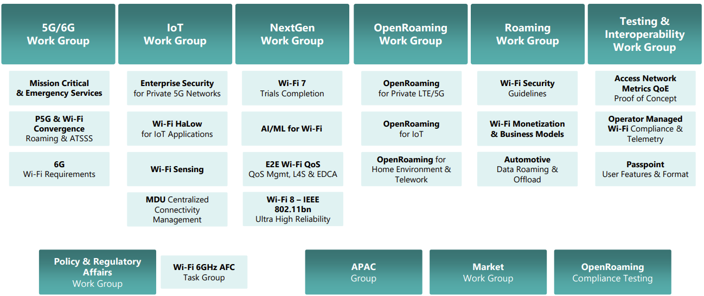
WBA Technical Activities & Roadmap for 2025
https://wballiance.com/wba-program-overview-2025/
https://wballiancec.com/proejcts-details

Slide 89

Access Network Metrics
This report defines how service providers, network operators, and technology vendors can collect, standardize, and transmit key Wi-Fi performance metrics.
https://wballiance.com/wp-content/uploads/2025/05/Access-Network-Metrics-Phase-2-Whitepaper-V1.0.0-Public-.pdf

Slide 90

Wi-Fi 7 Trial Report for Residential Settings by LG U+ and Intel
https://wballiance.com/wp-content/uploads/2025/03/WBA-Wi-Fi-7-Trials-Report-2025-LG-U-Plus-and-Intel-_FINAL-V1.0.0-1.pdf

Slide 91

Wi-Fi 7 Trials for Enterprise Scenarios by AT&T, CommScope and Intel
https://wballiance.com/wp-content/uploads/2025/05/WBA-Wi-Fi-7-Trials-Report-2025-ATT-CommScope-Intel-V1.0.0-1.pdf

Slide 92

Wi-Fi HaLow
https://wballiance.com/wp-content/uploads/2025/07/What-is-Wi-Fi-HaLow.pdf
Wi-Fi HaLow, based on the IEEE 802.11ah standard, is a breakthrough low-power, long-range Wi-Fi technology purpose-built for the Internet of Things (IoT).

Slide 93
6G Wi-Fi Requirements Project
Launched in June’25
This project addresses challenges in network convergence, spectrum allocation, and interoperability, aiming to enhance network efficiency and ensure seamless connectivity across public and private networks, including indoor and outdoor spaces. By reducing network management complexity, it will create a more efficient, reliable, and cost effective infrastructure, promoting smoother handovers and better performance. Ultimately, the project seeks to improve user experiences and drive the adoption of converged networks across industries.

Slide 94
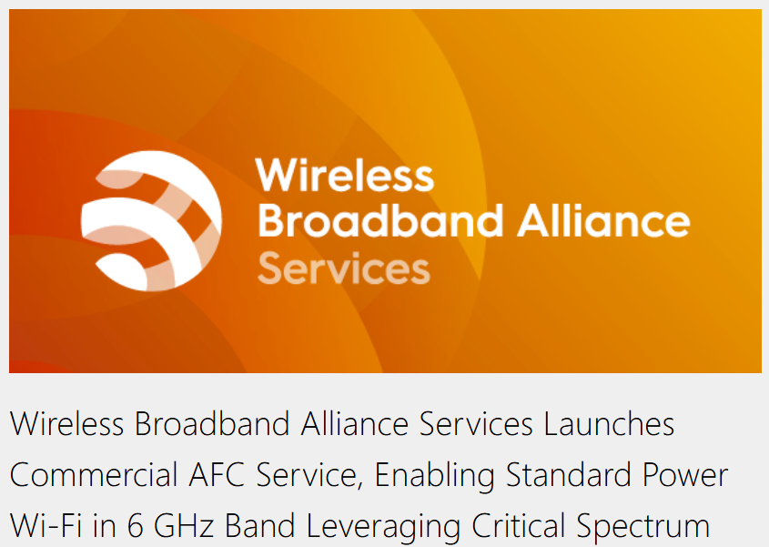
WBA AFC Services

Slide 95

Wireless Global Congress & Members Meetings
https://www.wirelessglobalcongress.com/

Slide 96
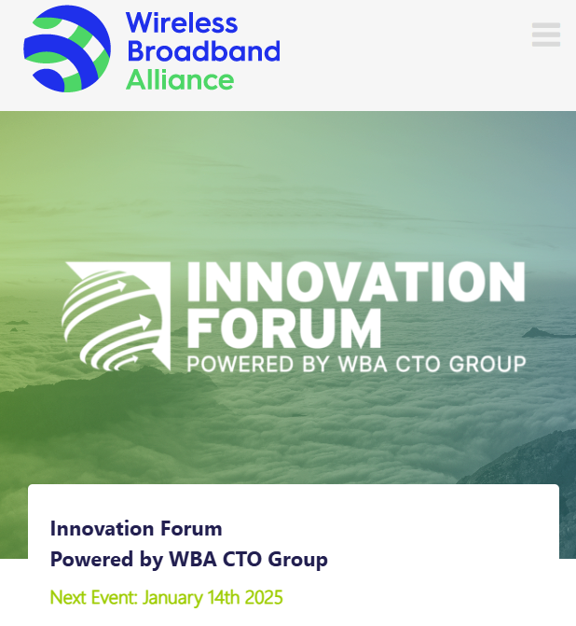
WBA Innovation Forum September
https://wballiance.com/innovation-forum/
Focus on key themes sharing perspectives that will shape the future of connectivity for the next decade and beyond

Slide 97
Further information
WBA information at https://wballiance.com/
Current work areas https://wballiance.com/wba-program-overview-2025/
WBA resource center https://wballiance.com/resource/
WBA events https://wballiance.com/events-awards/
WBA memberships: https://wballiance.com/membership/

Slide 98


WBA Focus Areas
WBA MEMBERS SOLVE
REAL BUSINESS ISSUES
Fosters success for its members
WBA’s mission is to enable collaboration between service providers, technology companies and organizations to drive positive change and enable opportunities for growth.
Standards & Specifications - Setting the scene, requirements and creating specifications
Testing & Interoperability - Creating test plans to showcase the technology capabilities
End-to-End Trials - Running field trials/ proof of concept on real-world environment
Guidelines & Best Practices – Accelerate deployments of services and technologies
Certification & Plug Fests - Addressing gaps and helping the industry to maximizing biz opportunities
Think Thank & Advocacy – Industry leaders roundtables and targeted verticals analysis

Slide 99
802.19 WG September 2025 Liaison Report
Date: 2025-9-17
Authors:

Slide 100
IEEE 802.19 Overview
IEEE 802.19 group reviews coexistence assessment documents (CAD) produced by working groups developing new wireless standards for unlicensed devices.
IEEE 802.19 develops standards for coexistence between wireless standards of unlicensed devices.
Monday PM3 and Thursday PM3 (6:30 PM).
Position | Person
Working Group Chair | Tuncer Baykas (Kadir Has Uni.)
Working Group Vice Chair | Steve Shellhammer (Qualcomm)
Work Group Secretary | Yukimasa Nagai (Mitsubishi Electric)
Task Group 3a Chair | Ben Rolfe (Blind Creek Associates)
Liaison To/From 802.11 | Tuncer Baykas (Self)

Slide 101
Coexistence Assessment Document Letter Ballots
IEEE P802.11bn Coexistence Assessment Document letter ballot will end on 28th of September.
If you are an 802.19 voter you can vote via: https://mentor.ieee.org/802.19/polls

Slide 102
802.19.3a Task Group
Scope of the project: This amendment updates and expands coexistence recommendations to address new market requirements, increasing data traffic, greater device density of devices, and increased potential for congestion based on both IEEE Std 802.11-2020 and IEEE Std 802.15.4 sub-1 GHz standards.
This amendment includes recommendations with respect to new devices, as well as compatibility with deployed legacy devices.
Draft proposal is in 802.19 Private area.

Slide 103
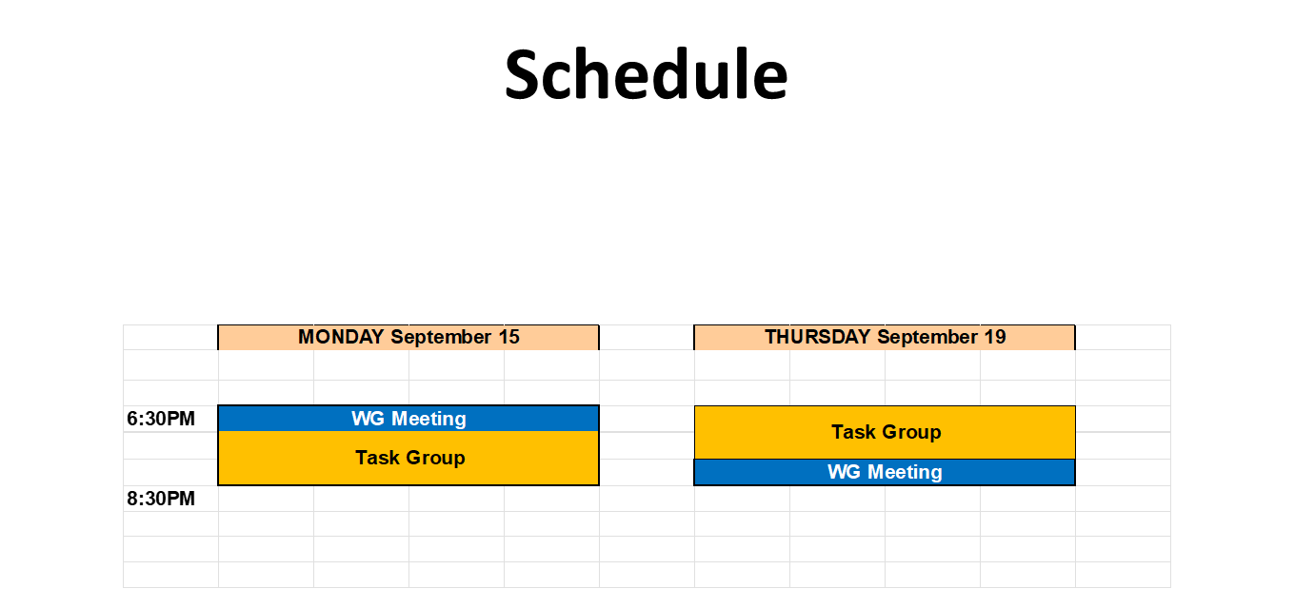

Slide 104
802.15 Liaison Report – Sept 2025
Date: 2025-09-19
Authors:
Details by 802 activity are available here: https://mentor.ieee.org/802-ec/dcn/22/ec-22-0061-02-00EC-rolfe-affiliations-by-802-activity.pdf

Slide 105
Working Group 15 September Agenda
Agenda:
https://mentor.ieee.org/802.15/dcn/25/15-25-0413-03-0000-sept-2025-802-15-agenda.xlsx
WG opening report:
https://mentor.ieee.org/802.15/dcn/25/15-25-0414-03-0000-sept-2025-802-15-opening-report.pptx

Slide 106
Subgroup Closing Reports
Title | URL
TG15.6ma Closing Report for | https://mentor.ieee.org/802.15/dcn/25/15-25-0492-01-006a-tg15-6ma-closing-report-for-september-2025.pptx
SCM Agenda, Opening and Closing Report | https://mentor.ieee.org/802.15/dcn/25/15-25-0475-01-0mag-scm-agenda-opening-and-closing-report-september-2025.pptx
TG4ab May Closing Report | https://mentor.ieee.org/802.15/dcn/25/15-25-0504-02-04ab-september-closting-report.pptx
TG4ac May Opening and Closing Report | https://mentor.ieee.org/802.15/dcn/25/15-25-0446-02-04ac-september-opening-and-closing.pptx
TG4ad Agenda, Opening and Closing Report | https://mentor.ieee.org/802.15/dcn/25/15-25-0434-01-04ad-tg4ad-agenda-opening-and-closing-report-september2025.pptx
TG4ae (ASCON) Opening and Closing | https://mentor.ieee.org/802.15/dcn/25/15-25-0444-02-04ae-september-opening-and-closing.pptx
IG Access agenda opening and closing report and Minutes | https://mentor.ieee.org/802.15/dcn/25/15-25-0474-02-acss-ig-access-september-meeting-slides-and-closing-report.pptx
TG9A Opening and Closing report | https://mentor.ieee.org/802.15/dcn/25/15-25-0445-02-009a-september-opening-and-closing.pptx
TG16me Revision to 802.16-2017 report | https://mentor.ieee.org/802.15/dcn/25/15-25-0503-01-16me-sept-2025-meeting-closing-report.pptx
IEEE 802.15 IG NG-OWC Closing Report | https://mentor.ieee.org/802.15/dcn/25/15-25-0494-00-07ma-ieee-802-15-ig-ng-owc-closing-report-sept-2025.pptx

Slide 107
Subgroup Closing Reports
Title | URL
IG Next Generation Optical | https://mentor.ieee.org/802.15/dcn/25/15-25-0494-01-07ma-ieee-802-15-ig-ng-owc-closing-report-sept-2025.pptx
IG Surface Wave Communications | https://mentor.ieee.org/802.15/dcn/25/15-25-0456-01-swcs-ig-swc-sept-2025-slide-deck.pptx

Slide 108
802.15 Overview
Wireless Specialty Networks Active standards:
802.15.3 - no active projects but a bunch of really cool stuff
802.15.4 - many current projects (see next slide)
802.15.6a Body Area Networks: Initial SA ballot completed, comment resolution
802.15.9a KMP Transport, extensions to key management: Initial SA ballot complete, first SA recirculation to commence soon
802.16.me Revision of 802.16-2017 – Just getting started
Interest Group Access: Focusing on analysis of current mechanisms in the standard (IEEE Std 802.15.4); exploring enhancements to Spectrum Resource Measurement features in the current standard
Interest Group NG-OWC: the next generation for optical wireless communication
Interest Group SWC: Surface Wave Communication
SC THz: No meeting this session

Slide 109
Standing Committee, Maintenance
Maintains internal support documents such as WG Operations manual, editor’s guide, motion templates, checklists and supporting material
Maintains “bug list” for each standard as input to the revision projects
Reviews PARs and provides comments for other WGs
Considers and responds to comments received on 802.15 PARs
This session:
  No PARs to review
  Began consideration of the next revision to 802.15.4 (Rev-mf)
  Updated WG sample motion templates
  Editorial corrections to operations manual

Slide 110
802.15.4 Projects
802.15.4ab Next Generation UWB: Second WG recirculation
802.15.4ac Enhanced Privacy: Initial WG ballot compete, recirculation to start RSN
802.15.4ad Next Generation SUN PHYs: Pre-draft, technical contributions and proposals, merging and converging
802.15.4ae ASCON light weight encryption extension for 802.15.4: Completed WG ballot, initial SA ballot to commence after November plenary

Slide 111
802.15.4ab Next generation UWB: Amendment to IEEE Std 802.15.4-2024 (rev E)
Recirculation comment resolution in progress
Closing report: https://mentor.ieee.org/802.15/dcn/25/15-25-0504-02-04ab-september-closting-report.pptx
Current status: First RC complete; second RC to commence RSN
Action | Date
Approve comment resolutions and RC2 | 18-Sep-2025
Start RC2 | 20-Sep-2025
Close RC2 | 5-Oct-2025
Resolve comments | 7-Oct-2025
Start RC3 | TBD
Close RC3 | TBD
Start Nov Plenary | 10-Nov-2025

Slide 112
802.15.4ac Enhanced Privacy
This amendment specifies modifications to the IEEE Std 802.15.4 medium access control (MAC) specification to specify mechanisms that address and improve user privacy. These mechanisms include randomized addresses, and exchanges that support session continuity. This amendment maintains backward compatibility with the base standard.
State: Initial SA ballot complete, 1st SA recirc to commence shortly
Opening and closing report: https://mentor.ieee.org/802.15/dcn/25/15-25-0446-02-04ac-september-opening-and-closing.pptx

Slide 113
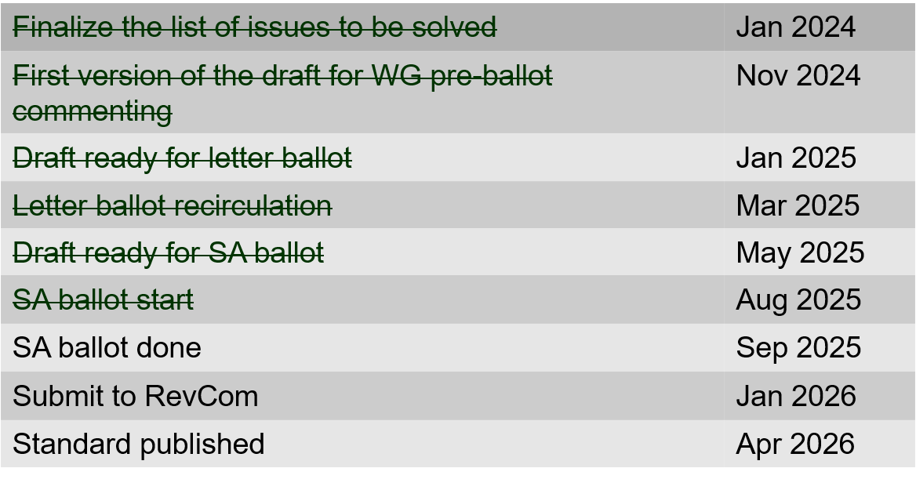
802.15.4ac Enhanced Privacy Timeline

Slide 114
802.15.4ad Next Generation SUN PHYs
Developing enhancements to the 802.15.4 SUN PHYs (FSK, OFDM)
State: pre-draft development
Meeting goals: Merge and converge technical proposals
Closing report: https://mentor.ieee.org/802.15/dcn/25/15-25-0434-01-04ad-tg4ad-agenda-opening-and-closing-report-september2025.pptx
Accomplished:
  Approval of July session minutes
  Presentations (see next page)
  Agreed baselines for OFDM-LR and OFDM-HR
  September meeting minutes posted as 15-25-452-00-04ad

Slide 115
802.15.4ad Timeline
2024
November: Approve Technical Guidance Document
Call for proposals issued
2025
January: Hear initial proposals
March: Hear updated proposals
March to May – 2 conference calls
  Simulation results of remaining proposals not yet provided
  Prepare table of proposals for analysing against technical guidance document
May: Hear final proposals
May to July – 2 conference calls
  Simulation results and proposal categorisation.
July: Heard final proposals. Categorized and summarized proposals
July – September: Merging proposals
September: Select OFDM LR and HR baseline
October conf call
November: goals – to finalise OFDM preamble – be ready to start drafting OFDM LR and HR , Merge FSK proposals – ready for baseline.

Slide 116
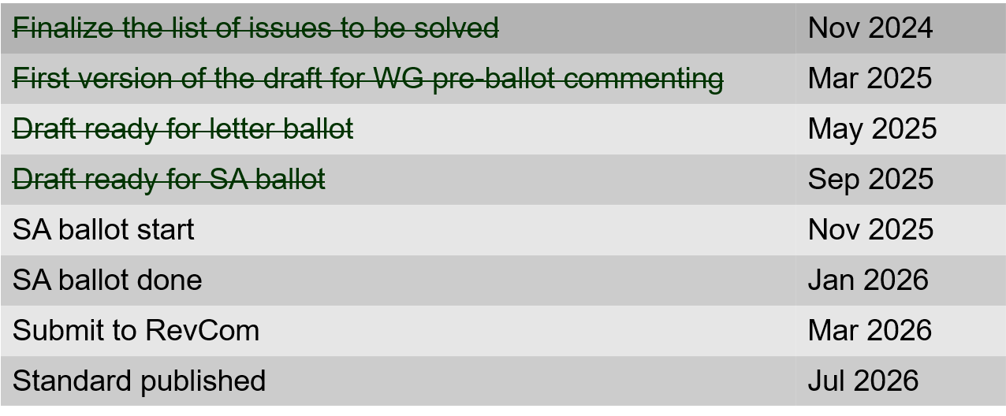
802.15.4ae (ASCON)
ASCON light weight encryption extension for 802.15.4
Meeting achievements
Completed final WG recirculation
Draft ready for SA ballot
SA Ballot to start following Nov plenary
Closing report: https://mentor.ieee.org/802.15/dcn/25/15-25-0444-02-04ae-september-opening-and-closing.pptx

Slide 117
802.15.6ma
Competed first SA ballot
Resolved SA ballot comments
Initiate SA recirc (RSN)
Closing report: https://mentor.ieee.org/802.15/dcn/25/15-25-0492-01-006a-tg15-6ma-closing-report-for-september-2025.pptx

Slide 118
September 2025
TG 6ma Timeline(expected)
Final SB recirculation, if required. Submission to RevCom
Jan 2026
Tech Req Doc July 2022
Presentation of proposals
May 2023
Comment Resolutionfor LB210
Nov. 2024
Comment Resolutionfor LB212
March 2025
Comment Resolutionfor LB217
May
2025
Comment Resolution for LB217
July
2025
SA Ballot
Sept
2025
WG PreBallot submission for Draft2.5 August 2024
Revcom Approve
March 2026
SA recirculation if required
Oct 2025
^{Draft V1,18 Com}
May. 2024
Recirculation (LB212)
Jan. 2025
RevcomSubmission
Feb. 2026
TRD,CMD
Call Proposals Sept 2022
Std. Draf V1.9 Proposals
Nov. 2023
Comment Resolution fo Draft v2.3 on WG for PreBallot July 2024
1st Letter Ballot(LB210)
Sept. 2024
2nd Recirculation (LB217)
April 2025
3rd Recirculation (LB)
June 2025
Unconditional approval for Standard Association Ballot (SA)
July 2025
Request EC approval for SA Ballot
Nov. 2026
Comment Resolution for SA Ballot
Oct. 2025
Notes: SASB/RevCom scheduled for 2024 a guess

Slide 119
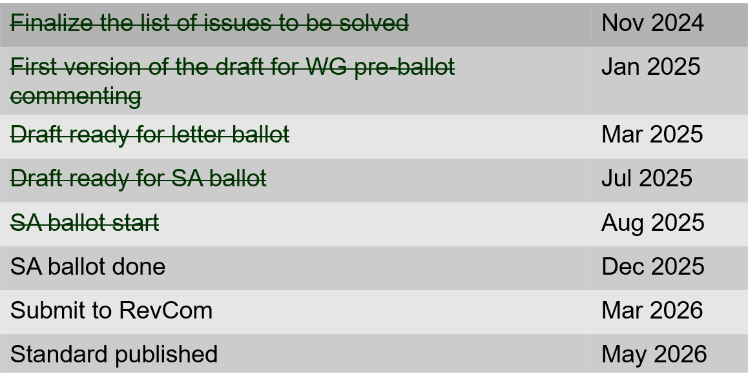
802.15.9a KMP Transport
Extensions to key management: extending to support EDHOC
Processed all standard association ballot comments
Prepared draft for recirculation
Form a CRG
Start recirculation ballot after this session
Opening and closing report: https://mentor.ieee.org/802.15/dcn/25/15-25-0445-02-009a-september-opening-and-closing.pptx

Slide 120
IG Access
Agenda, closing report and minutes: https://mentor.ieee.org/802.15/dcn/25/15-25-0474-02-acss-ig-access-september-meeting-slides-and-closing-report.pptx
Presentations:
  Effect of using different CCA Modes and different ED Threshold in suspendable CSMA-C https://mentor.ieee.org/802.15/dcn/25/15-25-0455-02-acss-effect-of-using-different-cca-modes-and-different-ed-threshold-in-suspendable-csma-ca.pptx
  Enhancement of SRM for Adapting Coexisting Environments https://mentor.ieee.org/802.15/dcn/25/15-25-0457-03-acss-enhancement-of-srm-for-adapting-coexisting-environments.pptx
November:
  Follow-up with additional contributions
  Consider preparing a technical report for the WG

Slide 121
TG16me Revision of 802.16-2017
Revision to 802.16
  Includes rollup of 16t
Roll-up preparation underway
Heard additional technical contributions
Closing report: https://mentor.ieee.org/802.15/dcn/25/15-25-0503-01-16me-sept-2025-meeting-closing-report.pptx

Slide 122
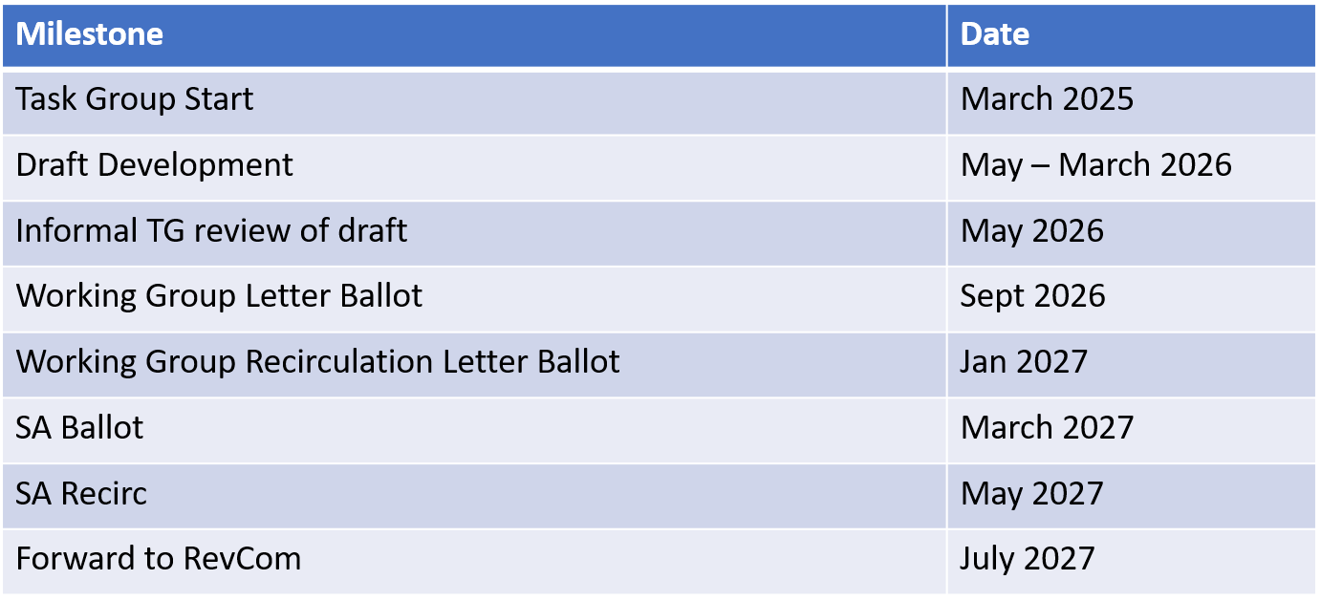
TG16me Revision Project Timeline

Slide 123
Interest Group Next Generation Optical Wireless Communication (NG-OWC)
IG NG-OWC Closing Report: https://mentor.ieee.org/802.15/dcn/25/15-25-0494-01-07ma-ieee-802-15-ig-ng-owc-closing-report-sept-2025.pptx
Session objectives and accomplishments:
Heard ten contributions related to the future of next generation OWC(OCC, FSO) technology
Extended Call for Applications on IG NG-OWC by Nov. meeting
Invite contributors:
IEEE 802.15 IG NG-OWC (OCC or FSO) Extended Call For Applications
https://mentor.ieee.org/802.15/dcn/25/15-25-0162-02-07ma-ieee-802-15-ig-ng-owc-call-for-applications.doc

Slide 124
Interest Group Surface Wave Communication (SWC)
IG SWC Opening and Closing Report: https://mentor.ieee.org/802.15/dcn/25/15-25-0456-01-swcs-ig-swc-sept-2025-slide-deck.pptx
Technical Contributions:
Surface-Wave Communication: Rethinking the Future of Wireless Communications, 15-25-0440-01
The Use cases for Metal Surface Magnetic Communications(MSMC) in ship, 15-25-443-01
Preliminary Surface-wave Propagation Characteristics in metal-rich environments, 15-25-0450-00
Proposal for a PHY frame considering the effect of metal structures on surface wave propagation characteristics, 15-25-0442-01
Next Steps:
Define use-cases
Define channel models / describe channel characteristics
Show feasibility and market demand
Plan: WNG presentation in January 2026

Slide 125
802.18 Liaison Report – September 2025
Date: 17 September 2025
Author:
Name | Company | Address | Phone | Email
Edward Au | Huawei Technologies |  |  | edward.ks.au@gmail.com

Slide 126
RR-TAG at a glance
Membership as of 1 August 2025
  71 voters (including 10 on LMSC)
  7 nearly voters
  11 aspirants
Officers
  Chair: Edward Au (Huawei Technologies)
  Co-Vice Chair: Gaurav Patwardhan (Hewlett Packard Enterprise)
  Co-Vice Chair: Al Petrick (Jones-Petrick Associates)
  Secretary: Chenhe Ji (Huawei Technologies)
  IEEE SA Program Manager: Jodi Haasz (IEEE SA)

Slide 127
Progress since the 2025 July plenary
Reviewed the latest ongoing consultations
Approved the following IEEE 802 LMSC submissions:
  EC RSPG: Draft RSPG Opinion on Long-term vision for the upper 6 GHz band
  Nigeria NCC: Regulatory Guidelines for the use of the lower part of the 6 GHz (5925 – 6425) MHz band in Nigeria
  CEPT ECC PT1 #82: A submission related to the upper 6 GHz band studies - protection of WAS/RLAN
Discussed the latest topics related to spectrum and regulation in Europe, North America, and Asia Pacific.

Slide 128
Objectives this week
Reviewed the following consultation:
  Belgium BIPT: Consultation on the draft decision radio interfaces related to short-range devices
  Japan MIC: Frequency Reorganization Action Plan (2025 Edition) (Draft)
Discussed the latest topics related to spectrum and regulation in Europe, North America, and Asia Pacific

Slide 129
802.24 Vertical Applications TAG
September 2025
Closing Report
Sept 2025 Wireless Interim Session
Waikoloa, Hawaii, USA

Slide 130
802.24 Overview
September 2025
802.24 Vertical Applications TAG
802.24.1 Smart Grid TG
802.24.2 IoT TG
Officers
  TAG Chair: Tim Godfrey
  Secretary & TAG Vice Chair: Ben Rolfe
Task Groups
  802.24.1 Smart Grid TG Tim Godfrey
  802.24.2 IoT TG <open>
23 Voting Members

Slide 131
Agenda
September 2025
Meeting Plan: Two slots:
  Tuesday PM2 (16:00 Hawaii)
  Wednesday PM2 (16:00 Hawaii)
Call session to order / “Guidelines for IEEE SA meetings”
Review of Agenda / Approval of Agenda / Approve Minutes
Liaison Updates / Regulatory
IoT white paper Development and Contributions
Development of update to Smart Grid White paper.
AFV Infrastructure communications white paper: Review contributions and white paper draft
Discussion: new work?
AoB

Slide 132
Liaison Updates
September 2025
Wi-Fi Alliance (Informal) <vacant>
CSA / Matter / Aliro (Informal) Clint Powell Active
FiRa (UWB ranging based on 15.4) <vacant>
CCC (access control and automotive key based on NFC, next gen will be UWB) (new – liaison needed)
TIA-TR42 IoT Entity <vacant>
  ISO IEC WG3
Wi-SUN Alliance (informal) Phil Beecher
802.18 Edward Au
ATIS TOPS <vacant>

Slide 133
CSA Matter / Aliro / WFA Liaison Update
September 2025
Matter / WFA certification is for AP’s only today – using WiFi 6 and power save modes .
Future Matter protocol base Unsyncronized Service Discovery USD could be incorporated in a future device certification related to Matter. This would enable Wi-Fi only onboarding. Today Bluetooth is required by Matter for onboarding.
Aliro is another profile that defines application layers. ZigBee, Matter, and Aliro are orthogonal. Aliro is for secure entry (door locks, automobiles, hotels). New development underway to identify which door in multi-door environment. Can be incorporated into APs for location mapping.

Slide 134
IoT White paper Action Item Tracker Sept 2025
September 2025
Section 5 – Section 5 replaced and reviewed by TAG
Section 7 - Diagram showing a neighborhood-area network. Tim inserted a diagram – Phil Beecher is providing others .
Section 8 – Ask Chris DiMinico to extract from SPE white paper. (open)
Section 10 – move frequency tables to appendix. Create a graphic showing range of all bands from DC to light, and where 802 wireless standards operate
  Horizontal – frequency 50 MHz to 50 GHz logarithmic. Vertical IEEE 802 standards in groups. (Open task need volunteer to create this graphic)
Section 11 – Closing paragraph. (completed by Ann)
Output draft from September 2025 meeting 802.24-25-0014r5

Slide 135
Smart Grid White Paper Actions Tracker Sept 2025
September 2025
Provide draft to Phil for update on energy constrained, low power devices (in process)
Phil will provide text introduce concept of AMI 2.0, and heterogeneous networks combining mesh and Private Cellular. (in process)
Raquel to provide text on self-healing (not present – maybe Sandia?)
Companion document “IEEE 802 recommendations on IEEE 802 related Smart Grid standards” needs update (open – need volunteer)
Text on Spectrum Sharing (In process - Ben will provide )
Replace figure 1 with hourglass diagram showing IP as middle layer (Tim – Completed )
Output Draft document from September – 802.24-25-0013r3

Slide 136
AFV White Paper Draft Discussion
September 2025
802.24-25-0017r2 was reviewed by the TAG in July
  No Update at September meeting
  Further additions and revisions to be incorporated in late October – to be reviewed at November meeting.
Discussion on a potential new topic to be included is the use of 802.15.4z UWB for positioning the inductive charging coils.

Slide 137
Potential new activity - indoor agriculture
September 2025
Paul Nicolich joins the group to update us that Chris DiMinico has a new activity to propose, and intends to return to IEEE 802 in November
  Indoor Agriculture use cases.
  Sensors, power management, etc
  Need for integration or coordination of standards.
Potential to explore need for new standards that could be assigned to a WG
  Need for a more efficient means of controlling DC power – ala POE.
Will be on November agenda.

